Slide 1
What you’ve learned

Slide 2
The cell uses packets of energy of ≈ 25kT
ATP:
Small enough amounts that you can use it efficiently.
Molecular motors (kinesin, F₁F₀ ATPase: like >50%-100%. Car motor- < 20%.
Evolution gone to lots of trouble to make it so: Take glucose makes 36-38 ATP in cellular respiration (which is 39% of PE in glucose bonds).
Make special compartments to do this—like stomach (which begins with acid breakdown of large polymers: doesn’t chew up itself), intestines and mitochondria.
Mitochondria came from an ancient bacteria that was engulfed (has it’s own DNA).

Slide 3

Thermal energy matters a lot!
Everything (which goes like x² or v² in PE or KE) has ½ kT of energy.
If a barrier has on this order, you can jump over it and you will be a mixture of two states.
Boltzman distribution = Z⁻¹ exp (-ΔE/k_{B}T)
k_{f}
k_{b}
K_{eq} = k_{f}/k_{b}
ΔE

Slide 4
Entropy also matters
(if lots of states can go into due to thermal motion)
Probability of going into each state increases as # of states increases
ΔE
ΔE
ΔE
Add up the # of states, and take logarithm: ln σ = S = Entropy

Slide 5
Free energy
ΔG= free energy = ΔE - TΔS
(Technically ΔG = ΔH - TΔS: ΔH = enthalpy but doesn’t make a difference when dealing with a solution)
Just substitute in ΔG for ΔE
and equations are fine.

Slide 6
Diffusion
Kinetic thermal energy: ½ mv² = ½ k_{B}T (in one D; 3/2 in 3D).
Things move randomly.
Simple derivation x² = 2^{n}Dt (where n = # dimensions; t = time).
Where D = kT/f is the diffusion constant
f = friction force = 6πηr. (η = viscosity, r = radius)
[Note: when trying to remember formulas, take limit → 0 or →infinity.]

Slide 7
Diffusion
Efficient at short distances,
not-so at long distance
Distances across nerve synapses is short (30-50 nm) and neurotransmitters are small (like an amino acid). Diffusion is fast enough for nerve transmission.
In bacteria, typically ≈1 um. Fast enough.
In eukaryotes, typically ≈10-100 um, too slow.

Slide 8
Molecular Motors
Instead of relying on diffusion, where x² α (D)(time), and therefore x α [Dt]^{1/2} , you have x α (velocity)(time).
Translating motors (myosin, kinesin, dynein)
Rotating motors (F₁F₀ATPase)
Combination (DNA or RNA polymerase, Ribosomes)

Slide 9
How to measure?
Lots of ways.
Cantilevers—AFM
Magnetic Tweezers
Optical Traps
Fluorescence
Patch-clamping
“Diving board” Wobbles
Bead fluctuating
Limit your bandwidth (Fourier Transform)
Inherent photon noise, Poisson – √N
Inherent open/closing of channels
You have to worry about getting reasonable
signal/noise.
Noise– motion do to diffusion, photon noise

Slide 10
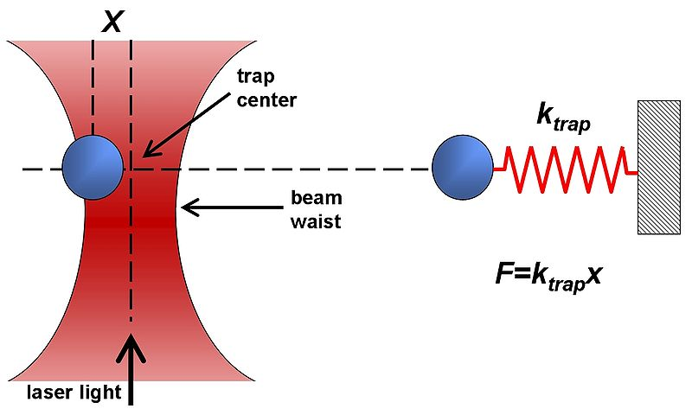
Optical Traps (Tweezers)
Dielectric objects are attracted to the center of the beam, slightly above the beam waist. This depends on the difference of index of refraction between the bead and the solvent (water).
Vary k_{trap} with laser intensity such that k_{trap} ≈ k_{bio} (k ≈ 0.1pN/nm)
Can measure pN forces and (sub-) nm steps!
http://en.wikipedia.org/wiki/Optical_tweezers

Slide 11
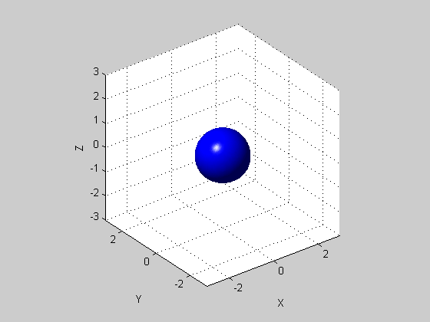
Optical Traps
Brownian motion as test force: limiting BW
Langevin equation:
≈0
k_{B}T
Trap force
Inertia
term
(ma)
Drag force
Fluctuating
Brownian
force
γ = 6πηr
Inertia term for um-sized objects is always small
(…for bacteria)
<F(t)> = 0
<F(t)F(t’)> = 2k_{B}Tγδ (t-t’)
k_{B}T= 4.14pN-nm
Notes:
kT = 1.38e-23*300 = 4.14e-21 = 4.14pN nm
Sqrt(<x^2>) = sqrt(kT/k) = sqrt(4.14/0.1) = sqrt(41.4) ~ 6 nm

Slide 12
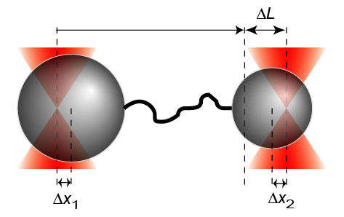
Basepair Resolution—Yann Chemla @ UIUC
1
unpublished
1bp = 3.4Å
2
1
3
2
4
3
4
5
5
6
6
7
7
8
9
9
8
UIUC - 02/11/08
3.4 kb DNA
F ~ 20 pN
f = 100Hz, 10Hz

Slide 13
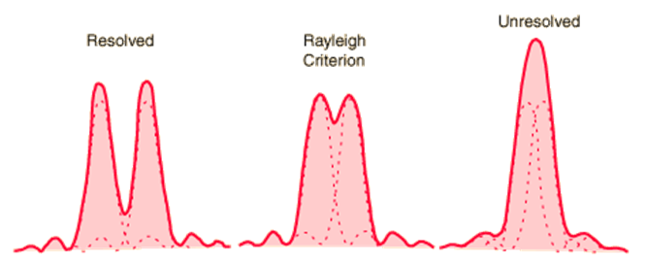
Photon: the diffraction limit
There is an “Inherent” uncertainty
– width = λ/2N.A. or 250 nm
This is the the best at which you can tell where a photon is going to land. It doesn’t matter how many photons you collect.

Slide 14
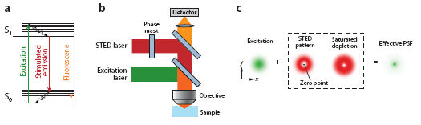
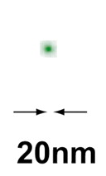
Diffraction Limit beat by STED
200nm
If you’re clever with optical configuration, you can make width smaller: STED.
You get down to 50 nm or-so.

Slide 15
Photon Statistics
You measure N photons, are there is an inherent fluctuation.
Known as Poisson noise: p(k) =r^{k}/k!e^{r}
Where p(k) = probability of getting k events (k = # photons), r is the rate of photons/time.
The result depends on one quantity: the average rate, r, of occurrence of an event per module of observation.
For N “reasonably big, e.g. > 10 or 100 photons,
The fluctuation goes like √N.

Slide 16
Super-Accuracy: Photon Statistic con’t
center
But if you’re collecting many photons, you can reduce the uncertainty of how well you know the average. You can know the center of a mountain much better than the width.
Standard deviation
vs.
Standard Error off the Mean
width

Slide 17
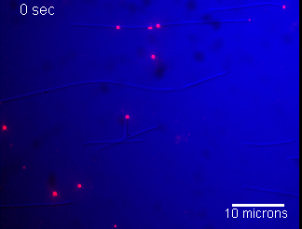
Motility of quantum-dot labeled Kinesin (CENP-E)
Streptavidin
Quantum Dot
Streptavidin conjugate
Biotinylated
Anti-Pentahis
antibody
Six-histidine tag
Leucine zippered
CENP-E dimer
w/ six histidine-tag
Axoneme
or microtubule
-
+
8.3 nm/step from optical trap
Notes:
17

Slide 18
Super-accuracy Microscopy
By collecting enough photons, you can determine the center by looking at the S.E.M. SD/√N.
Try to get fluorophores that will emit enough photons. Typically get nanometer accuracy.

Slide 19
You can get super-resolution to a few 10’s nm as well
Turn a fluorophore on and off.

Slide 20
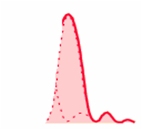
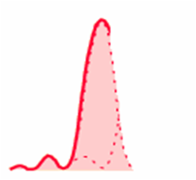
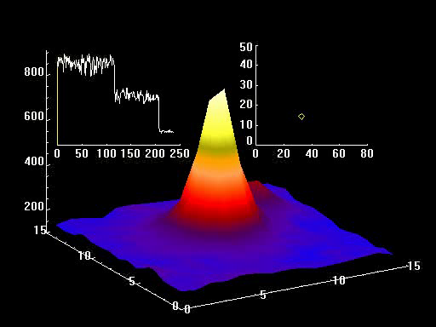
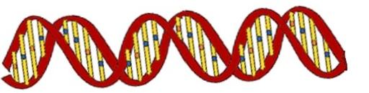

Super-Resolution:
Nanometer Distances between two (or more) dyes
Know about resolution of this technique
SHRImP
Super High Resolution IMaging with Photobleaching
132.9 ± 0.93 nm
8.7 ± 1.4 nm
72.1 ± 3.5 nm
In vitro

Slide 21
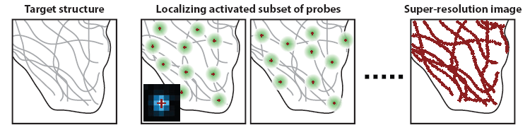
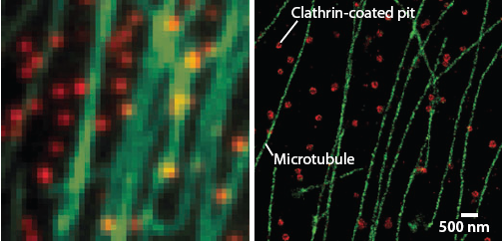
Super-Resolution Microscopy
Inherently a single-molecule technique
Huang, Annu. Rev. Biochem, 2009
STORM
STochastic Optical Reconstruction Microscopy
PALM
PhotoActivation Localization Microscopy (Photoactivatable GFP)
Bates, 2007 Science

Slide 22

Don’t forget about nerves!

Slide 23
Class evaluation
1. What was the most interesting thing you learned in the course?
2. What are you confused about?
3. Related to the course, what would you like to know more about?
4. Any helpful comments.
Answer, and turn in at the end of class.

