Slide 1
Announcements
Homework due on Wednesday. Turn in at beginning of class.
There will be another homework assigned on Wednesday
Special lecture by Tom Kuhlman this Wednesday.
Paper – due on final at 7pm Monday May 6th
8-10 pages double-spaced, NOT including pictures.
You must have an introduction which clearly motivates the reader why you’ve chosen this paper, what is so important about it, in general terms (for a non-scientist), and for a scientist.
You must discuss how they did this (a discussion of their methods).
You must discuss what they concluded.
You must discuss what questions are left or new questions.

Slide 2
Today: Ion Channels
Ion Channels are membrane-bound proteins
Involved in communication
3 types, voltage, ligand and mechanically-sensitive
Nerves:
They rely on “batteries”—constant source of voltage
Voltage generated through K⁺/Na⁺ exchange.
On/Off is digital, not analog–have transistors in you.
Analogs in Fruit flies have relevance for humans.

Slide 3
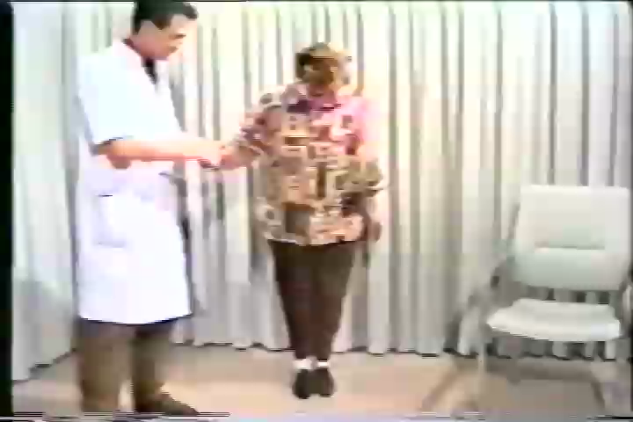
Nerve Mutation in Potassium Ion Gene

Slide 4
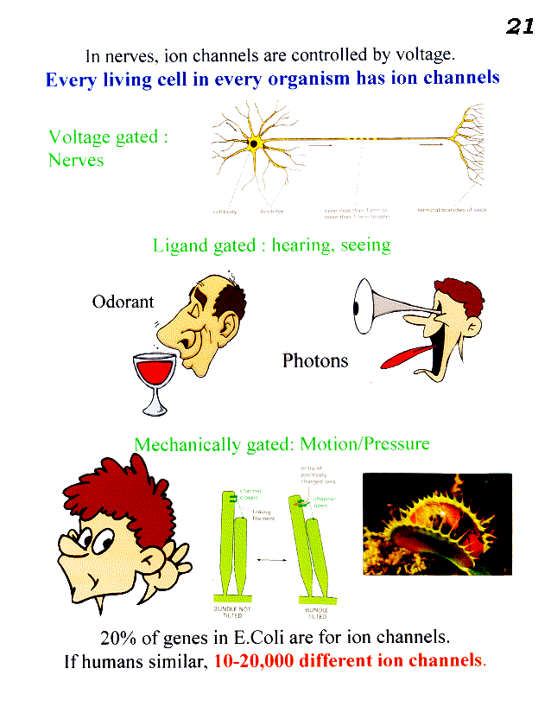
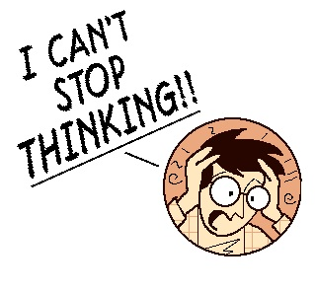
Ion channels are used to communicate to a cell. Are turned on/off by 3 types of signals.
Every cell in every organism has ion channels.
1.
2.
Photons
C.N.S.
3.
how many different ion channels?
Ans: 25,000 genes: 5000 genes. One or more polypeptide/ion channel– could get less, or more, ion channels.

Slide 5
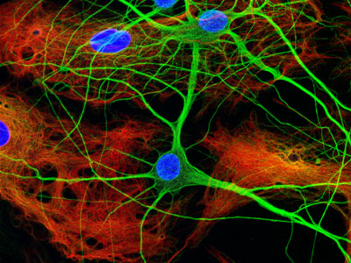
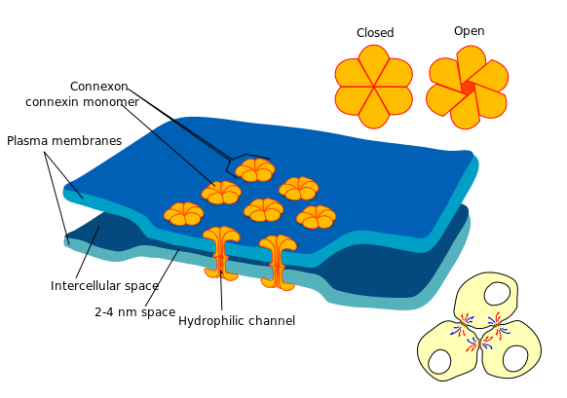
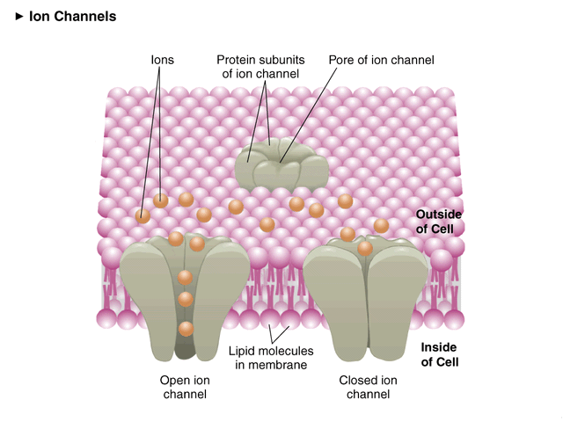
(Focus on Chemical Synapse) Ion Channels
www.nikonsmallworld.com/gallery/year/2005/36
http://en.wikipedia.org/wiki/Electrical_synapse
Electrical
3.5 nm synapses
Fastest. Bidirectional, no gain (post< pre).
Chemical
20-40 nm synapses
Unidirectional (gain).
0 mV (Outside)
0 mV (Inside)
open (depolarized)
-60 to -100 mV (Inside)
closed (polarized)
In general, every cell is like battery.

Slide 6
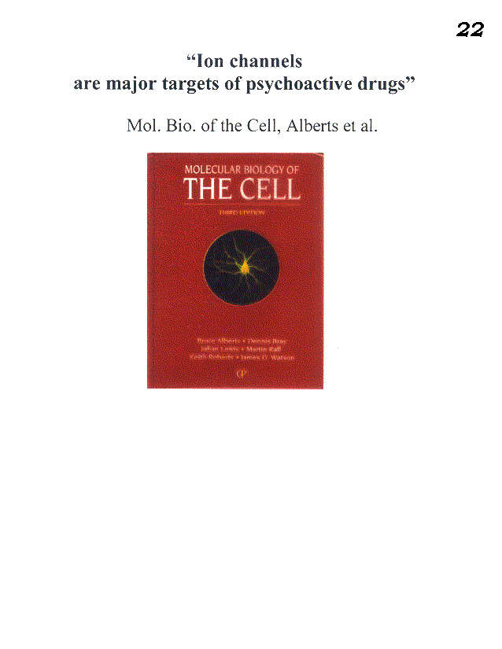
Major source of drug targets.
Valium binds to serotonin (ligand) receptor called GABA receptor– relaxes nerves.

Slide 7
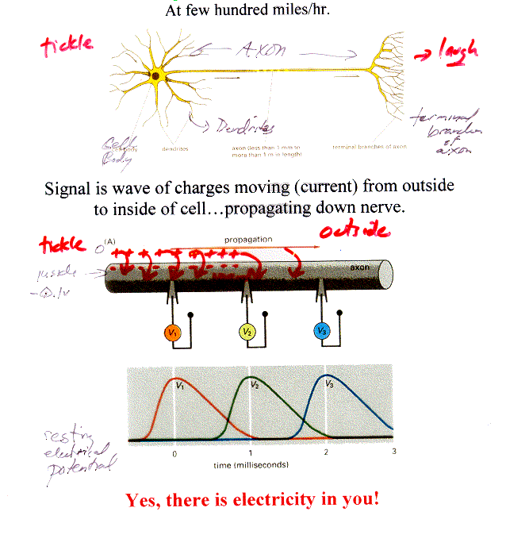
Nerves
How (electrical) signal is transported along a nerve

Slide 8
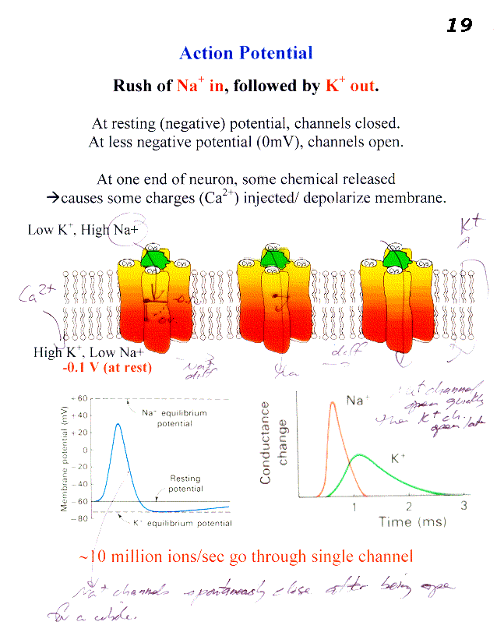

Slide 9
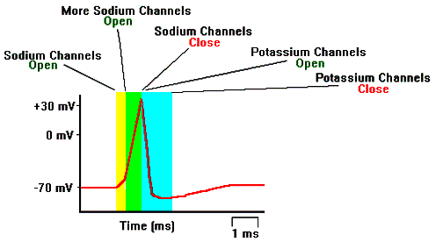
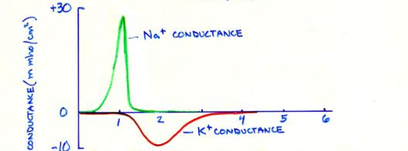
Action Potential– Nerves Firing
http://www.biologymad.com/NervousSystem/nerveimpulses.htm

Slide 10
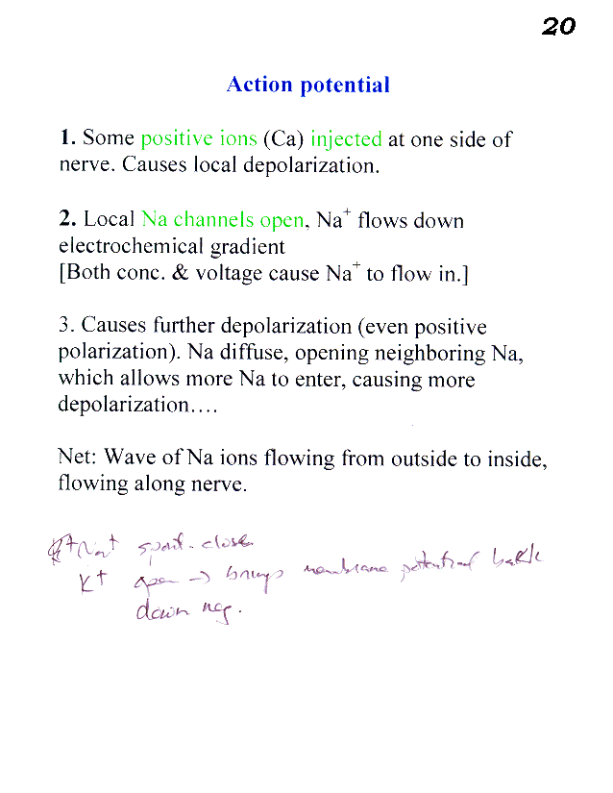
To close ion channels, to stop wave:
4. Na⁺ spontaneously close
5. K⁺ open → brings membrane potential back down negative.

Slide 11
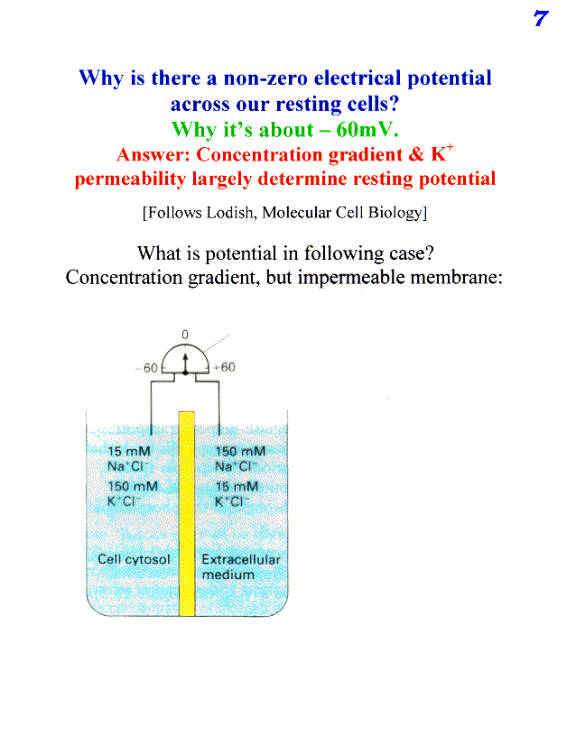
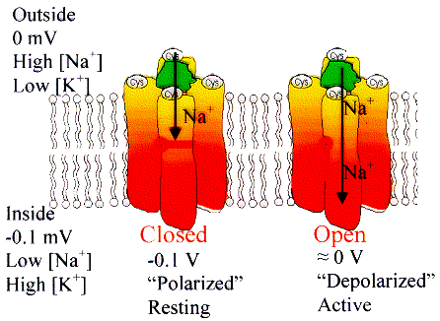
Gradient set-up by Na/K Transporters [will go over]

Slide 12

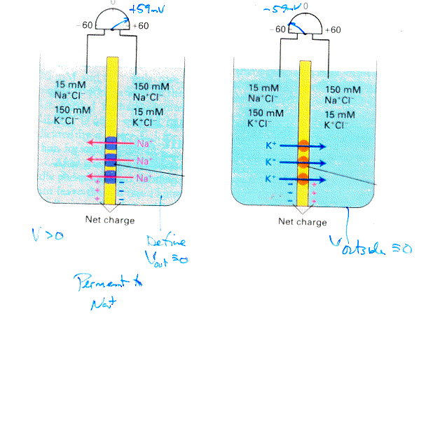
Membrane permeant to only one ion
What is voltage (electrical potential)
in each case
Membrane permeant to Na⁺
Membrane permeant to K⁺
V>0 or <0?
Just a tiny amount of charge causes potential: much less than 15 mM or 150 mM.
What causes charge to stop flowing?
A sufficiently large force (electrical potential) preventing more ions from going.
Given that V ~ -60mV and Na/K are two major ions, which is your membranes permeant to?
K⁺

Slide 13

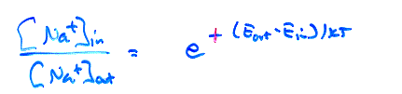
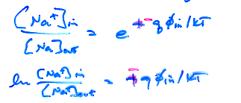
What is Boltzmann’s Factor?:
Z⁻¹exp(-E_{i}/kT)
Probability of being inside/outside?
exp(E_{out}-E_{in}/kT)
e
Let φ = voltage
Energy outside?
= q φ_{out}
= 0
Energy inside?
= q φ_{in}
e
-

Slide 14
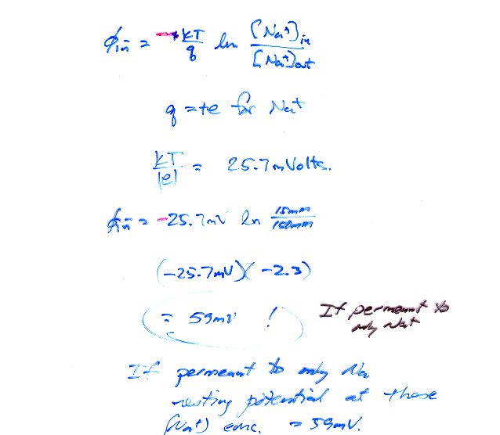
q = ? for Na.
+59 mV if permeable only to Na⁺
If permeant to only K⁺,
resting potential =
-59 mV
Resting potential = -60→ -100 mV

Slide 16
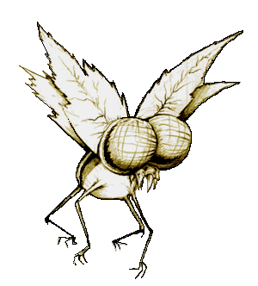
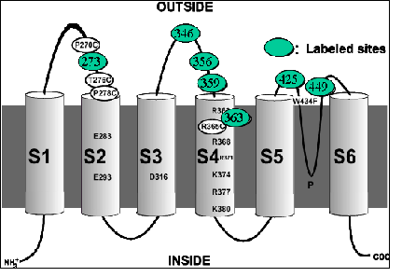
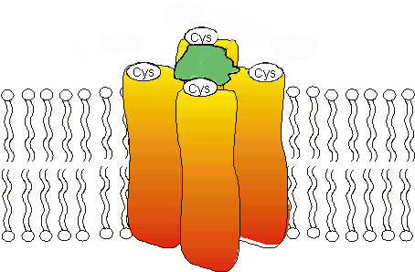
How does gate turn on/shut off?
S4 has lots of charge
Feels effect of external ions
S5
K+
S3
S6
S2
S4
S1
S4—gate
S1-S4: switch
that feels voltage
Outside
0 mV
Low K+
(High Na+)
K⁺
+ + +
K⁺
+ + +
High K+
(Low Na+)
K⁺
-0.1 V
0 V
Closed
Open
There is some charged amino acids, which feels the force of voltage.

Slide 17
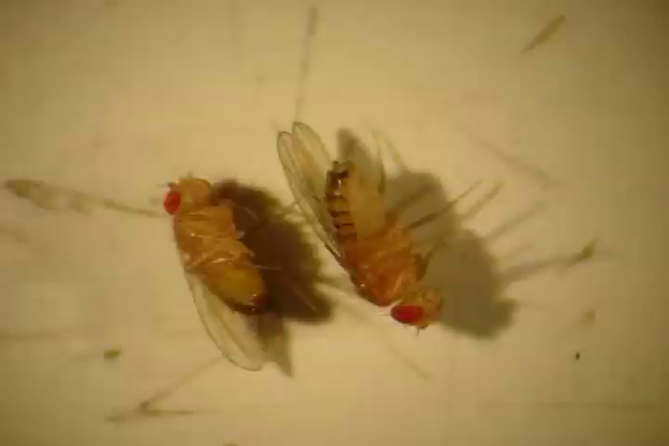
Study of Fruit Flies (Drosophila)
Mutant: Shaker Gene: Potassium ion channels
Mutation causes change in conductance
when given ether, legs shake (hence the name)
Even unanaesthesized, weird movement., repetitive firing due to neurotransmitters
Requires less sleep.
In Drosophila, the shaker gene is located on the X chromosome.
The closest human homolog is KCNA3.

Slide 18
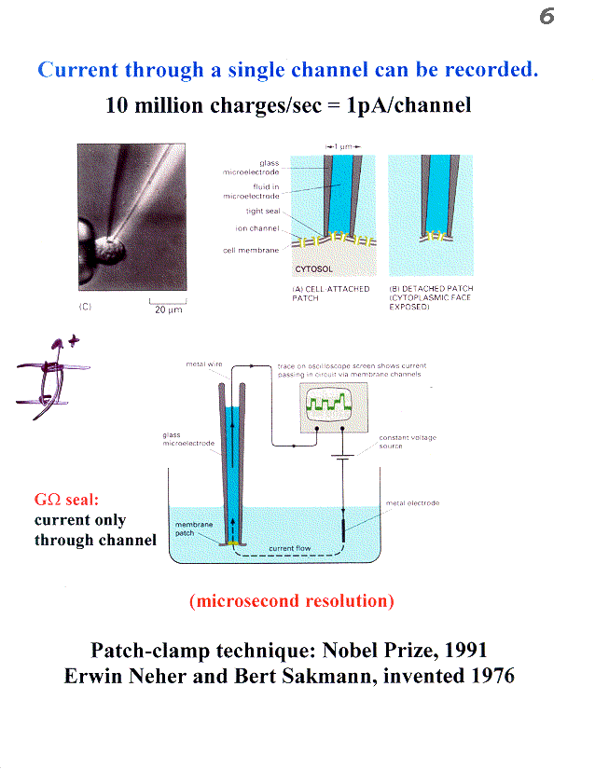
Is the Ion Channel Digital or Analog?

Slide 19
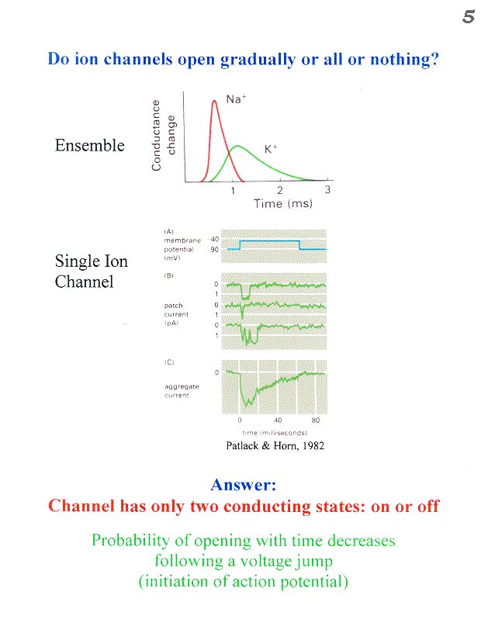

Slide 20
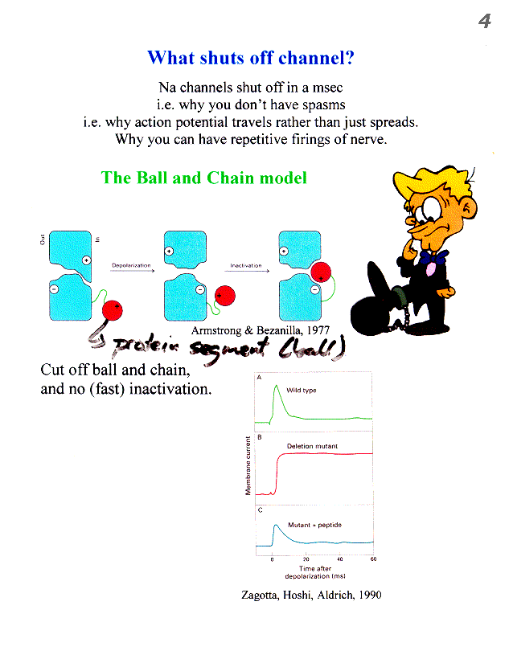
Nerve Impulse propagate, not spread, because Na⁺ spontaneously shut-off.

Slide 21
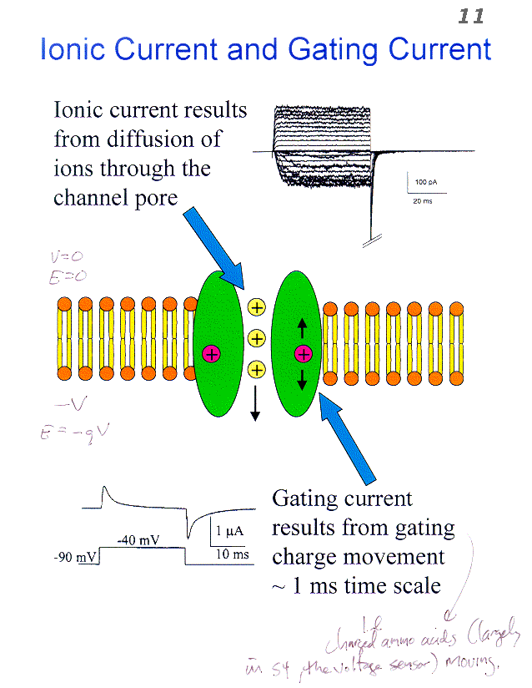
Charged amino acids (largely in the voltage sensor) move.

Slide 22
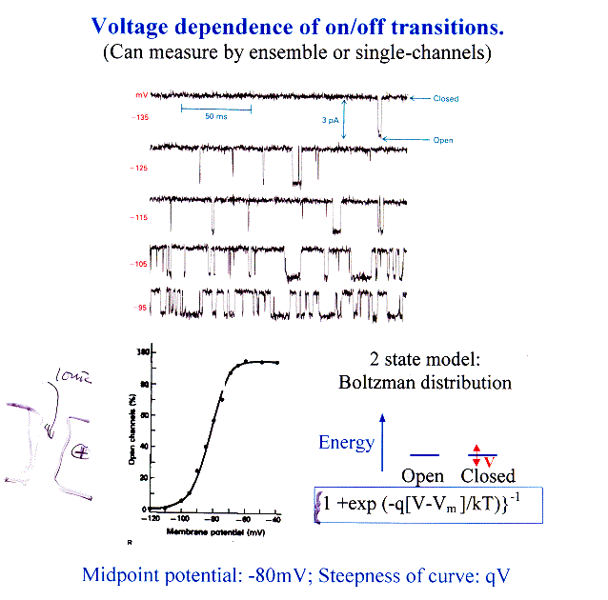
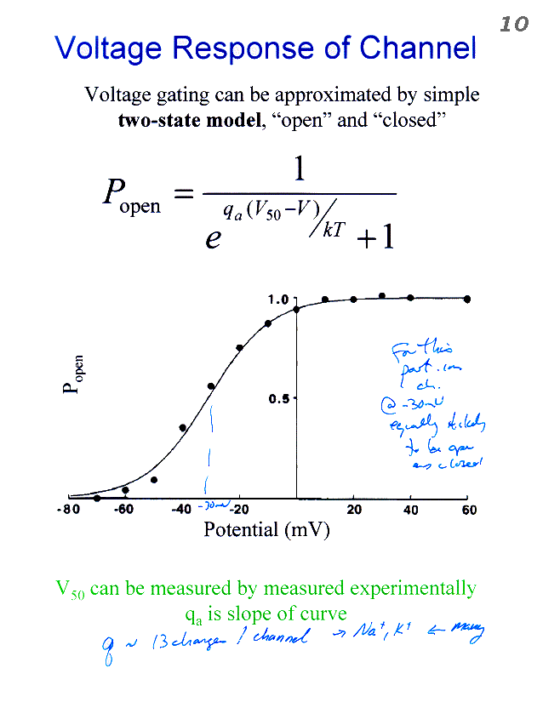
Single Ion
Channel
Conductance
Midpoint Potential: -80 mV; Steepness of curve: qV
Suggests model where 2 states that differ in energy by qV
Where q is about 13e, or 13e/4 per S1-S4 sub-unit; V= -80mV.
q is part of channel—gating current, not ionic current!

Slide 23
Structure of Pore-Domain
(S5-S6) is known
(KvAP, Kv1.2… all yield the same structure)
Explains ion selectivity (K⁺ > Na⁺) and rapid ion flux.
Excellent agreement between FRET and Crystallography
But how S4 (and S1-S3) move, remain controversial.
Rod MacKinnon won Nobel Prize

Slide 24
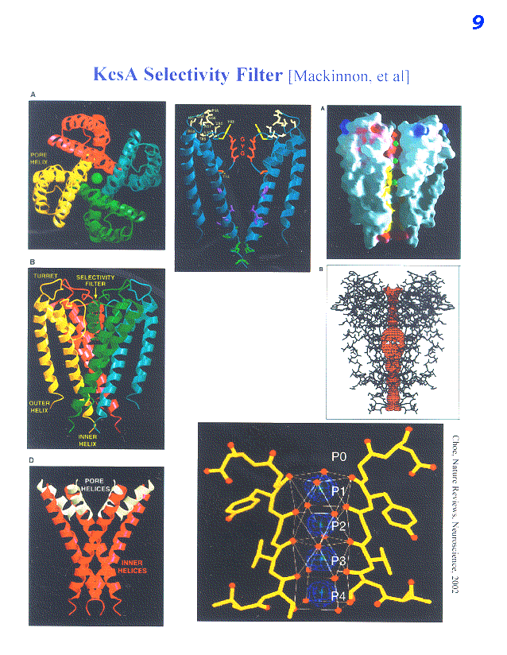
Notice Selectivity Filter (GYG)

Slide 25
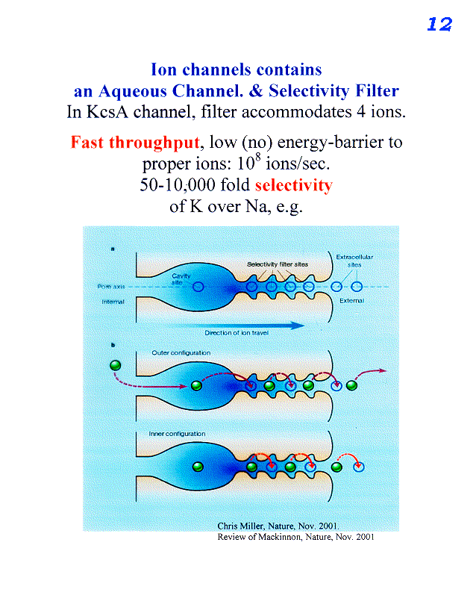
Inside
Outside

Slide 26
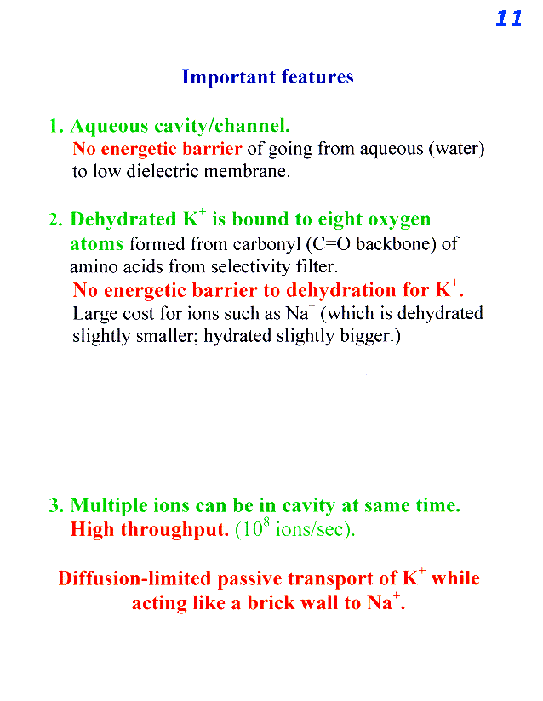

Slide 27
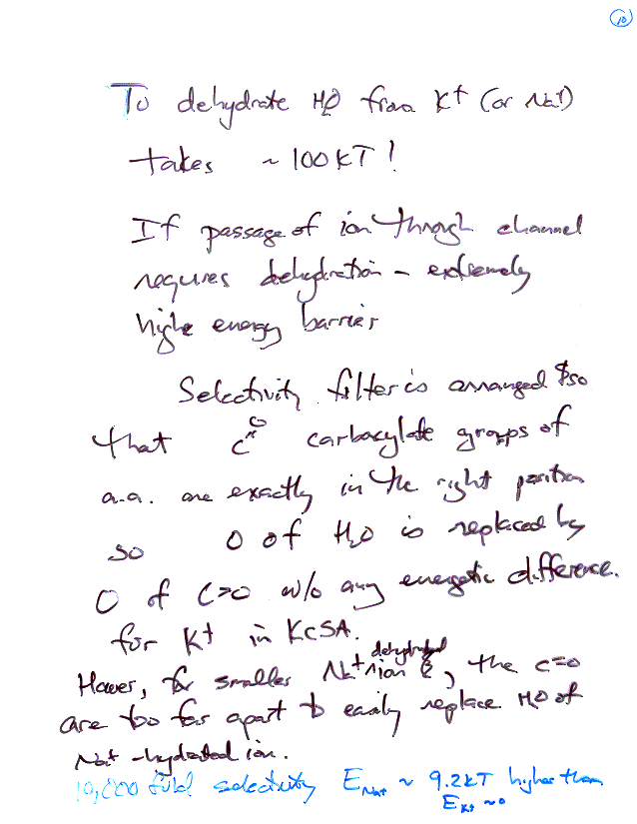
Hydration Energy
If 10,000 fold selectivity, what is E_{Na} vs. E_{K} ?
Ans: 9.2kT
Sodium channel been crystallized. C=O just right for Na⁺.

Slide 28
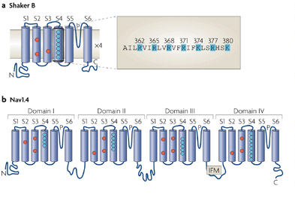
Potassium & Sodium Channel Similar
K⁺ Channel: homotetramer S1-S6
Na⁺ Channel heterotetramer S1-S6:
with each sub-unit having slight variations
--accounts for differences between dehydration of K⁺ and Na⁺ ions.
S5
K+
S3
S6
S2
S4
S1
Bezanilla, 2008, Nature Reviews

Slide 29
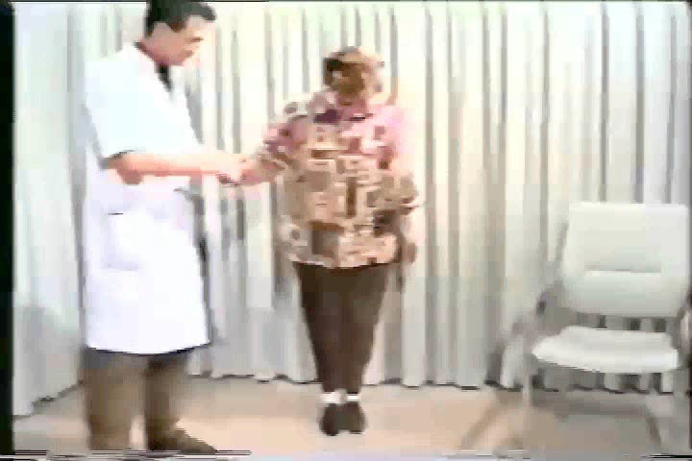
Point mutation in Potassium Gene that affects Potassium Channel

Slide 30
Class evaluation
What was the most interesting thing you learned in class today?
2. What are you confused about?
3. Related to today’s subject, what would you like to know more about?
4. Any helpful comments.
Answer, and turn in at the end of class.

Slide 31
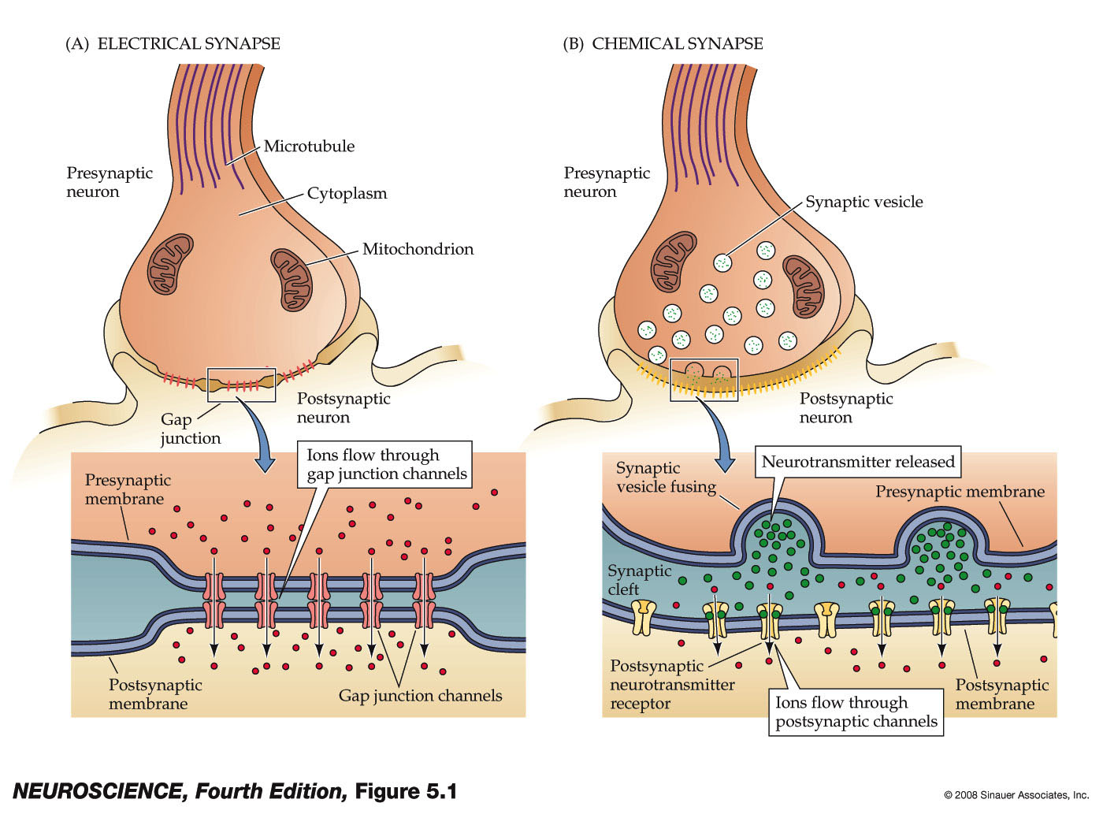
Summary Comparison of the 2 Principal kinds of Synapses: Electrical and Chemical

Slide 32
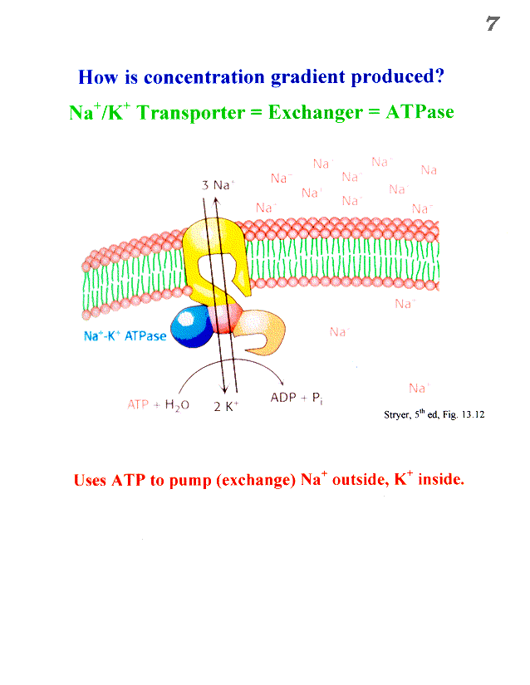
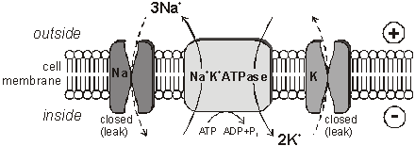
http://www.biologymad.com/NervousSystem/nerveimpulses.htm

Slide 33
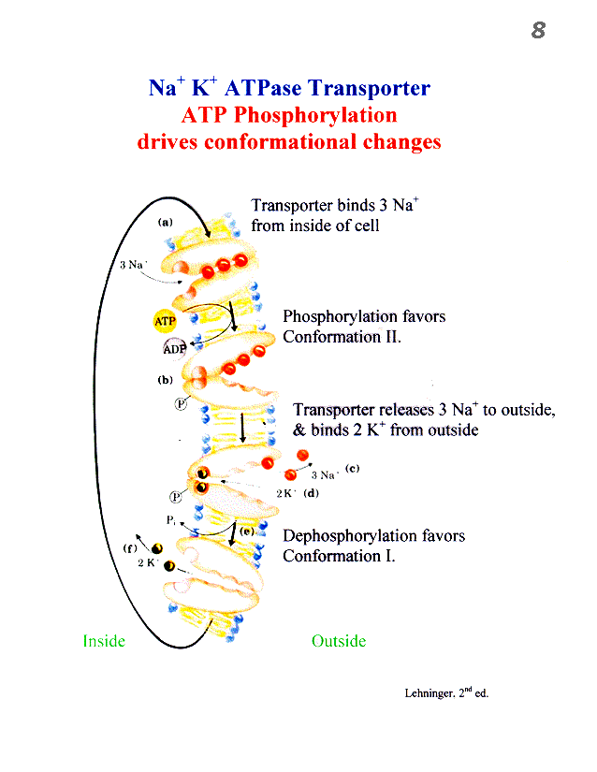
Can account for as much as 60%
of total ATP consumption

