Slide 1
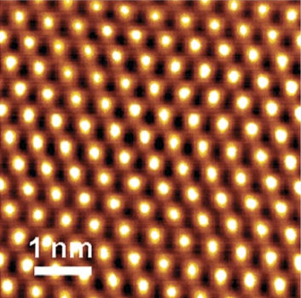
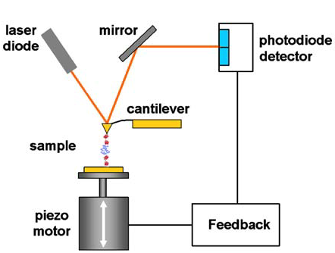
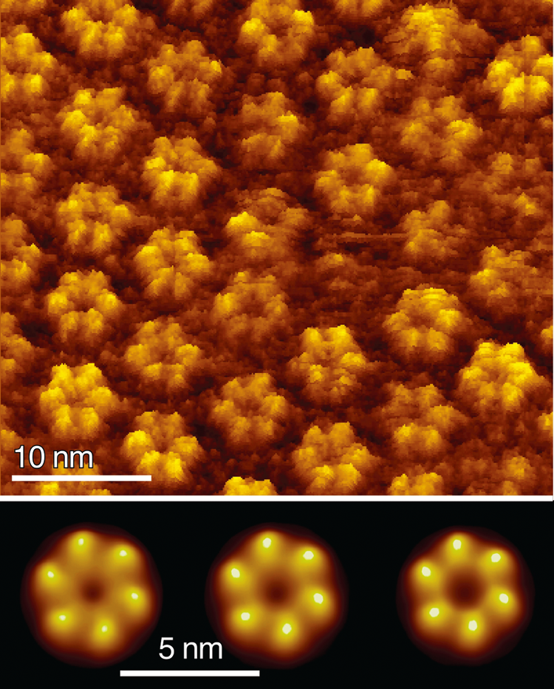
Experimental Protein Folding
Atomic Force Microscopy
Muller,
Biochemistry, 2008
Extracellular surface of Cx26 gap junction hemichannels.
In the presence of Ca²⁺, the hemichannel surface structures moved radially to close the channel entrance.
Bottom: The closed channels (left) switch, via an intermediate conformation (middle), to the open state (right) in the presence of 0.5 mM Ca2+
The precursor to AFM, called the Scanning Tunneling Microscope, won the Nobel Prize, 1986.
Can see fraction of a nanometer, >1000x better than (standard) optical techniques.

Slide 2
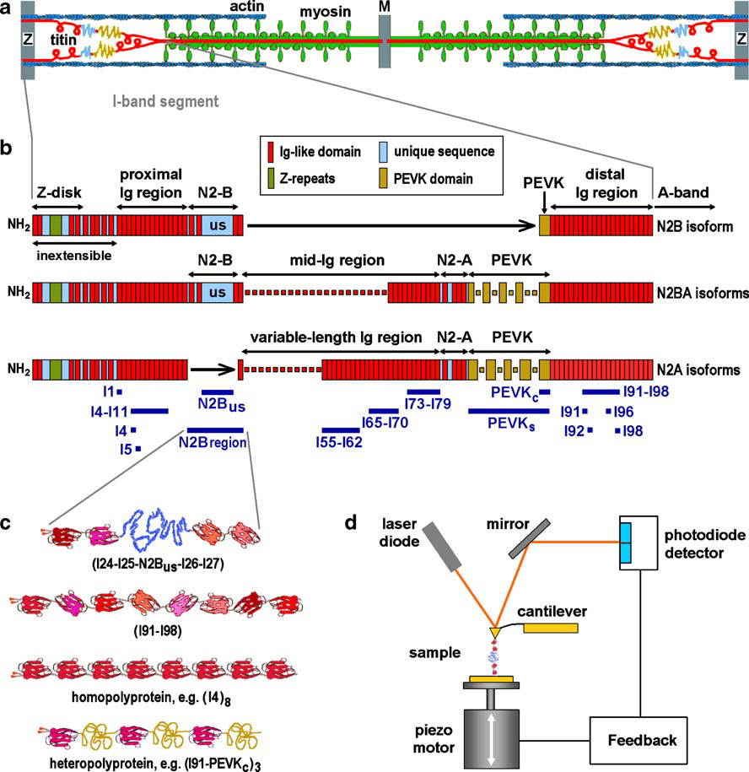
Titin: Human’s Biggest protein
Each domain IgG
Silicon Nitride lever: 10’s pN – several nN’s measureable
Titin: 4.2MDa; Gene (on # 2) = 38,138 aa: Goes from Z-disk to Center; stretchy =I Band
Cardiac (N2B &N2BA), Skeletal (N2A), Smooth all have different regions.

Slide 3
Picking up a single protein
“needle in a haystack”: usually pick up > 1 protein
“Fingerprint” of e.g. (I91)₈: by using identical repeats, unfolding forces are nearly identical with peaks equally spaced. (see Fig d)
1 sub-unit unfolding
Force is steadily increasing—like pulling a spring
have slope = k, i.e. F=kx)
(but is actually more like WLC);
Each time you have to apply a little bit of force to keep the whole thing stretched out.
1 sub-unit unfolding
till it “breaks. Force goes way down; then start on next sub-unit
Spring “breaks”, and F returns to very little until you start to stretch out next sub-unit. Since each sub-unit is the same, it repeats.
I91 repeated 8x
(short or no linker connecting them)
Protein stretched at constant velocity
Titin: ≈ 1 um/sec
Physiological range
The whole thing is stretch out. You keep pulling until it breaks/detaches.
Worm-like Chain (WLC) is very good approximation to
F vs. x of individual unit (protein, DNA) expansion.

Slide 4
Analysis: The Worm-Like Chain for elasticity
Increase in end-to-end length (x) of polypeptide when one IgG domain unfolds
Worm Like Chain (WLC) of entropic elasticity.
Note: WLC model can work for polypeptides only in "good solvent" where interaction between chains is weak and the protein behaves like a WLC polymer where elasticity is entropic in nature.
Most of energy into unfolding a peptide is entropy, not energy.
Force related to fractional increase (x/L)
where A = L_{p}: persistence length, a measure of the chains bending rigidity
= 2x Kuhn Length; L = contour length; x = extension
L_{p} = 4 Å (really short!)
Folded Ig domain length = 4.5 nm; 7x increase upon unfolding,
which explains why the force goes down dramatically after each unfolding
Each unfolding event increases the contour length of the homopolymer by a constant value, ∆L. For (I91)₈ = 28.1 nm.
(For other domains, it varies, typically from 27-31 nm.)

Slide 5
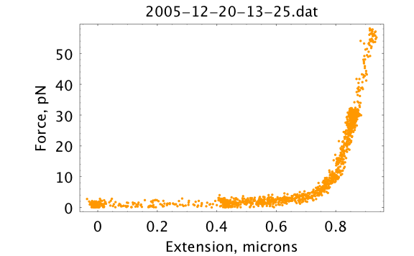
Analysis: The Worm-Like Chain for elasticity
F= - kx
Hooke’s Law: You apply a force on something and it increases in length linearly. Proportional constant = k. Minus sign because it’s a restoring force.
Force related to fractional increase (x/L). What if force isn’t proportional to distance?
http://biocurious.com/2006/07/04/wormlike-chains

