Slide 1
What you’ve learned

Slide 2
The cell uses packets of energy of ≈ 25kT
ATP:
Small enough amounts that you can use it efficiently.
Molecular motors (kinesin, F₁F₀ ATPase: like >50%-100%. Car motor- < 20%.
Mitochondria came from an ancient bacteria that was engulfed (has it’s own DNA).

Slide 3

Thermal energy matters a lot!
Everything (which goes like x² or v² in PE or KE) has ½ kT of energy.
If a barrier has on this order, you can jump over it and you will be a mixture of two states.
Boltzman distribution = Z⁻¹ exp (-ΔE/k_{B}T)
k_{f}
k_{b}
K_{eq} = k_{f}/k_{b}
ΔE

Slide 4
Entropy also matters
(if lots of states can go into due to thermal motion)
Probability of going into each state increases as # of states increases
ΔE
ΔE
ΔE
Add up the # of states, and take logarithm: ln σ = S = Entropy

Slide 5
Free energy
ΔG= free energy = ΔE - TΔS
(Technically ΔG = ΔH - TΔS: ΔH = enthalpy but doesn’t make a difference when dealing with a solution)
Just substitute in ΔG for ΔE
and equations are fine.

Slide 6
Diffusion
Kinetic thermal energy: ½ mv² = ½ k_{B}T (in one D; 3/2 in 3D).
Things move randomly.
Simple derivation x² = 2^{n}Dt (where n = # dimensions; t = time).
Where D = kT/f is the diffusion constant
f = friction force = 6πηr. (η = viscosity, r = radius)
[Note: when trying to remember formulas, take limit → 0 or →infinity.]

Slide 7
Diffusion
Efficient at short distances,
not-so at long distance
Distances across nerve synapses is short (30-50 nm) and neurotransmitters are small (like an amino acid). Diffusion is fast enough for nerve transmission.
In bacteria, typically ≈1 um. Fast enough.
In eukaryotes, typically ≈10-100 um, too slow.

Slide 8
Molecular Motors
Instead of relying on diffusion, where x² α (D)(time), and therefore x α [Dt]^{1/2} , you have x α (velocity)(time).
Translating motors (myosin, kinesin, dynein)
Rotating motors (F₁F₀ATPase)
Combination (a little: DNA or RNA polymerase, helicases)

Slide 9
How to measure?
Lots of ways.
Cantilevers—AFM
Magnetic Tweezers
Optical Traps
Fluorescence
Patch-clamping
“Diving board” Wobbles
Bead fluctuating
Limit your bandwidth (Fourier Transform)
Inherent photon noise, Poisson – √N
Inherent open/closing of channels
You have to worry about getting reasonable
signal/noise.
Noise – motion due to diffusion, photon noise

Slide 10
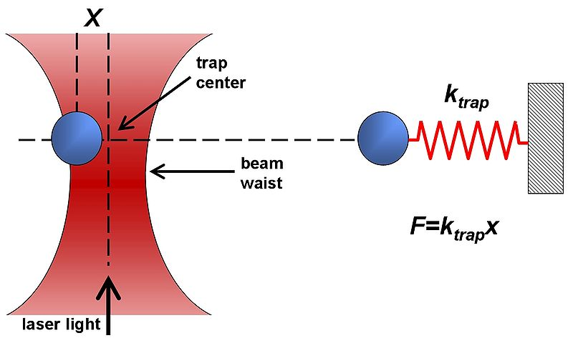
Optical Traps (Tweezers)
Dielectric objects are attracted to the center of the beam, slightly above the beam waist. This depends on the difference of index of refraction between the bead and the solvent (water).
Vary k_{trap} with laser intensity such that k_{trap} ≈ k_{bio} (k ≈ 0.1pN/nm)
Can measure pN forces and (sub-) nm steps!
http://en.wikipedia.org/wiki/Optical_tweezers

Slide 11
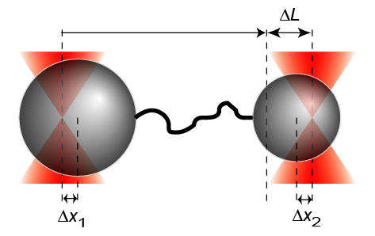
Basepair Resolution—Yann Chemla @ UIUC
1
unpublished
1bp = 3.4Å
2
1
3
2
4
3
4
5
5
6
6
7
7
8
9
9
8
UIUC - 02/11/08
3.4 kb DNA
F ~ 20 pN
f = 100Hz, 10Hz

Slide 12
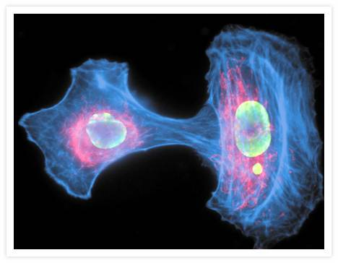
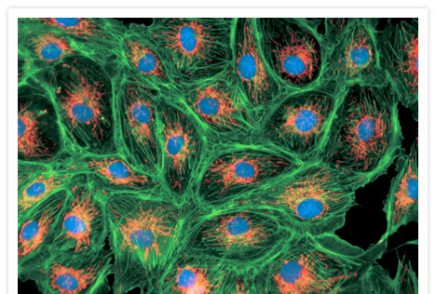
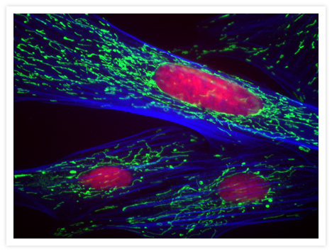
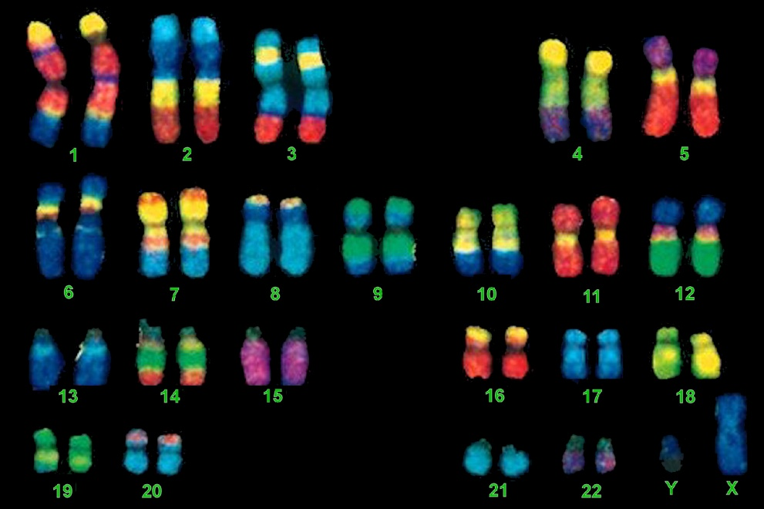
You can get beautiful pictures
www.invitrogen.com

Slide 13
Super-Accuracy: Photon Statistic con’t
center
If you’re collecting many photons, you can reduce the uncertainty of how well you know the average. You can know the center of a mountain much better than the width.
Standard deviation (w)
vs.
Standard Error off the Mean (center)
Sem = width/√N = 250/100 nm (few nm)
width

Slide 14
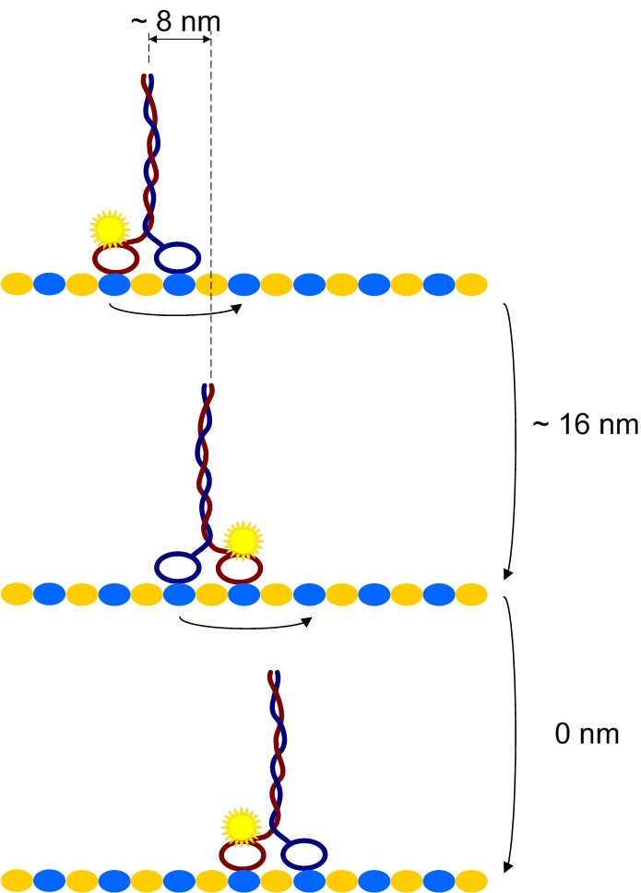


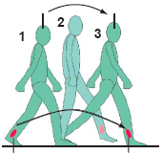
Kinesin: Hand-over-hand or Inchworm?
qs655
8.3 nm, 8.3 nm
16 nm
8.3 nm
8.3
8.3 nm
16.6 nm
16.6 nm
0 nm
16.6, 0, 16.6 nm, 0…
pixel size is 160nm
2 x real time

Slide 15
Super-accuracy Microscopy
By collecting enough photons, you can determine the center by looking at the S.E.M. SD/√N.
Try to get fluorophores that will emit enough photons. Typically get nanometer accuracy.

Slide 16
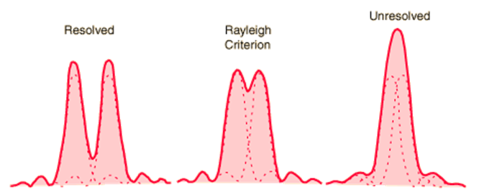
Photon: the diffraction limit
There is an “Inherent” uncertainty
– width = λ/2N.A. or 250 nm
This is the the best at which you can tell where a photon is going to land. It doesn’t matter how many photons you collect.

Slide 17
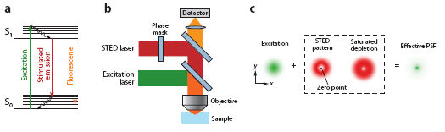
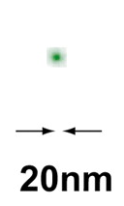
Diffraction Limit beat by STED
200nm
If you’re clever with optical configuration, you can make width smaller: STED.
You get down to 50 nm or-so.

Slide 18
You can get super-resolution to a few 10’s nm as well
Turn a fluorophore on and off.

Slide 19
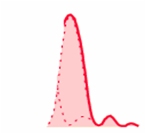
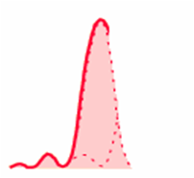
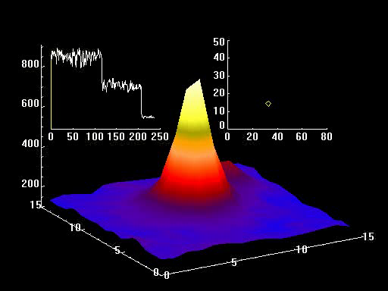
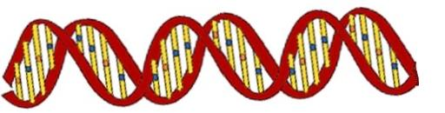

Super-Resolution:
Nanometer Distances between two (or more) dyes
Know about resolution of this technique
SHRImP
Super High Resolution IMaging with Photobleaching
132.9 ± 0.93 nm
8.7 ± 1.4 nm
72.1 ± 3.5 nm
In vitro

Slide 20
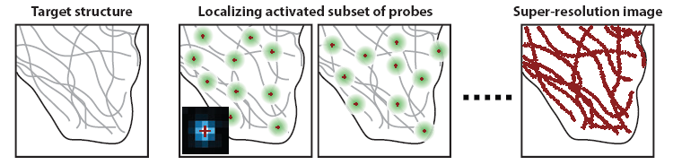
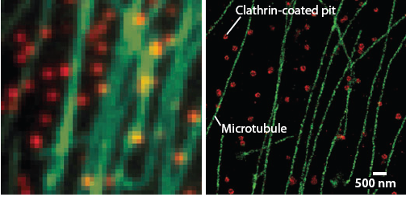
Super-Resolution Microscopy
Inherently a single-molecule technique
Huang, Annu. Rev. Biochem, 2009
STORM
STochastic Optical Reconstruction Microscopy
PALM
PhotoActivation Localization Microscopy (Photoactivatable GFP)
Bates, 2007 Science

Slide 21
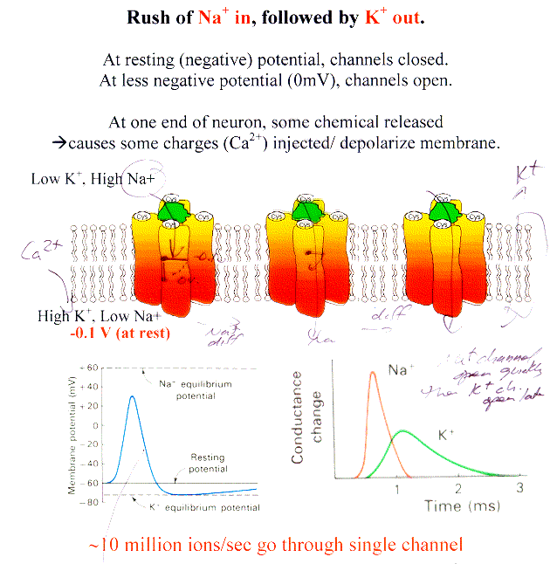
Nerves & Action Potentials

Slide 22

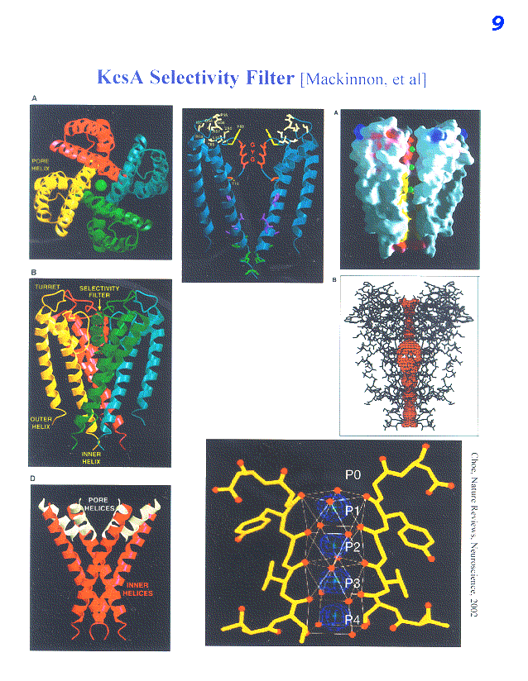
S4 has lots of amino acid charge
Feels effect of external voltage
S5
K+
S3
S6
S2
S4
S1
S5, S6: Notice Selectivity Filter (GYG)
C=O binds to K+, displaces OH₂
For K channels: Energy for K⁺ dehydration is close to zero, but very high for Na⁺ (or any other ion). Same for Na⁺ channels (see calculation).

Slide 23
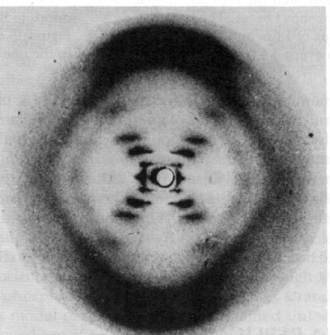
“Photo 51” – Rosalind Franklin 1952
X pattern
Layer Lines
Missing 4th layer
Diamond Pattern

Slide 24
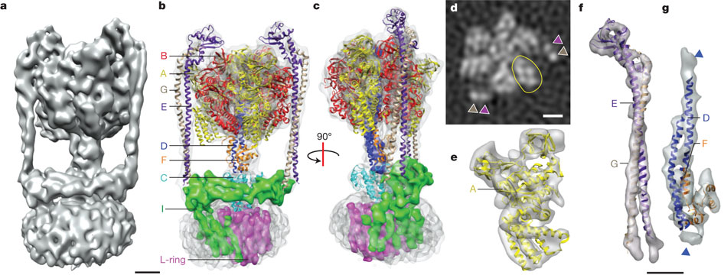
Three-dimensional map of the T. thermophilus ATP synthase
WCY Lau & JL Rubinstein Nature (2011)

Slide 25

See you at the Final
Dec 18, 8-11am, 136 LLP
Don’t forget to fill out course evaluation

