Slide 1
Announcements
1) Paper due tonight (at midnight)
2) Homework 9, assigned (on web).
Fluorescence, Diffusion
Due Tuesday Dec 2, 5 pm (in rm 364LLP)
3) Homework 10, on web. (formally assigned Dec 2)
Nerves
Due Wednesday Dec 10, 2 pm (in rm 364LLP)
(I need to leave for a trip at 3pm, so don’t be late!)
Today: Ion Channels II
Ion Channels, particularly voltage driven are what causes nerves to fire, by generate an action potential. [Know the various steps in an ion channe leading to an action potential—I will ask you this on final; e.g. imagine that ion channels are made of some negative conducting channels.]
They rely on “batteries”—constant source of voltage
Voltage generated through K⁺/Na⁺ exchange.
On/Off is digital, not analog–have transistors in you.
Analogs in Fruit flies have relevance for humans.

Slide 2
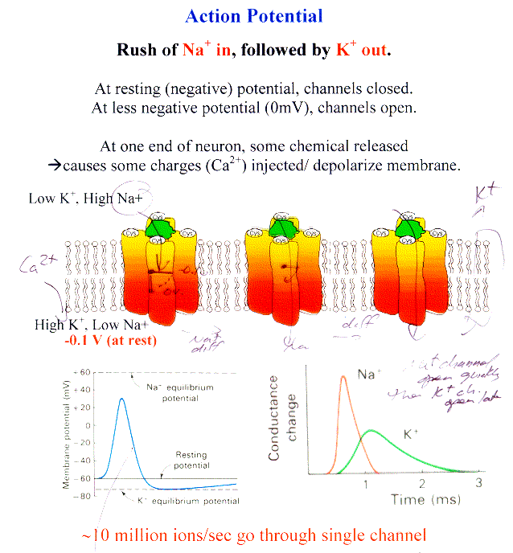
Na⁺ channels open quickly; K⁺ opens later
Na⁺ channels spontaneously close after being open for a while

Slide 3
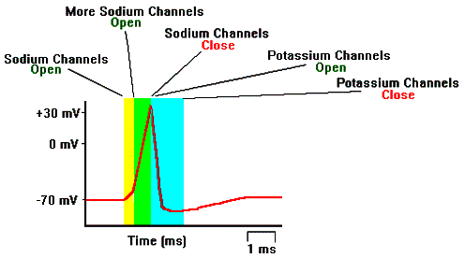
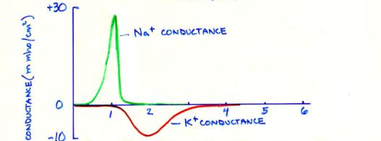
Action Potential– Nerves Firing
Na⁺ Conductance
K⁺ Conductance
http://www.biologymad.com/NervousSystem/nerveimpulses.htm

Slide 4

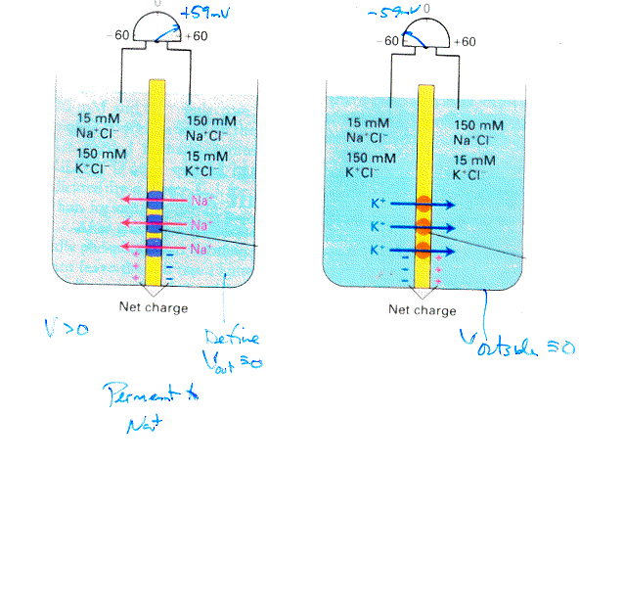
Membrane permeant to only one ion
What is voltage (electrical potential)
in each case
Membrane permeant to Na⁺
Membrane permeant to K⁺
V>0 or <0?
Just a tiny amount of charge causes potential: much less than 15 mM or 150 mM.
What causes charge to stop flowing?
A sufficiently large force (electrical potential) preventing more ions from going.
Given that V ~ -60mV and Na/K are two major ions, which is your membranes permeant to?
K⁺

Slide 5

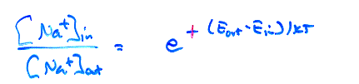
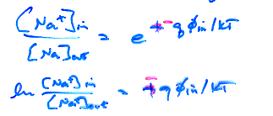
What is Boltzmann’s Factor?:
Z⁻¹exp(-E_{i}/kT)
Probability of being inside/outside?
exp(E_{out}-E_{in}/kT)
e
Let φ = voltage
Energy outside?
= q φ_{out}
= 0
Energy inside?
= q φ_{in}
e
-

Slide 6
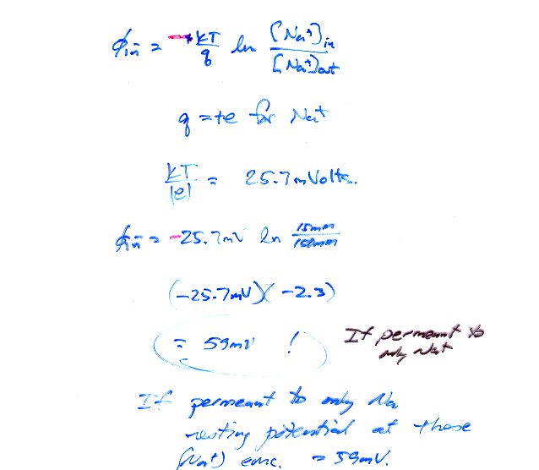
q = ? for Na.
+59 mV if permeable only to Na⁺
If permeant to only K⁺,
resting potential =
-59 mV
Resting potential = -60→ -100 mV

Slide 7
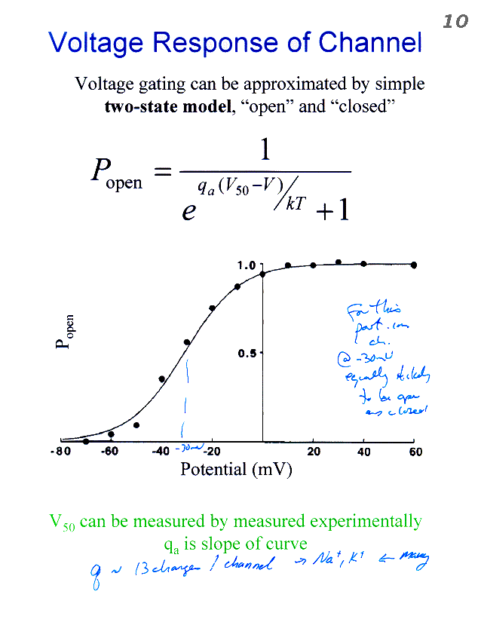
Nernst Equation
Getting the probability of being open, P_{open}:
V₅₀ = voltage at which 50% chance
of being open vs. being close

Slide 8

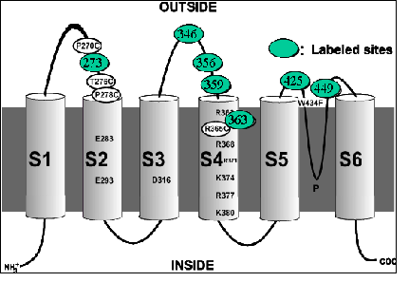
How does gate turn on/shut off?
S4 has lots of charge
Feels effect of external ions
S5
K+
S3
S6
S2
S4
S1
Particular channel is for K⁺; very similar for Na⁺;
Similar for different gating mechanisms—e.g. temperature
S4—gate
S5-S6 : pore
S1-S3 : helps
modulates S4

Slide 9
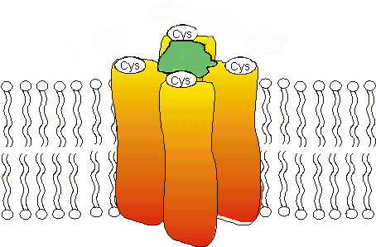
Outside
0 mV
Low K+
(High Na+)
K⁺
+ + +
+ + +
High K+
(Low Na+)
K⁺
K⁺
-0.1 V
0 V
Closed
Open
There is some charged amino acids (on S4), which feels the force of voltage. Moves and opens/closes the pore. You can measure the distance between a donor & acceptor via FRET

Slide 10
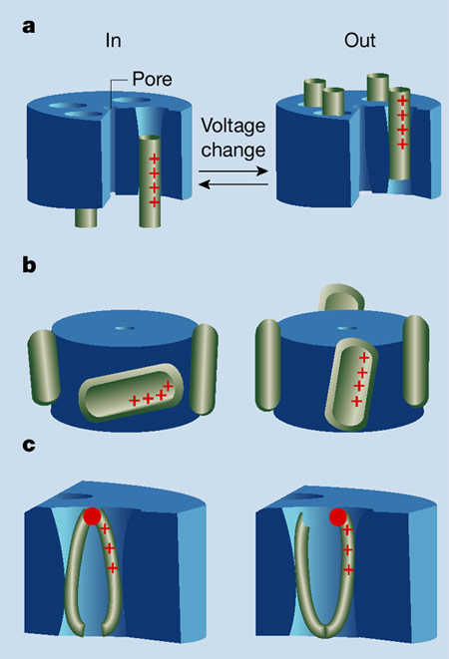
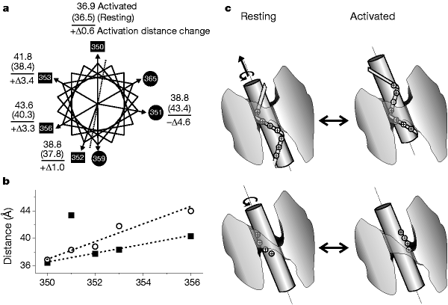
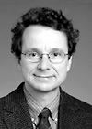
How does gate (S4) move? General Models
Piston?
Rotation?
Resting
Roderick
MacKinnon
S4
S4
Paddle?
Cork-screw?
Jiang et al.
Nature, 2003
Blaustein and Miller,
Nature 427, 499-500. (2004).
FRET can (mostly) tell
Crevice Reshaping?

Slide 11
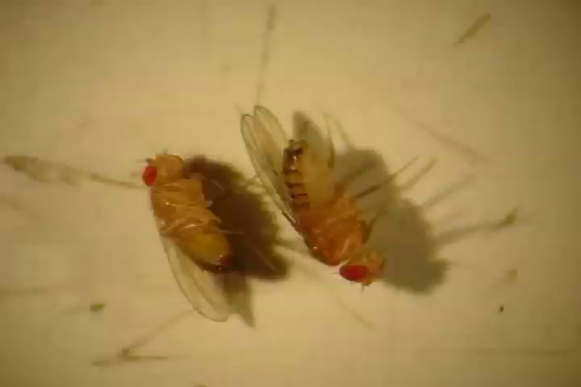
Fruit Flies (Drosophila)
Mutant: Shaker Gene: Potassium ion channels
Mutation causes change in conductance
When given ether, legs shake (hence the name)
Even unanaesthesized, weird movement, repetitive firing due to neurotransmitters
Requires less sleep.
In Drosophila, the shaker gene, located on the X chromosome.
The closest human homolog is KCNA3.

Slide 12
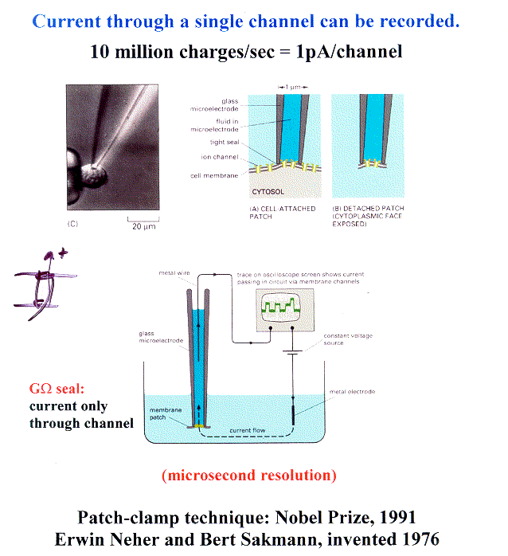
Is the Ion Channel Digital or Analog?
Note: Measuring ionic current– Na or K flowing through channels

Slide 13
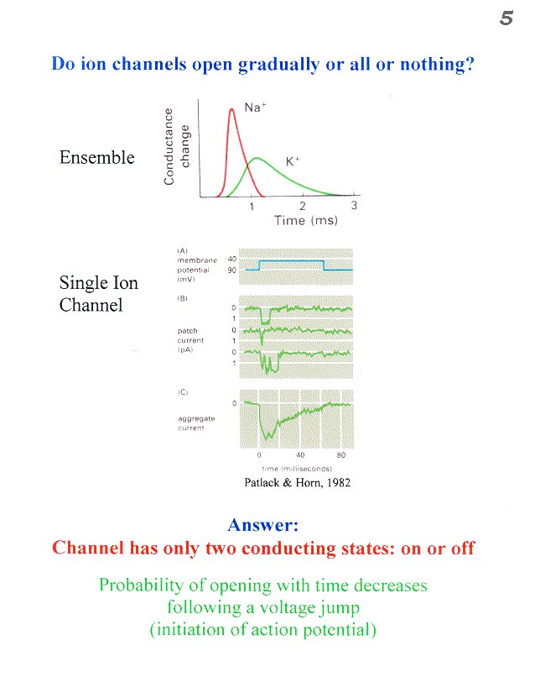

Slide 14
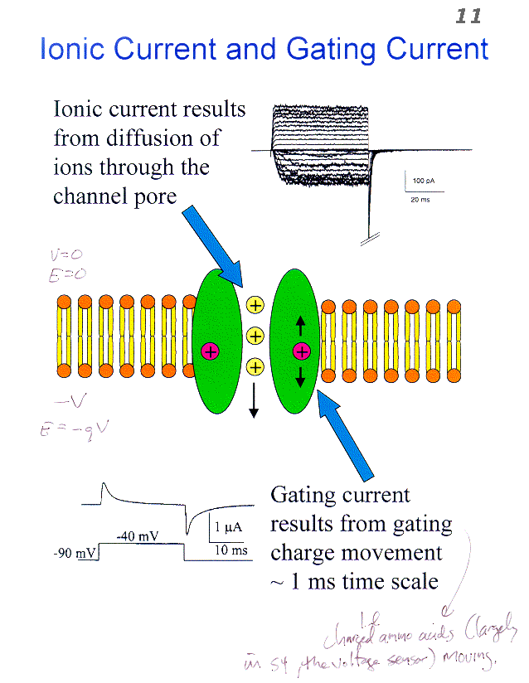
There are two types: measuring ionic currents for the previous
Charged amino acids (largely in the voltage sensor) move.

Slide 15
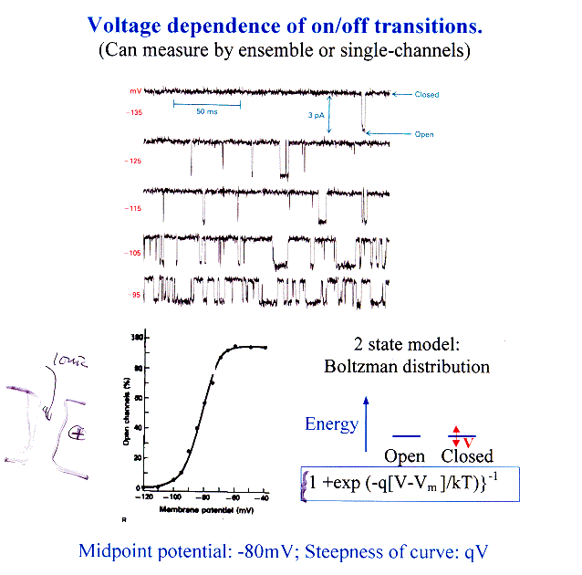
Single Ion
Channel
Conductance
Midpoint Potential: -80 mV; Steepness of curve: qV
Suggests model where 2 states that differ in energy by qV
Where q is about 13e, or 13e/4 per S1-S4 sub-unit; V= -80mV.
q is part of channel—gating current, not ionic current!

Slide 16
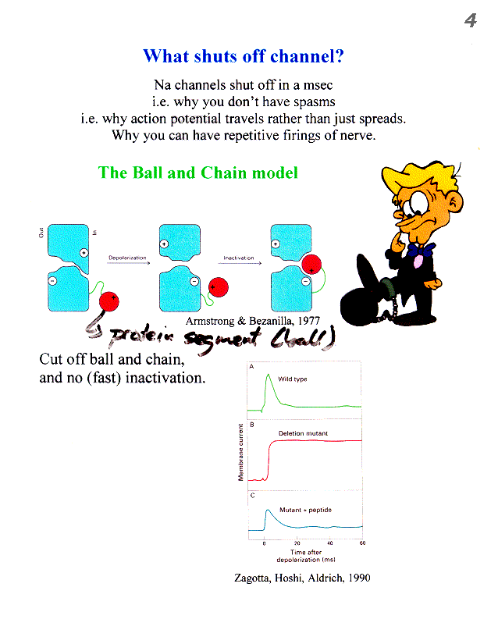
Nerve Impulse propagate, not spread, because Na⁺ spontaneously shut-off.

Slide 17
Structure of Pore-Domain
(S5-S6) is known
(KvAP, Kv1.2… all yield the same structure)
Explains ion selectivity (K⁺ > Na⁺) and rapid ion flux.
Excellent agreement between FRET and Crystallography
But how S4 (and S1-S3) move, remain controversial.
Rod MacKinnon won Nobel Prize

Slide 18
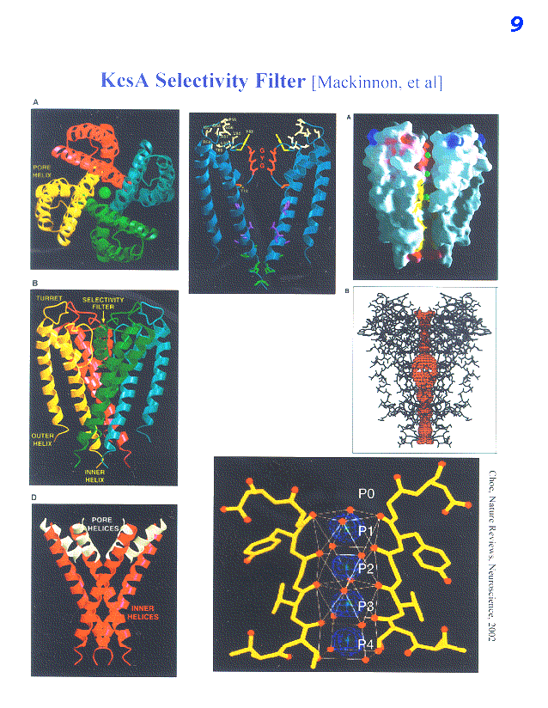
Notice Selectivity Filter (GYG)

Slide 19
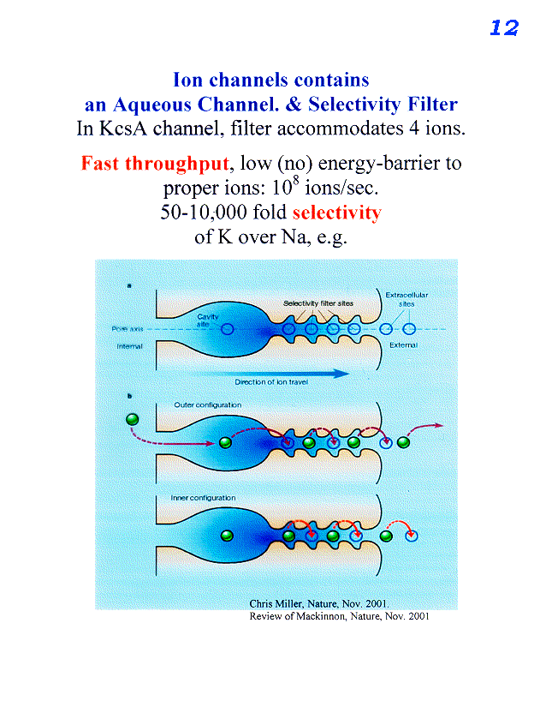
Inside
Outside

Slide 20
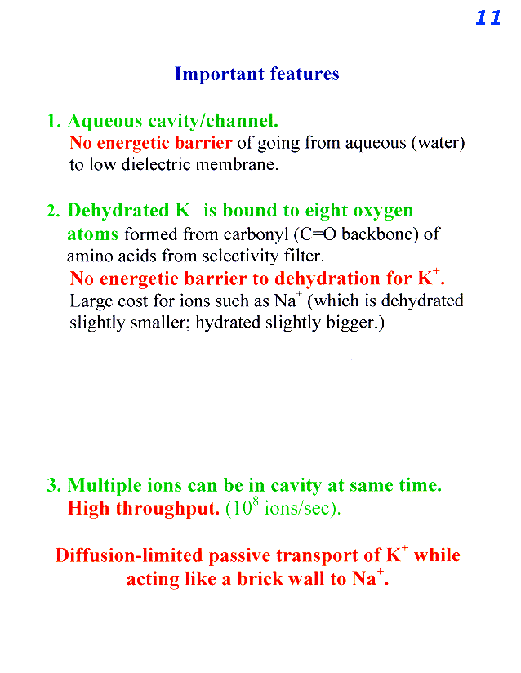

Slide 21
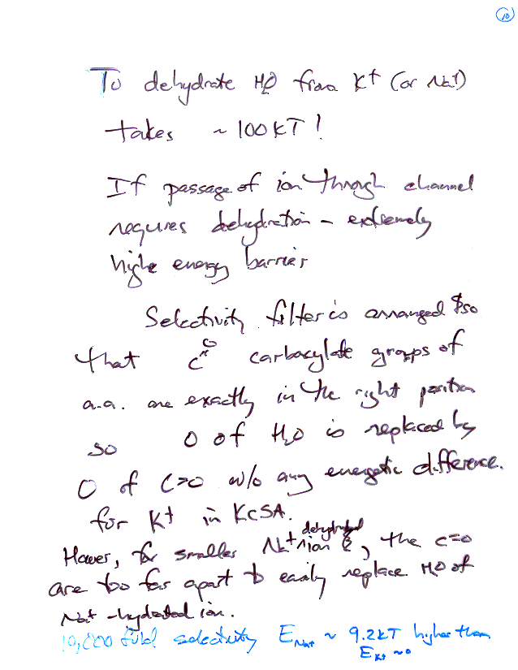
Hydration Energy
If 10,000 fold selectivity, what is E_{Na} vs. E_{K} ?
Ans: 9.2kT
Sodium channel been crystallized. C=O just right for Na⁺.

Slide 22
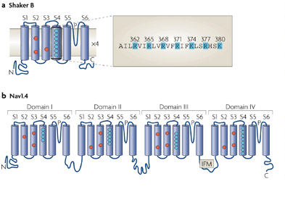
Potassium & Sodium Channel Similar
K⁺ Channel: homotetramer S1-S6
Na⁺ Channel heterotetramer S1-S6:
with each sub-unit having slight variations
--accounts for differences between dehydration of K⁺ and Na⁺ ions.
S5
K+
S3
S6
S2
S4
S1
Bezanilla, 2008, Nature Reviews

Slide 23
Class evaluation
What was the most interesting thing you learned in class today?
2. What are you confused about?
3. Related to today’s subject, what would you like to know more about?
4. Any helpful comments.
Answer, and turn in at the end of class.

