Slide 1
Today: Ion Channels
Ion Channels are membrane-bound proteins
Involved in communication
3 types, voltage, ligand and mechanically-sensitive
Nerves:
They rely on “batteries”—constant source of voltage
Voltage generated through K⁺/Na⁺ exchange.
(Next time:) On/Off is digital, not analog–have transistors in you.
Analogs in Fruit flies have relevance for humans.

Slide 2
Nerve Mutation in Potassium Ion Gene Analog to mutation in fruit fly

Slide 3
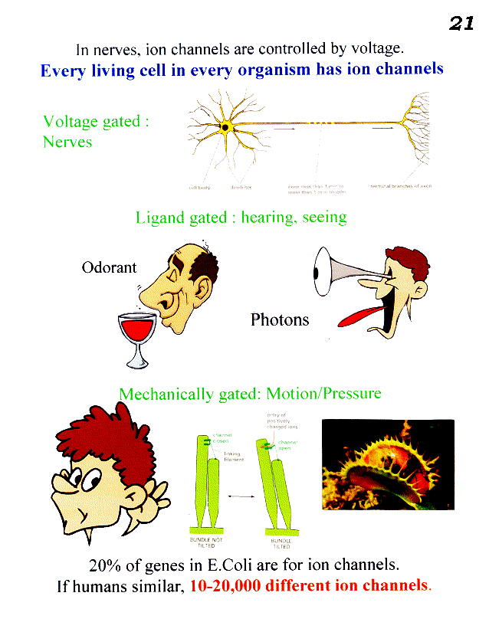
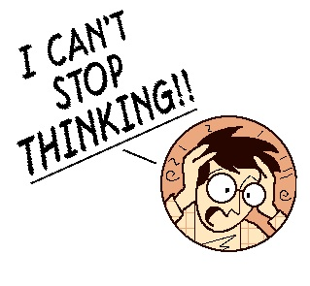
Ion channels are used to communicate to a cell. Are turned on/off by 3 types of signals.
Every cell in every organism has ion channels.
1.
2.
Photons
C.N.S.
3.
how many different ion channels?
Ans: 25,000 genes: 5000 genes. One or more polypeptide/ion channel– could get less, or more, ion channels.

Slide 4
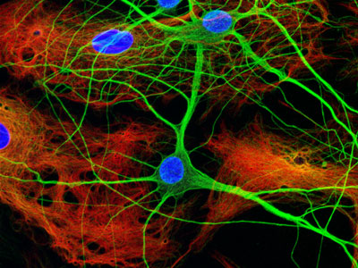
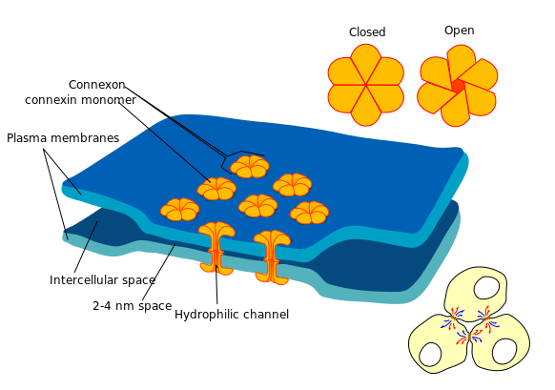
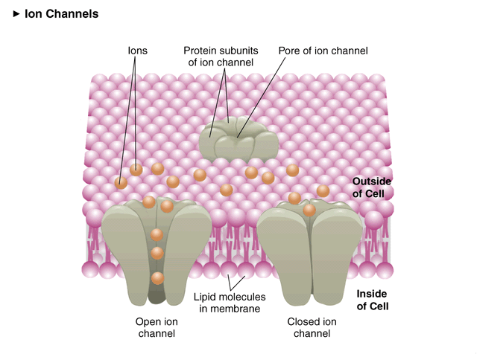
(Focus on Chemical Synapse) Ion Channels
www.nikonsmallworld.com/gallery/year/2005/36
http://en.wikipedia.org/wiki/Electrical_synapse
Electrical
3.5 nm synapses
Fastest. Bidirectional, no gain (post< pre).
Chemical
20-40 nm synapses
Unidirectional (gain).
0 mV (Outside)
0 mV (Inside)
open (depolarized)
-60 to -100 mV (Inside)
closed (polarized)
In general, every cell is like battery.

Slide 5
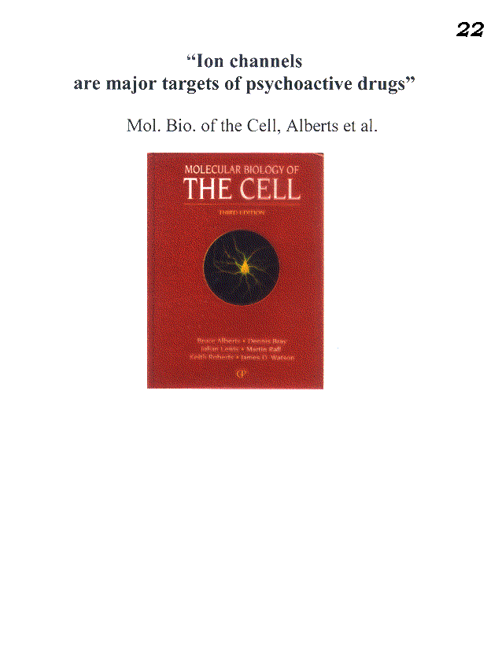
Major source of drug targets.
Valium binds to serotonin (ligand) receptor called GABA receptor– relaxes nerves.

Slide 6
Nerves
How (electrical) signal is transported along a nerve
Axon
Dendrites
Terminal Branch of Axon
Cell Body
Inside
~-0.1V
Resting potential
(~-0.1V)

Slide 7
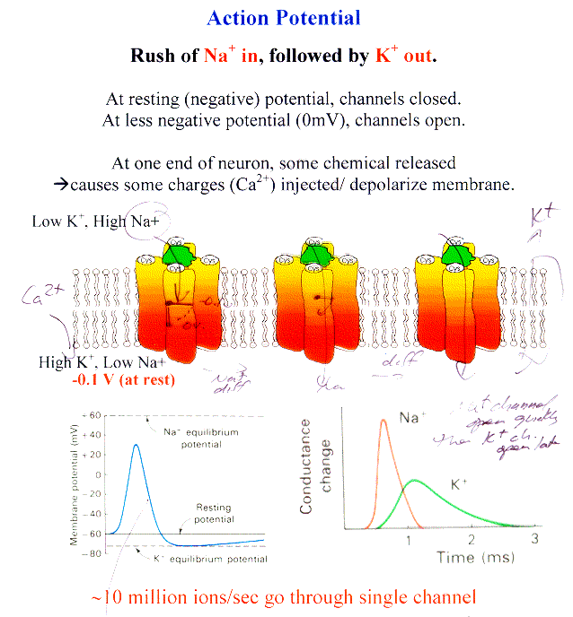
Na⁺ channels open quickly; K⁺ opens later
Na⁺ channels spontaneously close after being open for a while

Slide 8
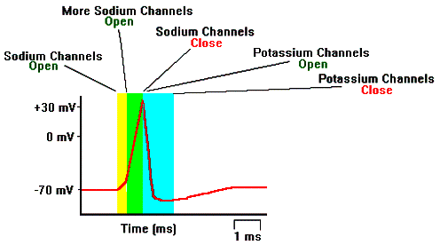
Action Potential– Nerves Firing
http://www.biologymad.com/NervousSystem/nerveimpulses.htm

Slide 9
To close ion channels, to stop wave:
4. Na⁺ spontaneously close
5. K⁺ open → brings membrane potential back down negative.

Slide 10
Gradient set-up by Na/K Transporters [will go over]

Slide 11
Membrane permeant to only one ion
What is voltage (electrical potential)
in each case
Membrane permeant to Na⁺
Membrane permeant to K⁺
V>0 or <0?
Just a tiny amount of charge causes potential: much less than 15 mM or 150 mM.
What causes charge to stop flowing?
A sufficiently large force (electrical potential) preventing more ions from going.
Given that V ~ -60mV and Na/K are two major ions, which is your membranes permeant to?
K⁺

Slide 12
Class evaluation
What was the most interesting thing you learned in class today?
2. What are you confused about?
3. Related to today’s subject, what would you like to know more about?
4. Any helpful comments.
Answer, and turn in at the end of class.

