Slide 1
The Protein Energy Landscape
Largely from Martin Gruebele, Chemistry, Physics UIUC
Also from Maria Spies, Biochemistry, UIUC

Slide 2
Announcements
This is Lec 8. The midterm will be Tuesday Oct 7th in class. (It is a few classes later than I planned.)
Last lecture covered on Mid-Term will be Sept. 25th or Sept. 30th. (Will tell you when we are a bit closer.) There will be a homework (on Protein folding, today; on Magnetic Traps) which will be covered in Mid-term.
The exam will cover:
Readings (of Chpt 1 of Berg); Scientific American; Article on PCR, other?)
All Homeworks
All Lecture Materials.

Slide 3
Future Readings
Ubiquitin:
Want you to be able to read Science general article. For example, the article by Jean Marx on Ubiquitin (see Web site).
And you should also be able to read the Wikipedia section on ubiquitin: http://en.wikipedia.org/wiki/Ubiquitin.
(I’m not making it a formal assignment now since you have a lot of HW, but be forewarned!)

Slide 4
Slight modification of HW 4c, Gene Chips
c) What are the problems you might have when doing DNA microarrays? You can think of problems that may arise during the PCR reaction (temperature used, buffer/ salt) or when cDNA is made from mRNA or pre-mRNA (introns vs exons)

Slide 5
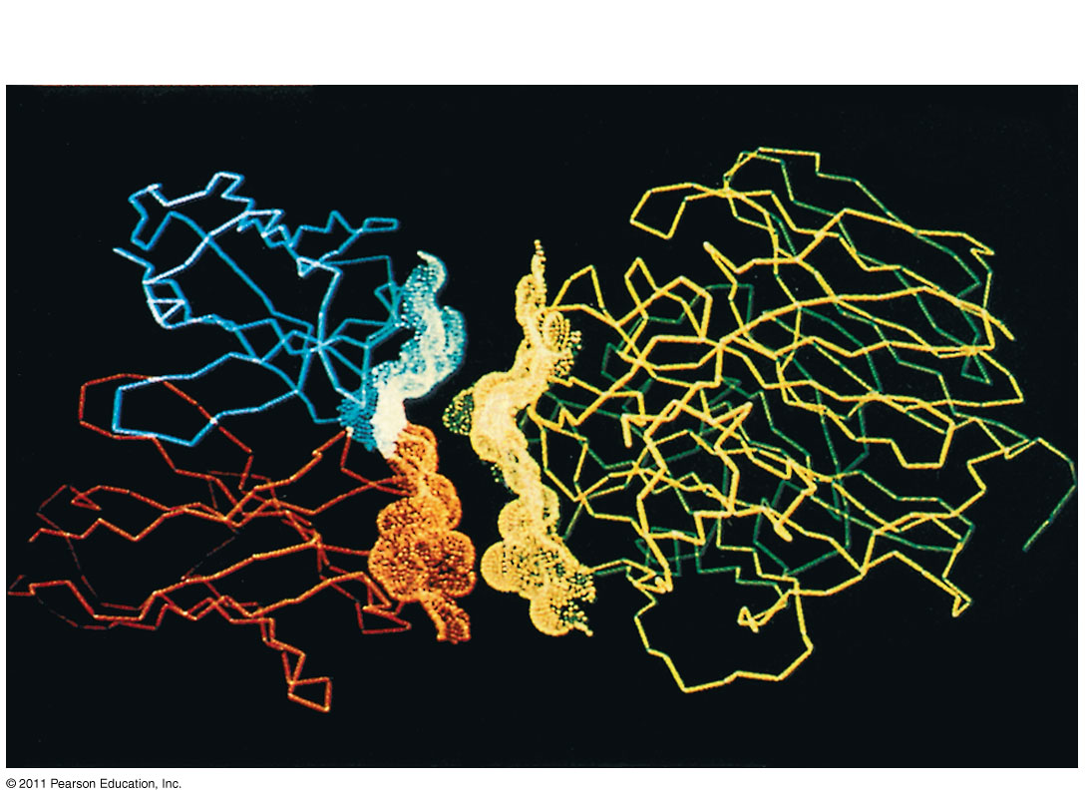
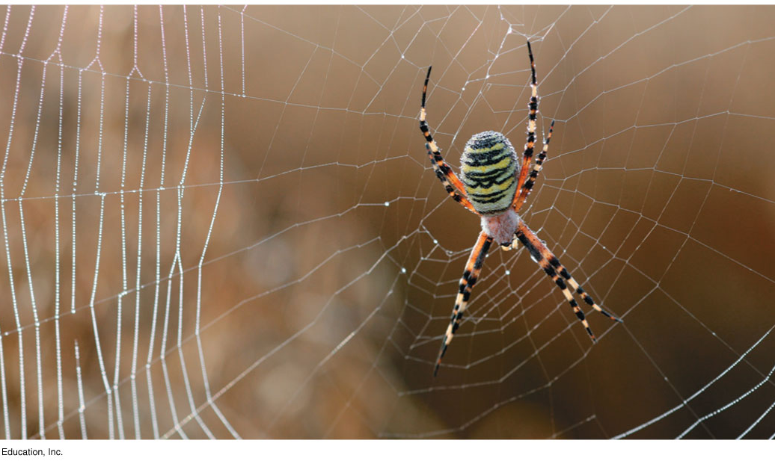
Protein Structure and Function
A functional protein consists of one or more polypeptides precisely twisted, folded, and coiled into a unique shape
Antibody protein
Protein from flu virus
Figure 5.20d
Figure 5.19
© 2011 Pearson Education, Inc.

Slide 6
Sickle-Cell Disease: A Change in Primary Structure
A slight change in primary structure can affect a protein’s structure and ability to function
Sickle-cell disease, an inherited blood disorder, results from a single amino acid substitution in the protein hemoglobin
© 2011 Pearson Education, Inc.

Slide 7
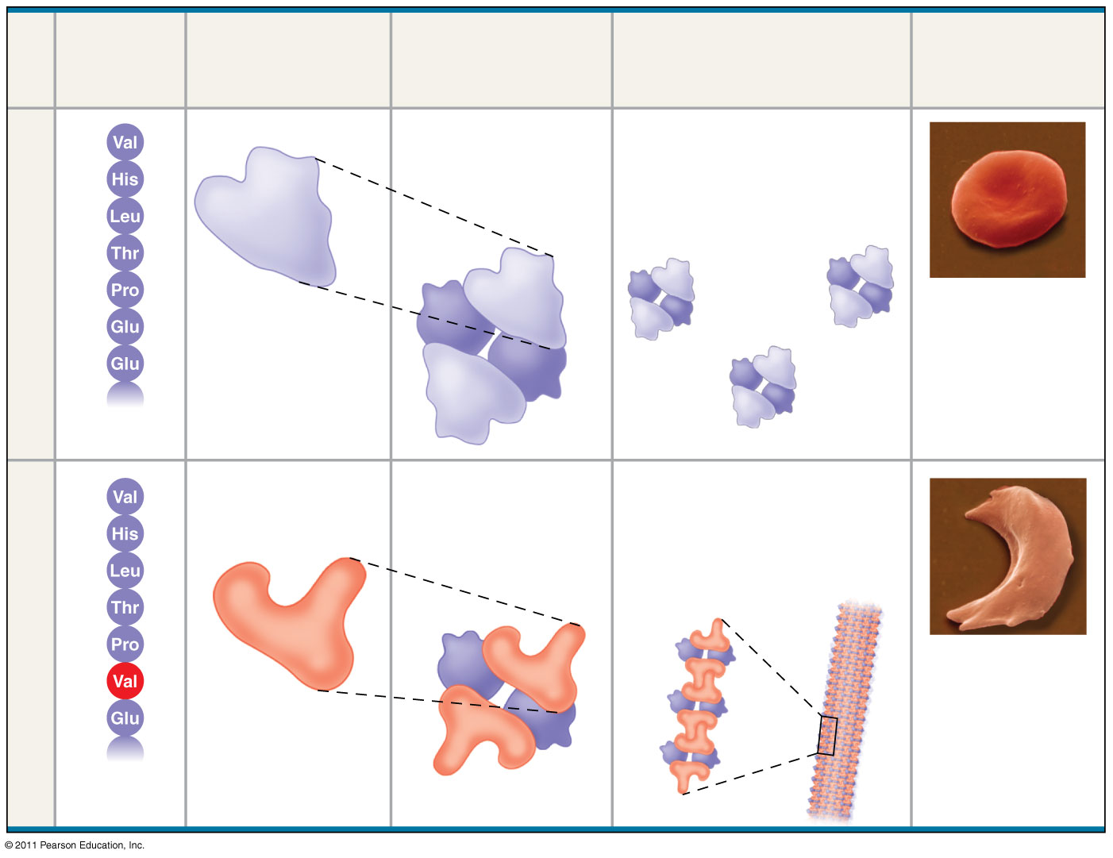
Figure 5.21
Sickle Cell Anemia:
β-Hemoglobin, 146aa (3 exons) codon GAG is replaced by GTG. This results in the replacement of hydrophilic amino acid glutamic acid with the hydrophobic amino acid valine at the sixth position.
Primary
Structure
Secondary
and Tertiary
Structures
Quaternary
Structure
Red Blood
Cell Shape
Function
1
Normal
hemoglobin
Molecules do not
associate with one
another; each
carries oxygen.
2
3
4
5
α
Normal hemoglobin
β subunit
β
10 μm
6
7
α
β
1
Exposed
hydrophobic
region
Sickle-cell
hemoglobin
Molecules crystallize
into a fiber; capacity
to carry oxygen is
reduced.
2
3
4
5
Sickle-cell hemoglobin
α
10 μm
6
β
7
β subunit
α
β
Notes:
Figure 5.21 A single amino acid substitution in a protein causes sickle-cell disease.

Slide 8
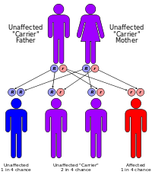
Why does sickle cell anemia still exist?
It is clearly disadvantageous to have disease; (natural selection) make probability of passing on your genes/reproducing less likely.
Recall you’re diploid—have two copies of each gene.
If have both SS, then you have anemia.
If both genes unmutated: “normal”.
If heterozygote, (one “good”, one “bad”) then have certain advantages.
If mother/father have SS and NN, probability of kid having SS? NN? SN?
¼; ¼; ½
If you have N-N, you’re completely “normal”, can reproduce fine.
If S-S, you have sickle-cell anemia, chance are you die early (before you have kids). Unlikely to reproduce. This is natural selection –evolution-- working against them, i.e. less likely to pass your genes on.
With N-S : You’re more likely to survive (than N-N) if malaria around. This advantage-- more resistant to malaria-- apparently overcomes the probability/disadvantage of having a kid with S-S and hence less likely to pass on your genes for future generations.

Slide 9
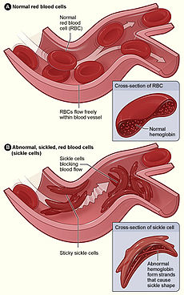
Why chances of surviving malaria is better of you’re N-S (rather than N-N)
The malaria parasite has a complex life cycle and spends part of it in red blood cells. In a carrier, the presence of the malaria parasite causes the red blood cells with defective hemoglobin to rupture prematurely, making the plasmodium unable to reproduce. Further, the polymerization of Hb affects the ability of the parasite to digest Hb in the first place. Therefore, in areas where malaria is a problem, people's chances of survival actually increase if they carry sickle-cell trait (selection for the heterozygote).
The pathogen that causes the disease spends part of its cycle in the red blood cells and triggers an abnormal drop in oxygen levels in the cell. In carriers, this drop is sufficient to trigger the full sickle-cell reaction, which leads to infected cells being rapidly removed from circulation and strongly limiting the infection's progress. These individuals have a great resistance to infection and have a greater chance of surviving outbreaks. However, those with two alleles for SCA may survive malaria, but will typically die from their genetic disease unless they have access to advanced medical care. Those of the homozygous "normal" or wild-type case will have a greater chance of passing on their genes successfully, in that there is no chance of their offspring's suffering from SCA; yet, they are more susceptible to dying from malarial infection before they have a chance to pass on their genes.
http://en.wikipedia.org/wiki/Heterozygote_advantage
http://en.wikipedia.org/wiki/Sickle-cell_disease

Slide 10
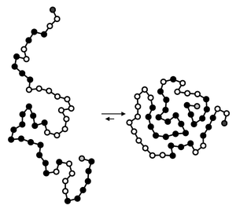
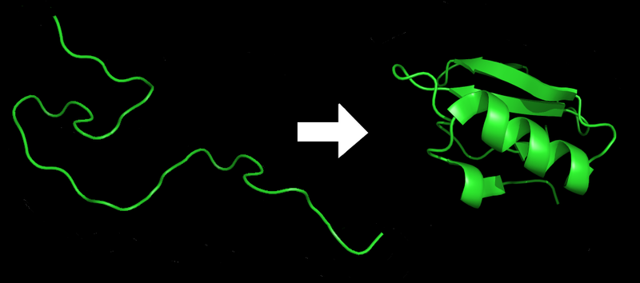
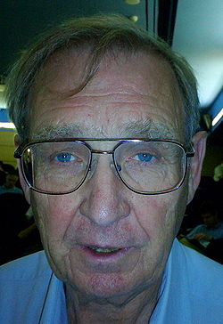
How does a Protein go from unfolded to folded a) at all; b) in 1 msec; c) with no (help), chaperones?
(Helping proteins)
Unfolded → Folded
Inactive → Active
Hans Frauenfelder, founder of biological physics.
Main driving forces:
Shield hydrophobic (black spheres) residues/a.a. from water;
Formation of intramolecular hydrogen bonds.
Active areas: 4 centuries on it
Predicting tertiary structures from primary sequence still not solved!
Difficulty relating to experimental observations.

Slide 11
Simple Calculation of ∆G from K_{eq}.
Let’s say you have protein K_{eq} = 1000
Free energy
So what fraction of states are folded?
So what’s ∆G?
K_{eq} = exp(-∆G/kT)
∆G =7 k_{B}T
-1
0
1
x
How many hydrogen bonds is this?
That’s equivalent to just a couple of Hydrogen bonds.
∆G is (almost flat).
How can this be? What about ∆E, ∆S? (Recall: ∆G = ∆E – T∆S)
If ∆S is large and ∆E is large, then ∆G can be small.
This is what happens: ∆E, T∆S ≈ -100’s kJ/mole
(Lots of bonds form but loss of a lot of entropy)

Slide 12
Protein folding: the energy landscape theory
ENTROPY
Unfolded state
Molten Globule State
Intermediate states
I_{A}
Is this “free energy”, or “energy = enthalphy”?
ENERGY
Ans: Energy (Enthalpy)
I_{B}
Native state

Slide 13
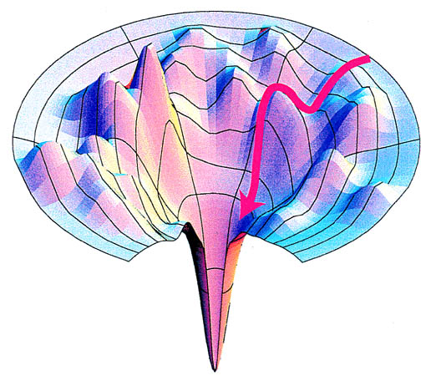
Protein folding: the energy landscape theory
Fast – (on a ms timescales for single domains). Unfolded proteins “roll downhill” towards smaller populations of conformations.
2. Highly cooperative – intermediates are rarely observed
3. Heterogeneity of the starting points – each unfolded molecule has different conformation and different path downhill the folding funnel
4. In many cases is coupled to translation

Slide 14
Example: the lattice model
A simplified model of protein folding:
Only 2-D motion allowed; only 90˚ motion.
(Real proteins are 3D; are not restricted to 90˚ rotation.)
6-mer peptide (2 hydrophobic and 4 hydrophilic amino acids)
Each amino acid is represented as a bead
  Black bead: hydrophobic (H)
  White bead: hydrophilic (P)
Bonds represented by straight lines
H-H (=1 KJ/mole = 1/3 k_{B}T/molecule) and P-P (=250J) bonds favorable
Single 90˚ rotation per time step allowed.
What about length-dependence:
do peptides (short proteins) fold-up?
Note: Proteins fold; Peptides don’t fold
Peptides have too few H-H and P-P to fold stably.
Based on work from Ken A. Dill, 1989, and Peter Wolynes, 1987

Slide 15
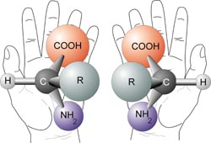
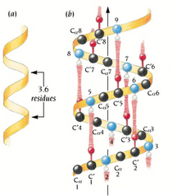
Chirality in Amino acids
Although most amino acids can exist in both left and right handed forms, Life on Earth is made of left handed amino acids, almost exclusively. Why?
Not really known. Meteorites have left-handed aa.
http://en.wikipedia.org/wiki/File:Chirality_with_hands.jpg
Alpha helix is a right-handed coil, with left-handed amino acids. (There is steric hinderance for a left-handed helix from left-handed amino acids.) Similar for β-sheets.
In 2D: To avoid issues with chirality, all molecules are made so that the first two amino acids go upwards.
Also, the first kink always goes to the right.
Notes:
Paul,
the issues you mention only arise because the simple model for folding is a lattice model. Of course, the real backbone linkages are not at 90° angles, and can go in any direction.
When the folding problem is mapped into a planar 90° lattice, some issue arise when counting conformation. For example, the 'vertical' conformation (* = residue)
*
*
*
*
is really the same as the 'horizontal' conformation
* * * *
just rotated 90°. This we do not want to double count. Hence the rule about the 1st 2 amino acids going upward (or sideways, or any direction, but just ONE direction) so we do not need to worry about rotational degeneracy and partition function, which has nothing to do with folding.
Furthermore, in 2D, chirality is represented by the sense of the "S" for a "helix. For example
(<- there's a figure here)
is the opposite chirality of
(<- there's a figure here)
in 2-D. (Obviously, if I could rotate these objects in 3-D, I can get them to overlap, but not by rotating in 2-D).
Finally, real proteins flip anywhere but just 90°! But in the 2-D lattice model, that's how we simplify the motion. A bet sheet becomes
(<- there's a figure here)
a helix becomes what I showed in the figures above, a loop becomes
(<- there's a figure here)
as crude approximations for the real things.
By restricting the motions to 90° flips, one is basically saying that only local rearrangements of the chain are needed to account for all possible motions. On the 2-D lattice, you can get from ANY conformation to any other by just 90° flips. In real proteins, you can get from ANY backbone conformation to ANY other just by rotating 2 Ramachandran angles. Better models could include more motions, but the amazing thing is, this simple 2-D model with these simple motions captures all the correct free energy behavior of a folding protein!
The biggest improvement on this 2-D model is to account for the fact that it grossly underestimates the configurational entropy of the denatured state; in 3-D (even on a 90° lattice) you would obviously have way more unfolded conformations relative to folded conformations. This can be taken into account in the partition function by adding a factor alpha^(n), where n = number of free residues to each conformation in the partition function. Amazingly, doing that actually yields 90° lattice models that QUANTITATIVELY match up with experimental measurements for real RNA (or proteins). I attach a paper as an example, see eq. (4) in the attached paper, and figure 4 for pictures of the lattice model for an RNA hairpin.
Of course, MD simulation is physically much more accurate, but I think the simplified lattice models are much more conducive to understanding what is minimally needed to get things to fold!
Cheers,
Martin

Slide 16
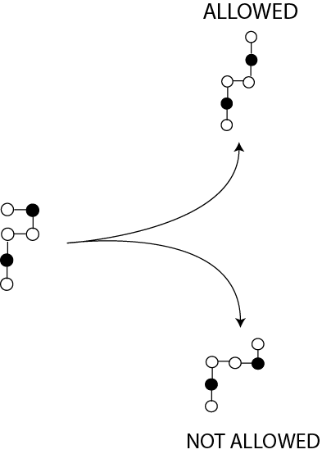
Rotation rules under Lattice Model
2-D model - no rotations allowed.
[Don’t allow over-counting: horizontal = vertical configuration]
Molecules are only allowed to change in a single “kink” in 90˚ increments per time.

Slide 17
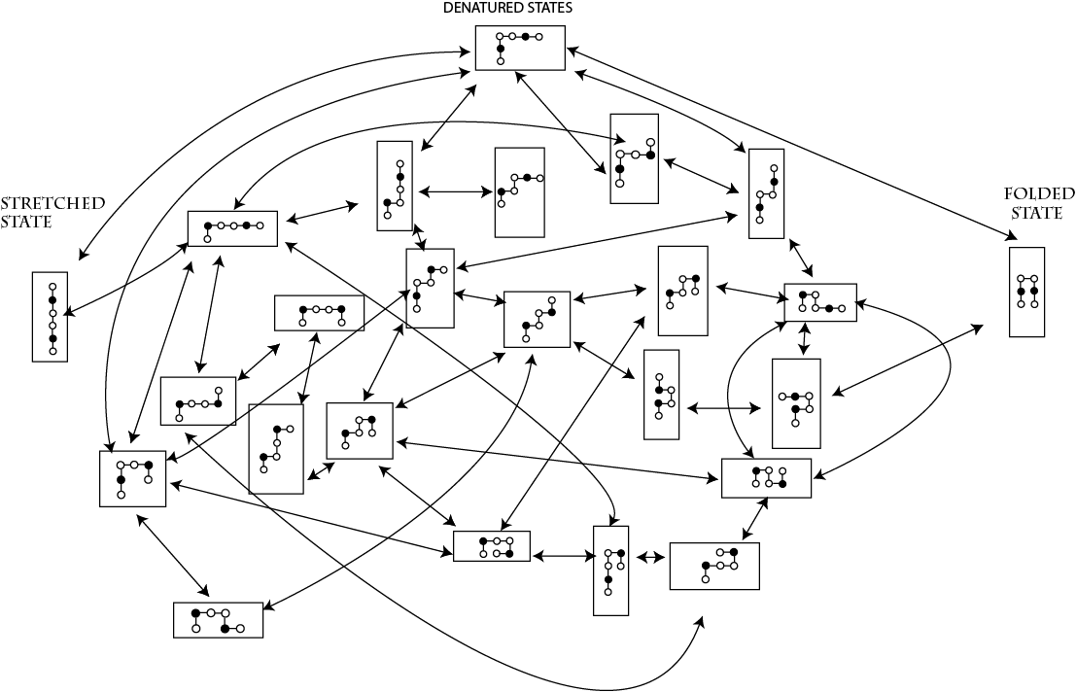
The Journey
Note: these two states would be equivalent by an out-of-plane rotation, but this is not allowed.

Slide 18
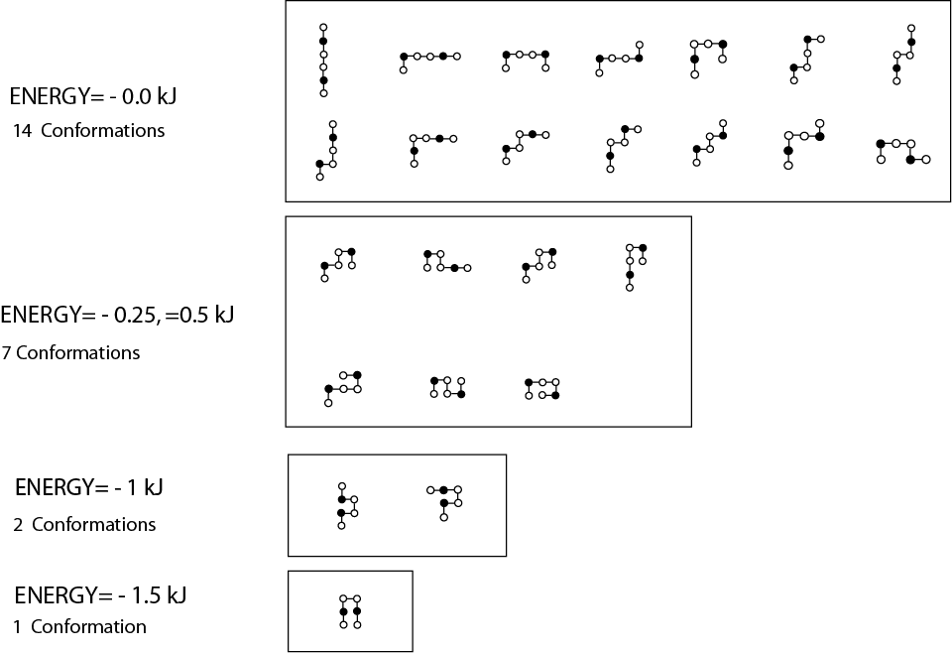
Conformation Analysis
[Add up E, S = k_{b} lnW]
Reaction
Coordinate
Energy = 0 kJ
W=13 (I initially said 14!)
S=Rln(13)≈22JK⁻¹mol⁻¹
x
E

0

Same!
Energy = -0.25 kJ; -0.5 kJ
W=7
S=Rln(7)≈16JK⁻¹mol⁻¹
-0.5 kJ
0.33
Energy = -1 kJ
W=2
S=Rln(2)≈5.8 JK⁻¹mol⁻¹
Kinetic trap
(Have to break two bonds)
0.66
Energy = -1.5 kJ
W=1
S=Rln(1)=0
1
Note: Only nearest neighbors that count
Molecular Dynamics has actually taken over to make it more realistic
Notes:
This diagram simply takes the diagram “The Journey” and organizes them via total bond energy. The reaction coordinate is simply the coordinate going from the denatured state to the native state.

Slide 19
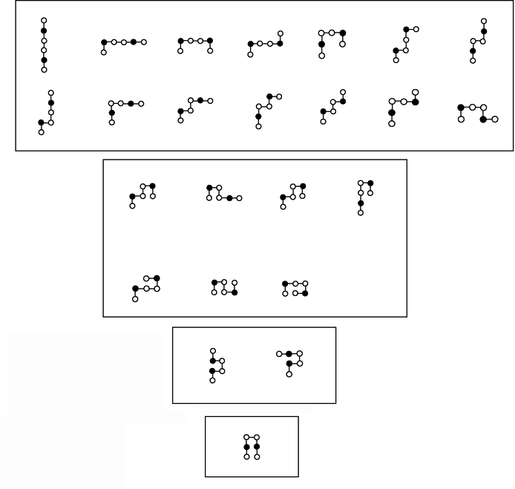
The Protein Folding funnel
Entropy
E
k ln13
k ln1 = 0
Entropy : horizonal scale
Notes:
This diagram simply takes the diagram “The Journey” and organizes them via total bond energy. The reaction coordinate is simply the coordinate going from the denatured state to the native state.

Slide 20
Entropy vs. Energy
(correlated monotonic function)
Ln 13
The folded state (-1.5kJ) has the lowest entropy, and the unfolded states have the highest entropy
Ln 1
Notes:
The folded state (-1.5kJ) has the lowest entropy, and the unfolded states have the highest entropy

Slide 21
Entropy vs. Reaction Coordinate

Slide 22
Free Energy Analysis (200°K)
Downhill folding (but in reality, at 200K, nothing moves)
At low temperatures, the lowest free energy state is the most ordered state, in this case the native state.
x
Notes:
At low temperatures, the lowest free energy state is the most ordered state, in this case the native state.

Slide 23
Free Energy Analysis (298°K)
At room temperature, the folded state (-1500J) has the lowest free energy, and thus is the most energetically favorable conformation to be formed.
Downhill folder
Notes:
At room temperature, the folded state (-1500J) has the lowest free energy, and thus is the most energetically favorable conformation to be formed.

Slide 24
Free Energy Analysis (2000°K)
At very high temperatures, the fully denatured state has the lowest free energy.
Downhill unfolder
Notes:
At very high temperatures, the fully denatured state has the lowest free energy.

Slide 25
Free Energy Analysis (360 °K)
This is likely the equilibrium of 50:50 where they are interconverting and equally stable.
Two state folder
Unfolded state—has some structure

Slide 26
Summary of Protein Folding
Proteins can fold.
Don’t need chaperones.
ΔG is always about zero.
Kinetics – fast cause not huge barriers

Slide 27
Class evaluation
1. What was the most interesting thing you learned in class today?
2. What are you confused about?
3. Related to today’s subject, what would you like to know more about?
4. Any helpful comments.
Answer, and turn in at the end of class.

