Slide 1
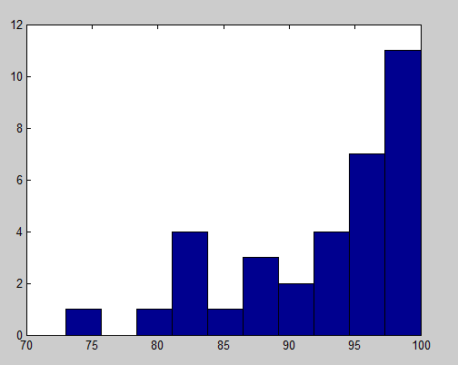
Today:
Finish up ATPase
Start Protein Folding
Homework #1

Slide 2
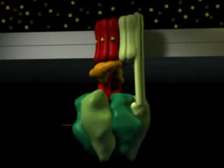
Amazing Animation of F₁F₀ ATPase
http://www.grahamj.com/fivth2.html

Slide 3
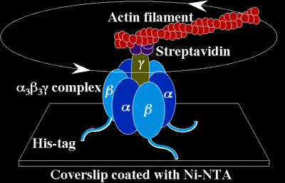
F1-ATPase
Enzyme which makes
ATP from ADP and P_{i}
by using electrochemical gradient
Energy + ADP+ P_{i} ↔ ATP
Amazingly efficient enzyme!
Many pictures taken from:
Real time imaging of rotating molecular machines,
By Kinosita

Slide 4
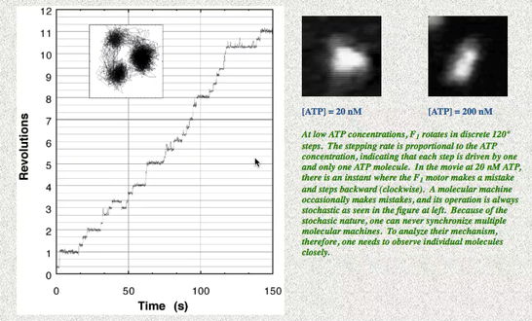
ATPase moves at 120° steps = f[ATP]

Slide 5
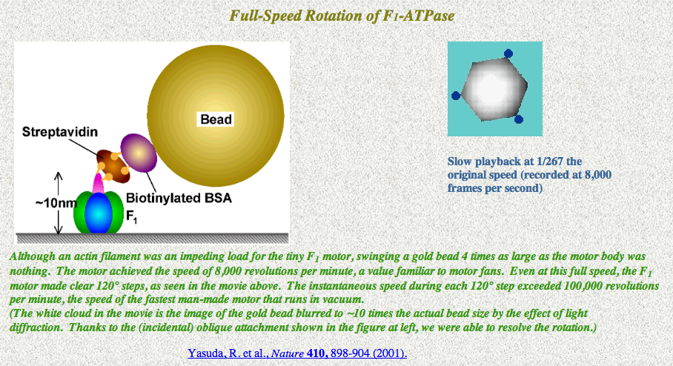
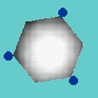
Takes 120° steps even at full-throttle!
See: http://www.k2.phys.waseda.ac.jp/F1movies/F1full.htm

Slide 6



Load Dependence of ATPase
Vary the length of Actin lever Arm– moving under friction
http://www.k2.phys.waseda.ac.jp/F1movies/F1long.htm
Rotation of F1 is slower when a longer rod (actin filament) is attached to the rotor subunit. This is because the rod is rotating in water and the viscous friction imposed on the rod is proportional to the cube of the rod length. Precise analysis indicates that F1 produces a constant torque (rotary force) of about 40 pN nm, irrespective of the viscous load.
At 2 mM (and 20 μM) ATP, the rotational rates were consistent with a constant frictional torque (the drag coefficient × the rotational rate) of 40 pN·nm, indicating that the sub-complex produced this much of torque irrespective of the frictional load.
Always operating at ~100% efficiency!
http://www.k2.phys.waseda.ac.jp/Movies.html

Slide 7

Scaling F1 to Size of a Person
Kinosita, FASEB

Slide 8
1st = 3 x 7kT. Practically 100% Efficient
2nd : Free energy in ATP
(Calculate #pN-nm for ΔG; compare it to ATP)
How Efficient is ATPase?
ATP → ADP + P_{i}
K_{eq} = exp –ΔG₀ / k_{b}T; ΔG₀ = -k_{b}T ln K_{eq}
At standard conditions (1M)
[in homework, we’ll go over difference between ΔG₀, and ΔG]
ΔG = ΔG₀ + k_{b}T .ln {[ADP][P_{i}]/[ATP]}

Slide 9
1st = 3 x 7kT. Practically 100% Efficient
2nd : Free energy in ATP
(Calculate #pN-nm for ΔG; compare it to ATP)
How Efficient is ATPase?
ΔG = ΔG₀ + k_{b}T .ln {[ADP][P_{i}]/[ATP]}
(Homework)
ΔG₀ = -50 pN nm (standard free-energy change per molecule for ATP hydrolysis at pH 7,
k_{b}T = 4.1 pN nm ; [ATP] = [P_{i}] = 10⁻³ M
Therefore:
ΔG = -100 pN-nm for [ADP] = 10 μM
ΔG = -90 pN-nm for [ADP] = 100 μM
Remember ATP = 20-25k_{b}T = 80-100 pN-nm
Practically 100% Efficient!

Slide 10
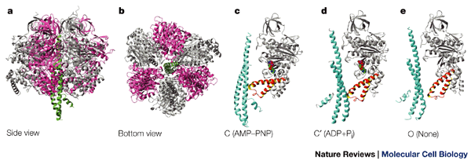
F₁
F₁
There are three nucleotide-binding catalytic sites, located at αβ interfaces but predominantly involving residues of the β subunits.
Each α subunit contains a tightly bound ATP, but is inactive in catalysis.
Mg⁺⁺ binds with the adenine nucleotides in both α & β subunits.
https://www.rpi.edu/dept/bcbp/molbiochem/MBWeb/mb1/part2/f1fo.htm

Slide 11
The conformation of each β subunit changes sequentially as it interacts with the rotating shaft.
Each β subunit is in a different stage of the catalytic cycle at any time. E.g, the green subunit sequentially changes to:
  a loose conformation in which the active site can loosely bind ADP + P_{i}
  a tight conformation in which substrates are tightly bound and ATP is formed
  an open conformation that favors ATP release.
https://www.rpi.edu/dept/bcbp/molbiochem/MBWeb/mb1/part2/f1fo.htm

Slide 12
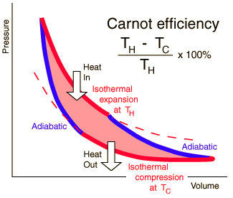
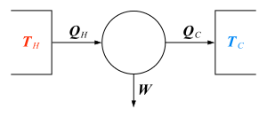
Why doesn’t ATPase violate 2nd law of thermodynamics (ΔS > 0)
Carnot cycle: thermal energy into work
Heat engine: heat → work
0!
Efficiency = ?
Carnot cycle is irrelevant: it’s at constant temperature. You are not converting heat into work. You are starting with some P.E. (7k_{B}T) and converting it into another P.E. (chemical bond of ATP)

Slide 13
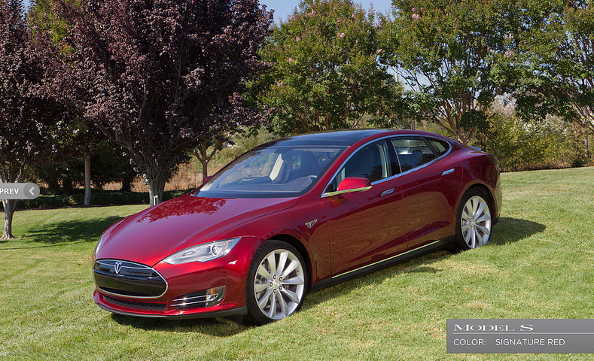
How does this relate to a Tesla car?
Regular car: heat engine. Tesla: Electrical P.E. to K.E.
Very efficient once battery is charged up. Regular Carnot engine (gasoline) is not very efficient
http://www.teslamotors.com/gallery#

Slide 14
The Protein Energy Landscape
Largely from Martin Gruebele, Chemistry, Physics UIUC
Also from Maria Spies, Biochemistry, UIUC

Slide 15
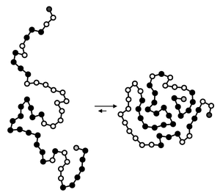
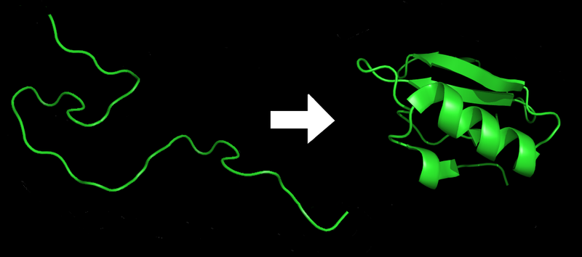
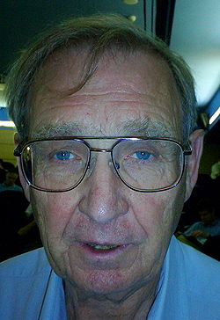
How does a Protein go from unfolded to folded a) at all; b) in 1 msec; c) with no (help), chaperones?
(Helping proteins)
Unfolded → Folded
Inactive → Active
Hans Frauenfelder, founder of biological physics.
Main driving forces:
Shield hydrophobic (black spheres) residues/a.a. from water;
Formation of intramolecular hydrogen bonds.
Active areas: 4 centuries on it
Predicting tertiary structures from primary sequence still not solved!
Difficulty relating to experimental observations.

Slide 16
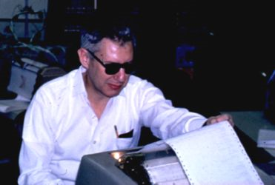
Levinthal’s Paradox
Protein folding – the process that results in acquisition of the native structure from a completely or partially unfolded state
Protein folding cannot proceed by purely random search among ALL possible conformations:
Imagine:
100 aa protein (M.W. 10kDaltons– very small)
Let’s say 3 configurations for each step
How Many possible configurations?
→ 3¹⁰⁰
It takes at minimum 10⁻¹⁵ sec for each step: (time scale required for bond rotation)
How long to fold?
→ longer than the age of the universe!!!

Slide 17
Protein Folding Summary
Proteins are made as a string of amino acids, supposedly unstructured, and then fold up into it’s shape.
Can fold and do say fairly fast (< second).
In most cases, don’t need help. In complicated cases (big proteins, very crowded conditions such as in a cell) proteins get help: proteins called chaperones.
ΔG is almost always small: (5-10 kT—few H-bonds). E goes down; S goes down. They compensate.
Kinetics – fast cause not huge barriers. (Detailed calculations necessary.)
Protein Funnel is a good model.

Slide 18
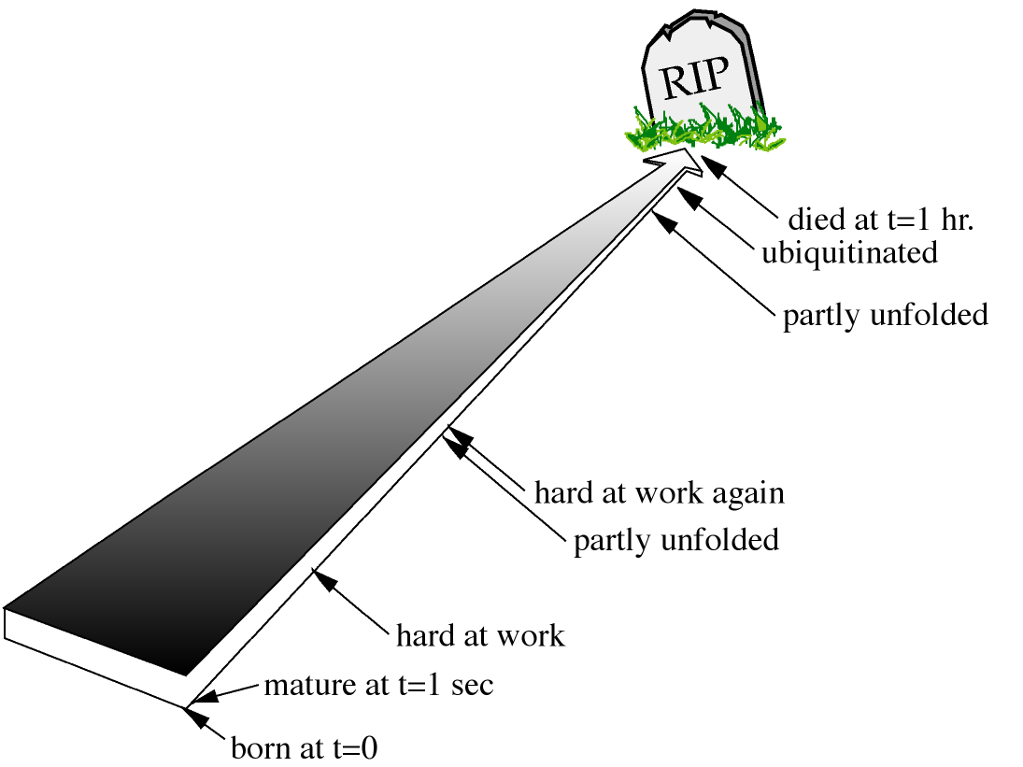
Proteins: A short, hard life.
A typical protein folding equilibrium
constant K_{eq} ≈ 3600.
k_{f}
A_{unfolded} → A_{folded}
2 weeks (typical)
→
k_{uf}
K_{eq}= [A_{folded}]/[A] _{unfolded}
=
Hydrophobic regions become exposed, becomes ubiquinated. Reused aa in proteasomes.
k_{f} / k_{uf}
This means a protein is
unfolded for how much
time/day?
≈1 hr (if K_{eq}=3600)
24 times/day
= once/hr!
Not nearly enough chaperones to help re-fold. Tend to do this by itself. 20-60% are natively unfolded– bind to negatively charged substrate and then folds.
50-100 aa

Slide 19
Simple Calculation of ∆G from K_{eq}.
Let’s say you have protein K_{eq} = 1000
Free energy
So what fraction of states are folded?
So what’s ∆G?
K_{eq} = exp(-∆G/kT)
∆G =7 k_{B}T
-1
0
1
x
How many hydrogen bonds is this?
That’s equivalent to just a couple of Hydrogen bonds.
∆G is (almost flat).
How can this be? What about ∆E, ∆S? (Recall: ∆G = ∆E – T∆S)
If ∆S is large and ∆E is large, then ∆G can be small.
This is what happens: ∆E, T∆S ≈ -100’s kJ/mole
(Lots of bonds form but loss of a lot of entropy)

Slide 20
Protein folding: the energy landscape theory
ENTROPY
Unfolded state
Molten Globule State
Intermediate states
I_{A}
ENERGY
I_{B}
Native state

Slide 21
Class evaluation
1. What was the most interesting thing you learned in class today?
2. What are you confused about?
3. Related to today’s subject, what would you like to know more about?
4. Any helpful comments.
Answer, and turn in at the end of class.

