Slide 1
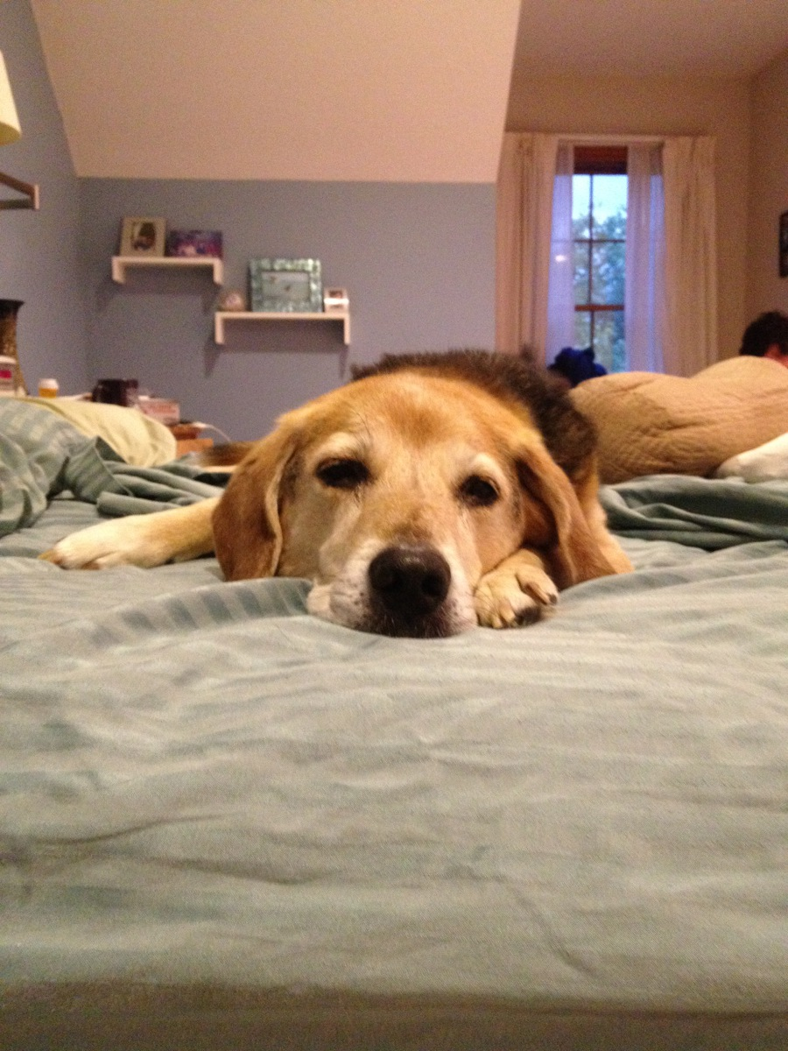
My dog Lucky

Slide 2
Quiz #2 covering “The Hidden Genetic Code”, Sci. Am.
1. What is the hidden Genetic code? Why is it hidden? Why genetic?
2. How is it subject to the laws of evolution?
3. What is the crucial difference between RNA and DNA that makes this possible?
4. What does it do to the old rule of “one gene, one protein”? Explain.
5. The author speculates why the amount of non-coding RNA (i.e. RNA which is not used to translate into protein) grows faster than coding RNA (used to create protein), with the complexity of the species. Why might that be?

Slide 3
Answers to Quiz #2
1, 2. Hidden Genetic code is the use of RNA that has both coding (protein producing) and non-coding (regulatory) RNA. It’s hidden in that one doesn’t directly see it, but in-fact, is present in the amount of proteins and what type they are. Hence, they determine a person’s evolutionary fitness.
3. RNA can be catalytic and can cut itself out of the mRNA.
One gene can now produce many different proteins by having introns, and they are cut out so that there can be adifferent number of exons making up the protein.
More complexity might require more regulatory RNA. Also, with more proteins being made from a given RNA, you can get greater complexity with a given amount of DNA.

Slide 4
Which strand of DNA is transcribed?
Ans: RNA poly goes 3’ to 5’
with a unique promoter for each gene
5’
3’
Sense strand
DNA
3’
5’
Anti-sense strand
Promoter sequence
RNA polymerase (makes RNA from DNA) binds to sigma factor, then to a promoter sequence ___ on dsDNA, makes a bubble, unwinding the DNA and then transcribes from 3’ to 5’.
Why doesn’t it bind to 3’ of other strand?.
Because of promotor is unique
http://en.wikipedia.org/wiki/Sense_strand
Notes:
It is thought that promoters are directional, but there exist bidirectional promoters as well. It's poorly understood, but the arrangement of transcription factor binding sites seems to determine the direction of transcription. Yes, most promoters in the human genome are unique to each gene.
Jun
On Sep 7, 2014, at 7:54 PM, "Selvin, Paul R" <selvin@illinois.edu> wrote:
Jun,
Another simple bio question.
When DNA is being transcribed, it transcribe the DNA-strand starting at
the 3’ end. How does it choose which strand to transcribe? Is it because
it binds to a promoter sequence and only a particular promoter sequence
works (and not the nucleotide sequence on the other transcribed)? And does
each and every gene have a unique starting sequence, I e. a unique
promoter? If so, this is like 20,000 promoter sequence. If not has does it
decide it’s now time to transcribe this gene and not some other gene?

Slide 5
Some additional questions
How are introns and exons recognized? Are they cut by proteins or by self-cleavage?
Answer: By their sequence– at both the 5’ and 3’ ends. Majority are cut by splicesomes, which are a combination are RNA and proteins (ribonucleoproteins , or snRNPs), inside a huge complex. But others self-cleave, for example the rRNA.
Introns are removed from primary transcripts by cleavage at conserved sequences called splice sites. These sites are found at the 5′ and 3′ ends of introns. Most commonly, the RNA sequence that is removed begins with the dinucleotide GU at its 5′ end, and ends with AG at its 3′ end. These consensus sequences are known to be critical, because changing one of the conserved nucleotides results in inhibition of splicing…. Another important sequence occurs at what is called the branch point, located anywhere from 18 to 40 nucleotides upstream from the 3′ end of an intron. The branch point always contains an adenine, but it is otherwise loosely conserved…. Splicing occurs in several steps and is catalyzed by small nuclear ribonucleoproteins (snRNPs)…. The splicing process occurs in cellular machines called spliceosomes, in which the snRNPs are found along with additional proteins.
In addition to consensus sequences at their splice sites, eukaryotic genes with long introns also contain exonic splicing enhancers (ESEs). These sequences, which help position the splicing apparatus, are found in the exons of genes and bind proteins that help recruit splicing machinery to the correct site.
Some RNA molecules have the capacity to splice themselves.
Also they have alternative splicing—they can cut out variable no. of introns. 90% of human genes are alternatively spliced.

Slide 6
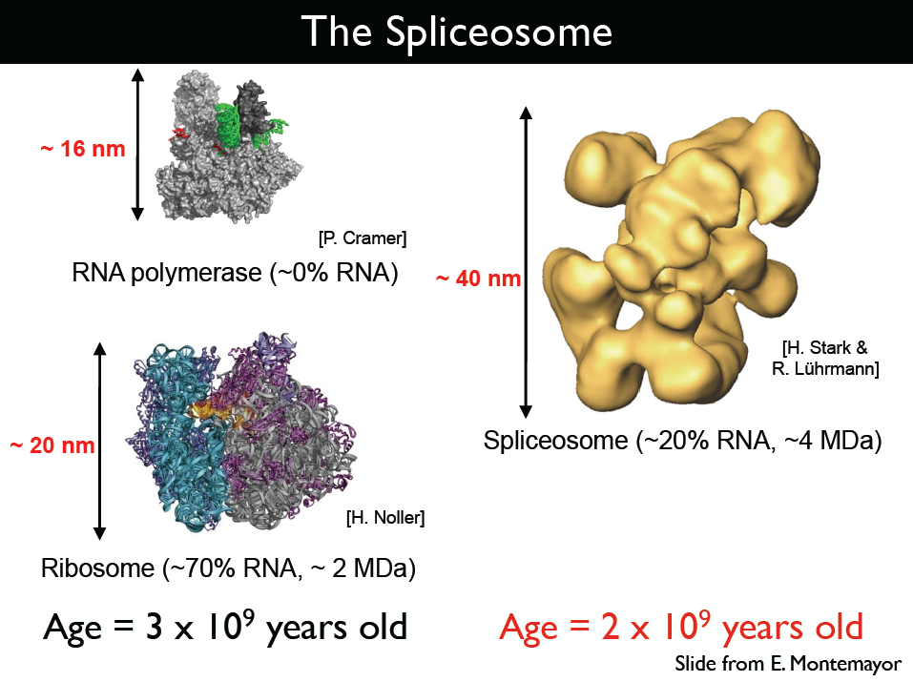

Slide 7
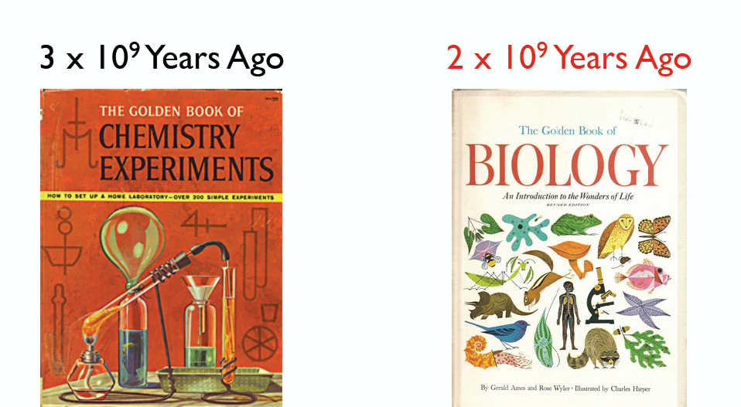
The Age of Biology began
2 Billion years ago

Slide 8
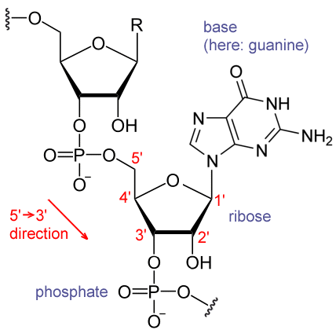
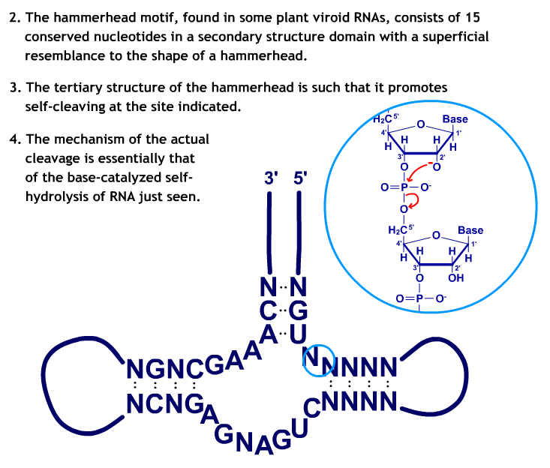
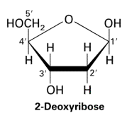
RNA: can attack itself via deprotonation of 2’ OH
RNA has 2’ OH group.
Under basic conditions 2’ OH becomes O⁻
Note: DNA has deoxy (an H)
O⁻ attacks the PO4, cleaves it, separating the backbone.
RNA → single RNA’s under basic conditions
Maybe why RNA isn’t a good lifetime-long storage of genetic information.
http://en.wikipedia.org/wiki/RNA

Slide 9
Under basic conditions OH of RNA become O⁻
Note : everything must be just right for this to happen, so even changing just a few (one) nucleotides, messes thing up (although N can be any 4 nucleotides).
This is used to (sometimes?) cleave introns from exons!
http://sites.fas.harvard.edu/~biotext/animations/Ribozymes.swf

Slide 10
Nice web-site on RNA vs. DNA http://sites.fas.harvard.edu/~biotext/animations/Ribozymes.swf

Slide 11
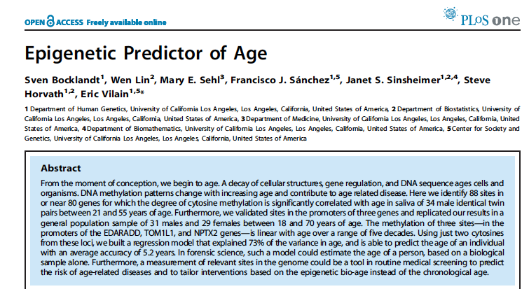
You can tell your Age just from your DNA via Methylation of (C or A) of DNA

Slide 12
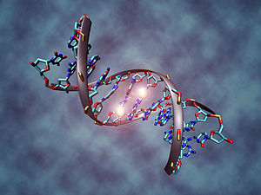
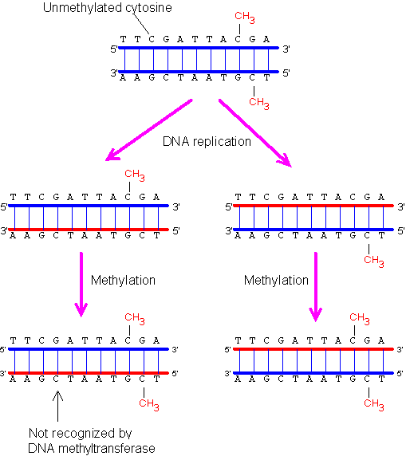
The resulting change is normally permanent and unidirectional, preventing a cell from reverting to a stem cell or converting into a different cell type.
DNA methylation suppresses the expression of endogenous retroviral genes and other harmful stretches of DNA that have been incorporated into the host genome over time. DNA methylation also forms the basis of chromatin structure, which enables a single cell to grow into multiple organs or perform multiple functions. DNA methylation also plays a crucial role in the development of nearly all types of cancer
http://en.wikipedia.org/wiki/DNA_methylation

Slide 13
How your body makes
ATP from ADP + P_{i}

Slide 14
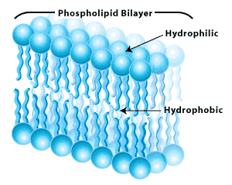
Life is powered by batteries (across your cell membranes)
In units of 4k_{B}T of electrical energy
(7kT of total electrochemical or “free” energy)
Energy to make ATP
membrane
5 nm
thickness
(really thin)
5 nm
0 Volts
-0.1 V
-
+
-
A few extra negative ions inside compared to the outside (or few less + ions outside compared to inside)
-
-
+
-
+
+
Excellent insulator.
(meaning?)
Inside is Hydrophobic—very greasy-- + or – ions really do not want to be in here—no current flow even with high voltage.

Slide 15
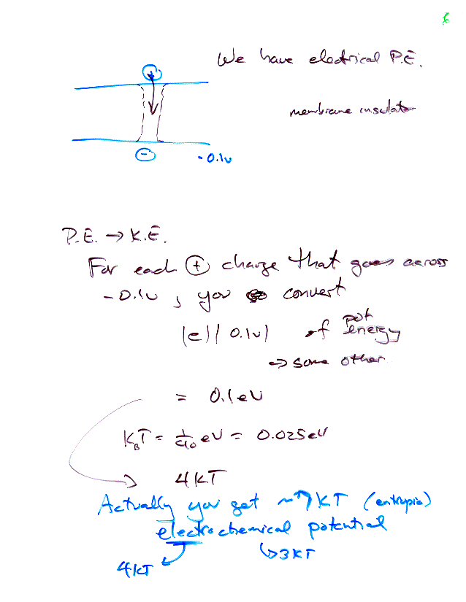
Electrical P.E. across our Cells
Move a positive ion from outside to inside, get 7kT of Potential Energy.
How much energy is lost by “letting” + ion go through membrane?
(assuming you can harness this)?
Energy = qV = |e|0.1V = 0.1 eV
k_{B}T = 1/40 eV = 0.025 eV
Therefore get 4k_{B}T of energy for every positive ion that flows through membrane
Get another 3 k_{B}T of entropic energy (TΔS)
7 k_{B}T of electrochemical (free) energy
Can you capture this energy? How do you create this imbalance in the first place?

Slide 16
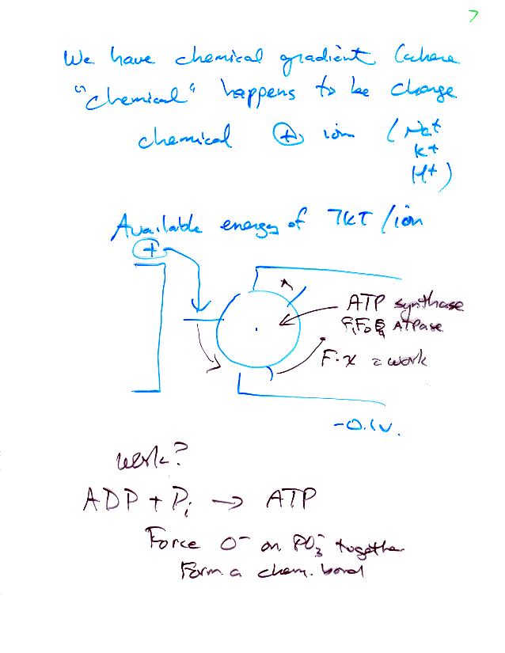
At minimum, how many charges need to be used up to generate 1 ATP?
ATP = 20 – 25 k_{B}T of energy.
If 100% efficient, need 3 (x 7 k_{B}T) charges to cross membrane.
Amazingly:
ATP Synthase = F₁F_{o} ATPase operates at ~100% efficiency!
Takes 3 protons and converts that energy into 1 ATP (from ADP+ P_{i}) !!
Does it by “turning a wheel”, 3 x 120º.
ATP Synthase: A rotary engine in the cell that drives you!

Slide 17
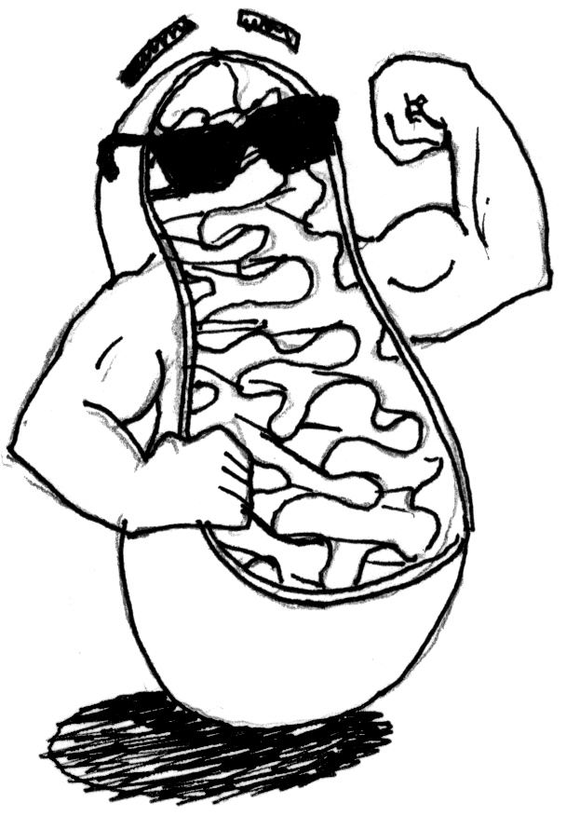
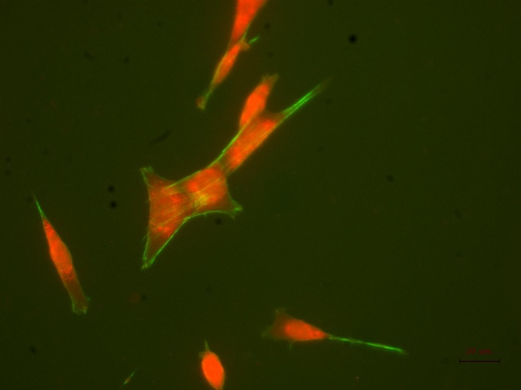
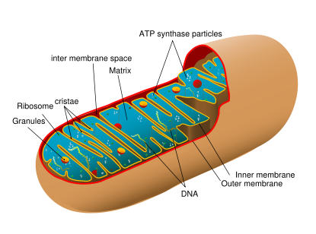
Many of our cells have a chemical gradient, where “chemical” happens to be charge (Na⁺, K⁺, H⁺)
Mitochondria is where ATP is generated from ADP + P_{i}
Mitochondria have their own DNA and may be descended from free-living prokaryotes. DNA comes from mother.
Mitochondria vary in size (0.5 μm-10 μm) and number (1 - 1000) per cell.
Chloroplasts are larger than mitochondria, have there own DNA, and convert solar energy into a chemical energy via photosynthesis. Chloroplasts are found only in photosynthetic eukaryotes, like plants and algae.
http://en.citizendium.org/wiki/Cell_(biology)
A gigantic enzyme called ATP synthase whose molecular weight is over 500 kg/mole (made of many proteins), synthesizes ATP in the mitochondria [in eukaryotes]. Very similar enzymes are working in plant chloroplasts and bacterial cell membranes.
By coupling the cells P.E. to the formation of ATP, the reaction ADP + P_{i} → ATP happens spontaneously.
Once have ATP, have usable energy for biology.

Slide 18
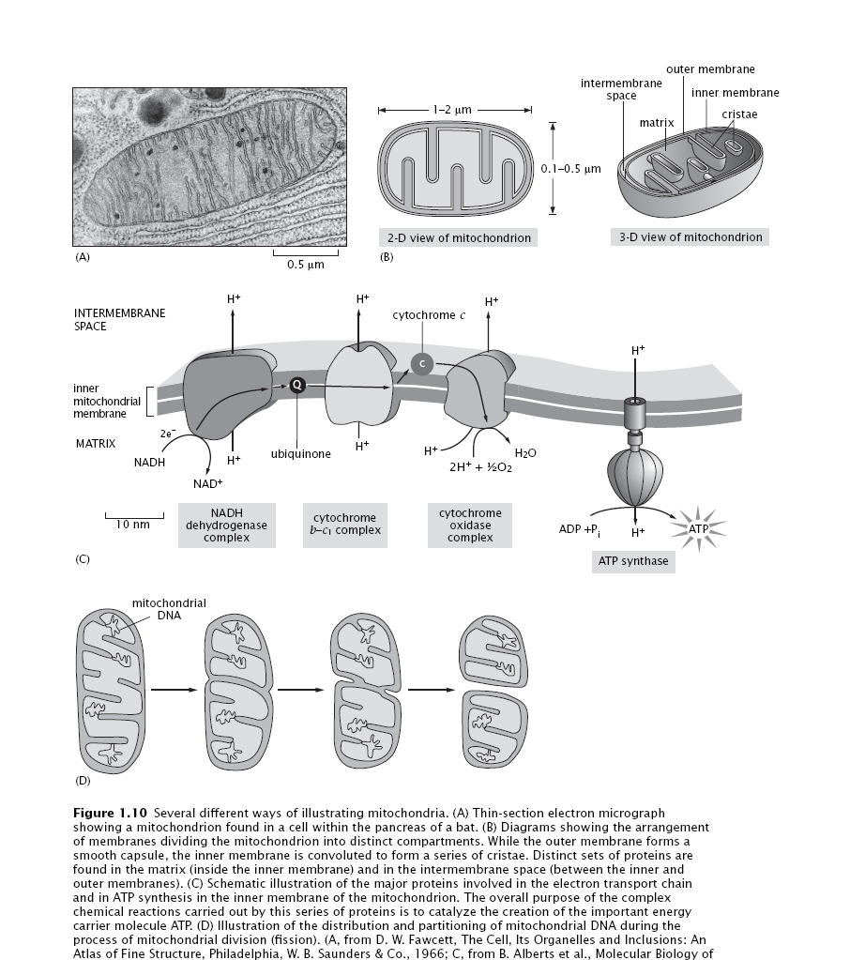
Mitochondrial Cartoons
From Phillips, 2009, Physical Biology of the Cell

Slide 19
F₁F₀ ATPase
Paul Boyer (UCLA) had predicted that some subunits in the ATP synthase rotated during catalysis to produce ATP from ADP+ Pi. John Walker (MRC, Britain) crystallized the ATP. They won Nobel Prize in 1997.

Slide 20
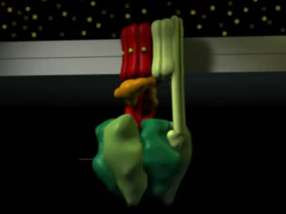
Amazing Animation of F₁F₀ ATPase
http://www.grahamj.com/fivth2.html

Slide 21
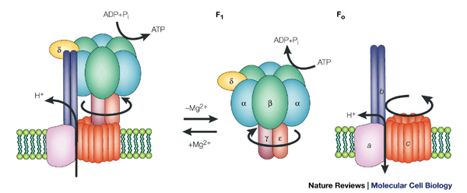
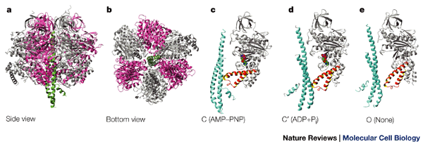
F₁ and F₀ can be separated
F₁
F₀
It is composed of a water-soluble protein complex, F₁, of 380 kDa, and a hydrophobic transmembrane portion, F_{o}. Removal of Mg²⁺ at low concentrations of salt allows the F₁ part to be extracted in water, leaving the F_{o} portion in the membrane.
F1 has been crystallized and extensively studied.
F₁
F₁

Slide 22
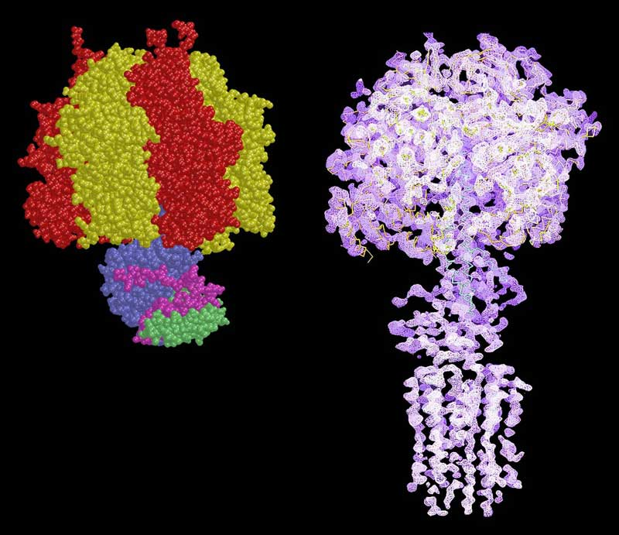
Atomic Structure of F₁F_{o} ATPase
The X-ray structure of the catalytic F1 domain has been completed (on the left– Nobel Prize, 1997 in Chemistry) and an electron density map of the F1-ATPase associated with a ring of ten c-subunits from the F_{o} domain (on the right) has provided a first glimpse of part of the motor.

Slide 23
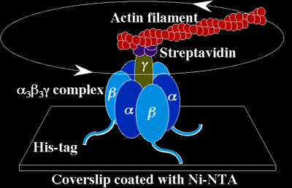
Does ATPase really go around in a circle?
(Noji et al. Nature 386 299-302 1997)
Rotation of the gamma subunit of thermophilic F1-ATPase was observed directly with an epifluorescent microscope. The enzyme was immobilized on a coverslip through His-tag introduced at the N-termini of the β subunit. Fluorescently labeled actin filament was attached to the γ subunit for the observation. Images of the rotating particles were taken with a CCD camera attached to an image intensifier, recorded on an 8-mm video tape and now can be viewed by just clicking on the figures below.
--http://www.res.titech.ac.jp/~seibutu/
Year of Nobel Prize for ATPase.

Slide 24
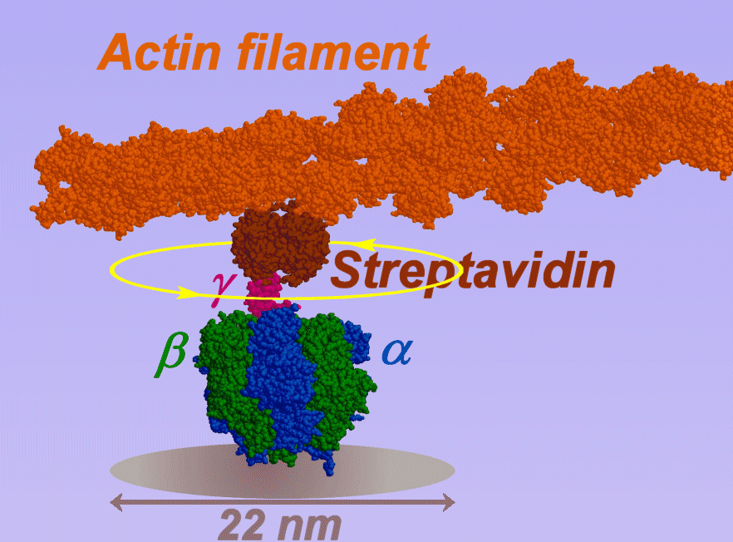
Yes, a Rotary Engine!
Noji, H. et al., Nature 386, 299-302 (1997).
http://www.k2.phys.waseda.ac.jp/F1movies/F1Prop.htm

Slide 25
Stepping rotation: 1 ATP per 120º
High ATP (2 mM)
A trace of the centroid of the actin going around (2.6um actin, 0.5 rps). Start: solid square; end: empty square.
Low ATP (20 nM)
As shown at left, the back steps are as fast as the forward steps, characterized by short stepping times, τ_{120°}, that would require a constant work per step, W, as large as 90 pN·nm (τ_{120°} = (2π/3)²ξ/W). Because the work, W, amounts to 20 times the thermal energy, the steps, should be powered by ATP.
http://www.k2.phys.waseda.ac.jp/F1movies/F1Step.htm
Stepping Rotation of F1-ATPase at Low ATP Concentrations

Slide 26
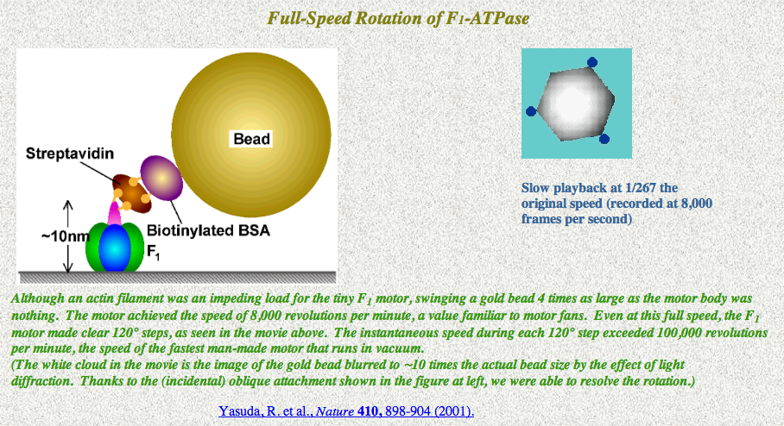
Takes 120° steps even at full-throttle!
See: http://www.k2.phys.waseda.ac.jp/F1movies/F1full.htm

Slide 27
Class evaluation
What was the most interesting thing you learned in class today?
2. What are you confused about?
3. Related to today’s subject, what would you like to know more about?
4. Any helpful comments.
Answer, and turn in at the end of class.

