Slide 1
Modern cosmology
Inflation and vacuum energy
Paper draft due April 17th

Slide 2
No static universe
The Perfect Cosmological Principle: the universe looks the same viewed from anywhere and at any time. It does not match what we see.
One of Leibniz’ arguments against Newton’s absolute space was:
An infinite and unchanging Euclidean space and an absolute time independent of the stuff that is in it implies either:
  The stuff is also infinite in extent (in space and time). But that is impossible, because it violates Newton’s own laws of motion.
  The stuff is finite in extent. But then symmetries are violated. There is a center (a preferred position) and a corresponding preferred velocity, which ought to be observable.
GR extends the problem to spacetime itself. It tells us that the universe must be expanding or contracting. It can’t be static. This means that either there is an earliest time or a latest time (or both).
This is easiest to visualize with our 2-d sphere analogy. The sphere is a balloon which is being blown up.
Some time in the past, the radius of the balloon (the area of its surface) must have been zero.
That’s the “big bang” singularity.

Slide 3
The universe is expanding
What is observed? (Hubble, 1932)
Distant galaxies are moving away from us. The farther they are, the faster they are receding (a linear relationship). This means that at some time in the past, they were all right here ... The whole universe was squashed together. This does not violate relativity. There is no center (preferred location).
Suppose I have several friends:
  A is 10 meters from me, moving away at 1 m/s
  B 20 2
  C 30 3
If they have been moving at a constant speed, I can say that 10 seconds ago, each was at my present location. Notice that A sees exactly the same thing that I do. (Different people, but the same relationships.) The quantity that describes this motion is: “H = 0.1 m/s per meter”. H is the Hubble expansion parameter.

Slide 4
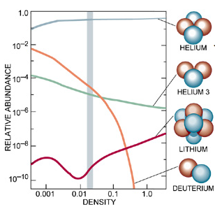
Did the Big Bang really happen?
Besides
  GR theory and
  the Hubble expansion
main evidences for the big bang are
  The relative abundances of the
  light nuclei (H, D, He, Li)
  are ~correctly predicted
  by the BB theory.
  the cosmic microwave background.
http://astro.berkeley.edu/
~mwhite/darkmatter/bbn.html

Slide 5
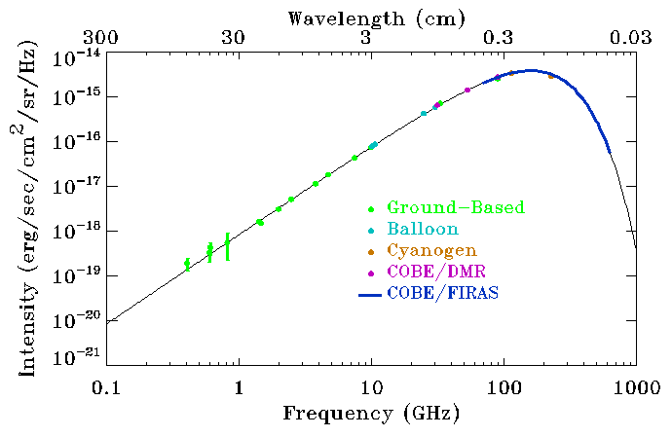
Cosmic Microwave Background Spectrum
  When the universe was much more compressed, it must have been much hotter than now. Hot objects glow with thermal radiation. Before the universe cooled to about 3000 K, it wasn't transparent, since when atoms are heated up above that the electrons fall off. Loose electrons are very good light absorbers/ reflectors, as in metals. So we should see back to the point at which it first became nearly transparent, at about 3000 K and ~400,000 years old.
  It shouldn’t look like a 3000K surface because
  the universe has expanded
  diluting the light and
  stretching out its
  wavelengths. It should
  look like it’s at ~2.7 K.
Only one adjustable parameter for the whole curve!
  Predicted by Gamow, Alpher and Herman in the 1940s and accidentally discovered in 1964 by Penzias and Wilson. Many details are now understood in terms of more elaborate BB theories.

Slide 6
How does GR describe the expansion?
Remember our balloon analogy for curved geometry:
Think of dots painted on a balloon. As the balloon expands, the dots move apart.
GR says the balloon must either be expanding or contracting.
It is expanding.
The age of the universe is not quite ~14 billion years, due to accelerations. The expansion rate is changing due to the mutual gravitational effects of all the energy in the universe.
Will the expansion ever stop? If I throw a ball in the air, will it fall down?
There are two simple possibilities.
  If the attraction is strong enough, and the speed small enough, then the expansion will stop, and the universe will collapse into a big crunch.
  If not, or if there is a repulsion, then it will continue to expand forever.
Right now, it looks as if the expansion will continue forever.

Slide 7
There is no edge, but there is a horizon
Even though the universe is expanding, it is not expanding “into” anything. There is not an edge to the matter, beyond which there is only empty space.
There is a GR analog to the edge, however. There is a horizon, dependent on the observer. The linear relationship between distance and speed tells us that beyond a certain distance (~c/H ≈ 14 billion light years) the stuff out there “is” moving away at faster than light speed. i.e. space is expanding so fast that it is being carried away faster than the speed of light.
  Why “is”?
  In standard “co-moving” coordinates, the distance across “now” is a lot bigger than 28 billion light years.
Doesn’t this violate special relativity? What's left of the SR speed-limit is the constraint that any local measurement of a speed give c or less. Inferred speeds of parts of the universe with which communication is impossible are not governed by that constraint.

Slide 8
The Cosmic microwave background (CMB)
When the universe was small, it must have been hot. It should be possible to see the afterglow. When the universe was about 10⁵ years old, T ~ 3000K. Below this temperature, atoms are not ionized, and the universe becomes transparent. The “relic photons” will have been red-shifted by the expansion of space to an effective temperature of only 2.7K.
The CMB is a nearly perfect “black body” spectrum. The only distortion larger than about a part in 10⁵ is an anisotropy that indicates that our galaxy is moving a few hundred km/s with respect to the matter that emitted the radiation.
Theories without a “hot big bang” need to propose alternative mechanisms for the CMB. None have been able to reproduce the spectrum.
At 10⁵ years the radius of causal connection corresponds to a ~1° circle in the sky. So, why is the CMB the same in every direction? There appears to be a deeper connection .
The fluctuations tell us something about how lumpy the matter distribution was at that epoch.

Slide 9
The main features of hot big bang cosmology
As the universe expands, it cools. The very early universe was very hot, and massive objects could be produced by the heat. Objects that are bound today were liberated then.
For a given expansion rate, there is a critical energy density, Ω_{o} , for which the geometry is flat. In a simple fixed-mass picture the mass density causes the expansion to decelerate. (now, Ω_{o}~ 10⁻²⁶ kg/m³, about 10 protons per cubic meter) In a fixed-density picture, the energy density causes the expansion to accelerate. If there were zero background density, Ω_{o} is the density just sufficient to bring the expansion to a halt. Ω > Ω_{o} would give a big crunch.
The gravitational dynamics of galactic clusters implies that they contain Ω » 0.3Ω_{o}, mostly non-stellar "dark matter.”
Density fluctuations increase with time. Way back then, the universe was very homogeneous, as shown by the CMB.
The overall density of the universe evolves away from Ω_{o}, the critical energy density needed for closure. Closer to t = 0, the density becomes closer to Ω_{o}.
One can’t extrapolate back to t = 0. Above about T=10³²K, one needs to be able to unify QM and gravity. New phenomena might appear first.

Slide 10
Dark Matter/Dark Energy
Dark Matter. An unknown “particle” that only interacts with as via gravity but whose mass is about 6 times more than all matter we can see. We can see its effects on galaxies
Dark Energy: (cosmological constant). A term in Einstein’s GR equations that makes space fly apart. The Universe is accelerating. Nobel Prize 2011: accelerating expansion of the universe: Perlmutter, Schmidt, Reiss

Slide 11
There are three big issues
Why is the universe so homogenous at early times? There hadn’t been enough time for the various regions that we can see to have communicated, so why do they look the same?
Why did the energy density of the universe start out so close to Ω_{o}? If it was so close to the critical value then (differing by about one part in 10⁻⁴² at the earliest times to which we think we can extrapolate known physics) why not exactly 1?
Entropy only increases with time. This implies that the universe was in a very low entropy state at early times. How is that consistent with high temperatures?
There is a proposed scenario to explain all this, but the last point needs some preliminary discussion

Slide 12
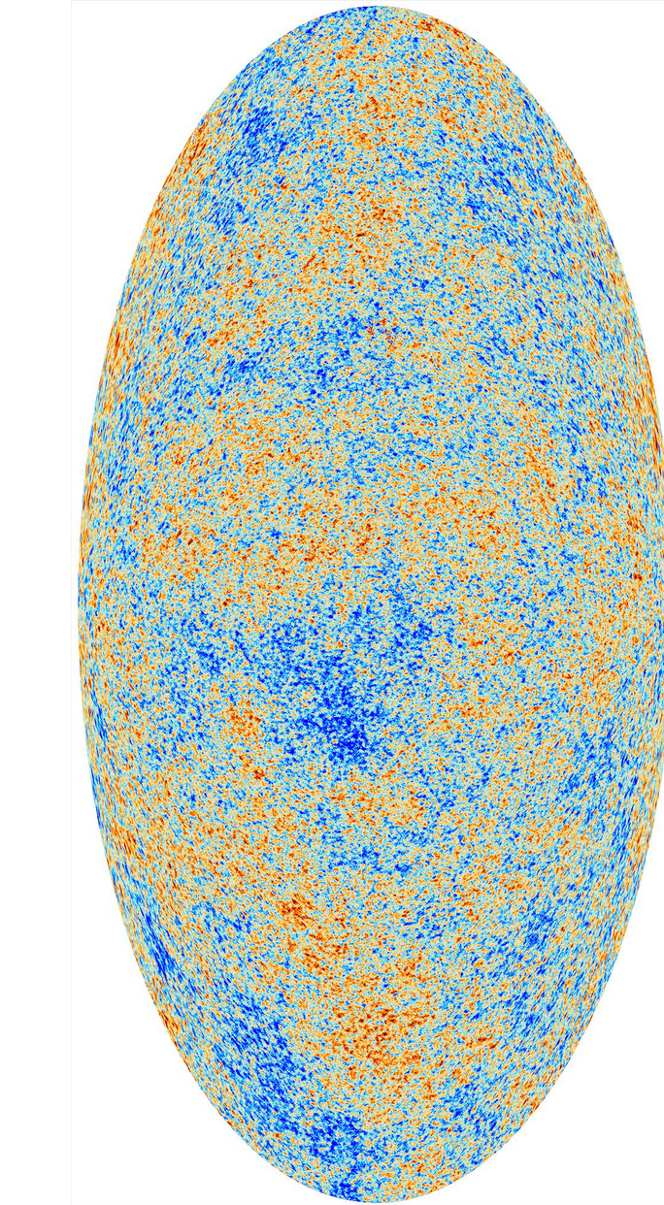
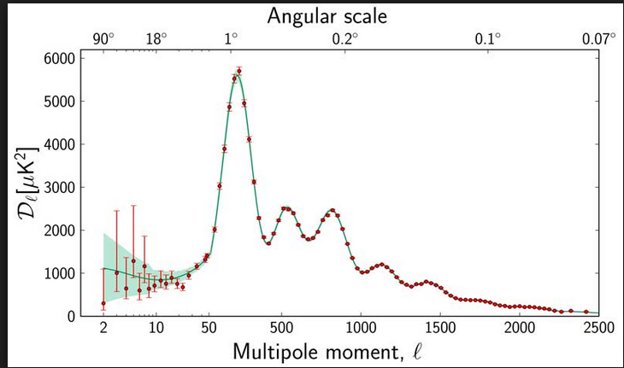
CMB is not isotropic
Nobel Prize 2006: CMB is anisotropic: Smoot, Mather
We see slightly different temperatures in different directions
The problem is that they are so uniform
Inflation (curve) did make predictions for the amount
of structure of various sizes in the universe,
especially in the background radiation.
Planck Result

Slide 13
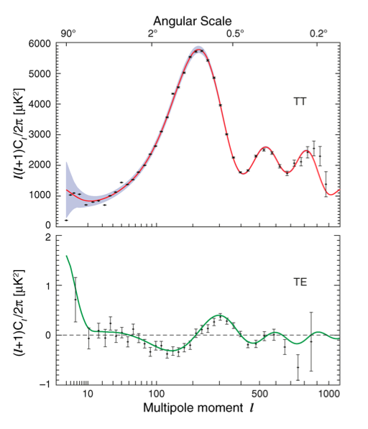
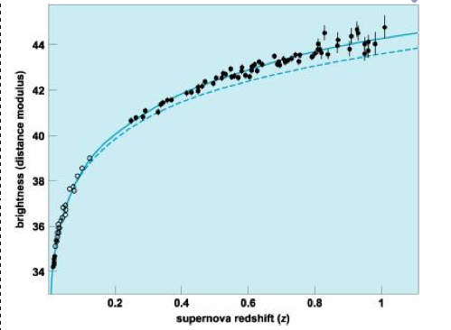
CMB Fits Theory
WMAP polarization
Does that mean that we are missing 70% of the matter in the universe, when we only find 30% of the critical density in galactic clusters?
No: the expansion of the universe is still accelerating according to pretty reliable measurements.
It looks like we're still in a period of weak inflation!
Hubble
revisited
So we have strong reasons to think that inflation made the total energy density very close to the critical value. If the same inflation that made the universe homogeneous also made it flat, the radius of curvature should be more than (10⁵)^{1/2} as large as the age of the universe times c. That means that the universe is extremely close to flat: right at the edge between open and closed.

Slide 14
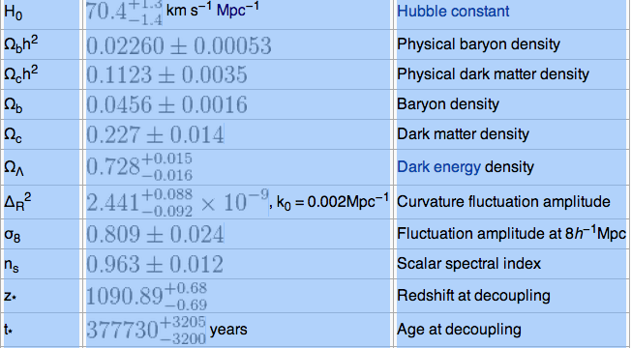
Parameters

Slide 15
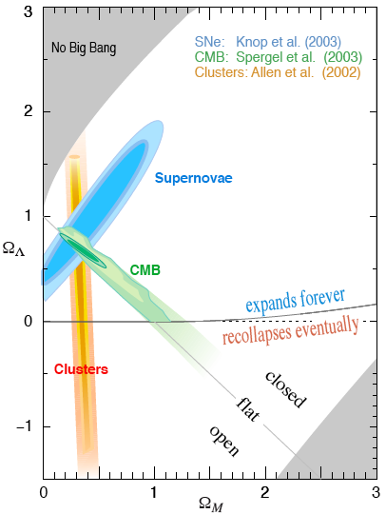
We’re here
The accelerating expansion from the background energy density, breaks the simple connection between energy density and the fate of the universe.
Depending on the ratio of the ordinary mass to the background density, you can have:
  Open/ always expands
  Closed/Collapses
  Closed/always expands
  Open/collapses
We’re almost exactly on the edge between open and closed, very near flat.

Slide 16
Key unanswered questions
If the field apparently causing the current acceleration of expansion remains constant, the expansion will continue forever. If it were to fall to zero, the expansion would still continue forever. But we really don't know what it is or what it will do.
What would make the background energy density so close to the matter density?
  In cosmological constant case, that would be a special recent historical feature. 1 billion years post BB, the background would be less than 1/1000 of the matter density.
What fine-tuned the parameters to give it a smooth landing?

Slide 17
Entropy in the big bang
The universe is not in thermal equilibrium. One indicator of low entropy is that there are hot objects and cold ones. Life requires such disequilibrium.
If the universe was uniformly hot at early times, one would guess that the entropy was very high then, i.e. at thermal equilibrium. If so, how do we explain the low entropy at the present time?
In the early universe, the matter was very hot and in a high entropy state (thermal equilibrium), but spacetime was in a low entropy state, i.e., the curvature of spacetime was not “wrinkled”. Geometry itself has entropy.
  The formation of gravitationally condensed objects like the Sun, neutron stars, and black holes, increases entropy. So, as long as stuff can keep falling into gravity wells, there will continue to be regions of high and low entropy.
Why did spacetime start out in this special, low-entropy state?
If there is to be a big crunch, the universe will collapse back to a singularity, but it will have high entropy. Without some further constraint, there is no known reason why a very dense universe must have low-entropy.

Slide 18
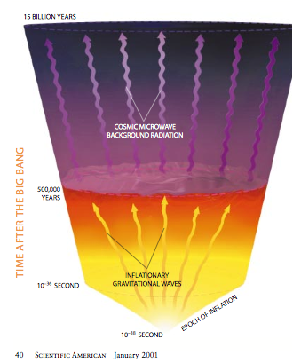
Inflation
The other two mysteries (large scale homogeneity and near flatness) might both be accounted for by a single explanation.
If "empty" space had a fixed positive energy density, space would expand exponentially. (Inflation) A period of such an expansion would:
  Pull causally connected regions far apart, so that simple extrapolation from a later Hubble constant would not reveal how close they had once been.
  Smooth out wrinkles in space.
  Dilute the concentration of magnetic monopoles

Slide 19
Spontaneous symmetry breaking in the vacuum
Our vacuum can have unusual properties that one would not expect from Newton’s or Leibniz’ (or even Einstein’s) space. It now makes sense to ask, “Are the virtual particles in our vacuum aligned in some way?” Do the underlying equations of physics have any symmetry that is not manifested by the world that we see?
The answer is yes. The symmetry is similar to the one that gives conservation of electric charge. It is not a spatial symmetry, but an “internal” one (i.e., a mathematical symmetry of the equations) called gauge invariance. In addition to enforcing conservation of charge, it also causes the photon to be massless, which is the reason the electrical force follows a 1/r² law. GR has a gauge invariance, as do the strong nuclear forces (QCD).
The gauge invariance of the weak nuclear force is spontaneously broken at the temperatures of the current world. The result of this loss of symmetry is that the particles (the W and Z bosons) that mediate the weak force are massive, and the force is not 1/r². At high temperature (e.g., in the early universe) the symmetry is restored. (like the symmetry of a magnet, or of a piece of ice.)

Slide 20
Spontaneous symmetry breaking in field theory
Let’s imagine a universe where every particle is massless. Suppose there is a particle which interacts with the other kinds of particles and with itself.
Consider a box containing these particles. How does the energy of the box vary as we increase the density of particles in the box? Normally, we would expect it to increase:
The graph is not linear, because the particles interact.

Slide 21
Phase Transitions of Fields
Suppose the particles have an attractive interaction such that above a certain density they begin to condense. Then the energy vs. density graph could look like one of these:
On the right two, the state of lowest energy has nonzero density!
There is nothing terribly exotic about these pictures of energy vs. density. Essentially identical pictures occur for ordinary gases, when you try to calculate whether they form dense liquids or stay as rarified gas. The difference arises in that we treat the gas molecules as coming from some reservoir with a fixed number of particles.
Here, in contrast, we're dealing with particles which can pop in or out of existence. Empty space itself provides the reservoir, and can always produce more particles.

Slide 22
“Symmetry Breaking”
Recall that the conservation laws follow from symmetries of laws. For example, angular momentum conservation follows from the invariance under rotations of the equations.
Nevertheless, the state of lowest energy doesn’t necessarily have to exhibit the symmetry.
Let’s consider an everyday example –
a piece of iron. Each atom behaves
like a little magnet, which we'll call
a spin.
Will the spins line up with each other?
The answer depends on the
temperature of the iron:
  At high temperatures, the spins point randomly. That's because there are many more quantum states with random-looking spins than there are with the spins in any simple pattern. The iron is not magnetized oriented and, on average, the material is isotropic.
  What happens at low T?

Slide 23
The spins have lower energy when they line up. At low T, that energy can make more entropy in the nearby reservoir than the spins lose by lining up. When the iron is cooled below about 770° C (the Curie temperature), the spins do align, maximizing the total entropy. The iron becomes magnetized.
However, they cannot align without
picking some particular direction to
align along. Now there is a preferred
direction, even though the physical
equations themselves contained
no special direction.
This process is called spontaneous symmetry breaking.
Rotational symmetry is broken in this example.
So is time reversal, since these are magnets, not little arrows.

Slide 24
Some symmetry remains unbroken
Symmetry breaking is described by a parameter whose value is zero when the symmetry is restored. Consider our magnetized iron:
At low temperature, the iron is not isotropic. There is a preferred direction.
The strength of the symmetry breaking is described by the magnetization.
  As that quantity goes to zero, the symmetry is restored.
If the symmetry is broken, how do we know it was ever there?
  A remnant of the original symmetry is always left behind.
  Depending on the details of the symmetry broken, there can be a variety of new types of excitations around the broken-symmetry state. E. g.
  There will be a new type of wave (a magnon) in which the spins twist a bit from the preferred orientation, and spring back due to torques from neighboring spins.
  There can be boundaries (domain walls, here) between regions which break the symmetry in different ways.

Slide 25
Other symmetries can spontaneously break
On the average, any position in a liquid is just like any other position. When the liquid cools, it can freeze into a solid, in which there is a distinction between the sites with atoms on them and the spaces in between. Spatial translation is the broken symmetry.
Some sugars (and other big molecules) have left-handed and right-handed forms, which twist polarized light opposite directions. Crystals form which contain only one type or the other. Within the crystal, PARITY (mirror-image) symmetry is broken. (If the interconversion rate between the two forms is big enough, all the molecules can end up in one crystal, breaking parity for the whole batch.)
We saw that physical laws can have various other symmetries, besides these simple spatial symmetries.
  time-reversal
  Lorentz transformations, …
Any underlying symmetry can be broken by the equilibrium physical state, just as the spatial symmetries were broken in the examples above.

Slide 26
What would drive inflation?
What energy density is to be used as the source of the gravitational effects? The zero-point energy would in principle be infinite. Even if we cut off the zero-point fluctuations at the Planck scale, where our current physics breaks down, the density would be ~10¹²⁵ times the critical density of cosmology. So the energy that counts seems to be only the energy above some reference vacuum state.
Consider the early, hot universe. Suppose that there is a scalar field which behaves as described earlier. Then, as time progresses, the free-energy-density graph will evolve.
The density of the field is zero at
  very early times, but as the temperature
  decreases, that is no longer the
  favored configuration. If the middle
  energy-density graph is
  correct, then the universe will become trapped in a false vacuum state, i.e. a state in which the free-energy is bigger than it has to be. Even if the last version is right, the universe will not instantly reach the true vacuum, but will spend a little time in false vacuum states. The false vacuum will cause the expansion of the universe to have unusual features.

Slide 27
Start and End of Inflation
(See Scientific American, Jan. 1999 for
articles on the difference between getting
stuck for a while in a false vacuum and
gradually rolling out of a false vacuum.)
The frozen symmetrical field has, at least
for a while, a fixed density- driving inflation.
In this scenario, the inflation was not caused by a change of the actual state of the vacuum but by the appearance of a new possible equilibrium state with lower energy. How does the universe know that there's a lower energy "real" vacuum?
Inflation may solve our two big cosmological problems.
Homogeneity. If the inflation lasted for 100 time constants, the universe expanded by a factor of e¹⁰⁰ = 10⁴³. The entire visible universe (10²⁵ m) was a basketball (~30 cm) just after inflation, but only a minute speck (10⁻⁴³ m) just before, much smaller than the causally connected region (10⁻²³ m) then.
Flatness. Suppose the universe wasn’t close to the critical density before inflation. This means, in the balloon analogy, that it was curved. Now, increase the radius of the balloon by x10⁴³. It will become indistinguishably close to flat.
Inflation could also account for the rarity of certain particles (magnetic monopoles) which should have been created, but have never actually been found.
Problem: The inflationary scenario requires some fine-tuning of the strength of competing terms in the interactions, in order for the inflationary period to end smoothly.

