Slide 1
Digital To Analog Conversion
The Adafruit MCP4725 and how it works

Slide 2
What is digital to analog conversion?
The conversion of digital data (a stream of discrete binary values) to an analog signal.
Analog signals take the form of some measurable physical property, such as voltage or pressure.
Analog signals are continuous functions.
Digital data must be converted to an analog signal for numerous uses discussed later.

Slide 3
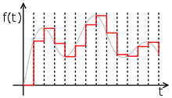
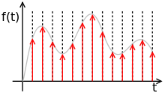
Visualizing the conversion:
Upper image: Data in digital form (discrete values)
Lower image: Analog signal generated by an ideal DAC from above digital input.

Slide 4
How does the conversion work?
Signal reconstruction:
Each digital value is held for one “time interval” (different lengths in different DACs). The smooth function is then interpolated by the DAC.
Unsurprisingly, smaller time intervals (higher sampling rate) give better reconstruction (of an original analog audio recording, for example)

Slide 5
Applications
DACs are most widely known from their use in playing digital music
Digital (MP3/WAV etc.) files must be converted to analog voltage signals before being sent to an amplifier and speaker.

Slide 6
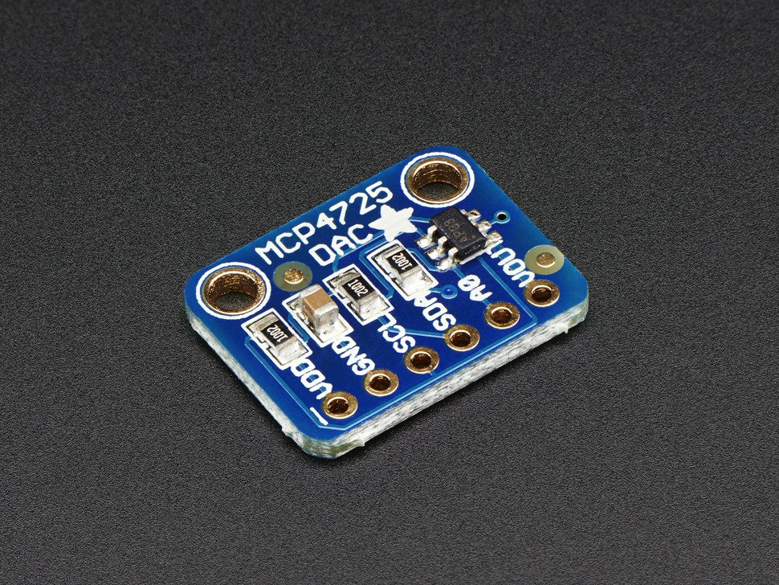
MCP4725 -What Is It?
Low Voltage, buffered output DAC
12 Bit = 2^12= output states
Controlled through 2 wire I2C serial interface
Stores data eg. commands through EEPROM

Slide 7
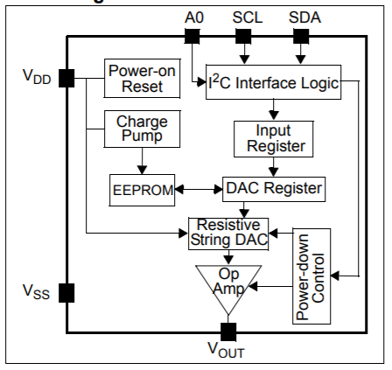
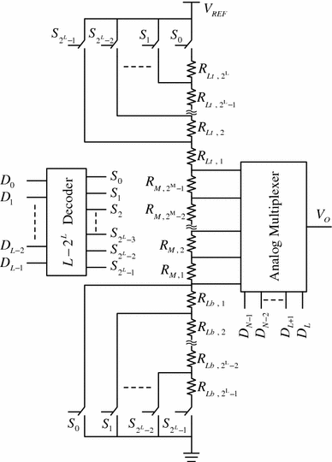
MCP4725 - How Does it Work?
Through I2C interface it uploads instructions to DAC Registry
It uses “Resistor String” large amount of switches
That determine the number of resistors that you hit
For 12 bits 2^12 resistors and switches
It then uses an amplifier to increase power of signal

Slide 8
References
https://www.elprocus.com/digital-to-analog-converter-dac-applications/
http://adafruit.com/product/935
https://www.analog.com/media/en/training-seminars/tutorials/MT-014.pdf

