Slide 1
ADC-
Analog to Digital
Converter
Group 7- Ramone Randle, Sergi Castells, Noah Rogers, Stephen Elliott

Slide 2
Analog vs Digital
Digital is either 0 or 1
Analog can have more meaning than on, 1, or off, 0
It’s continuous
Digital is useful for computers, but things in the real world are usually analog

Slide 3
Why Do We Need an ADC?
Computers speak binary, which can be limiting
Take measurements with a gradient of values and translate so the computer can understand

Slide 4
Real World Examples
Analog
VHS
Older land lines
Photocopier
Vinyl
Digital
CD’s and DVD’s
Iphone videos/recordings
Memes(or practically everything on the internet)

Slide 5
Errors
Due to having to convert between a continuous analog signal to an exact digital representation the ADC can present a different types of errors
Quantization Error (Rounding Error)
Non-Linearity (Physical Imperfections)

Slide 6
Physics of the ADC
There are many ways to make an ADC
Arduino has 10-bit ADC (2^10 = 1024 discrete levels)
Analog voltage → charge a capacitor → measure time to discharge across internal resistor
Microcontroller monitors number of clock cycles during discharge
Returns number of cycles once ADC is complete
Notes:
the most common technique uses the analog voltage to charge up an internal capacitor and then measure the time it takes to discharge across an internal resistor. The microcontroller monitors the number of clock cycles that pass before the capacitor is discharged. This number of cycles is the number that is returned once the ADC is complete.

Slide 7
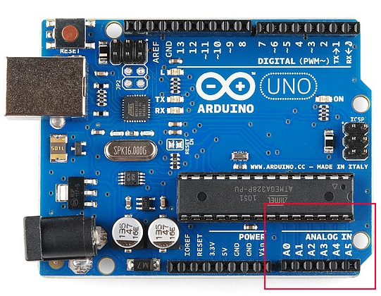
On the Arduino

Slide 8
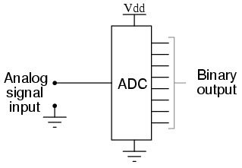
Relevant Information for the Course
Microphone, INA219, Thermometers and anything connected to Analog Pins on the Arduino board use the ADC in some capacity
Depending on what device is being used, the precision of the ADC can make a huge impact as with audio recordings the gain and subsequent sound quality can be affected depending on how well the ADC can handle processing voltage changes and such
Audio Recordings are the result of the ADC converting an analog signal such as voltage (usually somewhere between 0 to 10V or -5V to 5V) and then converting this into a sequence of binary numbers.

Slide 9
Resources
https://learn.sparkfun.com/tutorials/analog-to-digital-conversion/all
https://www.elprocus.com/analog-to-digital-adc-converter/
https://en.wikipedia.org/wiki/Analog-to-digital_converter

