Slide 1
BME 680 Temperature Sensor
By: Cecilia, Joseph, Shoham, Tirth

Slide 2
BME 680 Overview
BME 680 measures temperature, pressure, humidity, and VOC gas.
The temperature that it can detect ranges from -40 to 85 degrees celsius.
We can skip the measurement of temperature, but it is not recommended because the temperature measurement is used to compensate for the other parameters. This is only applied to the temperature.

Slide 3
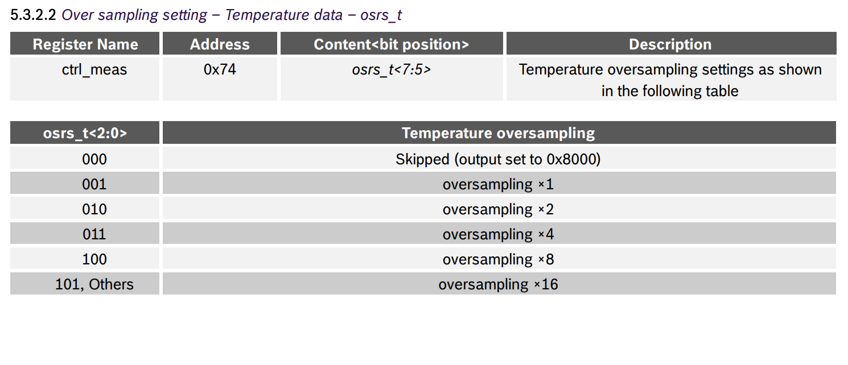
Oversampling in the BME 680
The temperature measurement is controlled by the osrs_t<2:0> setting.
Oversampling is possible to reduce the noise.
The resolution of the temperature data depends on the IIR filter and the oversampling setting:

Slide 4
Most Common Kinds of Temperature Sensors
Resistance Temperature Detector (RTD)
Measures temperature changes by tracking changes in resistance.
Negative Temperature Coefficient (NTC) Thermistor
Exhibits large changes in resistance with changes in temperature.
Thermocouple
Change in temperature creates a voltage difference between two wires of different materials.
Integrated Circuits (IC’s)
Measures temperature changes by tracking voltage in a semiconductor.

Slide 5
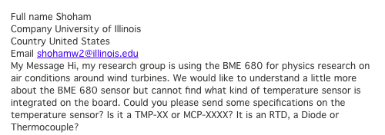

Slide 7
Which Sensor Does The BME 680 Use?
Resistance Temperature Detector (RTD)
-200 C to 600 C
Negative Temperature Coefficient (NTC) Thermistor
-50 C to 150 C
Thermocouple
-200 C to 1750 C
Integrated Circuits (IC’s)
-70 C to 150 C

Slide 8
How does Thermistor work?
A thermistor is an inexpensive and easily obtainable temperature sensitive resistor, thermistor working principle is, it’s resistance depends upon the temperature. When temperature changes, the resistance of the thermistor changes in a predictable way. The benefits of using a thermistor is accuracy and stability.

Slide 9
Calculating Temperature by Change in Resistance.
The temperature of the thermistor can be calculated from the measured resistance by using the Steinhart-Hart equation.
1/T=A+B*ln(R)+C*(ln(R))3
Where, R in Ohms and T in Kelvin.
A, B, and C are the constants, that can be determined from experimental measurements of resistance.

Slide 10
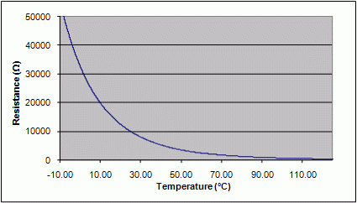

Slide 11
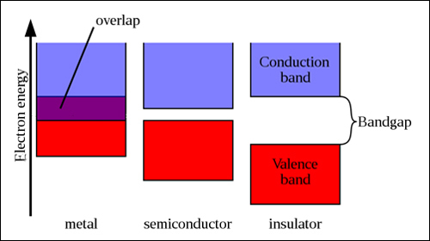
Thermistors: Semiconductors
Solid state materials can be classified as metals, semiconductors, or insulators
These classifications refer to how conductive a material is
How conductive a material is depends on temperature and the Band gap

Slide 12
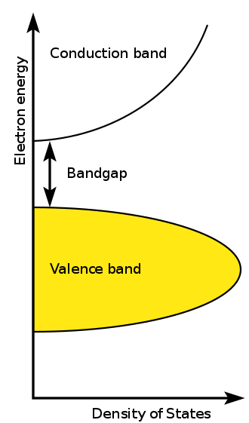
Thermistors: Band Gap
The Pauli exclusion principle dictates that no two electrons can have the same quantum numbers
When two atoms join to form a molecule the electrons must split into two molecular orbitals
A lattice of atoms creates an almost continuous “band” of electron orbitals
Band theory derives the ranges of energies allowed for electrons called “bands” and not allowed ranges called “band gaps” in lattices

Slide 13
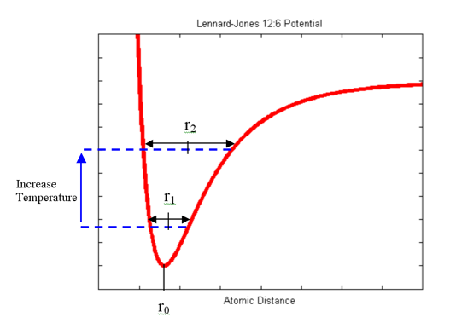
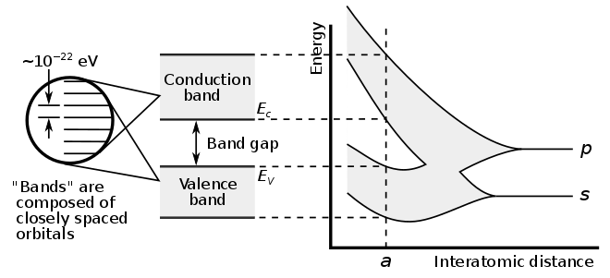
Thermistors: Temperature dependence
Increasing a semiconductors temperature, increases the interatomic spacing
Increased spacing decreases the band gap
Decreasing the band gap increases conductivity, decreasing resistance
Thermal Excitation of electrons and vibrational modes

Slide 14
Sources
https://www.bosch-sensortec.com/products/environmental-sensors/gas-sensors-bme680/
http://solarcellcentral.com/junction_page.html
https://en.wikipedia.org/wiki/Band_gap
https://en.wikipedia.org/wiki/Electronic_band_structure
https://en.wikipedia.org/wiki/Steinhart%E2%80%93Hart_equation
http://web.mit.edu/mbuehler/www/SIMS/Thermal%20Expansion.html
https://www.watelectrical.com/thermistor-working-principle-with-applications/
https://www.arroyoinstruments.com/thermistors.html
https://in.omega.com/prodinfo/Integrated-Circuit-Sensors.html

Slide 15
