Slide 1
Accelerometers
LSM9DS1 9-axis accelerometer
Ritika, Juliana, Sneh, Brock

Slide 2
Omg, what are these, 9 axes??
3-axis accelerometer
Where’s gravity??
3-axis magnetometer
B-field to find magnetic north
3-axis gyroscope
Twist and spin detection
Wow! Now we get 9 degrees of freedom (plus temperature)

Slide 3
How it works: Accelerometer
Measures “proper acceleration”
Acceleration in its own rest frame
Inertial frame guaranteed
Accelerometer on Earth’s surface measures 9.81 m/s^2 up
3D digital linear acceleration sensor
Acceleration scale of ±2g/±4g/±8/±16 g

Slide 4
How it works: Magnetometer
Measures magnetic fields, includes Earth’s
Can operate at 8 different refresh rates of: 0.625, 1.25, 2.5, 5, 10, 20, 40, or 80 Hz
Stores an internal 16-bit offset for each axis to compensate for effects from auxiliary magnetic fields
Can come from nearby metal objects and even parts of the accelerometer
Offers different calibration procedures to correct for this

Slide 5
How it works: Gyroscope
3 axes
Measures spin & twist
±245/±500/±2000 dps ranges
Large range of sensitivity
Uses “Zero Rate Level” to calibrate and find deviations if no acceleration
Want the lowest value possible

Slide 6
Applications
Measuring orientation, movement
3D motion capture
Inverted pendulum devices
Segway / Humans
Inertial guidance systems

Slide 7
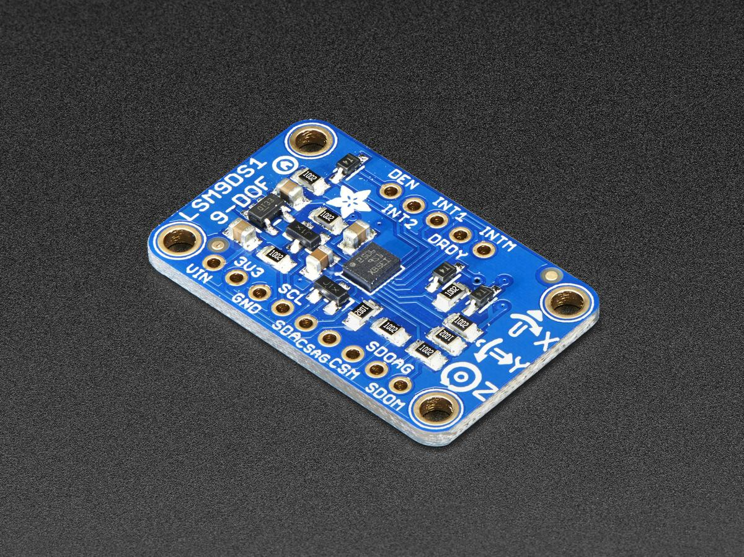

Slide 8
References
https://learn.adafruit.com/adafruit-lsm9ds1-accelerometer-plus-gyro-plus-magnetometer-9-dof-breakout
https://www.parallax.com/sites/default/files/downloads/28065-LSM9DS1-9-axis-IMU-Guide-v1.0.pdf

