Slide 1
Electret Microphone
Group 2
Michael Ruscito
Jinghan Huang
Mingshi Yang
Tomas Pavydis

Slide 2
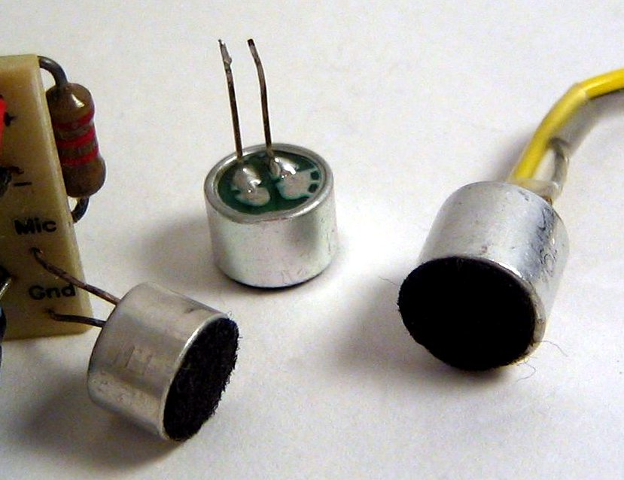
What is it?
A type of electrostatic capacitor-based microphone, which eliminates the need for a polarizing power supply by using a permanently charged material.
An electret is a stable dielectric material which contains a ‘permanent’ electric dipole charge
Electrets are created by melting dielectric materials which contain polar molecules and allowing the material to re-solidify in a strong electrostatic field

Slide 3
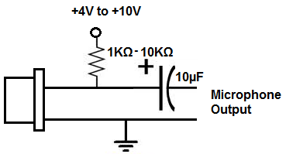
Components
Permanent built-in charge in parallel with a conductive metal backplate (does not need power to operate)
Only produces a very tiny electrical output, so requires an Operational Amplifier circuit to amplify its signal. (This requires power)

Slide 4
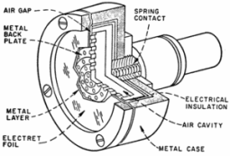
About the built-in charge
Material has very high resistivity.
Made by heating and form dielectric material in strong electric field.
Due to the high resistance and chemical stability of the material, will not decay for hundreds of years

Slide 5
Mechanism
Similar to all condenser microphones, the built-in charge is pushed closer or further apart from the backplate by pressure of sound wave.
The vibration generates a small ac voltage proportional to the sound pressure, which serves as the output signal.
The output signal can be converted to sound by connecting it to an audio device such as a speaker

Slide 6
Types of Electret Microphones
Foil-type or Diaphragm-type
A film of electret material is used as the diaphragm itself. This is the most common type, but also the lowest quality, since the electret material does not make a particularly good diaphragm.
Back electret
An electret film is applied to the back plate of the microphone capsule and the diaphragm is made of an uncharged material.
Front electret
Newest type, the capacitor is formed by the diaphragm and the inside surface of the capsule. The electret film is adhered to the inside front cover and the metalized diaphragm is connected to the input of the FET. It is equivalent to the back electret in that any conductive film may be used for the diaphragm.

Slide 7
References
“What Is an Electret Microphone?” What Is an Electret Microphone?, LearningaboutElectronics, www.learningaboutelectronics.com/Articles/Electret-microphones.
“Condenser Microphones” “Condenser Microphones”, LearningaboutElectronics, http://www.learningaboutelectronics.com/Articles/Condenser-microphones
Moeller, and Paul. “Electret Condenser Microphone (ECM).” Institut Für Nachrichtentechnik – Technische Universität Darmstadt, www.nt.tu-darmstadt.de/startseite_nt/fachgebiete_nt/ehemalige_fachgebiete_nt/fachgebiet_elektroakustik/glossar_1/elektretmikrofon_nt_ea/ecm_ea_nt_1.en.jsp.
Notes, Electronics. “Electret Microphone.” Electronics Notes, www.electronics-notes.com/articles/audio-video/microphones/electret-microphone.php.

Slide 8
Thank
You

