Slide 1
Group 8: Progress Report
Nayan Myerson-Jain, John Wang, Zhaoqi Wu, Steven Zhang

Slide 2
What is our project?
Examine temperature, humidity, barometric pressure profiles measured from different sensors.
We will examine these profiles in different ovens and refrigerators and compare them in household appliances versus more professional versions and how different processes in these appliances impact the data that we’ve taken.
This is a relatively simple idea, but allows us to learn interesting things about the appliances we use in our daily lives, as well as the devices we’ve been using in this class (BME680, Adafruit thermocouple and thermocouple amplifier, TMP36 temperature sensor).
Notes:
Nayan

Slide 3
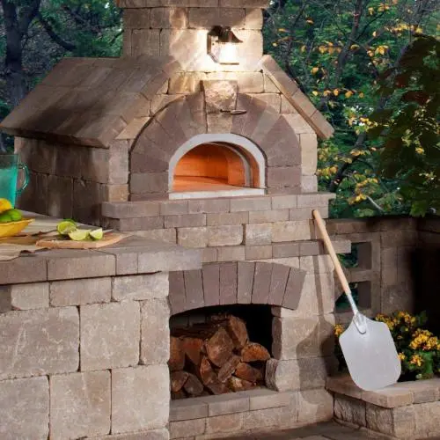
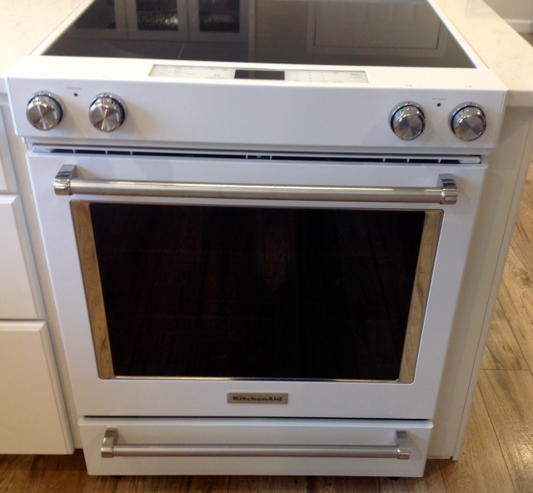
How is our project useful?
We can compare how different types of ovens heat up.
We can study how refrigerators control their temperature and humidity.
Also study properties of our instruments: how long it takes for them to reach equilibrium with the environment etc...
This is cool, because we can see how temperature and humidity changes in ovens through things like different cooking processes!
Notes:
Nayan

Slide 4
How do we collaborate?
We have weekly meetings on Thursdays at 2pm for about an hour.
Arduino codes:
LCD displays, BME680 data read and write into SD card: Steven
Thermocouple read and write: John
TMP reading and writing: Nayan
Measurement: temperature in ovens: Nayan, John
Data analysis: Nayan, Mike
Notes:
Steven

Slide 5
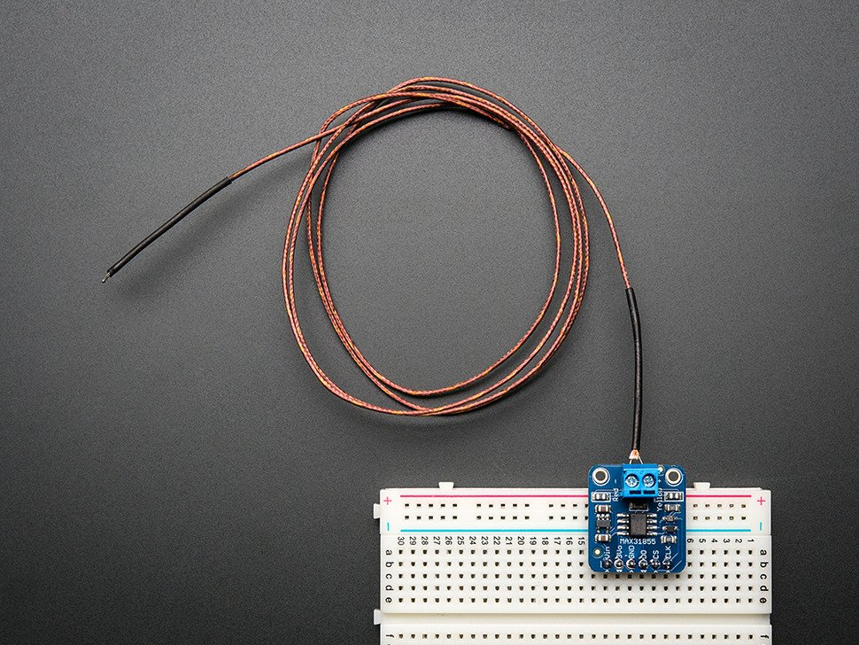
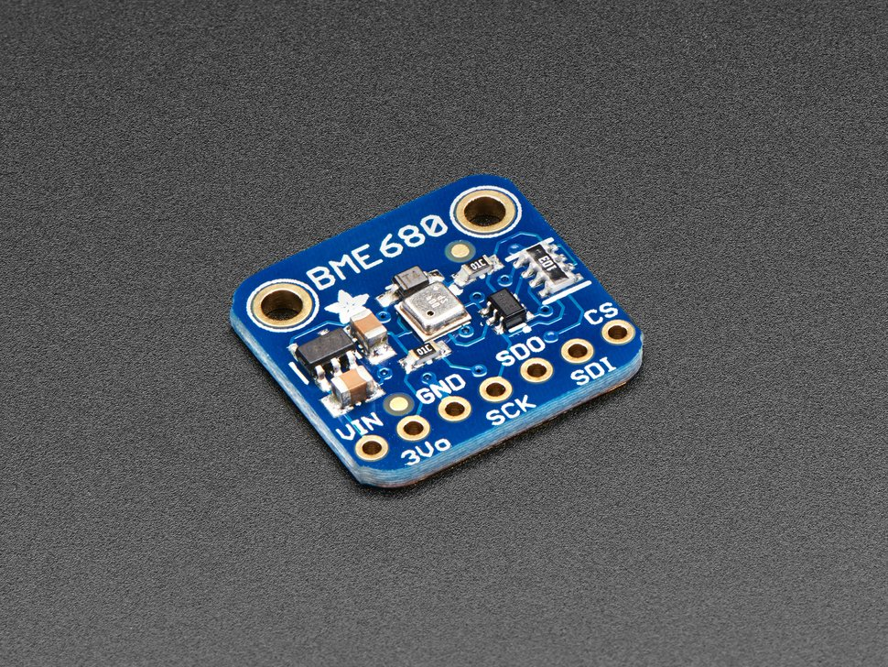
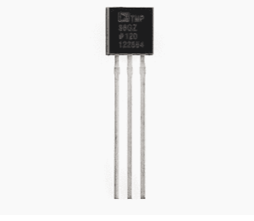
Instruments
Thermocouple
BME 680
TMP 36
Notes:
A thermocouple produces a temperature-dependent voltage as a result of the thermoelectric effect, and this voltage can be used to measure temperature.
can measure humidity with ±3% accuracy, barometric pressure with ±1 hPa absolute accuracy

Slide 6
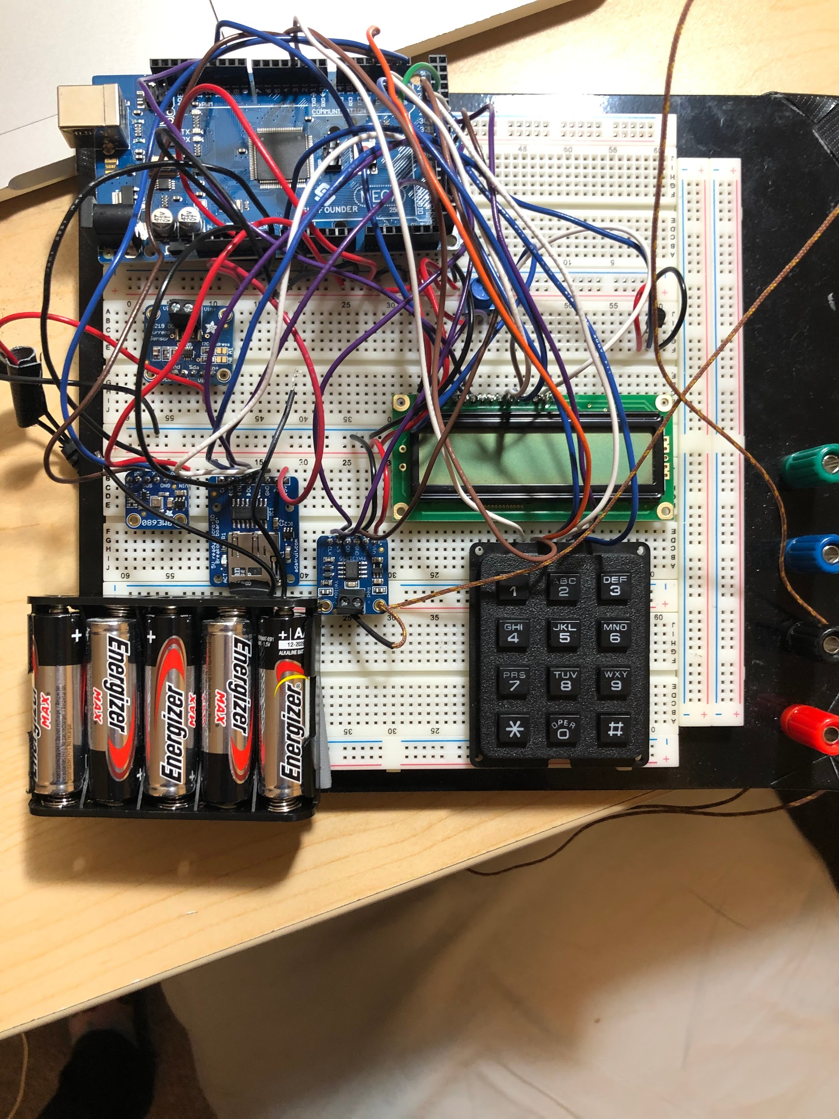
Current status of Breadboards.
Everything is set up on our breadboards: BME680, thermocouple, TMP36, battery pack, INA219, LCD, Keypad.
We can efficiently take data with one thermocouple using the breadboard.
Using it to take preliminary data, final data will be taken using PCBs

Slide 7
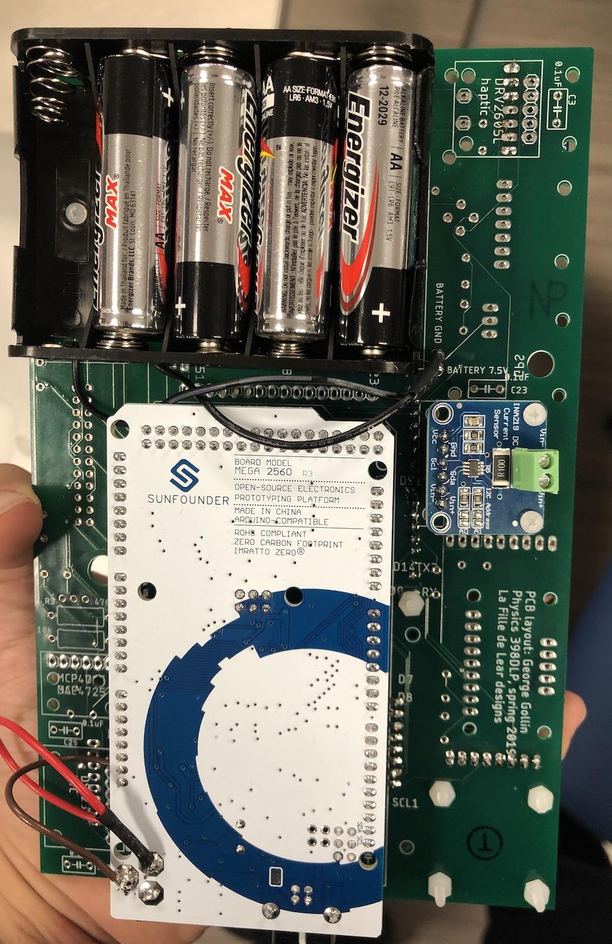
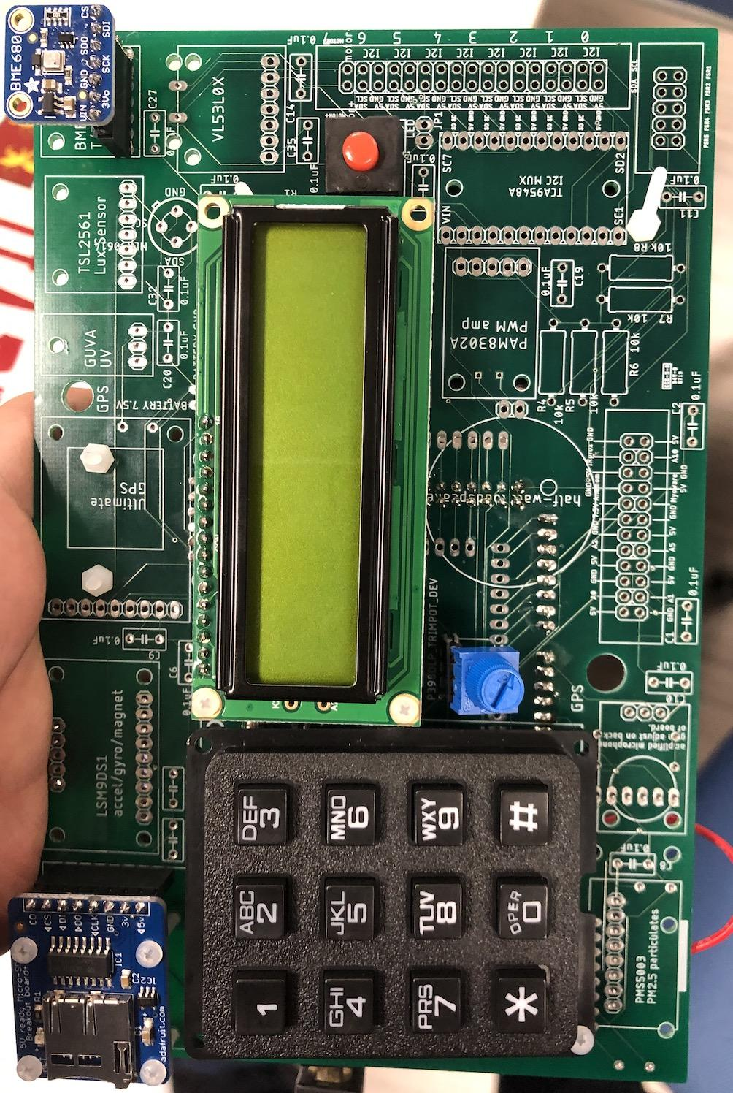
Current status of PCBs
1. We have the main devices installed on the PCB except the thermocouple breakout board
2. We are testing the communication between Arduino to multiple thermocouple breakout boards

Slide 8
Trial Experiment in the Oven
The experiment was done after the oven was turned down
The experiment was done with the breadboard
Procedure:
Put the thermocouple inside the oven
Shut the oven door
Wait for couple minutes and open the oven door
The trial experiment is to examine:
The response time of thermocouple ( time to reach thermal equilibrium)
If the thermocouple can show the slope change of temperature vs. time

Slide 9
Data Acquisition

Slide 10
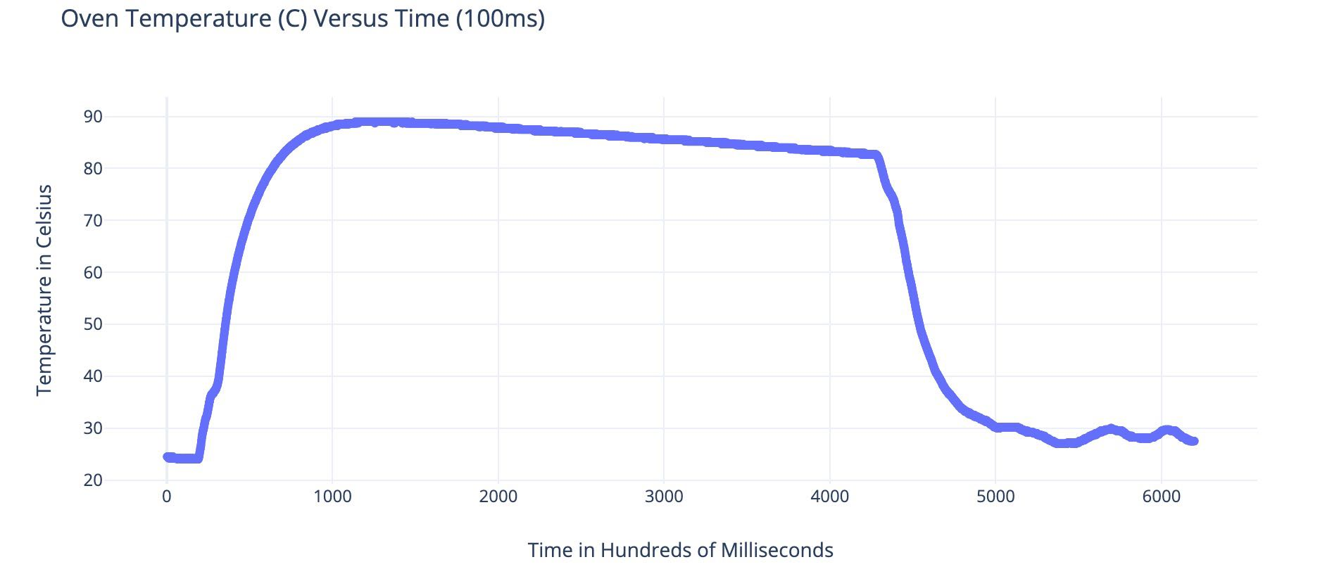
Trial Experiment Analysis
The oven door is opened
The oven door is shut
Thermocouple was put in oven

Slide 11
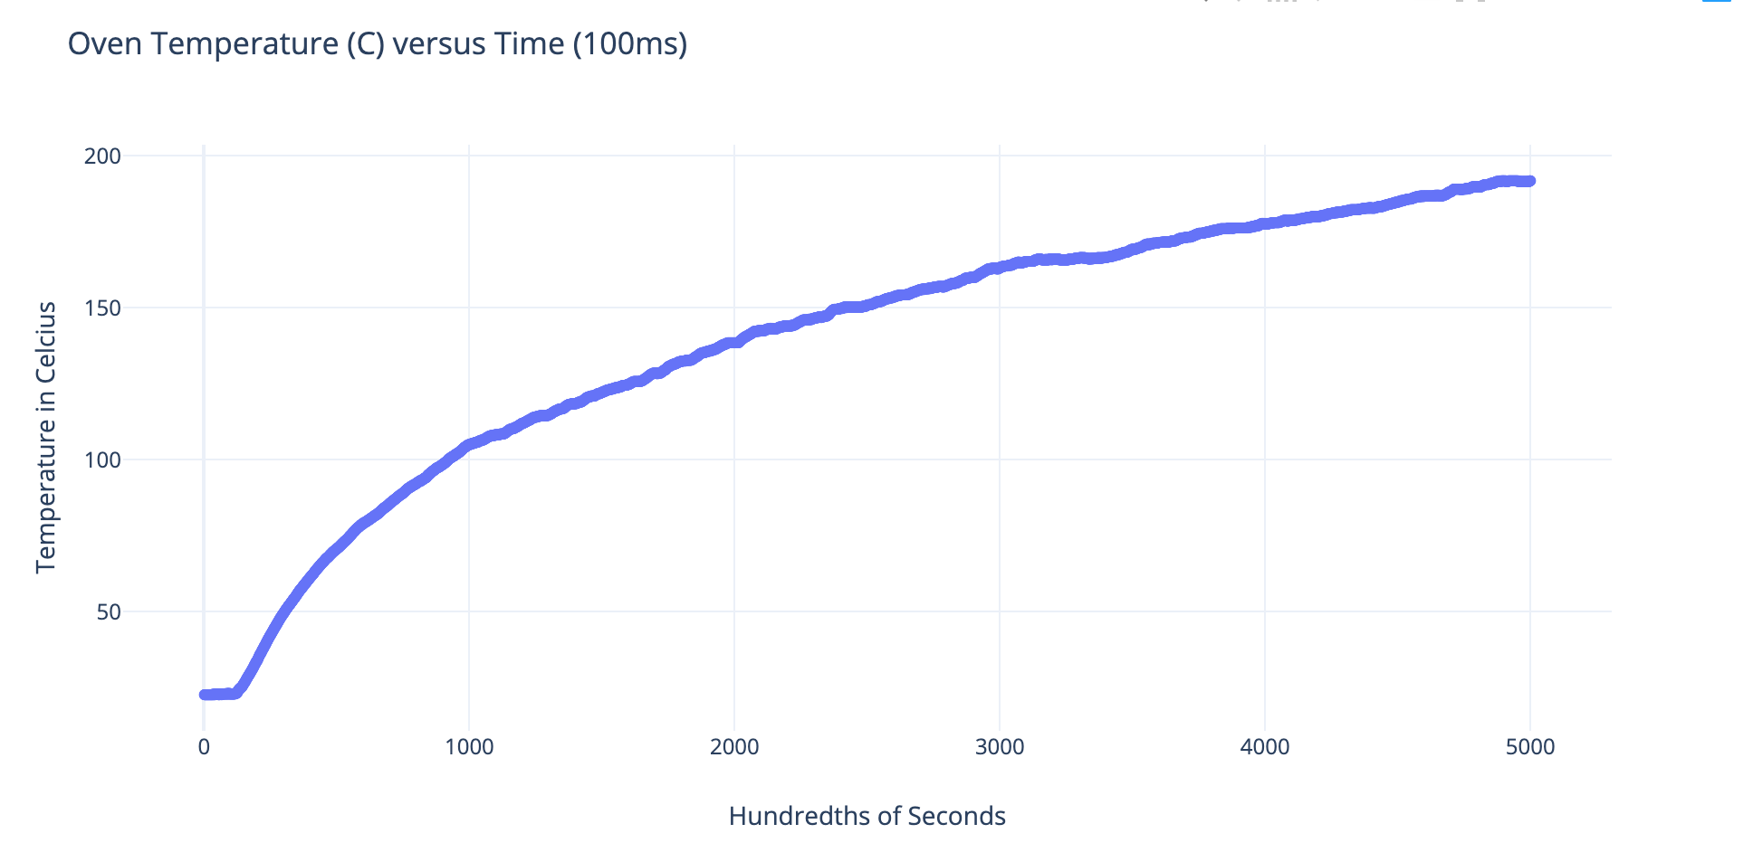
Run plan & collected data. (cont.)
We have also taken two more measurements using a thermocouple.
First measurement taken of oven heating up to about 180 degrees Celsius.
Second measurement taken of refrigerator.
In the future will use multiple thermocouples to create a ‘lattice’ and take measurement with them.
Notes:
Nayan

Slide 12
Plan for data analysis.
Data acquisition: not enough thermocouple, take measurements on each constant z-slices in each trial, and carry out multiple trials.
Date plotting: for each z-slice, take snapshots at fixed times, and make 2 types of plots of the measurements:
Plot 1: a 2-D plot with colored regions around each thermocouple, with darker colors indicating a higher temperature. Easy to see the temperature distribution.
Plot 2: a 3-D plot with the vertical axis as temperature. Easy to see how temperature changes with respect to space.
Coarse-graining method: evenly divide each z-slice into squares each of which contains exactly 1 thermocouple at the center. Do coarse-graining modelling for different scaling parameters. Find the critical scaling parameter for the the approximation is better compare to others.
3-D gradient: construct the 3-D gradient from each slice and corresponding critical scaling parameters.
Notes:
Steven

Slide 13
Things might on the project report
Investigate the temperature profile vs. time in oven (in different modes) and refrigerator
Investigate pressure profile in oven and refrigerator
Investigate humidity profile in refrigerator
Investigate the response time of the thermocouple vs. temperature (i.e. time the thermocouple takes in order to reach equilibrium with environment)
Notes:
Steven

