Slide 1
Vibrato in Stringed Instruments vs. Voices
Group 7- Ramone Randle, Sergi Castells, Noah Rogers, Stephen Elliott

Slide 2
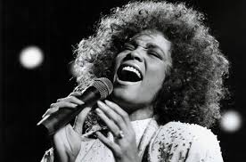
Introduction
What is Vibrato?
https://www.youtube.com/watch?v=HTPdB3McWpQ
https://www.youtube.com/watch?v=r2k7rcQ4P-Y
Vibrato is a modulation of pitch
https://www.youtube.com/watch?v=oOCNB1izw8A
Tremolo is the modulation of volume
Notes:
Stephen

Slide 3
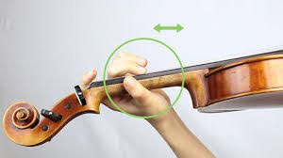
Motivation
Vibrato is an important textural component of most music
We were intrigued by what goes into vibrato
What characterizes vibrato
Notes:
Stephen

Slide 4
Collaboration
We meet Wednesdays to discuss our plans going forward and thoughts about current progress.
Lots of communication takes place through the week on discord.
Notes:
Sergi

Slide 5
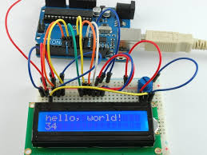
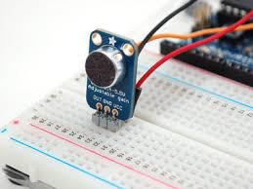
Instrumentation and DAQ
We use a microphone, SD card, LCD, current sensor, keypad, and a timer
32 KHz recording
Our DAQ software takes a .bin file recorded by our device and converts it into a .WAV file
Can also turn .bin file into array of ADC counts
Then we analyze the .WAV file with a Fourier Transform
Notes:
Sergi

Slide 6
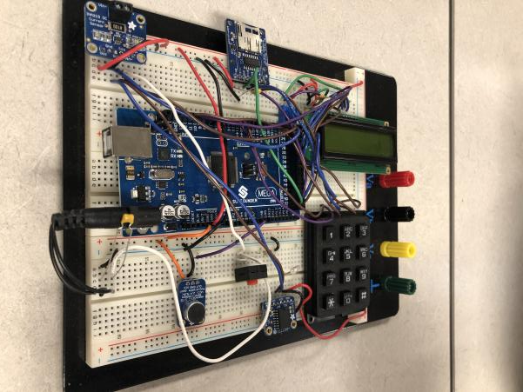
Breadboards
We can all do all of the necessary functions with our breadboards
Notes:
Stephen

Slide 7
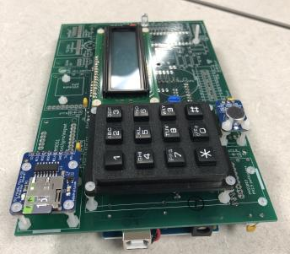
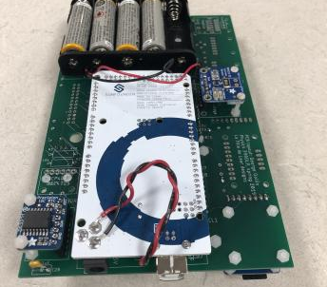
PCBs
Some of us need to finish up a small amount of hardware tweaks, but we will be ready to roll by the end of class
Notes:
Ramone

Slide 8
Run Plan
We have some recordings of music and voices to test our hardware and software
Many of us need an SD reader adaptor
We have performed Fourier Transforms on some WAV files to see if we get reasonable responses
We are planning to record Nathan Gunn, an Alumni who is a popular operatic baritone
We are also planning to get into touch with the music department to get recordings of stringed instruments
We also have access to a famous guitar player: Justin Languido
We don’t need lots of samples or long samples
Preferably, we will use a soundproof room
The audio files are generated with numbers appended
Notes:
Ramone

Slide 9
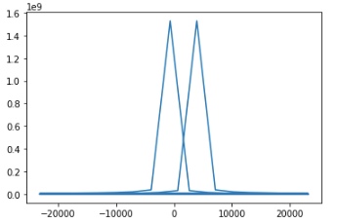
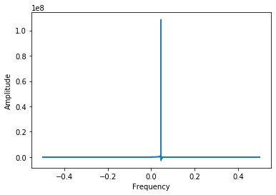
Data Analysis
Currently our offline analysis software is using the microphone to record sound that is then saved as a .WAV file to the SD card on the PCB
As far as we know, the offline software is complete for what we need it to do
We use a Python Script that converts .WAV files using a Fast Fourier Transform function in the Scientific Python Library
Our analysis will use a combination of Fast Fourier Transforms and Graph interpretations to determine characteristics of human vs instrumental Vibrato
If everything goes perfectly, we would like to train a machine learning model that would be able to interpret the sound waves and/or Fast Fourier Transforms and determine whether Vibrato is presents and which type of vibrato it is.
Notes:
Noah

Slide 10
Project Report
In an “ultimate” project report, our group would have a way to visually distinguish between vocal and instrumental Vibrato through analyzing the sound waves themselves or potentially just the Fast Fourier Transforms of the sound waves.
If everything goes perfectly, we would like to be able to create a Machine Learning Model that we could train to detect the difference for us (maybe even in a live experiment depending on memory and time issues).
Basically, we would be able to tell people about the physics behind why vibrato occurs and how to detect it.
Notes:
Noah

