Slide 1
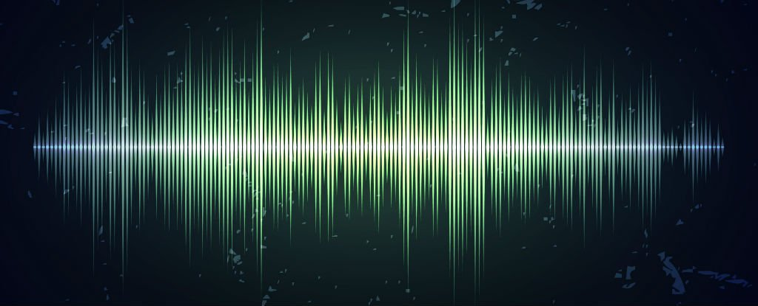
Psychoacoustics
Ritika Anandwade, Juliana Harr, Sneh Pandya, Brock Brendal

Slide 2
Introduction
Measuring? - “Pitch recall and reproduction.” How good are people at recalling pitch? Discrepancy in frequency between what subject hears and what they recall
Why is this interesting? - Music heavily depends on the notes being accurate/pleasing to the ear. How much can artists get away with when instruments are out of tune or notes deviate from a scale? How subjective is perfect pitch? Does it make a difference whether or not the subject is musically trained?
Notes:
Brock

Slide 3
Collaboration
Sneh / Brock: Audio Fourier analysis
Rithi / Juliana: Experimental procedures and testing
Weekly meetings usually happen Monday afternoons: lately have been doing PCB stuff, now shifting to finishing software
Notes:
Brock

Slide 4
Instruments and Data Acquisition
Microphone, DAC, SD-card reader, LCD, Keypad
Our record-sound function uses all of the above
Record .bin → generate .wav → fourier analysis of .wav → pick peak frequencies (primary + overtone)
Our recording is accurate to ~ 2 Hz (from breadboard), could be less once PCB’s are final with casing
Data also via questionnaires that subjects fill out
Notes:
Rithi

Slide 5
Breadboard Status
All functional
Arduino
SD card breakout
Electret microphone amplifier
LCD
Keypad
Speaker and amp
BME680
LED
INA219
Proofs of concept:
‘Hello world’
Recording sounds and saving file to SD
Playing music through speaker
Notes:
Sneh

Slide 6
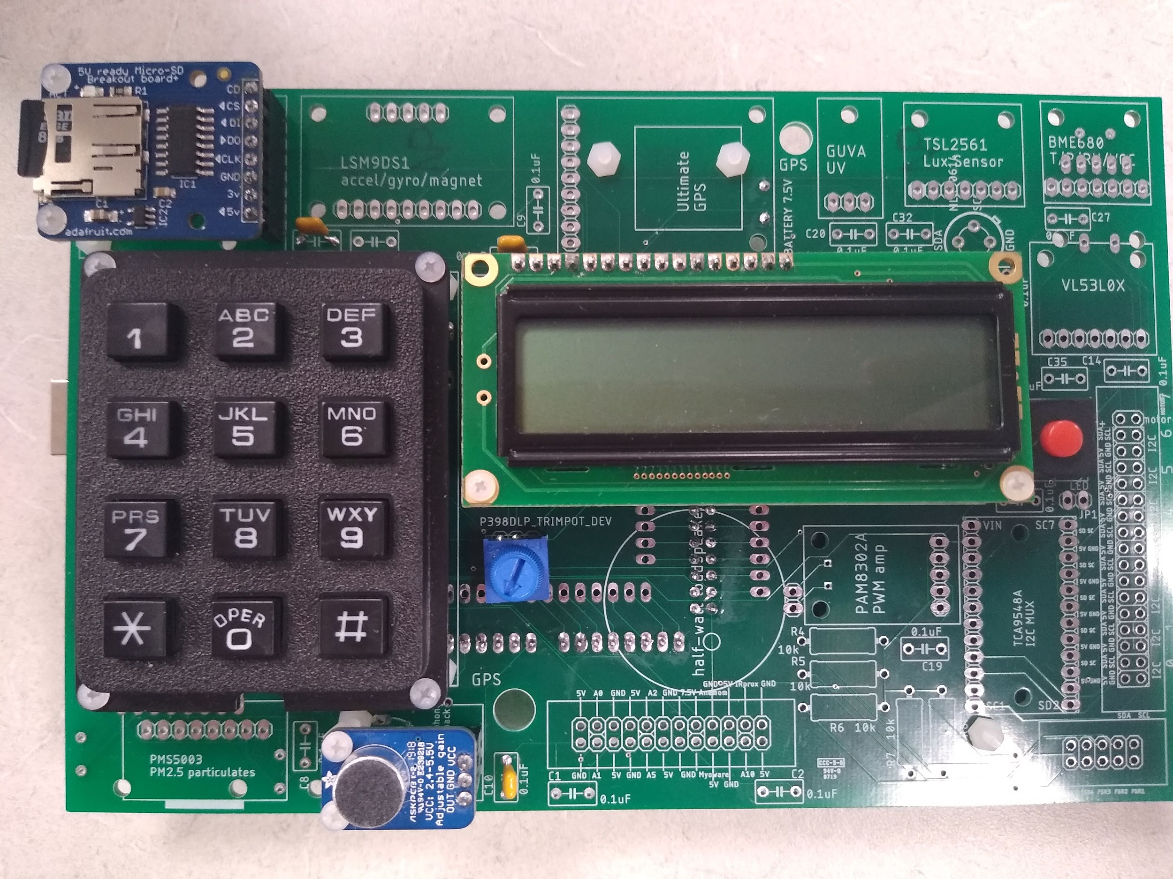
PCB Status
All functional
Arduino
SD card breakout
Electret microphone amplifier
LCD
Keypad
INA219
Casing coming soon
Notes:
Sneh

Slide 7
Experiment Run Plan / Field Tests
Test Subject 1: Male, 21, Musically Experienced
Testing Procedure: (Prototype using online tone generator)
Connect noise cancelling headphones to laptop
Play selected note for 5 seconds
Turn laptop to subject immediately and give them 20 seconds to identifies frequencies and select one
Repeat
Test Subject 2: Female, 22, Musically Experienced
Notes:
Rithi

Slide 8
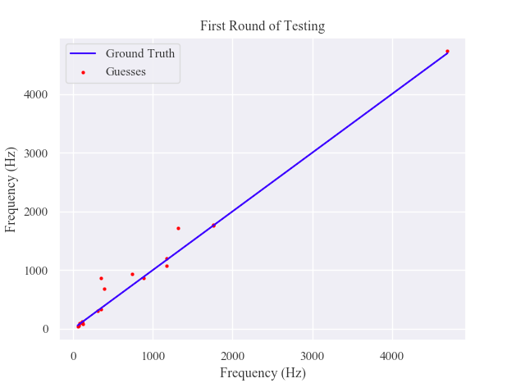
Notes:
Rithi

Slide 9
Proposed Plan
Questionnaire to collect data about the following:
Age and sex of subject
Auditory barriers
Instruments they can play
Self-defined musical talent
Testing Procedure: (Final Goal for >50 people)
Play note (C,F, or A) on guitar for 5 seconds
Fast Fourier Transform to identify peak frequencies
Give subject 20 seconds to identify frequency on laptop
Repeat with other notes for 3 octaves (9 samples total)
Notes:
Brock

Slide 10
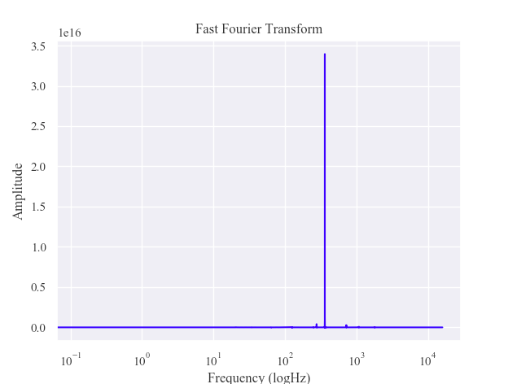
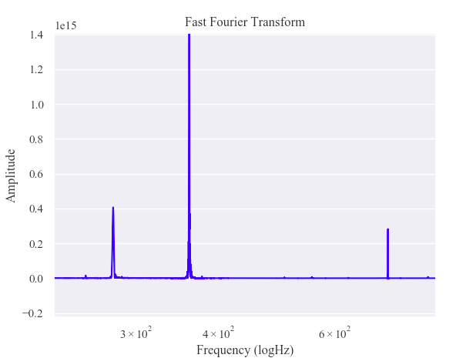
Data Analysis
Graphically determine frequencies via FFT using scipy
Peaks have a finite width, visible once zoomed in
Accurate to ~ 2 Hz
Measure difference from what subject picks
Working on code to print top frequencies
Notes:
Sneh

Slide 11
...looking to the future
In the paper:
The experiment and processes from top to bottom
How experiment was structured, data collection and processing, etc.
Plots of data and detailed/technical explanations
In the presentation:
All data and what they mean in bullet points
Raw numbers, characteristics of the subjects, plots, …
How the whole project went: ups and downs, challenges and triumphs
Notes:
Brock

