Slide 1
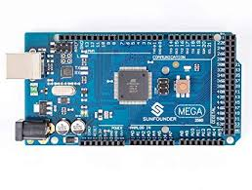
Group 1 Progress Report
March 6, 2020

Slide 2
Introduction and Motivation
The original project statement: “Precisely cross-timed distributed measurements of atmospheric conditions in an outdoor performance venue”
What does this mean?
How do atmospheric conditions in different locations affect sound propagation on very small time scales?
Motivation
Entities interested in our results might include:
Audio engineers
Venue designers and managers

Slide 3
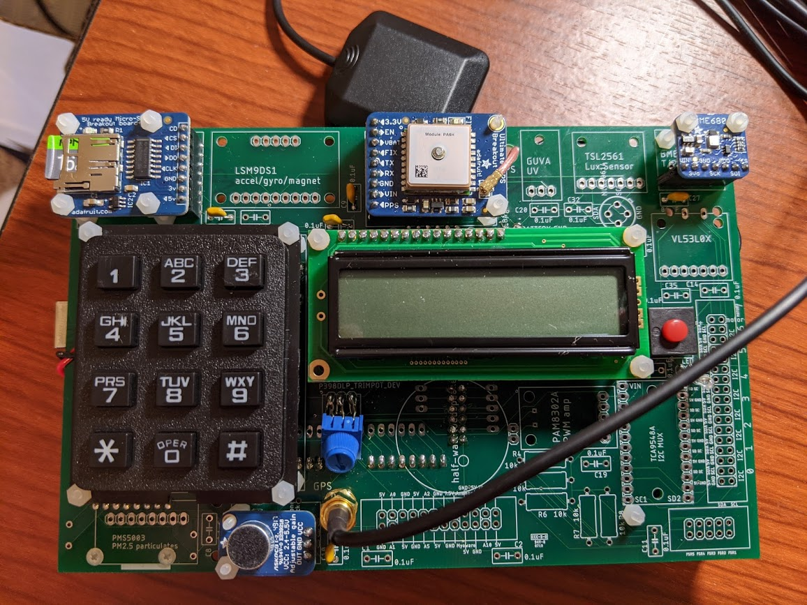
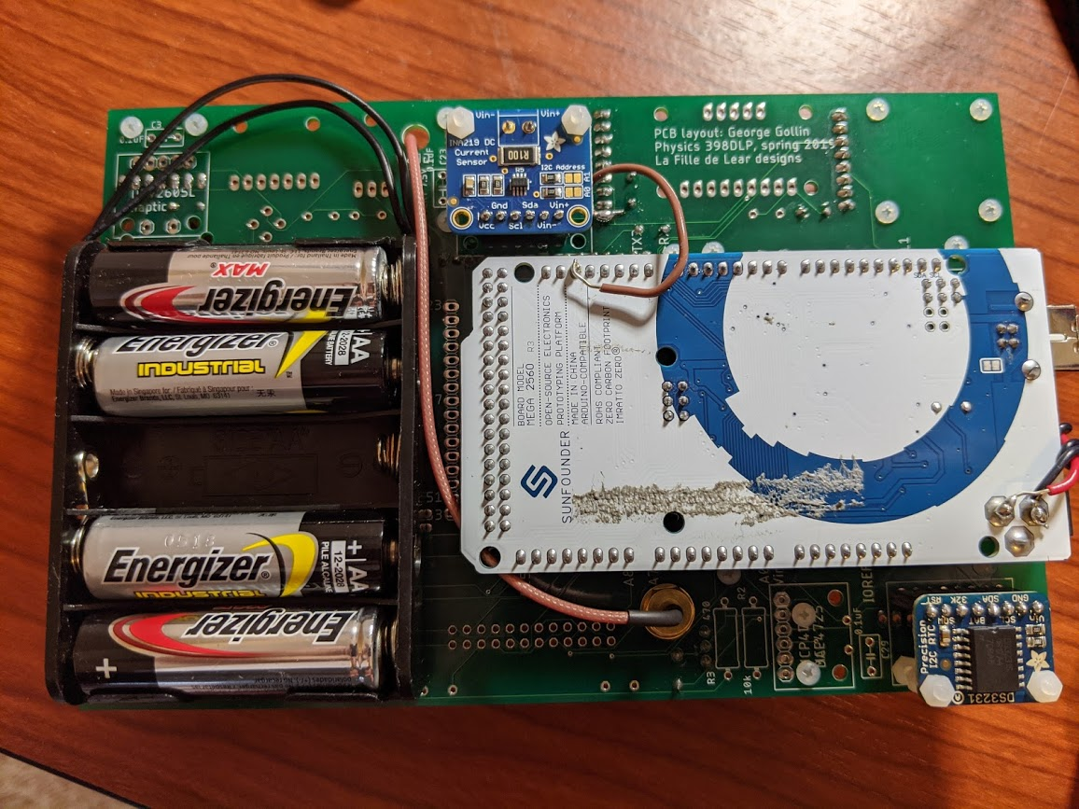
Our Hardware

Slide 4
Precision timing/synchronization
How can we ensure consistent timing across distributed sensors?
Arduino onboard clock drifts from real time ~ 10^-6 seconds every second.
Different Arduino board clocks actually drift at different rates (manufacturing tolerance)
If we simply timestamp our recorded data with the local clock time…
We can’t know when a certain measurement occurred on one Arduino relative to another.
Is there a way to synchronize Arduino clocks in real time?

Slide 5
Is it possible to synchronize in real time?
Sure, if you have some kind of very fast, low latency wireless communication method between Arduinos
Bluetooth?
Cellular?
WiFi?
Challenges of real-time synchronization
Bluetooth: too high-latency
Other methods: mostly expensive, time-consuming, and outside of the scope of this course.
Luckily, there is another way....

Slide 6
What’s the GPS for?
The PPS signal (Pulse Per Second)
Each GPS unit sends out a pulse at the instant that UTC (Coordinated Universal Time) turns to the next second.
This signal is much, much more accurate on a per-second basis than the Arduino’s onboard clock
PPS pulses from GPS units in different places go high at exactly the same time, to a few microseconds precision
Allows us a precise record of measurement times across several sensors.

Slide 7
Using the PPS signal to line up data from different Arduinos
It still is not feasible to coordinate measurements in real time
(1) We need to calculate how much each individual Arduino drifts from the PPS signal of its GPS.
(2) Once this is done, we must “stretch” or “compress” the recorded data to line up with a universal “second”.
(1) can be done locally right on the Arduino, and saved to the SD card.
(2) is more computationally intensive, and must be done in post-processing

Slide 8
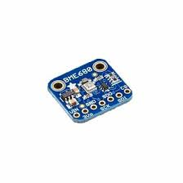
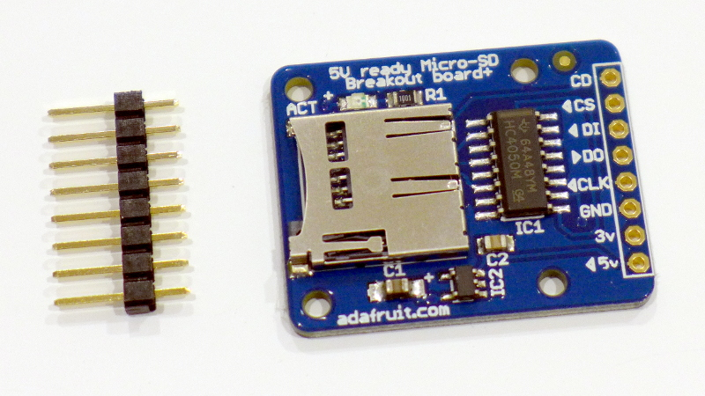
Logging the data
The main loop reads temperature, humidity, pressure, and altitude from the BME680, as well as a voltage level from the microphone
These data, along with the local clock time, are written to the local SD card.
Each full loop execution takes about 0.6 seconds.

Slide 9
Data Logging Hardware Concerns
BME680
Reading the BME680 takes about half a second.
Solution: only read BME once every “x” loops (maybe once every ten/twenty).
Assume atmospheric conditions do not change much over one second.

Slide 10
Data Analysis
Our data logging code calculates the drift between the local clock and the PPS signal.
After collecting data, we can use this relation to synchronize readings from all our Arduinos.
Haven’t yet completed this
Now, we can analyze how atmospheric conditions affect sound propagation...

Slide 11
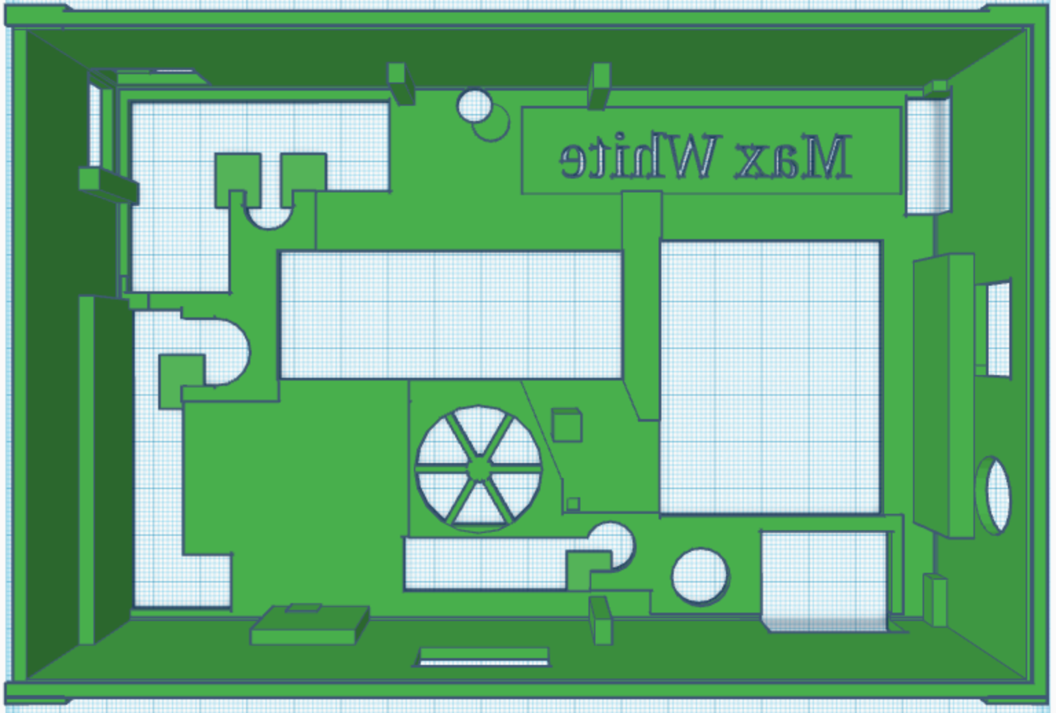
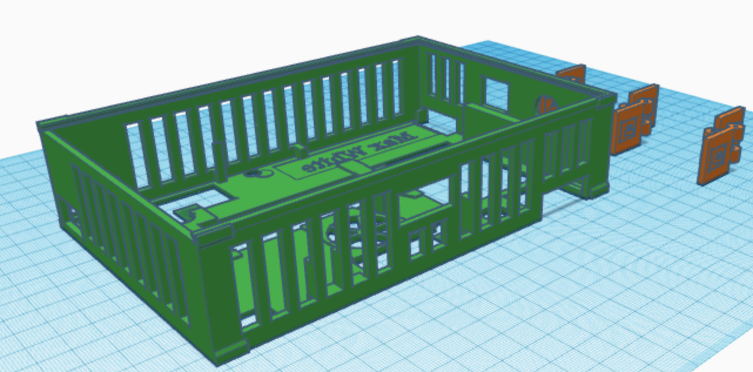
3D Printing Case for PCB
Printing time primarily depends upon two factors
Volume of printing filament
Complexity of part
Things to consider when using TinkerCAD
Structural Integrity
Print resolution

Slide 12
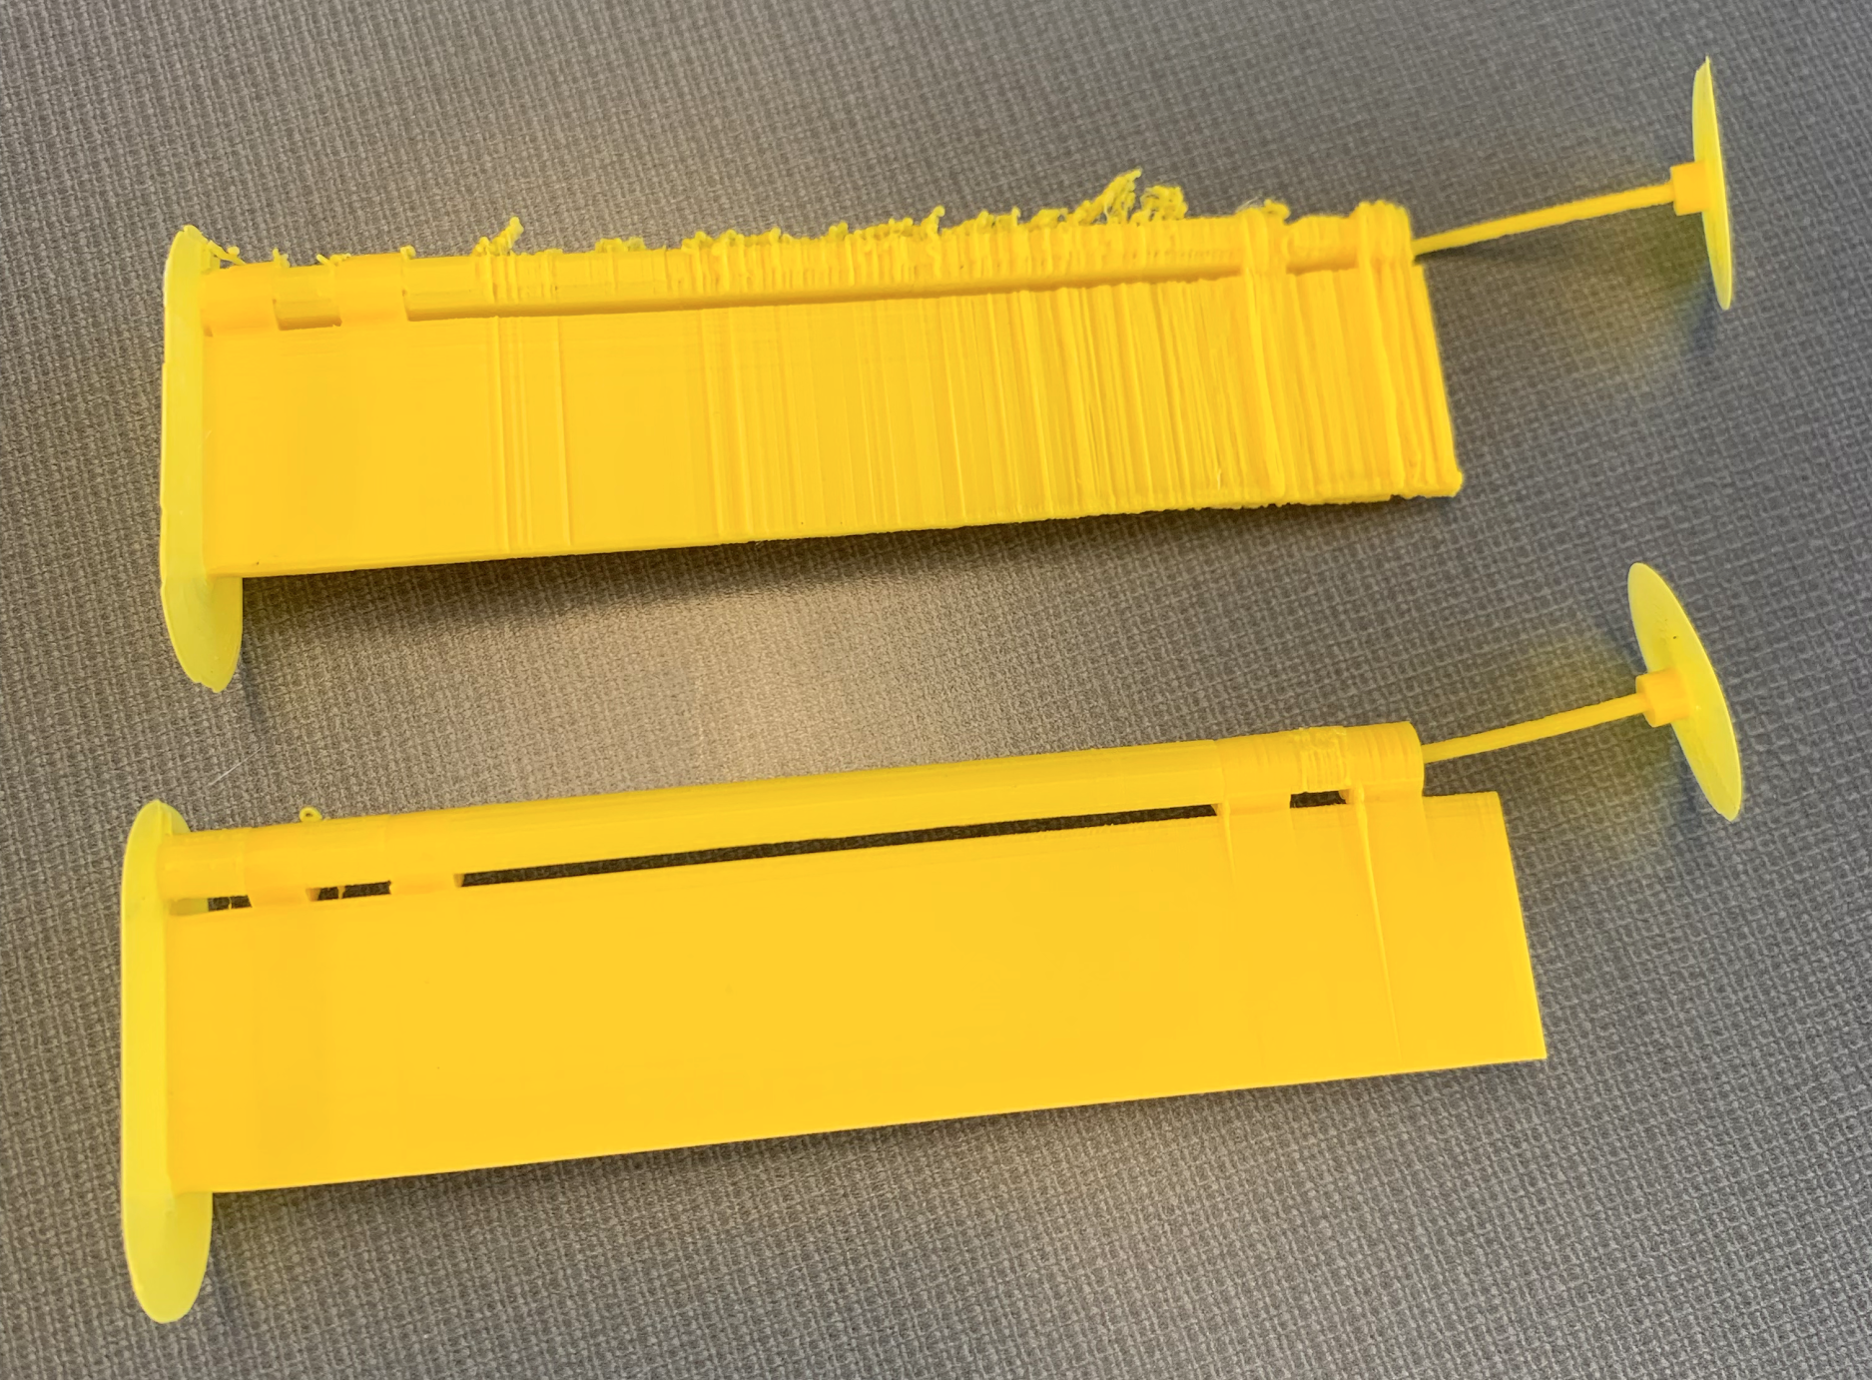
3D Printing Hinges

Slide 13
Tests, Calibration & Trials
Completed tests
Determine accuracy of the Arduino’s internal clock
Several PPS timing comparisons confirming their precision
To be completed today/this week
Single-sensor measurement sound level relative to temperature, atmospheric pressure and humidity
Observe the effect of location in a room on sound level
Analyze the Arduino clock’s accuracy over different temperatures, humidities, and pressures.
Our final run plan will depend on results of this week’s tests

Slide 14
Collaboration
Responsibilities based on each member’s strengths and prior knowledge
Alex has lots of experience with C++, so he’s taken the lead in writing most of our code.
Collin did much of our initial wiring on the breadboard, including researching exactly how to get all our hardware to communicate.
Bill lead most of our soldering and assembly of the PCBs, as well as helping Alex write and debug the DAQ code.
Max has taken the lead designing our 3D-printed cases and has come up with several possibilities for improving the basic design.

Slide 15
Run Plan and Final Thoughts
End goal: to compare characteristics of sound waves across distributed sensors with high time resolution and examine trends relative to atmospheric conditions.
Decide on a performance venue.
Propagate a tone from a central location (e.g. the stage) and collect data at several points in the venue simultaneously
Analyze data to study correlations between sound characteristics and atmospheric conditions.
May include reconstructing the waveform of the tone from microphone readings.

Slide 16
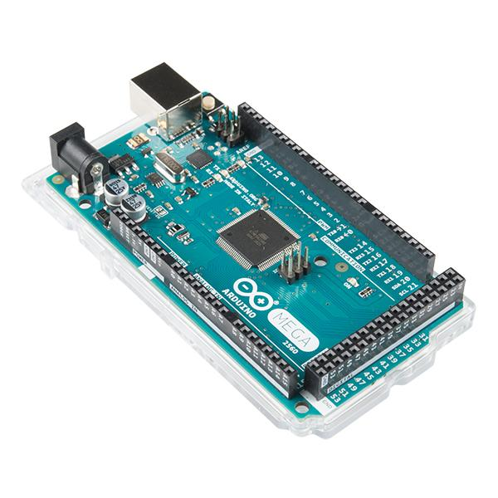
The End

