Slide 1
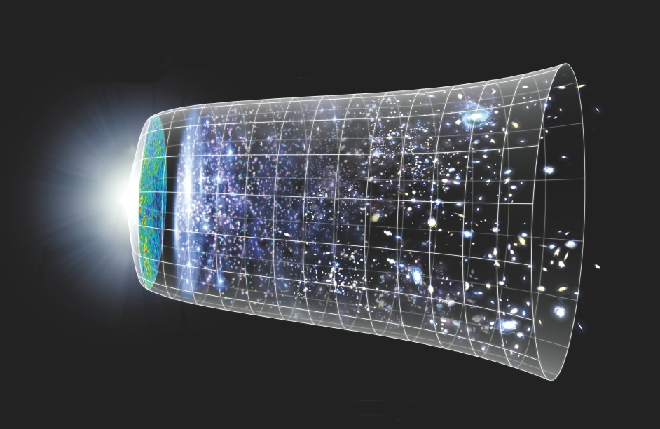
Phys 102 – Lecture 28
Life, the universe, and everything

Slide 2
Today we will...
Learn about the building blocks of matter & fundamental forces
Quarks and leptons
Exchange particle (“gauge bosons”)
Learn about the Big Bang theory
Hubble law & the expansion of the universe
The early universe
Unification of forces

Slide 3
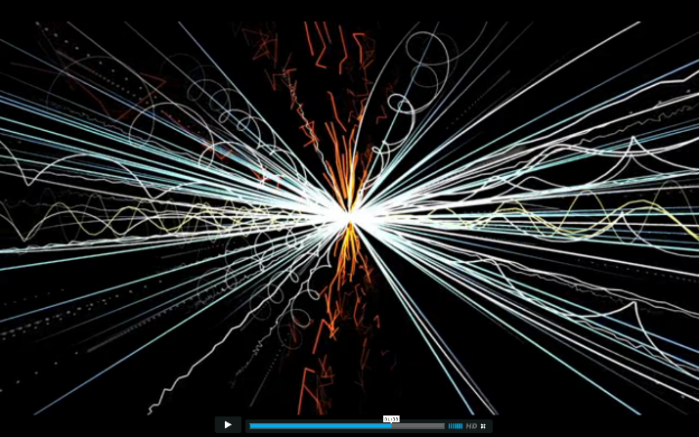
Fundamental particles
Are the electron, proton, and neutron the fundamental building blocks of matter?
Evidence says NO for proton & neutron
Particle “zoo”
Hundreds of particles identified in particle accelerator experiments
“sigma” Σ⁰, Σ⁺, Σ–
“xi” Ξ⁰, Ξ–
“pion” π⁰, π⁺, π–
etc...
“kaon” κ⁰, κ⁺
Neutron magnetic dipole moment
Neutron has spin ½, is electrically neutral, yet has a magnetic dipole moment!
neutron
Indicates these are composite particles

Slide 4
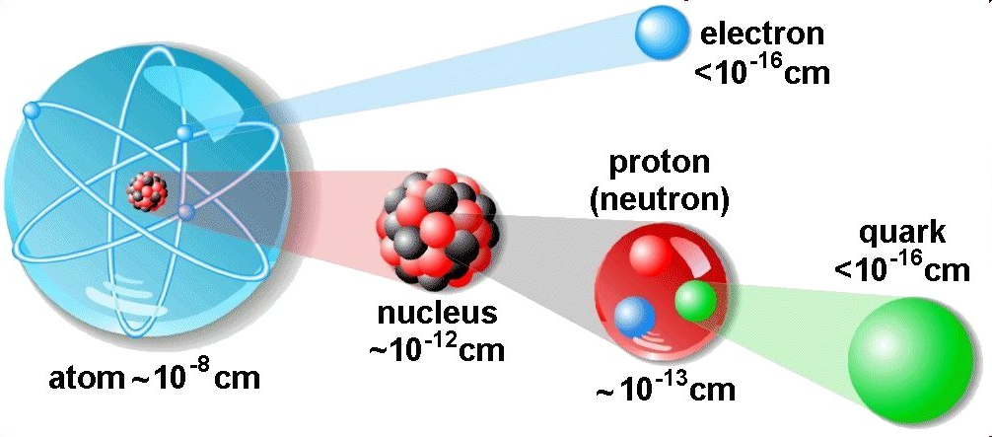
Quarks
“Three quarks for Muster Mark” Finnegan’s Wake, James Joyce
Neutrons and protons are composite particles
Discovered in 1968
“Flavors”
Hadrons are particles composed of quarks
Quark
up (u)
down (d)
1 proton = uud
1 neutron = udd
u
u
u
d
Charge
d
d

Slide 5
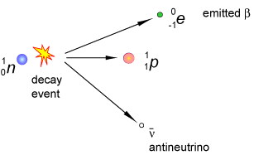
ACT: Beta decay
Last lecture, we saw that β– decay involves converting a neutron into a proton.
How could this decay be described in terms of quarks?
A d converts to a u
A u converts to a d
A d converts to an e–

Slide 6
ACT: Hadrons & quarks
The Δ– is an exotic hadron with charge –e.
?
?
?
What could the quark makeup of this particle be?
uuu
ddd
an e– & ν_{e}

Slide 7
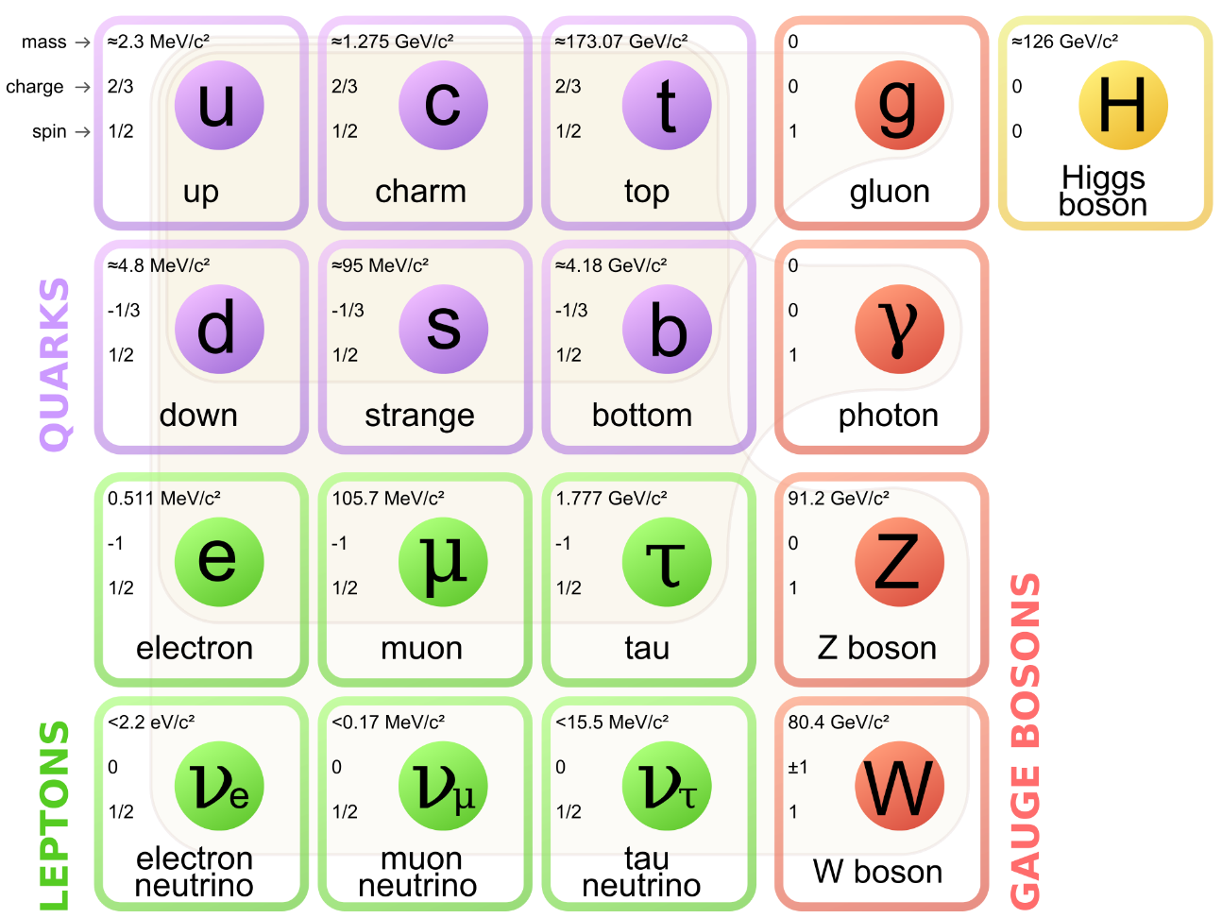
Building blocks of matter
Ordinary matter is made of u, d (quarks), e and ν_{e} (leptons)
Generation
1
2
3
‘74
‘95
Hadrons (ex: n, p) are composite particles made of quarks
‘74
‘77
Quarks and leptons (ex: e–) are believed to be the elementary particles
‘75
‘00
There is a corresponding anti-particles for each elementary particles! Same m, opposite q
Mass

Slide 8
ACT: Quarks
In Lect. 26 we saw that two electrons cannot be in the same state (i.e. have the same quantum numbers).
Can two quarks be in the same state?
Yes
No

Slide 9
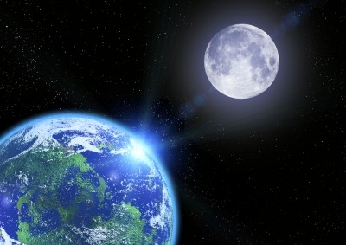
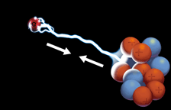
4 Fundamental forces of Nature
Gravitational force (solar system, galaxies)
Electromagnetic force (atoms, molecules)
Strong force (atomic nuclei)
Weak force (radioactive decay)
<
<
<
Gravitational
Weak
Electromagnetic
Strong
weakest
strongest

Slide 10
Particle physics view of forces
Matter interacts through exchange of mediator or exchange particles
Ex: electromagnetic exchange particle is the photon!
Photon is virtual and cannot be observed
γ
Time
Coulomb repulsion
Summing over all the possible ways photon can be exchanged leads to Coulomb’s law
–
–
Space
“Feynman diagram”

Slide 11
The “Standard Model”
Exchange particles for are known as gauge bosons
‘79
Strong force
Electromagnetic force
‘83
β– decay
Weak force
‘83
Only force that can change quark flavor
What about gravity?

Slide 12
The Higgs boson
Higgs boson gives elementary particles their masses
‘13
The more massive the particle, the more it interacts with the Higgs boson
Massless photon
γ
Massive electron
–

Slide 13
ACT: Fundamental forces
Which of the following particles can interact via the electromagnetic force?
A muon
An up quark
A strange quark
All of the above
None of the above

Slide 14
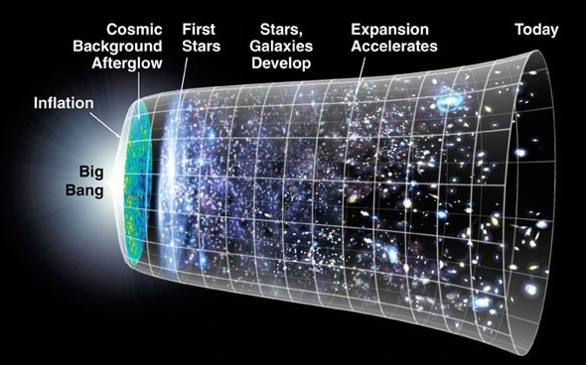
The expansion of the universe
Astronomers observed that all celestial bodies are receding from us. Therefore, the universe is expanding!

Slide 15
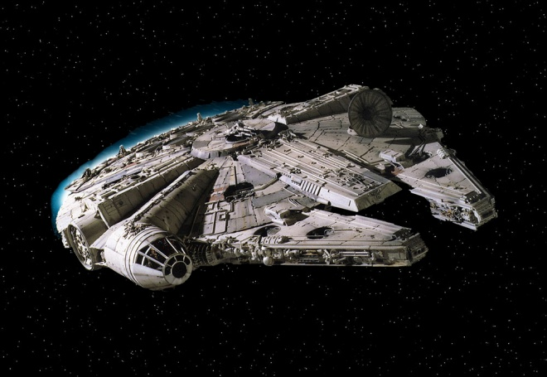
ACT: Doppler effect
Recall Lect. 15
The wavelength λ_{obs} observed on earth from the spaceship is
Earth
λ_{emit}
v
Larger than λ_{emit}
The same as λ_{emit}
Smaller than λ_{emit}

Slide 16
ACT: Hubble law
More distant celestial objects recede from us faster
Recessional velocity
Distance to object
“Hubble” constant
The light spectrum of a stationary galaxy is given by:
Recall Lect. 25
400
500
600
700
λ (nm)
Which of the following belongs to the most distant galaxy?

Slide 17
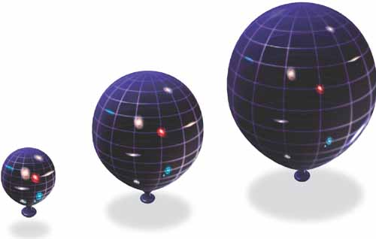
The Big Bang
All celestial bodies are receding from us and each other, so universe must be expanding...
DEMO
Distances increase in every direction
Past
Today
Future
Assuming a constant rate of expansion:
Best estimate is 13.8 Gyr
1 “Megaparsec”= 1 Mpc = 3×10¹⁹ km

Slide 18
A journey back in time...
Early universe was smaller, more dense, & hotter
Atoms are ionized & universe opaque
Matter coalesces by gravity into first stars & galaxies
First stable nuclei form
First hadrons form
Universe neutral atoms, “dark ages”
Universe quark-gluon plasma
1 μs
1 s
3 min
20 min
380 kyr
8 Myr
13.8 Gyr
TIME
ENERGY

Slide 19
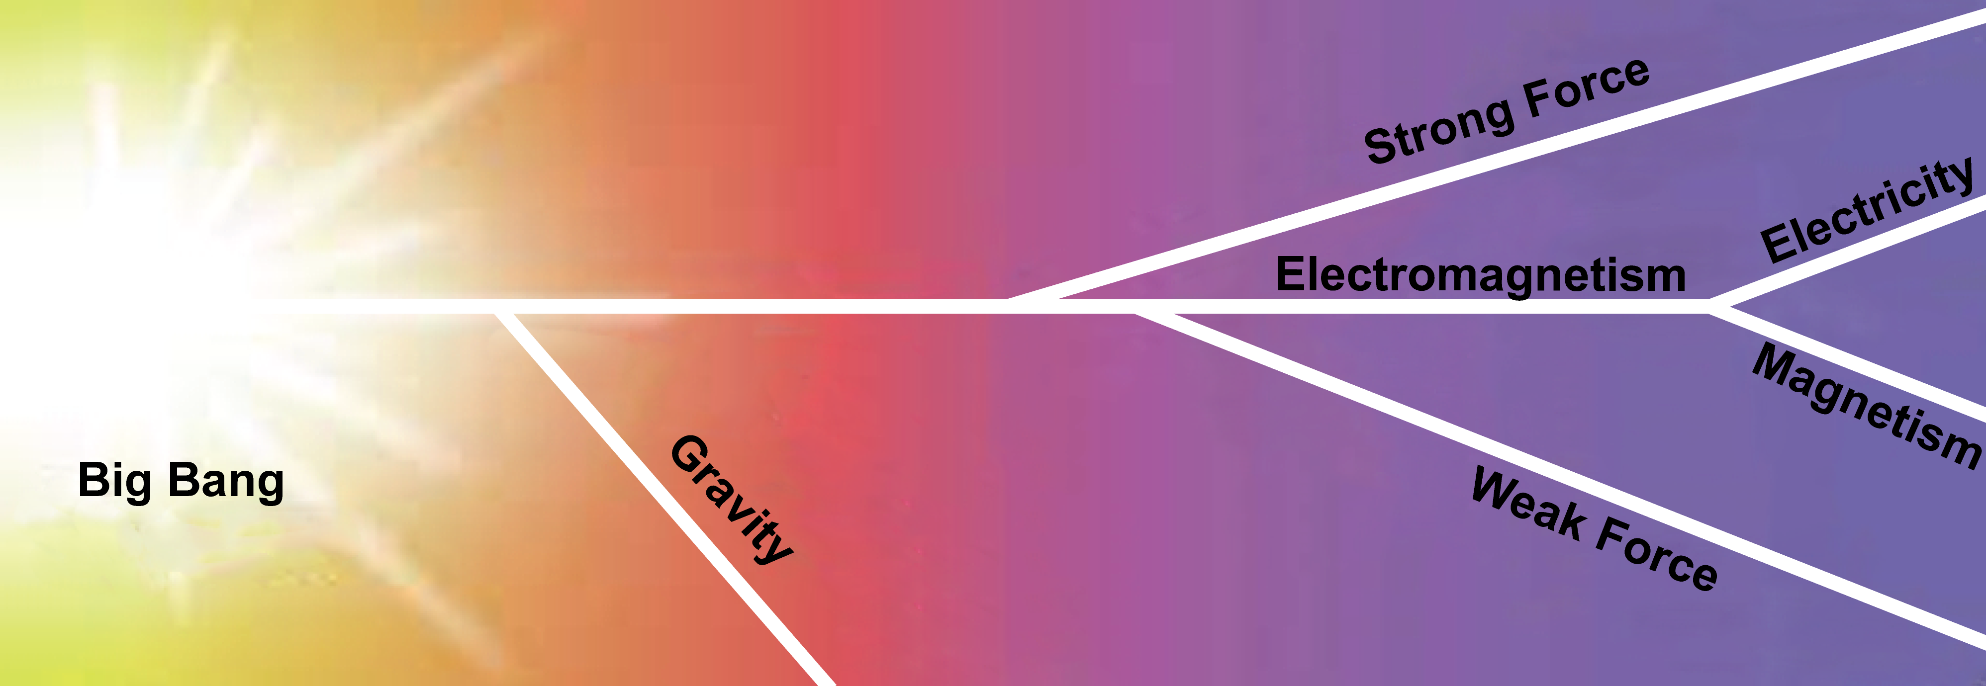
Unification
At high energies, fundamental forces begin to look the same
“Grand Unified Theories”
(~10¹⁶ GeV)
Electroweak Theory
(~10² GeV) 1979, 1983
“Theory of Everything”
(~10¹⁹ GeV)
String theory, quantum gravity, etc.
10^{–43} s
10^{–35} s
10^{–11} s
TIME
ENERGY

Slide 20
Some unsolved problems
What is dark matter?
We cannot detect most of the matter in the universe. It is “dark”.
What is the nature of dark energy?
The expansion of the universe is accelerating. A “dark energy” is driving this acceleration
Why is there more matter than antimatter?
The universe is made up mostly of matter
Can the fundamental forces be unified?
There is no unified model of electroweak & strong force, nor a quantum theory of gravity

