Slide 1
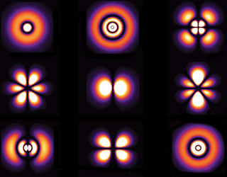
Phys 102 – Lecture 26
The quantum numbers and spin

Slide 2
Recall: the Bohr model
Only orbits that fit n e– wavelengths are allowed
SUCCESSES
Correct energy quantization & atomic spectra
+
FAILURES
Radius & momentum quantization violates
Heisenberg Uncertainty Principle
e– wave
Electron orbits cannot have zero L
Orbits can hold any number of electrons

Slide 3
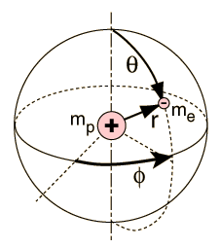
Quantum Mechanical Atom
Schrödinger’s equation determines e– “wavefunction”
3 quantum numbers
determine e– state
“SHELL”
“Principal Quantum Number” n = 1, 2, 3, …
Energy
s, p, d, f “SUBSHELL”
“Orbital Quantum Number” ℓ = 0, 1, 2, 3 …, n–1
Magnitude of angular momentum
“Magnetic Quantum Number” m_{ℓ} = –ℓ, …–1, 0, +1…, ℓ
Orientation of angular momentum

Slide 4
ACT: CheckPoint 3.1 & more
For which state is the angular momentum required to be 0?
n = 3
n = 2
n = 1
How many values for m_{ℓ} are possible for the f subshell (ℓ = 3)?
3
5
7

Slide 5
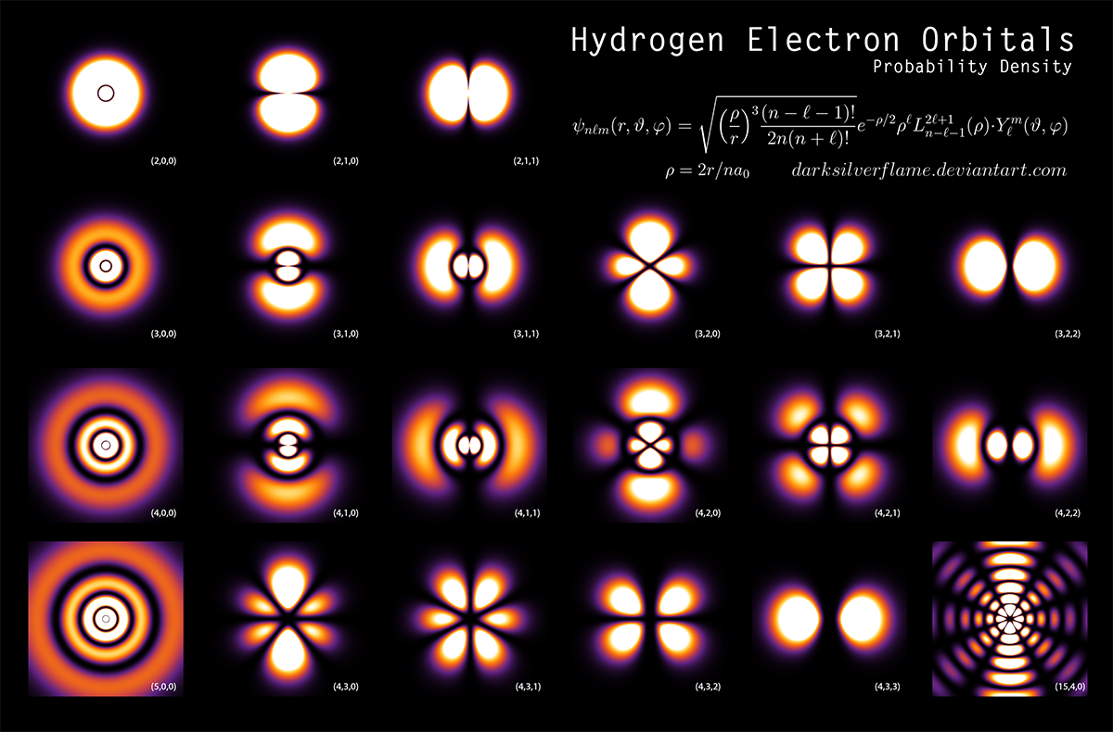
Hydrogen electron orbitals
∝ probability
Shell
(n, ℓ, m_{ℓ})
(2, 0, 0)
(2, 1, 0)
(2, 1, 1)
Subshell
(3, 0, 0)
(3, 1, 0)
(3, 1, 1)
(3, 2, 0)
(3, 2, 1)
(3, 2, 2)
(4, 0, 0)
(4, 1, 0)
(4, 1, 1)
(4, 2, 0)
(4, 2, 1)
(4, 2, 2)
(5, 0, 0)
(4, 3, 0)
(4, 3, 1)
(4, 3, 2)
(4, 3, 3)
(15, 4, 0)
Notes:
Compare states with seats in auditorium n=row, l=seat ml=??? Ms=male/female

Slide 6
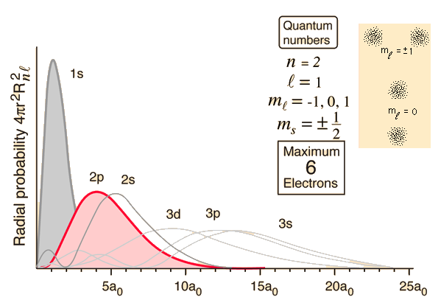
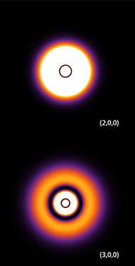
CheckPoint 2: orbitals
Orbitals represent probability of electron being at particular location
1s (ℓ = 0)
r
2p (ℓ = 1)
r
2s (ℓ = 0)
r
3s (ℓ = 0)
r

Slide 7
Angular momentum
What do the quantum numbers ℓ and m_{ℓ} represent?
Magnitude of angular momentum vector quantized
+
r
Only one component of L quantized
–
e–
Classical orbit picture
Other components L_{x}, L_{y} are not quantized

Slide 8
Orbital magnetic dipole
Electron orbit is a current loop and a magnetic dipole
Recall Lect. 12
+
r
Dipole moment is quantized
–
e–
What happens in a B field?
Recall Lect. 11
θ
z
Orbitals with different L have different quantized energies in a B field
+
e–
–
r
“Bohr magneton”

Slide 9
ACT: Hydrogen atom dipole
What is the magnetic dipole moment of hydrogen in its ground state due to the orbital motion of electrons?

Slide 10
Calculation: Zeeman effect
Calculate the effect of a 1 T B field on the energy of the 2p (n = 2, ℓ = 1) level
z
For ℓ = 1,
m_{ℓ} = –1, 0, +1
+
e–
–
Energy level splits into 3, with energy splitting

Slide 11
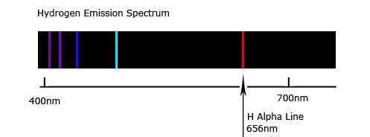
ACT: Atomic dipole
The H α spectral line is due to e– transition between the n = 3, ℓ = 2 and the n = 2, ℓ = 1 subshells.
How many levels should the n = 3, ℓ = 2 state split into in a B field?
E
1
3
5
ℓ = 2
n = 3
n = 2
ℓ = 1

Slide 12
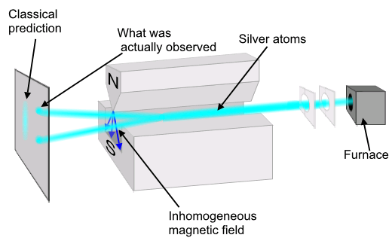
Intrinsic angular momentum
A beam of H atoms in ground state passes through a B field
n = 1, so ℓ = 0 and expect NO effect from B field
Atom with ℓ = 0
Instead, observe beam split in two!
–
Since we expect 2ℓ + 1 values for magnetic dipole moment, e– must have intrinsic angular momentum ℓ = ½.
–
“Spin” s
“Stern-Gerlach experiment”

Slide 13
Spin angular momentum
Electrons have an intrinsic angular momentum called “spin”
with s = ½
Spin also generates magnetic dipole moment
–
–
with g ≈ 2
Spin DOWN (– ½)
Spin UP (+½)

Slide 14
Magnetic resonance
e– in B field absorbs photon with energy equal to splitting of energy levels
Absorption
–
“Electron spin resonance”
Typically microwave EM wave
–
Protons & neutrons also have spin ½
since
“Nuclear magnetic resonance”

Slide 15
Quantum number summary
“Principal Quantum Number”, n = 1, 2, 3, …
Energy
“Orbital Quantum Number”, ℓ = 0, 1, 2, …, n–1
Magnitude of angular momentum
“Magnetic Quantum Number”, m_{l} = –ℓ, … –1, 0, +1 …, ℓ
Orientation of angular momentum
“Spin Quantum Number”, m_{s} = –½, +½
Orientation of spin

Slide 16
Electronic states
Pauli Exclusion Principle: no two e– can have the same set of quantum numbers
E
s (ℓ = 0)
p (ℓ = 1)
+½
–½
+½
–½
+½
–½
+½
–½
n = 2
–
–
–
–
–
–
–
–
m_{ℓ} = –1
m_{ℓ} = 0
m_{ℓ} = +1
m_{S} = +½
m_{S} = –½
n = 1
–
–

Slide 17
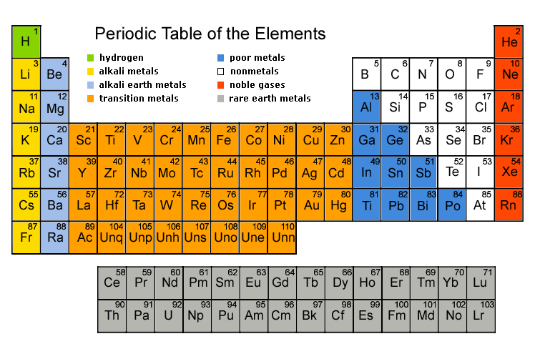
The Periodic Table
Pauli exclusion & energies determine sequence
s (ℓ = 0)
Also s
p (ℓ = 1)
n = 1
2
3
4
5
6
7
d (ℓ = 2)
f (ℓ = 3)

Slide 18
CheckPoint 3.2
How many electrons can there be in a 5g (n = 5, ℓ = 4) sub-shell of an atom?

Slide 19
ACT: Quantum numbers
How many total electron states exist with n = 2?
2
4
8

Slide 20
ACT: Magnetic elements
Where would you expect the most magnetic elements to be in the periodic table?
Alkali metals (s, ℓ = 1)
Noble gases (p, ℓ = 2)
Rare earth metals (f, ℓ = 4)

Slide 21
Summary of today’s lecture
Quantum numbers
Principal quantum number
Orbital quantum number
Magnetic quantum number
Spin angular momentum
e– has intrinsic angular momentum
Magnetic properties
Orbital & spin angular momentum generate magnetic dipole moment
Pauli Exclusion Principle
No two e– can have the same quantum numbers

