Slide 1
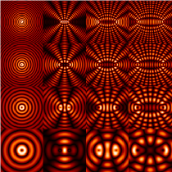
Phys 102 – Lecture 23
Diffraction

Slide 2
Today we will...
Learn about diffraction – bending of light by objects
  Single slit interference
  Circular aperture interference
Apply these concepts
  Resolution of optical instruments
  X-ray crystallography

Slide 3
Single slit interference?
What happens when light passes through a small slit?
Without diffraction
With diffraction
This is NOT what happens!
Diffraction – the apparent bending of light around an object or aperture

Slide 4
Diffraction & Huygens’ principle
Coherent, monochromatic light passes through one narrow slit
Wavelets through slit travel different distances and can interfere!
Where are the interference maxima and minima?

Slide 5
Single slit diffraction
Consider waves from top and bottom ½ of slit of width a
At this angle, every wave from top ½ of slit interferes destructively with corresponding wave from bottom ½
1
2
r₁
N
1’
r_{1'}
a/2
θ
2’
a
N’
Destructive:
1st minimum

Slide 6
Single slit diffraction
Consider waves from ¼’s of slit
1
At this angle, every wave from top ¼ of slit interferes destructively with corresponding wave from next ¼
2
1’
2’
r₁
a/4
N
r_{1'}
N’
a
Destructive:
2nd minimum

Slide 7
Single slit diffraction minima
Condition for sixths of slit to interfere destructively
m = +2
m = +1
a
m = –1
m = –2
In general,
THIS FORMULA LOCATES MINIMA!!
Note the maximum at m = 0, why?

Slide 8

ACT: CheckPoint 1
The width a of the slit in the screen is decreased
m = +2
m = +1
a
m = –1
m = –2
What happens to the light pattern on the screen?
A. It gets wider B. Stays the same C. It gets narrower

Slide 9
ACT: Wide double slits
Consider a double slit where the slit width a is not negligible. The separation d between slits is such that d = 3a.
θ
d
a
At an angle θ where d sin θ = 3λ, what do you see on the screen?
A. A maximum B. A minimum C. In between

Slide 10
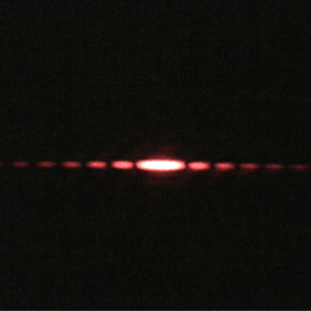

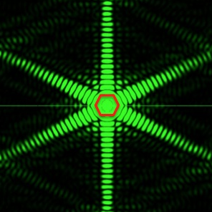
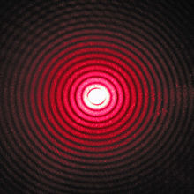
Diffraction in 2D
Single slit
Square aperture
Hexagonal aperture
Circular aperture
CheckPoint 2

Slide 11
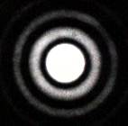
Diffraction from circular aperture
1st diffraction minimum
Central maximum
θ₁
D
Maxima and minima will be a series of bright and dark rings on screen

Slide 12
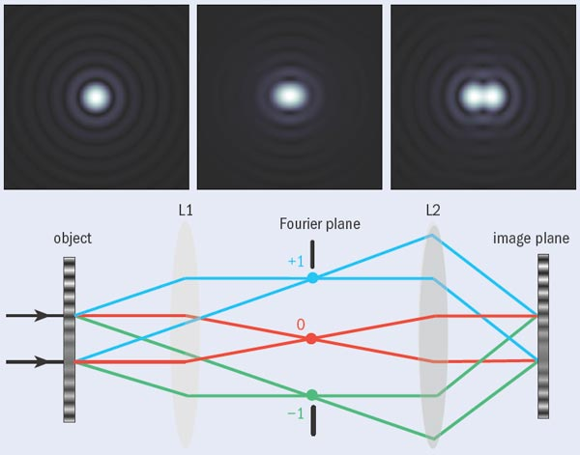
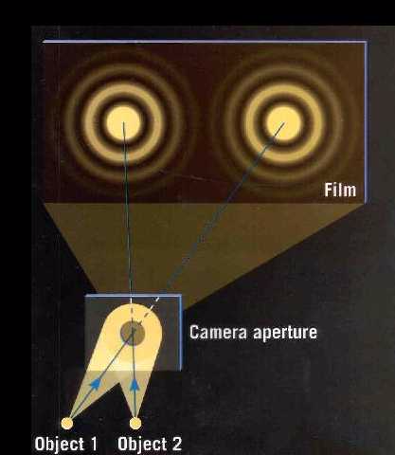
Resolving power
Demo: Resolving Power
Light through aperture (of eye, camera, microscope, telescope, etc.) creates diffraction pattern
θ_{obj}
Larger spacing
θ_{min}
θ_{obj}
θ_{obj}
θ_{min}
Not resolved
θ_{min}
θ_{obj}
Two objects are resolved only when:
θ_{min}
Just resolved
“Diffraction limit”

Slide 13
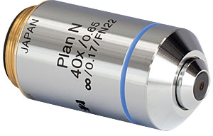
Calculation: microscope resolution
A microscope objective has an aperture size D = 6.8 mm, and a focal length f = 4 mm. What is the closest distance two green light sources (λ = 530 nm) can be to resolve them?
θ_{min}
Use small angle approximation:
Want:
θ_{obj}
D
D
f
Ultimate limit to resolution:
d_{obj}

Slide 14

ACT: CheckPoint 3
You are on a distant planet with binary suns. You decide to view them by building a pinhole camera. Light from both suns shines through the hole, but you can only see one spot on a screen.
You should make the pinhole ________
A. Larger B. Smaller

Slide 15
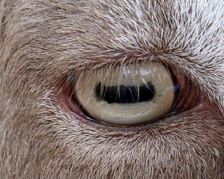
ACT: Rectangular slit
A goat has a rectangular shaped pupil, with the long axis along the horizontal.
In principle, in which direction should a goat’s eye have higher resolution?
A. Horizontal B. Vertical

Slide 16

Diffraction from a crystal
EM waves of short wavelength scatters off of atoms
If there is more than one atom, scattered waves can interfere
d
Crystals – periodic arrangements of atoms – create same interference pattern as diffraction grating!

Slide 17
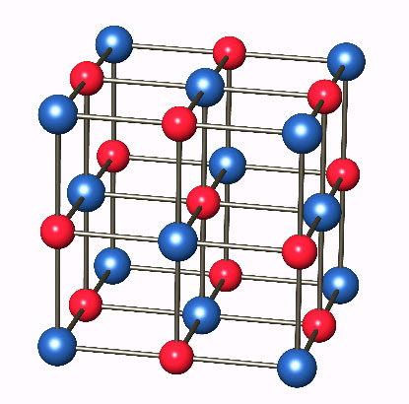
ACT: Crystal diffraction
In a NaCl crystal, the spacing between atoms is 0.282 nm. Which of the following wavelengths could be used to see a clear diffraction pattern?
0.282 nm
A. λ = 0.1 nm B. λ = 1 nm C. λ = 10 nm

Slide 18
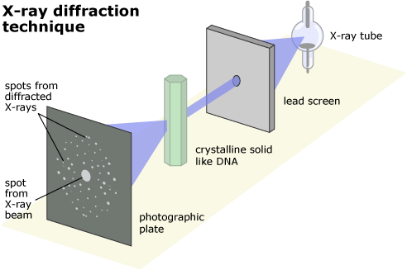
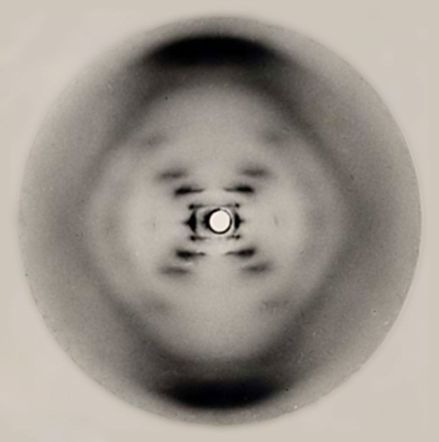
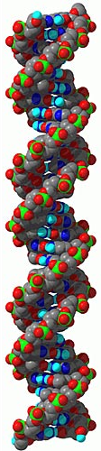
X-ray crystallography
Given X-ray wavelength λ, diffraction angles θ provide information about distance d between atoms in crystal
θ
“Photo 51” Rosalind Franklin
As long as λ < d, small features lead to large θ. BUT need regular ordering of atoms – i.e. a crystal!
Crystalline fiber of DNA

Slide 19
Diffraction pattern of DNA
Features of pattern:
Layer lines
Outer diamond
Cross pattern
Missing 4th layer line
2
3
1
4
“Photograph 51” – Rosalind Franklin

Slide 20
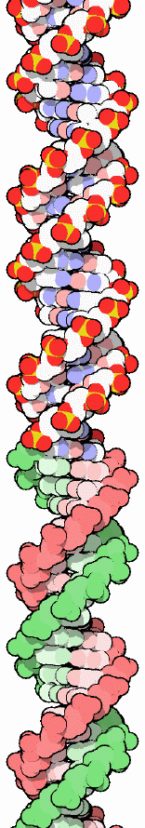
Layer lines & diamond pattern
What features in DNA generate layer lines and diamond pattern?
DNA bases every P/10
P/10 = 0.34 nm
θ
m = +5
+3
+2
+1
–1
–2
–3
Helix repeats every P
–5
P = 3.4 nm
Note that large (small) distances diffract to small (large) angles

Slide 21
Cross pattern
Why does DNA diffraction generate cross pattern?
Slit pattern
Strands are tilted at an angle
Interference pattern
P = 3.4 nm
Key to discovery of helix structure
Light diffracted ⊥ to slit

Slide 22
ACT: DNA cross pattern
You discover a new structure of DNA in which the diffraction pattern is the same as the “normal” DNA in every respect EXCEPT that the cross makes a more acute angle α
“Normal” DNA
New form of DNA
α
α
Δθ
Δθ
Which statement regarding the new DNA structure must be true?
A. It cannot be a helix
B. The helix repeat distance P must be different
C. The helix tilt angle must be different

Slide 23
Missing 4th layer
Why is there no interference maximum at m = 4?
“Missing order”
θ₄
m = +4
Two DNA helices shifted by 3P/8 (“minor groove”)
m = –4
3P/8 = 1.3 nm
Waves from helix 1 and 2 interfere destructively!
Key to discovery of double helix

Slide 24
Summary of today’s lecture
Single-slit diffraction
  Interference minima:
Circular aperture diffraction
  First interference minimum:
Resolution in optical instruments
  Angle subtended by objects ≥ angle of first diffraction minimum
X-ray diffraction
  Small distances -> large diffraction angles

