Slide 1
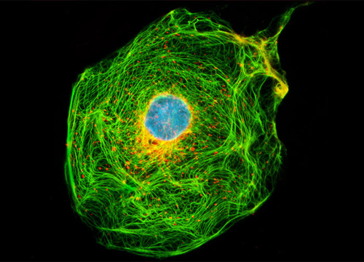
Phys 102 – Lecture 21
Optical instruments

Slide 2
Today we will...
Learn how combinations of lenses form images
Thin lens equation & magnification
Learn about the compound microscope
Eyepiece & objective
Total magnification
Learn about limits to resolution
Spherical & chromatic aberrations
Dispersion

Slide 3
CheckPoint 1.1–1.2: multiple lenses
Image of first lens becomes object for second lens, etc...
f1
f2
f2
p.a.
f1
Lens 1
Lens 2
65%
Lens 1 creates a real, inverted and reduced image of the object
Lens 2 creates a real, inverted and reduced image of the image from lens 1
The combination gives a real, upright, reduced image of the object
52%
DEMO
Notes:
DEMO 1101: Two big lenses

Slide 4
Calculation: final image location
Determine the final image location for the 2-lens system
s = 18 cm
d_{o,2}
d_{i,2}
p.a.
f1
f1
f2
f2
d_{o,1}
d_{i,1}
3 cm
Lens 1
Lens 2
3 cm
Diagram should agree!

Slide 5
Calculation: final magnification
Determine the final image size for the 2-lens system
h_{o,1}
h_{i,2}
p.a.
f1
f1
f2
f2
3 cm
Lens 1
Lens 2
3 cm
Upright, reduced image

Slide 6
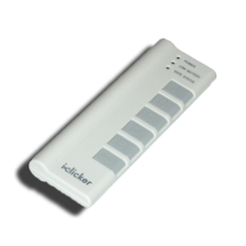
ACT: CheckPoint 1.3
Now, the second converging lens is placed to the left of the first lens’ image.
p.a.
f1
f1
f2
f2
Lens 1
2
Which statement is true?
Object after lens 2 is virtual: d_{o,2} < 0
Image still forms but rays seem to originate from point after lens 2
30%
38%
32%
Lens 2 has no object
Lens 2 has a real object
Lens 2 has a virtual object

Slide 7
ACT: CheckPoint 1.4
Now, the second converging lens is placed to the left of the first lens’ image.
p.a.
f1
f1
f2
f2
Lens 1
2
What is the image formed from lens 2?
33%
36%
31%
There is no image
Real
Virtual
d_{o,2} < 0, so d_{i,2} > 0

Slide 8
Lens combination: summary
...
f₁
f₂
...
f
f₂
d_{o,1}
d_{i,1}
d_{o,2}
d_{i,2}
Image of first lens becomes object of second lens, ...
d_{o} = distance object is from lens:
> 0: real object (before lens)
< 0: virtual object (after lens)
d_{i} = distance image is from lens:
> 0: real image (after lens)
< 0: virtual image (before lens)
f = focal length lens:
> 0: converging lens
< 0: diverging lens
Watch your signs!

Slide 9
Compound microscope
A compound microscope is made up of two converging lenses
Eyepiece (ocular)
f_{e}
Acts as a magnifying glass
Body tube
Tube length L = distance between focal points
L
f_{o}
Objective
f_{o}
Creates real, enlarged image of sample object
DEMO
Sample
Notes:
DEMO 459: compound microscope

Slide 10
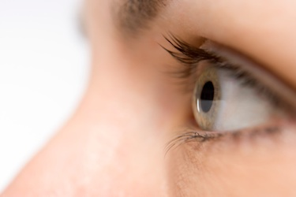
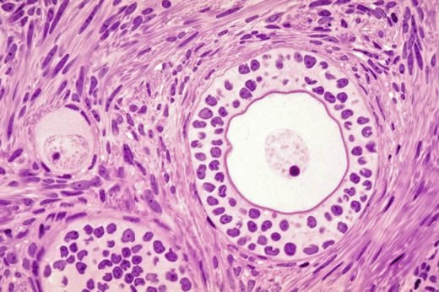
Microscope ray diagram
Total image magnification:
Eyepiece (ocular)
f_{e}
Eyepiece creates virtual, upright image at ∞
Recall Lect. 20
L
Object just past objective focal pt. creates real, inverted image at eyepiece focal pt.
f_{o}
f_{o}
Objective
Sample

Slide 11
ACT: Microscope eyepiece
The magnification written on a microscope eyepiece assumes the user has “normal” adult vision
10× means M_{e} = 10
Magnification
In normal vision d_{near} = 25 cm
What is the focal length of a 10× eyepiece?
f_{e} = 2.5 cm
f_{e} = 10 cm
f_{e} = 25 cm

Slide 12
ACT: Microscope objective
A standard biological microscope has a 160 mm tube length and is equipped with a 40× objective
Tube length
40× means m_{o} = –40
Magnification
What is the focal length of the objective?
f_{o} = 4 mm
f_{o} = 8 mm
f_{o} = 16 mm

Slide 13
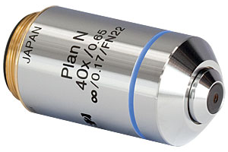
Modern microscope objectives
Most modern objectives are “infinity corrected”
“Finite” system
“Infinite” system
Eyepiece
Intermediate image
Extra “tube” lens creates intermediate image
Objective
Objective creates image at ∞; rays are ||
Infinite system allows filters to be inserted in optical path without affecting image

Slide 14
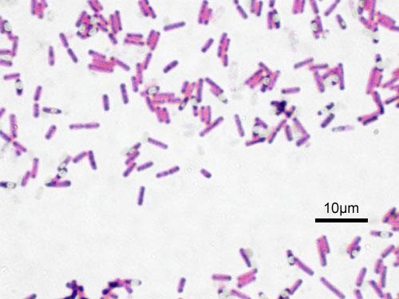
Calculation: Angular size
A microscope has a 10× eyepiece and a 60× objective. How much larger does the microscope image appear to our eyes?
At a near pt. of 25 cm, a 2-μm bacterium has angular size to an unaided eye of:
Bacillus subtilis
In the microscope the angular size is:
Equivalent to a 600 × 2 μm = 1.2 mm object at 25 cm
What limits the resolution of a light microscope?

Slide 15
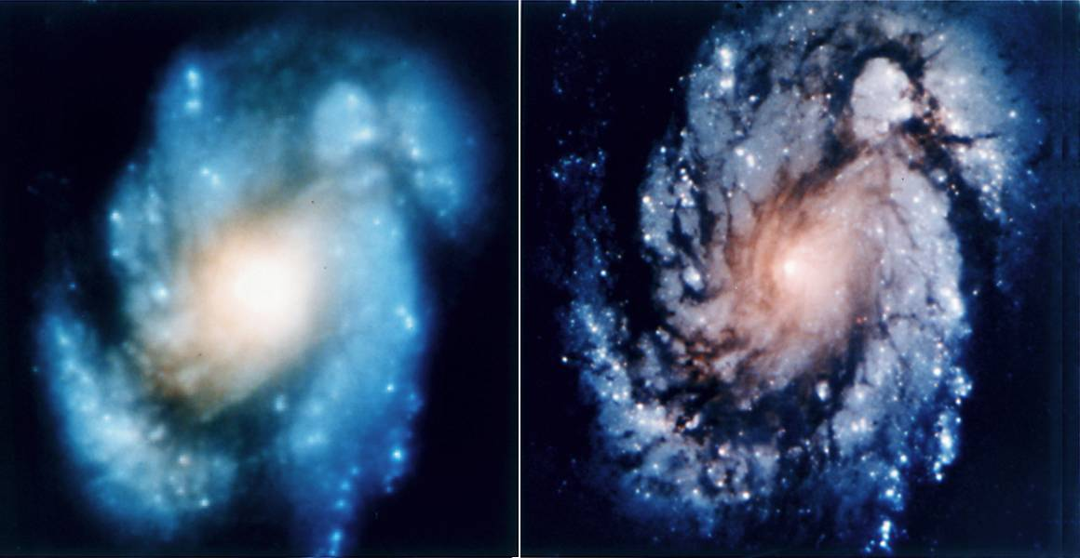
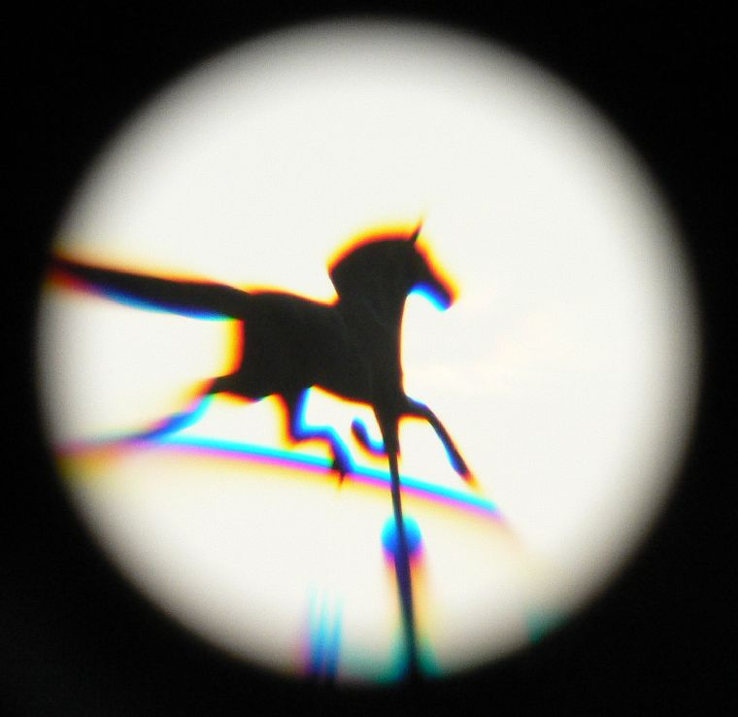
Aberrations
Aberrations are imperfections relative to ideal lens
Spherical: rays hitting lens at different points focus differently
Hubble space telescope
Chromatic: rays of different color focus differently
White light
Where do chromatic aberrations come from?
DEMO
Notes:
DEMO 516: spherical aberrations
DEMO 517: chromatic aberrations

Slide 16
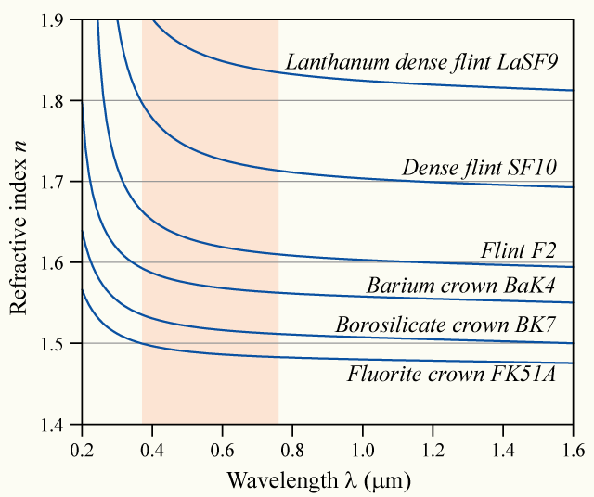
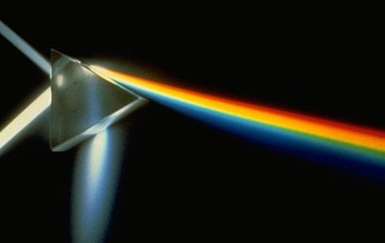
Dispersion
The index of refraction n depends on λ
In glass, n_{blue} > n_{green} > n_{red}
In prism, θ_{blue} < θ_{green} < θ_{red}
DEMO
θ_{red}
θ_{i}
θ_{green}
θ_{blue}
White light
Prism
Blue light gets deflected more
Notes:
DEMO 288: Prism dispersion

Slide 17
CheckPoint 2.1: Rainbows
Dispersion in water droplets create rainbows
θ_{i}
θ_{red}
Sunlight
θ_{blue}
θ_{green}
Blue light gets deflected more
In water, n_{blue} > n_{green} > n_{red}
Red rays from higher droplet, blue rays from lower droplet reach eye
See a rainbow with red on top, blue on the bottom
53%

Slide 18
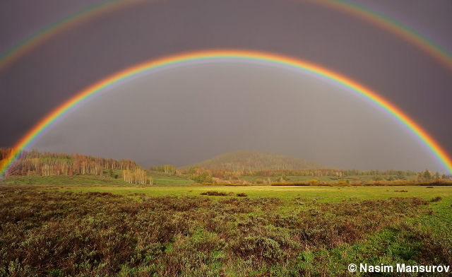
Double rainbow
LIKE SO!
Second rainbow created from second reflection inside droplet. Second reflection reverses pattern
Double rainbow

Slide 19
ACT: Dispersion
A diverging lens made of flint glass has n_{red} = 1.57, n_{blue} = 1.59. Parallel rays of white light are incident on the lens.
n_{blue} > n_{red}
Blue light gets deflected more
?
Which diagram best represents how light is transmitted?
A.
B.
C.
Notes:
High power/low dispersion converging + low power/high dispersion diverging lens can compensate for chromatic aberrations. Called an “achromatic doublet”

Slide 20
Ultimate limit of resolution
One can play clever tricks with combinations of lenses to compensate for spherical and chromatic aberrations
Ultimately, even with ideal lenses resolution of light microscope is limited to ~λ of light (~500 nm)
We won’t understand why using ray picture of light; we have to treat light as a wave again
Bacillus subtilis
Ray optics works for objects >> λ
Next two lectures!

Slide 21
Summary of today’s lecture
Combinations of lenses:
Image of first lens is object of second lens...
The compound microscope
Objective forms real image at focal pt. of eyepiece
Eyepiece forms virtual image at ∞
Limits to resolution
Spherical & chromatic aberrations
Dispersion
Diffraction limit – next week!
Watch signs!

