Slide 1
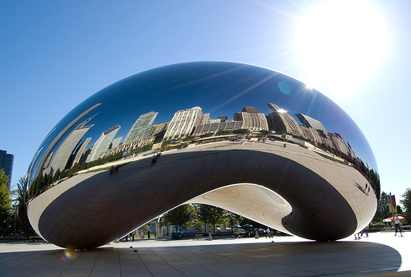
Phys 102 – Lecture 18
Spherical mirrors

Slide 2
Today we will...
Learn about spherical mirrors
Concave mirrors
Convex mirrors
Learn how spherical mirrors produce images
Ray diagrams – principal rays
Mirror & magnification equations

Slide 3
Curved mirrors
Spherical mirror – section of a sphere
“Concave” – inside surface of sphere
“Principal axis”
C
R
R
C
“Convex” – outside surface of sphere
Line through C and center of mirror
R
“Center of curvature”
“Principal axis”
C
How does light reflect off spherical mirrors?
C behind mirror

Slide 4
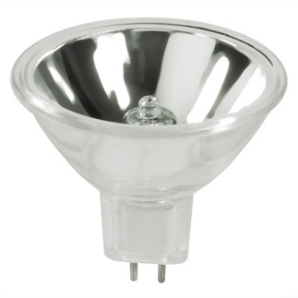
Concave mirror reflection
Concave mirror – rays || to p.a. reflect through focal point f in front of mirror
R
θ₂
θ₁
p.a.
C
f
“Focal length”
DEMO

Slide 5
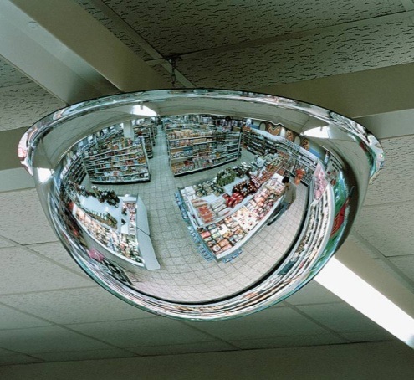
Convex mirror reflection
Convex mirror – rays || to p.a. reflect as if they originated from focal point f behind mirror
θ₂
θ₁
“Virtual rays”
R
p.a.
f
C
Since f is behind mirror, focal length < 0
DEMO

Slide 6
ACT: CheckPoint 1.1 & 1.2
What kind of mirror can be used to start a fire?
A. Concave
B. Convex
C. Plane
How far from the object to be ignited should the mirror be held?
A. farther than the focal length
B. closer than the focal length
C. at the focal length

Slide 7
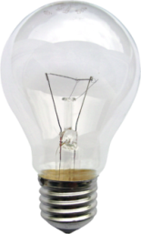
Lighting a match
DEMO
Rays traveling through focus before hitting mirror are reflected parallel to Principal Axis.
Rays traveling parallel to Principal Axis before hitting mirror are reflected through focus

Slide 8
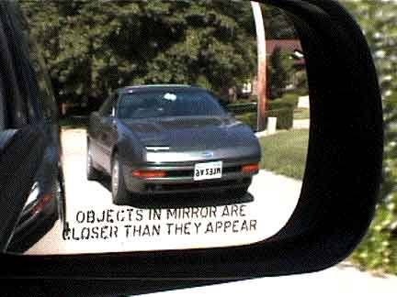
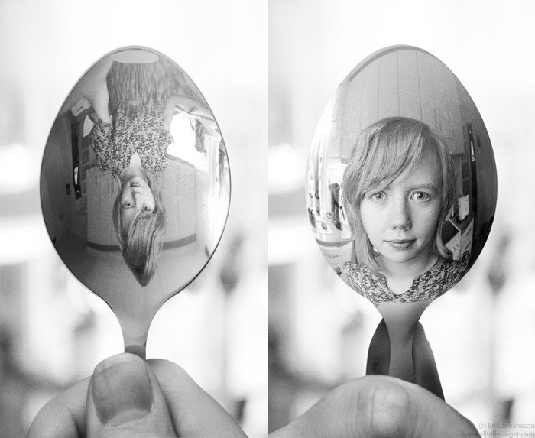
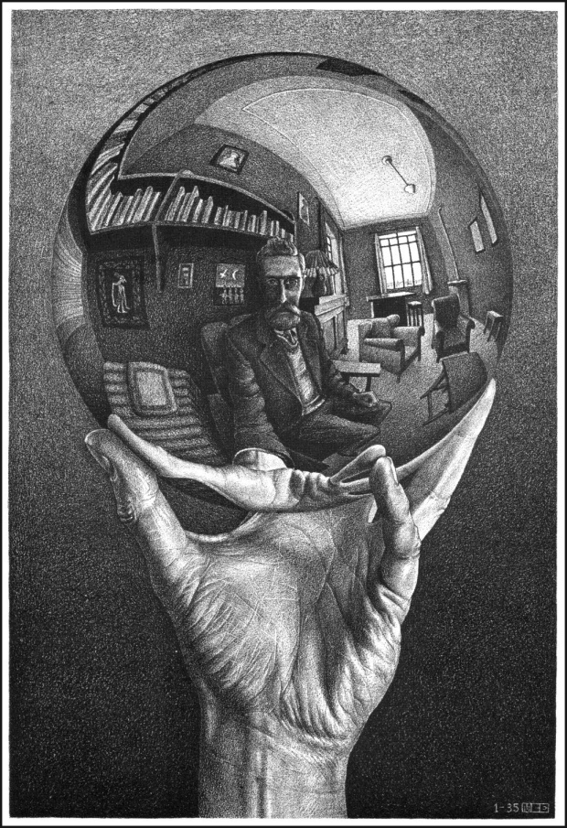
Images & spherical mirrors
Like plane mirrors, spherical mirrors produce images of objects
Key approaches:
Ray diagrams
Mirror & magnification equations

Slide 9
Principal rays – concave mirror
Ray from object traveling:
parallel to principal axis, reflects through f
through f, reflects parallel to principal axis
through C, reflects through C
3
Object
2
C
f
Image
1
Image is:
Real (light rays cross)
Inverted (opposite direction as object)
Reduced (smaller than object)

Slide 10
Principal rays – convex mirror
Ray from object traveling:
parallel to principal axis, reflects through f
through f, reflects parallel to principal axis
through C, reflects through C
1
3
Image
2
Object
f
C
Image is:
Virtual (light rays don’t really cross)
Upright (same direction as object)
Reduced (smaller than object)

Slide 11
ACT: Image formation
The diagram below shows the object and image, and one ray from the object
1
2
3
Which arrow most accurately represents how the ray is reflected?
1
2
3

Slide 12
ACT: CheckPoint 2.1
In the ray diagram below, which ray is NOT correct?
p.a.
1
C
f
1
2
3
2
3

Slide 13
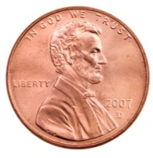
Optical illusion
Two identical concave mirrors
Each mirror is positioned at the focal point of the other
Image
f
Object
DEMO

Slide 14
Mirror & magnification equations
Mirror equation
Magnification
Object
C
f
Image
So,

Slide 15
Distance & magnification conventions
Object
h_{o}
Image
h_{i}
f
C
d_{o}
d_{i}
d_{o} = distance object is from mirror:
> 0: object in front of mirror
< 0: object behind mirror
h_{o} = height of object:
> 0: always
d_{i} = distance image is from mirror:
> 0: real image (in front of mirror)
< 0: virtual image (behind mirror)
h_{i} = height of image:
> 0: image is upright
< 0: image is inverted
f = focal length mirror:
> 0: concave mirror +R/2
< 0: convex mirror –R/2
|m| = magnification:
< 1: image is reduced
> 1: image is enlarged

Slide 16
Calculation: concave mirror
A 6-cm tall candle is placed 24 cm in front of a concave mirror with a focal length f = +8 cm. Determine the image location, size, and whether it is upright or inverted
p.a.
C
f
4 cm
4 cm
Diagram should agree!

Slide 17
ACT: Plane mirror
Concave mirrors have f > 0 and convex mirrors have f < 0
Object
What is the focal length f of a plane mirror?
f = 0
f = ∞
f is imaginary

Slide 18
Checkpoint 3.1
The image produced by a concave mirror of a real object is:
Always Real
Always Virtual
Sometimes Real, Sometimes Virtual

Slide 19
ACT: Concave Mirror
Where in front of a concave mirror should you place an object so that the image is virtual?
Closer than the focal length
Farther than the focal length
Either close or far
Not Possible

Slide 20
3 cases for concave mirrors
Object is:
Image is:
Inside f:
d_{o} < f
Upright: h_{i} > 0
Enlarged: m > 1
Virtual: d_{i} < 0
Object
C
f
Image
Between C & f:
f < d_{o} < R
Inverted: h_{i} < 0
Enlarged: m > 1
Real: d_{i} > 0
Object
Image
C
f
Object
Past C:
R < d_{o}
Inverted: h_{i} < 0
Reduced: m < 1
Real: d_{i} > 0
Image
C
f
DEMO

Slide 21
Calculation: convex mirror
A 6-cm tall candle is placed 12 cm in front of a convex mirror with a focal length f = –6 cm. Determine the image location, size, and whether it is upright or inverted
p.a.
f
C
4 cm
4 cm
Diagram should agree!

Slide 22
Checkpoint 3.2
The image produced by a convex mirror of a real object is
always real
always virtual
sometimes real and sometimes virtual

Slide 23
ACT: Convex mirror image
An object placed in front of a convex mirror will ________ produce an upright image
Image?
Object
f
C
Always
Sometimes
Never

Slide 24
Summary of today’s lecture
Curved mirrors
Principal rays – method for images
Parallel to p.a. –> reflects through f
Through f -> reflects parallel to p.a.
Through C -> reflects back through C
Mirror & magnification equations
Numerical answer consistent with ray diagram

