Slide 1

Phys 102 – Lecture 17
Introduction to ray optics

Slide 2
Physics 102 lectures on light
Light as a wave
Lecture 15 – EM waves
Lecture 16 – Polarization
Lecture 22 & 23 – Interference & diffraction
Light as a ray
Lecture 17 – Introduction to ray optics
Lecture 18 – Spherical mirrors
Lecture 19 – Refraction & lenses
Lecture 20 & 21 – Your eye & optical instruments
Light as a particle
Lecture 24 & 25 – Quantum mechanics

Slide 3
Today we will...
Introduce several key concepts
  Huygens’ principle
  Ray model of light
Learn about interaction of light with matter
  Law of reflection – how light bounces
  Snell’s law of refraction – how light bends
Learn applications
  How we see objects
  How we see images from reflection & refraction

Slide 4
Recall wavefronts
Wavefronts represent surfaces at crests of EM wave, ⊥ to direction of propagation
z
c
E
y
B
x
λ

Slide 5
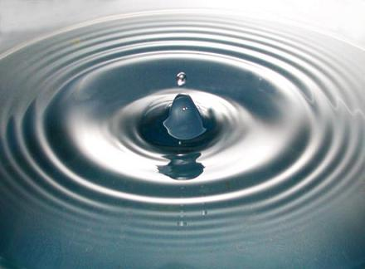
Huygens’ Principle
Every point on a wavefront acts as a source of tiny spherical “wavelets” that spread outward
“wavelet”
Planar wavefronts
Spherical wavefronts
Light represented as “rays” along direction of propagation
The shape of the wavefront at a later time is tangent to all the wavelets

Slide 6
Light rays
Rays represent direction of propagation of EM wave
Rays travel in a straight line inside transparent medium until they interact with different material
Three ways light rays interact with matter:
Absorption
Object
Reflection
Refraction
Usually, a bit of all three
This model of light works remarkably well for objects >> wavelength

Slide 7
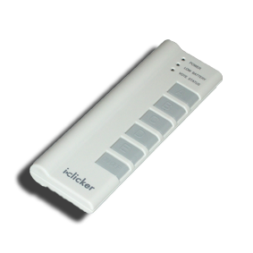
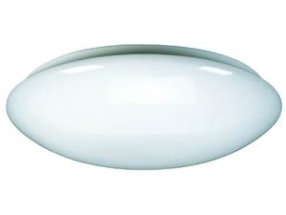
ACT: rays & shadows
A room is lit by an overhead, circular light fixture. A small opaque disk is placed in front of the light, as shown below.
1
2
At which position(s) does the disk cast a shadow on the floor that is completely dark?
A. 1 B. 2 C. Both D. Neither

Slide 8
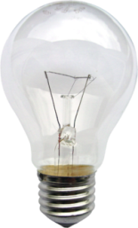
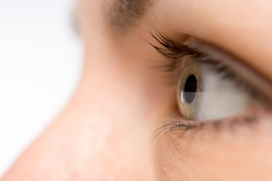

Seeing objects
How do we see objects?
We only see objects if light rays enter our eyes
We know object’s location by where rays come from
Rays from bulb reflect off plant and go in all directions. Some rays enter the eyes.
What if object does not emit light?
What about color?
Color results from some wavelengths of light being absorbed vs. others being reflected

Slide 9
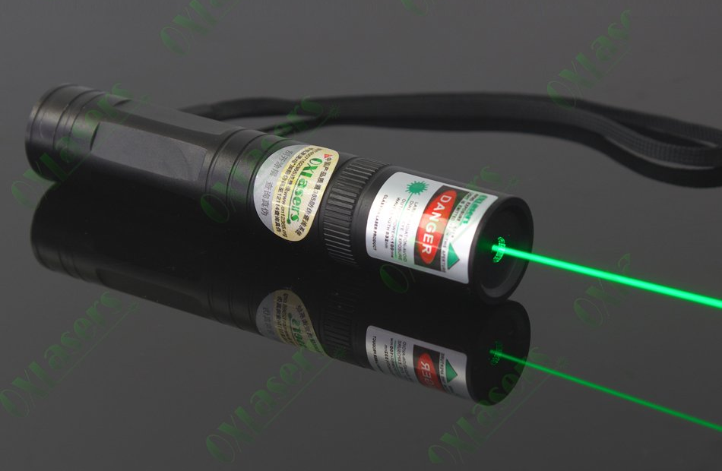
ACT: laser pointer
Should you be able to see the light from the laser pointer in the picture below?
Yes
No

Slide 10
Law of reflection
When light travels into a different material (ex: metal) it reflects
Incident wave
Reflected wave
θ_{i}
θ_{r}
E field oscillates surface charges. Charges act like antenna and emit EM wave
Angle of incidence = Angle of reflection
DEMO

Slide 11
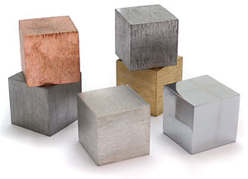
ACT: Materials
Why do you think metals are “shiny”, i.e. good at reflecting light?
Because:
  Electrons are free to move in metals
  Metals can be polished better than insulators
  The E field is zero inside conductors

Slide 12
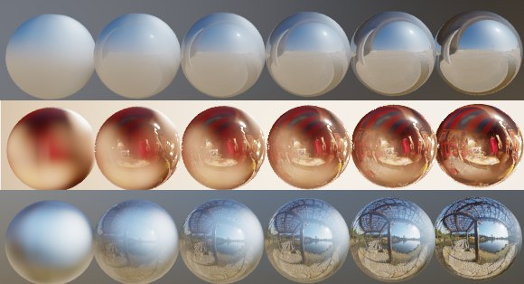
Specular & diffuse reflection
Specular reflection – reflection from a smooth surface
Diffuse reflection – reflection from a rough, irregular surface
θ_{i}
θ_{r}
θ_{i}
θ_{r}
Ex: plane mirror
Ex: rough surface
Specular
Mixed
Diffuse

Slide 13
Reflection & images
How do we see reflected images in a flat mirrors?
Rays from object reflect off of mirror according to law of reflection. Some reach the eyes.
θ_{i}
θ_{r}
All rays originating from point on object appear to come from point behind mirror!
Image is:
Virtual – no light behind mirror
Upright
Same size
Left & right are reversed!
Object
Image
“Ray diagram”

Slide 14

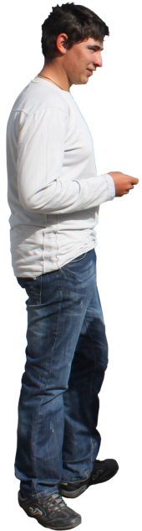
CheckPoints 1 & 2
Why is the word “AMBULANCE” written backwards on the front hood of all ambulances?
Can the man see the top of the plant in the mirror?

Slide 15

Calculation: Plane Mirror
A man is looking at himself in a mirror on the wall. His eyes are a distance h = 1.6 m from the floor.
At what maximum height above the floor must the bottom of the mirror be to see his shoes?
θ_{i}
θ_{r}
h
h/2

Slide 16
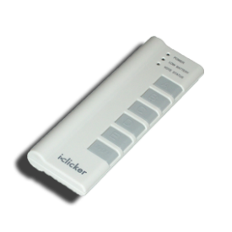

ACT: Plane mirror
The man is standing in front of a short flat mirror that is placed too high, so he can only see down to his knees
To see his shoes, he must move:
  closer to the mirror
  further from the mirror
  moving closer or further will not help

Slide 17
ACT: Two mirrors
An object is placed in front of two perpendicular plane mirrors
How many images will there be (not including the actual object)?
  1
  2
  3
  4

Slide 18
Index of refraction
When light travels in a transparent material (ex: a dielectric like glass) its speed is slower
c = 3×10⁸ m/s
v < c
Vacuum
Glass
EM wave must oscillate at same frequency, so wavelength and speed decrease:
Speed of light in vacuum
Material
n (λ = 590 nm)
Vacuum 1 (exactly)
Air 1.000293
Pure water 1.333
Oil 1.46
Glass 1.5-1.65
Diamond 2.419
Speed of light in material
Refractive index

Slide 19
Snell’s law of refraction
Light bends when traveling into material with different n
Incident wave
Reflected wave
λ₁
θ₁
θ₁
θ_{r}
h
λ₁
λ₂
θ₂
n₁
n₂ > n₁
λ₂ < λ₁
Refracted wave
θ₂

Slide 20
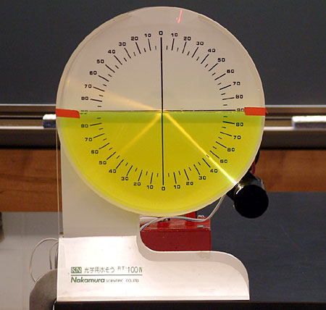
Calculation: Snell’s law
A ray of light traveling through the water (n = 1.33) is incident on air (n = 1.0). Part of the beam is reflected at an angle θ_{r} = 45°. The other part of the beam is refracted. What is θ₂?
Reflection
Refraction
refracted
θ₂
n₂
n₁ > n₂
θ_{r}
θ₁
reflected
incident

Slide 21
ACT: CheckPoint 3
A ray of light travels through two transparent materials as shown below.
θ₁
n₁
θ₂
n₂
Compare the index of refraction of the two materials:
n₁ > n₂
n₁ = n₂
n₁ < n₂

Slide 22

Calculation: refraction & images
A ball is placed at the bottom of a bucket of water at a depth of d_{true}. Where does its image appear to an observer outside the water?
θ₁
n₁ = 1
x
n₂ = 1.33
d_{app}
Note: Angles are exaggerated
θ₂
d_{true}
“Apparent depth” d_{app} < d_{true}
For small angles:
DEMO

Slide 23
Summary of today’s lecture
Ray model of light
  We see objects if emitted or reflected light rays enter our eyes
Light rays can be absorbed, reflected & refracted
  Law of reflection
  Snell’s law of refraction
Images from reflection & refraction
  We see images from where light rays appear to originate

