Slide 1
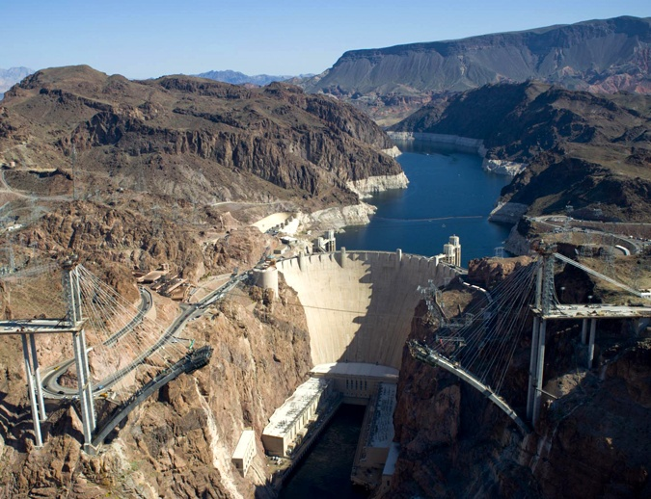
Phys 102 – Lecture 14
Faraday’s law of induction

Slide 2
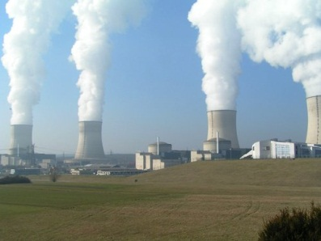
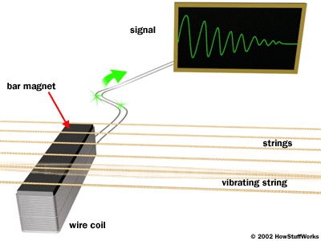
Today we will...
Continue our discussion of electromagnetic induction unifying electricity & magnetism
Last time: Lenz’ law for EMF direction
Today: Faraday’s law for EMF magnitude
Apply these concepts
Lenz’ & Faraday’s law are basis for electrical generators & transformers, and much more
Power plant
Credit card reader
Guitar pickup

Slide 3
Faraday’s law of induction
Change in flux Φ through a loop induces an EMF ε
Induced EMF ε
Rate of change of flux Φ
Magnitude
Induced EMF ε = rate of change of flux Φ
Direction
Lenz’ law: EMF ε opposes change in flux Φ

Slide 4
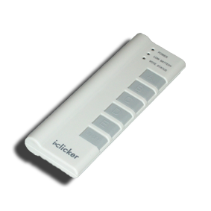
ACT: moving loops
Three loops are moving at the same speed v in a region containing a uniform B field. The field is zero everywhere outside.
B_{ext}
v
A
B
v
v
C
In which loop is |ε| greatest at the instant shown?
Loop A B. Loop B C. Loop C

Slide 5
Faraday’s Law of Induction
“Induced EMF” = rate of change of magnetic flux
Since , 3 things can change Φ
Area of loop covered by flux
Magnetic field B
Angle φ between normal and B
Notes:
http://demo.physics.uiuc.edu/LectDemo/scripts/demo_descript.idc?DemoID=1142 (Helmholtz & credit card)
http://demo.physics.uiuc.edu/LectDemo/scripts/demo_descript.idc?DemoID=371 (Helmholtz & magnet)

Slide 6
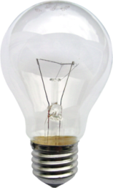
Calculation: changing area
A bar slides with speed v on a conducting track in a uniform B field
B_{ext}
v
L
x
What is the magnitude of the EMF induced in the circuit?
and only x is changing
Notes:
http://demo.physics.uiuc.edu/LectDemo/scripts/demo_descript.idc?DemoID=1329

Slide 7
Moving loops revisited
Three loops are moving at the same speed v in a region containing a uniform B field. The field is zero everywhere outside.
w
B_{ext}
v
A
B
v
v
L
C

Slide 8
ACT: Moving loop
A loop moves through a region with a uniform B field at a constant speed v. The field is zero outside.
v
Which diagram best represents the EMF ε in the loop vs. time?
B. C.
ε
ε
ε
t
t
t

Slide 9
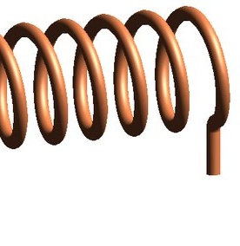
Calculation: solenoid cannon
A loop of radius r_{loop} = 11 cm is placed around a long solenoid. The solenoid has a radius r_{sol} = 4.8 cm and n = 10,000 turns/m of wire. The current I through solenoid increases at a rate of 1.5 A/s.
EXAM 2, FA13
What is the EMF |ε| in the loop?
B_{sol}
B_{sol}
r_{sol}
B field is changing, area is constant
I
r_{loop}
Side view
Top view

Slide 10
ACT: time-varying B field
A circular loop is placed in a uniform B field that varies in time according to the plot on the right.
B(t) (T)
From EX2, SP11
+1.0
+0.5
0
t (sec)
0
5
10
15
20
-0.5
-1.0
At which time is the EMF magnitude |ε| in the loop largest?
t = 5 s
t = 12 s
t = 20 s

Slide 11
Changing φ
EMF can be induced by changing angle φ between loop normal and B field
φ
normal
B
Rotating loop: Angle φ increases at a rate ω (in rad/s)
Φ
AB
t
–AB
φ = 30° (CheckPoint 1.1)
Notes:
DEMO 109

Slide 12
Calculation: EMF from changing φ
What is the EMF induced by changing angle φ between loop normal and B field?
Φ
AB
t
ΔΦ/Δt represents rate of change or slope of Φ vs. t at that particular time
–AB
ε
ε_{max}
EMF is a sine wave!
t
–ε_{max}
φ = 30° (CheckPoint 1.2-1.3)

Slide 13
ACT: Rotating loop
The loop below rotates in a uniform B field. Which of the following factors can increase the EMF in the loop?
normal
B
DEMO
Increasing the rotation rate ω
Wrapping more turns of wire around the loop
Increasing the B field
All of the above
Notes:
http://demo.physics.uiuc.edu/LectDemo/scripts/demo_descript.idc?DemoID=109

Slide 14
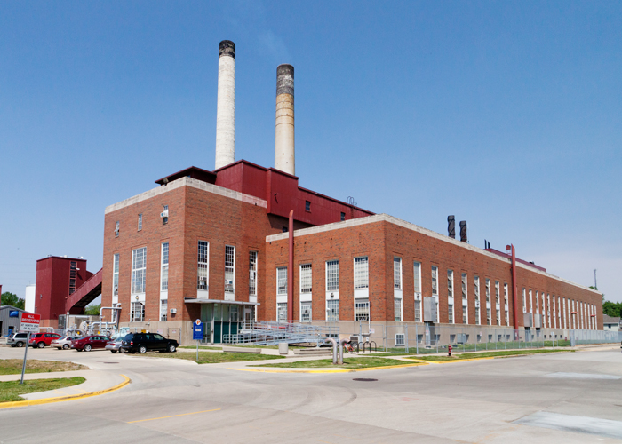
Application: generators
Electrical generators use external energy source (gas, steam, water, wind, nuclear, etc) to spin loop in B field
U of I coal power plant
Why electrical current from outlets is alternating current (AC)
In US, current oscillates at a frequency of 60 Hz (cycles/s)

Slide 15
Calculation: CheckPoint 2
A generator produces 1.2 Giga Watts of power, which it transmits to a town through power lines with total resistance 0.01 Ω.
How much power is lost in the lines if it is transmitted at 120 V?
P_{lost} = ?
I
R = 0.01 Ω
Power delivered by generator through lines:
ε_{gen} = 120 V
P_{gen} = 1.2 GW
Power lost in lines:
Notes:
Try this example for motivating power lines. Resistivity=10^-8 Ohm Meters. 1 inch square copper wire has about 0.1 ohm resistance in 7 km.

Slide 16
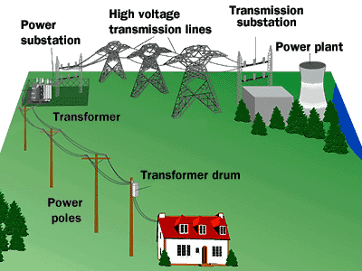
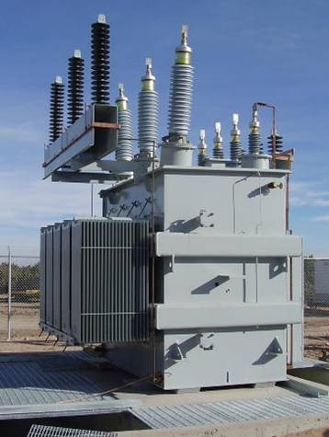
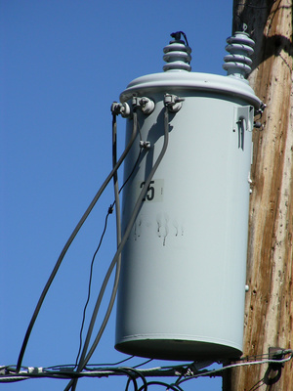
Electrical power distribution
Transformers make it possible to distribute electrical power at high voltage and “step-down” to low voltage at your house.
500,000 V
Low current
240 / 120 V
High current
Notes:
http://demo.physics.uiuc.edu/LectDemo/scripts/demo_descript.idc?DemoID=407 (power line model)

Slide 17
Transformers
Transformers are made of two coils wound around a common iron core
Key to modern electrical system
Transform between high and low voltages
Very efficient
Notes:
http://demo.physics.uiuc.edu/LectDemo/scripts/demo_descript.idc?DemoID=255 (transformer)

Slide 18
Principles of transformers
Transformers work by Faraday’s law. Changing current in “primary” creates changing flux in primary and “secondary”
“Step-up” transformer: N_{s} > N_{p}
“Primary” coil
with N_{p} turns
“Secondary” coil
with N_{s} turns
Energy is conserved
Core ensures B field of primary passes through secondary

Slide 19
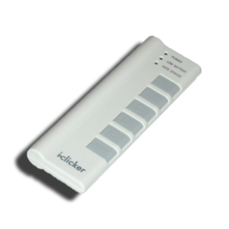
ACT: CheckPoint 3.1
You are going on a trip to France where the outlets are 240 V. You remember from PHYS 102 that you need a transformer, so you wrap 100 turns of a primary.
How many turns should you wrap around the secondary to get 120 V out to run your hair dryer?
A. 50 B. 100 C. 200

Slide 20
ACT: Transformers
A 12 V battery is connected to a transformer that has a 100 turn primary coil and 200 turn secondary coil.
+
12 V
What is the voltage across the secondary after the battery has been connected for a long time?
A. V_{s} = 0 V B. V_{s} = 6 V C. V_{s} = 12 V D. V_{s} = 24 V

Slide 21
Summary of today’s lecture
Faraday’s law: “Induced EMF” = rate of change of magnetic flux
Since , 3 things can change Φ
Area of loop
Magnetic field B
Angle φ
B(t)
v
+1.0
ω
n
+0.5
B
0
t
0
10
20
-0.5
-1.0

