Slide 1
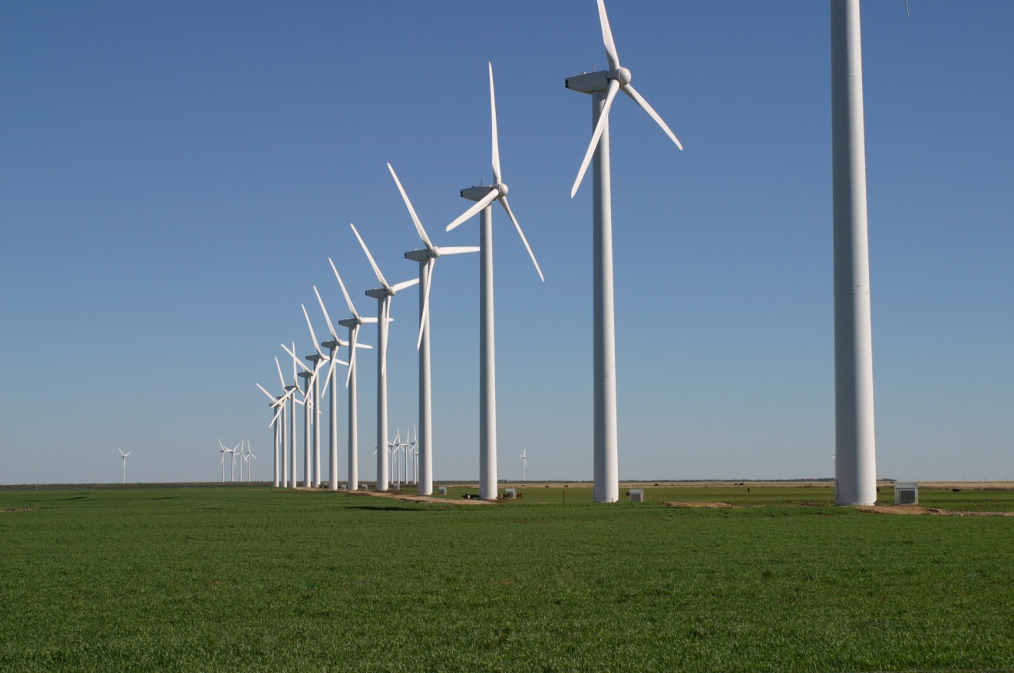
Phys 102 – Lecture 13
Motional EMF & Lenz’ law

Slide 2
Physics 102 recently
Basic principles of magnetism
Lecture 10 – magnetic fields & forces
Lecture 11 – magnetic dipoles & current loops
Lecture 12 – currents & magnetic fields
Connection between electricity & magnetism
Lecture 13 – motional EMF & Lenz’ law
Lecture 14 – Faraday’s law of induction
Lecture 15 – electromagnetic waves

Slide 3
Today we will...
Learn how electric fields are created from...
Motion in magnetic fields (“motional EMF”)
Changing magnetic fields
Learn Lenz’ law: principle unifying electricity and magnetism
Apply these concepts:
Magnetoreception
Electrical generators & hybrid cars

Slide 4
CheckPoint 1: Moving bar
A conducting bar moves in a uniform external B field at speed v
B_{ext}
–
v
–
–
–
Magnetic force pushes – electrons to top, leaves + charge at bottom of bar
Separated + and – charge induces E field & ΔV
At equilibrium, forces must sum to zero
Moving bar acts like a battery! Motional EMF

Slide 5
Magnetoreception in sharks
Sharks can sense changes in magnetic fields
Ampullae of Lorenzini
Shark do not have magnetic organelles like magnetotactic bacteria, but they do have “ampullae of Lorenzini”, which sense E field
Model of magnetoreception in sharks: motional EMF from moving in B field generates E field detected by ampullae

Slide 6
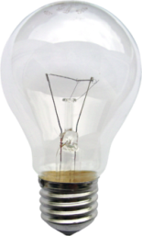
Motional EMF
Bar slides with speed v on a conducting track in a uniform B field
I
B_{ext}
+
+
+
v
I
I
L
+
R_{bulb}
+
+
I
Can moving bar drive current around the circuit?
+ charges in moving bar experience force down
Electrical current induced clockwise!
(Recall that e– actually move, opposite current)
Notes:
DEMO: 1329

Slide 7
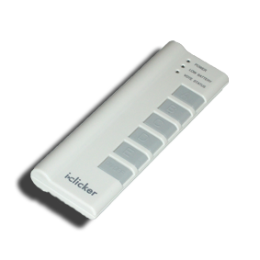
ACT: CheckPoint 2.1
The conducting bar moves to the right in the opposite B field
B_{ext}
v
Which way does the current flow?
Clockwise
Counterclockwise
The current is zero

Slide 8
ACT: Two metal bars
Circuit now has two metal bars moving right at the same speed v
B_{ext}
v
v
Which way does the current flow?
Clockwise
Counterclockwise
The current is zero

Slide 9
Motional EMF and force
Where does the energy come from to generate electricity?
B_{ext}
I
v
L
F_{bar}
B_{ext}
Moving bar carries current, so B field exerts a force F_{bar}
Note: F_{bar} is NOT F_{B} which drives current around loop
F_{bar} opposes v, so bar decelerates
To maintain constant v, you must provide external force F_{ext} opposing F_{bar}
F_{ext} does the work to generate electrical energy

Slide 10
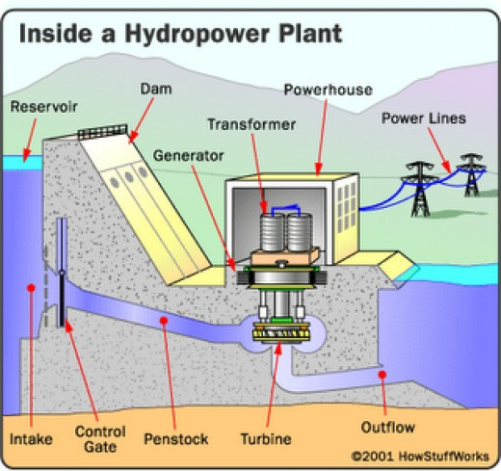
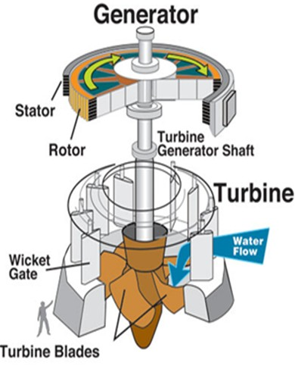
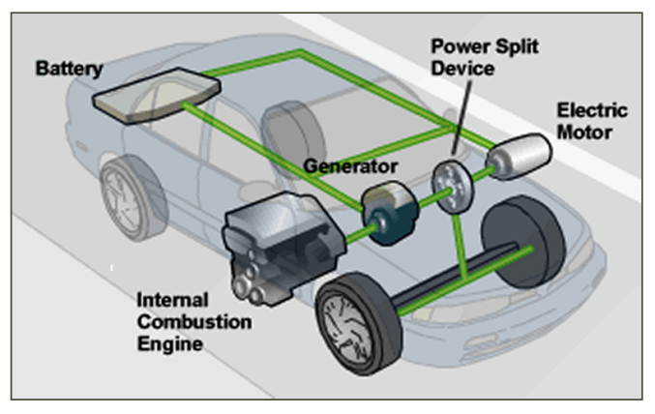
Electrical generators
Motional EMF is the basis for modern electrical generation
Instead of sliding bar, use spinning loop in B field
External torque (from turbine, gas engine, hand crank) spins loop
DEMO

Slide 11
ACT: CheckPoint 2.2
The B field is now reversed and points into the page.
B_{ext}
v
To keep the bar moving at the same speed, the hand must supply:
A force to the right
A force to the left
No force, the bar slides by inertia

Slide 12
Changing B field
Now loop is fixed, but B field changes
B_{ext}
If B_{ext} increases, current I flows clockwise
If B_{ext} decreases, current I flows counterclockwise
If B_{ext} is constant, no current flows
What is changing here and in previous cases? Magnetic flux Φ!

Slide 13
Magnetic flux
Flux “counts” number of B field lines passing through a loop
Angle between normal vector and B field
Unit: Wb (“Weber”)
1 Wb = 1 T∙m²
B field in loop
Area inside loop filled with B field
Angle φ affects how many B field lines pass through loop
B
B
φ
normal
normal
Top view
Side view
Notes:
DEMO: 1350 (hula hoop flux)

Slide 14
CheckPoint 3.1
Compare the flux through loops a and b
normal
normal
B
a
b
A. Φ_{a} > Φ_{b} B. Φ_{a} < Φ_{b} C. Φ_{a} = Φ_{b}

Slide 15
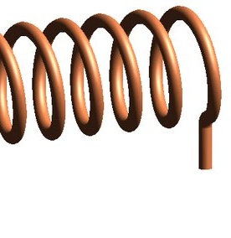
Magnetic flux practice
A solenoid generating a B field is placed inside a conducting loop. What happens to the flux Φ through the loop when...
B_{sol}
B_{sol}
Loop
Loop
I
Top view
Side view
The area of the solenoid increases?
The current in the solenoid increases?
The area of the loop increases?

Slide 16
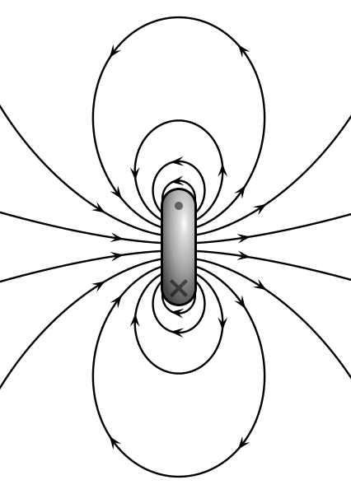
Lenz’s law
Induced EMF ε opposes change in flux Φ
B_{ext}
If Φ increases:
ε generates new B field opposite external B field
If Φ decreases:
ε generates new B field along external B field
If Φ is constant:
ε is zero
B_{ind}
Side view
B_{ext}
B_{ind}
One principle explains all the previous examples!
Top view
Notes:
DEMO: 543 – light bulb with induction magnet
DEMO: 371 – Helmholtz coil & magnet
DEMO: 1142 – credit card demo

Slide 17
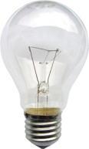
Lenz’s law: changing loop area
ε opposes change in flux Φ
EX 1
I
B_{ind}
v
A & Φ increases
ε generates B_{ind} opposite B_{ext}
EX 2
I
B_{ext}
B_{ind}
v
A & Φ decreases
ε generates B_{ind} along B_{ext}
Same answers as before!
EX 3
v
v
A & Φ remains constant
ε is zero

Slide 18
ACT: Lenz’ law: changing B field
A loop is placed in a uniform, increasing B field
B_{ext}
In which direction does the induced B field from the loop point?
Into the page
Out of the page
There is no induced B field

Slide 19
ACT: moving loops
Three loops are moving in a region containing a uniform B field. The field is zero everywhere outside.
A
B
C
In which loop does current flow counterclockwise at the instant shown?
Loop A B. Loop B C. Loop C
ε opposes change in flux Φ

Slide 20
ACT: Solenoid & loop
A solenoid is driven by an increasing current. A loop of wire is placed around it. In which direction does current in the loop flow?
B_{sol}
B_{sol}
Clockwise
Counterclockwise
The current is zero
I
Top view
Side view

Slide 21
Induction cannon
A solenoid is driven by an increasing current. A loop of wire is placed around it.
Current loop and solenoid behave like magnetic dipoles
Opposite currents = opposite polarities
Like poles repel, so loop shoots up!
Recall Lect. 11
I
B_{sol}
DEMO
Notes:
DEMO: 157

Slide 22
Summary of today’s lecture
Electric fields are created from
Motion in magnetic fields (“motional EMF”)
Changing magnetic fields
Lenz’ Law: EMF ε opposes change in flux Φ
ε does NOT oppose Φ
ε opposes change in Φ
Lenz’ law gives direction of EMF
Faraday’s law gives us magnitude of EMF (next lecture!)

