Slide 1
Lecture 5: Bitcoin Network
P2P gossip

Slide 2
What are our requirements
No centralized server(Single point of failure, censorship)
Main usage: Broadcast blocks and transactions to all nodes
Robust if some nodes are offline

Slide 3
Types of Network Architecture
Peer to Peer
Client server
Server
Clients
Server stores most of the data
Each node acts as a client and a server
ECE 598PV course website
BitTorrent, Napster

Slide 4
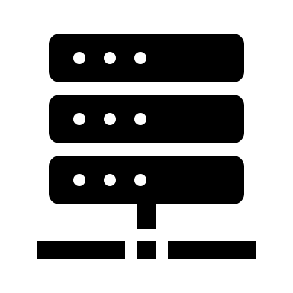
Overlay network
Virtual links
Virtual topology
Physical Network

Slide 5
Overlay Network- Structured
0
Example: CHORD
Assign a graph node identifier to each node
Well defined Peer routing rules
O(log N) routing
O(log N) connections per node
1
7
2
6
5
3
4

Slide 6
Overlay Network-Unstructured
Example: d-regular graph
No node graph identifier
Connect to any random d-nodes
O(log N) routing (difficult to route)
O(1) connections per node
O(log N) broadcast

Slide 7
Gossip - Flooding
Mimics the spread of an epidemic
Once a node is “infected”, it “infects” it’s peers
Information Spread exponentially and reaches nodes in O(log(N)) time

Slide 8
Expander graph
Very connected but sparse graph
Sparse graph G(V,E): |E| = O(|V|)
Expander graph: |$∂A\left| ≥ ε\right|A|$
| $∂A$| = number of vertices outside $A$ with at-least one neighbor in $A$.
A random d-regular(d $≥$3) graph for large |V| is an expander graph (w h p)*
Intuition for O(log N) broadcast

Slide 9
Bitcoin network
TCP connection with peers
At most 8 outbound TCP connections
May accept up to 117 inbound TCP connections
Maintains a large list of nodes(IP, port) on the bitcoin network
Establishes connection to a subset of the stored nodes

Slide 10
Peer discovery
DNS seed nodes (Hard coded in the codebase)
Easy to be compromised, do not trust one seed node exclusively
Hardcoded peers (fallback)
Ask connected peers for additional peers
Version
Get addr
Version
addr
Verack
Gathering additional peers
Addr: contains list of up to 1000 nodes
Verack
Connecting to a peer

Slide 11
Block transmission
Block is broadcasted to the network using gossip-flooding
Standard block relay protocol to gossip blocks
Relay after block validation
Inv(blockhash): inventory message containing blockhash
Block-First
Getdata asks for the same block as inv
Can download orphan blocks and keep it in memory
inv
Header-First
Getheaders asks for the same block as inv or a few parent headers (in case of orphan block)
Will not download orphan blocks if no header chain established
inv
getheaders
getdata
or
headers
block
getdata
block

Slide 12
Transaction broadcast
Transactions broadcasted using Gossip-flooding
Each node maintains a non-persistant memory to store unconfirmed tx (mempool)
inv(txid): Check if peer has a transaction with id: txid in mempool
inv
getdata
transaction
Some unconfirmed tx might be removed from mempool

Slide 13
Compact blocks
Block
Sendcmpct(0)
Legacy relaying sends transactions twice
Guess the mempool of the receiving node
Compact block has block header, txids, some full transactions
The receiving node sends getblktxn to receive missing transactions
Block
inv
inv
getdata
getdata
Cmpctblock
block
getblktxn
blktxn
Legacy relaying
Compact block relaying

Slide 14
Capacity/Delay
C = communication/processing capacity of the network (tx/s)
D = speed-of-light propogation delay
End to end delay(𝛅):
Propagation delay: D
Processing delay: B/C (where B is block size in tx)
Queuing delay
Delay increases with increase in block size

Slide 15
Effects of delay
Wasted hashpower
𝛅
Branching

Slide 16
Disadvantages of current p2p network
Not efficient (total communication is O(Nd))
Easy to deanonymize (due to symmetric flooding)
Plausible deniability for forking

Slide 17
Speeding up the network
Miner rely on a trusted fast relaying network
Falcon, FIBRE, FRN, etc
FRN(Fast relay network): Hub and spoke model, trusted servers, servers are fast
FRN servers
Miners
Notes:
Auditability?

Slide 18
Speeding up the network
Falcon network: cut through routing for servers, only verify headers before forwarding
Legacy routing
Cut through routing
b
a’
b
a
b
Latency
N(a+b)
Latency
Na’+b
Notes:
Why verify blocks?

Slide 19
Information Eclipse attack
Surrounds a node by adversarial peers

Slide 20
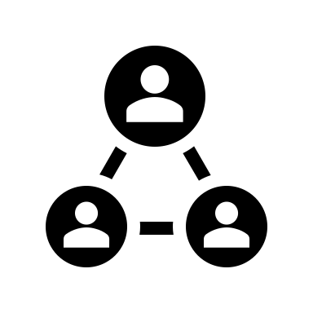
Information eclipse attack
Pay to merchant
Pay to self
30%
40%
30%
40%
0%
60%
Mining attack
Merchant
Double spend attack

Slide 21
Information Eclipse attack
Attack
Fill node’s peer tables with attacker ip
Node restarts and makes new outgoing connections
New connections made to only attacker’s ip
Exploits biases in outbound connection selection (bias towards recent timestamps)
Prevention
Heuristic and randomized selection and eviction from peer table

Slide 22
Thank you

