Slide 1
Lecture 4: Decentralized Cryptocurrency
Longest Chain Rule
Decentralized Identity, Ownership, Teansfer
Bitcoin’s backbone
Reference: Chapter 2, Princeton University Press book

Slide 2
Basic Cryptocurrency: ScroogeCoin
Coin: (coinID, signature of Scrooge)
Scrooge creates coins
Transaction: Transfer of coin ownership
Pay this to Alice
Transaction:
This: hash pointer to coin
Alice: publickey of Alice
Signed by owner of coin
Notes:
Start demo:
launch network, how many AWS EC2 nodes
Show dashboard
Discuss plots: throughput, latency, forking performance

Slide 3
Two types of transactions
Createcoins
can only be created by Scrooge
multiple coins created at the same time
each coin has a recipient (identified via public key)
Paycoins
consumed coins (list)
coins created (list)
Total wealth consumed = total wealth created
Signed by owner of coins
Notes:
Start demo:
launch network, how many AWS EC2 nodes
Show dashboard
Discuss plots: throughput, latency, forking performance

Slide 4
Transactions are put into a block
Data in the Block
consumed coins (list)
coins created (list)
Total wealth consumed = total wealth created
Hash pointer to previous block
Overall block signed by Scrooge
Notes:
Start demo:
launch network, how many AWS EC2 nodes
Show dashboard
Discuss plots: throughput, latency, forking performance

Slide 5
Transactions are organized into a Blockchain
1. Tamper evident information log
2. Append-only data structure
3. Head of the chain being known is enough to find tamper evidence in any internal block
otherwise you’d have to key track of all blocks signed by Scrooge
Append only Ledger
Blockchain of transactions
Signed by Scrooge
Notes:
Start demo:
launch network, how many AWS EC2 nodes
Show dashboard
Discuss plots: throughput, latency, forking performance

Slide 6
Centralization
Scrooge
new coins can only be created by Scrooge
every block has to be formed and signed by Scrooge
Main Property
security of ownership, transfer of coins.
tamper resistant to anyone other than Scrooge
tamper evident if Scrooge changes ownership
Drawback
Scrooge
Rent seeking behavior
Notes:
Start demo:
launch network, how many AWS EC2 nodes
Show dashboard
Discuss plots: throughput, latency, forking performance

Slide 7
Decentralization
Solution: Get rid of Scrooge
Questions
Who maintains the ledger of transactions?
Who verifies validity of transactions
Who creates new coins?
Ideal answer: everyone!
Notes:
Start demo:
launch network, how many AWS EC2 nodes
Show dashboard
Discuss plots: throughput, latency, forking performance

Slide 8
Distributed Consensus
Question: Who maintains the ledger of transactions?
Distributed Consensus
Interactive Protocol
Allows distributed non-trusting nodes to come to agreement
Traditional area of computer science (Byzantine Fault Tolerance)
Bitcoin’s consensus protocol is vastly different
decentralized identity (permissionless setting)
less pessimistic network assumptions
Notes:
Start demo:
launch network, how many AWS EC2 nodes
Show dashboard
Discuss plots: throughput, latency, forking performance

Slide 9
Decentralized Identity
Public keys are used as identity
Single entity can create vast number of identities
Sybil
Cannot do majority or super-majority voting
Notes:
Start demo:
launch network, how many AWS EC2 nodes
Show dashboard
Discuss plots: throughput, latency, forking performance

Slide 10
Network Assumption
Any node can broadcast to all nodes into the network
fully connected network
Every broadcast message reaches every node
albeit with some delay
Bitcoin: ten minutes
Notes:
Start demo:
launch network, how many AWS EC2 nodes
Show dashboard
Discuss plots: throughput, latency, forking performance

Slide 11
Scrooge is replaced by an Oracle
Time is organized into slots
Oracle selects one of the nodes (public identities)
random
everyone can verify the unique winner
The proposer replaces Scrooge in that slot
constitutes a block with transactions
validates transactions
includes hash pointer to previous block
signs the block
Notes:
Start demo:
launch network, how many AWS EC2 nodes
Show dashboard
Discuss plots: throughput, latency, forking performance

Slide 12
Elements of Bitcoin
Ownership and Transfer of Coins
Integrity maintained (no stealing of coins)
Tamper resistant to anyone other than the winner of that slot
Tamper evident if the winner changed the block later on
Resistant to Denial of Service
No transactions can be permanently eclipsed
Liveness
Notes:
Start demo:
launch network, how many AWS EC2 nodes
Show dashboard
Discuss plots: throughput, latency, forking performance

Slide 13
Double Spend Attack
Adversary can point its block to an older part of the chain
Duplicate transaction inserted
Plausible Deniability
network latency
an offline user will not know which block came earlier
blocks have no wall clock reference (time stamps).
Notes:
Figure to be drawn here of the double spend attack

Slide 14
Longest Chain Rule
Nakamoto protocol
followed by participants when its their turn to propose a block
attach block to tip of the longest chain in its’ block tree
Confirmation rule
wait until the transaction is buried k-deep in the longest chain
Notes:
Figure to be drawn here of the double spend attack

Slide 15
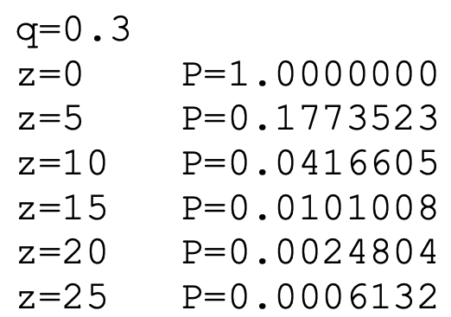
Bitcoin protocol
Satoshi’s Table
1 deep => .45
25 deep => 0.0006
Proposing
Voting
G
low mining rate
low mining rate
low throughput
low voting rate
$$k$$
-deep
high latency
Notes:
Private attack in terms of voters over time.

