Slide 1
An Overview of Byzantine Fault Tolerant Consensus
Ling Ren
ECE 598, April 16

Slide 2
So Far in the Course
A deep dive into Bitcoin and its variants
Nakamoto consensus (PoW and longest-chain-wins)
Today: non-Nakamoto consensus
Overview of 40 years of research
A latest protocol: Sync HotStuff
A quick comparison

Slide 3
Consensus
One of the most fundamental problems in distributed computing [Pease-Shostak-Lamport,1980]
Target application: replicated service
Provide an abstraction of a single non-faulty server
Safety (consistency): all nodes commit the same sequence of “values”
Liveness: keep committing new “values”

Slide 4
Many Faces of Consensus
How is the consensus problem defined?
Replication / Broadcast / Agreement / …
Is every pair of node connected?
Yes / No (static or dynamic?)
Is there a bound on message delay?
Synchrony (Yes) / Asynchrony (No) / Partial Synchrony (Sometimes)
What types of faults?
Crash / Byzantine / …
…

Slide 5
40 Years of Research
Pick a problem and a model
Design protocols with lower latency, less communication, higher fault tolerance
Prove impossibility and lower bounds
A myriad of results, complicated and subtle, sensitive to seemingly minor changes in model

Slide 6
Some Well-known Results
Fault tolerance bounds of Byzantine Agreement (BA) and Byzantine Broadcast (BB)
n nodes in total, f nodes are faulty
Synchrony
BB f < n [Dolev-Strong 1982] while BA f < n/2
Asynchrony
BB f = 0
BA deterministic f = 0 [Fischer-Lynch-Patterson, 1985]
BA randomized f < n/3 [Bracha, 1984]

Slide 7
Some Well-known Results
Fault tolerance bounds of replication
n nodes in total, f nodes are faulty
 | Synchrony | Partial synchrony
Crash | f < n | f < n / 2
Byzantine | f < n / 2 | f < n / 3
Primary-backup
Paxos
Today
PBFT/HotStuff
Deterministic asynchrony f = 0
Randomized asynchrony same

Slide 8
Sync HotStuff: Simple and Practical Synchronous State Machine Replication
Ittai Abraham Dahlia Malkhi Kartik Nayak Ling Ren Maofan Yin

Slide 9
Model
How is the consensus problem defined?
Replication / Broadcast / Agreement / …
Is every pair of node connected?
Yes / No (static or dynamic?)
Is there a bound on message delay?
Synchrony (Yes) ∆ / Asynchrony (No) / Partial Synchrony (Sometimes)
What types of faults?
Crash / Byzantine (n = 2f + 1) / …
Public key setup; all messages are signed

Slide 10
Sync HotStuff – Overview
Leader proposes x (signed)
Upon receiving the first proposal, each node forwards and votes for the proposal
Commit x if nothing “bad” happens within 2∆
Node 1
(leader)
n = 2f+1
Node 2
|← 2∆ →|
Node 3
|← 2∆ →|

Slide 11
Sync HotStuff – Overview
Propose, forward/vote, commit after 2∆
If leader does not misbehave (nothing bad happens), every honest node votes for the same value
We say f+1 (signed) votes form a certificate
Repeat
View (leader) change if the leader misbehaves
Alice pays Bob $10
Alice pays Dan $22
Dan pays Carol $50
……
Carol pays Bob $50
Dan pays Bob $30
……
……
Bob pays Alice $10
……
……
……
Cert
Cert
Cert

Slide 12
What Misbehavior or “Bad’’ Things?
Leader equivocation stops a commit
Both proposals are signed by the leader
Why 2∆
Node 1
(leader)
Node 2
|← 2∆ →|
Node 3
|← 2∆ →|

Slide 13
What Misbehavior or “Bad’’ Things?
Leader equivocation stops a commit
Both proposals are signed by the leader
Why 2∆
t
Node 2
|← 2∆ →|
t+∆

Slide 14
What Misbehavior or “Bad’’ Things?
Leader equivocation stops a commit
Leader equivocation also triggers a view change
Forward (signed) equivocating proposals to all
Proof of
misbehavior
t
Node 2
|← 2∆ →|
t+∆

Slide 15
What Misbehavior or “Bad’’ Things?
Leader equivocation stops a commit
Leader equivocation also triggers a view change
Lack of progress triggers a time-out (blame)
f+1 blames trigger a view change
View change on provable leader misbehavior
Forward proof of misbehavior and quit view
stop commit countdown
Wait for ∆ before entering new view
honest nodes won’t be split into two views

Slide 16
Sync HotStuff – So Far …
Propose, forward/vote, commit after 2∆
Lack of progress → send blame
Equivocation or f+1 blames → view change
Quit view, wait for ∆
Are we done? Can you find an attack?
, enter new view
Node 1
(leader)
Node 2
|← 2∆ →|
Node 3
|← 2∆ →|

Slide 17
Sync HotStuff – So Far …
In a view, a malicious leader makes one (and only one) honest node commit
shows
equivocating
proposal
Node 1
(leader)
Node 2
Node 3
|← 2∆ →|
Node 4
|← 2∆ →|
|← 2∆ →|
Node 5

Slide 18
Sync HotStuff – So Far …
In a view, a malicious leader makes one (and only one) honest node commit x
In the next view, propose y
Node 1
Node 2
(leader)
Node 3
Node 4
|← 2∆ →|
Node 5
|← 2∆ →|

Slide 19
Sync HotStuff – Commit-Lock
If one honest commits x, all lock x
Lock: will not vote differently (unless convinced to)
Upon entering a new view, lock on a value certified (f+1 votes) from the latest view
<vote, x, #view>_{signed}
Breaking ties arbitrarily
Will be unique if an honest commits x
t
Node 3
|← 2∆ →|
t+∆

Slide 20
Sync HotStuff – Commit-Lock
If one honest commits x, all lock x
Lock: will not vote differently (unless convinced to)
If no way to change mind, lock == commit
Deadlock when honest nodes lock different values
What convinces a node to change mind?
Another value certified in an equal or higher view
If one honest commits x, x will remain the unique highest certified value forever

Slide 21
Sync HotStuff – Commit-Lock
Possible scenario: adversary shows highest cert to a subset of (non-leader) nodes
Honest leader cannot make progress
Upon entering a view, nodes report their lock status to leader
Leader re-proposes highest certified

Slide 22
Sync HotStuff – Status Step
Propose, forward/vote, commit after 2∆
Lack of progress → send blame
Equivocation or f+1 blames → view change
Quit view, wait for ∆
Report lock status to new leader
Leader re-proposes highest certified
(This way, an honest leader always makes progress.)
Are we done? Can you find an attack?
, enter new view

Slide 23
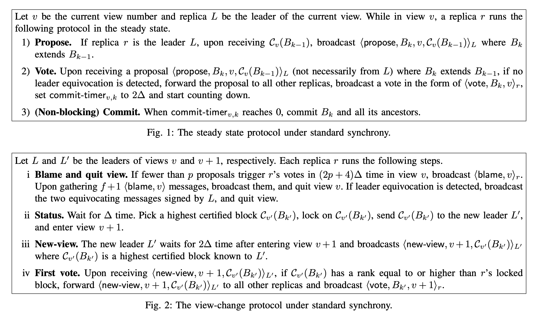
Sync HotStuff – Full Protocol

Slide 24
What’s New in Nakamoto
Same as before: replication, synchrony, Byzantine
What do nodes know about each other?
Public keys / identifying information
Nakamoto: nothing (hence permissionless)
What fraction of nodes are faulty?
Honest majority computation (hence PoW)
Protocol-wise: who can propose?
Protocol-wise: vote in parallel vs. sequentially

