Slide 1
Main Memory System
Nam Sung Kim
Dept. of Electrical and Computer Engineering
University of Illinois-Urbana Champaign
Acknowledgement: Many slides were adapted from Prof. Mutulu’s ECE740 Computer Architecture at CMU with his generous permission.

Slide 2
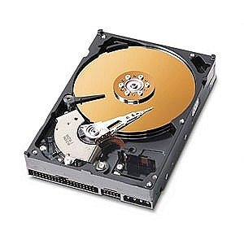
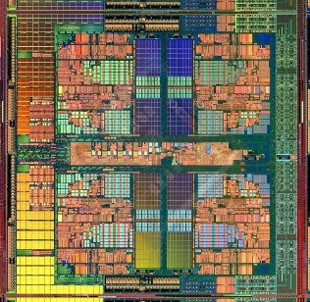
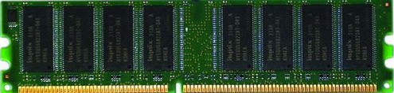
The Main Memory System
main memory is a critical component of all computing systems: server, mobile, embedded, desktop, sensor
main memory system must scale (in size, technology, efficiency, cost, and management algorithms) to maintain performance growth and technology scaling benefits
Processor
and caches
Main Memory
Storage (SSD/HDD)

Slide 3
State of the Main Memory System
recent technology, architecture, and application trends
  lead to new requirements
  exacerbate old requirements
DRAM and memory controllers, as we know them today, are (will be) unlikely to satisfy all requirements
some emerging non-volatile memory technologies (e.g., PCM) enable new opportunities: memory+storage merging
we need to rethink the main memory system
  to fix DRAM issues and enable emerging technologies
  to satisfy all requirements

Slide 4
Major Trends Affecting Main Memory (I)
need for main memory w/ high capacity and bandwidth
main memory energy/power is a key system design concern
DRAM technology scaling is ending

Slide 5
Major Trends Affecting Main Memory (II)
need for main memory w/ high capacity and bandwidth
  multi-core: increasing number of cores
  data-intensive applications: increasing demand/hunger for data
  consolidation: cloud computing
main memory energy/power is a key system design concern
DRAM technology scaling is ending

Slide 6
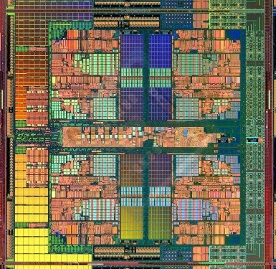
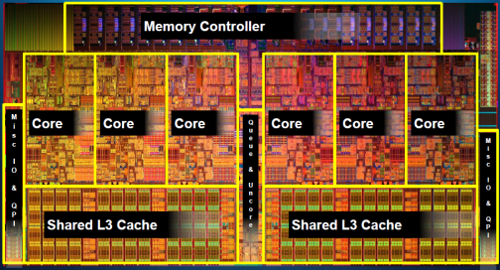
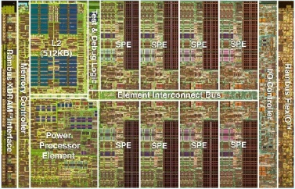
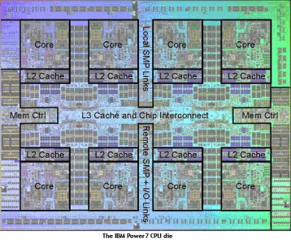
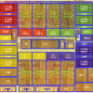
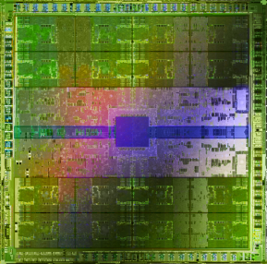
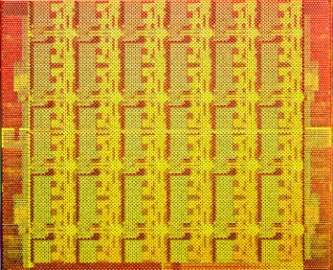
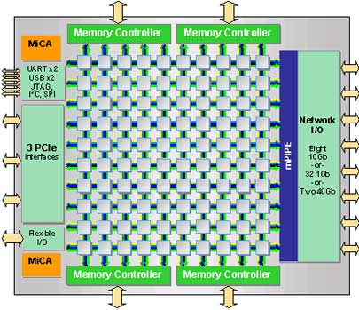
Example Trend: Many Cores on Chip
simpler and lower power than a single large core
large-scale parallelism on chip
Intel Core i7
8 cores
IBM Cell BE
8+1 cores
IBM POWER7
8 cores
AMD Barcelona
4 cores
Nvidia Fermi
448 “cores”
Intel SCC
48 cores, networked
Tilera TILE Gx
100 cores, networked
Sun Niagara II
8 cores

Slide 7
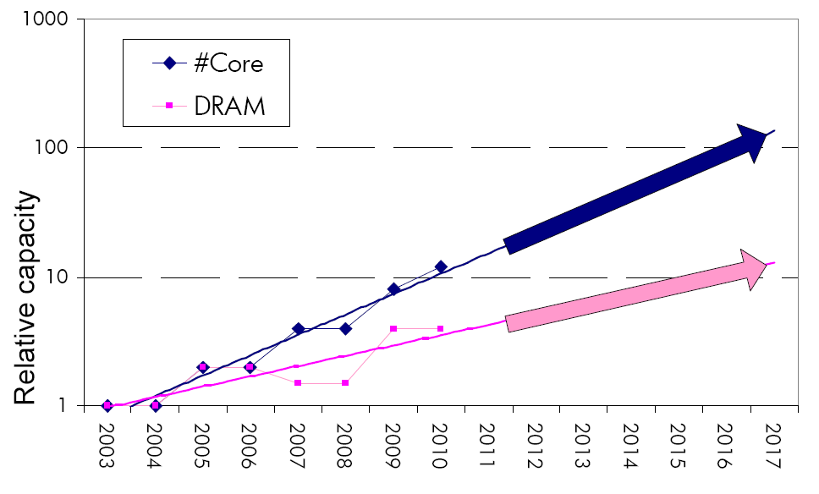
Consequence: The Memory Capacity Gap
core count doubling ~ every 2 years
DRAM DIMM capacity doubling ~ every 3 years
memory capacity per core expected to drop by 30% every two years
trends worse for memory bandwidth per core!

Slide 8
Major Trends Affecting Main Memory (III)
need for main memory w/ high capacity and bandwidth
main memory energy/power is a key system design concern
  ~40-50% energy spent in off-chip memory hierarchy [Lefurgy, IEEE Computer 2003]
  DRAM consumes power even when not used (periodic refresh)
DRAM technology scaling is ending

Slide 9
Major Trends Affecting Main Memory (IV)
Need for main memory capacity, bandwidth, QoS increasing
Main memory energy/power is a key system design concern
DRAM technology scaling is ending
  ITRS projects DRAM will not scale easily below X nm
  Scaling has provided many benefits:
    higher capacity (density), lower cost, lower energy

Slide 10
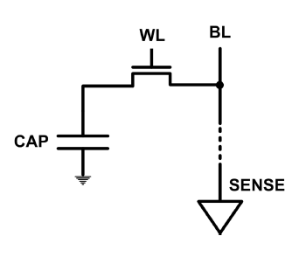
The DRAM Scaling Problem
DRAM stores charge in a capacitor (charge-based memory)
  capacitor must be large enough for reliable sensing
  access transistor should be large enough for low leakage and high retention time
  scaling beyond 40-35nm (2013) is challenging [ITRS, 2009]
DRAM capacity, cost, and energy/power hard to scale

Slide 11
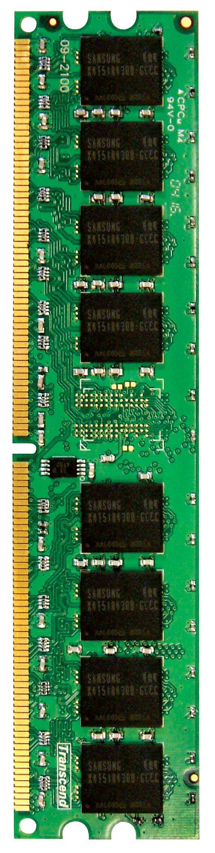

Main Memory in the System
CORE 0
L2 CACHE 1
CORE 1
L2 CACHE 0
SHARED L3 CACHE
DRAM INTERFACE
DRAM MEMORY CONTROLLER
DRAM BANKS
L2 CACHE 2
CORE 3
CORE 2
L2 CACHE 3

Slide 12
Ideal Memory
zero access time (latency)
infinite capacity
zero cost
infinite bandwidth (to support multiple accesses in parallel)

Slide 13
The Problem
ideal memory’s requirements oppose each other
bigger is slower
  bigger → Takes longer to determine the location
faster is more expensive
  memory technology: SRAM vs. DRAM
higher bandwidth is more expensive
  need more banks, more ports, higher frequency, or faster technology

Slide 14
Memory Technology: DRAM
dynamic random access memory
capacitor charge state indicates stored value
  whether the capacitor is charged or discharged indicates storage of 1 or 0
  1 capacitor
  1 access transistor
capacitor leaks through the RC path
  DRAM cell loses charge over time
  DRAM cell needs to be refreshed
row enable
_bitline

Slide 15
The DRAM Subsystem

Slide 16
DRAM Subsystem Organization
channel
DIMM
rank
chip
bank
row/column

Slide 17
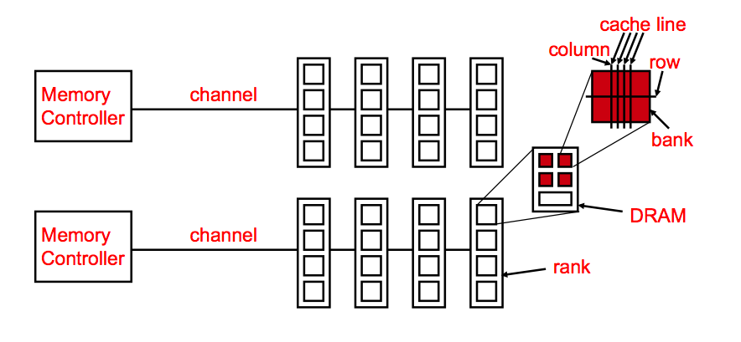
Generalized Memory Structure

Slide 18
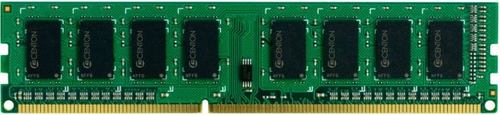
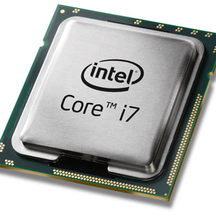
The DRAM subsystem
“channel”
DIMM (dual in-line memory module)
2 independent channels: 2 memory controllers (Above)
2 dependent/lockstep channels: 1 memory controller w/ wide interface (bot shown above)
processor
memory channel
memory channel

Slide 19
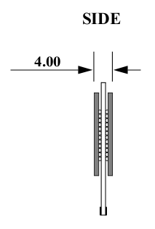
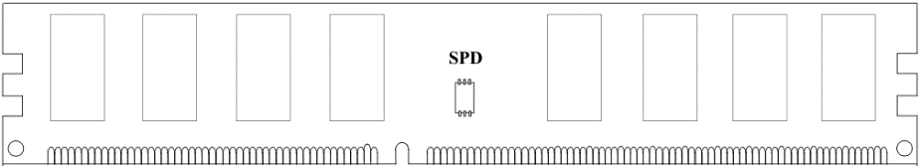
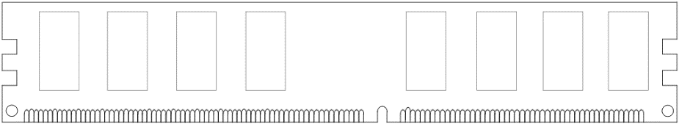
Breaking down a DIMM
DIMM (Dual in-line memory module)
Side view
Front of DIMM
Back of DIMM

Slide 20
Breaking down a DIMM
DIMM (Dual in-line memory module)
Side view
Front of DIMM
Back of DIMM
Rank 0: collection of 8 chips
Rank 1

Slide 21
DIMM & Rank
DIMM
  what you plug into your motherboard
  consists of one or more ranks
rank: multiple chips operated together to form a wide interface
  all chips comprising a rank are controlled at the same time
    respond to a single command
    share address and command buses, but provide different data
  advantages:
    acts like a high-capacity DRAM chip with a wide interface
    flexibility: MC doesn’t need to deal with individual chips
  disadvantages:
    granularity: accesses can’t be smaller than the interface width

Slide 22
Rank
Rank 0 (Front)
Rank 1 (Back)
<0:63>
<0:63>
Addr/Cmd
CS <0:1>
Data <0:63>
Memory channel

Slide 23
Breaking down a Rank
. . .
Chip 0
Chip 1
Chip 7
Rank 0
<0:63>
<0:7>
<8:15>
<56:63>
Data <0:63>

Slide 24
Breaking down a Chip
consists of multiple banks (2-16 in Synchronous DRAM)
banks share command/address/data buses
the chip itself has a narrow interface (4-16 bits per read)
8 banks
Chip 0
Bank 0
<0:7>
<0:7>
<0:7>
...
<0:7>
<0:7>

Slide 25
Breaking down a Bank
2kB
1B (column)
row 16k-1
Bank 0
...
row 0
<0:7>
Row-buffer
1B
1B
1B
...
<0:7>

Slide 26
Page Mode DRAM
a DRAM bank is a 2D array of cells: rows x columns
a DRAM row is also called a DRAM page
sense amplifiers also called “row buffer”
each address is a <row,column> pair
access to a “closed row”
  activate command opens row (placed into row buffer)
  read/write command reads/writes column in the row buffer
  precharge command closes the row and prepares the bank for next access
access to an “open row”
  no need for activate command

Slide 27
DRAM Bank Operation
access address:
(row 0, column 0)
columns
(row 0, column 1)
(row 0, column 85)
(row 1, column 0)
row address 1
row address 0
row decoder
rows
row buffer
CONFLICT !
HIT
row 1
HIT
empty
row 0
column address 0
column mux
column address 0
column address 1
column address 85
data

Slide 28
Memory Bank: A Fundamental Concept
problem: a single monolithic memory array takes long to access and does not enable multiple accesses in parallel
goal: reduce the latency of memory array access and enable multiple accesses in parallel
idea: divide the array into multiple banks that can be accessed independently (in the same cycle or in consecutive cycles)
  each bank is smaller than the entire memory storage
  accesses to different banks can be overlapped

Slide 29
Interleaving Multiple Banks and Channels
multiple banks
  enable concurrent DRAM accesses
  bits in address determine which bank an address resides in
multiple independent channels serve the same purpose
  but they are even better because they have separate data buses
  increased bus bandwidth
enabling more concurrency requires reducing
  bank conflicts
  channel conflicts
how to select/randomize bank/channel indices in address?
  lower order bits have more entropy
  randomizing hash functions (XOR of different address bits)

Slide 30
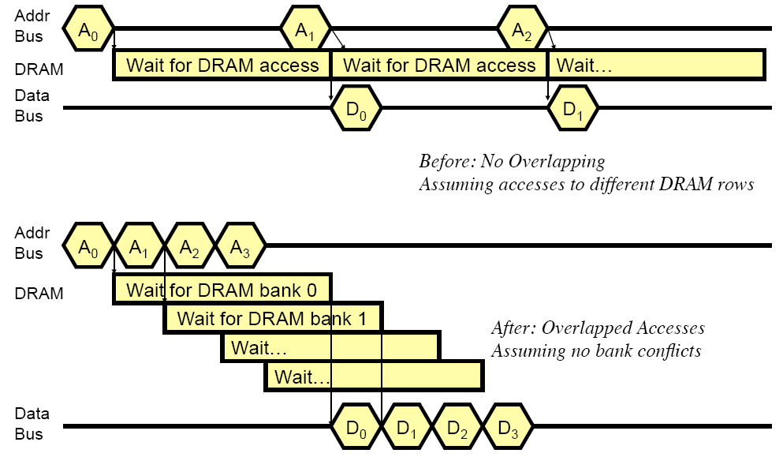
How Multiple Banks Help

Slide 31
Address Mapping (Single Channel)
single-channel system with 8-byte memory bus
  2GB memory, 8 banks, 16K rows & 2K columns per bank
row interleaving
  consecutive rows of memory in consecutive banks
  accesses to consecutive cache blocks serviced in a pipelined manner
cache block interleaving
    consecutive cache block addresses in consecutive banks
    64 byte cache blocks
    accesses to consecutive cache blocks can be serviced in parallel
row (14 bits)
bank (3 bits)
column (11 bits)
byte in bus (3 bits)
row (14 bits)
high column
bank (3 bits)
low col.
byte in bus (3 bits)
8 bits
3 bits

Slide 32
Address Mapping (Multiple Channels)
C
row (14 bits)
bank (3 bits)
column (11 bits)
byte in bus (3 bits)
where are consecutive cache blocks?
row (14 bits)
C
bank (3 bits)
column (11 bits)
byte in bus (3 bits)
row (14 bits)
bank (3 bits)
C
column (11 bits)
byte in bus (3 bits)
row (14 bits)
bank (3 bits)
column (11 bits)
C
byte in bus (3 bits)
C
row (14 bits)
high column
bank (3 bits)
low Col.
byte in bus (3 bits)
8 bits
3 bits
row (14 bits)
C
high column
bank (3 bits)
low Col.
byte in bus (3 bits)
8 bits
3 bits
row (14 bits)
high column
C
bank (3 bits)
low Col.
byte in bus (3 bits)
8 bits
3 bits
row (14 bits)
high column
bank (3 bits)
C
low Col.
byte in bus (3 bits)
8 bits
3 bits
row (14 bits)
high column
bank (3 bits)
low Col.
C
byte in bus (3 bits)
8 bits
3 bits

Slide 33
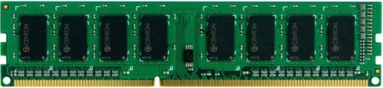


Example: Transferring a cache block
Physical memory space
0xFFFF…F
Channel 0
...
DIMM 0
Mapped to
0x40
Rank 0
64B
cache block
0x00

Slide 34
Example: Transferring a cache block
Physical memory space
Chip 0
Chip 1
Rank 0
Chip 7
0xFFFF…F
. . .
...
<0:7>
<8:15>
<56:63>
0x40
64B
cache block
Data <0:63>
0x00

Slide 35
Example: Transferring a cache block
Physical memory space
Chip 0
Chip 1
Rank 0
Chip 7
0xFFFF…F
. . .
Row 0
Col 0
...
<0:7>
<8:15>
<56:63>
0x40
64B
cache block
Data <0:63>
0x00

Slide 36
Example: Transferring a cache block
Physical memory space
Chip 0
Chip 1
Rank 0
Chip 7
0xFFFF…F
. . .
Row 0
Col 0
...
<0:7>
<8:15>
<56:63>
0x40
64B
cache block
Data <0:63>
8B
0x00
8B

Slide 37
Example: Transferring a cache block
Physical memory space
Chip 0
Chip 1
Rank 0
Chip 7
0xFFFF…F
. . .
Row 0
Col 1
...
<0:7>
<8:15>
<56:63>
0x40
64B
cache block
Data <0:63>
8B
0x00

Slide 38
Example: Transferring a cache block
Physical memory space
Chip 0
Chip 1
Rank 0
Chip 7
0xFFFF…F
. . .
Row 0
Col 1
...
<0:7>
<8:15>
<56:63>
0x40
8B
64B
cache block
Data <0:63>
8B
0x00
8B

Slide 39
Example: Transferring a cache block
Physical memory space
Chip 0
Chip 1
Rank 0
Chip 7
0xFFFF…F
. . .
Row 0
Col 1
...
<0:7>
<8:15>
<56:63>
0x40
8B
64B
cache block
Data <0:63>
8B
0x00
A 64B cache block takes 8 I/O cycles to transfer.
During the process, 8 columns are read sequentially.

Slide 40
DRAM Refresh (I)
DRAM capacitor charge leaks over time
memory controller needs to read each row periodically to restore the charge
  activate + precharge each row every N ms
  typical N = 64 ms
implications on performance?
  -- DRAM bank unavailable while refreshed
  -- long pause times: if we refresh all rows in burst, every 64ms the DRAM will be unavailable until refresh ends
burst refresh: all rows refreshed immediately after one another
distributed refresh: Each row refreshed at a different time, at regular intervals

Slide 41
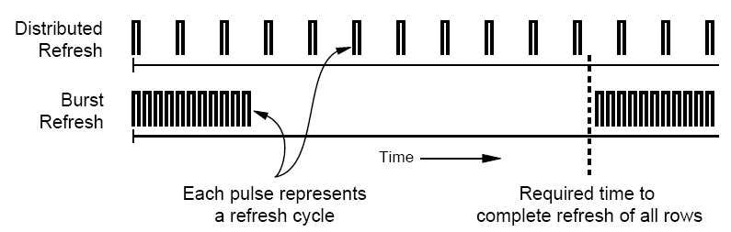
DRAM Refresh (II)
distributed refresh eliminates long pause times
how else we can reduce the effect of refresh on performance?
  can we reduce the number of refreshes?

Slide 42
Downsides of DRAM Refresh
-- energy consumption: Each refresh consumes energy
-- performance degradation: DRAM rank/bank unavailable while refreshed
-- QoS/predictability impact: (Long) pause times during refresh
-- refresh rate limits DRAM density scaling
  Liu et al., “RAIDR: Retention-aware Intelligent DRAM Refresh,” ISCA 2012.

Slide 43
Memory Controllers

Slide 44
DRAM Controller: Functions
ensure correct operation of DRAM (refresh and timing)
service DRAM requests while obeying timing constraints of DRAM chips
  constraints: resource conflicts (bank, bus, channel), minimum write-to-read delays
  translate requests to DRAM command sequences
buffer and schedule requests to improve performance
  reordering, row-buffer, bank, rank, bus management
manage power consumption and thermals in DRAM
  turn on/off DRAM chips, manage power modes

Slide 45
DRAM Controller: Where to Place
in chipset
  + more flexibility to plug different DRAM types into the system
+ less power density in the CPU chip
on CPU chip
  + reduced latency for main memory access
  + higher bandwidth between cores and controller
    more information can be communicated (e.g. request’s importance in the processing core)

Slide 46
A Modern DRAM Controller

Slide 47
DRAM Scheduling Policies (I)
FCFS (first come first served)
  oldest request first
FR-FCFS (first ready, first come first served)
  1. row-hit first
  2. oldest first
  goal: maximize row buffer hit rate → maximize DRAM throughput
  actually, scheduling is done at the command level
    column commands (read/write) prioritized over row commands (activate/precharge)
    within each group, older commands prioritized over younger ones

Slide 48
DRAM Scheduling Policies (II)
a scheduling policy is essentially a prioritization order
prioritization can be based on
  request age
  row buffer hit/miss status
  request type (prefetch, read, write)
  requestor type (load miss or store miss)
  request criticality
    oldest miss in the core?
    how many instructions in core are dependent on it?

Slide 49
Row Buffer Management Policies
open row
  keep the row open after an access
  + next access might need the same row → row hit
  -- next access might need a different row → row conflict, wasted energy
closed row
  close the row after an access (if no other requests already in the request buffer need the same row)
  + next access might need a different row → avoid a row conflict
  -- next access might need the same row → extra activate latency
adaptive policies
  predict whether or not the next access to the bank will be to the same row

Slide 50
Open vs. Closed Row Policies
Policy | First access | Next access | Commands needed for next access
Open row | Row 0 | Row 0 (row hit) | Read
Open row | Row 0 | Row 1 (row conflict) | Precharge + Activate Row 1 + Read
Closed row | Row 0 | Row 0 – access in request buffer (row hit) | Read
Closed row | Row 0 | Row 0 – access not in request buffer (row closed) | Activate Row 0 + Read + Precharge
Closed row | Row 0 | Row 1 (row closed) | Activate Row 1 + Read + Precharge

