Slide 1
ECE 476
Power System Analysis
Lecture 8: Transmission Line Parameters
Prof. Tom Overbye
Dept. of Electrical and Computer Engineering
University of Illinois at Urbana-Champaign
overbye@illinois.edu

Slide 2
Announcements
Please read Chapters 5 and 3
Quiz today on HW 3
HW 4 is 4.32, 4.41, 5.1, 5.7, 5.14; this one must be turned in on Sept 22 (hence there will be no quiz that day)

Slide 3
Transmission Line Models
Previous lectures have covered how to calculate the distributed inductance, capacitance and resistance of transmission lines.
In this section we will use these distributed parameters to develop the transmission line models used in power system analysis.

Slide 4
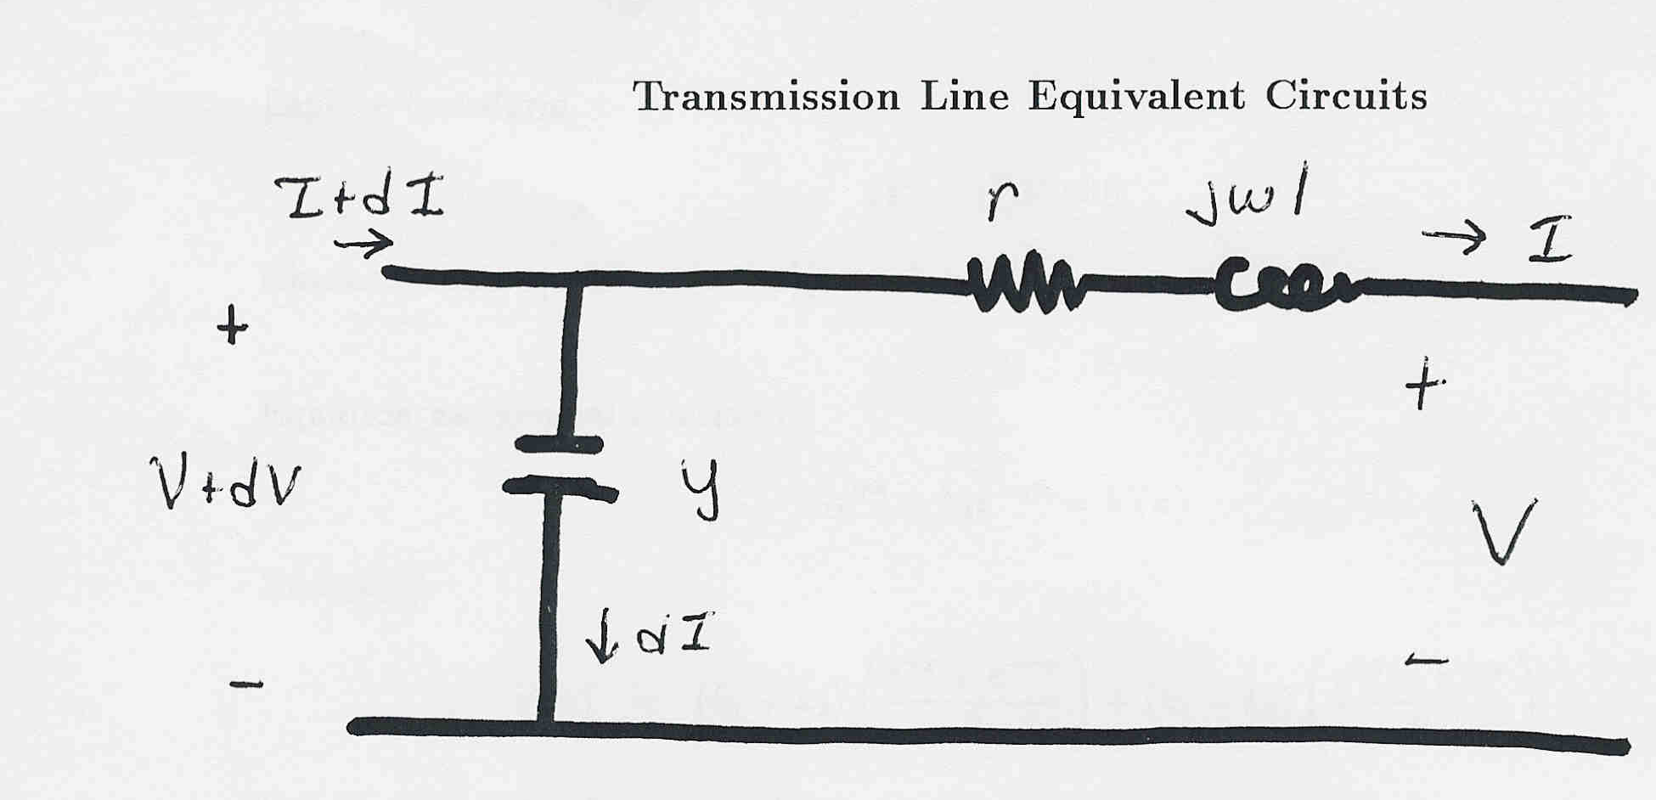
Transmission Line Equivalent Circuit
Our current model of a transmission line is shown below
Units on
z and y are
per unit
length!

Slide 5

Derivation of V, I Relationships

Slide 6
Setting up a Second Order Equation

Slide 7
V, I Relationships, cont’d

Slide 8
Equation for Voltage

Slide 9
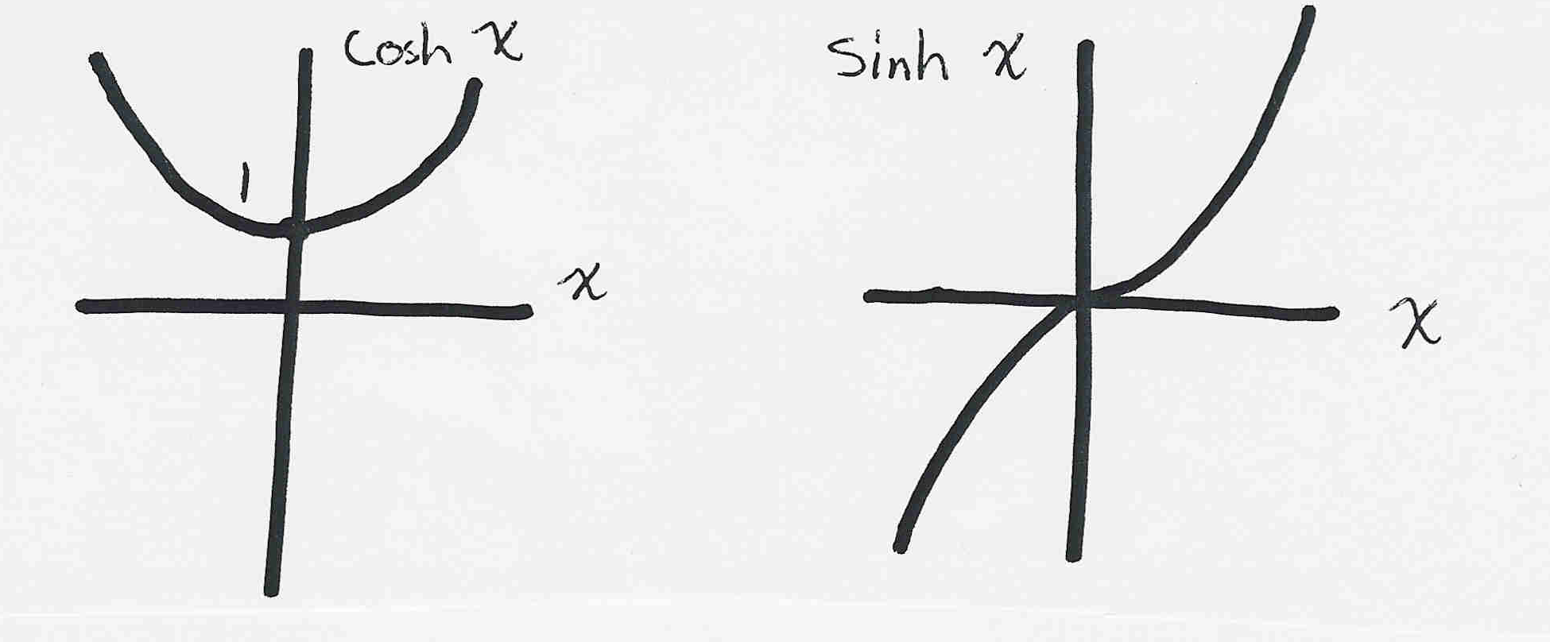
Real Hyperbolic Functions
For real x the cosh and sinh functions have the following form:

Slide 10
Complex Hyperbolic Functions
For x = α + jβ the cosh and sinh functions have the following form

Slide 11
Determining Line Voltage

Slide 12
Determining Line Voltage, cont’d

Slide 13
Determining Line Current

Slide 14
Transmission Line Example

Slide 15
Transmission Line Example, cont’d

Slide 16
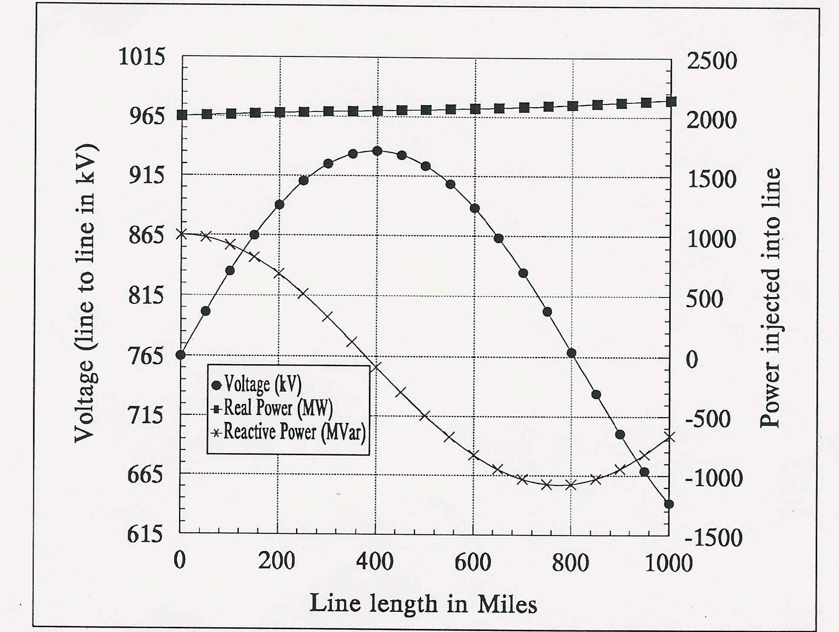
Transmission Line Example, cont’d

Slide 17
Lossless Transmission Lines

Slide 18
Lossless Transmission Lines
If P > SIL then line consumes
vars; otherwise line generates vars.

Slide 19
Example 5.4 (SIL Loading and Maximum Loading)

Slide 20
Transmission Matrix Model
Oftentimes we’re only interested in the terminal characteristics of the transmission line. Therefore we can model it as a “black box”.
I_{S}
I_{R}
+
Transmission
Line
+
V_{S}
V_{R}
-
-

Slide 21
Transmission Matrix Model, cont’d

Slide 22
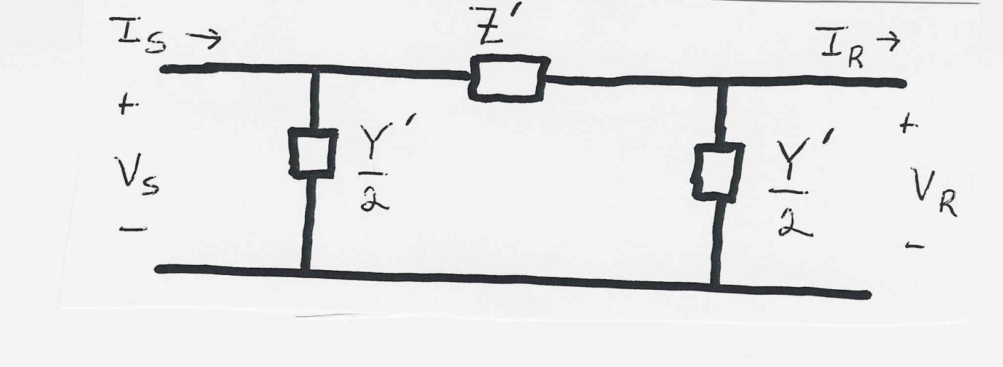
Equivalent Circuit Model
Next we’ll use the T matrix values to derive the
parameters Z' and Y'.

Slide 23

Equivalent Circuit Parameters

Slide 24
Equivalent circuit parameters

Slide 25
Simplified Parameters

Slide 26
Simplified Parameters

Slide 27
Medium Length Line Approximations

Slide 28
Three Line Models

Slide 29
Power Transfer in Short Lines
Often we'd like to know the maximum power that could be transferred through a short transmission line
I₁
I₁
+
Transmission
Line with
Impedance Z
+
V₁
S₁₂
S₂₁
V₂
-
-

Slide 30
Power Transfer in Lossless Lines

