Slide 1
ECE 476
Power System Analysis
Lecture 26: Transient Stability, Smart Grid, Distribution System, High Impact Events
Prof. Tom Overbye
Dept. of Electrical and Computer Engineering
University of Illinois at Urbana-Champaign
overbye@illinois.edu

Slide 2
Announcements
Please read Chapters 12 and 14
HW 11 is 11.25, 12.3, 12.11, 14.15
  Should be done before the final but is not turned in
Chapter 6 Design Project 1 is due on Wednesday Dec 7
  Simplified to change limit on Cedar69-Olive69 to 95 MVA
  Contingency low voltages limit to 0.93 per unit
Final exam is on Monday December 12, 1:30-4:30pm
  Comprehensive, closed book/notes; three note sheets allowed
  Last name A-H in ECEB 3013, rest in ECE 3017

Slide 3
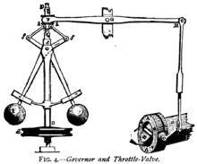
Generator Governors
The other key generator control system is the governor, which changes the mechanical power into the generator to maintain a desired speed and hence frequency.
Historically centrifugal “flyball” governors have been used to regulate the speed of devices such as steam engines
The centrifugal force varies
with speed, opening or
closing the throttle valve
Photo source: en.wikipedia.org/wiki/Centrifugal_governor
2

Slide 4
Isochronous Governors
Ideally we would like the governor to maintain the frequency at a constant value of 60 Hz (in North America)
This can be accomplished using an isochronous governor.
  A flyball governor is not an isochronous governor since the control action is proportional to the speed error
  An isochronous governor requires an integration of the speed error
Isochronous governors are used on stand alone generators but cannot be used on interconnected generators because of “hunting”
3

Slide 5
Generator “Hunting”
Control system “hunting” is oscillation around an equilibrium point
Trying to interconnect multiple isochronous generators will cause hunting because the frequency setpoints of the two generators are never exactly equal
  One will be accumulating a frequency error trying to speed up the system, whereas the other will be trying to slow it down
  The generators will NOT share the power load proportionally.
4

Slide 6
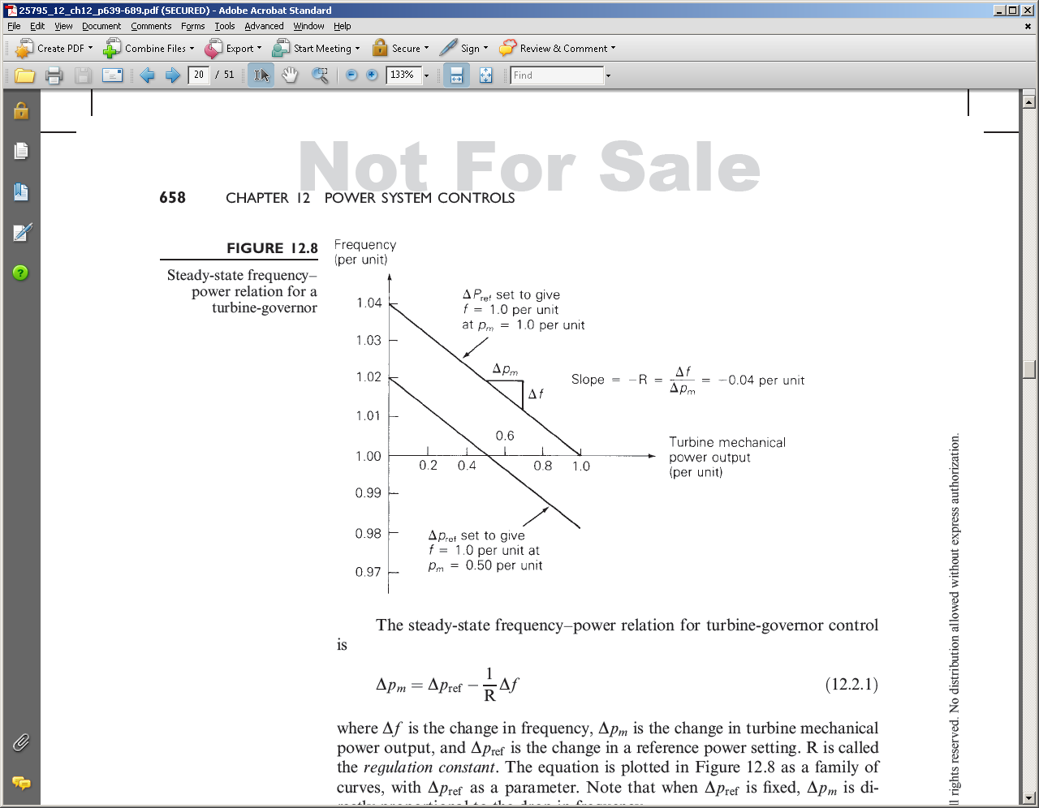
Droop Control
The solution is to use what is known as droop control, in which the desired set point frequency is dependent upon the generator’s output
R is known as the
regulation constant
or droop; a typical
value is 4 or 5%.
5

Slide 7
Governor Block Diagrams
The block diagram for a simple stream unit, the TGOV1 model, is shown below. The T1 block models the governor delays, whereas the second block models the turbine response.
6

Slide 8
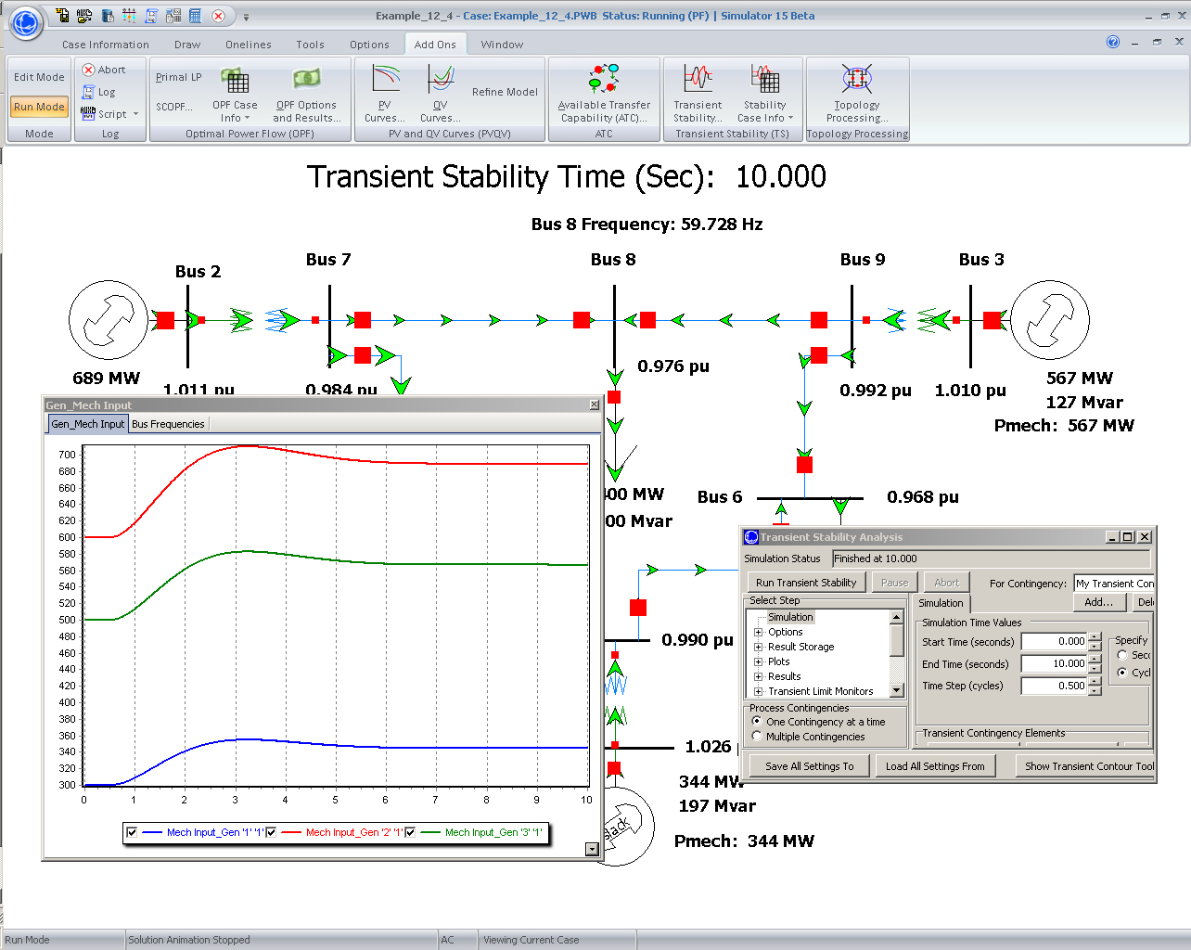
Example 12.4 System Response
7

Slide 9
Problem 12.11
8

Slide 10
Restoring Frequency to 60 Hz
In an interconnected power system the governors to not automatically restore the frequency to 60 Hz
Rather this is done via the ACE (area control area calculation). Previously we defined ACE as the difference between the actual real power exports from an area and the scheduled exports. But it has an additional term
ACE = P_{actual} - P_{sched} – 10β(freq_{act} - freq_{sched})
β is the balancing authority frequency bias in MW/0.1 Hz with a negative sign. It is about 0.8% of peak load/generation
9

Slide 11
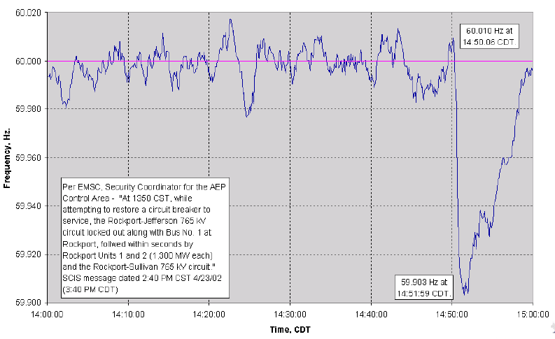
2600 MW Loss Frequency Recovery
Frequency recovers in about ten minutes
10

Slide 12
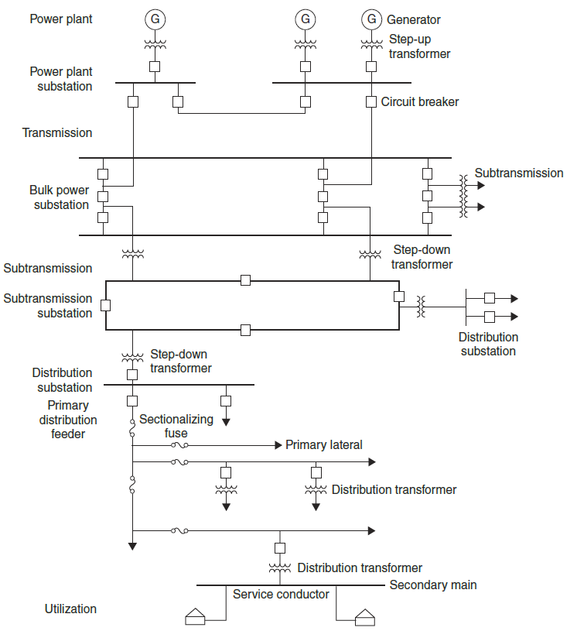
Distribution System
The distribution system is the lower voltage portion (< 50 kV) of the grid
  Usually radial, though
  networked in some urban
  areas
  Historically the power flow
  was from transmission,
  into distribution to load;
  but this is changing with
  more distributed generation
Much recent interest in
the distribution system
11

Slide 13
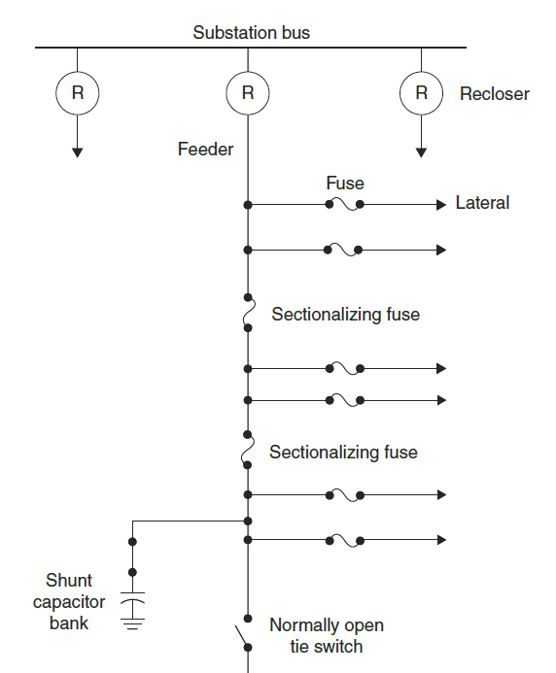
Distribution System Components
Primary distribution uses
voltages between 34.5 kV down
to 2.4, with 13.8 and 12.4 kV
common
Secondary distribution uses the
end customer utilization voltages
(120/240, 208Y/120,
480Y/277 V)
Distribution transformers come in a wide variety of sizes; often they have load tap changers (LTCs) to control the voltage
12

Slide 14
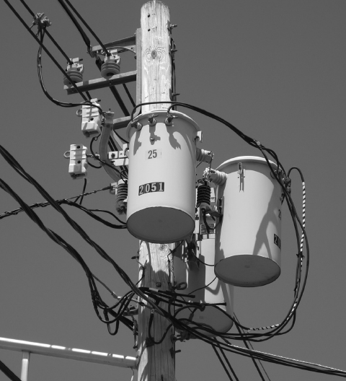
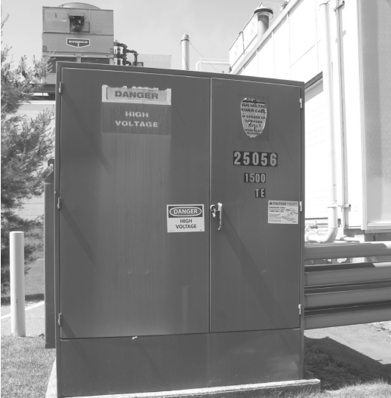
Pole and Padmount Transformers
13

Slide 15
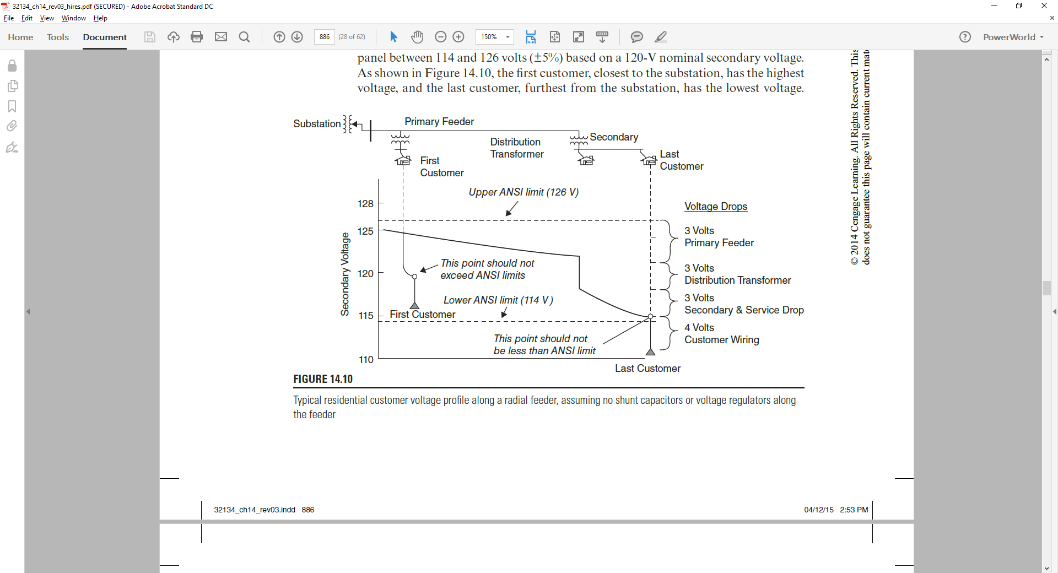
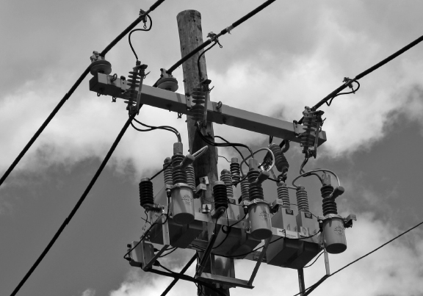
Distribution System Components, cont.
Maintaining adequate
voltage levels to all
customers is a key
distribution system
requirement
Shunt capacitors are
widely used for
voltage control
  In the future some of
  this reactive power could
  come for solar PV
  inverters
14

Slide 16
PowerWorld Figure 14.22 Case
15

Slide 17
The Smart Grid
As defined by DOE a Smart Grid has the following seven characteristics
  Self-healing from power disturbance events
  Enabling active participation by consumers in demand response
  Operating resiliently against physical/cyber attack
  Providing power quality for 21st century needs
  Accommodating all generation and storage options
  Enabling new products, services, and markets
  Optimizing assets and operating efficiently

Slide 18
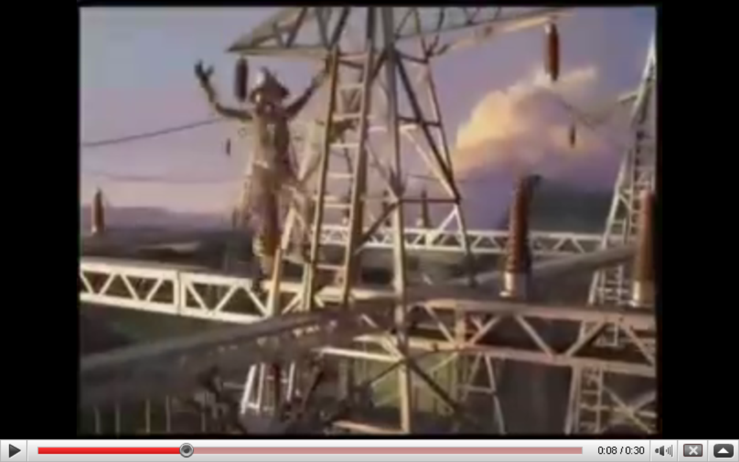
The Smart Grid: Not quite as Dumb as They Think
Source: GE SmartGrid Superbowl ad; https://www.youtube.com/watch?v=Mtdv2FCJMBc

Slide 19
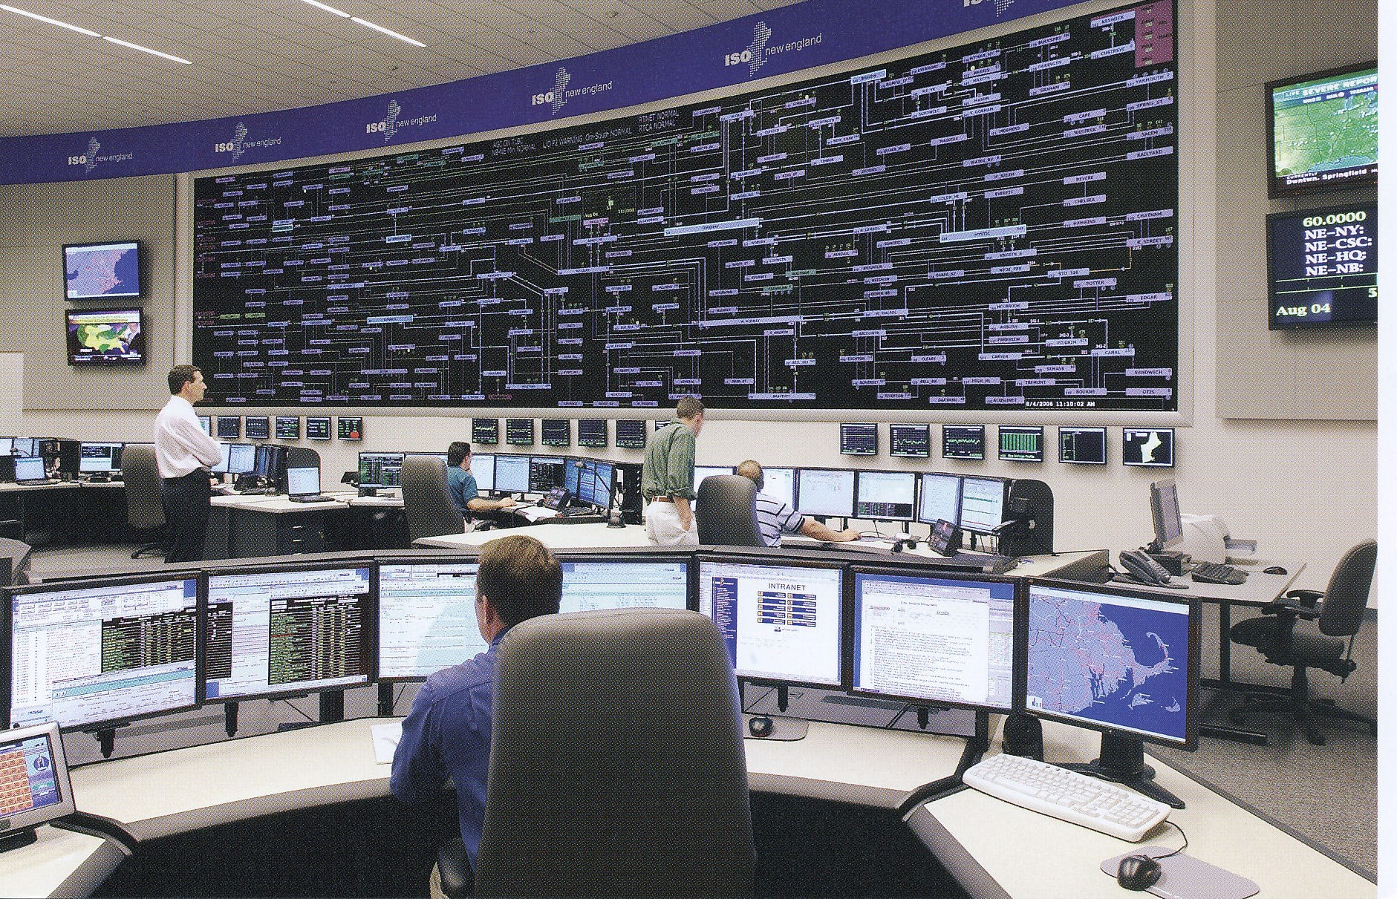
Electric Utilities have Been Leaders in the Use of Technology
ISO New England Control Center

Slide 20
Key Drivers for Smart Grid: Control and Improved Reliability
Key needs for the Smart Grid idea are to allow for the integration of much more non-controllable electric generation like wind and solar, and improved customer reliability
Adding electric vehicle loads also requires charging control
Germane Power Grid characteristics
  Electric energy cannot be economically stored
  Electric power flow is difficult to directly control
  Customers have been in complete control

Slide 21
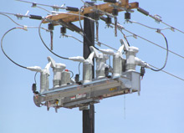
Smart Grid and the Distribution System
Distribution system automation has been making steady advances for many years, a trend that should accelerate with smart grid funding
Self-healing is often
used to refer to
automatic distribution
system reconfiguration
Some EMSs already
monitor portions of the
distribution system
S&C IntelliRupter® PulseCloser

Slide 22
Smart Grid and Controllable Load
A key goal of the smart grid is to make the load more flexible (controllable). One advantage (to utilities) of smart meters is the ability to remotely disconnect folks.
This requires 1) two-way communication, and 2) at least some loads equipped with controls
The best methods for achieving this control are still being considered. Communications is key, with the “last mile” the key challenge.
Potential options are 1) use existing customer broadband connections, 2) broadband over power line (BPL), 3) meshed wireless

Slide 23
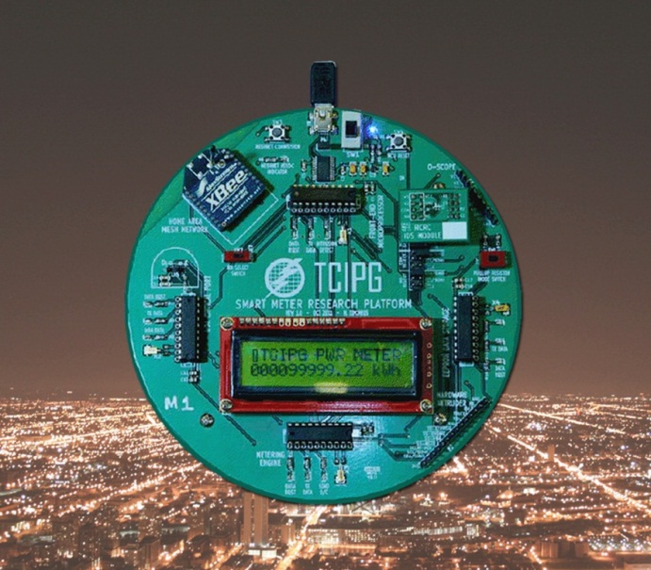
The Smart Grid Starts at the Meter
Traditional electric meters integrated the electric demand and had no communication capability
  needed to be read manually.
Newer meters have the ability to
measure the demand on a second by
second basis, and have at least
some communication capability
  Can be used to provide consumer
  access to their electric demand, and also
  can be used by the utility to remotely disconnect customers

Slide 24
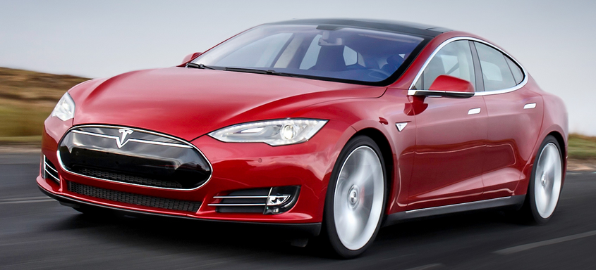
Electric Vehicles
The real driver for widespread implementation of controllable electric load could well be pluggable hybrid electric vehicles (PHEVs) or completely
electric vehicles
Recharging PHEVs when
their drivers return home
at 5pm would be a really
bad idea, so some type of
load control is a must.
Range on the all electric Tesla Model S (shown above) is about 270 with a 85 kWh battery
Image: www.teslamotors.com/models/drive

Slide 25
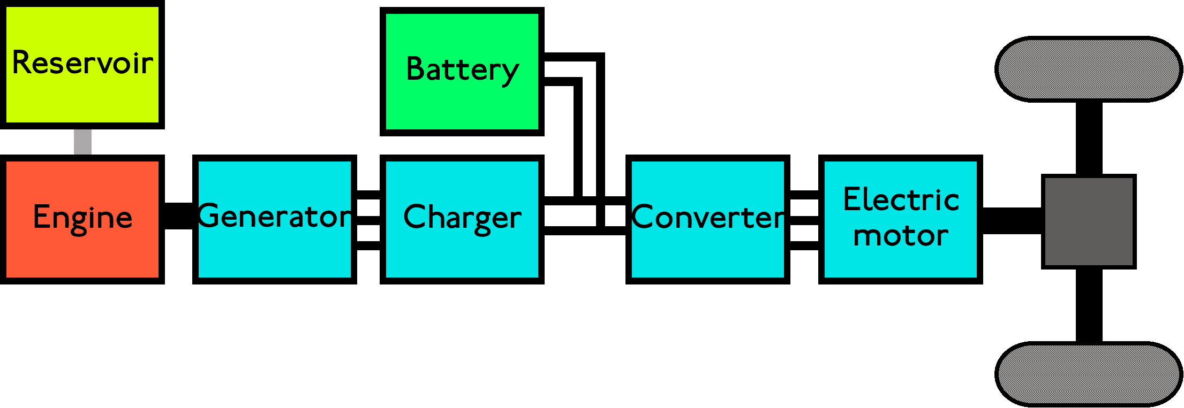
PHEVs
PHEVs give the range of a gas vehicle with the lower cost of an electric vehicle, allowing all electric travel for about 40 miles with an energy storage capacity of around 10 to 17 kWh
  One gallon of gasoline has 36.6 kWh but the energy in the battery can be used with a much higher efficiency than that stored in chemical form in gasoline

Slide 26
PHEV Charging Rate and Demand
Power demand and time required to fully charge depend upon the energy needed and the charging voltage
  A standard 120V, 20A outlet change provide a maximum of about 1.5 kW, requiring 6 hours to provide 9 kWh.
  A 240V, 60A outlet could provide the same charge in about 1 hour at 9.0 kW.
Having people in a neighborhood trying to simultaneously charge their cars at high rates could overload the distribution system

Slide 27
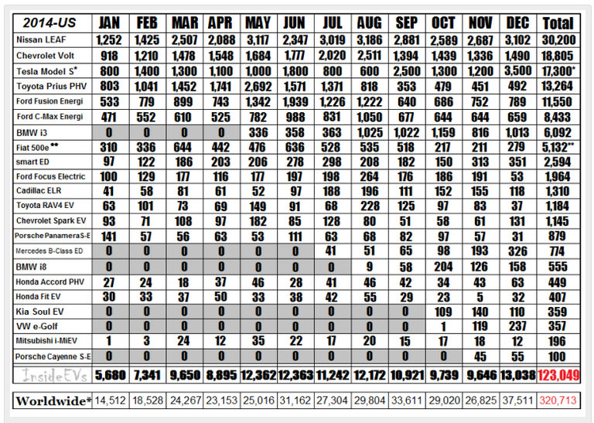
PHEV and EV Sales
Sales have increased from 17,000 cars to 2011 to 52,000 in 2012, 97,000 in 2013 and 123,049 in 2014
Total US car
sales in 2014
were about
8 million
http://insideevs.com/monthly-plug-in-sales-scorecard/

Slide 28
High-Impact, Low-Frequency Events
In 2010 the North American Electric Reliability
Corporation (NERC) identified some severe grid threads called High-Impact, Low-Frequency Events (HILFs); others call them black
swan events or black sky days
  Large-scale, potentially long duration blackouts
HILFs identified by NERC were
  a coordinated cyber, physical or blended attacks,
  pandemics,
  geomagnetic disturbances (GMDs), and
  high altitude electromagnetics pulses (HEMPs)
27

Slide 29
Geomagnetic Disturbances (GMDs)
GMDs are caused by corona mass ejections (CMEs) from the sun; a GMD caused the Quebec blackout in 1989
They have the potential to severely disrupt the electric grid by causing quasi-dc geomagnetically induced currents (GICs) in the high voltage grid
Until recently power engineers had few tools to help them assess the impact of GMDs
GMD assessment tools are now moving into the realm of power system planning and operations engineers
Wide industry interest in GMD assessment
28

Slide 30
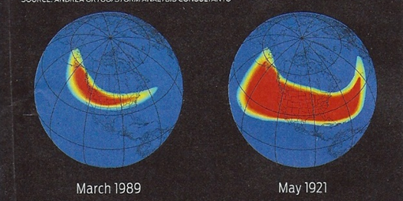
GMD Overview
Solar corona mass ejections (CMEs) can cause changes in the earth’s magnetic field (i.e., dB/dt). These changes in turn produce a non-uniform electric fields
  Changes in the magnetic flux are usually expressed in nT/minute; from a 60 Hz perspective
  they produce an almost dc electric field
  1989 North America storm produced a
  change of 500 nT/minute, while a stronger storm, such as the ones in 1859 or 1921, could produce 2500 nT/minute variation
  Storm “footprint” can be continental in scale
  Earth’s magnetic field is normally between 25,000 and 65,000 nT, with higher values near the poles
29
Image source: J. Kappenman, “A Perfect Storm of Planetary Proportions,” IEEE Spectrum, Feb 2012, page 29

Slide 31
Electric Fields and Geomagnetically Induced Currents (GICs)
The induced electric field at the surface is dependent on deep earth (hundreds of km) conductivity
  Electric fields are vectors (magnitude and angle); values expressed in units of volts/mile (or volts/km);
  A 2400 nT/minute storm could produce 5 to 10 volts/mile.
The electric fields cause GICs to flow in the high voltage transmission grid
The induced voltages that drive the GICs can be modeled as dc voltages in the transmission lines.
30

Slide 32
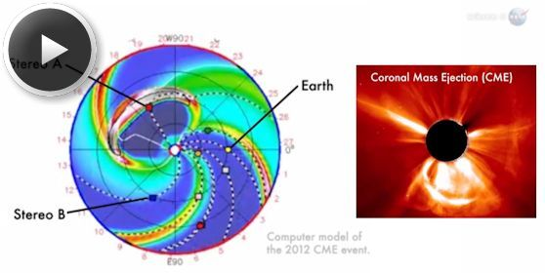
July 2012 GMD Near Miss
In July 2014 NASA said in July of 2012 there was a solar CME that barely missed the earth
  It would likely have
  caused the largest
  GMD that we have
  seen in the last 150
  years
There is still lots of
uncertainly about
how large a storm
is reasonable to
consider in electric utility planning
Image Source: science.nasa.gov/science-news/science-at-nasa/2014/23jul_superstorm/
31

Slide 33
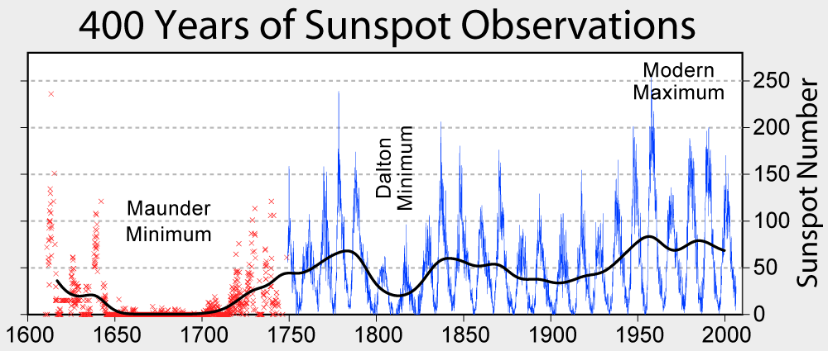
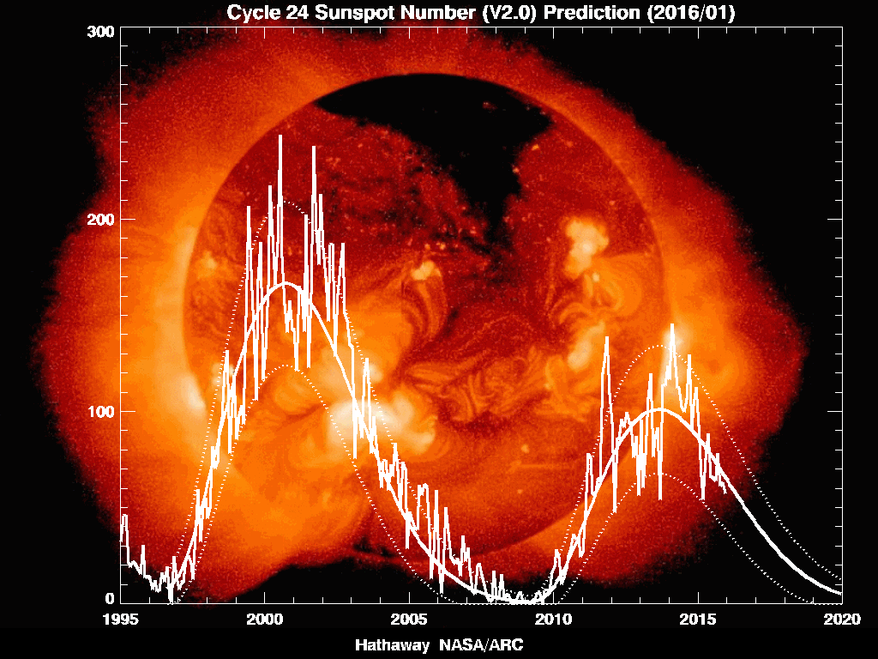
Solar Cycles
Sunspots follow an 11 year cycle, and have been observed for hundreds of years
We're in solar cycle 24 (first numbered cycle was in 1755); minimum was in 2009, maximum in 2014/2015
Images from NASA
32

Slide 34
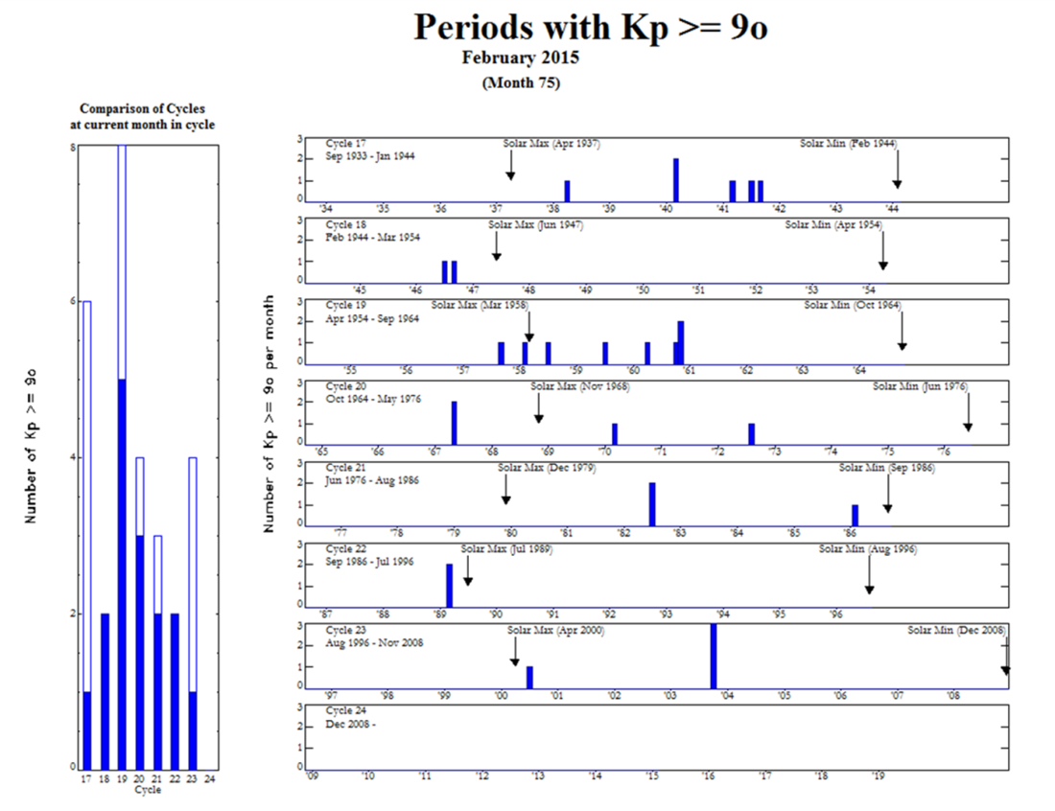
But Large CMEs Are Not Well Correlated with Sunspot Maximums
The large
1921 storm
occurred
four years
after the
1917
maximum
33

Slide 35
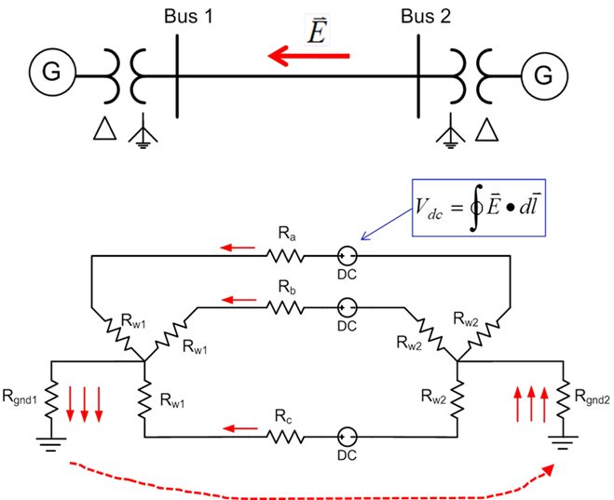
Geomagnetically Induced Currents (GICs
GMDs cause slowly varying electric fields
Along length of a high voltage transmission line, electric fields can be modeled as a dc voltage source superimposed on the lines
These voltage sources
produce quasi-dc
geomagnetically induced
currents (GICs) that are
superimposed on the ac
(60 Hz) flows
34

Slide 36
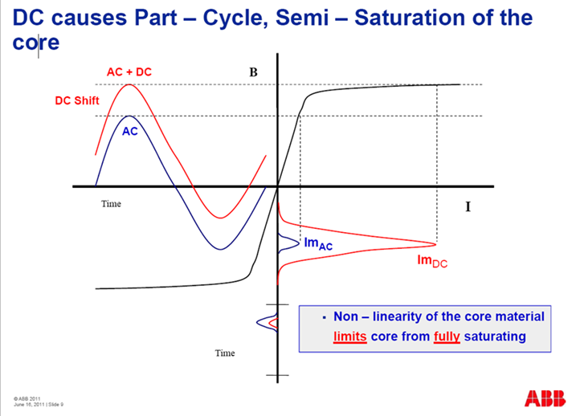
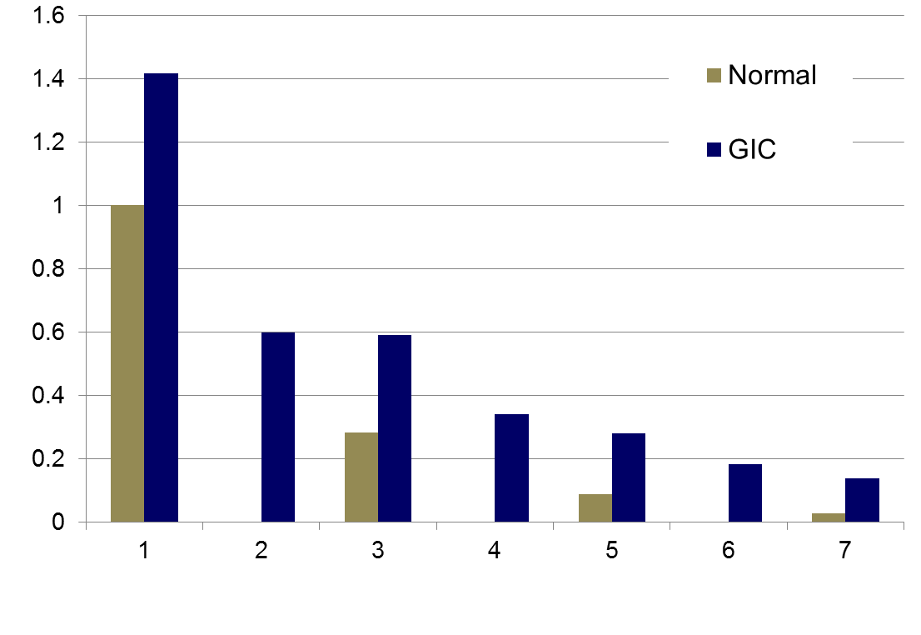
Transformer Impacts of GICs
The superimposed dc GICs can push transformers into
saturation for part of the ac cycle
This can cause large harmonics; in the positive sequence (e.g., power flow and transient
stability) these harmonics can be represented by increased reactive power losses in the transformer
Harmonics
Images: Craig Stiegemeier and Ed Schweitzer, JASON Presentations,
June 2011
35

Slide 37
GMD Enhanced Power Analysis Software
By integrating GIC calculations directly within power flow and transient stability engineers can see the impact of GICs on their systems, and consider mitigation options
GIC calculations use many of the existing model parameters such as line resistance. Some non-standard values are also needed; either provided or estimated
  Substation grounding resistance
  transformer grounding configuration
  transformer coil resistance
  whether auto-transformer
36

Slide 38
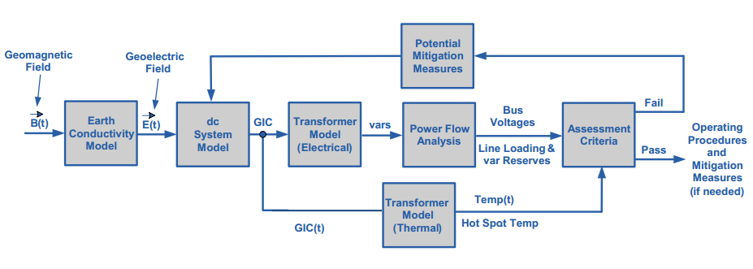
Overview of GMD Assessments
In is a quite interdisciplinary problem
The two key concerns from a big storm are 1) large-scale blackout
due to voltage collapse, 2) permanent transformer damage due to
overheating
Image Source: http://www.nerc.com/pa/Stand/WebinarLibrary/GMD_standards_update_june26_ec.pdf
37

Slide 39
Determining GMD Storm Scenarios
The starting point for the GIC analysis is an assumed storm scenario; determines the line dc voltages
Matching an actual storm can be complicated, and requires detailed knowledge of the associated geology
GICs vary linearly with the assumed electric field magnitudes and reactive power impacts on the transformers is also mostly linear
Working with space weather community to determine highest possible storms
38

Slide 40
The Impact of a Large GMD
From an Operations Perspective
Would be maybe a day warning but without specifics
  Satellite at Lagrange point one million miles from earth would give more details, but with just 30 minutes before impact
  Would strike quickly ; rise time of minutes, rapidly covering a good chunk of the continent
Reactive power loadings on hundreds of transformers could sky rocket, causing heating issues and potential large-scale voltage collapses
Power system control software could fail
Control room personnel would be overwhelmed
The storm could last for days with varying intensity
Waiting until it occurs to prepare might not be a good idea
39

Slide 41
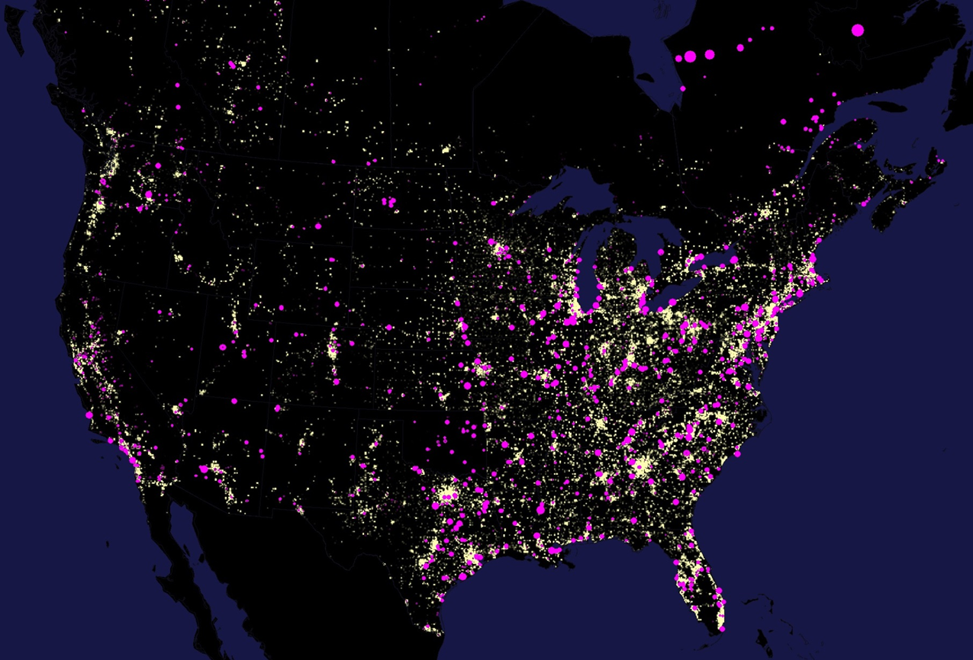
Large-Scale Studies Require
Geo-mapped Buses
Image
is based
on power
flow data
(summer
2015) for
the four
North
American
grids
40

Slide 42
GIC Flows in WECC for a Uniform 2.0 V/km, East-West Field
41

Slide 43
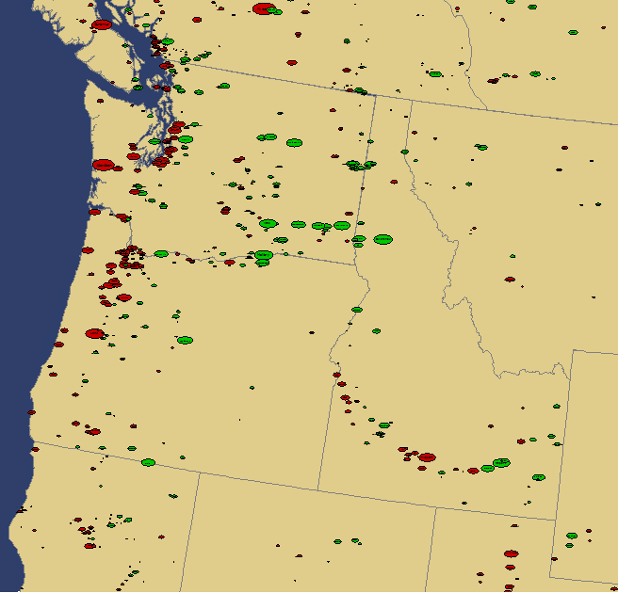
Geographic Data Views: Displaying Net Substation Current Injections
GICs tend to concentrate at network boundaries
42

Slide 44
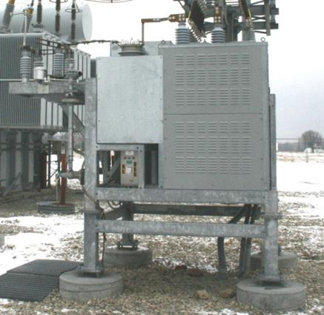
GIC Mitigation
Engineers need tools to determine mitigation strategies
  Cost-benefit analysis
GIC flows can be reduced both
through operational strategies
such as opening lines,
and through longer term
approaches such as installing
blocking devices
Redispatching the system can
change transformer loadings,
providing margins for GICs
43

Slide 45
Nuclear Electromagnetic Pulses (EMPs)
Much of the information on nuclear EMPs is classified
Various public documents exist, including
IEC 1000-2-9 (from 1996); some of the information presented here comes from this standard
The primary concern about nuclear EMPS is the impacts caused by high altitude EMPs (HEMPs)
  From 30 to 100’s of km in altitude
  For a high altitude explosion the other common nuclear impacts (blast, thermal, radiation) do not occur at the ground
  Scope of HEMP impact can be almost continental
More localized EMPs can be created by surface blasts; known as source region EMP (SREMP)
44

Slide 46
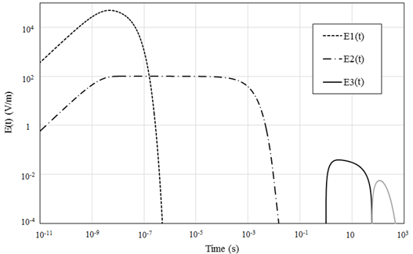
HEMP Time Frames
The impacts of an HEMP are typically divided into three time frames: E1, E2 and E3
The quickest, E1 with
maximum electric
fields of 10’s of kV
per meter, can
impact unshielded
electronics
E2, with electric fields of up to 100 volts per meter, is similar to lightning
Power grid concerns with E3; similar to GMDs
Image Source Data is IEC 1000-2-9
45

Slide 47
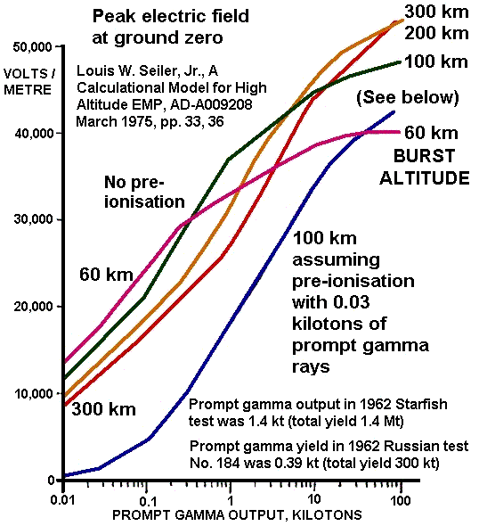
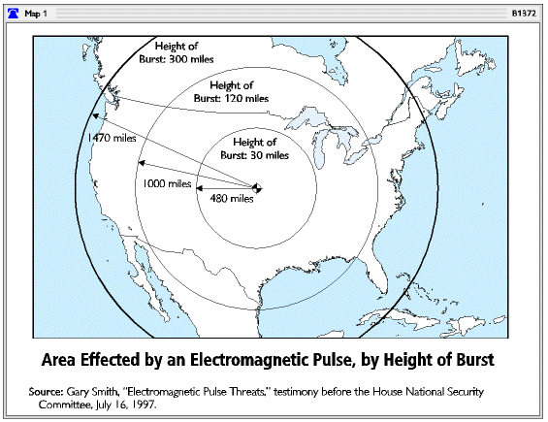
HEMP Impacts versus Size and Altitude
EMP impacts do not scale
linearly with weapon size
  Even quite small weapons
  (such as 10 kilotons) can
  produce large EMPs
Low altitude EMPs
can still have large
footprints
Image Sources: en.wikipedia.org/wiki/Nuclear_electromagnetic_pulse

