Slide 1
ECE 476
Power System Analysis
Lecture 23: Transient Stability
Prof. Tom Overbye
Dept. of Electrical and Computer Engineering
University of Illinois at Urbana-Champaign
overbye@illinois.edu

Slide 2
Announcements
Please read Chapters 11
HW 10 is 11.1, 11.4, 11.12, 11.19, 11.21; quiz on Dec 1 (hence it will not be turned in)
  We will be dropping your lowest two HW and/or Quiz scores
Chapter 6 Design Project 1 is assigned. It will count as three regular home works and is due on Dec 3.
  For tower configurations assume a symmetric conductor spacing, with the distance in feet given by the following formula: (Last two digits of your EIN+150)/10. Example student A has an UIN of xxx65. Then his/her spacing is (65+150)/10 = 21.50 ft.
Final exam is on Monday December 12, 1:30-4:30pm

Slide 3
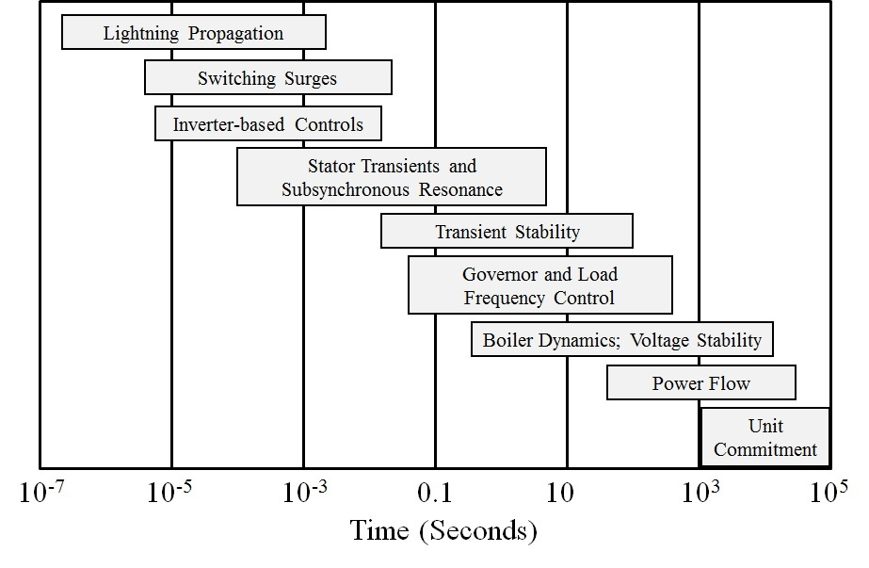
Power System Time Scales and Transient Stability
Image source: P.W. Sauer, M.A. Pai, Power System Dynamics and Stability, 1997, Fig 1.2, modified
2

Slide 4
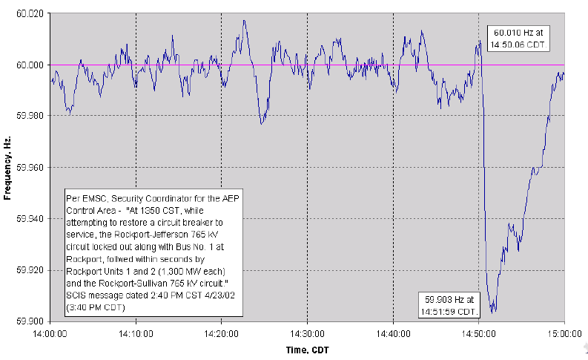
Example of Frequency Variation
Figure shows Eastern Interconnect frequency variation after loss of 2600 MWs
3

Slide 5
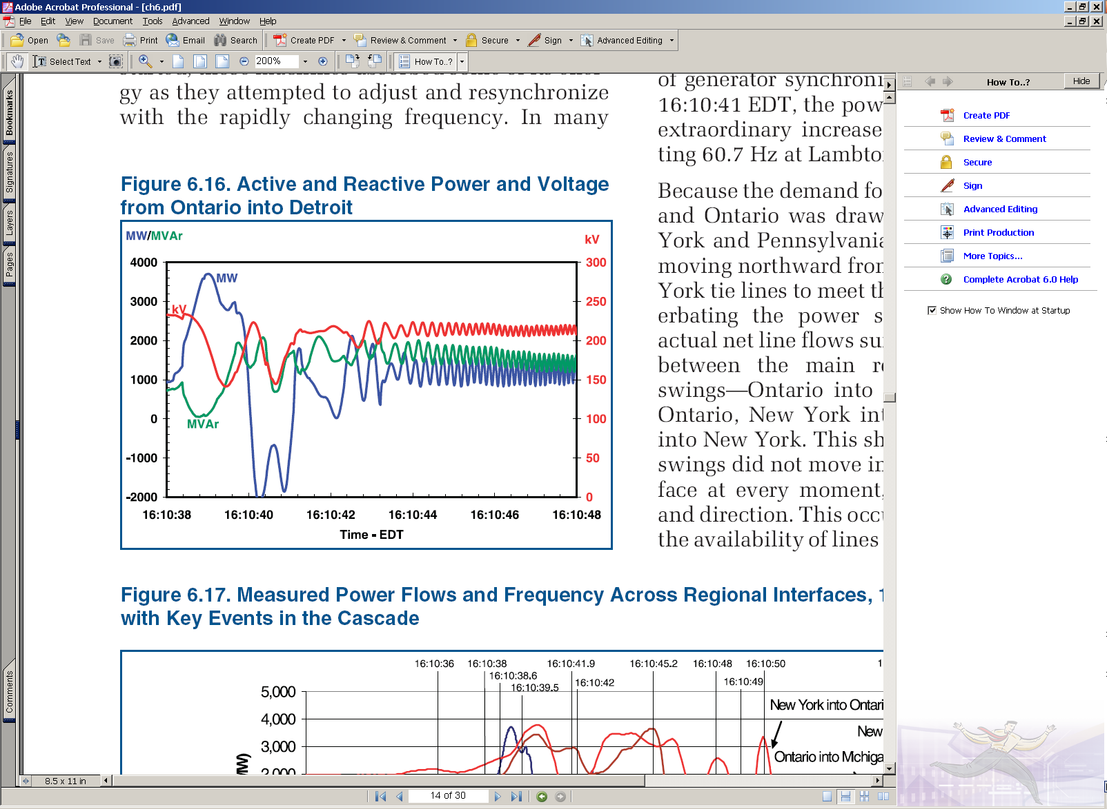
Example of Dynamics Behavior
Source: August 14th 2003 Blackout Final Report
4

Slide 6
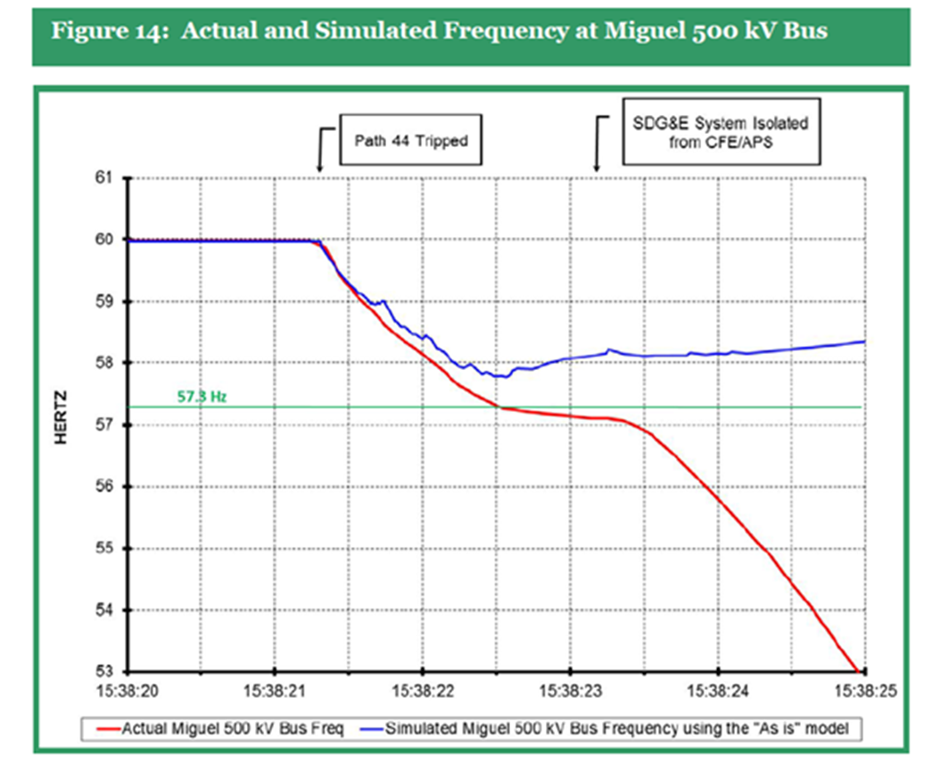
Power System Dynamics Motivation: Frequency Decline September 2011 Blackout
Image Source: Arizona-Southern California Outages on September 8, 2011 Report, FERC and NERC,April 2012
5

Slide 7
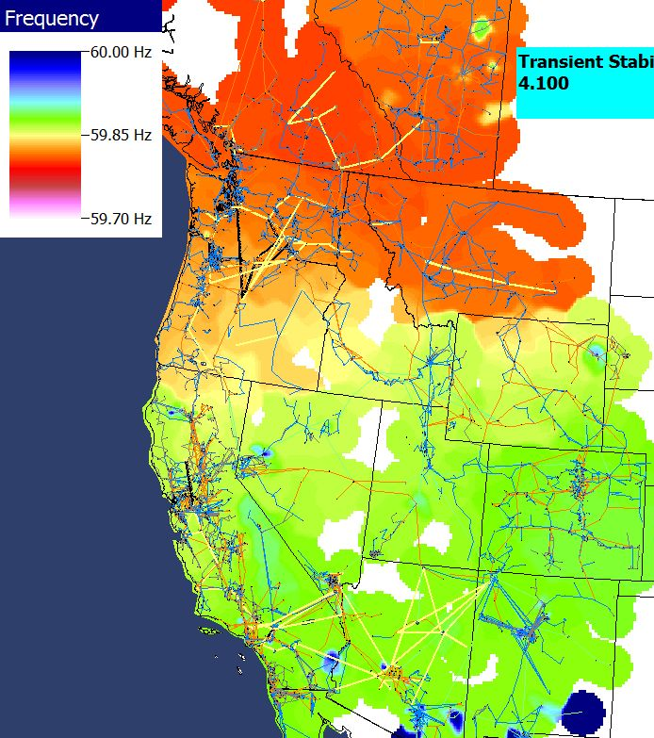
Power Grid Disturbance Example
Figures show the frequency change as a result of the sudden loss of a large amount of generation in the Southern WECC
Green is bus quite close to location of generator trip while blue and red are quite distant.
Time in Seconds
Frequency Contour
6

Slide 8
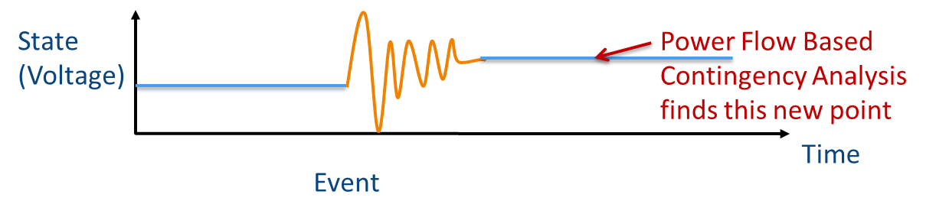
Recap: Power Flow
The power flow is used to determine a quasi steady-state operating condition for a power system
  Goal is to solve a set of algebraic equations
    g(y) = 0 [y variables are bus voltage and angle]
  Models employed reflect the steady-state assumption
  Using a power flow, after a contingency occurs (such as opening a line), the algebraic equations are solved to determine a new equilibrium
7

Slide 9
Power Flow vs. Dynamics
Dynamics simulations is used to determine whether following a contingency the power system returns to a steady-state operating point
  Goal is to solve a set of differential and algebraic equations,
    dx/dt = f(x,y) [y variables are bus voltage and angle]
    g(x,y) = 0 [x variables are dynamic state variables]
  Starts in steady-state, and hopefully returns to a new steady-state value
  Models reflect the transient stability time frame (up to dozens of seconds)
    Slow Values → Treat as constants
    Ultra Fast States → Treat as algebraic relationships
8

Slide 10
Power System Transient Stability
In order to operate as an interconnected system all of the generators (and other synchronous machines) must remain in synchronism with one another
  synchronism requires that (for two pole machines) the rotors turn at exactly the same speed
Loss of synchronism results in a condition in which no net power can be transferred between the machines
A system is said to be transiently unstable if following a disturbance one or more of the generators lose synchronism
9

Slide 11
Generator Transient Stability Models
In order to study the transient response of a power system we need to develop models for the generator valid during the transient time frame of several seconds following a system disturbance
We need to develop both electrical and mechanical models for the generators
10

Slide 12
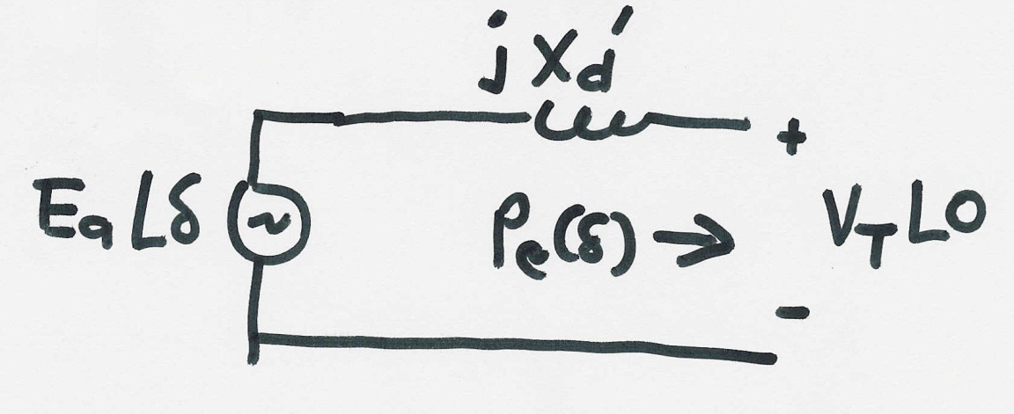
Generator Electrical Model
The simplest generator model, known as the classical model, treats the generator as a voltage source behind the direct-axis transient reactance; the voltage magnitude is fixed, but its angle changes according to the mechanical dynamics
11

Slide 13
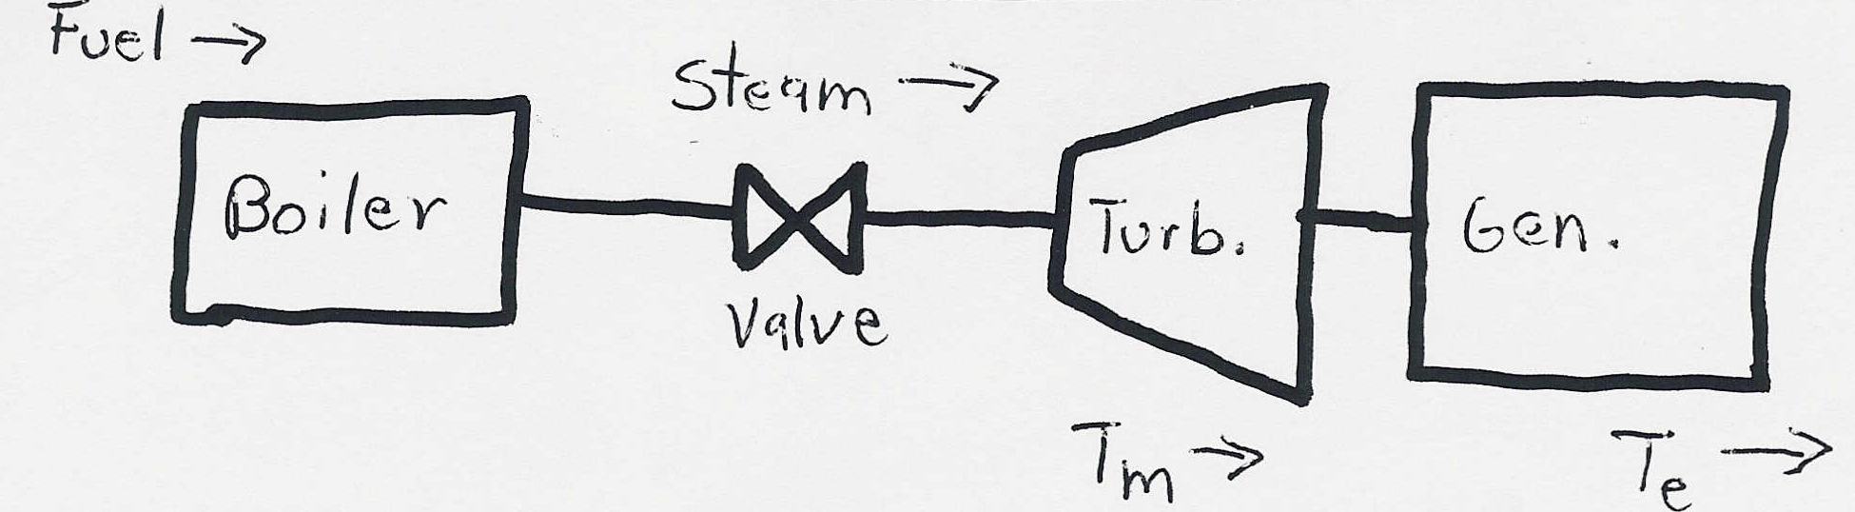
Generator Mechanical Model
Generator Mechanical Block Diagram
12

Slide 14
Generator Mechanical Model, cont’d
13

Slide 15
Generator Mechanical Model, cont’d
14

Slide 16
Generator Mechanical Model, cont’d
15

Slide 17

Generator Swing Equation
16

Slide 18
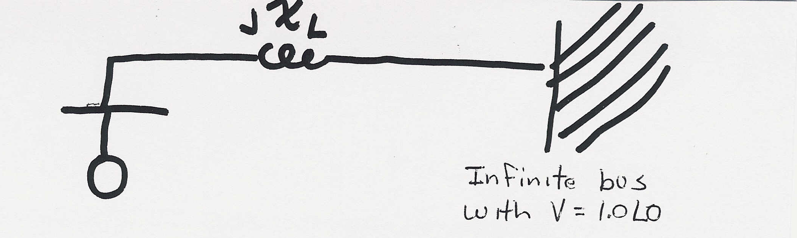
Single Machine Infinite Bus (SMIB)
To understand the transient stability problem we’ll first consider the case of a single machine (generator) connected to a power system bus with a fixed voltage magnitude and angle (known as an infinite bus) through a transmission line with impedance jX_{L}
17

Slide 19
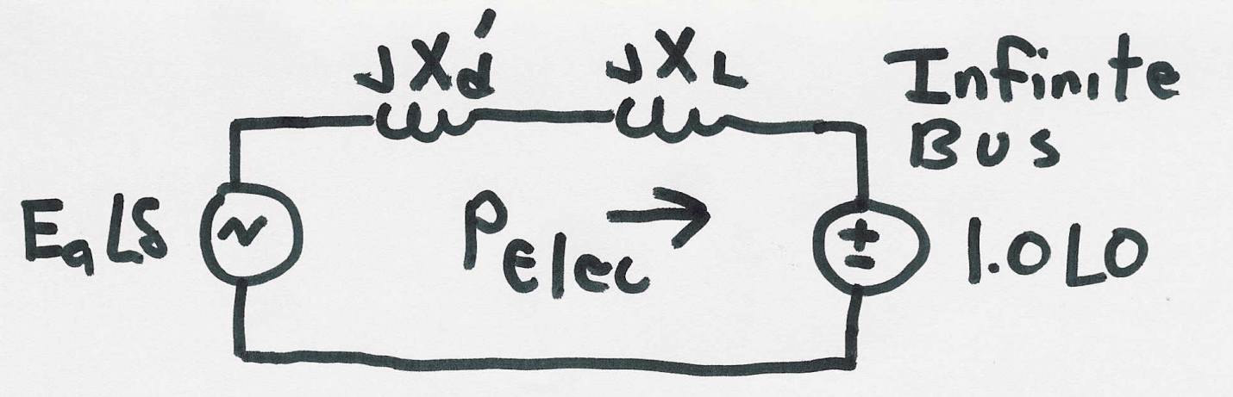
SMIB, cont’d
18

Slide 20
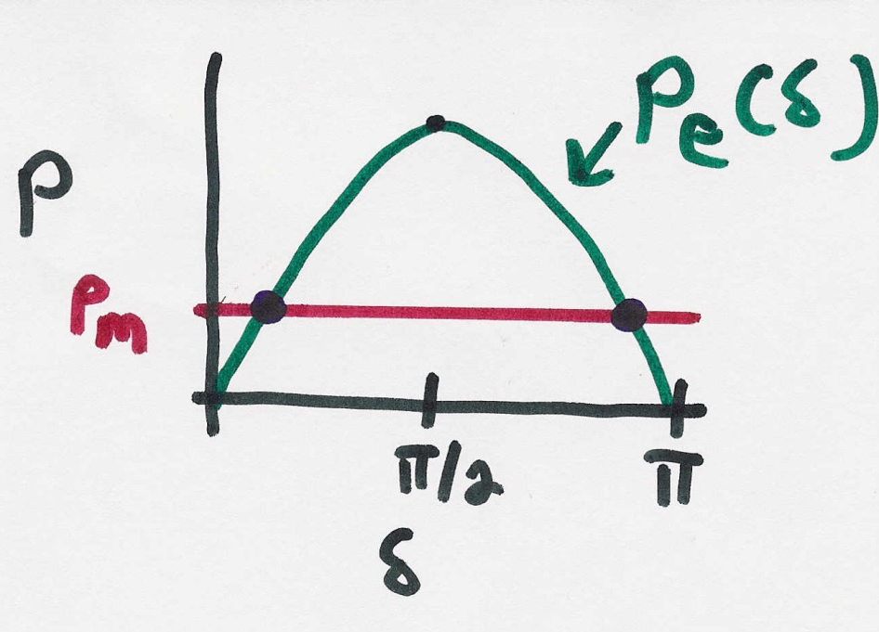
SMIB Equilibrium Points
19

Slide 21
Transient Stability Analysis
For transient stability analysis we need to consider three systems
  Prefault - before the fault occurs the system is assumed to be at an equilibrium point
  Faulted - the fault changes the system equations, moving the system away from its equilibrium point
  Postfault - after fault is cleared the system hopefully returns to a new operating point
Actual transient stability studies can have
multiple events
20

Slide 22
Transient Stability Solution Methods
There are two methods for solving the transient stability problem
  Numerical integration
    this is by far the most common technique, particularly for large systems; during the fault and after the fault the power system differential equations are solved using numerical methods
  Direct or energy methods; for a two bus system this method is known as the equal area criteria
    mostly used to provide an intuitive insight into the transient stability problem
21

Slide 23
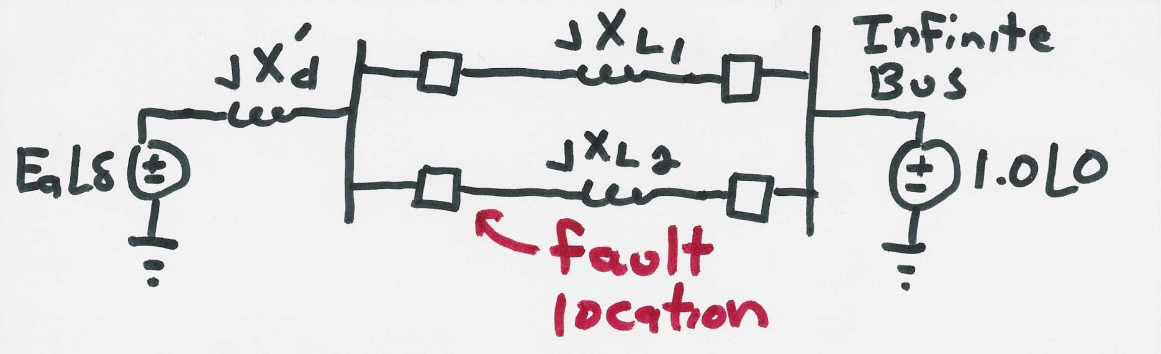
SMIB Example
Assume a generator is supplying power to an infinite bus through two parallel transmission lines. Then a balanced three phase fault occurs at the terminal of one of the lines. The fault is cleared by the opening of this line’s circuit breakers.
22

Slide 24
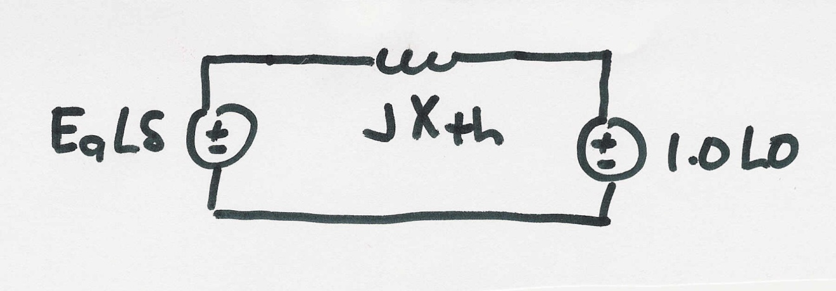

SMIB Example, cont’d
Simplified prefault system
23

Slide 25
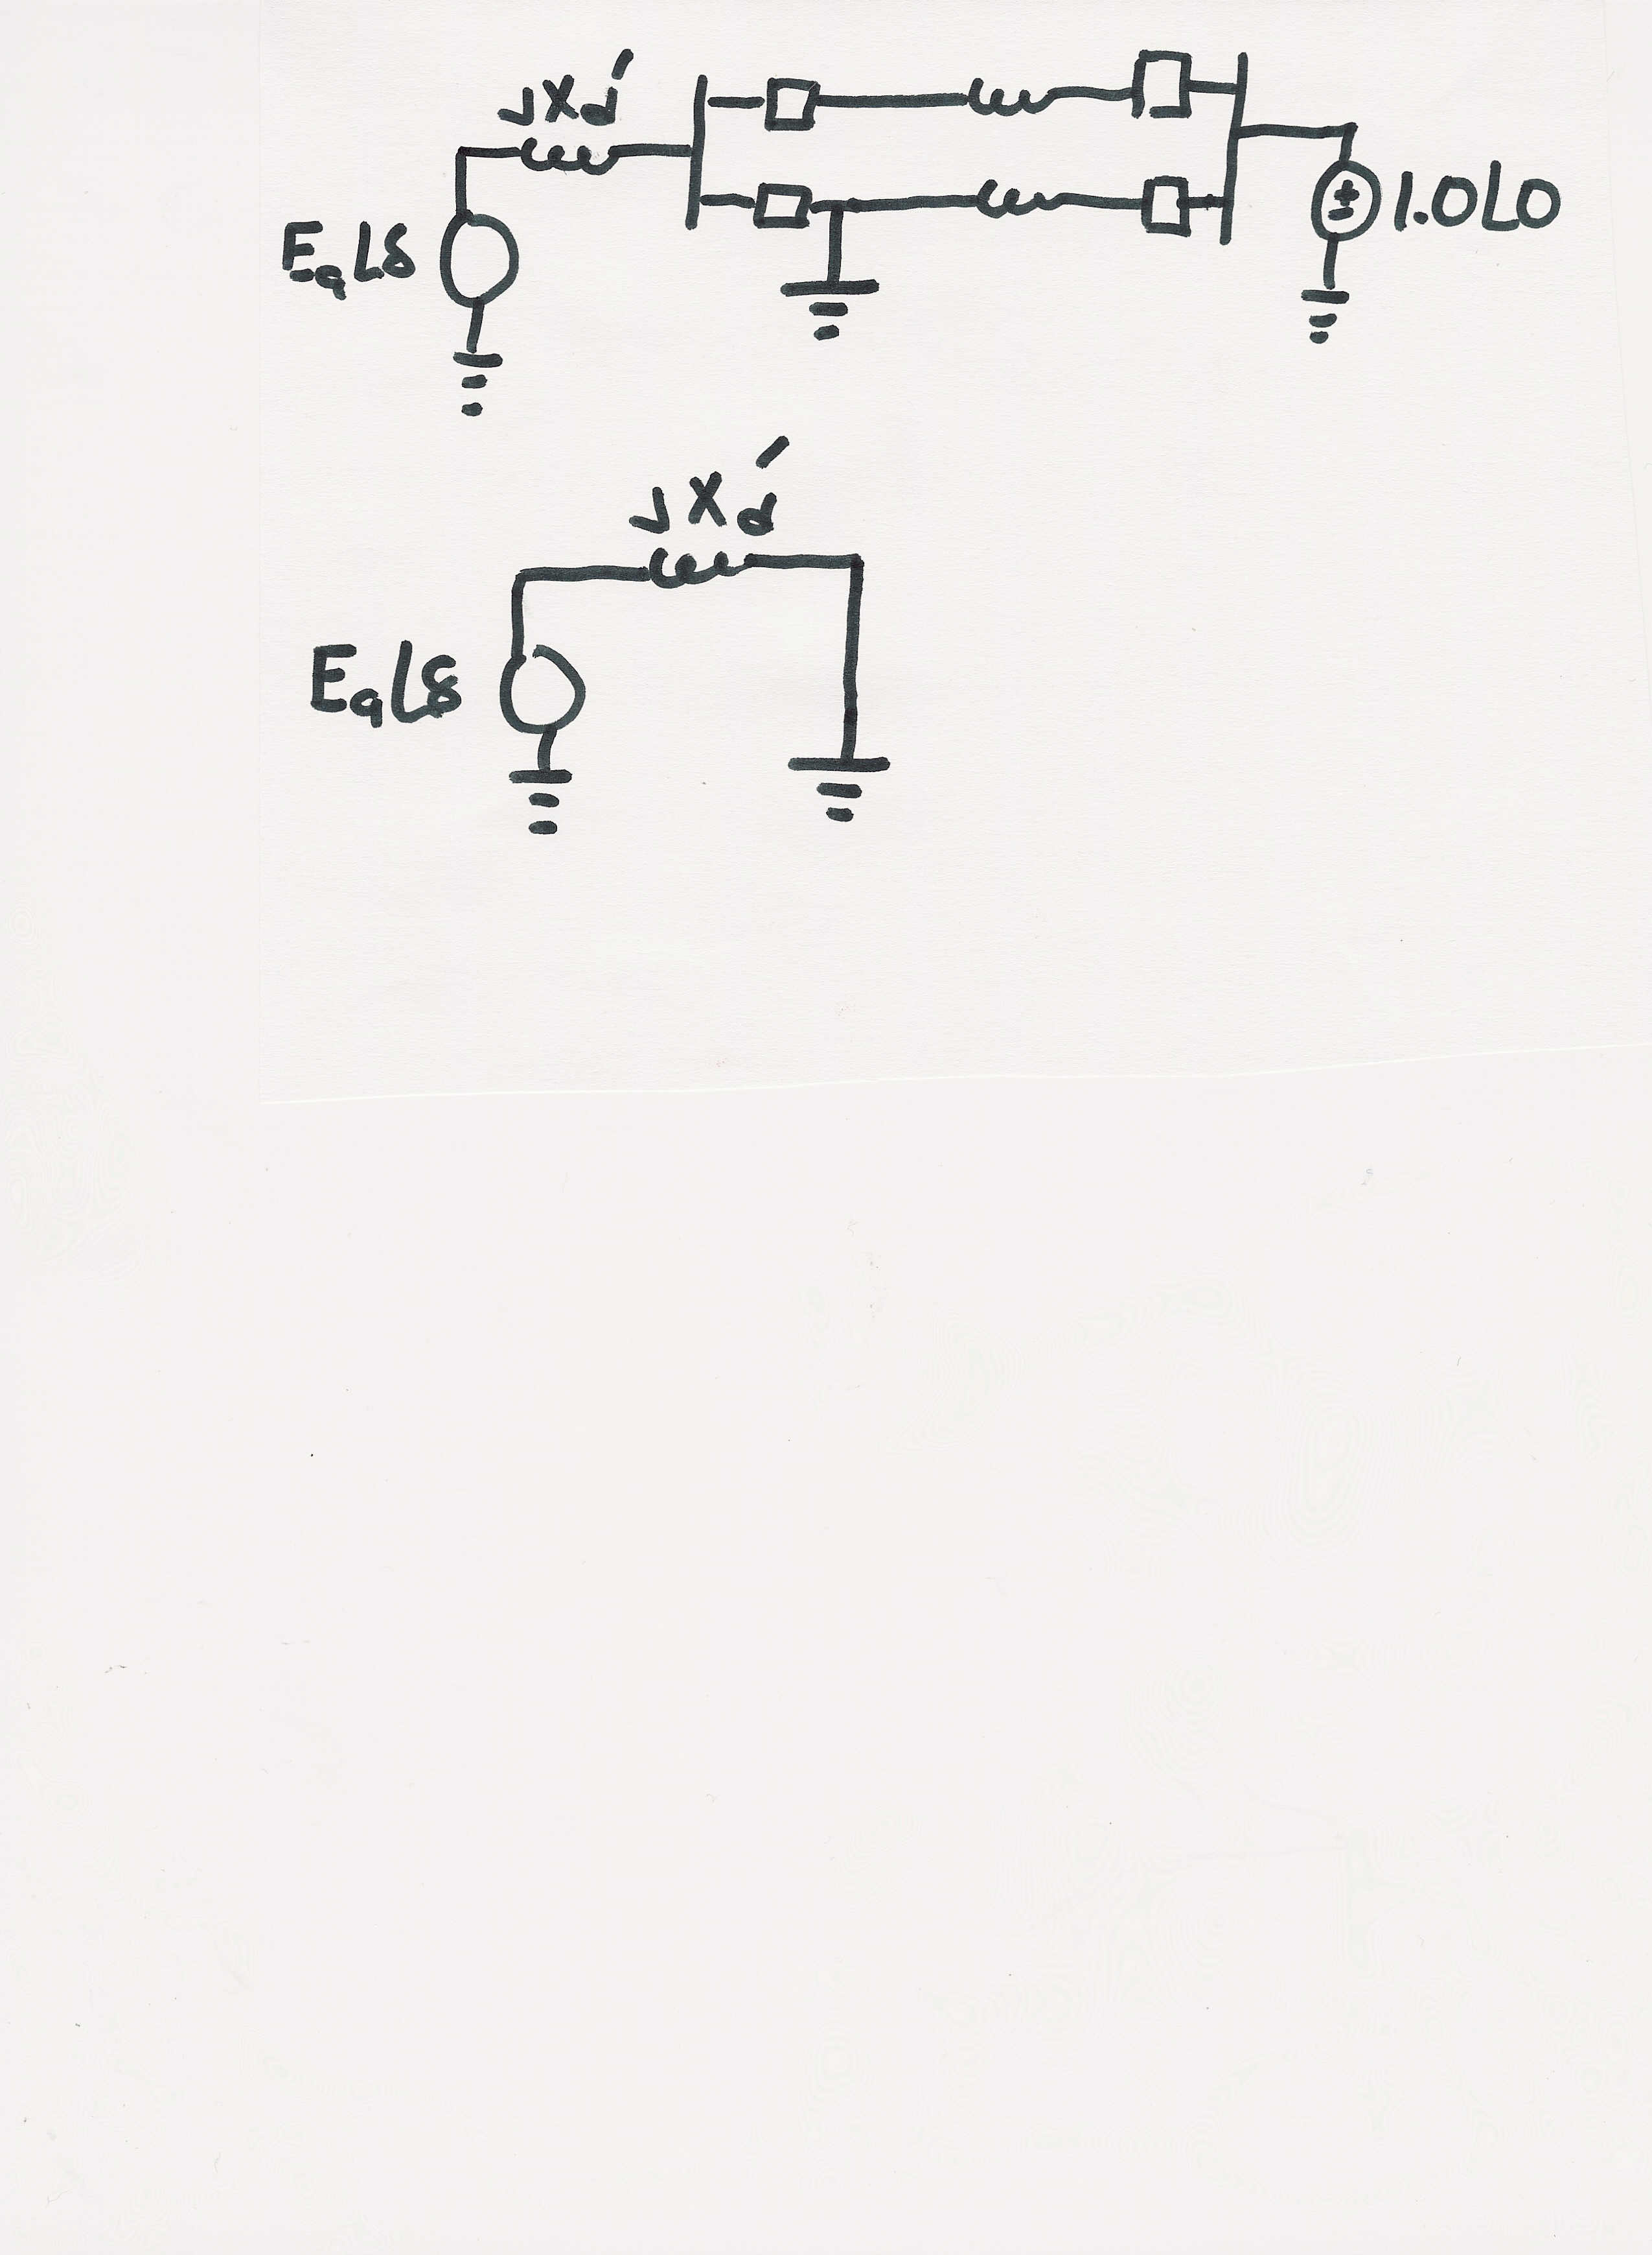
SMIB Example, Faulted System
During the fault the system changes
The equivalent system during the fault is then
During this fault no
power can be transferred
from the generator to
the system
24

