Slide 1
ECE 476
Renewable Energy Systems
Lecture 2: Power Industry History,
Review of Phasors
Prof. Tom Overbye
Dept. of Electrical and Computer Engineering
University of Illinois at Urbana-Champaign
overbye@illinois.edu

Slide 2
Announcements
Please read Chapters 1 and 2
HW 1 is 2.7, 16, 24, 33, 47; due Thursday 9/1
  Do the regular problems (not multiple choice)
  HW 1 will be turned in (for other homework we may have an in-class quiz)
  For Problem 2.33 you need to use the PowerWorld Software. You can download the software and cases at the below link; get Version 19 (August 11, 2016) www.powerworld.com/gloveroverbyesarma

Slide 3
History, cont’d – 1990’s & 2000’s
Major opening of industry to competition occurred as a result of National Energy Policy Act of 1992
This act mandated that utilities provide “nondiscriminatory” access to the high voltage transmission
Goal was to set up true competition in generation
Result over the last few years has been a dramatic restructuring of electric utility industry (for better or worse!)
Energy Bill 2005 repealed PUHCA; modified PURPA

Slide 4
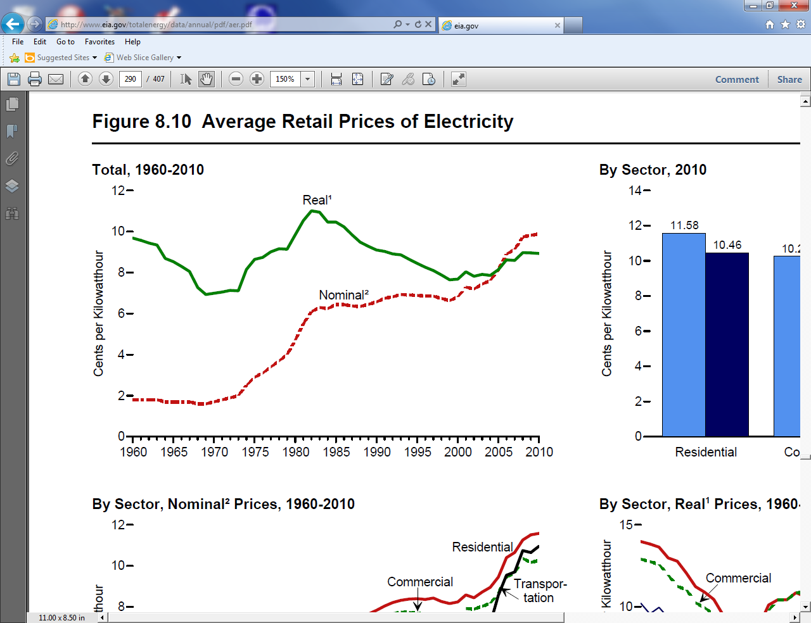
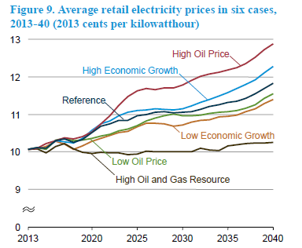
Electricity Prices, 1960-2010
Sources: EIA, Annual Energy Review, 2010, Figure 8.10; 2015, Fig 9

Slide 5
Utility Restructuring
Driven by significant regional variations in electric rates
Goal of competition is to reduce rates through the introduction of competition
Eventual goal is to allow consumers to choose their electricity supplier

Slide 6
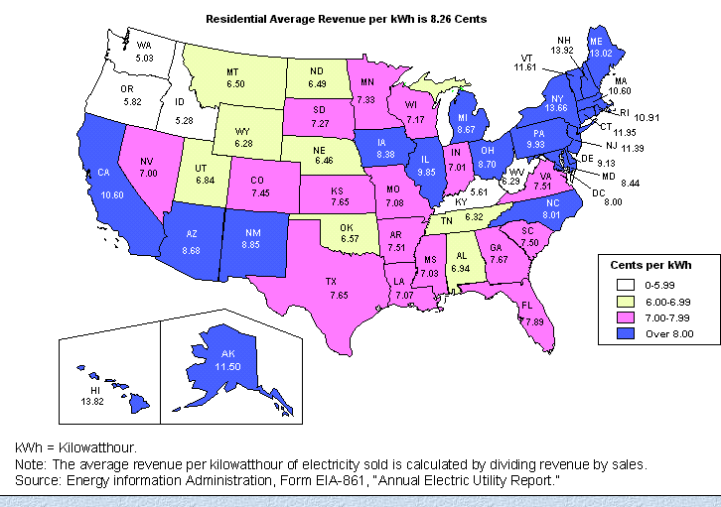
State Variation in Electric Rates

Slide 7
The Goal: Customer Choice

Slide 8
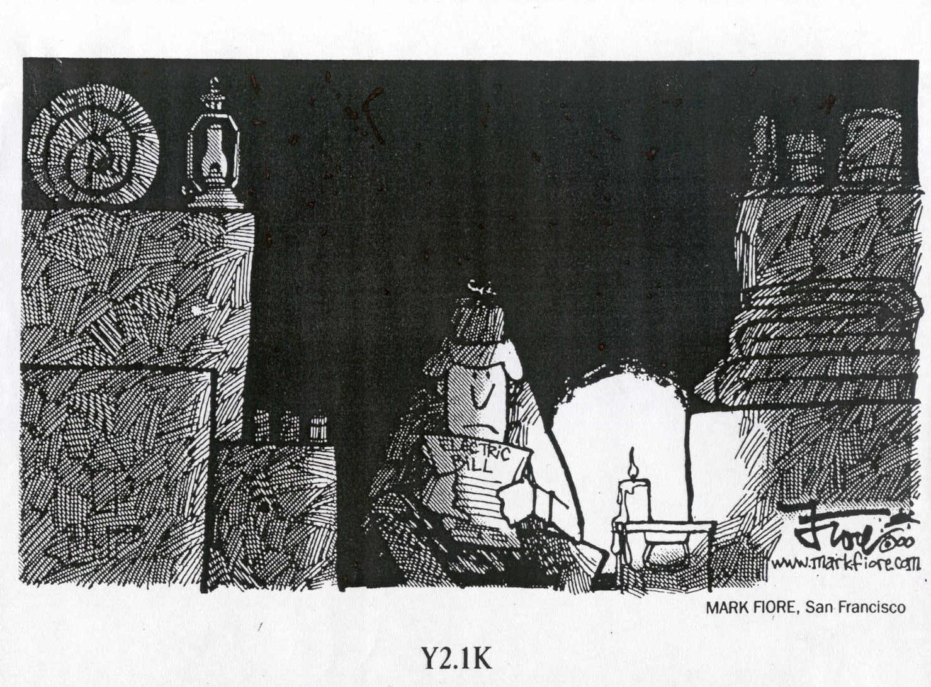
The Result for California in 2000/1
OFF
OFF

Slide 9

The California-Enron Effect
WA
MT
ND
VT
ME
OR
MN
ID
SD
WI
NH
WY
NY
MA
MI
RI
NV
IA
PA
CT
NE
OH
NJ
UT
IL
IN
DE
DC
CO
W
VA
VA
MD
CA
KS
MO
KY
AZ
TN
NC
NM
OK
AR
SC
MS
AL
GA
TX
LA
AK
FL
HI
electricity
restructuring
delayed
restructuring
suspended
restructuring
no activity
Source : http://www.eia.doe.gov/cneaf/electricity/chg_str/regmap.html

Slide 10
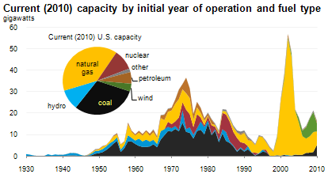
The Rise of Natural Gas
Source: US EIA, 2011

Slide 11
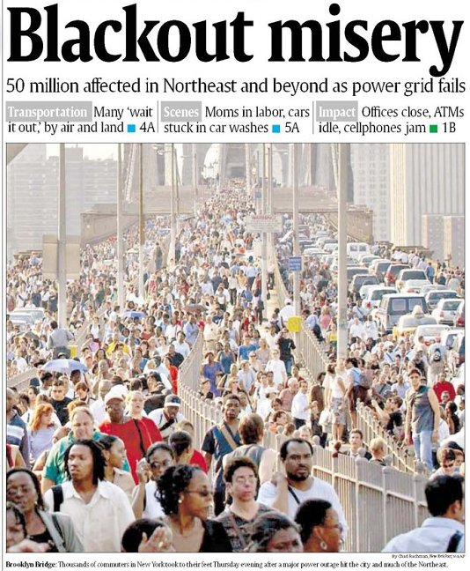
August 14th, 2003 Blackout

Slide 12
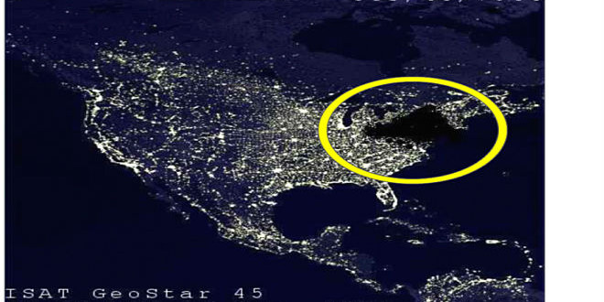
My Favorite Blackout Hoax Photo

Slide 13
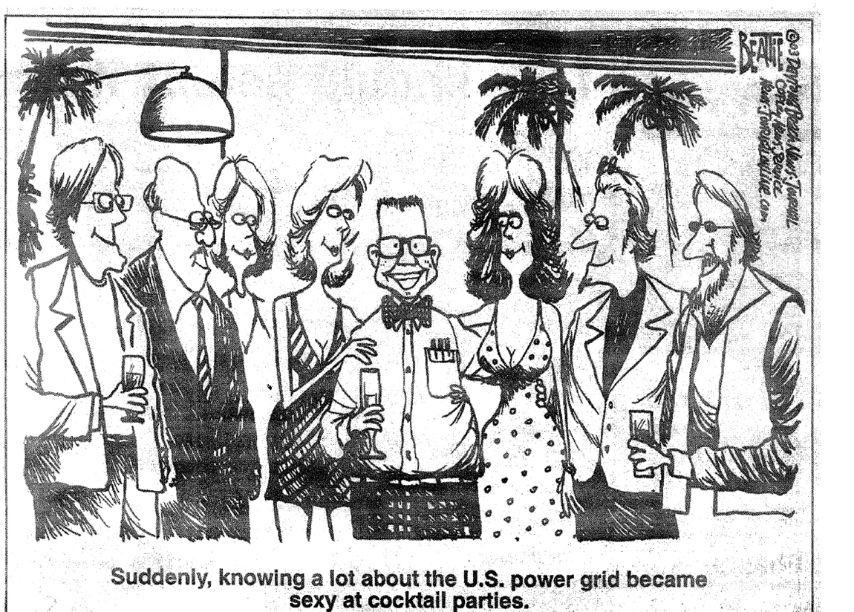
My Favorite 8/14/2003 Blackout Cartoon!

Slide 14
The Smart Grid
The term “Smart Grid” dates officially to the 2007 “Energy Independence and Security Act”, Title 13 (“Smart Grid”)
  Use of digital information and control techniques
  Dynamic grid optimization with cyber-security
  Deployment of distributed resources including
  Customer participation and smart appliances
  Integration of storage including PHEVs
  Development of interoperability standards

Slide 15
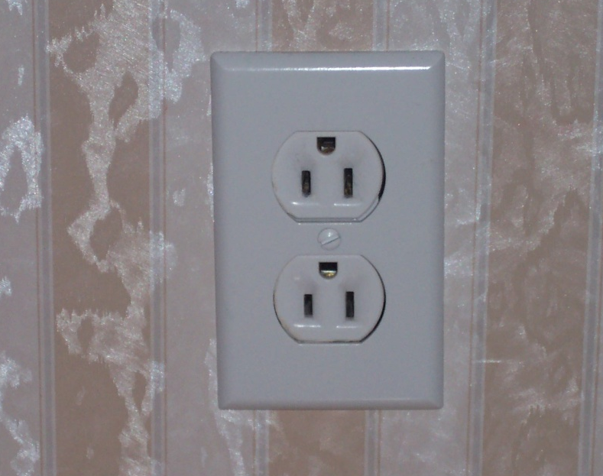
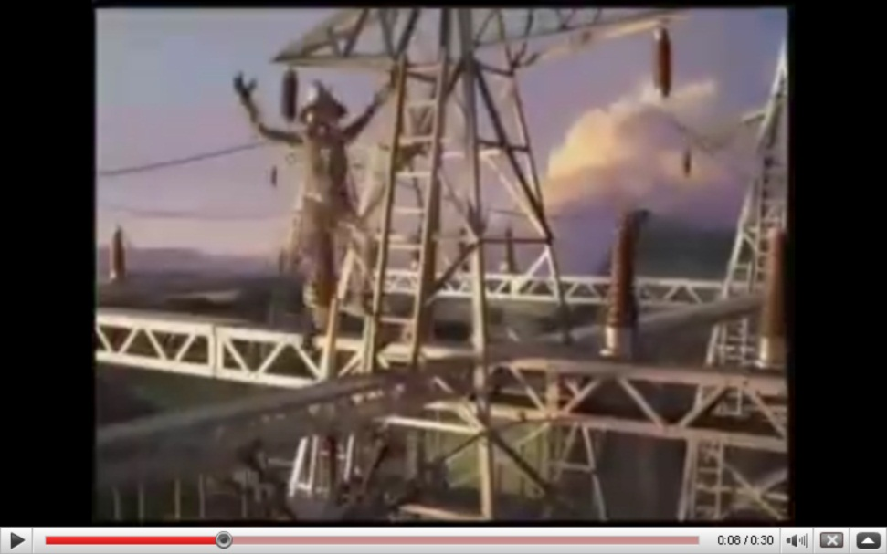
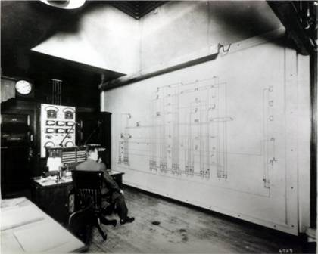
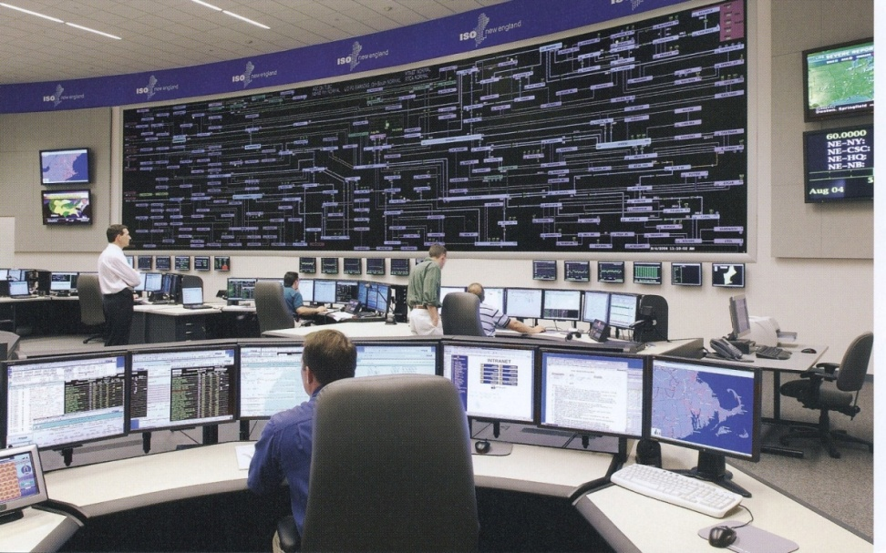
Smart Grid Perceptions (Some of Us Like the Term “Smarter”)

Slide 16
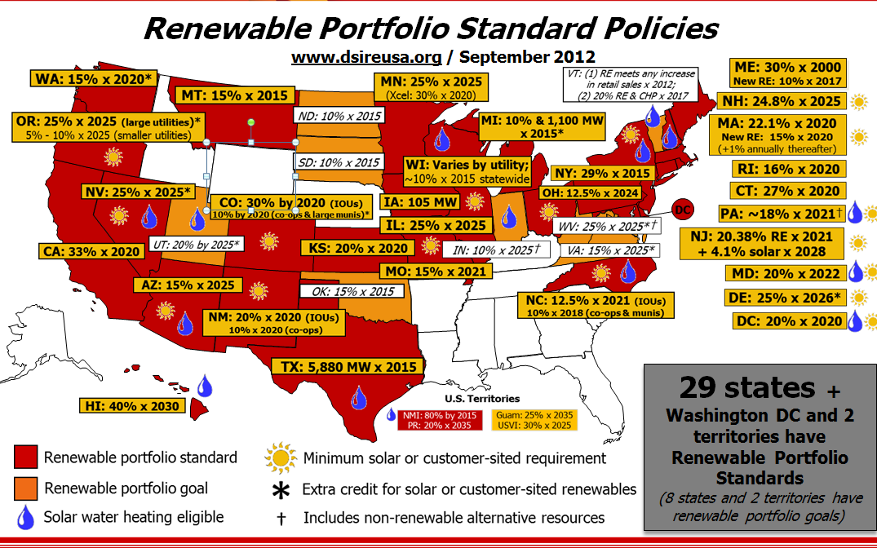
Renewable Portfolio Standards (September 2012)
Source: http://www.dsireusa.org/

Slide 17
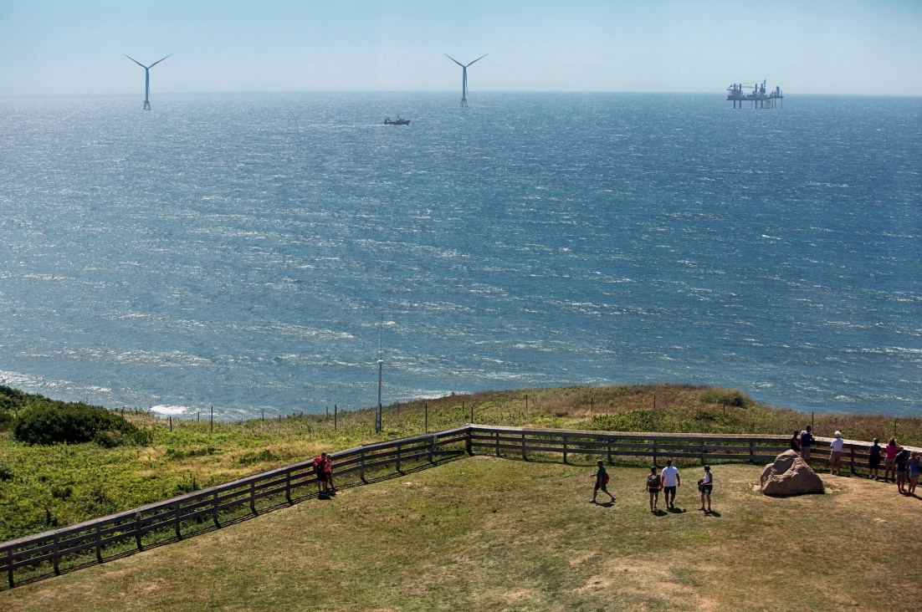
In the News: First US Offshore Wind is Complete
US wind has grown rapidly, but none has been offshore
First offshore wind, Block Island Wind Farm, is now complete and should be generating in October 2016
  It has five 6 MW GE
  direct drive wind
  turbines (30 MW total)
  Located three miles
  southeast of Block Island,
  Rhode Island
  Connected to grid by
  underwater 34.5 kV
  three-phase cables
Image source: New York Times, Aug 22, 2016

Slide 18
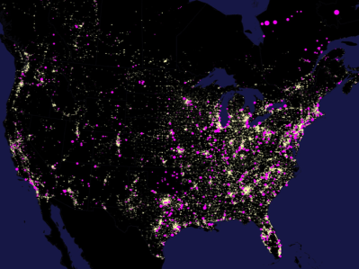
North America Electric Load and Generation

Slide 19
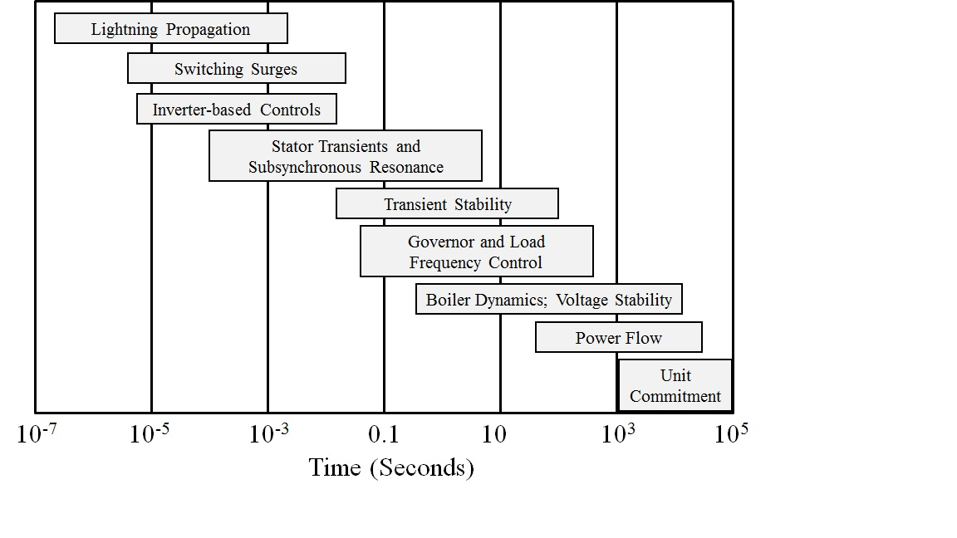
Power System Modeling and Time Frames
Much of class covers power system models. An important quote to keep in mind is
  “Essentially, all models are wrong, but some are useful. However, the approximate nature of the model must always be borne in mind.” G.E.P. Box, N.R. Draper, Empirical Model-Building and Response Surfaces, Wiley, 1987, p. 424.
Power systems covers
many different time
frames, with essentially
no models valid for
all of them
Image: Sauer, P.W., M. A. Pai, Power System Dynamics and Stability, Stripes Publishing, 2007

Slide 20
Review of Phasors
Goal of phasor analysis is to simplify the analysis of constant frequency ac systems
v(t) = V_{max} cos(ωt + θ_{v})
i(t) = I_{max} cos(ωt + θ_{I})
Root Mean Square (RMS) voltage of sinusoid

Slide 21
Phasor Representation

Slide 22
Phasor Representation, cont’d
(Note: Some texts use “boldface” type for complex numbers, or “bars on the top”)

Slide 23
Advantages of Phasor Analysis
(Note: Z is a complex number but not a phasor)

Slide 24
RL Circuit Example

Slide 25
Complex Power

Slide 26
Complex Power, cont’d

Slide 27
Complex Power
(Note: S is a complex number but not a phasor)

Slide 28
Complex Power, cont’d

Slide 29
Conservation of Power
At every node (bus) in the system
  Sum of real power into node must equal zero
  Sum of reactive power into node must equal zero
This is a direct consequence of Kirchhoff’s current law, which states that the total current into each node must equal zero.
  Conservation of power follows since S = VI*

Slide 30
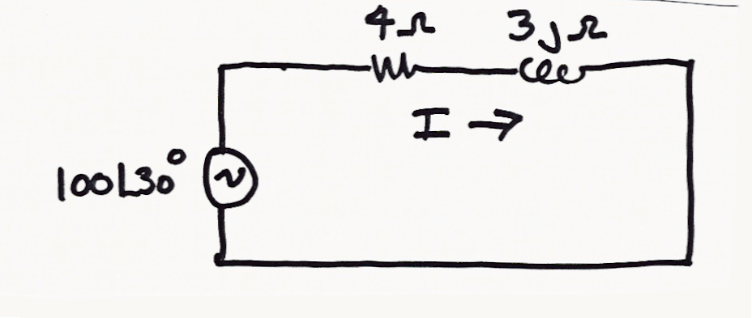
Conversation of Power Example
Earlier we found
I = 20∠-6.9° amps

