Slide 1
ECE 476
Power System Analysis
Lecture 16: Power Flow Sensitivities,
Economic Dispatch
Prof. Tom Overbye
Dept. of Electrical and Computer Engineering
University of Illinois at Urbana-Champaign
overbye@illinois.edu

Slide 2
Announcements
Please read Chapter 6
HW 6 is 6.9, 6.18, 6.34, 6.38, 6.48, 6.53; this one must be turned in on Oct 20 (hence there will be no quiz that day)
Optional: Read the August 14, 2003 Blackout Report, which is available at
  energy.gov/sites/prod/files/oeprod/DocumentsandMedia/BlackoutFinal-Web.pdf

Slide 3
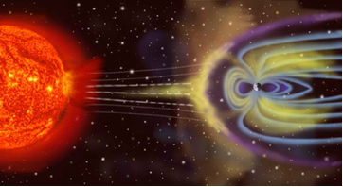
In the News: Presidential Order Associated with Space Weather
On Oct 13, 2016 President Obama issued an executive order directing the government to prepare for space weather events
  Power grid is particularly vulnerable to space weather
Corona mass ejections from
sun impact earth’s magnetic
field, causing a geomagnetic
disturbance (GMD). The
GMD induces quasi-steady
geomagnetically induced currents (GICs) in the power, causing transformer saturation
https://www.whitehouse.gov/the-press-office/2016/10/13/executive-order-coordinating-efforts-prepare-nation-space-weather-events

Slide 4
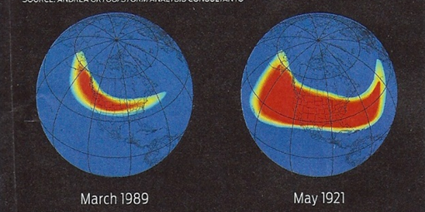
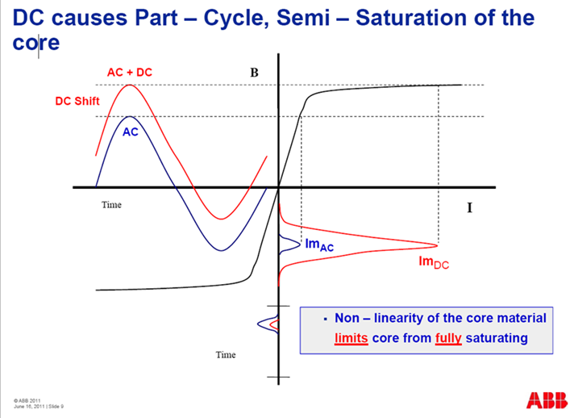
In the News: GMDs and GICs
GMDs are continental in size
In 1989 a 500 nT/minute storm
blacked out Quebec
Much larger stores occurred in
1859 and 1921, that could produce much larger magnetic field variations
  A very large “near miss” occurred
  in July 2012
The induced GICs offset the
ac currents, pushing transformers
into saturation
Top image source: J. Kappenman, “A Perfect Storm of Planetary Proportions,” IEEE Spectrum, Feb 2012, page 29
Bottom image source: Craig Stiegmeirer, ABB, JASON Presentation, June 2011

Slide 5
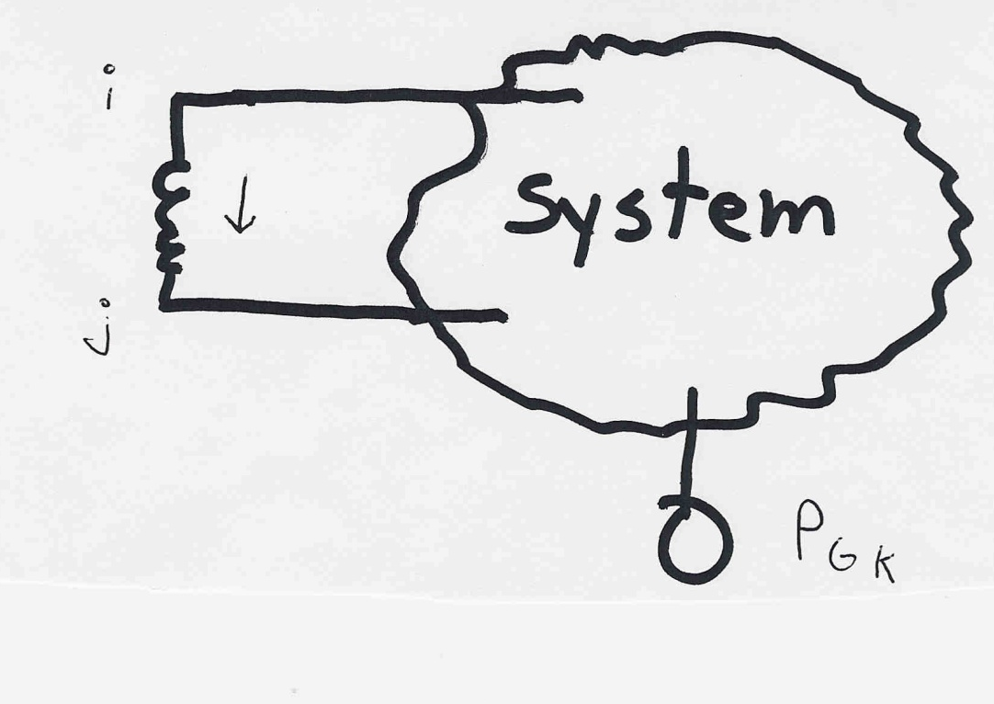
Indirect Transmission Line Control
What we would like to determine is how a change in
generation at bus k affects the power flow on a line
from bus i to bus j.
The assumption is
that the change
in generation is
absorbed by the
slack bus
4

Slide 6
Power Flow Simulation - Before
One way to determine the impact of a generator change is to compare a before/after power flow.
For example below is a three bus case with an overload
5

Slide 7
Power Flow Simulation - After
Increasing the generation at bus 3 by 95 MW (and hence
decreasing it at bus 1 by a corresponding amount), results
in a 31.3 drop in the MW flow on the line from bus 1 to 2.
6

Slide 8
Analytic Calculation of Sensitivities
Calculating control sensitivities by repeat power flow solutions is tedious and would require many power flow solutions. An alternative approach is to analytically calculate these values
7

Slide 9
Analytic Sensitivities
8

Slide 10
Three Bus Sensitivity Example
9

Slide 11
Balancing Authority Areas
An balancing authority area (use to be called operating areas) has traditionally represented the portion of the interconnected electric grid operated by a single utility
Transmission lines that join two areas are known as tie-lines.
The net power out of an area is the sum of the flow on its tie-lines.
The flow out of an area is equal to
total gen - total load - total losses = tie-flow
10

Slide 12
Area Control Error (ACE)
The area control error (ace) is the difference between the actual flow out of an area and the scheduled flow, plus a frequency component
Ideally the ACE should always be zero.
Because the load is constantly changing, each utility must constantly change its generation to “chase” the ACE.
11

Slide 13
Automatic Generation Control
Most utilities use automatic generation control (AGC) to automatically change their generation to keep their ACE close to zero.
Usually the utility control center calculates ACE based upon tie-line flows; then the AGC module sends control signals out to the generators every couple seconds.
12

Slide 14
Power Transactions
Power transactions are contracts between generators and loads to do power transactions.
Contracts can be for any amount of time at any price for any amount of power.
Scheduled power transactions are implemented by modifying the value of P_{sched} used in the ACE calculation
13

Slide 15
PTDFs
Power transfer distribution factors (PTDFs) show the linear impact of a transfer of power.
PTDFs calculated using the fast decoupled power flow B matrix
14

Slide 16
Nine Bus PTDF Example
Figure shows initial flows for a nine bus power system
15

Slide 17
Nine Bus PTDF Example, cont'd
Figure now shows percentage PTDF flows from A to I
16

Slide 18
Nine Bus PTDF Example, cont'd
Figure now shows percentage PTDF flows from G to F
17

Slide 19
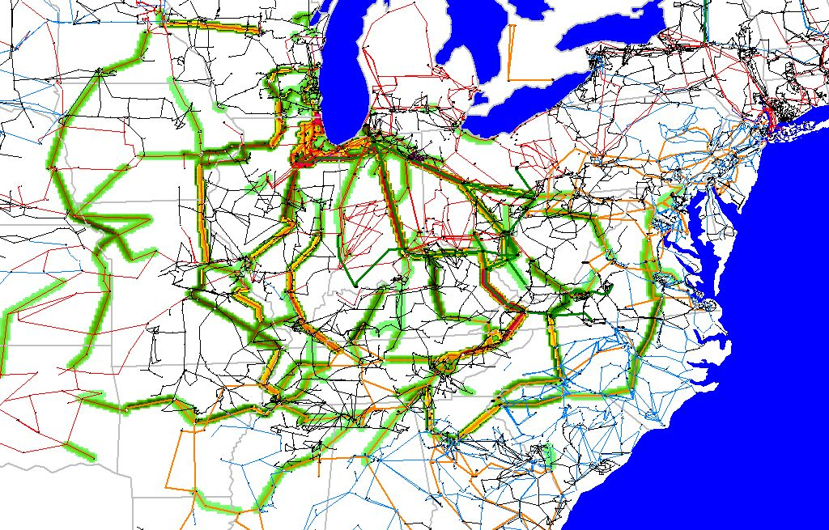
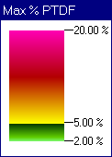
WE to TVA PTDFs

Slide 20
Line Outage Distribution Factors (LODFS)
LODFs are used to approximate the change in the flow on one line caused by the outage of a second line
  typically they are only used to determine the change in the MW flow
  LODFs are used extensively in real-time operations
  LODFs are state-independent but do dependent on the assumed network topology

Slide 21
Flowgates
The real-time loading of the power grid is accessed via “flowgates”
A flowgate “flow” is the real power flow on one or more transmission element for either base case conditions or a single contingency
  contingent flows are determined using LODFs
Flowgates are used as proxies for other types of limits, such as voltage or stability limits
Flowgates are calculated using a spreadsheet

Slide 22
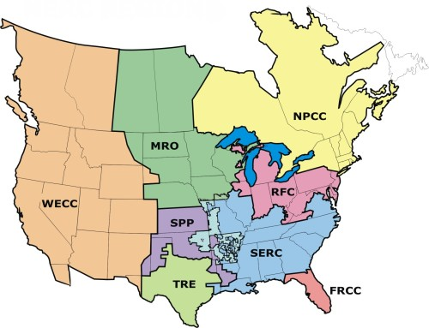
NERC Regional Reliability Councils
NERC
is the
North
American
Electric
Reliability
Council

Slide 23
Generation Dispatch
Since the load is variable and there must be enough generation to meet the load, almost always there is more generation capacity available than load
Optimally determining which generators to use can be a complicated task due to many different constraints
  For generators with low or no cost fuel (e.g., wind and solar PV) it is “use it or lose it”
  For others like hydro there may be limited energy for the year
  Some fossil has shut down and start times of many hours
Economic dispatch looks at the best way to instantaneously dispatch the generation
22

Slide 24
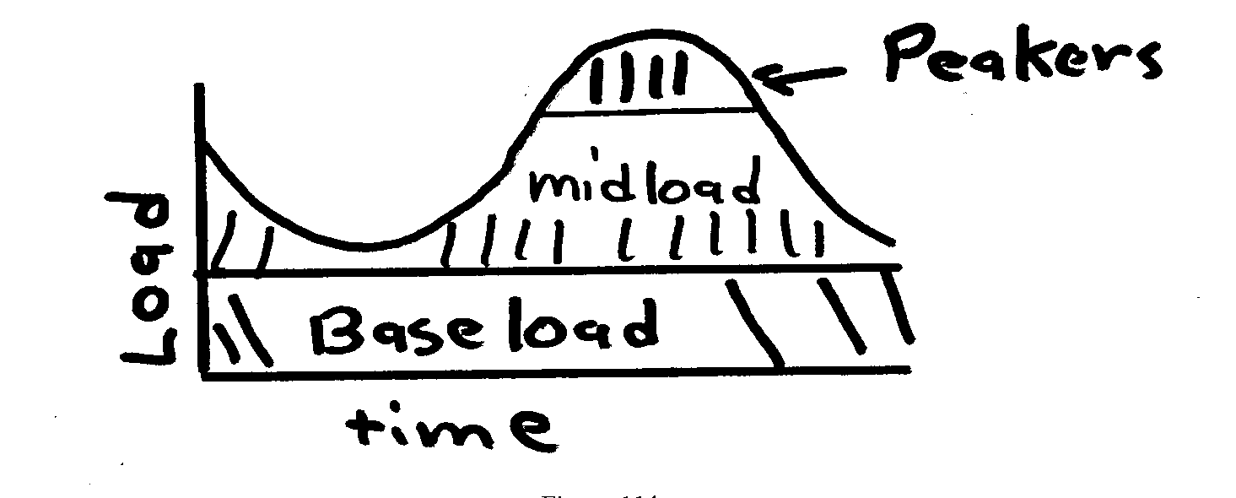
Generator types
Traditionally utilities have had three broad groups of generators
  baseload units: large coal/nuclear; always on at max.
  midload units: smaller coal that cycle on/off daily
  peaker units: combustion turbines used only for several hours during periods of high demand
Wind and solar
PV can be
quite variable;
usually they are
operated at max.
available power
23

Slide 25
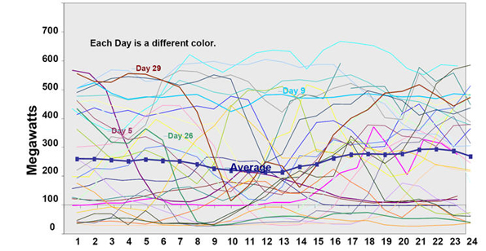
Example California Wind Output
Image shows wind output for a month by hour and day
Source: www.megawattsf.com/gridstorage/gridstorage.htm
24

Slide 26
Thermal versus Hydro Generation
The two main types of generating units are thermal and hydro, with wind rapidly growing
For hydro the fuel (water) is free but there may be many constraints on operation
  fixed amounts of water available
  reservoir levels must be managed and coordinated
  downstream flow rates for fish and navigation
Hydro optimization is typically longer term (many months or years)
In 476 we will concentrate on thermal units and some wind, looking at short-term optimization
25

Slide 27
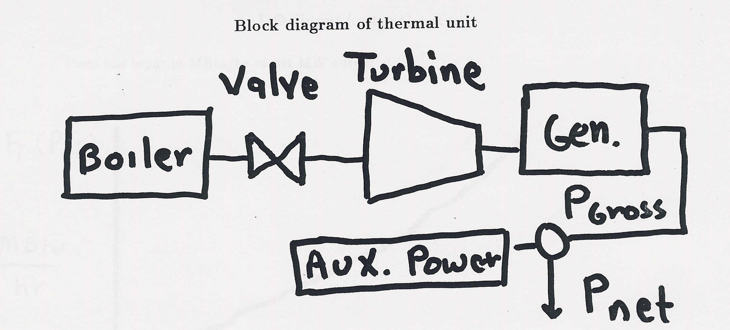
Block Diagram of Thermal Unit
To optimize generation costs we need to develop
cost relationships between net power out and operating
costs. Between 2-6% of power is used within the
generating plant; this is known as the auxiliary power
26

Slide 28
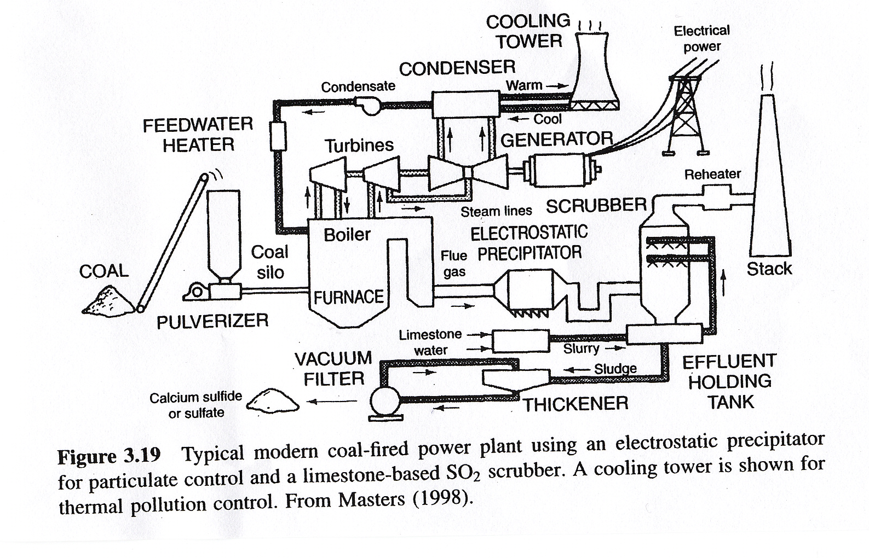
Modern Coal Plant
Source: Masters, Renewable and Efficient Electric Power Systems, 2004
27

Slide 29
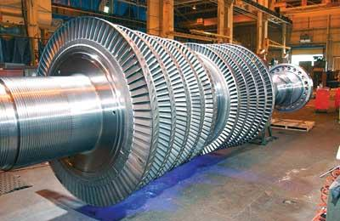
Turbine for Nuclear Power Plant
Source: http://images.pennnet.com/articles/pe/cap/cap_gephoto.jpg
28

Slide 30
Basic Gas Turbine
Brayton Cycle: Working fluid is
always a gas
Most common fuel is natural gas
Typical efficiency is around 30 to 35%
29

