Slide 1
ECE 476
Power System Analysis
Lecture 15: Power Flow
Prof. Tom Overbye
Dept. of Electrical and Computer Engineering
University of Illinois at Urbana-Champaign
overbye@illinois.edu

Slide 2
Announcements
Please read Chapter 6
HW 6 is 6.9, 6.18, 6.34, 6.38, 6.48, 6.53; this one must be turned in on Oct 20 (hence there will be no quiz that day); (there is no HW due on Oct 12 and no quiz)

Slide 3
Voltage Regulation Example: 37 Buses
Display shows voltage contour of the power system, demo
will show the impact of generator voltage set point,
reactive power limits, and switched capacitors
2
Notes:
2

Slide 4
Solving Large Power Systems
The most difficult computational task is inverting the Jacobian matrix
  inverting a full matrix is an order n³ operation, meaning the amount of computation increases with the cube of the size size
  this amount of computation can be decreased substantially by recognizing that since the Y_{bus} is a sparse matrix, the Jacobian is also a sparse matrix
  using sparse matrix methods results in a computational order of about n^{1.5}.
  this is a substantial savings when solving systems with tens of thousands of buses

Slide 5
Newton-Raphson Power Flow
Advantages
  fast convergence as long as initial guess is close to solution
  large region of convergence
Disadvantages
  each iteration takes much longer than a Gauss-Seidel iteration
  more complicated to code, particularly when implementing sparse matrix algorithms
Newton-Raphson algorithm is very common in power flow analysis

Slide 6
Modeling Voltage Dependent Load

Slide 7
Voltage Dependent Load Example

Slide 8
Voltage Dependent Load, cont'd

Slide 9
Voltage Dependent Load, cont'd
With constant impedance load the MW/Mvar load at
bus 2 varies with the square of the bus 2 voltage
magnitude. This if the voltage level is less than 1.0,
the load is lower than 200/100 MW/Mvar

Slide 10
Dishonest Newton-Raphson
Since most of the time in the Newton-Raphson iteration is spend calculating the inverse of the Jacobian, one way to speed up the iterations is to only calculate/inverse the Jacobian occasionally
  known as the “Dishonest” Newton-Raphson
  an extreme example is to only calculate the Jacobian for the first iteration

Slide 11
Dishonest Newton-Raphson Example

Slide 12
Dishonest N-R Example, cont’d
We pay a price
in increased
iterations, but
with decreased
computation
per iteration

Slide 13
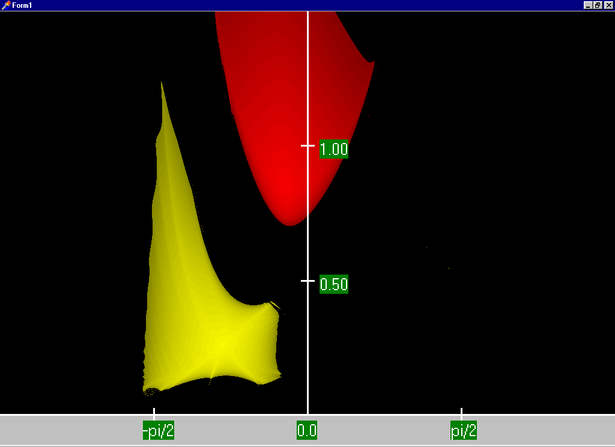
Two Bus Dishonest ROC
Slide shows the region of convergence for different initial
guesses for the 2 bus case using the Dishonest N-R
Red region
converges
to the high
voltage
solution,
while the
yellow region
converges
to the low
voltage
solution

Slide 14
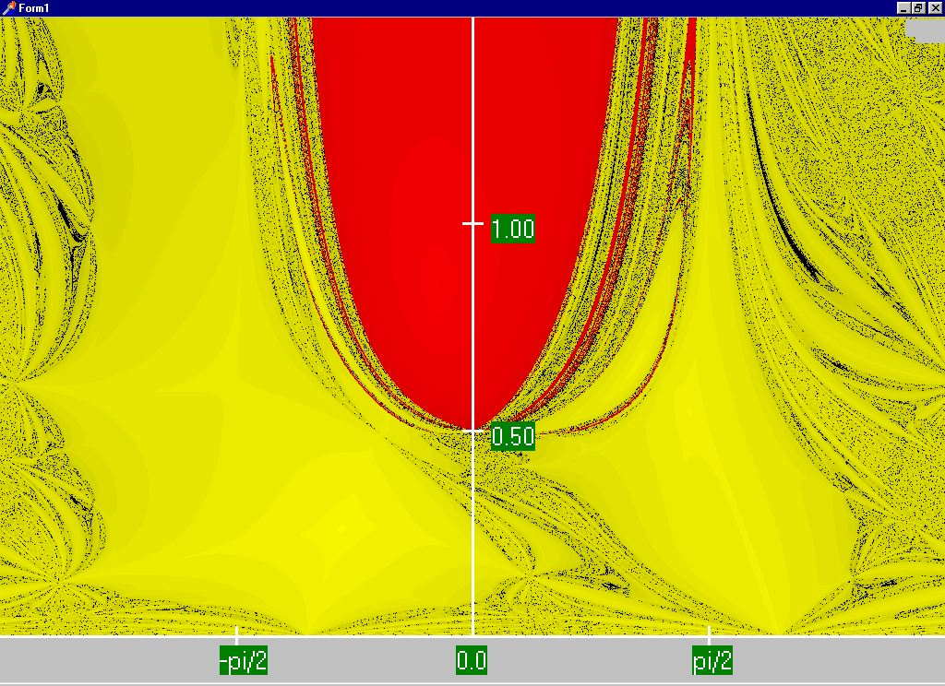
Honest N-R Region of Convergence
Maximum
of 15
iterations

Slide 15
Decoupled Power Flow
The completely Dishonest Newton-Raphson is not used for power flow analysis. However several approximations of the Jacobian matrix are used.
One common method is the decoupled power flow. In this approach approximations are used to decouple the real and reactive power equations.

Slide 16
Decoupled Power Flow Formulation

Slide 17
Decoupling Approximation

Slide 18
Off-diagonal Jacobian Terms

Slide 19
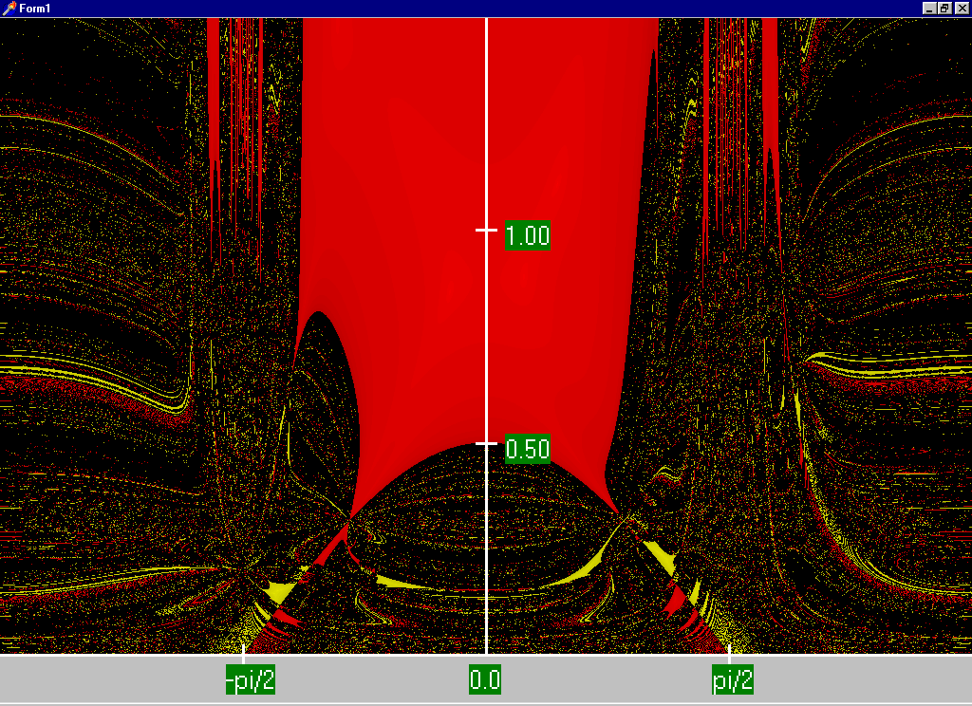
Decoupled N-R Region of Convergence

Slide 20
Fast Decoupled Power Flow
By continuing with our Jacobian approximations we can actually obtain a reasonable approximation that is independent of the voltage magnitudes/angles.
This means the Jacobian need only be built/inverted once.
This approach is known as the fast decoupled power flow (FDPF)
FDPF uses the same mismatch equations as standard power flow so it should have same solution
The FDPF is widely used, particularly when we only need an approximate solution

Slide 21
FDPF Approximations

Slide 22
FDPF Three Bus Example
Use the FDPF to solve the following three bus system

Slide 23
FDPF Three Bus Example, cont’d

Slide 24
FDPF Three Bus Example, cont’d

Slide 25
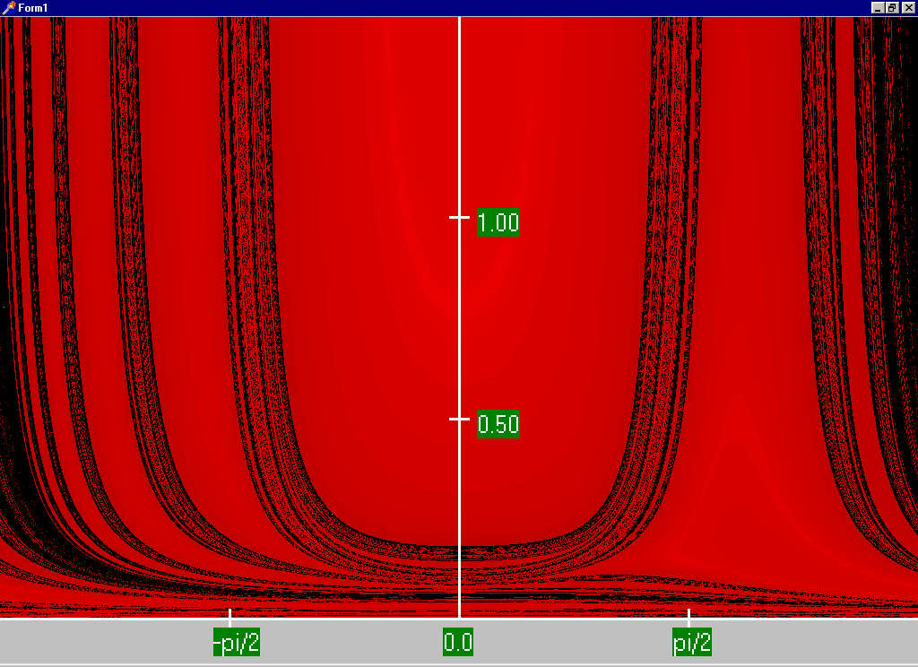
FDPF Region of Convergence

Slide 26
“DC” Power Flow
The “DC” power flow makes the most severe approximations:
  completely ignore reactive power, assume all the voltages are always 1.0 per unit, ignore line conductance
This makes the power flow a linear set of equations, which can be solved directly

Slide 27
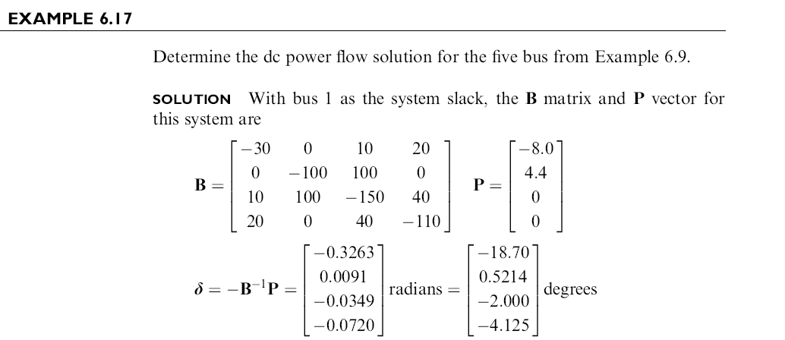
DC Power Flow Example
26
Notes:
26

Slide 28
DC Power Flow 5 Bus Example
Notice with the dc power flow all of
the voltage magnitudes are 1 per unit.
27
Notes:
27

Slide 29
Power System Control
A major problem with power system operation is the limited capacity of the transmission system
  lines/transformers have limits (usually thermal)
  no direct way of controlling flow down a transmission line (e.g., there are no valves to close to limit flow)
  open transmission system access associated with industry restructuring is stressing the system in new ways
We need to indirectly control transmission line flow by changing the generator outputs
Similar control issues with voltage

Slide 30
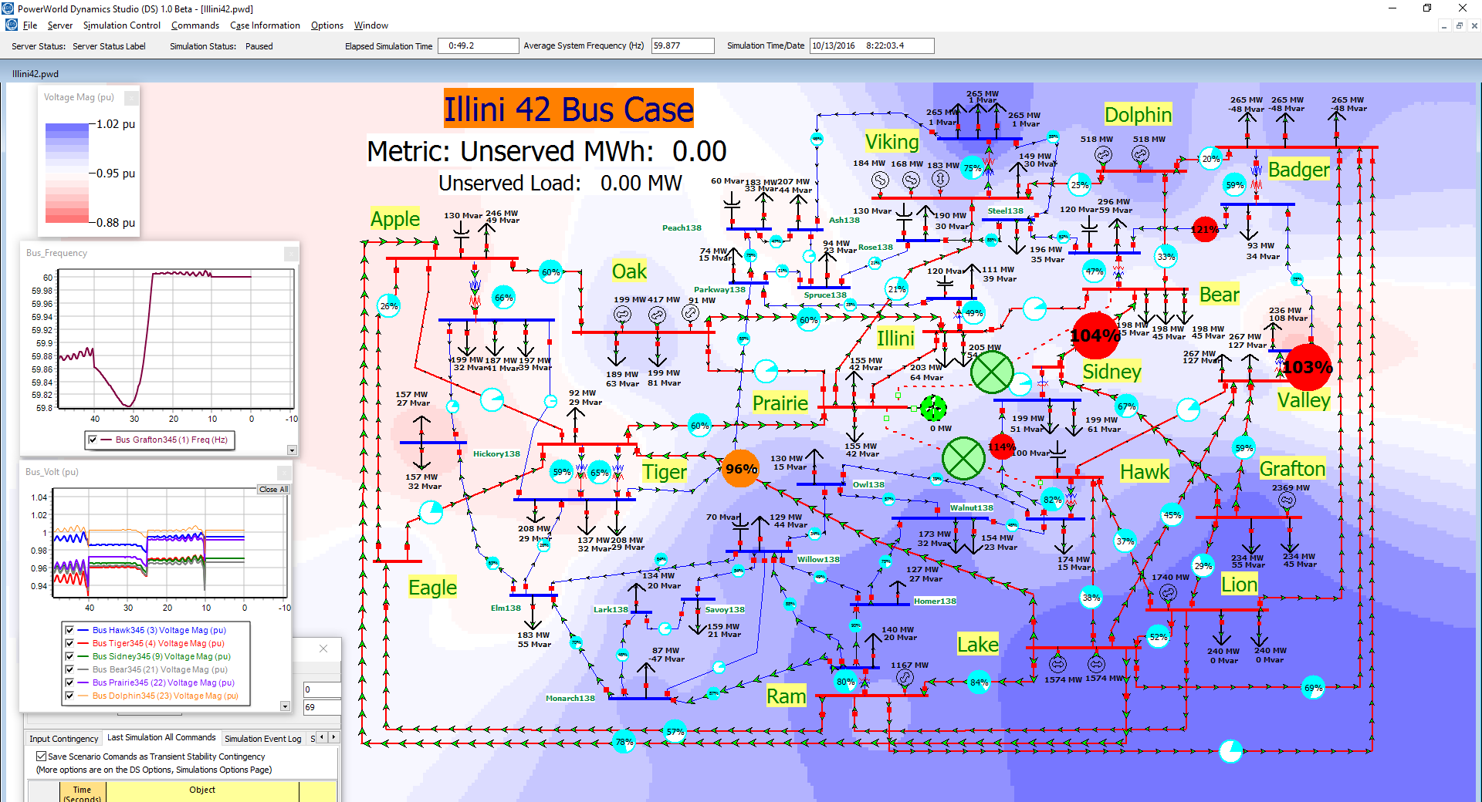
Extreme Control Example: 42 Bus Tornado Scenario

Slide 31
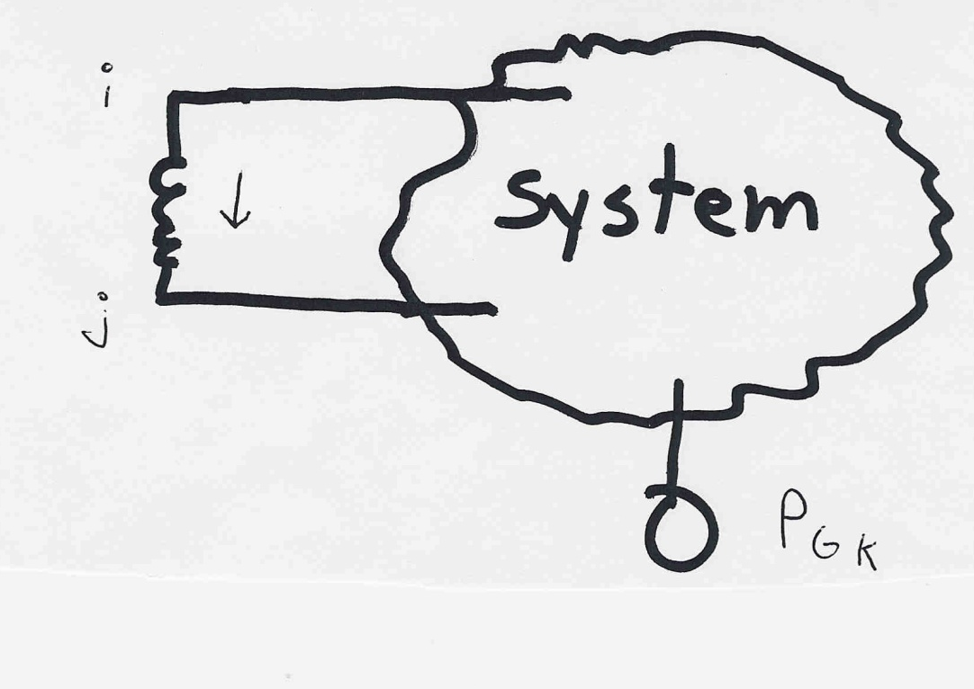
Indirect Transmission Line Control
What we would like to determine is how a change in
generation at bus k affects the power flow on a line
from bus i to bus j.
The assumption is
that the change
in generation is
absorbed by the
slack bus
30

Slide 32
Power Flow Simulation - Before
One way to determine the impact of a generator change is to compare a before/after power flow.
For example below is a three bus case with an overload
31

Slide 33
Power Flow Simulation - After
Increasing the generation at bus 3 by 95 MW (and hence
decreasing it at bus 1 by a corresponding amount), results
in a 31.3 drop in the MW flow on the line from bus 1 to 2.
32

