Slide 1
Lecture 39 – final exam review
Mark Hasegawa-Johnson
5/4/2020

Slide 2
Facts about the final exam
Final exam will be on Compass.
The regular section is 7-10pm on May 13.
Alternate exam is 7-10am May 13; if you prefer 7am, please e-mail the instructor.
Exam is open-book, open-notes, open-internet. You can search for a solution on-line, but you MAY NOT ASK FOR HELP from another human being.
Exception: you can ask the instructors, if you have a question. Piazza will be locked so that it ONLY accepts private posts to the instructors; please use piazza if you have questions during the exam.

Slide 3
Topics covered
There will be approximately 20 questions on the exam (at most two parts per question), distributed as follows:
Part 1 of the course (Search-based AI): ~4 questions
Part 2 of the course (Probability-based AI): ~4 questions
Part 3 of the course (Learning-based AI): ~12 questions

Slide 4
Material from part 1 of the course
Search (BFS, DFS, UCS, Greedy, A*): lectures 2-4
Constraint satisfaction problems & planning: lectures 5 and 8
Robots/configuration space: lectures 6-7
Two-player games (minimax and alpha-beta): lectures 9-10

Slide 5
Material from part 2 of the course
Probability & Naïve Bayes: lectures 12, 14
Bayes Nets: lectures 15, 16
Natural language and Computer vision: lectures 17, 20
HMMs: lectures 18, 19

Slide 6
Material from part 3 of the course
Linear classifiers, KNN, Perceptron: lectures 22, 25, 26
Differentiable loss functions & Deep neural networks (logistic regression, softmax, cross-entropy loss, back-propagation): lectures 26-28
MDP (Bellman’s equation, value iteration, policy iteration) & Reinforcement learning (model-based, Q-learning, deep Q-learning, actor-critic): lectures 29-32
RL for two-player games, games of chance, imperfect information: lectures 33-34
Game theory & Mechanism design: lectures 35-36

Slide 7
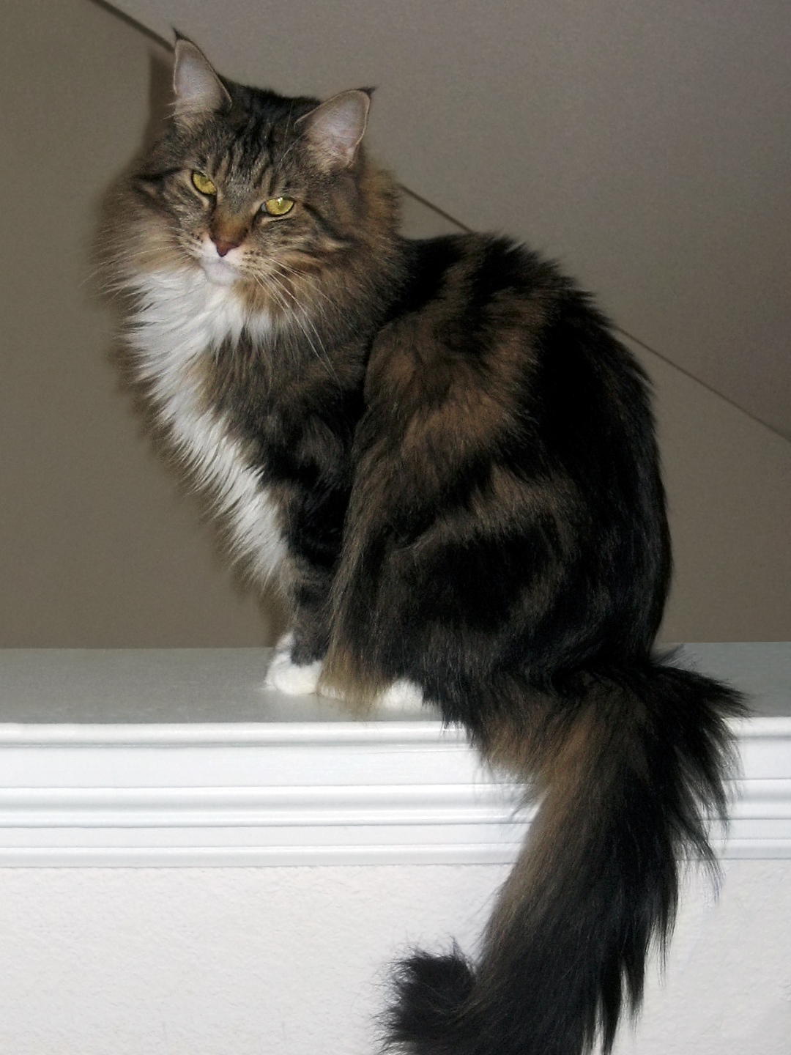
Linear classifiers
$y^{∗} =\operatorname{sgn}\left(w1x1+…+wDxD+b\right)=sgn⁡({\vec{w}}^{T}\vec{x}$)
A linear classifier can learn many types of binary functions (e.g., AND, OR, NOT), but it can’t learn XOR.
Perceptron:
If $y_{i}=y_{i}^{∗}$ then do nothing.
If $y_{i}≠y_{i}^{∗}$ then set $\vec{w}=\vec{w}+η{y_{i}\vec{x}}_{i}$
If the data are linearly separable, perceptron converges with $η=1$. If not, you need a decreasing $η$, e.g., $η=\frac{1}{n}.$
K-nearest neighbors (KNN):
Find the K training tokens closest to the test token. Have them vote: majority label is the label of the test token.
Result is a piece-wise linear classifier because the boundary between the features where training token #1 is closest, vs. training token #2 closest, is a line.
By Smok Bazyli - Own work, CC BY-SA 3.0, https://commons.wikimedia.org/w/index.php?curid=16864492
$$x_{2}$$
By Mandruss - This file was derived from: Maine Coon female 2.jpg, CC BY-SA 4.0, https://commons.wikimedia.org/w/index.php?curid=79389146
$$x_{1}$$
CC BY-SA 4.0, https://commons.wikimedia.org/w/index.php?curid=55084303

Slide 8
Deep neural networks
$$y_{1i}^{∗}$$
$$y_{2i}^{∗}$$
$$y_{Vi}^{∗}$$
Each excitation is a linear combination of the previous node’s activations:
$$β_{ki}^{(l)}=\sum_{j=1}^{N+1}{w_{kj}^{(l)}h_{ji}^{(l−1)}}$$
…where $w_{kj}^{(l)}$is called a “network weight,” and will be learned using back-propagation.
Each activation is a scalar nonlinearity applied to the excitation:
$$h_{ki}^{(l)}=g\left(β_{ki}^{(l)}\right)$$
…where $g\left(∙\right)$ is called the “activation function;” it needs to be chosen in advance by the network designer.
$$1$$
$$1$$
$$x_{1i}$$
$$x_{2i}$$
$$…$$
$$x_{Di}$$
$$1$$

Slide 9
Softmax
Training target is a one-hot vector:
$$\vec{y}=[0,…,0,1,0,…,0]$$
Classifier output is
${\vec{y}}^{∗}=\left[y_{0}^{∗},…,y_{V−1}^{∗}\right],$ where $y_{c}^{∗}=\frac{\exp\left({\vec{w}}_{c}^{T}\vec{x}\right)}{\sum_{j=0}^{V−1}{\exp\left({\vec{w}}_{j}^{T}\vec{x}\right)}}$
We usually train using the cross-entropy loss, also known as negative log-likelihood: $$L=−\frac{1}{n}\sum_{i=1}^{n}{\sum_{c=0}^{V−1}{y_{c}}\ln{y_{c}^{∗}}}$$
The derivative of L w.r.t. W has a surprisingly simple form:
$$\frac{dL}{dw_{cd}}=−\frac{1}{n}\sum_{i=1}^{n}{(y_{c}−y_{c}^{∗})x_{d}}$$
Input
Weights
1
$$b_{0}$$
$$b_{1}$$
x₁
Output: ${softmax}_{c=0}^{V−1}\left({\vec{w}}_{c}^{T}\vec{x}\right)$
softmax
x₂
.
.
.
.
.
.
.
.
.
$$b_{V−1}$$
$$w_{0D}$$
$$w_{1D}$$
x_{D}
$$w_{V−1,D}$$

Slide 10
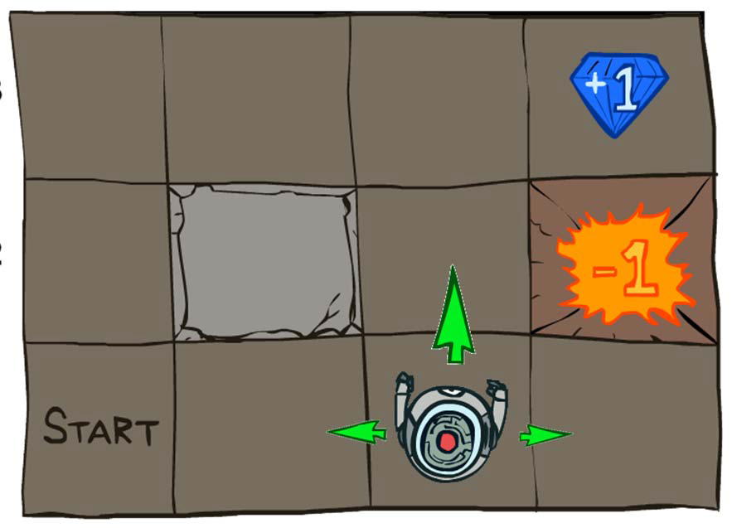
Markov Decision Process
MDP defined by states, actions, transition model, reward function
The “solution” to an MDP is the policy: what do you do when you’re in any given state
The Bellman equation :
$$U\left(s\right)=R\left(s\right)+γ\max_{a}{\sum_{s′}{P\left(s^{′} | s,a\right)U(s^{′})}}$$
Value iteration:
Start with $U^{(0)}\left(s\right)=0$
$U^{(t+1)}\left(s\right)=R\left(s\right)+γ\max_{a}{\sum_{s′}{P\left(s^{′} | s,a\right)U^{(t)}(s^{′})}}$
Policy iteration:
Start with arbitrary $π^{(0)}\left(s\right)$
$U^{(t)}\left(s\right)=R\left(s\right)+γ\sum_{s′}{P\left(s^{′} | s,π^{(t)}\left(s\right)\right)U^{(t)}(s^{′})}$
$π^{(t+1)}\left(s\right)=\underset{a}{argmax}{\sum_{s′}{P\left(s^{′} | s,a\right)U^{(t)}(s^{′})}}$
Grid World drawings © Peter Abbeel and Dan Klein, UC Berkeley CS 188

Slide 11
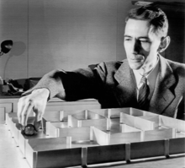
Model-based reinforcement learning
Start with an initial policy that includes some randomness, governed by an “exploration vs. exploitation” tradeoff, e.g., epsilon-greedy or epsilon-first
Test a few actions, and observe the results
Based on those results, estimate a model: a lookup table (or neural network estimate) of the transition probabilities $P(s’|s,a)$, and of the reward function $R(s)$.
Based on the model, use value iteration or policy iteration to update your policy.
… and repeat this loop, as often as you can.
© Bell Labs, part of a press release, widely circulated in the public domain, https://en.wikipedia.org/w/index.php?curid=4289542

Slide 12
Model-free reinforcement learning, e.g., Q-learning
Putting it all together, here’s the whole TD learning algorithm:
When you reach state s, use your current exploration versus exploitation policy, $π_{t}(s)$, to choose some action ${a=π}_{t}(s)$.
Observe the state s’ that you end up in, and the reward you receive, and then calculate Qlocal:
$$Q_{local}\left(s,a\right)=R_{t}(s)+γ\max_{a′∈A(s′)}{Q_{t}(s′,a′)}$$
Calculate the time difference, and update:
$$Q_{t+1}\left(s,a\right)=Q_{t}\left(s,a\right)+α\left(Q_{local}\left(s,a\right)−Q_{t}\left(s,a\right)\right)$$
Repeat.
0.78
0.77 | 0.81
0.74
0.83
0.78 | 0.87
0.83
0.88
0.81 | 0.92
0.68
$$Q_{t+1}\left(s,a\right)=Q_{t}\left(s,a\right)+α\sum_{s,a=s_{i},a_{i}}{\left(Q_{local,i}−Q_{t}\left(s,a\right)\right)}$$
0.76
0.72 | 0.72
0.68
0.66
0.64 | -.69
0.42
0.71
0.67 | 0.63
0.66
0.62
0.66 | 0.58
0.62
0.59
0.61 | 0.40
0.55
-0.74
0.39 | 0.21
0.37

Slide 13
Deep Q-learning and Actor-Critic Learning
What is deep Q-learning?
How to make Q-learning converge to the best answer?
How to make it converge more smoothly?
What are policy learning and actor-critic networks?
What is imitation learning?
Estimate Q(s,a) using a neural net, with Qlocal as training signals.
Epsilon-greedy usually works.
Experience replay.
Actor network: $Pr⁡(a is the best action)$. Critic network: $Q(s,a)$, used only to train the actor.
Learn to imitate an expert player.

Slide 14
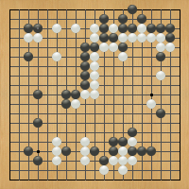
RL for two-player games
Review: minimax and alpha-beta
Complexity: ${(2b−1)}^{d/2}=O\{b^{d/2}\}$ with depth d and branching factor b, if the children of each node are ordered just right (MAX: largest first, MIN: smallest first)
Move ordering: policy network
Can be used to order the children, with no loss of accuracy; Can also limit the set of moves evaluated, with some loss of accuracy
Evaluation function: value network
Estimates the value of each board position in limited-horizon search
Exact value: endgames
Minimax search backward from a set of known terminal positions
Stochastic training: Monte Carlo tree search
Choose a policy that includes exploration vs. exploitation, play games at random, use the data to estimate win frequency

Slide 15
Games of chance and imperfect information
0
T
H
Stochastic games: Expectiminimax
$$U\left(s\right)=\max_{a}{\sum_{s′}{P\left(s^{′} | s,a\right)U(s^{′})}}$$
$$U\left(s′\right)=\min_{a′}{\sum_{s′′}{P\left(s^{′′} | s′,a′\right)U(s^{′′})}}$$
Imperfect information: belief states
$$PREDICT\left(b,a\right)=\left\{s^{′}:s∈b,s′=RESULT(s,a)\right\}$$
$$UPDATE\left(b,o\right)=\left\{s:s∈b,o=PERCEPT(s)\right\}$$
0
0
T
H
T
H
-1
1
1
-1
T
H
T
H
T
H
T
H
-1
-1
1
1
1
1
-1
-1
T
H
H
0
-2
-2
0
2
0
0
2
2
0
0
2
0
-2
-2
0

Slide 16
Game Theory
Player 1
Player 2
Straight
Chicken
Straight
Dominant strategy
a strategy that’s optimal for one player, regardless of what the other player does
Not all games have dominant strategies
Nash equilibrium
an outcome (one action by each player) such that, knowing the other player’s action, each player has no reason to change their own action
Every game with a finite set of actions has at least one Nash equilibrium, though it might be a mixed-strategy equilibrium.
Pareto optimal
an outcome such that neither player would be able to win more without simultaneously forcing the other player to lose more
Every game has at least one Pareto optimal outcome. Usually there are many, representing different tradeoffs between the two players.
Mixed strategies
A mixed strategy is optimal only if there’s no reason to prefer one action over the other, i.e., if $0≤p≤1$ and $0≤q≤1$ such that:
$$\left(1−p\right)w+px=\left(1−p\right)y+pz$$
$$\left(1−q\right)a+qc=\left(1−q\right)b+qd$$
Chicken
 | Straight | Chicken
Straight
Chicken
-10
-1
-10
1
1
0
-1
0
 | $$1−p$$ | $$p$$
$$1−q$$
$$q$$
$$a$$
$$b$$
$$w$$
$$x$$
$$c$$
$$d$$
$$y$$
$$z$$

Slide 17
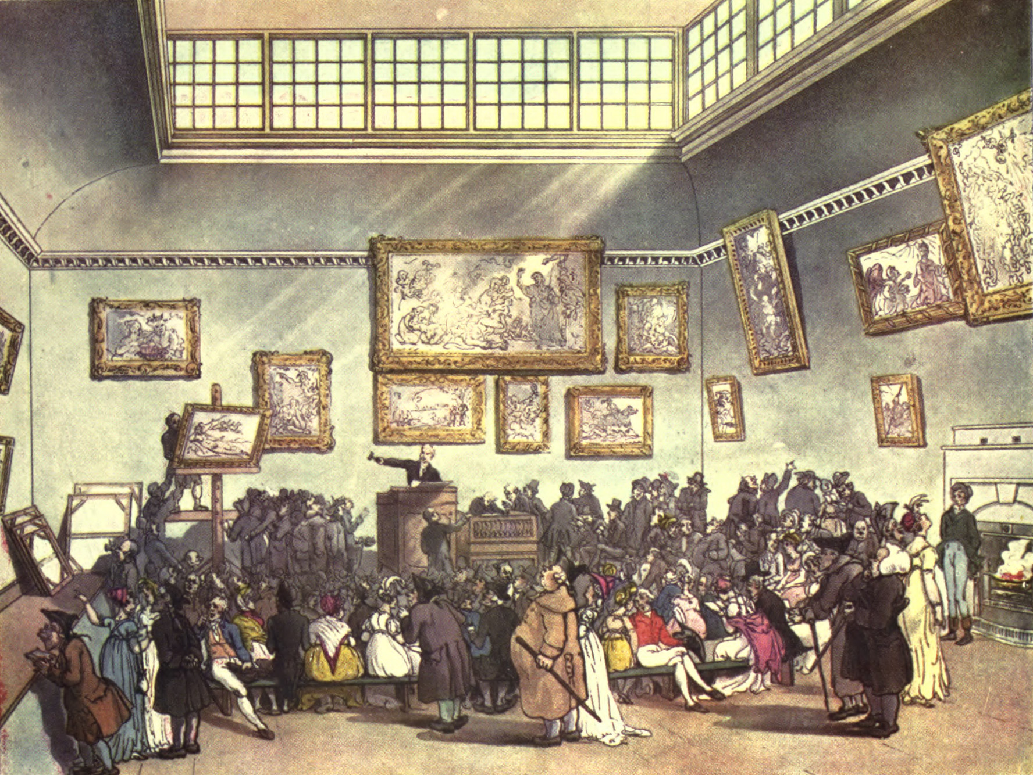
Mechanism Design
Nash equilibrium occurs if:
All players have sufficient computation
All available actions listed in the payoff matrix
Payoff matrix lists true outcome values
Iterated games:
Fixed # games: start from the end, plan backward
Random # games: maximize expected gain
Nash Equilibrium in various auctions:
English auction: $b_{i}=d+\max_{j≠i}{v_{j}}$ iff $v_{i}>\max_{j≠i}{v_{j}}$
Sealed Bid: $b_{i}=d+\max_{j≠i}{p_{ij}}$ iff $v_{i}>\max_{j≠i}{p_{ij}}$
Second-Price: $b_{i}=v_{i}$, all players
VCG mechanism to avoid tragedy of the commons: each unsuccessful bidder pays nothing; each successful bidder pays $b_{N+1}$.

Slide 18
Some sample problems
Linear classifiers: practice exam problem 4 (today)
DNNs: next lecture, probably I’ll write a new practice problem
Q-learning: next lecture, probably I’ll write a new practice problem
Games of chance & imperfect information: next lecture
Game theory & Mechanism design: next lecture

Slide 19
Practice Exam Problem 4
You are a Hollywood producer. You have a script in your hand, and you want to make a movie. Before starting, however, you want to predict if the movie you want to make will rake in huge profits, or utterly fail at the box office. You hire two critics A and B to read the script and rate it on a scale of 1 to 5 (assume only integer scores). Each critic reads it independently and announces their verdict. Of course, the critics might be biased and/or not perfect, therefore you may not be able to simply average their scores. Instead, you decide to use a perceptron toclassify your data. There are three features: a constant bias, and the two reviewer scores. Thus f0 = 1 (a constant bias), f1 = score given by reviewer A, and f2 = score given by reviewer B.
Movie Name | A | B | Profit?
Pellet Power | 1 | 1 | No
Ghosts! | 3 | 2 | Yes
Pac is bac | 4 | 5 | No
Not a pizza | 3 | 4 | Yes
Endless Maze | 2 | 3 | Yes

Slide 20
Practice Exam Problem 4
(a) Train the perceptron to generate Y* = 1 if the movie returns a profit, Y* = -1 otherwise. The initial weights are w0 = -1,w1 = 0,w2 = 0. Present each row of the table as a training token and update the perceptron weights before moving on to the next row. Use a learning rate of eta=1. After each of the training examples has been presented once (one epoch), what are the weights?
Movie Name | A | B | Profit?
Pellet Power | 1 | 1 | No
Ghosts! | 3 | 2 | Yes
Pac is bac | 4 | 5 | No
Not a pizza | 3 | 4 | Yes
Endless Maze | 2 | 3 | Yes

Slide 21
Practice Exam Problem 4
Iteration | Weights | $y^{∗} =sgn⁡({\vec{w}}^{T}\vec{x}$) | Change weights? | $$η{y_{i}\vec{x}}_{i}$$
1 | $$[−1,0,0]$$ | $$−1$$ | No
2 | $$[−1,0,0]$$ | $$−1$$ | Yes | $$[1,3,2]$$
3 | $$[0,3,2]$$ | $$+1$$ | Yes | $$[−1,−4,−5]$$
4 | $$[−1,−1,−3]$$ | $$−1$$ | Yes | $$[1,3,4]$$
5 | $$[0,2,1]$$ | $$+1$$ | No
Movie Name | A | B | Profit?
Pellet Power | 1 | 1 | No
Ghosts! | 3 | 2 | Yes
Pac is bac | 4 | 5 | No
Not a pizza | 3 | 4 | Yes
Endless Maze | 2 | 3 | Yes

Slide 22
Practice Exam Problem 4
(b) Suppose that, instead of learning whether the movie is profitable, you want to learn a perceptron that will always output Y* = +1 when the total of the two reviewer scores is more than 8, and Y* = -1 otherwise. Is this possible? If so, what are the weights w0, w1, and w2 that will make this possible?
Movie Name | A | B | Profit?
Pellet Power | 1 | 1 | No
Ghosts! | 3 | 2 | Yes
Pac is bac | 4 | 5 | No
Not a pizza | 3 | 4 | Yes
Endless Maze | 2 | 3 | Yes

Slide 23
Practice Exam Problem 4
(b) Suppose that, instead of learning whether the movie is profitable, you want to learn a perceptron that will always output
$$Y^{∗}=sgn\left(A+B−8\right)$$
(Y* = +1 when the total of the two reviewer scores is more than 8, and Y* = -1 otherwise). Is this possible?
Answer: yes, sure. For example,
$$w_{0}=−8, w_{1}=1,w_{2}=1$$
Movie Name | A | B | Profit?
Pellet Power | 1 | 1 | No
Ghosts! | 3 | 2 | Yes
Pac is bac | 4 | 5 | No
Not a pizza | 3 | 4 | Yes
Endless Maze | 2 | 3 | Yes

Slide 24
Practice Exam Problem 4
(c) Instead of either part (a) or part (b), suppose you want to learn a perceptron that will always output Y*= +1 when the two reviewers agree (when their scores are exactly the same), and will output Y*= -1 otherwise. Is this possible? If so, what are the weights w0, w1 and w2 that will make this possible?
Movie Name | A | B | Profit?
Pellet Power | 1 | 1 | No
Ghosts! | 3 | 2 | Yes
Pac is bac | 4 | 5 | No
Not a pizza | 3 | 4 | Yes
Endless Maze | 2 | 3 | Yes

Slide 25
Practice Exam Problem 4
$$f_{2}$$
The XOR problem
$$f_{1}$$
(c)
$$Y^{∗}=\left\{\begin{matrix}1 & A−B=0 \\ −1 & otherwise\end{matrix}\right.$$
Is this possible? If so, what are the weights w0, w1 and w2 that will make this possible?
Answer: NO. This is basically the XOR problem (but in reverse). There is no linear classifier that can solve this problem.
$$f_{2}$$
This
problem
$$f_{1}$$

