Slide 1
CS440/ECE448 Lecture 20 Computer Vision: Image Formation
Mark Hasegawa-Johnson, 3/11/2020
License: CC-BY 4.0.

Slide 2
Outline
Space
Pinhole camera equations
Vanishing point
Color
Structure of the eye
RGB displays
Color features: YPrPb
Edges
Things that look like edges
Edge detection: the difference-of-Gaussians filter

Slide 3
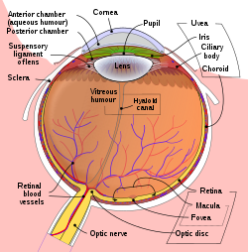
Lenses and focus
The lens in your eye collects light.
Light that passes directly through the center of the lens is not bent.
Light that passes above center is bent back toward center, and vice versa, so that it can all be collected in the same point on the image plane.
Image
plane
Lens
Object
By Rhcastilhos. And Jmarchn. - Schematic_diagram_of_the_human_eye_with_English_annotations.svg, CC BY-SA 3.0, https://commons.wikimedia.org/w/index.php?curid=1597930

Slide 4
The “pinhole camera” approximation
A “pinhole camera” is a camera that only allows light through a very small hole.
Disadvantage: A pinhole camera gets much less light than a lens (because the hole is smaller).
Advantage: A pinhole camera focuses on all objects, at every distance, simultaneously.
Image
plane
Pinhole
Object

Slide 5
Converting a 3D world to a 2D picture
Different spots in the real world are projected onto different points in the image plane.
Light that passes through the center of the lens is not bent.
Therefore, we can use the pinhole camera approximation to analyze the relationship between real world position (x,y,z) and position on the image plane (x’,y’).
Image
plane
Lens
Object

Slide 6
The pinhole camera equations
y
Define the origin (0,0,0) to be the pinhole.
Define (x,y,z) as position of the object: x is horizontal (into the slide), y is vertical (upward), z is away from the camera.
Define (x’,y’) as the position on the image plane where the light strikes (upside down).
Define f as the distance from the pinhole to the image plane.
y’
z
Image
plane
Pinhole
-f
Object

Slide 7
The pinhole camera equations
y
These are similar triangles! So
$$\frac{x′}{x}=\frac{y′}{y}=\frac{−f}{z}$$
Solving for (x’,y’), we get the famous pinhole camera equations:
$$x^{′}=\frac{−fx}{z}, y′=\frac{−fy}{z}$$
y’
z
Image
plane
Pinhole
-f
Object

Slide 8
Outline
Space
Pinhole camera equations
Vanishing point
Color
Structure of the eye
RGB displays
Color features: YPrPb
Edges
Things that look like edges
Edge detection: the difference-of-Gaussians filter

Slide 9
Vanishing point
When you take a picture, lines that are parallel in the real world appear to converge.
The point toward which they converge is called the vanishing point. It lies on the horizon.
The “horizon” is a line in the image, where a plane parallel to the ground passes through the pinhole.

Slide 10
Vanishing point
y
Recall the pinhole camera equations:
$$x^{′}=\frac{−fx}{z}, y′=\frac{−fy}{z}$$
Suppose we have a couple of lines, in the plane y=g (the ground plane):
Line 1: $x_{1}=mz+b_{1}$
Line 2: $x_{2}=mz+b_{2}$
These are parallel lines, so they have the same slope, $m$.
y’
z
Image
plane
Pinhole
-f
Object

Slide 11
Vanishing point
Vanishing point (x’,y’)=(-fm,0)
y
Plug equations for the lines into the pinhole camera equations:
$${x_{1}}^{′}=\frac{−f(mz+b_{1})}{z}, y_{1}′=\frac{fg}{z}$$
$$x_{2}^{′}=\frac{−f\left(mz+b_{2}\right)}{z}, y_{2}′=\frac{fg}{z}$$
As $z→∞$, the two lines converge to the vanishing point
$$\left(x^{′},y^{′}\right)=(−fm,0)$$
y’
z
Image
plane
Pinhole
f
Object

Slide 12
Vanishing point
(-fm,0):
Notice that, if the lines are on a flat plane (e.g., the ground), then the vanishing point is at the eye level of the camera (y’=0).
The line y’=0 is therefore called the “horizon.”
If the lines are not on a flat plane, they would not converge at y’=0.

Slide 13
Outline
Space
Pinhole camera equations
Vanishing point
Color
Structure of the eye
RGB displays
Color features: YPrPb
Edges
Things that look like edges
Edge detection: the difference-of-Gaussians filter

Slide 14
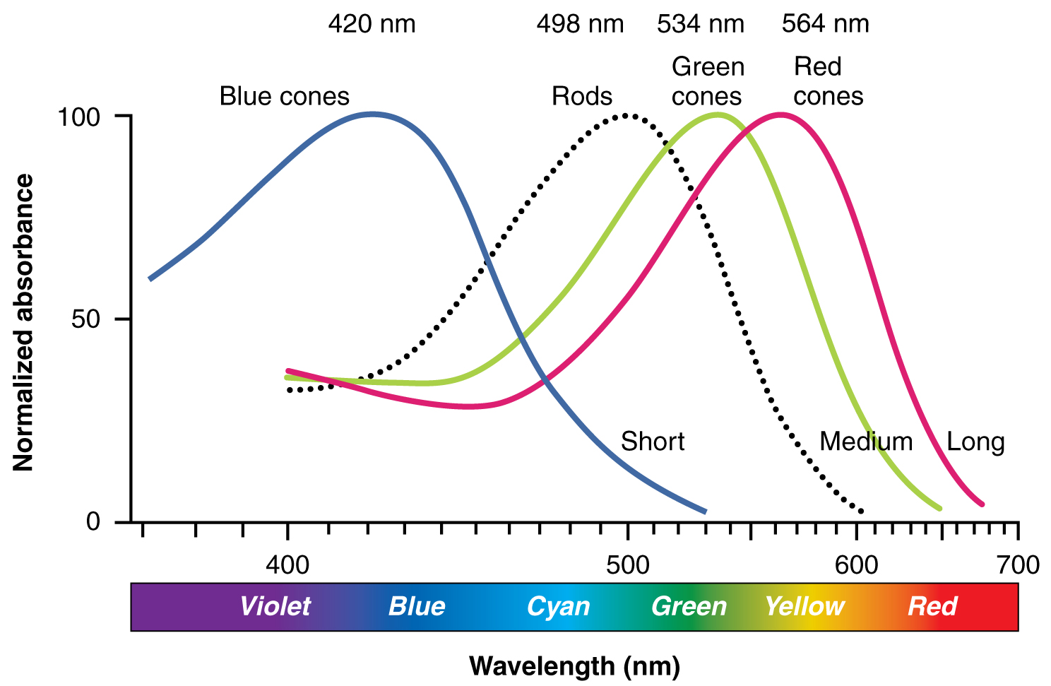
Color spaces: RGB
Every natural object reflects a continuous spectrum of colors.
However, the human eye only has three color sensors:
Red cones are sensitive to lower frequencies
Green cones are sensitive to intermediate frequencies
Blue cones are sensitive to higher frequencies
Illustration from Anatomy & Physiology, Connexions Web site. http://cnx.org/content/col11496/1.6/, Jun 19, 2013.

Slide 15
Structure of the eye
Cones (color-sensitive cells) are located in only a small area, close to the fovea
Rods (black-and-white cells) are spread more widely.
By Rhcastilhos. And Jmarchn. - Schematic_diagram_of_the_human_eye_with_English_annotations.svg, CC BY-SA 3.0, https://commons.wikimedia.org/w/index.php?curid=1597930

Slide 16
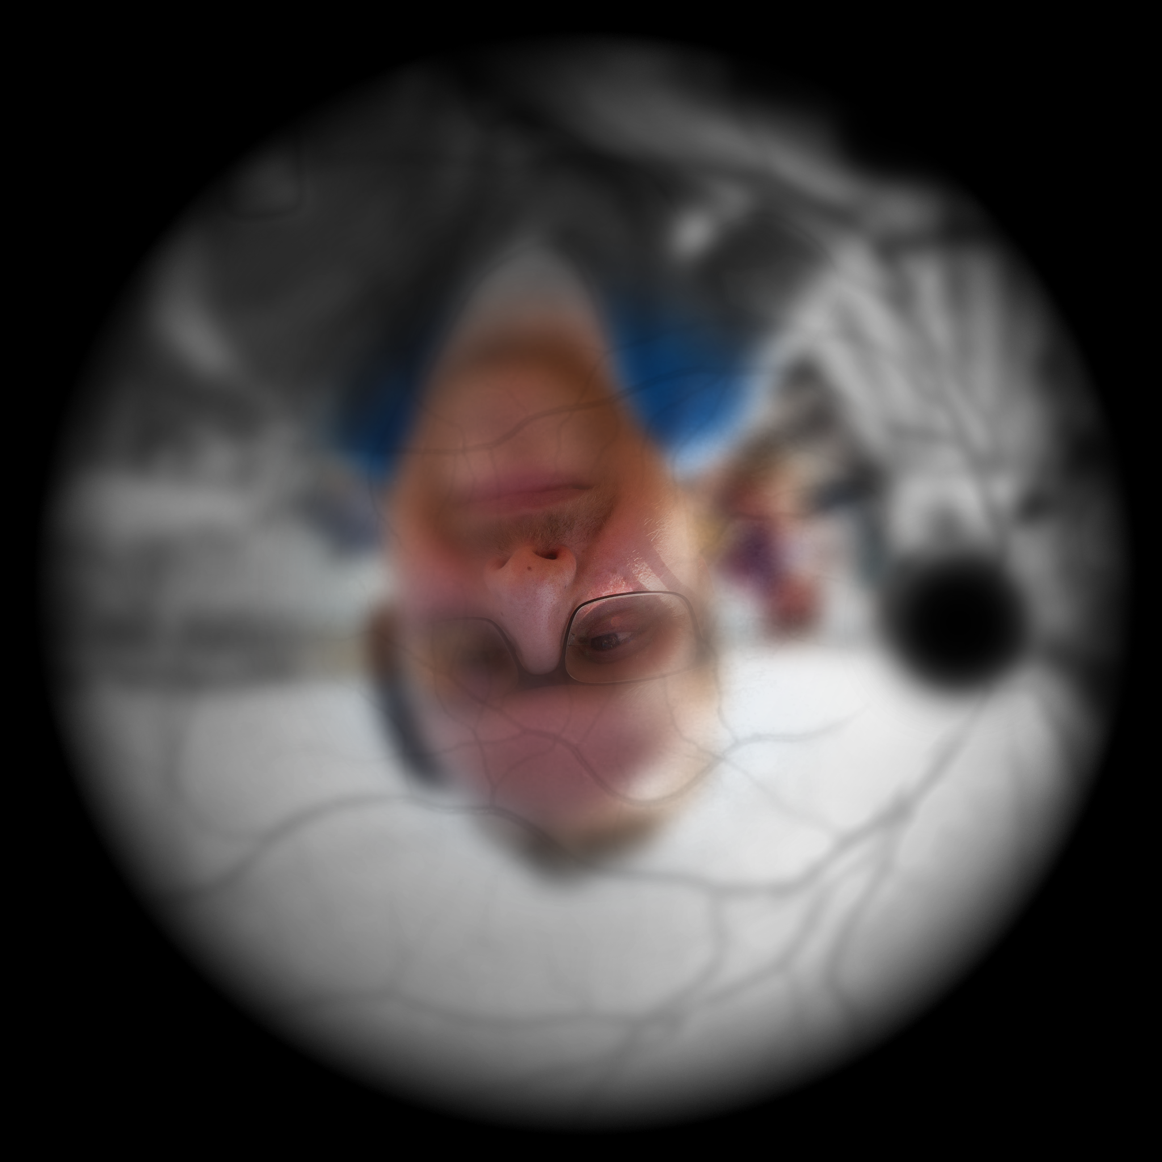
Structure of the eye
Illustration of image as 'seen' by the retina independent of optic nerve and striate cortex processing.
Because we only have cones in the center of the eye, we can only actually see color in the center.
The colors that you believe you see, in the periphery of your vision, are being filled in from memory by your pre-conscious visual processes (optic nerve and striate cortex).
By Ben Bogart - Own work, CC BY-SA 3.0, https://commons.wikimedia.org/w/index.php?curid=31009153

Slide 17
Outline
Space
Pinhole camera equations
Vanishing point
Color
Structure of the eye
RGB displays
Color spaces: YPrPb, HSV
Edges
Things that look like edges
Edge detection: the difference of Gaussians filter

Slide 18
Color spaces: RGB
Every natural object reflects a continuous spectrum of colors.
However, the human eye only has three color sensors:
Red cones are sensitive to lower frequencies
Green cones are sensitive to intermediate frequencies
Blue cones are sensitive to higher frequencies
Illustration from Anatomy & Physiology, Connexions Web site. http://cnx.org/content/col11496/1.6/, Jun 19, 2013.

Slide 19
Color spaces: RGB
A photograph of Mohammed Alim Khan (1880–1944), Emir of Bukhara, taken in 1911 by Sergey Prokudin-Gorsky using three exposures with blue, green, and red filters.
By activating LED or other display hardware at just three discrete colors (R, G, and B), it is possible to fool the human eye into thinking that it sees a continuum of colors.
Therefore, a so-called “color” camera is really three different black-and-white photographs:
R(x’,y’) is the brightness of red light at position (x’,y’)
G(x’,y’) is brightness of green.
B(x’,y’) is brightness of blue.
By Sergei Prokudin-Gorskii - Taken from the Library of Congress' website and converted from TIFF to PNG.TIFF file from LOC, Public Domain, https://commons.wikimedia.org/w/index.php?curid=1470606

Slide 20
Outline
Space
Pinhole camera equations
Vanishing point
Color
Structure of the eye
RGB displays
Color features: YPrPb
Edges
Things that look like edges
Edge detection: the difference-of-Gaussians filter

Slide 21
Color features: Luminance
The “grayscale” image is often computed as the average of R, G, and B intensities, i.e., $I\left[x^{′},y′\right]=\frac{1}{3}\left(R\left(x^{′},y^{′}\right)+G\left(x^{′},y^{′}\right)+B(x^{′},y^{′})\right)$
The human eye, on the other hand, is more sensitive to green light than to either red or blue.
The intensity of light, as viewed by the human eye, is well approximated by the standard ITU-R BT.601:
$$Y(x^{′},y^{′}) =0.299R(x^{′},y^{′}) +0.587G(x^{′},y^{′}) +0.114B(x^{′},y^{′})$$
The signal $Y(x^{′},y^{′})$ is called the luminance of light at pixel $(x^{′},y^{′})$.

Slide 22
Color features: YPrPb
The human eye is much more sensitive to spatial variation in luminance (brightness) than to spatial variation in chrominance (color)
For this reason, the JPG image coding standard represents luminance, Y(x’,y’), at twice the spatial resolution of chrominance:
First, JPG converts (R,G,B) into (Y,Pr,Pb), where Pr and Pb represent the “degree of redness” and “degree of blueness.”
Second, JPG downsamples Pr(x’,y’) and Pb(x’,y’), so that they have ½ as many rows and ½ as many columns as Y(x’,y’).
For computer vision, we can use the same logic: represent Pr and Pb at half the resolution that we use for luminance.

Slide 23
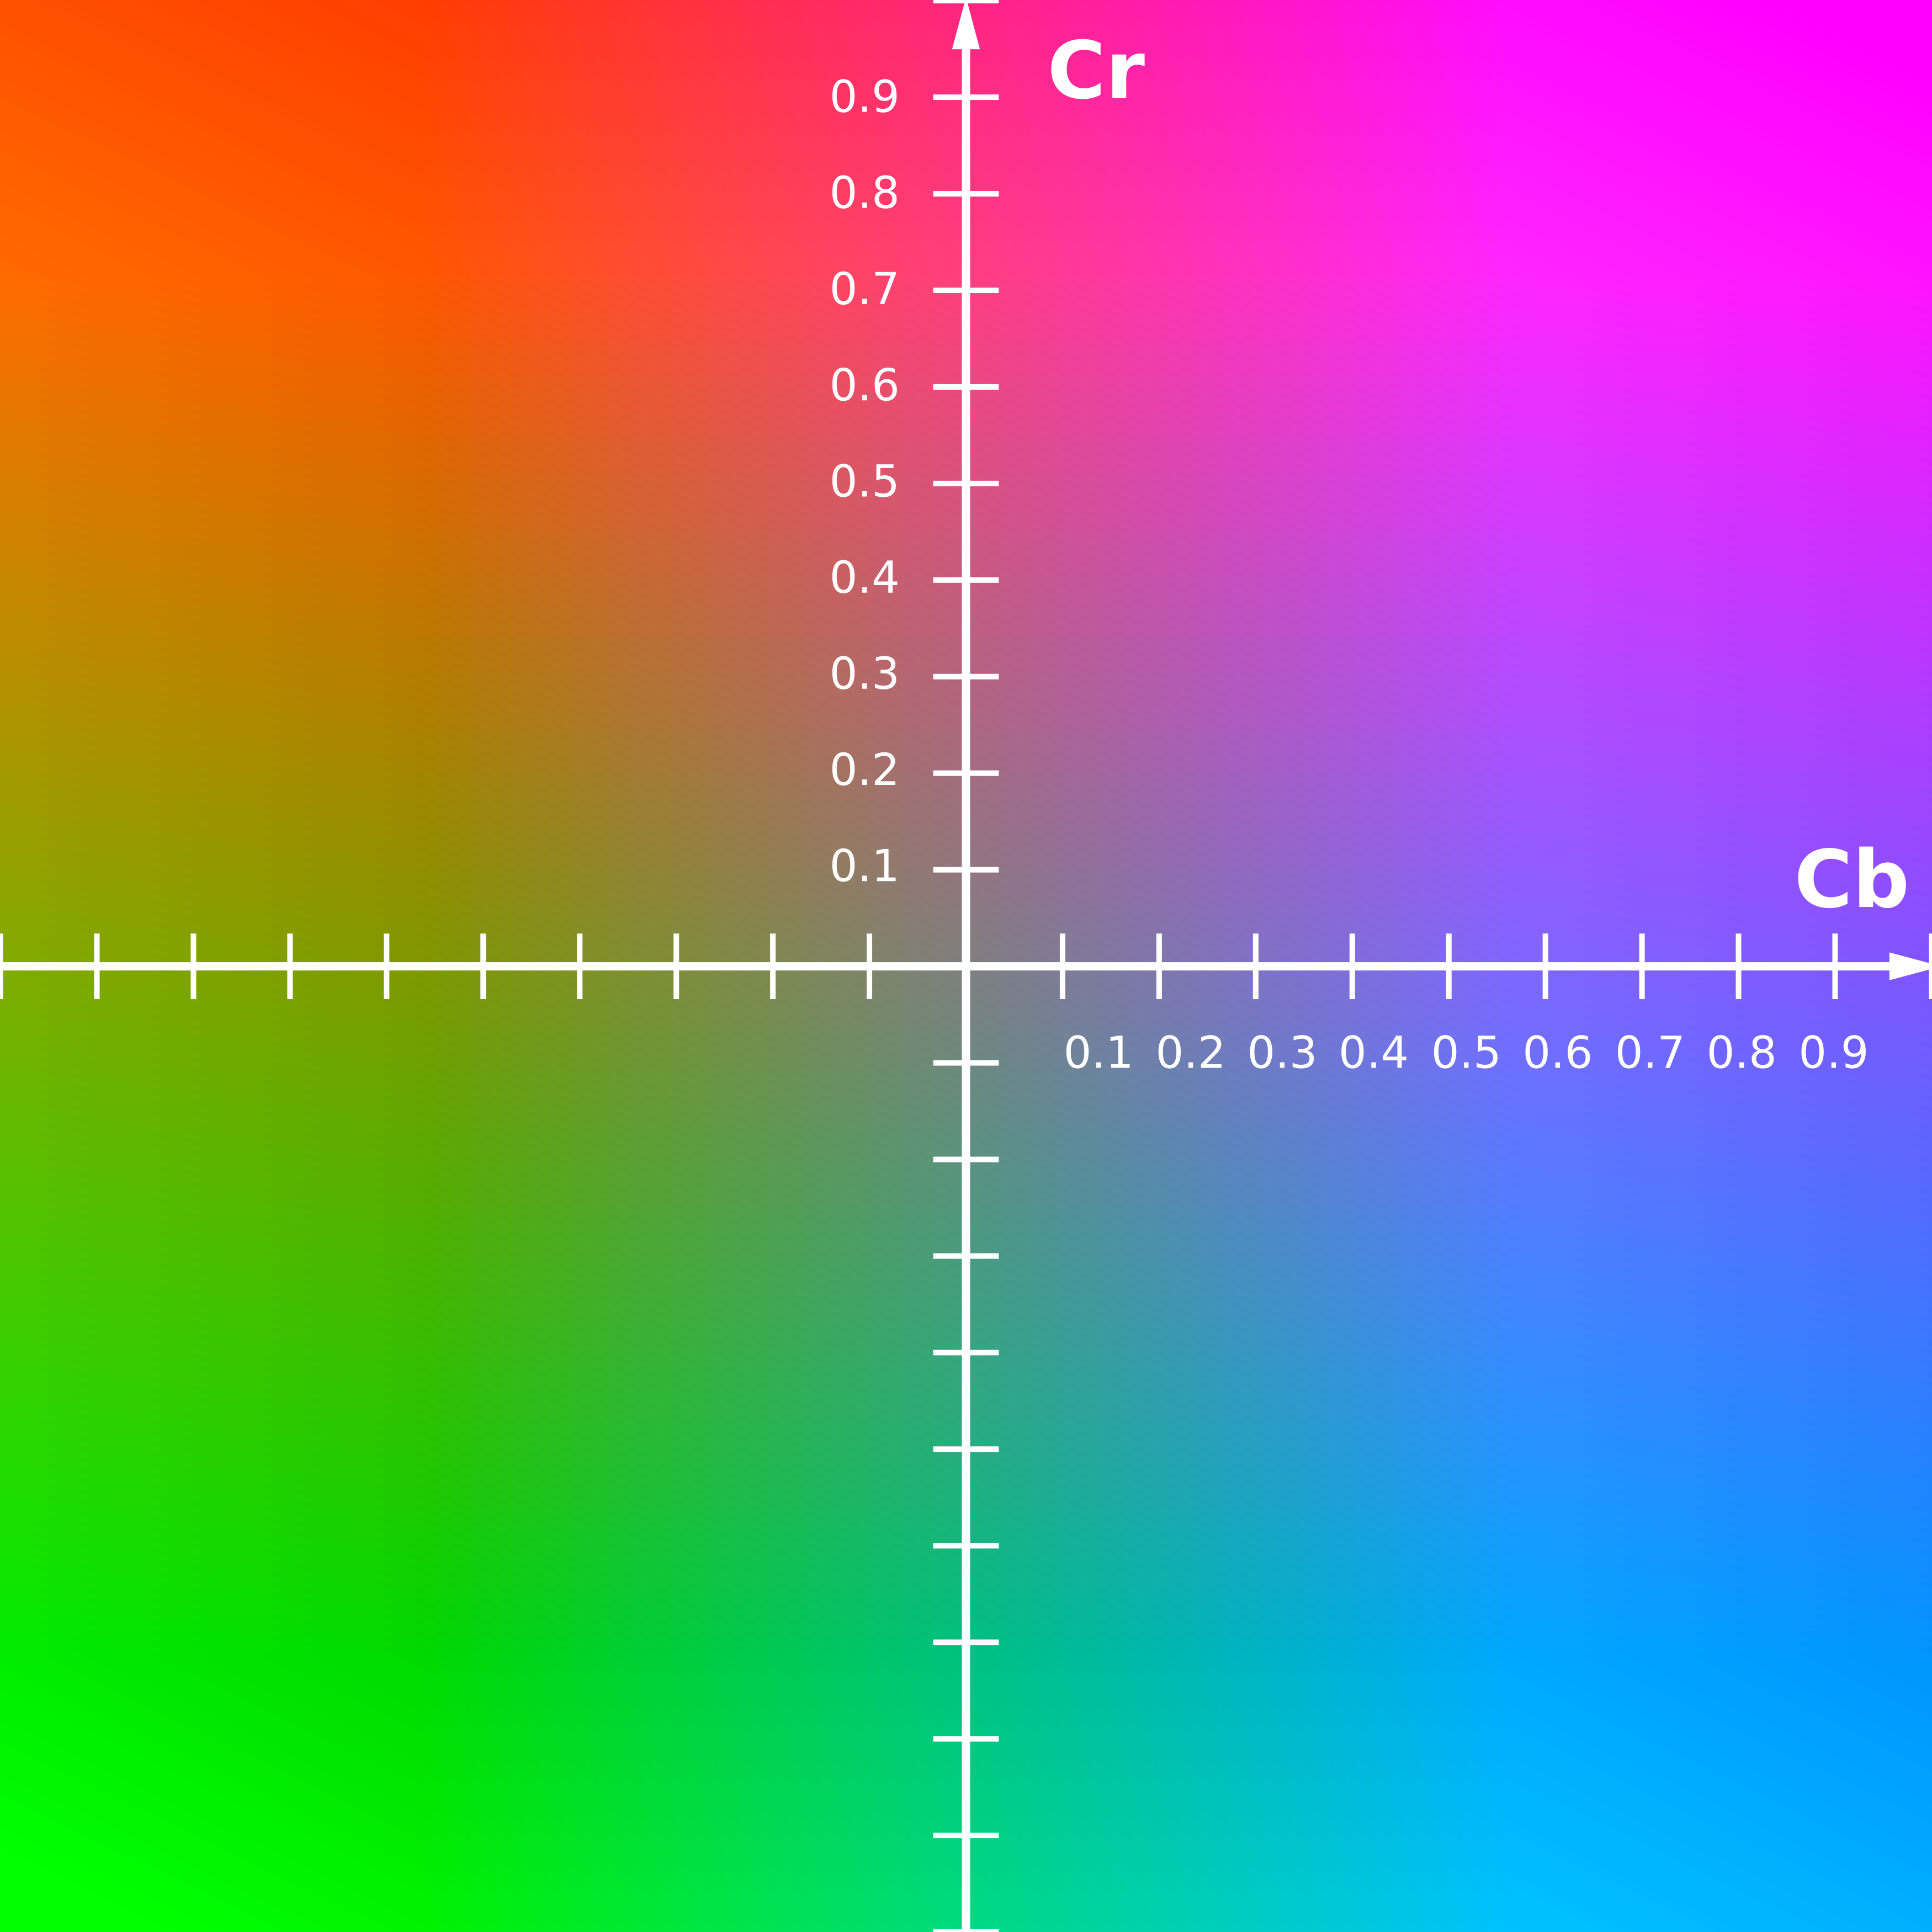
Color features: Chrominance
Chrominance = color-shift of the image.
We measure $P_{R}$=red-shift, and $P_{B}$=blue-shift, relative to luminance (luminance is sort of green-based, remember?)
We want $P_{R}(x^{′},y^{′})$ and $P_{B}(x^{′},y^{′})$ to describe only the color-shift of the pixel, not its average luminance.
We do that using
$$\left[\begin{matrix}Y \\ P_{B} \\ P_{R}\end{matrix}\right]=\left[\begin{matrix}{\vec{v}}_{Y} \\ {\vec{v}}_{B} \\ {\vec{v}}_{R}\end{matrix}\right]\left[\begin{matrix}R \\ G \\ B\end{matrix}\right]$$
Where $sum({\vec{v}}_{R})=sum({\vec{v}}_{B})=0$.
Cr and Cb, at Y=0.5
Simon A. Eugster, own work.

Slide 24
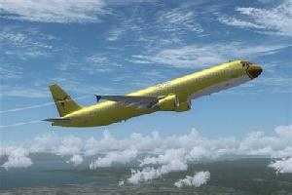
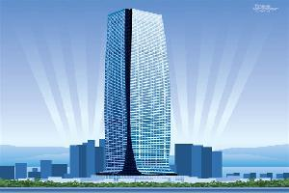
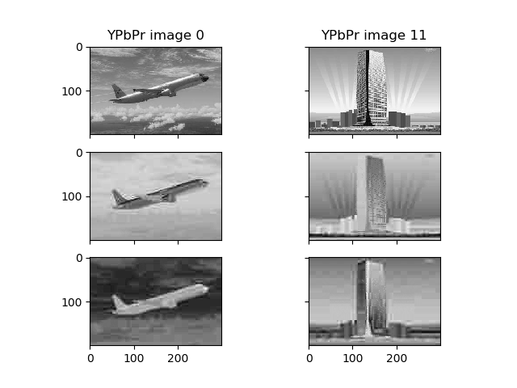
Color features: Chrominance
$$\left[\begin{matrix}Y \\ P_{B} \\ P_{R}\end{matrix}\right]=\left[\begin{matrix}0.299 & 0.587 & 0.114 \\ −0.168736 & −0.331264 & 0.5 \\ 0.5 & −0.418688 & −0.081312\end{matrix}\right]\left[\begin{matrix}R \\ G \\ B\end{matrix}\right]$$
gives $sum({\vec{v}}_{R})=sum({\vec{v}}_{B})=0$. You don’t need to memorize those numbers, but you should know that
Y = weighted average(R,G,B)
Pr = (1/2) (R – weighted average(G,B))
Pb = (1/2) (B – weighted average(R,G))

Slide 25
Color features: Chrominance
Some images are obviously red! (e.g., fire, or wood)
Some images are obviously blue! (e.g., water, or sky)
Average(Pb)-Average(Pr) should be a good feature for distinguishing between, for example, ”fire” versus “water”

Slide 26
Outline
Space
Pinhole camera equations
Vanishing point
Color
Structure of the eye
RGB displays
Color features: YPrPb
Edges
Things that look like edges
Edge detection: the difference-of-Gaussians filter

Slide 27
Things that look like edges
3. Illumination discontinuities
(shadows)
2. Orientation discontinuities
4. Color discontinuities
1. Depth discontinuities
El Castillo (pyramid of Kukulcán) in Chichén Itzá
By Daniel Schwen - Own work, CC BY-SA 4.0, https://commons.wikimedia.org/w/index.php?curid=7647000

Slide 28
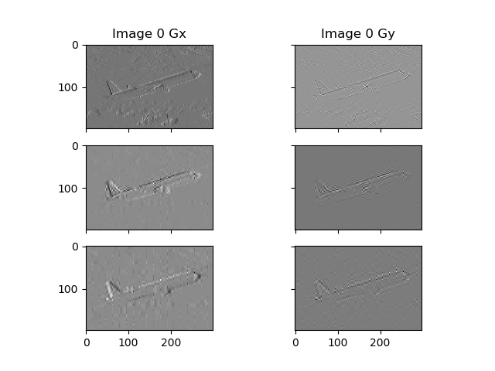
Edge detection by subtraction
Subtract neighboring pixels, to compute an “image gradient:”
X gradient:
$$G_{x}\left(x’,y’\right)=\frac{\left(Y(x’+1,y’)−Y(x’−1,y’)\right)}{2}≈\frac{∂Y}{∂x′}$$
Y gradient:
$$G_{y}\left(x’,y’\right)=\frac{\left(Y(x’,y’+1)−Y(x’,y’−1)\right)}{2}≈\frac{∂Y}{∂y′}$$
Magnitude of the edge:
$$G\left(x’,y’\right)=\sqrt{G_{x}^{2}+G_{y}^{2}}≈\sqrt{{\left(\frac{∂Y}{∂x′}\right)}^{2}+{\left(\frac{∂Y}{∂y′}\right)}^{2}}$$

Slide 29
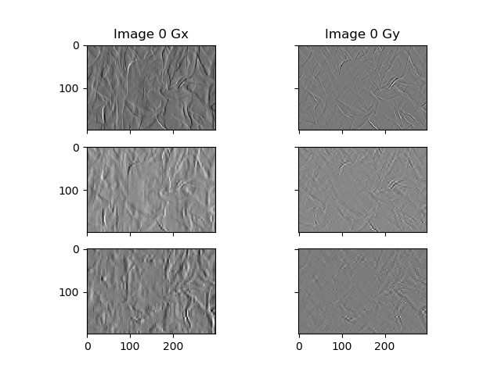
A problem with “edge detection by subtraction”
It tends to exaggerate noise.

Slide 30
Solving the noise problem
We can solve the noise problem by smoothing the image first, then taking the difference.
Smoothing is done by taking a local average, e.g.,
$$S\left(x^{′},y^{′}\right)=\sum_{m=−5}^{5}{\sum_{n=−5}^{5}{\left(\frac{1}{{\left(11\right)}^{2}}\right)Y(x^{′}−m,y^{′}−n)}}$$
$$G_{x}\left(x’,y’\right)=\frac{\left(S(x’+1,y’)−S(x’−1,y’)\right)}{2}$$
$$G_{y}\left(x’,y’\right)=\frac{\left(S(x’,y’+1)−S(x’,y’−1)\right)}{2}$$

Slide 31
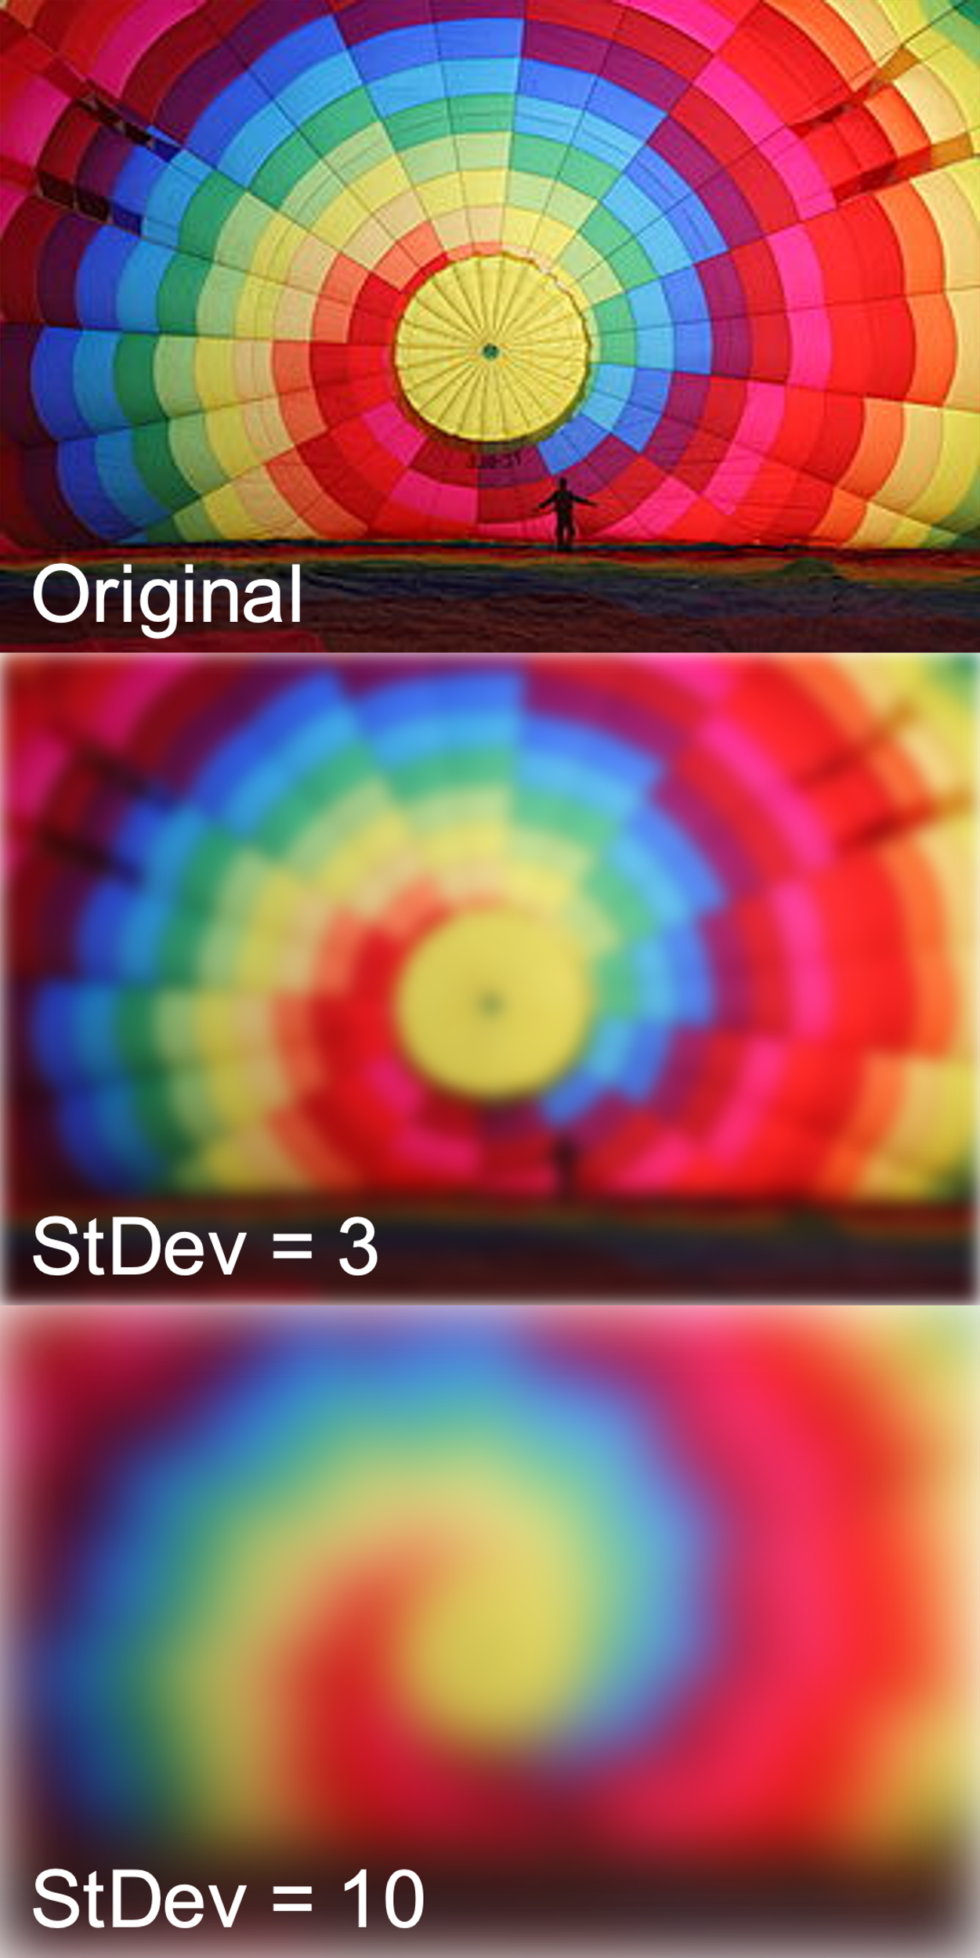
Gaussian blur
The Gaussian blur filter $h\left(m,n\right)$results in different degrees of smoothness of $S\left(x^{′},y^{′}\right)$, depending on how we set the hyperparameter $σ$ (the StDev):
Weighted averaging is a little better than unweighted averaging. We just need to make sure that the weights add up to one. For example:
$$S\left(x^{′},y^{′}\right)=\sum_{m=−5}^{5}{\sum_{n=−5}^{5}{h(m,n)Y(x^{′}−m,y^{′}−n)}}$$
$$h\left(m,n\right)=\frac{1}{2πσ^{2}}e^{−\left({\left(\frac{m}{σ}\right)}^{2}+{\left(\frac{n}{σ}\right)}^{2}\right)}$$
$$G_{x}\left(x’,y’\right)=\frac{\left(S(x’+1,y’)−S(x’−1,y’)\right)}{2}$$
$$G_{y}\left(x’,y’\right)=\frac{\left(S(x’,y’+1)−S(x’,y’−1)\right)}{2}$$
By IkamusumeFan - Own work, CC BY-SA 4.0, https://commons.wikimedia.org/w/index.php?curid=41790217

Slide 32
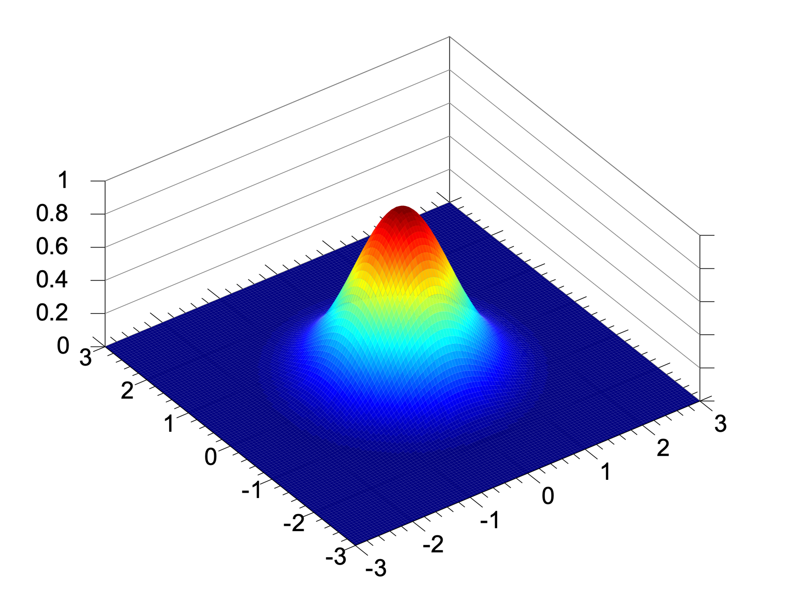
Gaussian blur
The Gaussian blur filter $h\left(m,n\right)$looks kind of like this (plotted as a function of just $n$, for the coordinate $m=0$):
Weighted averaging is a little better than unweighted averaging. We just need to make sure that the weights add up to one. For example:
$$S\left(x^{′},y^{′}\right)=\sum_{m=−5}^{5}{\sum_{n=−5}^{5}{h(m,n)Y(x^{′}−m,y^{′}−n)}}$$
$$h\left(m,n\right)=\frac{1}{2πσ^{2}}e^{−\left({\left(\frac{m}{σ}\right)}^{2}+{\left(\frac{n}{σ}\right)}^{2}\right)}$$
$$G_{x}\left(x’,y’\right)=\frac{\left(S(x’+1,y’)−S(x’−1,y’)\right)}{2}$$
$$G_{y}\left(x’,y’\right)=\frac{\left(S(x’,y’+1)−S(x’,y’−1)\right)}{2}$$
$$h\left(0,n\right)$$
$$n$$
Plotted in 2D, it looks kind of like this:
By Krishnavedala - Own work, CC0, https://commons.wikimedia.org/w/index.php?curid=35701251

Slide 33
Difference of Gaussians
A “difference-of-Gaussians” filter looks kind of like this:
$$h_{x}′\left(x’,0\right)$$
A “difference-of-Gaussians” filter is created by subtracting two Gaussian-blur filters, like this:
$$h\left(m,n\right)=\frac{1}{2πσ^{2}}e^{−\left({\left(\frac{m}{σ}\right)}^{2}+{\left(\frac{n}{σ}\right)}^{2}\right)}$$
$$h_{x}′\left(x’,y’\right)=\frac{\left(h(x’+1,y’)−h(x’−1,y’)\right)}{2}$$
$$h_{y}′\left(x’,y’\right)=\frac{\left(h(x’,y’+1)−h(x’,y’−1)\right)}{2}$$
$$x’$$
$$h_{x}′\left(1,y′\right)$$
$$y’$$

Slide 34
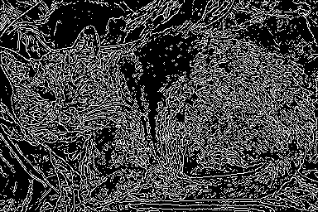
Difference of Gaussians
The difference-of-Gaussians filters, $h_{x}′(m,n)$ and $h_{y}′(m,n)$, detect more or less edges, depending on how we set the hyperparameter $σ$. Here is $\sqrt{G_{x}^{2}+G_{y}^{2}}$, thresholded to make it black and white:
If we pre-compute the difference-of-Gaussians filters, then we can combine the weighted-average and the subtraction into just one operation, to save computation:
$$G_{x}\left(x^{′},y^{′}\right)=\sum_{m=−5}^{5}{\sum_{n=−5}^{5}{h_{x}′(m,n)Y(x^{′}−m,y^{′}−n)}}$$
$$G_{y}\left(x^{′},y^{′}\right)=\sum_{m=−5}^{5}{\sum_{n=−5}^{5}{h_{y}′(m,n)Y(x^{′}−m,y^{′}−n)}}$$
… so we never need to compute the smoothed image, $S\left(x^{′},y^{′}\right)$, at all. We just go directly from the luminance, $Y(x^{′}−m,y^{′}−n)$, to the edge detection.
By Overremorto - Own work, Public Domain, https://commons.wikimedia.org/w/index.php?curid=10581259

Slide 35
Conclusions
Pinhole camera equations tell you the relationship between the position on the image, (x’,y’), and the position in the real world, (x,y,z). In particular, they tell you why parallel lines seem to converge at the vanishing point.
The eye has two types of light sensors: cones (see color, only near the center), and rods (see black & white, near the periphery). The real world has all colors, but we can fool the eye by stacking up three images (R, G, and B). The YPrPB color space separates luminance (Y = average(R,G,B)) from chrominance (Pr=R-average(G,B), Pb=B-average(R,G)).
Edges are caused by discontinuities of depth, orientation, illumination, and color. It’s useful to detect where such things happen! Subtracting pixels is noisy, so use a difference-of-Gaussians filter instead.

