Slide 1
ECE 445 / ME 470 Weekly Team Meetings
Spring 2023

Slide 2
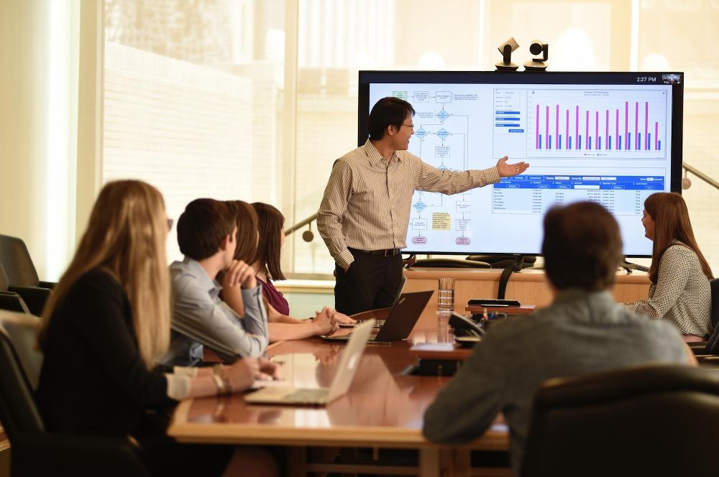
Each Team Will Present a Weekly Progress Report
Purpose: the course staff wants to provide guidance/assistance
This DOES NOT replace technical meetings with your faculty mentor (the technical expert)
Your presentation is not graded but your participation is required

Slide 3
Team Progress Report Overview
Each team has 5 minutes to present their progress and then $≈$5 minutes for Q&A (10 minutes total)
Every team member must speak
Prepare a slide presentation (PPT/PDF)

Slide 4
Team Progress Report Outline
USE ONLY THREE SLIDES TO REPORT THE FOLLLOWING!
Brief introduction
Progress since last week
Report both successes and setbacks
Be clear and concise
Objectives for this week
Be specific and quantitative
Identify tasks for each team member
Short term / long term tasks

Slide 5
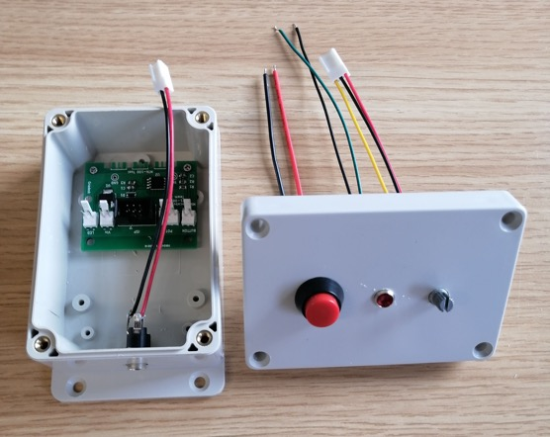
Slide 1: Introduction (30 seconds or less)
Team 99: Micro-Encabulators for the Masses
Goal: a box with a button and dial that flashes an LED at a specified frequency
Team:
John Doe (button / dial subsystems)
Jane Doe (LED subsystem)
Hiro Protagonist (PCB design)
Bill Everyman (Packaging)

Slide 8
Define S.M.A.R.T. Goals

Slide 9
Some Dos and Don’ts
Consider your audience (ECE 445 / ME 470 staff):
Provide (brief) background and context
Avoid needless detail / discuss at a high-level
Rehearse your presentation!
Do not read from a script
You will deliver an “elevator pitch” sometime in your engineering career
Do not hide failure / setbacks / unexpected challenges
We cannot offer guidance on issues we are unaware of
Present using 3 slides: Intro, SMART Goals, and Individual Tasks
You can reach out to ECE 445 / ME 470 staff (web board, email, etc.)

Slide 10
Logistics / Further Information
Weekly team progress report presentations begin Friday, March 17
We will be in touch to schedule the time and location
All team members must attend
Contact your faculty mentor to arrange a regular meeting (preferably weekly)

