Slide 1
ECE 445/ME470 ZJUI: Proposal Logistics Spring 2023
Prof. Arne Fliflet (afliflet@illinois.edu)
Prof. Mark Butala (MarkButala@intl.zju.edu.cn)
Prof. Timothy Lee (timothylee@intl.zju.edu.cn)
Prof. Chenhui Shao (chshao@Illinois.edu)
Prof. Rakesh Kumar (rakeshk@Illinois.edu)

Slide 2
Proposal Logistics
Proposal Early Deadline (worth 3 points extra credit) due Mar. 8, 2022.
Regular deadline still Mar. 13, 2022.
Submit to course website under My Project.

Slide 3
Proposal Logistical Details
Keys to success
Class logistics
Introduction
What is the problem?
Why is it important?
How will you solve it (high level)?
Due 3/8 (early +3 points) or 3/13 (see Calendar)
Design & Requirement
How is your solution implemented?
What requirements do each part satisfy?
What are the risks? Prove it will work.
Rubric, description and examples see proposal
Ethics & Safety
What ethics code did you follow?
What are the project’s safety concerns?
Submit PDF to Project Page

Slide 4
Writing the Ethics and Safety Section
Ethics
Refer to Ethical Guidelines
IEEE/ACM code of ethics
Discuss ethical concerns as they apply to your project.
Do not simply copy/paste!
“Security is a big concern with the data we are collecting. We plan to use asynchronous cryptography to have a public key that will encrypt all data that is sent from each individual device……
In addition to the above, our team pledges to follow the IEEE Ethics guidelines
[14] as well as the ACM Ethics guidelines [7] as closely as possible. ”
BusPlan Fall 2018

Slide 5
Writing the Ethics and Safety Section
Safety
Refer to the Safety Guidelines.
Discuss safety concerns (Electrical, Mechanical, Lab Safety, etc.)
For example, almost all wearable devices will have a safety code to cite!
“The heart rate monitor uses an IR transmitter and receiver and can be classified as a Class I or II medical device by the FDA since it is
interacting with humans and measuring a part of the body [14]….. We would only need to gain approval from the FDA if we were to put our project on the market. ”
Get Active Gaming System
Fall 2018

Slide 6
Formatting Citations
Citations and References
List of references formatted using the IEEE standard
Should include...
Textbooks or datasheets
IEEE or ACM Code of Ethics
Informative articles or tutorials (example codes)
Everything that you did not generate for your project in this course.
If your project is a continuation of a previous project,
you need to cite the previous project.

Slide 7
Writing Guidelines
Writing
All writing assignments in this course follow the final report
Guidelines.
Recommend using a LaTeX template (Linked on course website on Proposal page)
Having professional writing starting from the first
assignment is very important in this course!
Send drafts to ???????, if you want help with editing your writing.

Slide 8
Writing Guidelines
Writing
Some excerpts of the writing guidelines:
Include a Title Page, with Project Name, Team Names, Team emails (university emails), TA Name, Date
Include a Table of Contents
Every section must be numbered (like 1. Introduction)
Subsections numbered as subsection (like 1.1. Objective)
References does not count as a section, does not need to be numbered.
Each section starts on a new page. Subsections do not.
Every figure, table, and equation must be numbered and have a caption.

Slide 9
Writing Guidelines
Writing
Make sure to check your grammar, spelling, etc.
References must be appropriately cited throughout the document!
References must be in a proper format (IEEE format recommended).
Try not to have tables span multiple pages if at all avoidable.
Block Diagram font size must be readable!

Slide 10
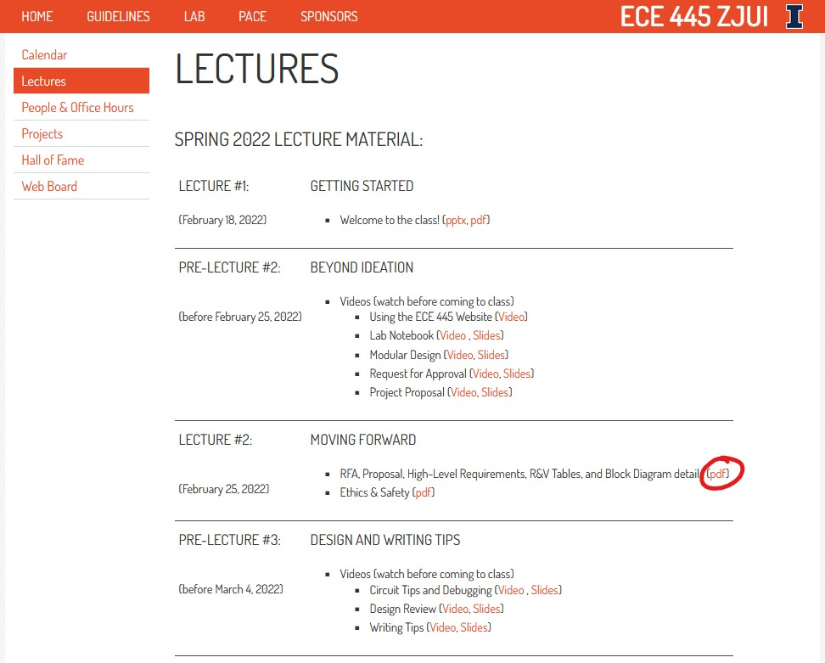
Where to find guidelines & information

Slide 11
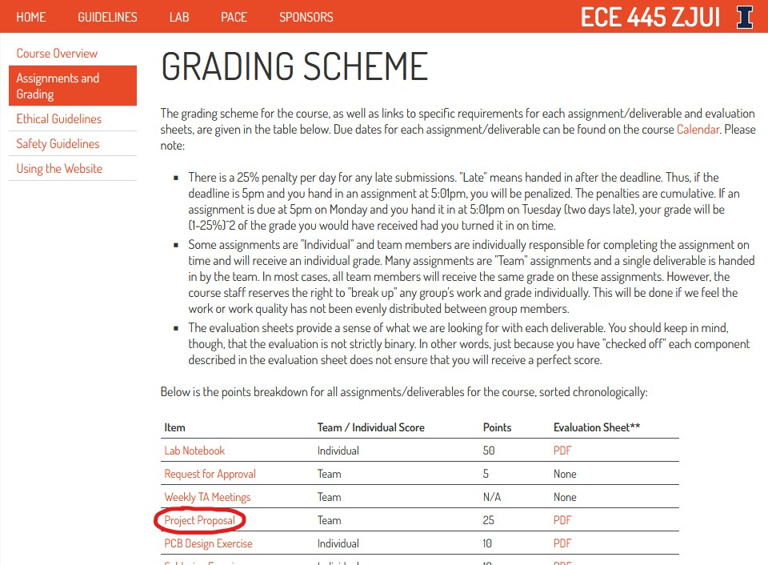
Where to find guidelines & information

Slide 12
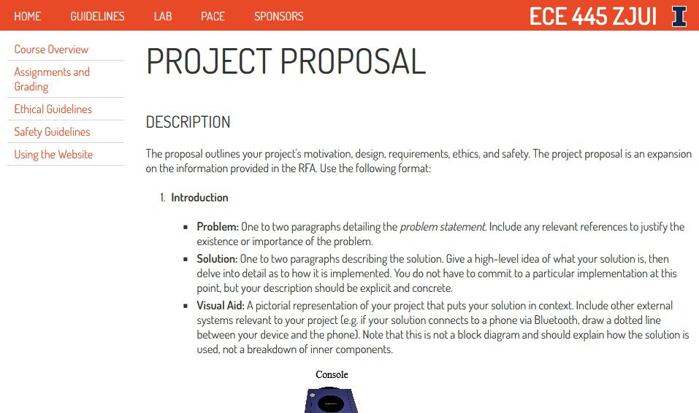
Where to find guidelines & information

