Slide 1
How to prepare a good Proposal
Prof. Fliflet

Slide 2
Project Proposal Preparation Guide (available on course website)
The proposal outlines your project's motivation, design, requirements, ethics, and safety. The project proposal is an expansion on the information provided in the RFA.
The proposal provides a good foundation for the Design Document
Use the format and structure needed for the final report

Slide 3
What is the project proposal?
THE PLAN

Slide 4
The “plan” contains three sections whose purpose is to articulate:
Introduction
What is your problem?
Why is it important?
How do you propose to solve it?
What is different about your approach?
Design and Requirements
How will you implement your proposed solution?
What are the requirements the components need to satisfy?
What is the most difficult/risky part?
Ethics and Safety

Slide 5
Introduction
Objective: One to two paragraphs detailing the problem statement and proposed solution.
Background: Explain the context of the problem to be solved by your project, including any relevant references to justify the existence and/or importance of the problem (i.e., the need or want for a solution).
Physical Design: A pictorial representation of your project that puts your solution in context. Not necessarily restricted to your design. Include other external systems relevant to your project (e.g. if your solution connects to a phone via Bluetooth, draw a dotted line between your device and the phone). Note that this is not a block diagram and should explain how the solution is used, not a breakdown of inner components.
High-level requirements list: A list of three quantitative characteristics displayed as a bulleted list that this project must exhibit in order to solve the problem. Each high-level requirement should be stated as a complete sentence. It does not refer to a specific technical approach. Avoid mentioning "cost" as a high-level requirement.

Slide 6
Problem and solution example (ECE445 Project 13, Fall 2020)
Problem:
Every year, there are hundreds of trade shows, career fairs, expos, etc. held globally wherein there a hundred of presenters (i.e. exhibition booths) and thousands of attendees. All of these events have a commonality, one that has led to a quite noticeable issue. Given that each attendee visits a multitude of booths, it is inevitable that an attendee would fail at recalling every detail regarding the booths they visited, and the contact information for the respective presenters. Furthermore, the presence of a crowd in each booth could lead the presenters to miss out on talking to every attendee that may have been interested in their company, project, or idea.
Solution:
We propose a standalone, battery powered device which will continuously monitor for booth attendants via Bluetooth Low Energy. Upon detecting an attendee, it will sync with the companion smartphone app and provide information about that booth. This information could be a website link, contact information, an introduction to the booth itself, etc. The smartphone app would keep track of how long it has been nearby any given booth and log that data to be presented to the user to show what booths (and information about the booths) they attended. An attendee would be marked as visited for a booth based on the relative distance to the device itself and the amount of time they were near the booth.
Extensive background was also provided

Slide 7
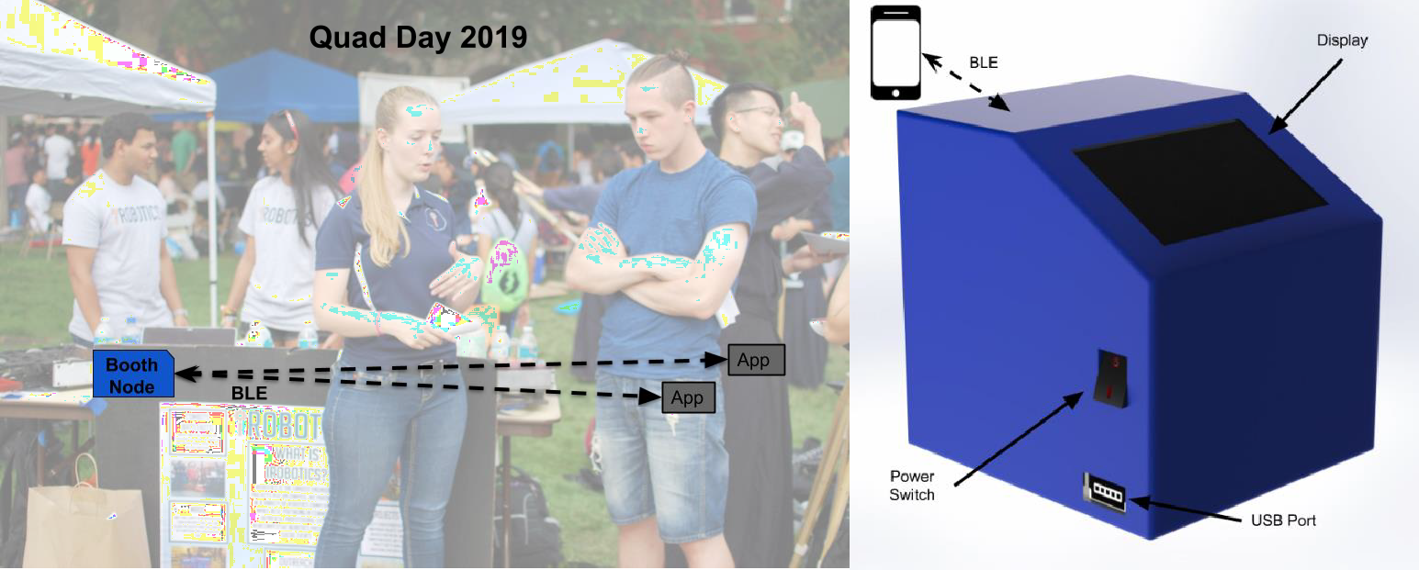
Physical Design Example (Project 13)
I.III
Physical Design
Figure 1: Device Physical Design

Slide 8
High Level Requirements Example (Project 13)
I.IV
High-Level Requirements
The device’s battery will need to be able to provide sufficient power for normal operation for a period of at least 4 hours per charge.
The interface between the ESP32 and the Smartphone itself must be able to log attendees within 3 meters from the booth they are at provided that they meet the minimum time requirement for the booth, which would be user configurable from 1-15 minutes. Additionally, they must be at least 8 meters away from the device present at another booth.
The transfer of user data between the smartphone and the device should be completed in under 250 milliseconds after initial connection, thereby allowing fast, efficient, and concurrent booth polling.

Slide 9
II. Design
Block Diagram: A general block diagram of the design of your solution. Each block should be as modular as possible and represent a subsystem of your design. The block diagram should be accompanied by a brief (1 paragraph) description of the high-level design justifying that the design will satisfy the high-level requirements.
Functional Overview: A brief description of the function of each block in the block diagram and explain how each block contributes to the overall design. Include a discussion of the interface with other blocks. Every block in the block diagram must have its own description and each description should be 1-2 paragraphs in length.
Block Subsystem Requirements: For each subsystem in your block diagram, you should include a detailed description. Each description must include a statement indicating how the block subsystem contributes to the overall design dictated by the high-level requirements.
Tolerance (Risk) Analysis: Identify the block or subsystem of your project that poses the greatest risk to successful completion of the project. Discuss the analysis needed to assess this risk and assure success

Slide 10
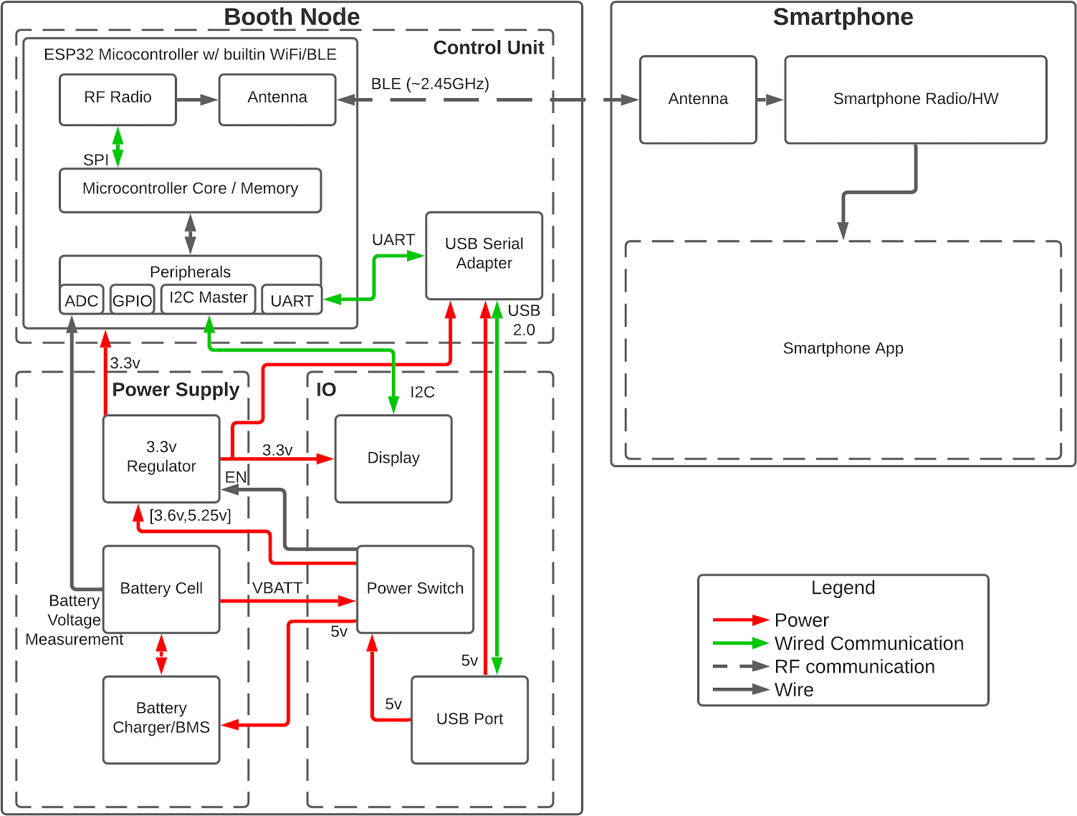
Block Diagram (ECE445 Project 13, Fall 2020)
Figure 2: Block Diagram

Slide 11
Functional Overview Example
II.II.III Control Unit
This subsystem is responsible for handling all of the BLE communication, as well as the UART to USB communication. The BLE communication enables the device to record attendees, as well as provides a way for the smartphone application to determine the booth it is at, which allows the system to fulfil two of the high-level requirements.
II.II.III.I ESP-32 Microcontroller
Using BLE communication with the microcontroller in this subsystem, the smartphone app would be able to determine which specific booth it is at and record how long the attendee was at each booth by communicating with the BLE device. This communication would also allow the device …

Slide 12
Control Unit Requirements
II.II.III.III Requirements
Requirements
This subsystem must be able to be detected as a BLE device when within 5 meters.
When the USB port is plugged into a computer, the device must show up as a working (without errors according to the OS) serial COM/tty device.
The I2C bus must be able to detect and communicate with any devices connected to the bus at the correct address(es).
The ADC of the control unit must correctly measure the voltage of the battery cell within ±0.1v of the actual voltage across the battery range (3.5v ~ 4.2v).

Slide 13
Tolerance Analysis Example
II.III Risk Analysis
We believe that the RF (BLE) communication poses the greatest risk to successful completion of the project because our idea for implementing range estimation using signal strength does not have a simple correlation (interference/obstacles both can reduce signal strength at a fixed distance). We are unsure of whether instantaneous signal strength will be a sufficient metric on its own, or if it will need to be thoroughly filtered in an attempt to determine a value more directly correlated to distance. Additionally, this component of the project will likely require the most amount of characterization and calibration to achieve optimal performance. It is possible that our approach is valid, but we believe this aspect could lead to significant development time usage in order to develop the technology sufficiently such that it meets our performance metrics. Additionally, the RF module will consume a majority of the power [11] for our device, with the possible exception of the OLED display at full brightness [7]. As such, it could additionally pose a challenge to meeting our expectations for battery performance.

Slide 14
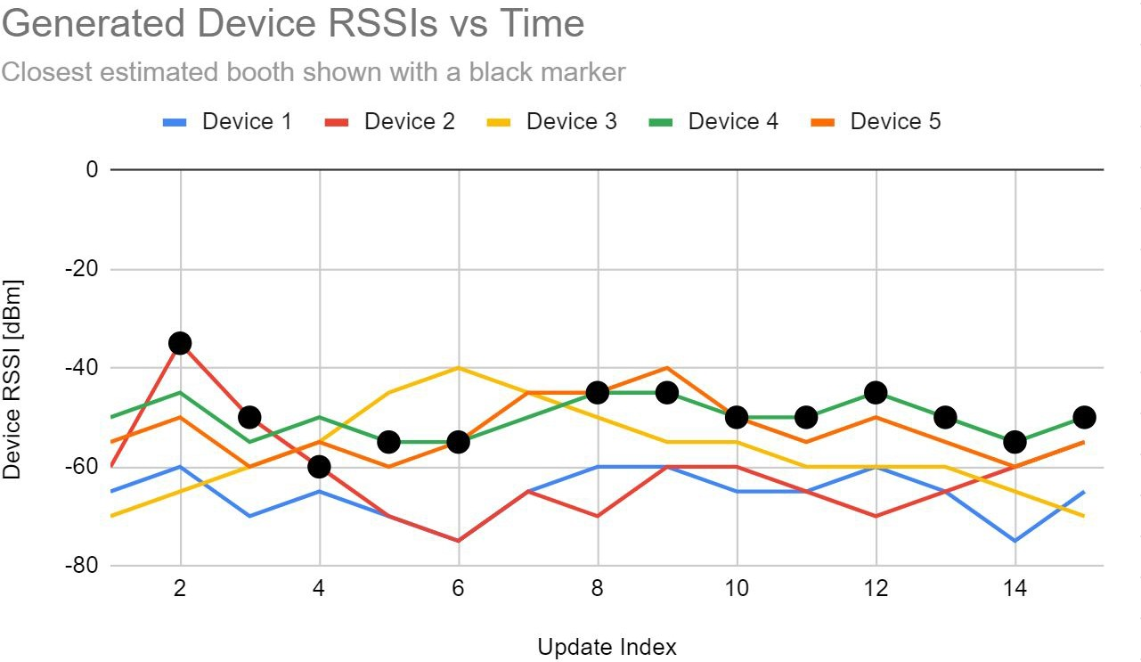
Tolerance analysis that was ultimately done during the project

Slide 15
Ethics and Safety
Assess the ethical and safety issues relevant to your project. Consider both issues arising during the development of your project and those which could arise from the accidental or intentional misuse of your project.
Specific ethical issues should be discussed in the context of the IEEE and/or ACM Code of Ethics.
Cite, but do not copy the Codes. Explain how you will avoid ethical breaches.
Cite and discuss relevant safety and regulatory standards as they apply to your project. Review state and federal regulations, industry standards, and campus policy. Identify potential safety concerns in your project
If you think there are no issues, justify your belief

Slide 16
ECE445 Project 13, Fall 2020
III. Ethics and Safety
Our device has a few potential safety concerns that must be addressed during the development process. This device will incorporate a lithium-polymer cell battery; this type of battery chemistry can be prone to explosions or fire when not kept in a safe voltage/current draw range or if exposed to high temperatures [5]. We must ensure that the battery control circuitry can maintain the operation of the device and keep the battery cell
within safe operating ranges for both voltage and current draw [5]. This, in addition to warnings about not exposing to extreme temperatures, will help to reduce the chance of the device posing a risk of personal injury or property damage. The best way to approach this challenge would be to use conventional and reliable components and implement them to manufacturer specifications. This means we can leverage the development and testing the manufacturer went through in the design process to ensure the device operates as expected and will safely manage the battery.
This device will incorporate RF communication via Bluetooth Low Energy and any venture into RF transmission requires adhering to FCC guidelines.
“The FCC regulates radio frequency (RF) devices contained in electronic-electrical products that are capable of emitting radio frequency energy by radiation, conduction, or other means. These products have the potential to cause interference to radio services operating in the radio frequency range of 9 kHz to 3000 GHz.” [12]
Specifically, our device is what is designated as an “Intentional Radiator” [12]. For this application we will be using an RF IC incorporated into a ESP32 SOM with an intentionally limited communication power. As such there will be little to no risk of introducing adverse amounts of RF interference, even with several of these devices operating in close proximity. By using an FCC certified device [6], the ESP32, as well as responsibly utilizing the RF communication (not constantly broadcast at max transmission power) through BLE, we can insure the device does not interfere with the operation of other wireless devices nearby beyond what the standard for BLE allows.
IEEE’s 7.8 Code of Ethics, Section I Policy 1 [13] “To hold paramount the safety, health, and welfare of the public... “ is relevant when considering the use of a display in our device, as any flashing lights could lead to photosensitive epileptic seizures. As such the display would only be used to show attendee count and battery status, with no additional animations or flashing lights which could lead to a seizure. Every effort will be made to negate the possibility for the display to cause an epileptic seizure.

Slide 17
Proposal Preparation Resources
Grading and Examples
Please see the Proposal Grading Rubric for grading details.
Please see Example Proposal as a guideline for document detail and length. (However, be aware that this proposal uses a rubric from previous years)
Proposal writing style and format is graded in addition to technical content
Proposals from Teams 12*, 13*, 15, and 22 in Fall 2020 scored 22/25 or better (proposals available on course website).
* Received awards
Submission and Deadlines
The Project Proposal document should be uploaded to My Project on PACE in PDF format before the deadline listed on the Calendar.

Slide 18
Proposal Grading Rubric (on website)
Introduction 5 points
Design 10 points
Ethics and Safety 5 points
Writing 5 points

