Slide 1
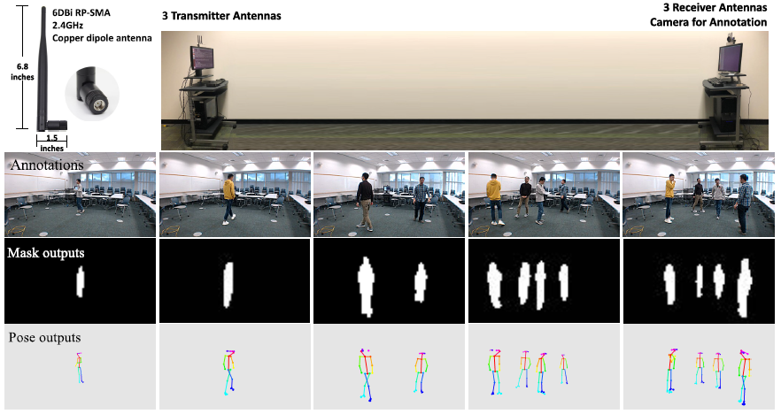
Privacy-protected Elderly monitoring system:
Wi-Fi and wearable sensors
Sponsor: | Huan Hu
Affiliation: | ZJUI
Elec. | Comp. | Mech. | Civil
1 | 3 | 0 | 0
Description:
Design Wi-Fi devices that could send Wi-Fi signals used for motion detection to ensure data privacy
Make wearable devices with multiple sensors attached to assist Wi-Fi monitoring
Build an integrated monitoring system combining Wi-Fi monitoring devices and wearable sensors used for emergency happening in old people’s home
Deliverables:
Special devices that could send Wi-Fi signals used for motion detection
Special wearable devices with multiple sensors used for motion detection and emergency
Emergency monitoring system designed for elderly
Notes:
* Not main purpose but might be applicable.

