Slide 1
Digitizing the Restaurant with Network-Enabled Smart Tables
ECE 445 Fall 2020
Group 3
Andrew Chen (andrew6)
Eric Ong (eong3) Can Zhou (czhou34)

Slide 2
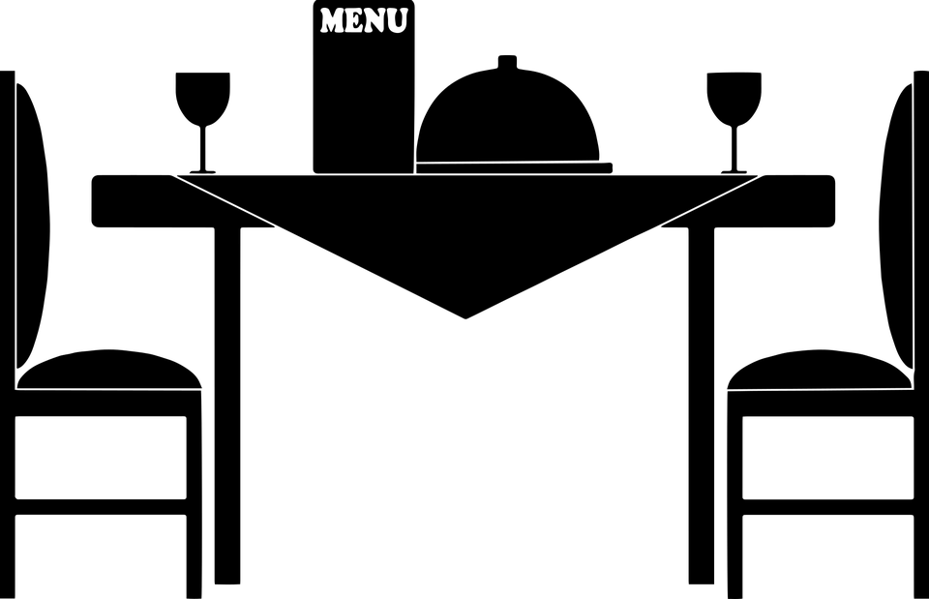
Challenges in the Restaurant Industry
- The Archaic Restaurant System
- Pandemic Regulations
Restricted Dining Spaces
Limited Person-to-Person contact in Restaurant
Public domain picture from pixabay

Slide 3
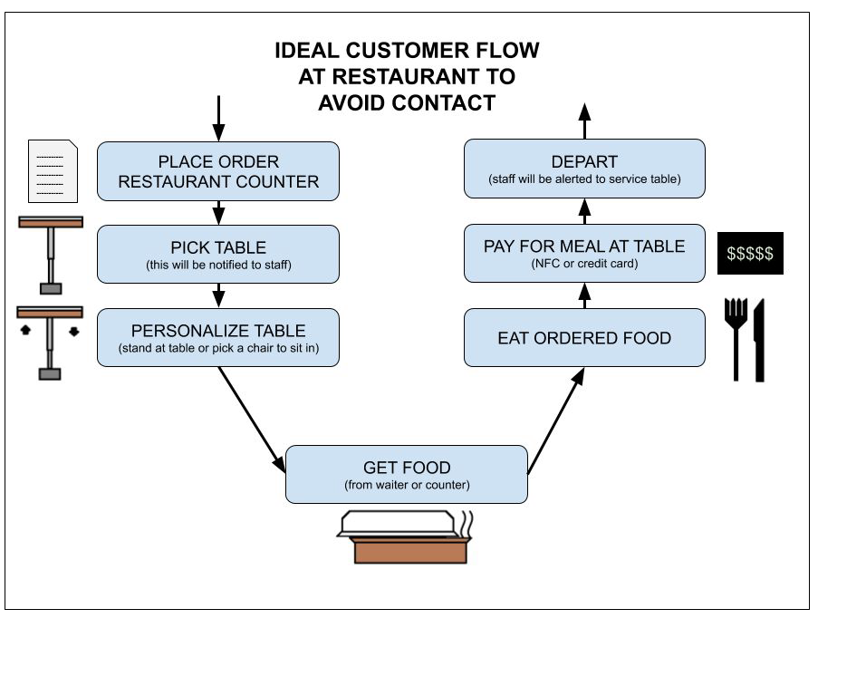
Our Solution
Modular seating device
Restaurant seating management system
Contactless payment system built into dining tables

Slide 4
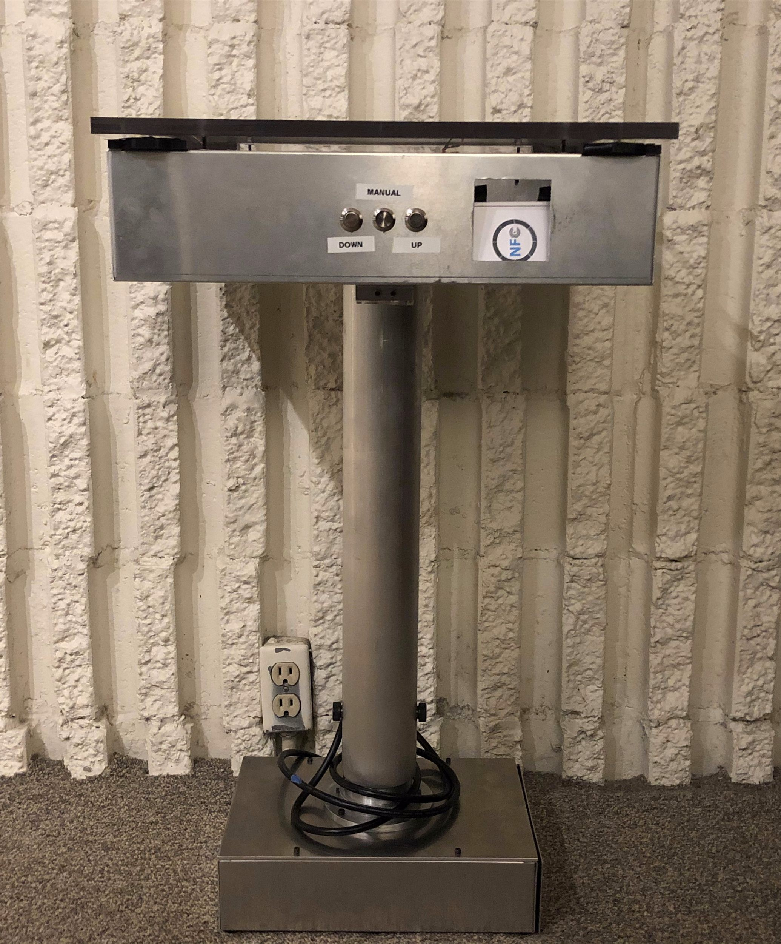
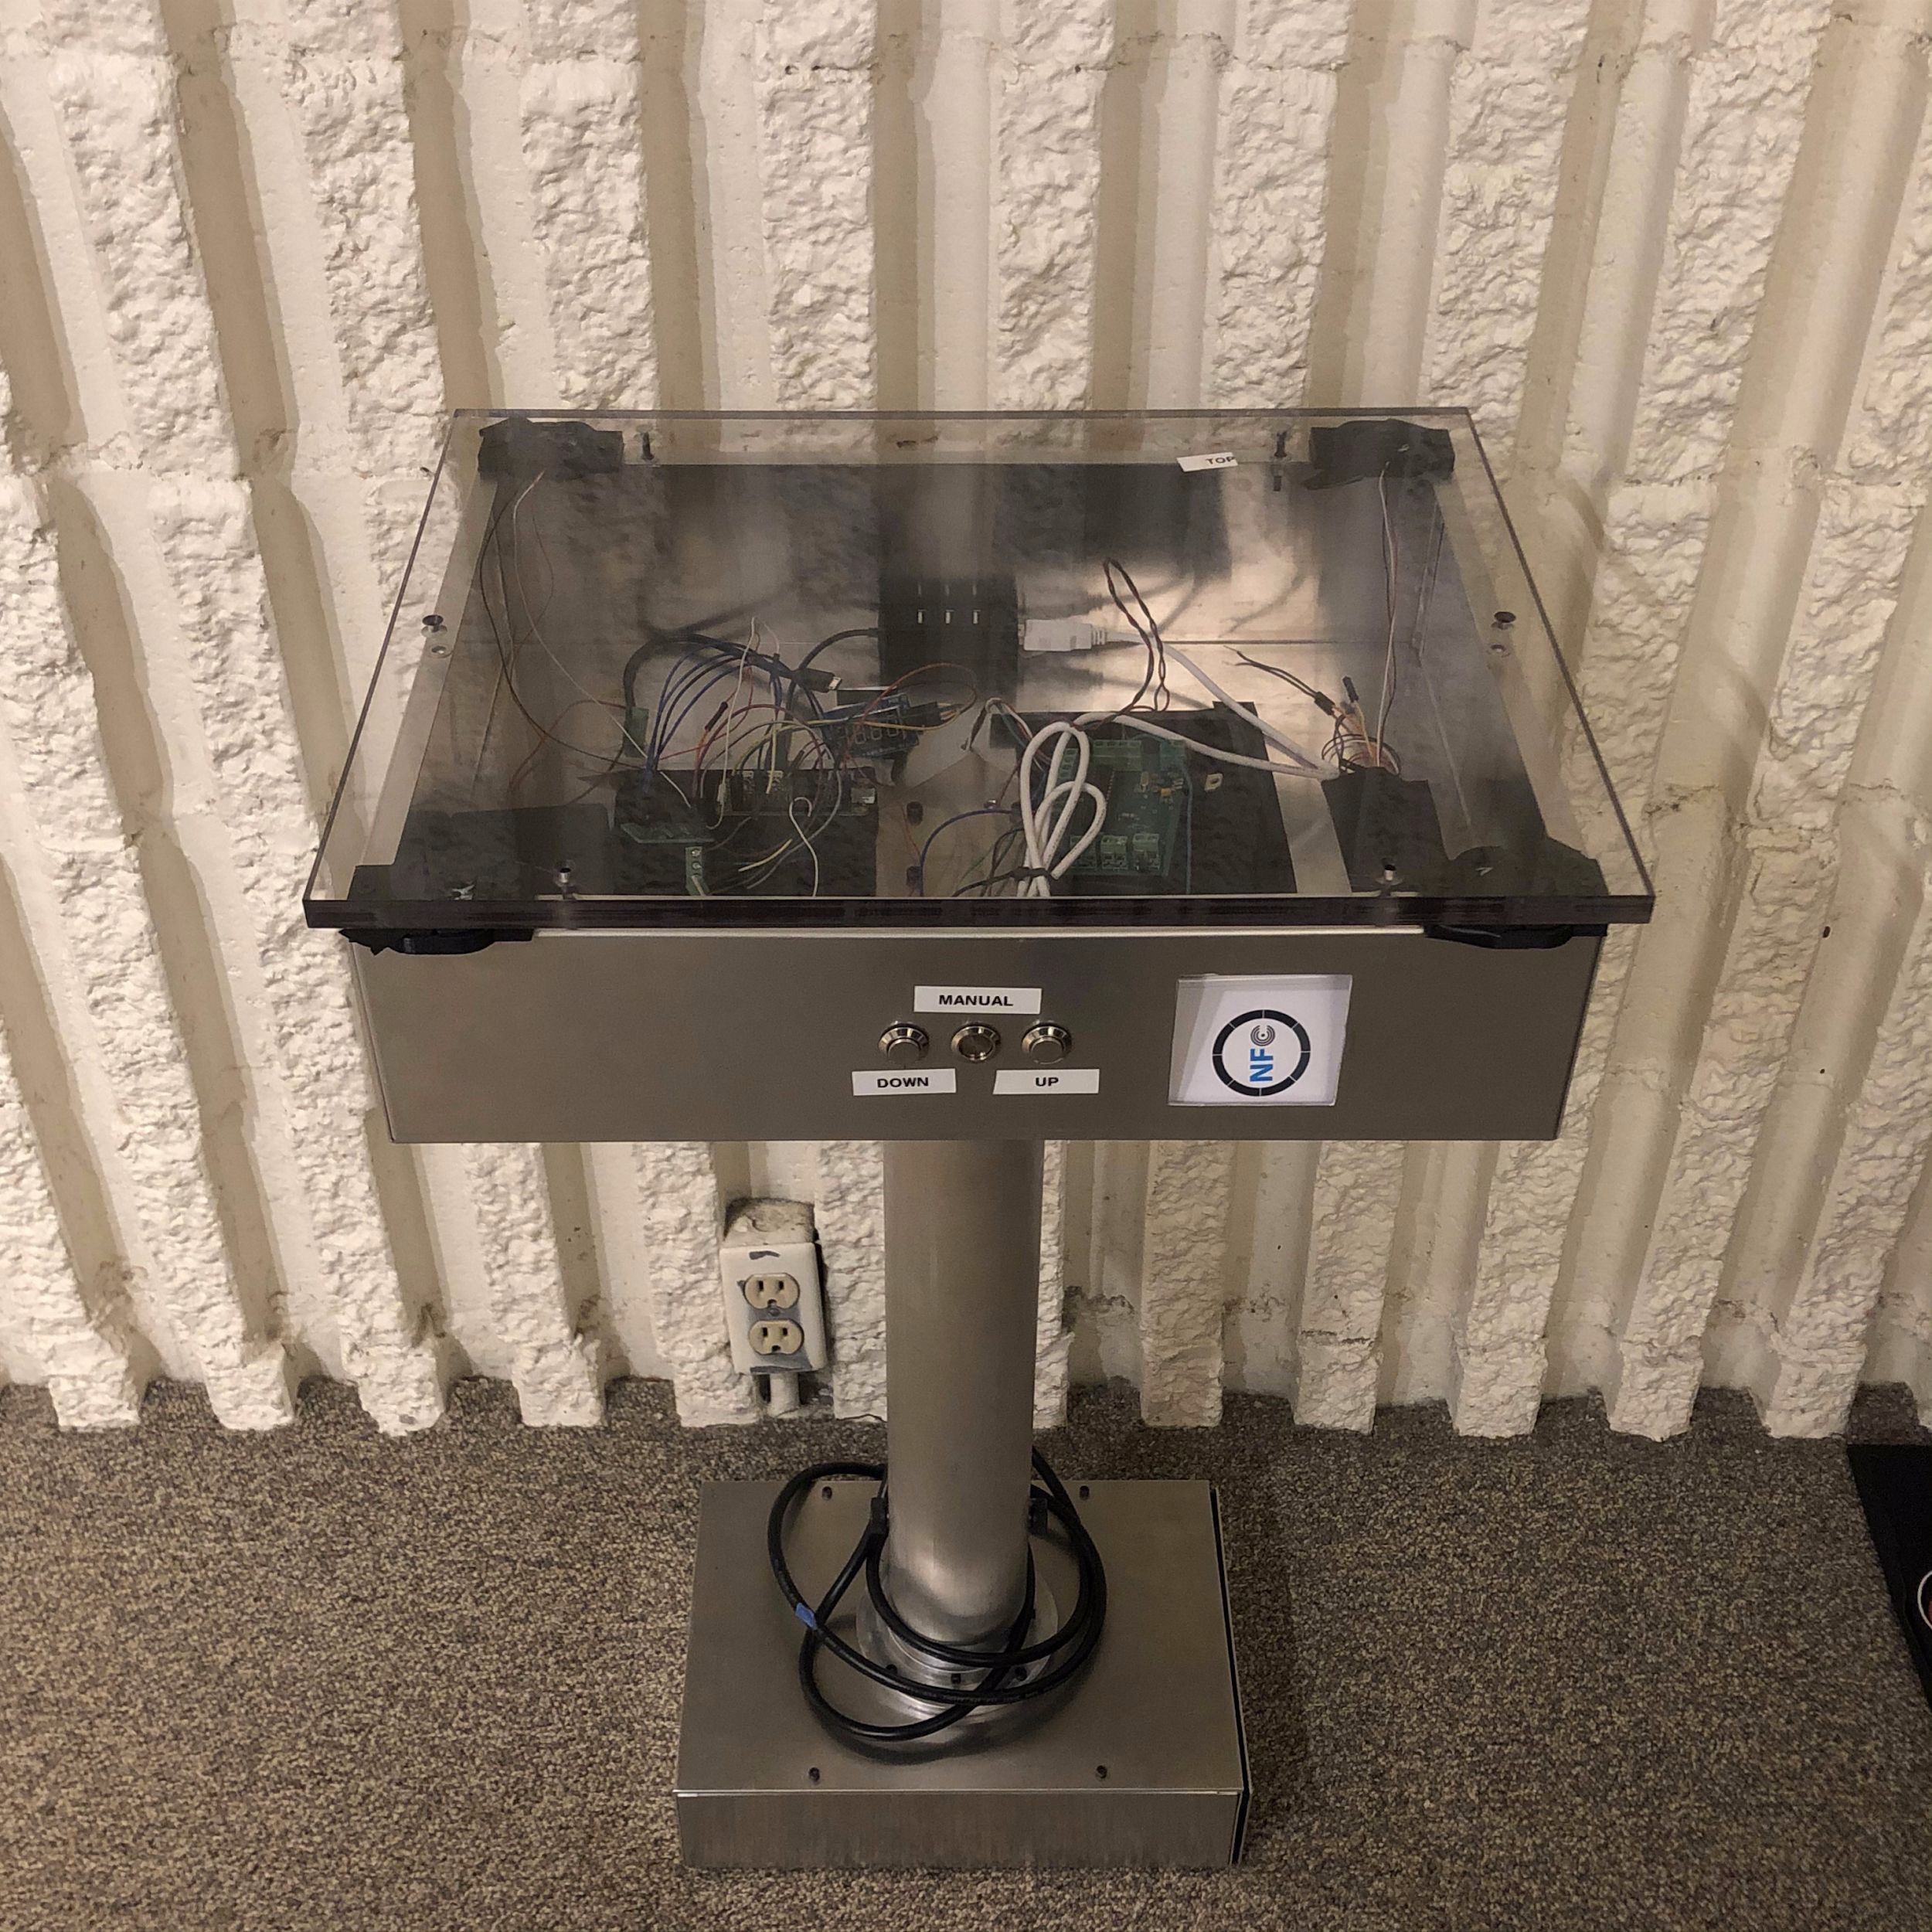

Slide 5
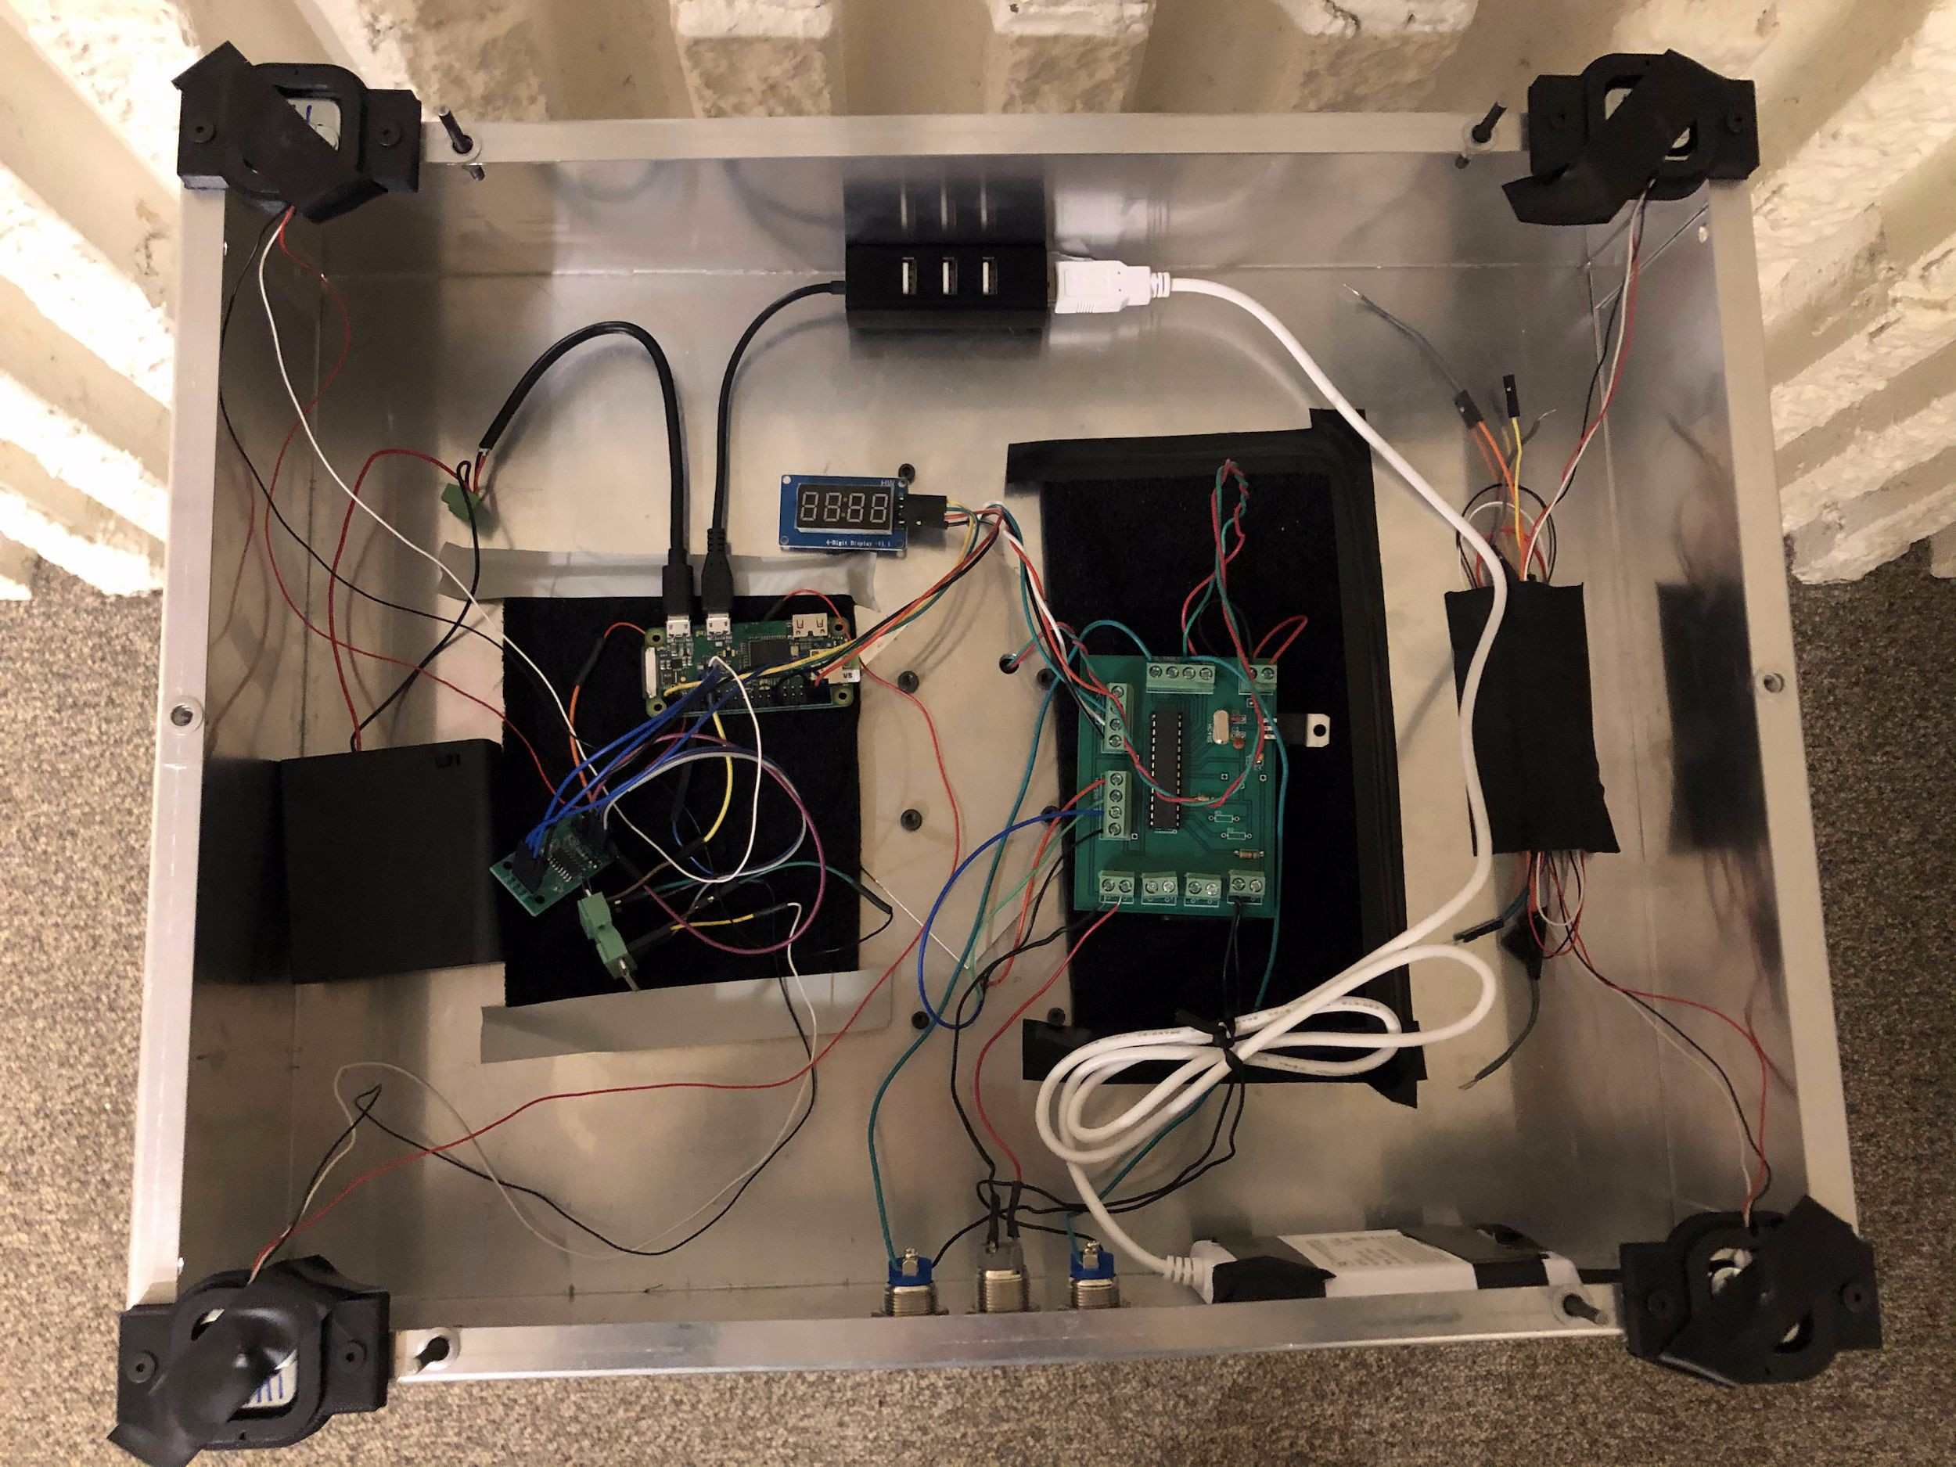
Power & Control Units
Weight Sensors
Raspberry Pi Zero
NFC Reader Bill Display

Slide 6
Table Design

Slide 7
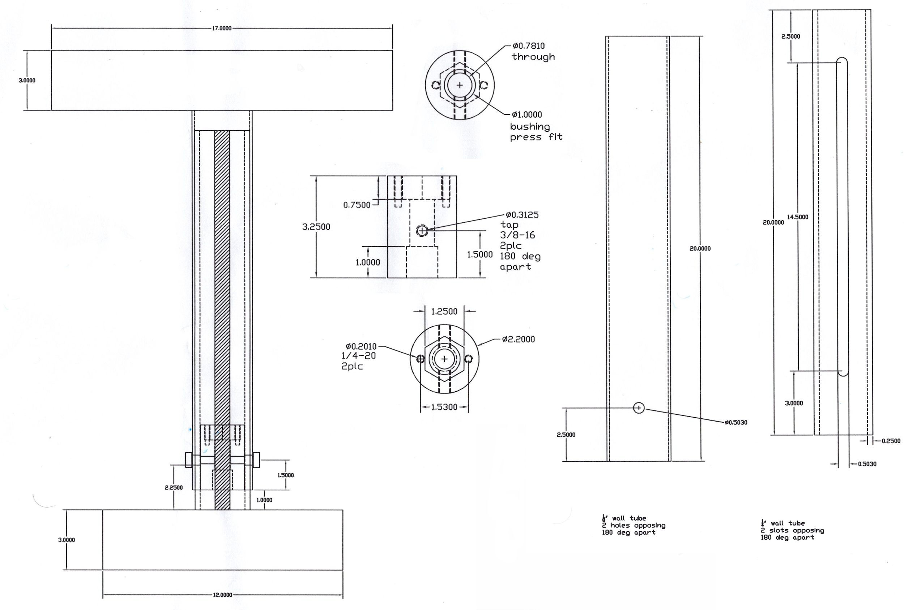
Table - Physical Design
Wireless communication and payment modules are contained within the table.
Height adjustment driven by a motor attached to a lead screw, which rotates the load of the table itself.
Picture Source: UIUC ECE Machine Shop

Slide 8
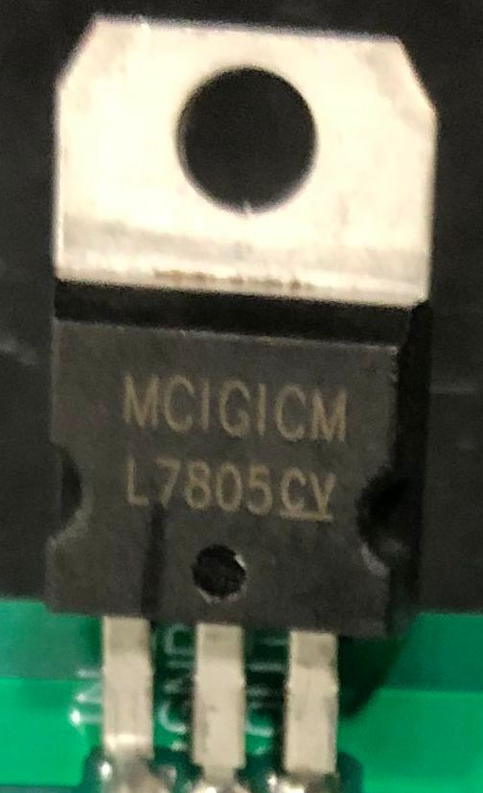
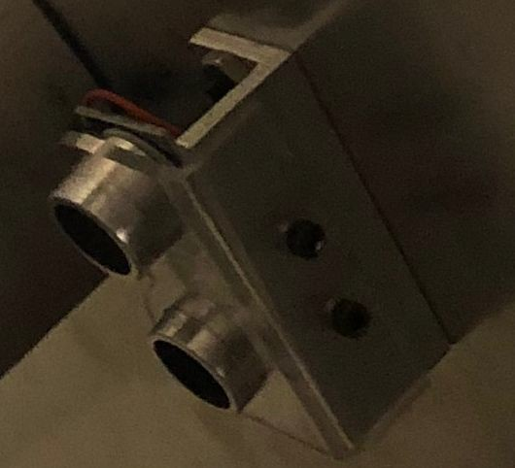
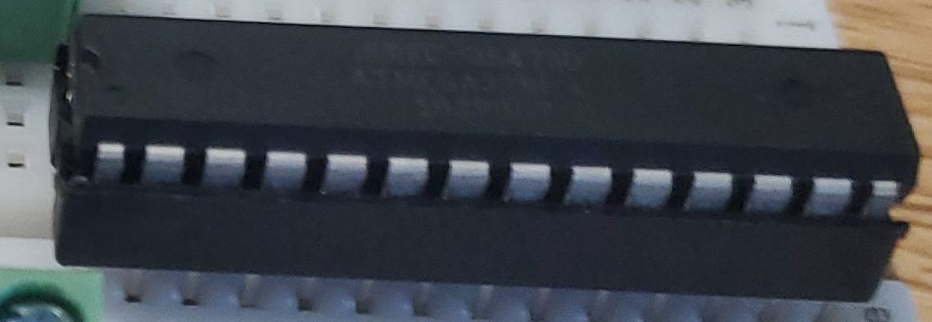
Table - Component Choices
L7805CV Linear Regulators -- More stable than batteries
HC-SR04 Ultrasonic Distance Sensors -- Familiar, fast, and long range
L7805CV
HC-SR04
ATMEGA328P-PU Microcontrollers -- Programmable with Arduino IDE, both digital and analog inputs, PWM output (for motor)
ATMEGA328P-PU

Slide 9
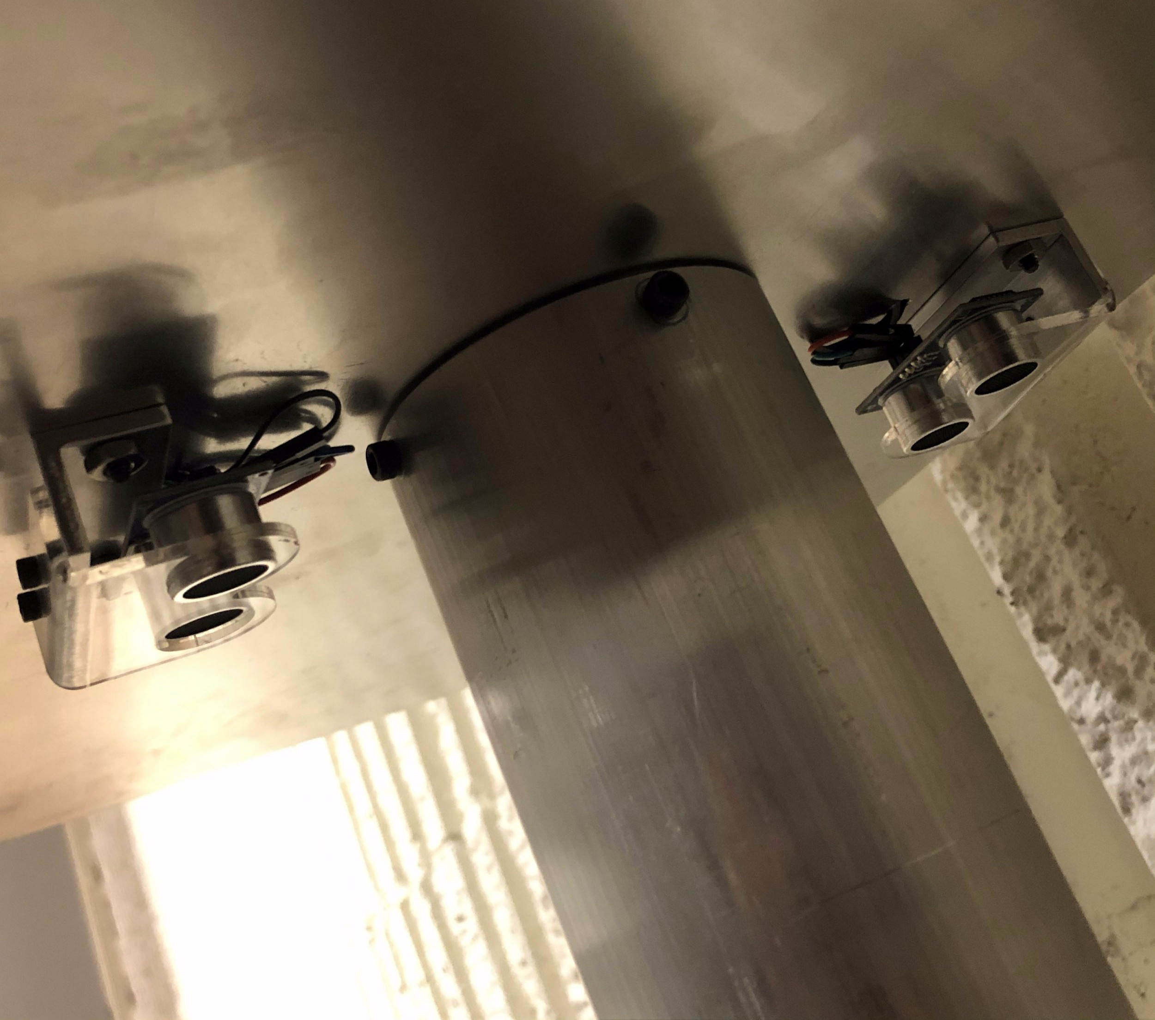
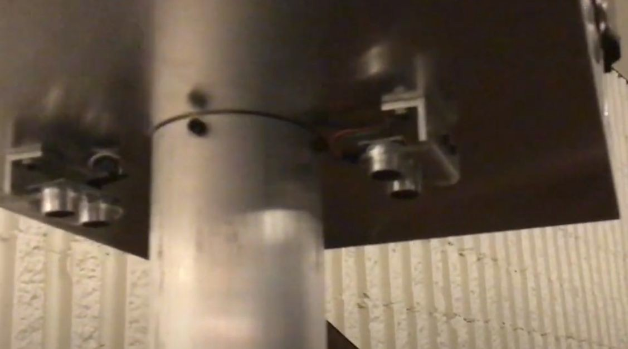
Table - Height Adjusting Algorithm
Used two HC-SR04 ultrasonic sensors, one for table height, the other for customer height detection
The prototype moved according to the customer height:
- <7" or >19": Up
- >7" or <9": Standby
- >9" and <19": Down

Slide 10
Table Height Adjustment R & V
Requirements:
Sensors: The ultrasonic sensors must be able to take 10 samples a second to determine the distance to any customer seating under it, and use a median to eliminate outliers
Speed: The height adjustment must work at a rate of an inch vertically around every 20 seconds
Safety: The height adjustment system must be able to work manually and must have safeties implemented, such that automatic adjustment is disabled
Verification:
We print the values read by the ultrasonic sensors into the serial output of our microcontroller, and confirm 10 values every second with a median
We set the table to run automatically and use a tape measure to confirm the height adjustment rate
We toggle the manual safety mode of the table while the table is adjusting automatically, and confirm that manual controls work

Slide 11
Table Height Adjustment R & V (1 of 3)
Requirements:
The ultrasonic sensors must be able to take 10 samples a second to determine the distance to any customer seating under it, and use a median to eliminate outliers
Verification:
We print the values read by the ultrasonic sensors into the serial output of our microcontroller, and confirm 10 values every second with a median
Using the Arduino IDE and connecting to a computer:
Print the ordered readings every second
Print the acquired median every second

Slide 12
Table Height Adjustment R & V (2 of 3)
Requirements:
The height adjustment must work at a rate of an inch vertically around every 20 seconds
Verification:
We set the table to run automatically and use a tape measure to confirm the height adjustment rate
Set table to manual mode
Hold tape measurer parallel with shaft of the table
Time the descent of the table and verify an inch takes between 10 and 20 seconds

Slide 13
Table Height Adjustment R & V (3 of 3)
Requirements:
The height adjustment system must be able to work manually and must have safeties implemented, such that automatic adjustment is disabled
Verification:
We toggle the manual safety mode of the table while the table is adjusting automatically, and confirm that manual controls work
Using the Arduino IDE and connecting to a computer:
Print polling from automatic collection
Enable the manual safety mode
Print and visually confirm operation

Slide 14
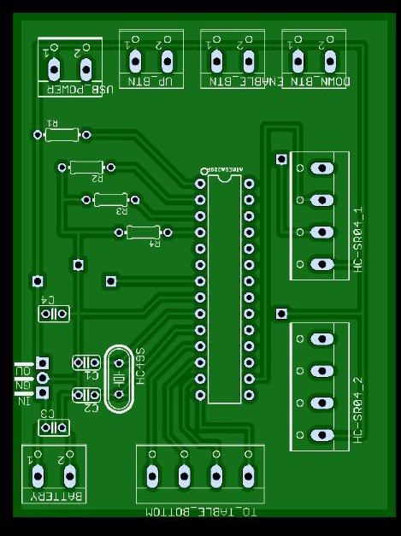
Table Height Adjustment Challenges
Problem: Digital pins 0 and 1 were dedicated to serial input/output -- limited functionality!
Unreliable input/output to microcontroller!

Slide 15
Table Height Adjustment Challenges
Solution: We had two vacant pins due to physical design constraints, and these were the same type of pins!
Available input pins!

Slide 16
Table Height Adjustment Challenges
New problem: No way to power pins connected here, nor any feasible way to pull down these signals!
Incompatible!

Slide 17
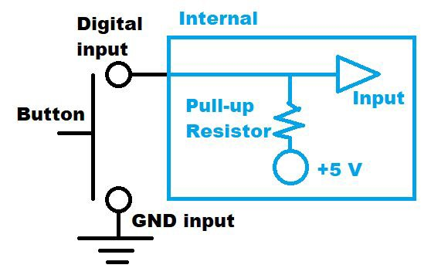
Table Height Adjustment Challenges
Solution: Use the pull-up resistors in each of these digital pins!
Have pull-up resistors

Slide 18
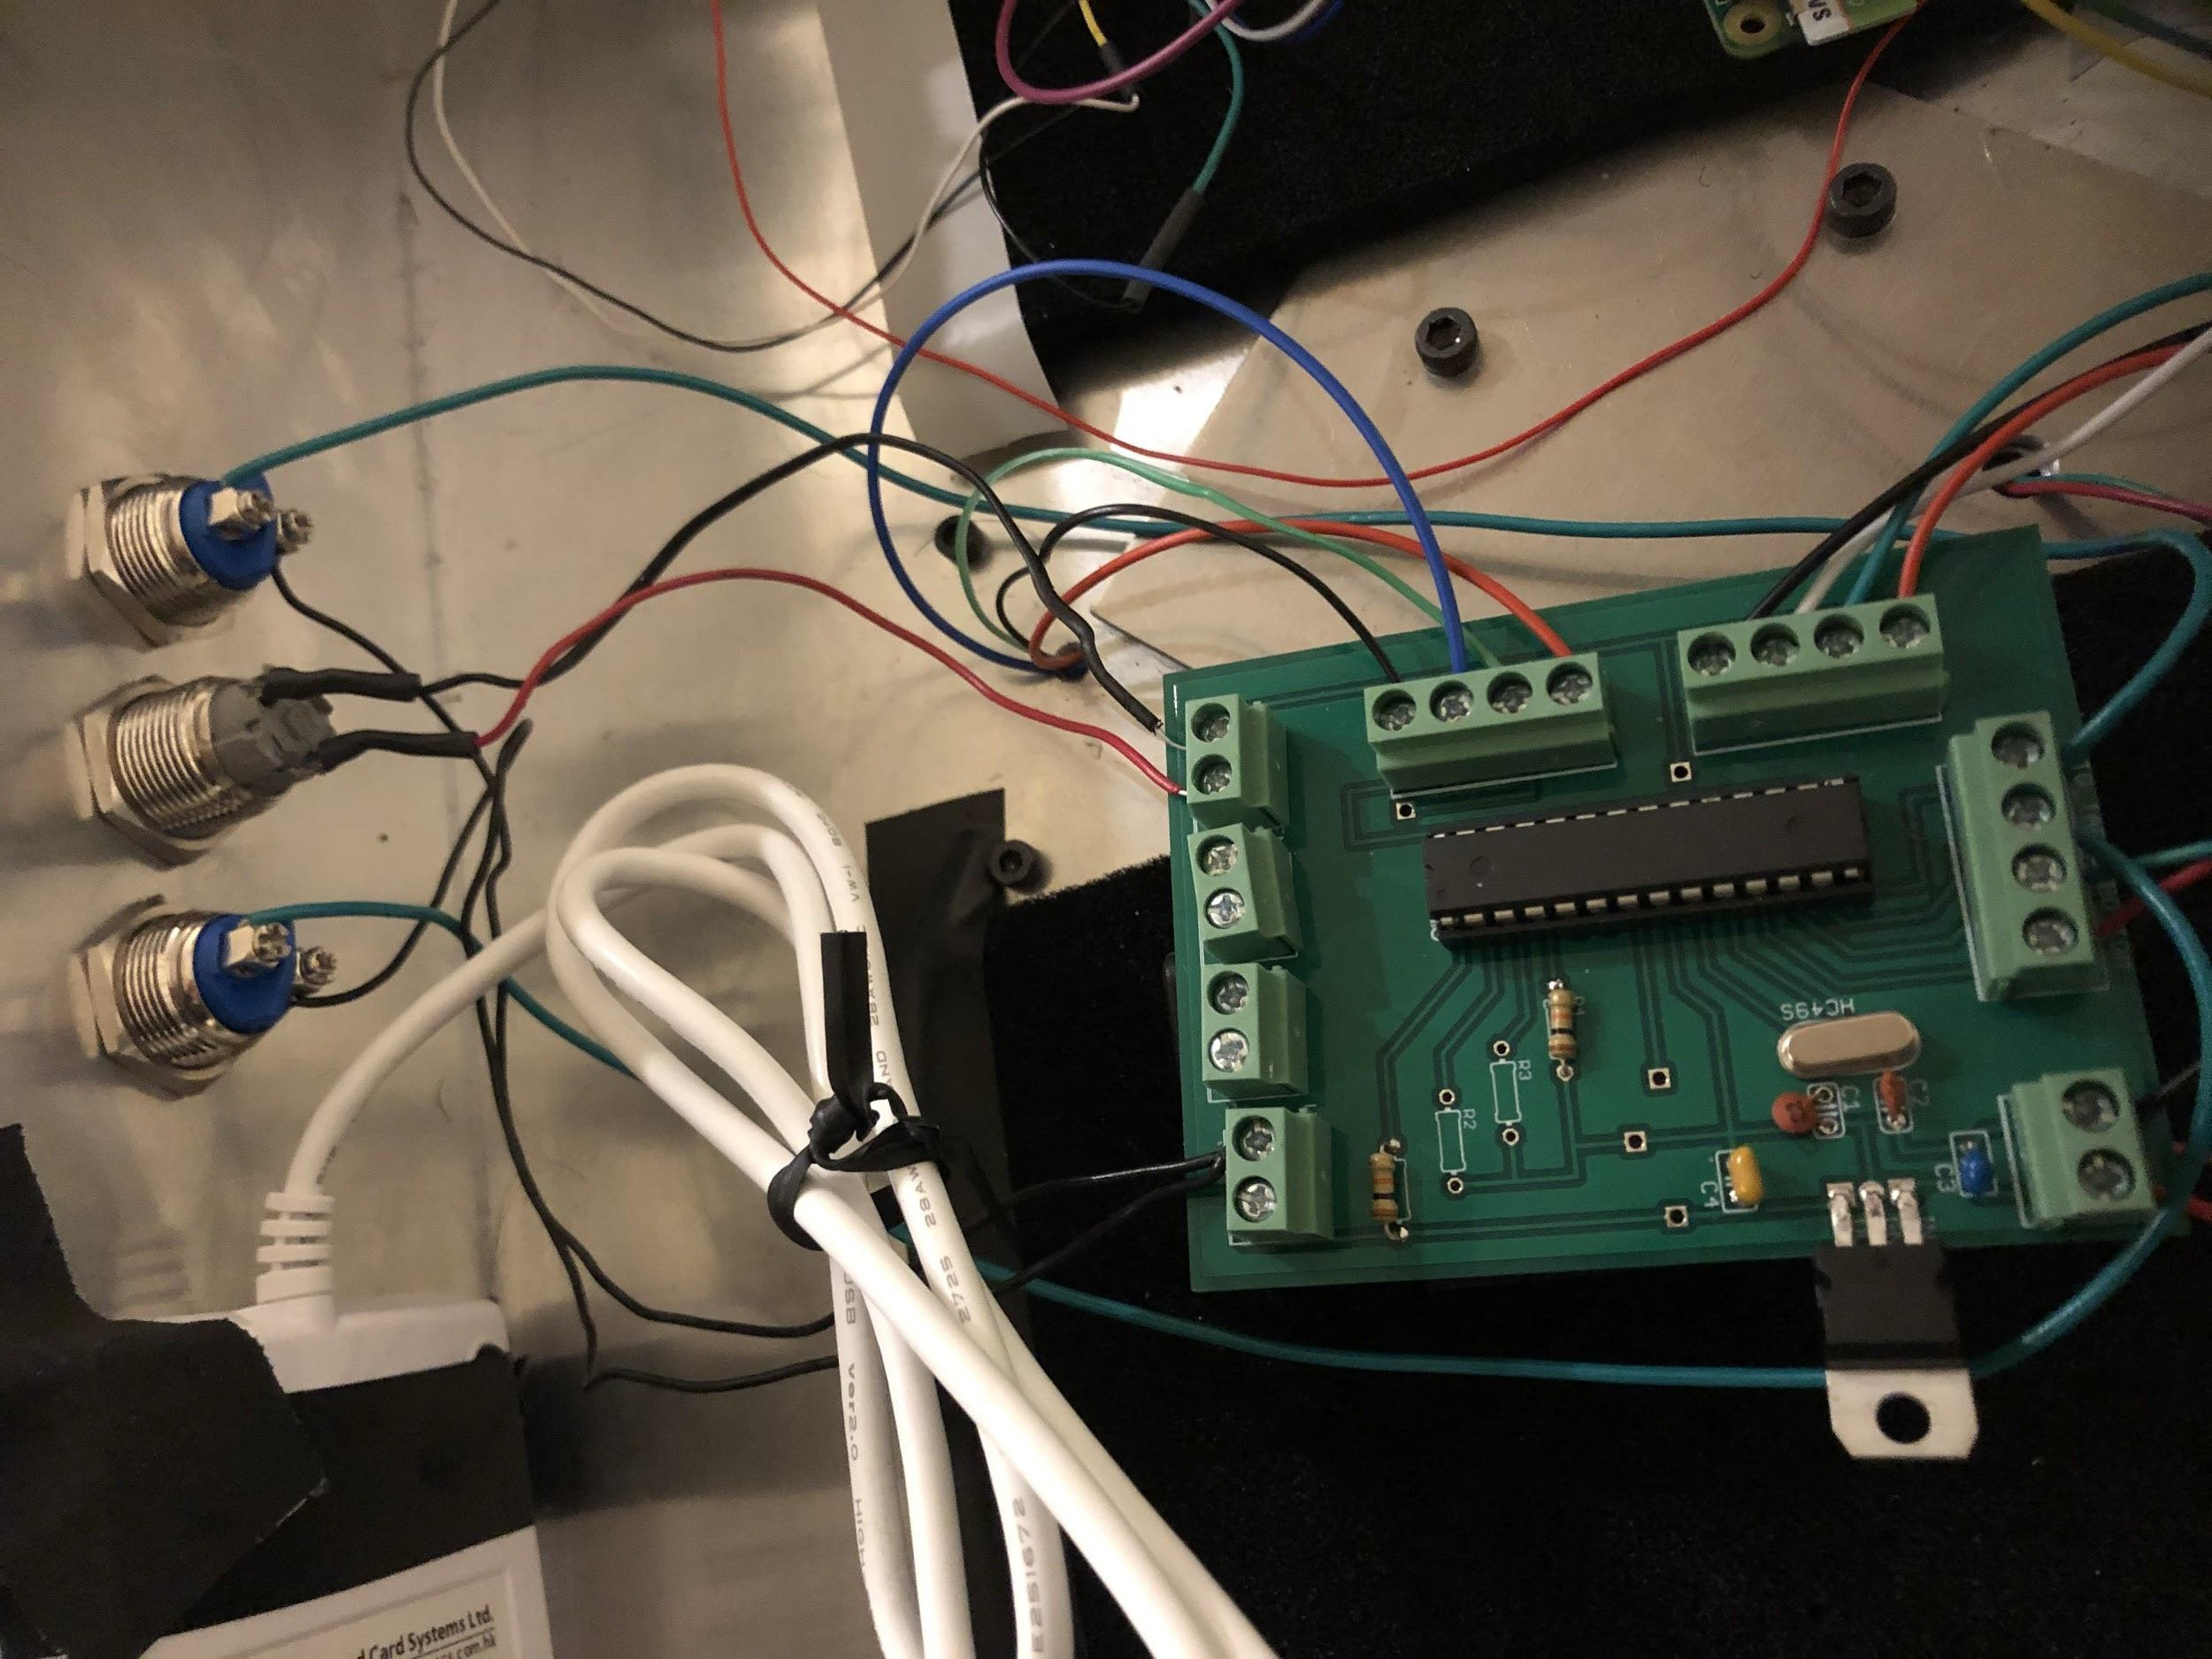
Table Height Adjustment Challenges
We retained all PCB functionality!
Bonus: Freed pins let us directly program the microcontroller via the PCB during testing!

Slide 19
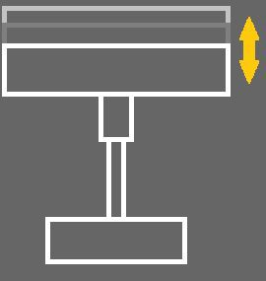
Table - Customer-Customized Seating
A system with adjustable height means every table can serve as:
A standard height dining table
A table that accommodates those with seating accommodations
A bar height table
A standing table

Slide 20
Table Network

Slide 21
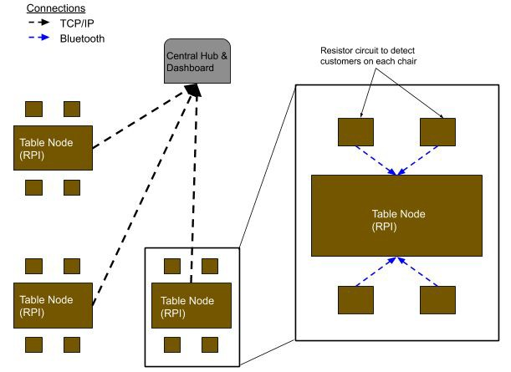
Table Network - Communications
TCP/IP for
Table-to-Dashboard
Bluetooth for Chair-to-Table

Slide 22
Table Network - Customer Presence
How do we know when someone is sitting at the table?
Chair Force Sensing Resistor
How do we know if the tabletop is still dirty?
Tabletop Load Cells

Slide 23
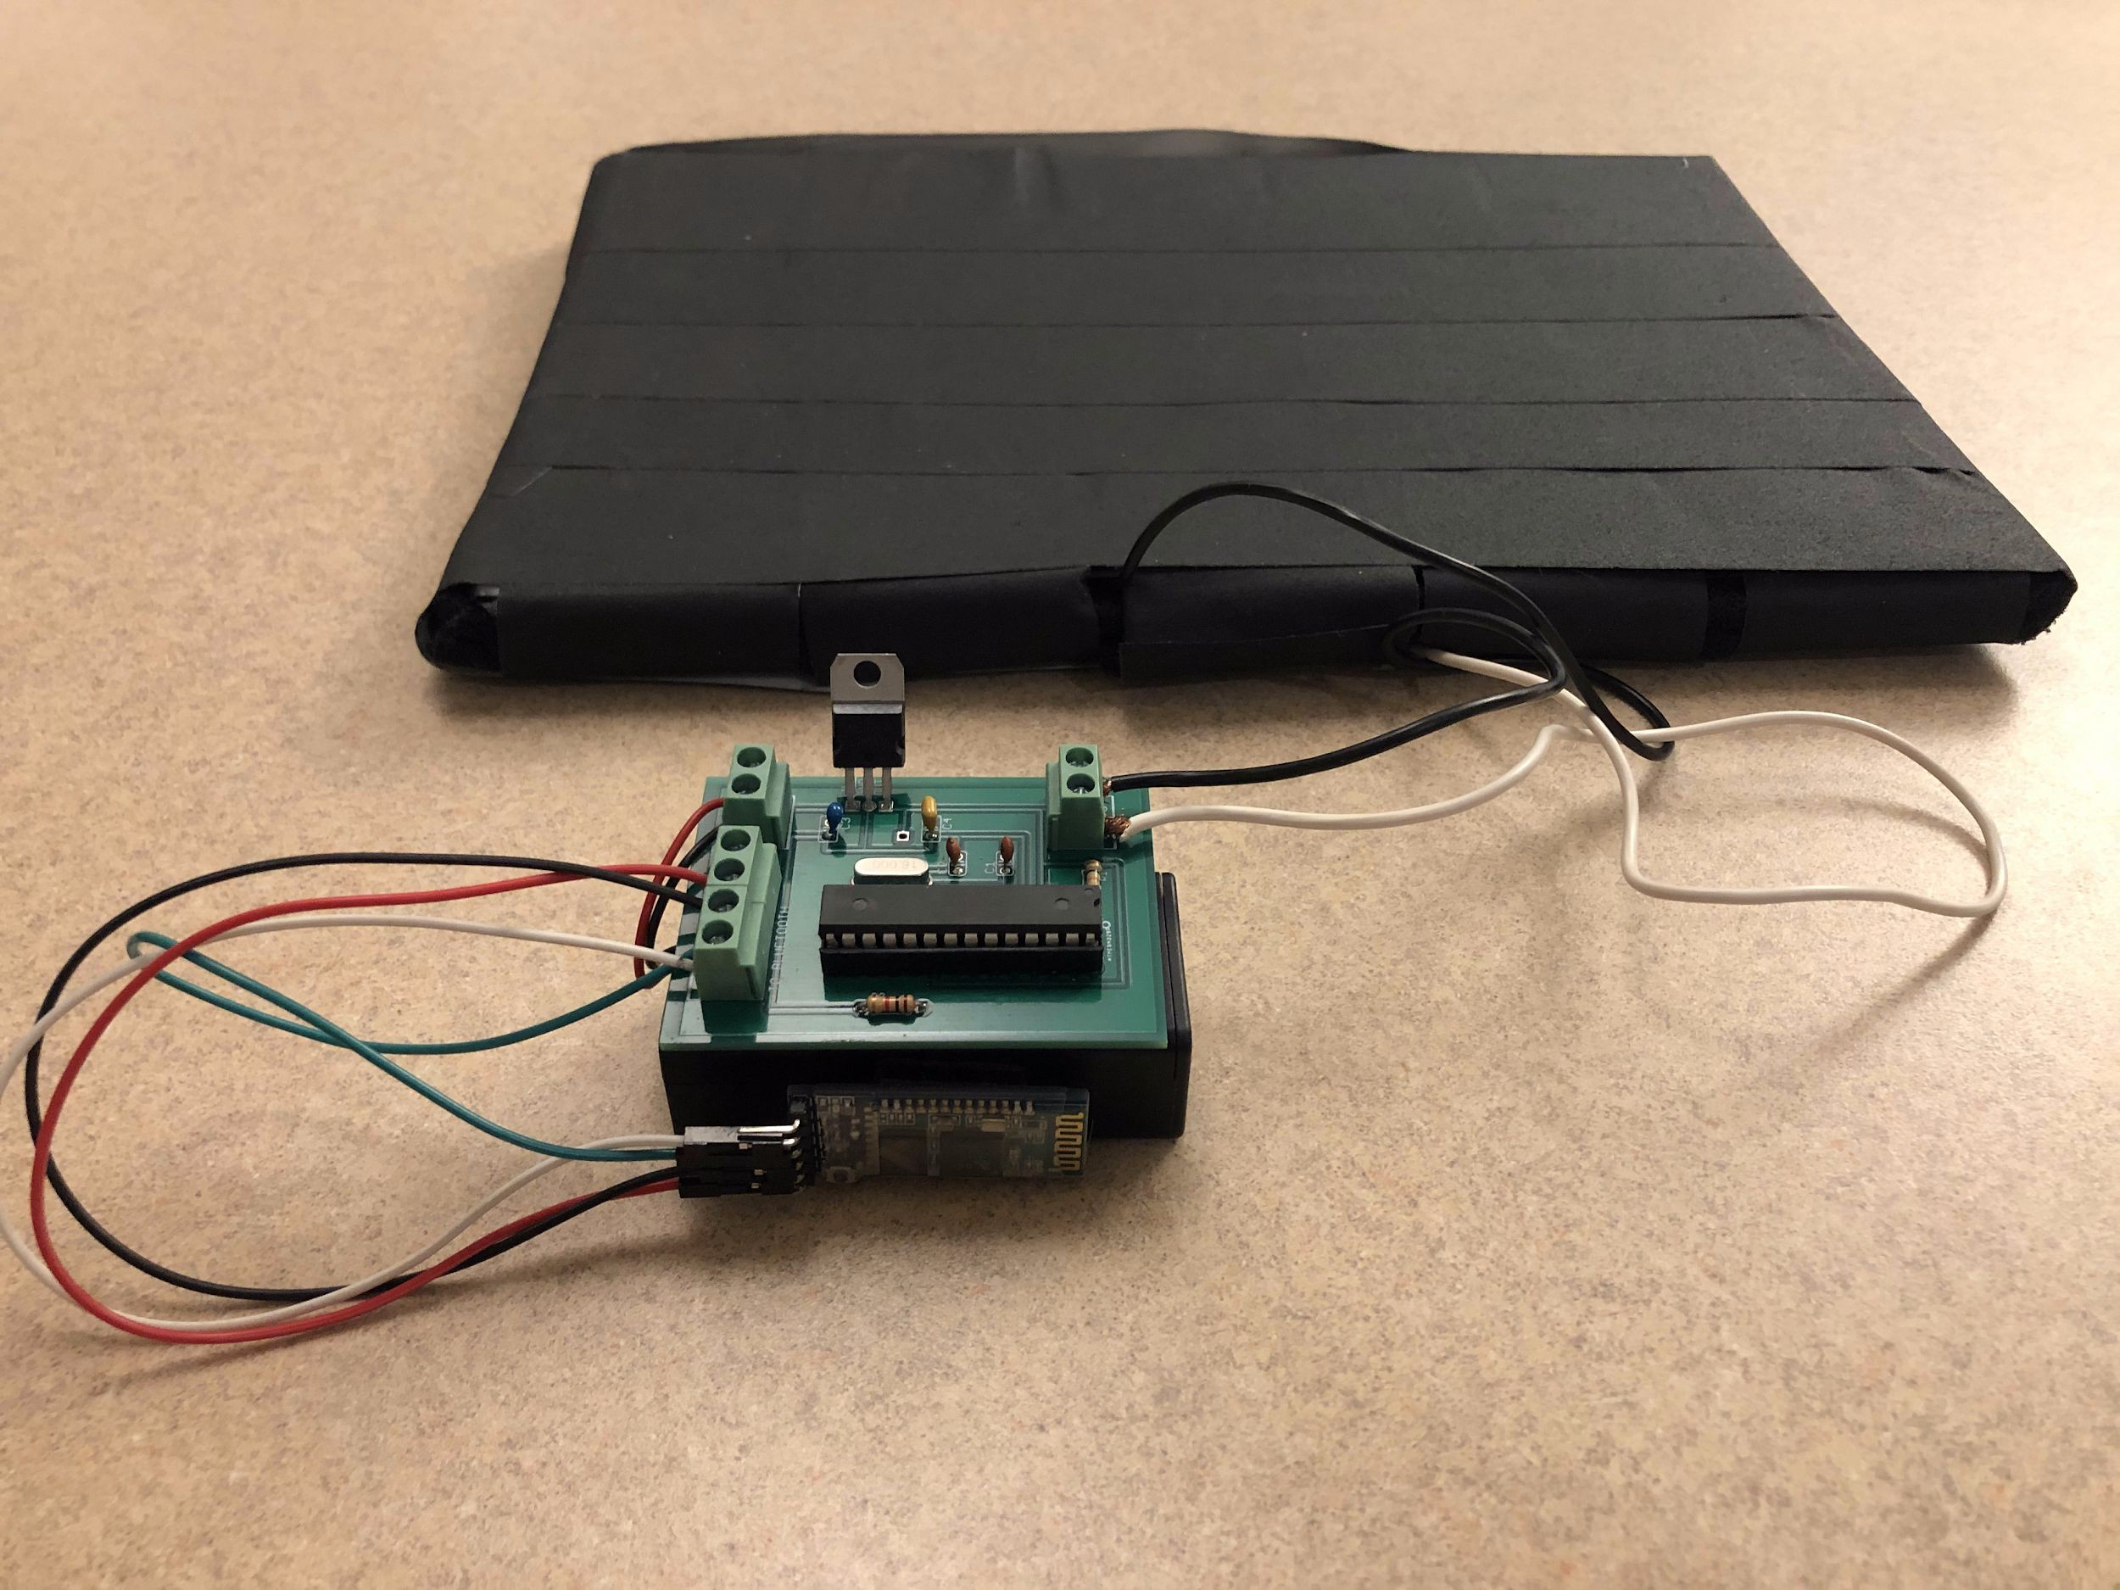
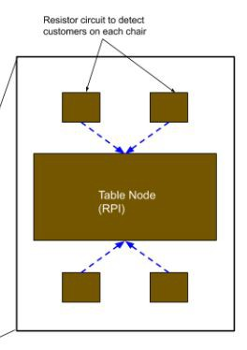
Table Network - Detecting Customers
Force-sensing Resistor

Slide 24
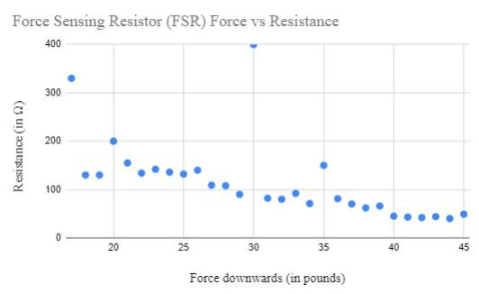
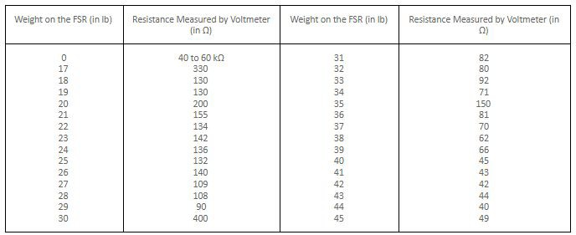
Collected FSR Values

Slide 25
Table Network - Detecting Customers
Bluetooth

Slide 26
Table Network - Detecting Objects on the Tabletop
Load Cells
Hx711 ADC
Raspberry Pi Zero

Slide 27
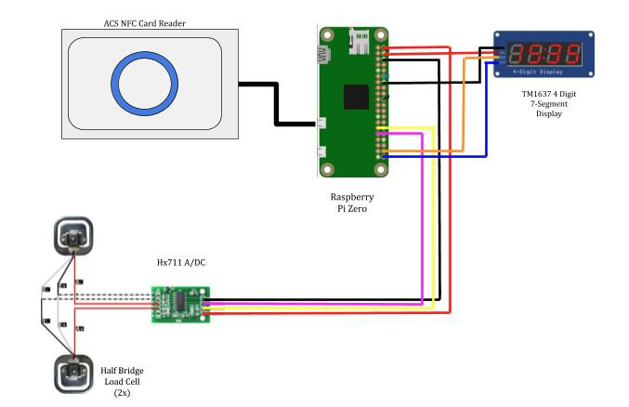
Table Network - Detecting Objects on the Tabletop
Load Cells
Hx711 ADC
Raspberry Pi Zero

Slide 28
Table Network - Detecting Objects on the Tabletop

Slide 29
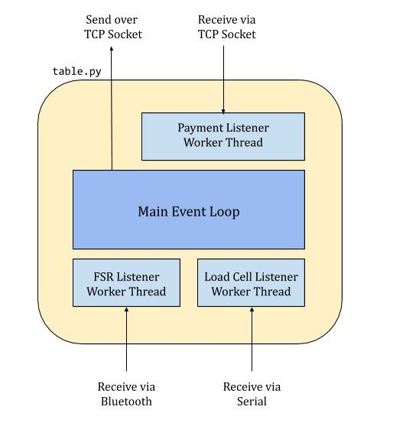
Table Network - Talking to the Dashboard

Slide 30
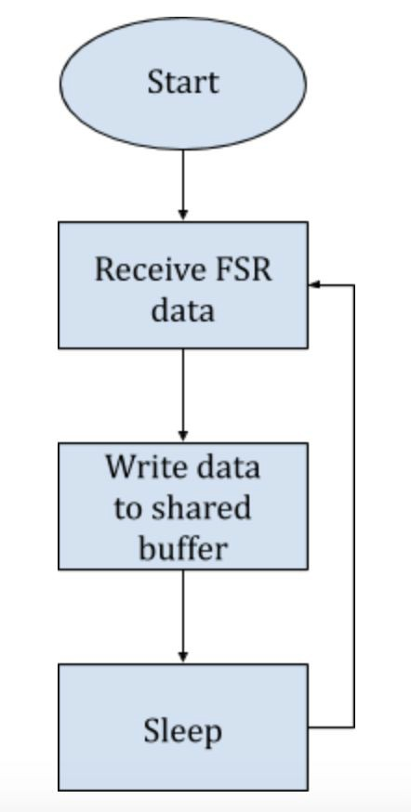
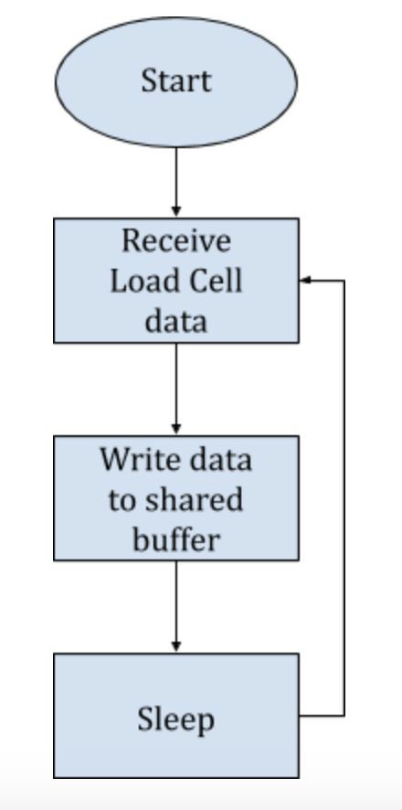
Table Network - Talking to the Dashboard
FSR Listener Thread
Load Cell Listener Thread

Slide 31
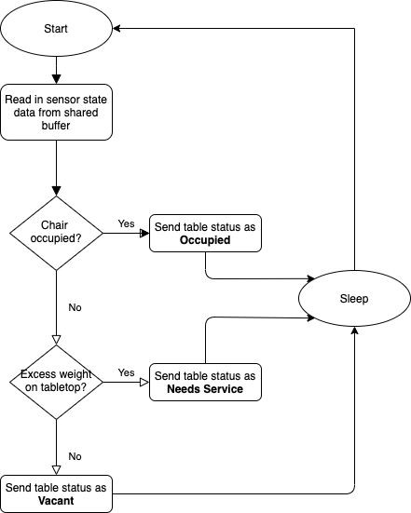
Table Network - Talking to the Dashboard

Slide 32
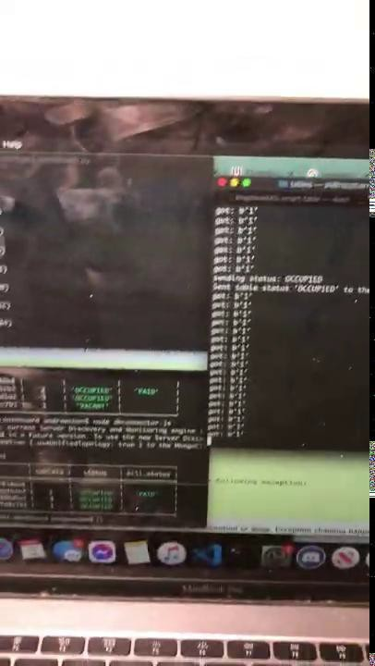
Table Network - Requirements & Verification (1 of 3)
Requirements:
Data from FSR sent via Bluetooth can be read at an approximate rate of one message every five minutes.
Verification:
Pair Bluetooth device with Raspberry Pi
Send and read in bytes across the devices.
Result:
Requirement met but modified: Instead of reading once per five minutes we instead read once every 3 seconds.

Slide 33
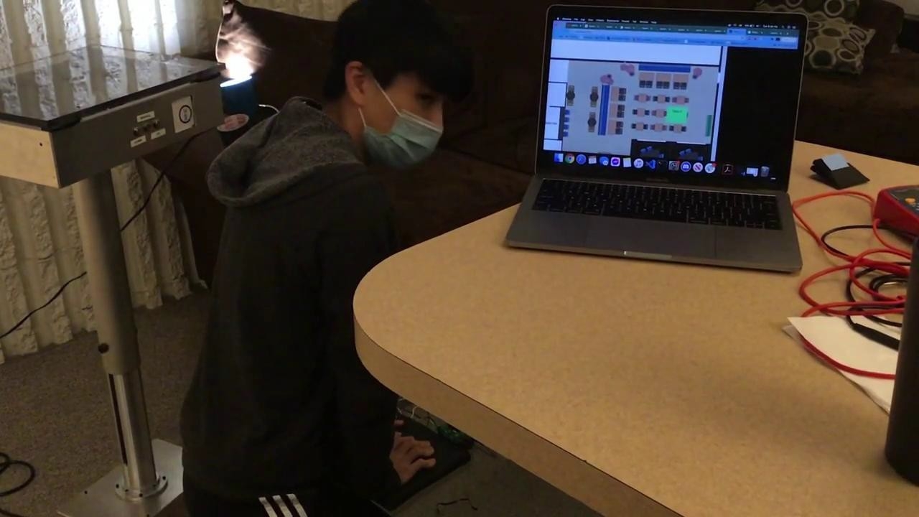
Table Network - Requirements & Verification (2 of 3)
Requirements:
Load Cell can detect when there is an excess amount of weight on the tabletop.
Verification:
Wire up the load cells to the ADC and Raspberry Pi
Run the Python software to read in values
View the output while placing various weights
Result: Requirement met.

Slide 34
Table Network - Requirements & Verification (3 of 3)
Requirements:
All table nodes will be able to send information to a single central server node via sockets over a network.
Verification:
Connect devices to be on
the same network
Ping one device from the other to verify a connection.
Run server and client software on each respective device and send data over a socket.
Result: Requirement met.

Slide 35
Table Network - Talking to the Dashboard
What’s this?

Slide 36
Dashboard

Slide 37
Dashboard
Talks to all the tables.
Displays the status of all tables in real time.
Issues bills.
Runs on your computer.

Slide 38
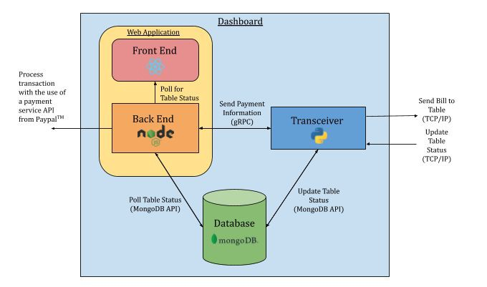
Dashboard Architecture

Slide 39
Dashboard Architecture

Slide 40
Dashboard Architecture

Slide 41
Dashboard Architecture

Slide 42
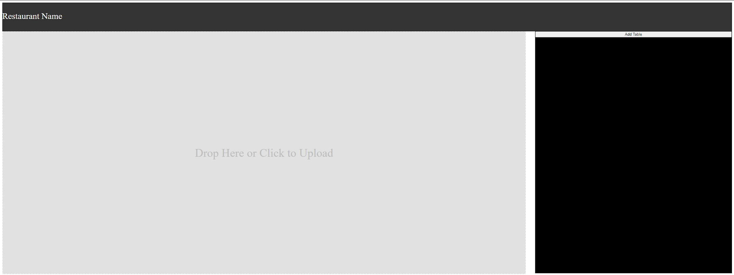
Web Application - Frontend
Drag and drop or upload Floor Plan
Click and drop tables onto Floor Plan
Table changes color based on their status
Send Bills to each Table

Slide 43
Web Application - Requirements & Verification (1 of 3)
Requirements:
User will be able to upload a floor plan onto the dashboard
Verification:
Drag and drop or upload a floor plan in image format onto the dashboard

Slide 44
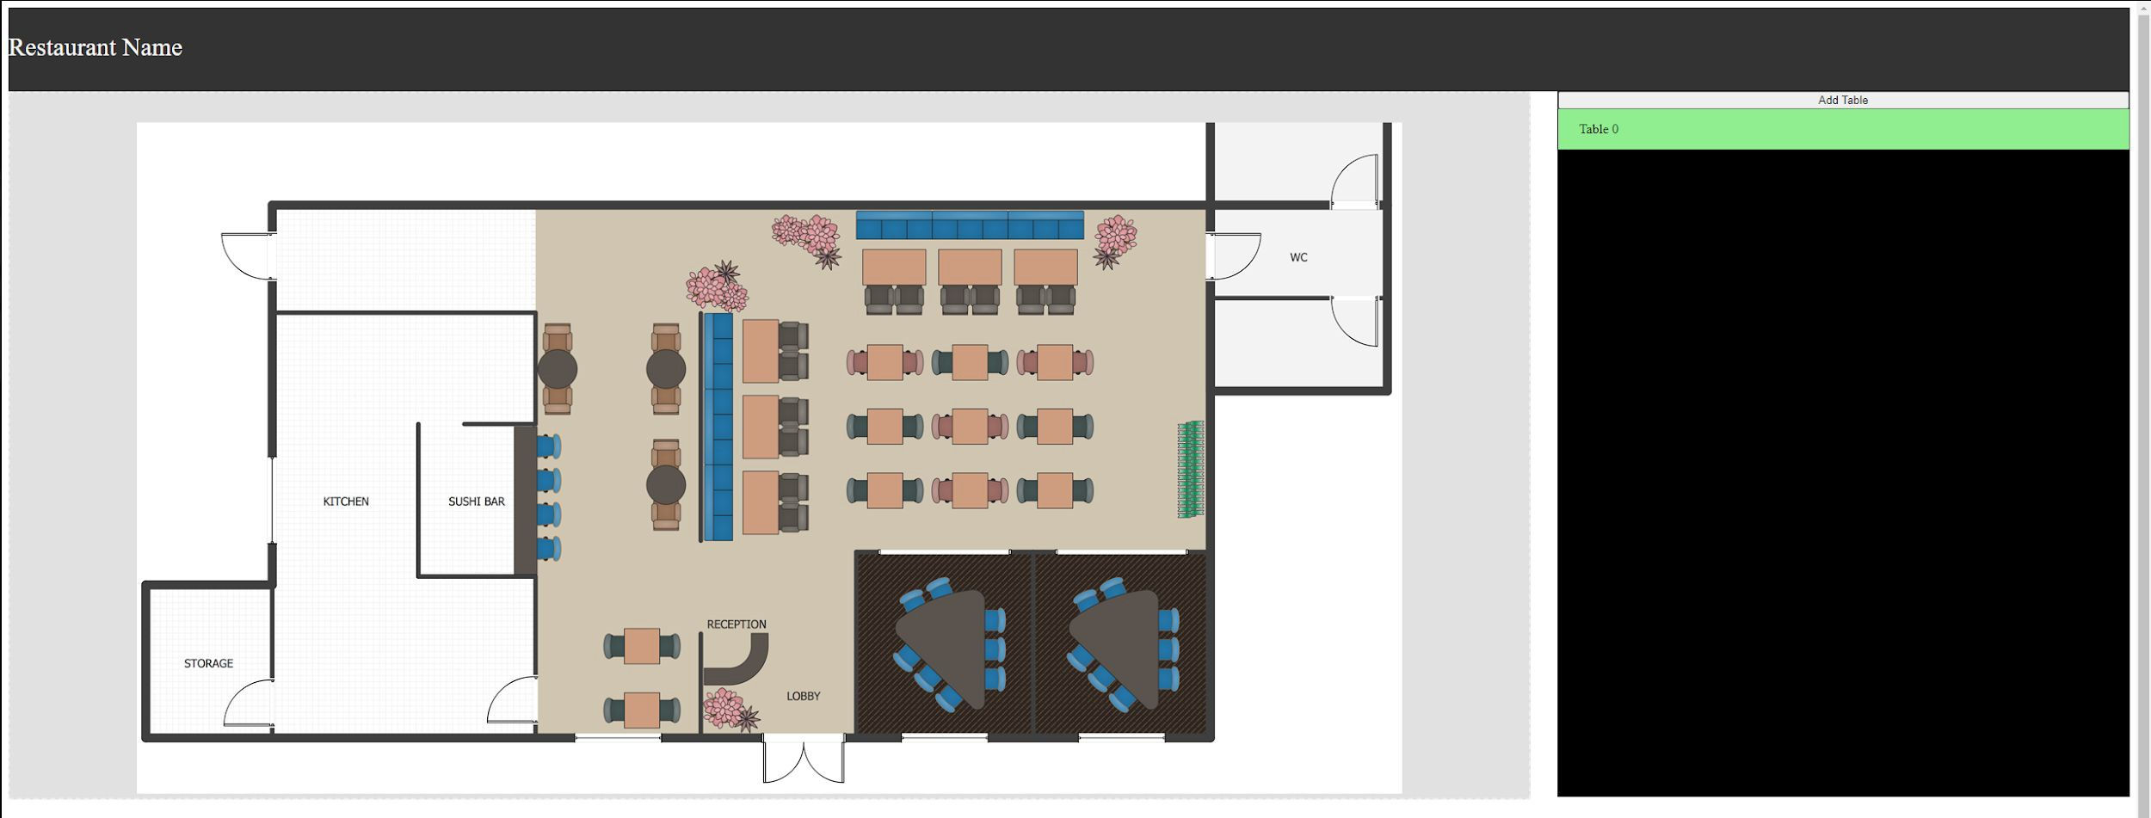
Web Application - Frontend

Slide 45
Web Application - Requirements & Verification (2 of 3)
Requirements:
User will be able to mark and drop a table onto the uploaded floor plan
Verification:
Click on the floor plan and drag a table block from the right side onto the floor plan and verify its on the floor plan

Slide 46
Web Application - Requirements & Verification (3 of 3)
Requirements:
The dashboard will update the status represented by color of each table in realtime.
Verification:
Change the status of the table by either pushing on the FSR or Table load cell to update the Database or manually updating the Database. Verify the color of the table changes according to the status.

Slide 47
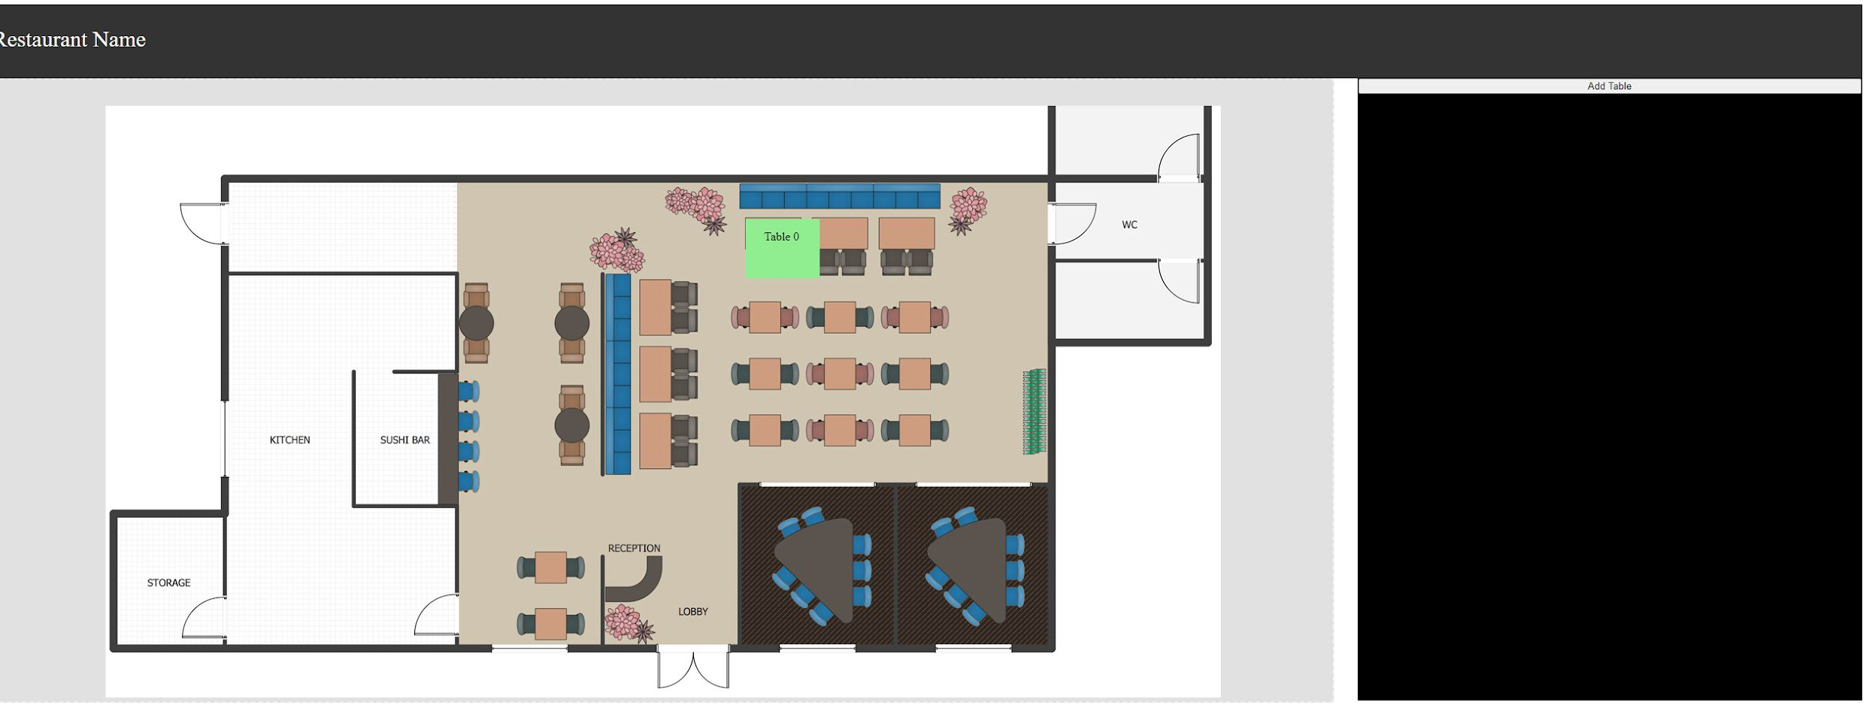
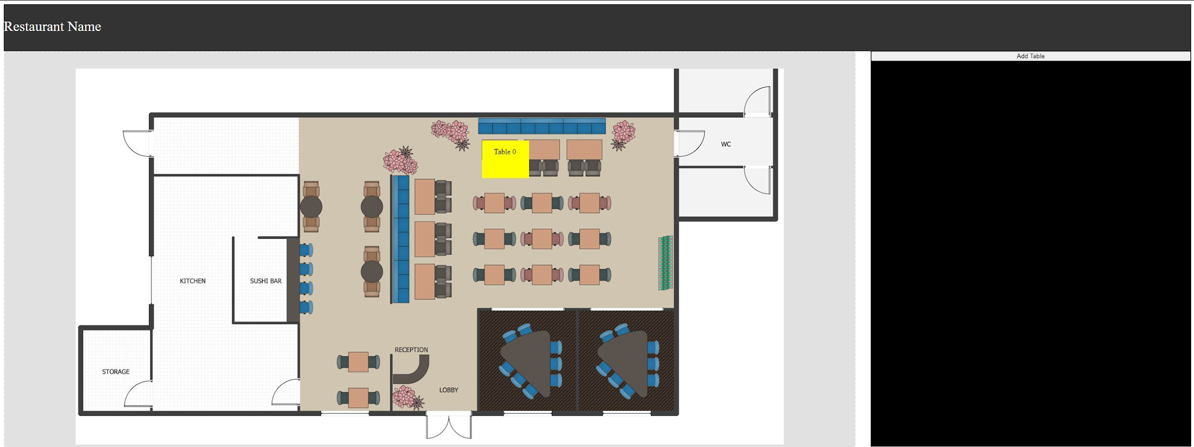
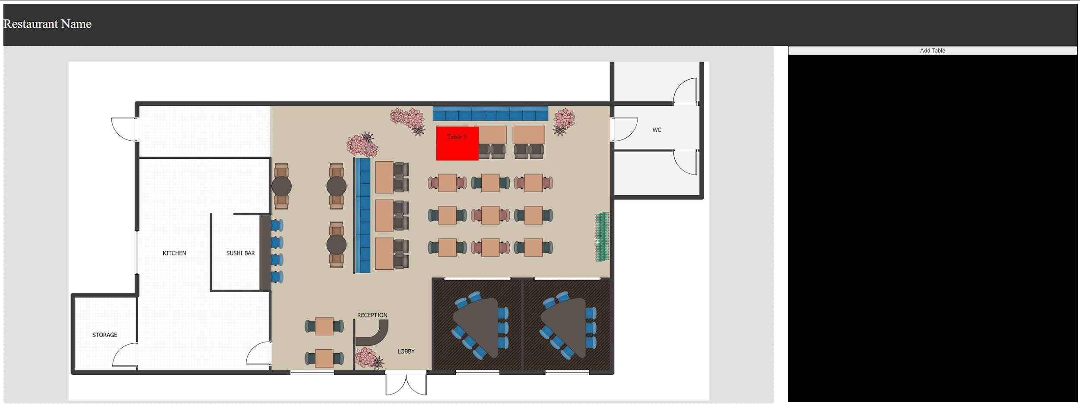
Web Application - Frontend Cont.

Slide 48
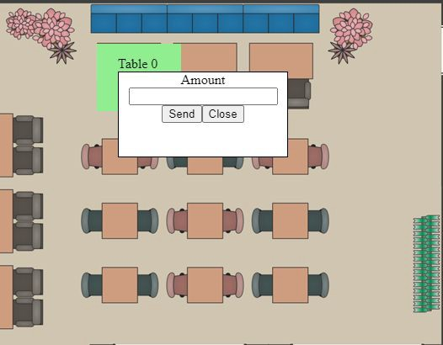
Payment
Send bill to table independent of each other.
Payment process via Paypal
Sends bill amount and payment status to table’s hex display
Waits for NFC contact

Slide 49
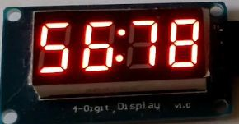
Payments Hardware - Requirements & Verification (1 of 2)
Requirements:
Seven-segment display will be able to output integer values.
Verification:
Wire up the seven-segment display and program the GPIOs to print something on it.

Slide 50
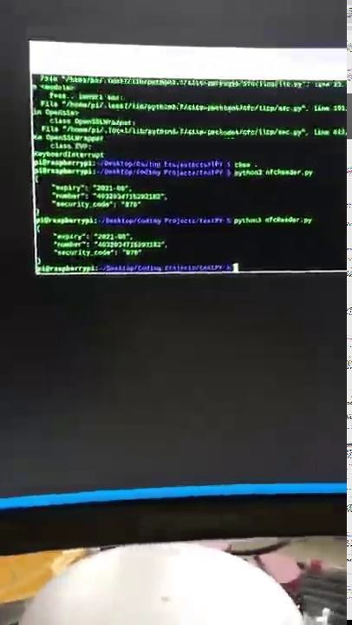
Payments Hardware - Requirements & Verification (2 of 2)
Requirements:
NFC Reader is able to wait for NFC cards and read the data in the card
Verification:
Connect the NFC Reader to a Raspberry Pi and run the reading program to print the data from the card when it is near the reader

Slide 51
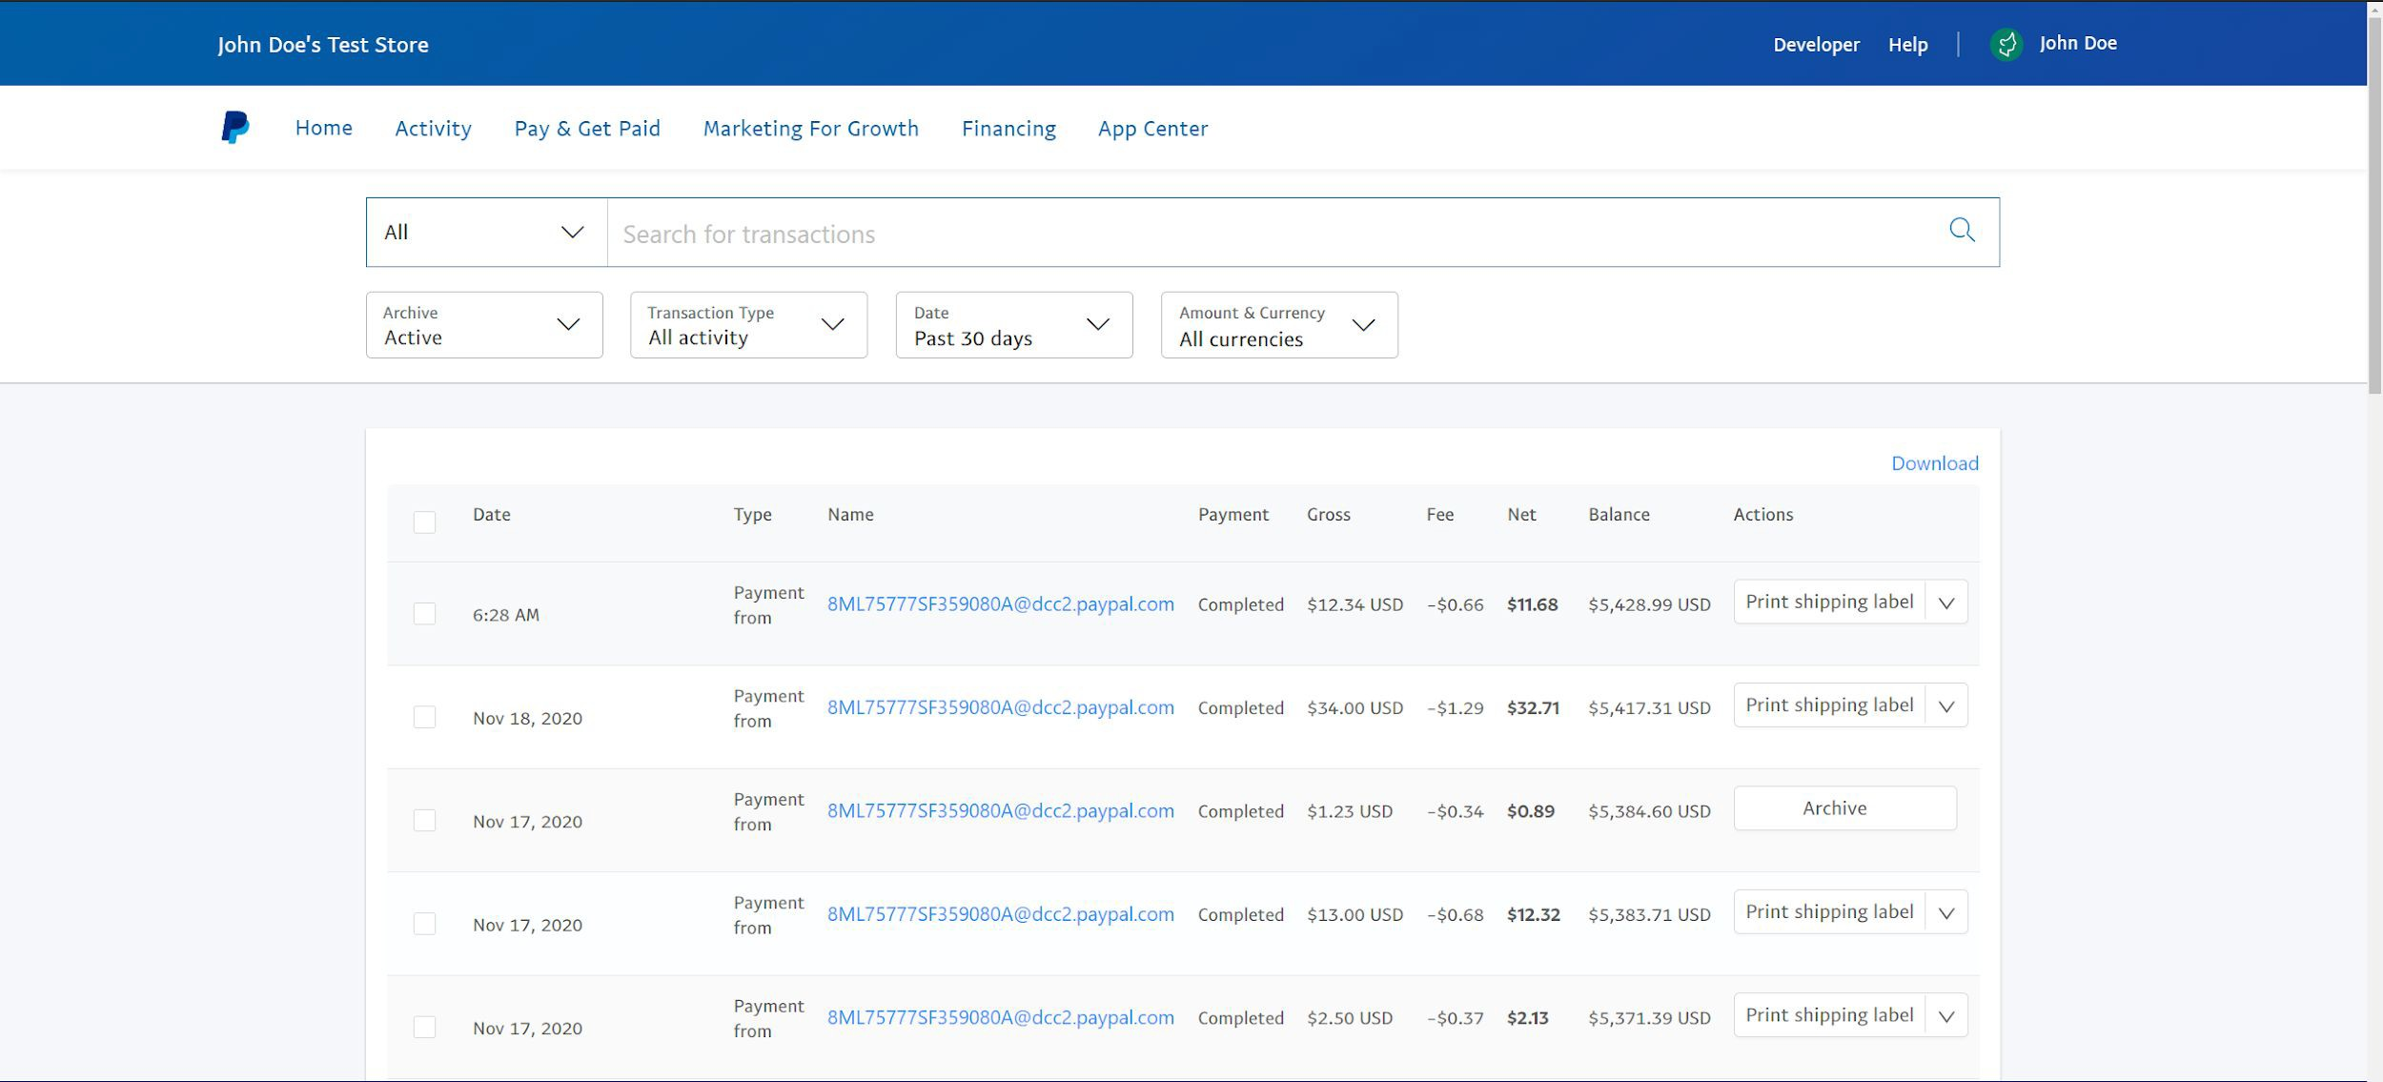
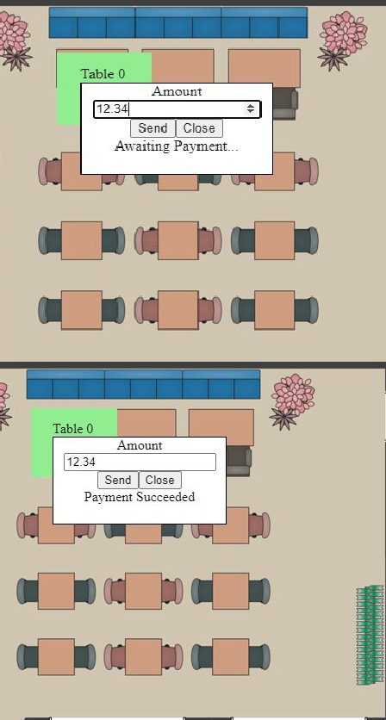
Payment Cont.

Slide 52
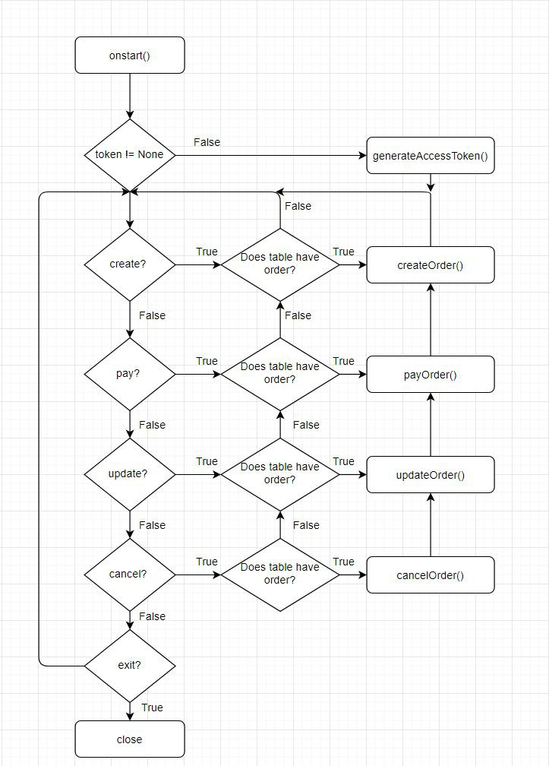
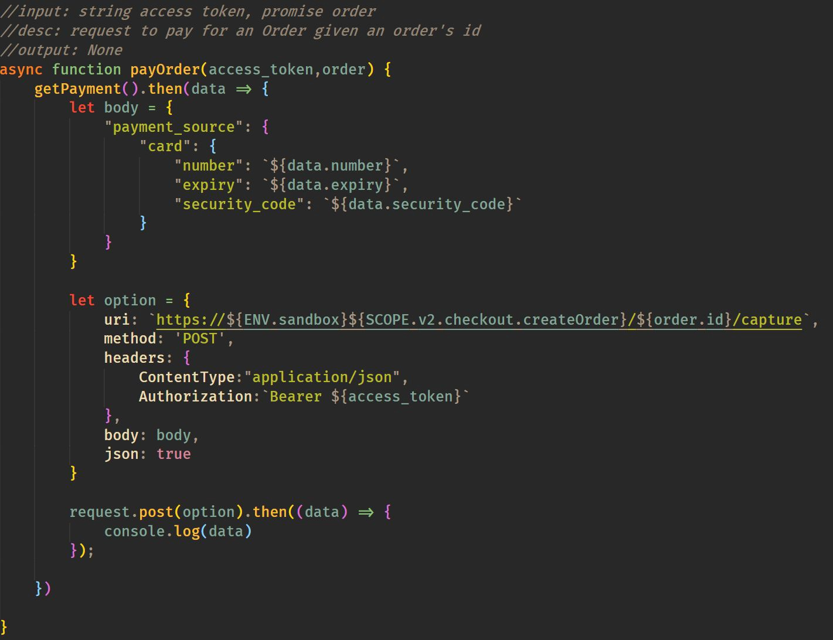
Payment Flowchart and Paypal API

Slide 53
Payments Hardware
Hex Display
NFC Card Reader

Slide 54
Going Forward
Explore different sensors for use with the tables in operation if desired
Better integrate modules with dining room furniture
Upgrade our payment system to have better NFC encryption

Slide 55
Ethics and Safety
Table could malfunction and injure the customer’s legs
IEEE Code of Ethics #9
Manual height adjustment system
Sensors use a median system to eliminate erroneous readings
Movement is slow enough to notice and slow enough not to disrupt food on table
Sensitive data transfers between tables and dashboard
IEEE Code of Ethics #1
Kept on a private network
In the future, can apply encryption such as AES, OTP, or 3DES
In the future, a better NFC solution is needed for reading credit card information

Slide 56
Acknowledgements
Special thanks to:
Professor Jing Jiang Our TA: Sophie Liu
Our sponsor: Neil Misak and his Restaurant Technology Associates Jordan Spezia, Gregg Bennett, and the ECE Machine Shop Team

