Slide 1
Event Attendance Tracker
Team 13:
Anand Sunderrajan, Eric Layne, Mason Edwards
Notes:
Anand
Hi, we’re team 13 and our project is the event attendance tracker.

Slide 2
What is it?
A system to track attendance at booths during an event such as CES or a career fair
Utilizes Bluetooth Low Energy (BLE) to handle booth detection and communication
Records what booths a user attends at event, provides additional information about those booths
Provides attendance statistics to the booth presenters
Notes:
Mason
We have developed a system to allow attendees to easily recall important information about booths they have visited at events such as career fairs or CES. Our device can automatically detect if an attendee is visiting a booth and relay information about the company or product on offer via Bluetooth Low Energy. This can also provide valuable data to the presenters, such as the number of people who have attended their booth or other metrics that could be added in future, such as the average time attendees spend at the booth.

Slide 3
Objective
Event attendees often see a large number of booths
Recalling all the booths after the event can be difficult if not impossible
Requirements
Needs to run on battery power for at least 4 hours
Log attendance at correct booth when multiple are available
Send up to 1kB of data from the booth to a user’s device in under 250ms
Notes:
Mason
The problem our project solves is that attendees see a variety of booths at these events and can easily forget information like URLs or emails for booths they have seen.
Current alternatives to provide this information are expensive, and still require the attendees to do something at each booth (like scan a QR code)
Our system will manage all of this in the background so attendees can focus on what is happening at the booths
Our system meets all of our initial high level requirements,which include:
Instead of the minimum of 4 hours it needed to run on battery power for, it is able to run for at least 12 hours
It is able to log attendance at correct booth when multiple are available
Furthermore, instead of the initial requirement of sending 1kB of data from the booth to a users device in under 250ms, our system transfers 4kB of randomly generated data in 110ms +- 15ms. About 8x required speed

Slide 4
Design Choices
BLE over WiFi or Cellular
Tilted OLED display rather than LCD
Lithium polymer battery cell rather than NiMH, Lithium Ion, etc
Notes:
Eric
First we’ll go over the major design choices we made throughout the project.
The largest one was choosing Bluetooth Low Energy over WiFi, cellular, or any other wireless communication. The decision for BLE was two-fold; first, the architecture of BLE works perfectly for this project, allowing us to easily distinguish and communicate with only booth nodes (ignoring all other Bluetooth/BLE devices like smartphones). Additionally, the low transmission power means the range that BLE devices are detected in can be quite short, simplifying the problem of selecting the closest device; this low power also helps reduce current consumption to make our battery last longer.
Our next choice was to use an OLED display mounted at an angle, as opposed to an LCD. This was decided based on the energy savings of OLED displays when any pixels are turned off (they draw no current), and for the much wider viewing angles of OLED displays compared to LCD. To aid in viewing angles further, we tilted the screen to make the display easily readable when standing or sitting at a booth.
Lastly, we chose to use a Lithium polymer battery, and we chose this over other options such as Nickel Metal Hydride or Lithium ion for a few reasons. Lithium polymer batteries are available in many more sizes, shapes, and capacities; this allowed us to pick one that fit well within our device in the capacity range we needed. If we had chose an alternative, the shapes are almost always cylindrical and with predefined dimensions which would not have fit well into a small form factor device.

Slide 5
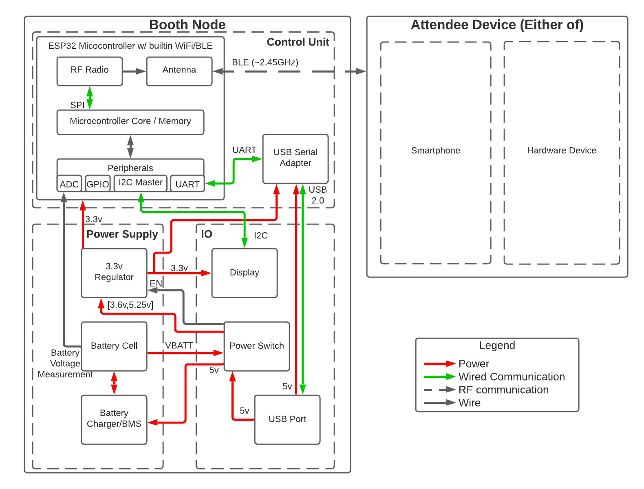
System Overview
Power Supply
Control Unit
I/O Subsystem
Event Attendee
Attendee Device
Smartphone App
Notes:
Mason
-Booth node
-PSU
-Contains the main voltage regulator, battery cell, and the battery management circuitry to keep the battery safe and working correctly.
-IO
-Contains the tilted OLED display, the power switch, and the USB port for charging and flashing
-Control unit
-The control unit is where the fun stuff happens as it contains the ESP32 microcontroller and bluetooth hardware that interfaces with the attendee device
-Attendee Device block could consist of either
Attendee Device
This is made from one of the PCB’s without a case or display, and is used to emulate what the user’s smartphone would do, for users who do not have a compatible device
Smartphone App
Developed for Android to communicate with the Booth Node

Slide 6
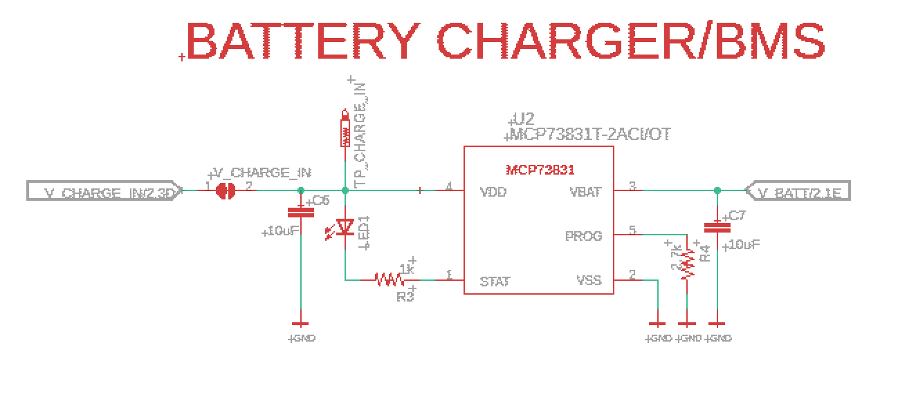
Power Supply - BMS
Safely charges internal lithium polymer battery cell
Uses constant current charging until reaching a preset voltage, then uses constant voltage to finish and maintain charge
Notes:
Mason
As mentioned before, we have a battery management system to safely charge the battery. Ours is a convenient 5-pin integrated circuit that features a 4.2V voltage regulator and a constant current driver. To test this part of the system, we connected the output in series with an ammeter and powered the board via a USB power bank. This allowed us to confirm that the BMS was providing the correct voltage and consistently providing the correct current. The BMS is only active when USB power is applied, as its purpose is only to charge the battery, which cannot charge itself.
Reqs:
Provided steady USB voltage, must charge at max 0.5C (min 800mAh battery -> charge at 400mA max), and stop without exceeding 4.2+- 0.1V
Verifications:
Connected USB power bank to USB port, measured the current drawn from the USB port (using the solder jumpers to insert ammeter) and voltage of battery; measured at various points through charging process, and after the charging indicator turns off.

Slide 7
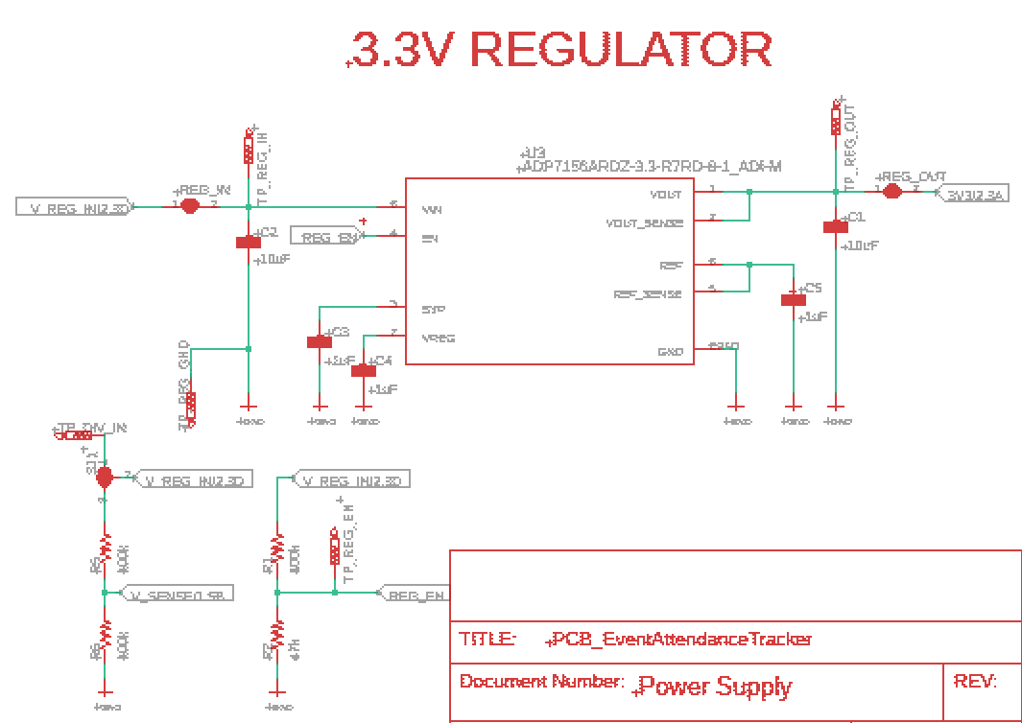
Power Supply - Regulator
Regulates battery or USB voltage to 3.3V
Configurable hardware voltage cutoff (set at 3.5V)
Notes:
Mason
Power from either USB or the battery feeds into the 3.3V regulator to supply the rest of the circuit, but never both. For this we chose a standard LDO regulator as we did not need voltages that were significantly lower or higher than either of our input voltages. Also shown are the two voltage dividers that we use for the automatic battery cutoff as well as measuring the battery voltage via the microcontroller for an extra layer of safety. Like the BMS, this part comes as a convenient integrated circuit that only requires some external bypass and decoupling capacitors to function. From testing, we have found that this part is overkill as it is capable of providing 750mA but our maximum average current draw is in the low 100’s.
-Primary voltage regulator that regulates either the battery input or the USB input, but never both at once. Also shown are the voltage dividers we used for the automatic battery cut off as well as reading the battery voltage with the microcontroller
Reqs:
Must provide 3.3v +- 0.1v at 750mA across 3.6V to 5.25V
Verifications:
Provide 4.2v from a power supply to the input of the regulator (using solder jumpers), and draw 750mA out of the output of the regulator (sweep input voltage across range)

Slide 8
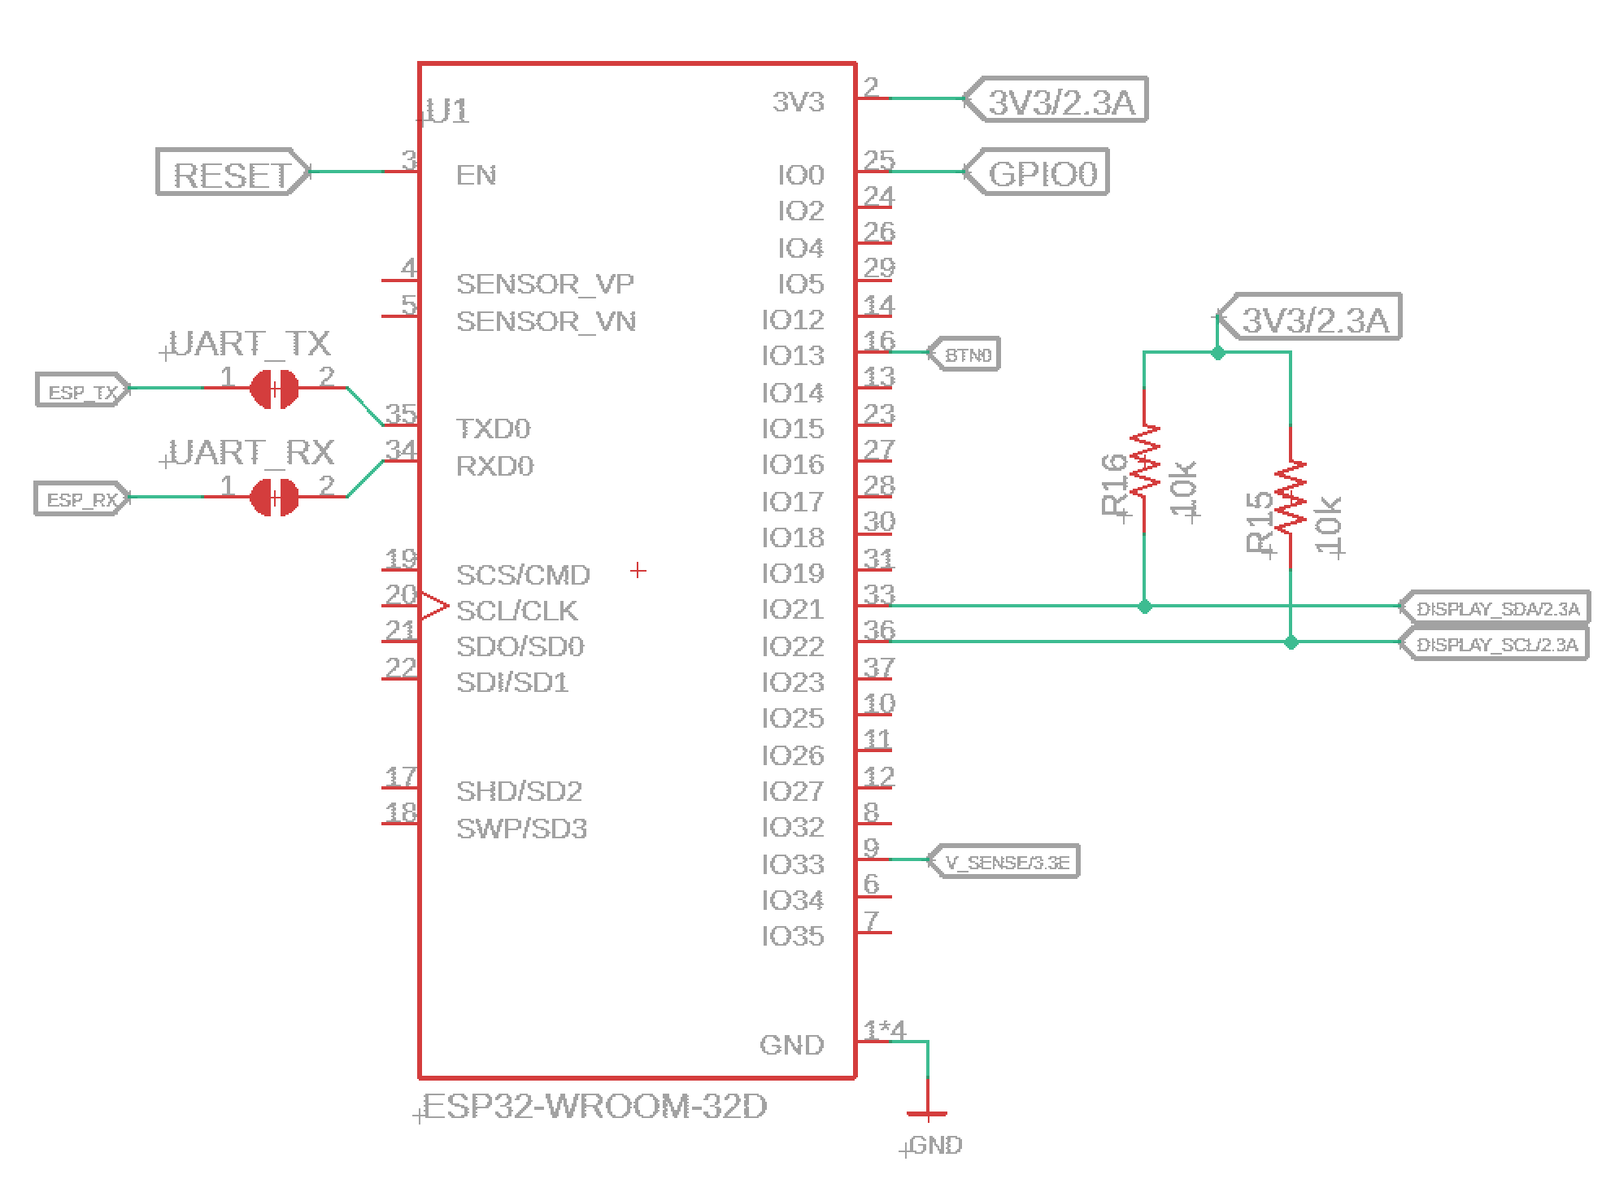
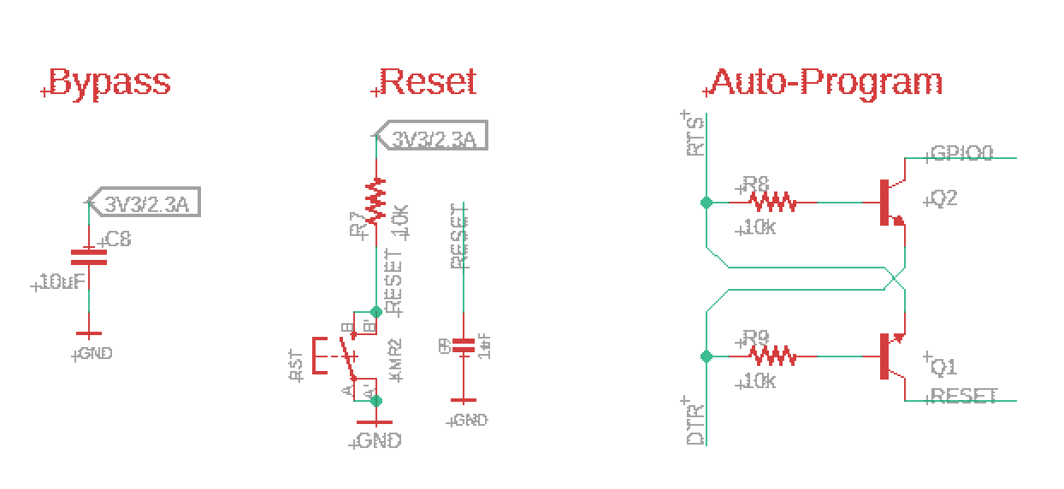
Control Unit
ESP32 microcontroller (built in RF radio)
Handles BLE communication
Manages device hardware
OLED display
Battery voltage monitoring
USB port serial communication
Notes:
Eric
The control unit subsystem runs the whole device, and interacts with the attendee’s device. This is based around an ESP32, as it has built in BLE support, an accurate enough ADC, and an easily implementable serial port.
The BLE communication of the control unit had a major requirement of being able to transmit 4kB of data within 1 second to ensure we can meet our high level requirement to satisfy a large number of attendees at each booth.
This was tested by generating 4kB of random bytes, and a test firmware was uploaded to transmit these bytes over BLE until either an timer interrupt triggered after 1 second, or upon completion of the transfer. At the end the received bytes were compared to the original. This test passed, and the device was able to transmit 4kB in 110ms +- 15ms.
Next, the control unit manages the booth hardware, controlling the OLED display, measuring the battery voltage, and communicating over the serial port.
We also tested the ADC, and needed to ensure it was able to measure the battery voltage within 35mV of the actual voltage across the battery range.
To do this, we used a DMM and measured the actual voltage while recording the ESP32’s ADC value; this was repeated at several points across the battery voltage range. This test also passed, with the voltage calibration shown on the next slide.

Slide 9
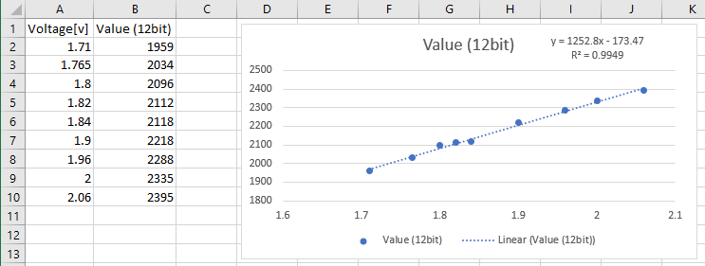
Control Unit
Battery voltage ADC calibration
Notes:
Eric
This graph shows the ADC value on the y-axis, with the actual voltage of the input to the ADC on the x-axis (with battery voltage being two times the ADC input voltage). This gave us a linear regression which satisfied our requirement of maximum +- 35mV deviation from the actual voltage.

Slide 10
I/O Subsystem
OLED display shows the booth name, battery percentage, and attendee count, and a low battery screen
Switch circuit uses USB power when available and ensures battery safety
USB port allows communication
with the device for extracting data
Notes:
Eric
The next subsystem in the booth hardware is the I/O subsystem, this allows the booth presenters to interface with the device and control it’s operation. They also can see useful information in realtime through the display, showing the name of the booth (to ensure it matches up with what they want the name to be), the battery percentage remaining, an attendee count, as well as a low battery screen if the device reaches 0% charge left. The switch allows the user to change the device between “active” and charging modes, and they can communicate with the device for extracting attendee data and statistics through the USB port.
We tested the OLED display and I2C bus by toggling each pixel of the display on and off individually, and verified all pixels were changed as expected.
The power switch circuit must isolate the battery current to ensure the devices uses USB power when available, and does not allow significant leakage current into or out of the battery block. This was tested with a DMM to measure the leakage currents while the device is “active” and when it is “charging”
Finally, we tested the USB port could provide sufficient power, we did this by plugging the port into a high power USB bank, and allowed the device to pull maximum current (400mA), and measured if any component exceeded an acceptable temperature.

Slide 11
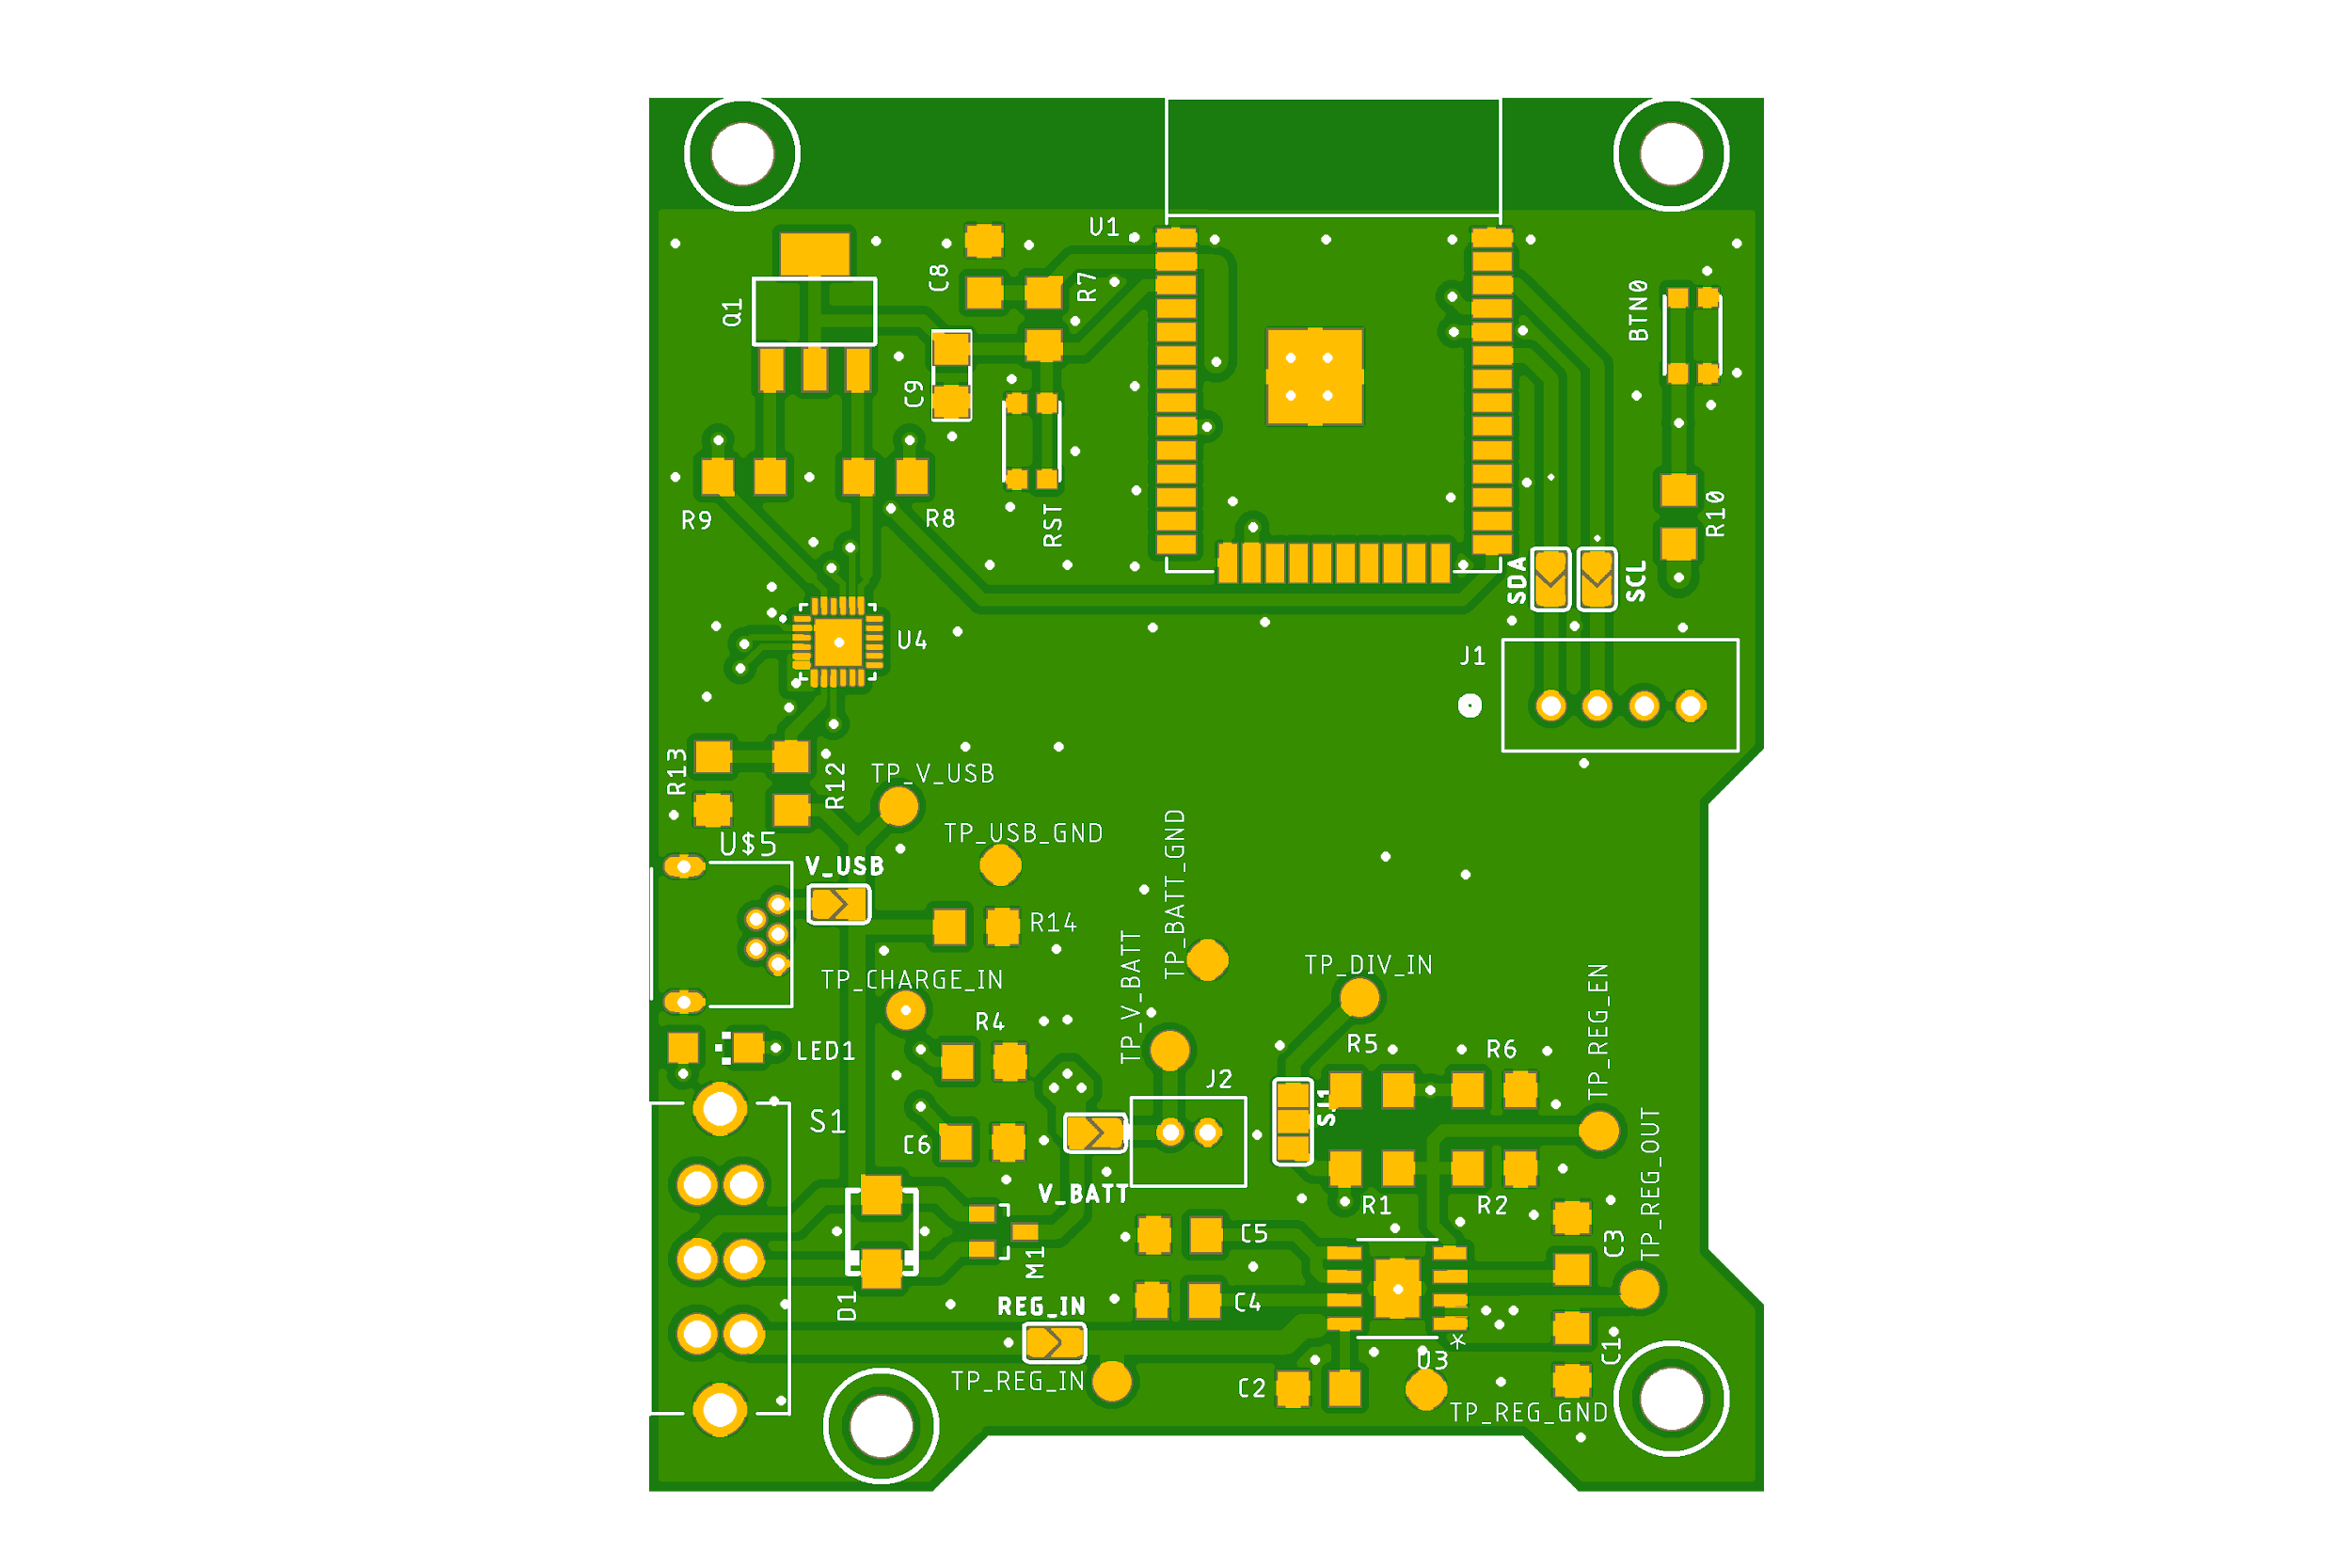
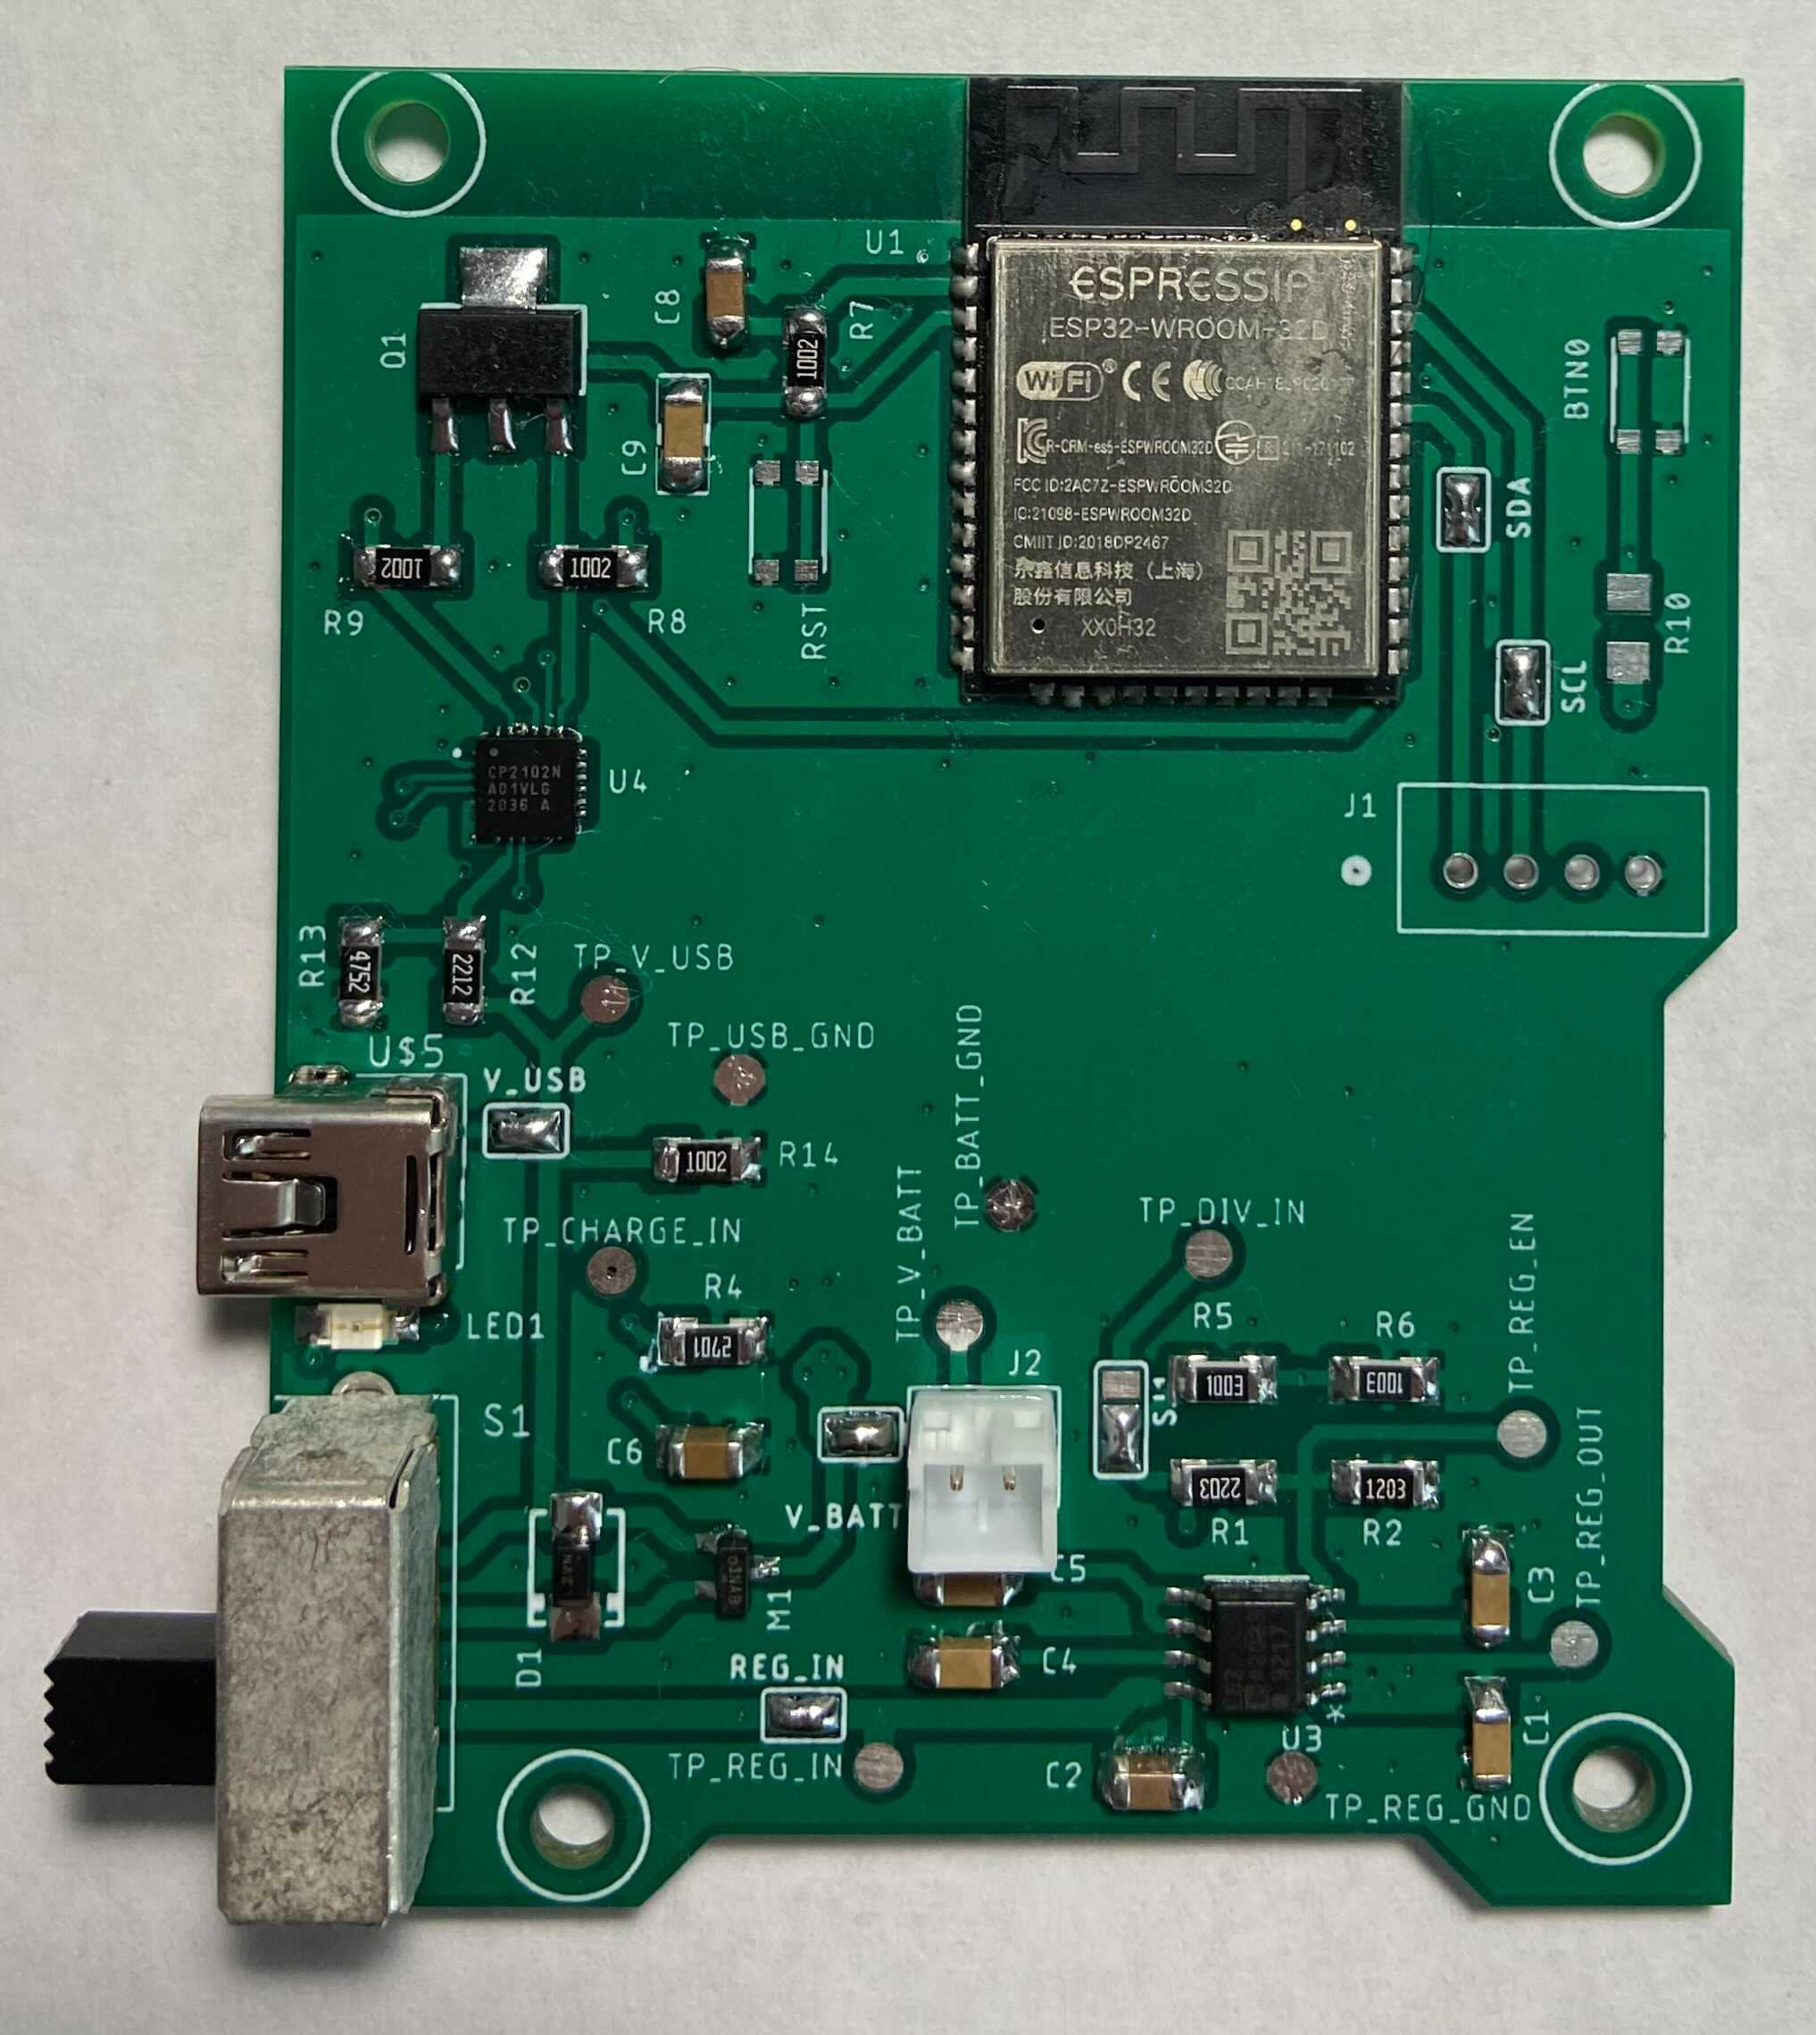
PCB
Notes:
Eric
This is our PCB design and assembled version of the booth node hardware. I’m the upper right you can see the ESP32 microcontroller, which manages the hardware and handles the BLE communication with user devices. On the bottom of the board is the battery charger and voltage regulator. Nor this area is separated from the BLE antenna to reduce any switching noise interference.

Slide 12
Software Design
Attendee Device
Utilizes the same hardware as a booth node
Battery/USB powered
Decision making is self contained
Smartphone App
Currently only for android devices
Utilizes devices owned by attendees
Lightweight with low battery and memory consumption
Notes:
Anand
So lets talk about the software for our project. As mentioned in our block diagram, the Event Attendee could have one of two things. An attendee device, or a smartphone app.
The attendee device is built on the same hardware as a booth node, thereby allowing it to be powered via a battery or through USB. The decision making for whether a booth is attended or not is entirely self contained within the device.
The smartphone app is currently only available for android devices. This would provide an alternative to the hardware solution at no cost to the attendees. Furthermore, the app itself is extremely lightweight with low battery and memory consumption.

Slide 13
Requirements
Detect nearby booths and display them with their respective signal strengths
Distinguish between nearby booths and determine the closest
Flag the closest booth as attended after the user configurable parameters are met
Notes:
Anand
Moving on to the requirements for this block. Well, first of all, we need to be able to detect nearby booths and display them with their respective signal strengths, denoted by the RSSI values.
Next, we must be able to distinguish between nearby booths and determine which booth is the closest to us
Finally, we should flag the closest booth as attended after certain user configurable parameters are met

Slide 14
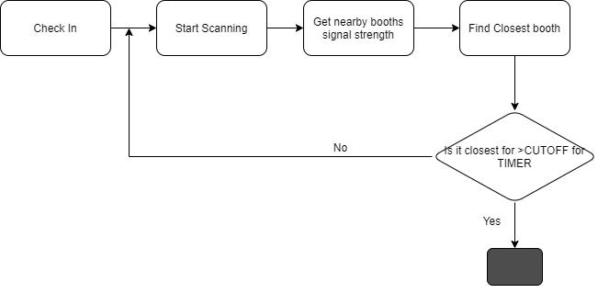
Decision Making Algorithm
Notes:
Anand
Before we move on to the verification aspect, here’s an extremely high level view of the algorithm we used. Any time someone used the app or attendee device and checked in, we would start scanning for nearby booths and assigning them their respective RSSI value. Subsequently, we would find the closest booth and check if the booth met a cutoff threshold within a certain time period.
If it did, we would move on to the next part. If not, we would start scanning again.

Slide 15
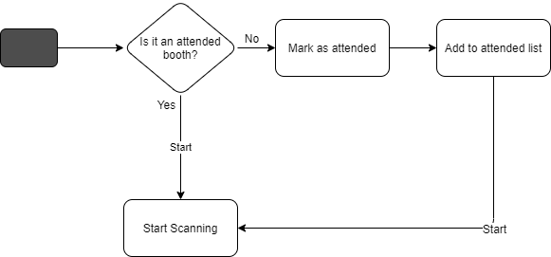
Decision Making Algorithm
Notes:
Anand
Now, onto the next part, we would check if the booth was an already attended booth. If so, we would go back to scanning for nearby booths. On the other hand, if the closest booth was not present in the list, we would mark it as attended, and add it to the list. Following which we would go back to scanning.

Slide 16
Decision Making Analysis Algorithm
Notes:
Anand
A high level overview of the algorithm for determining the closest booth is shown here. This would consist of 3 user configurable parameters - the timer, the scan interval, and the cutoff threshold percentage.
Well, first off, we would start the timer, and continuously scan at every interval unless the timer is complete. Upon its completion we would check if any of the booths met the cutoff threshold, and if so we would mark it as attended.

Slide 17
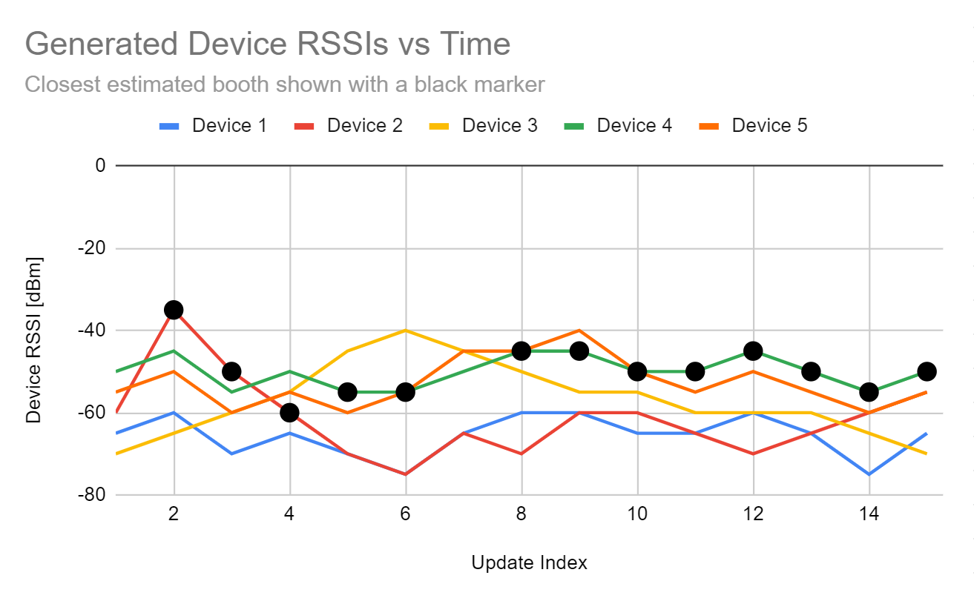
Decision Making Analysis
Notes:
Eric
This graph shows the operation of our algorithm, and was ran on 5 devices’ random RSSI data. These RSSI values are shown on the y axis, with the x axis showing the algorithm update iteration. The black dots show what the algorithm currently thinks is the closest device. The algorithm determines closest based on the history and current RSSI value for all the devices it can see; this is apparent for the first few iterations as it simply chooses the highest one as the closest. As the algorithm has more time to converge, this initial spike is overtaken by the higher and more consistent device 4, and note the algorithm selects this device fairly quickly, and continues to select the device even if another device momentarily has a stronger RSSI value. This was included in the algorithm to allow it to cope with environmental factors like BLE interference or having clear line of sight to another booth while the actual closest one is occluded by something momentarily.

Slide 18
Attendee Device
Utilizes same hardware as booth node
Software built using C++
Displays nearby booths and attended booths on console
Modular programming allows for user configurable variables
Notes:
Eric
Our hardware designed for the booth was also able to be used for the attendee device; this was programmed similarly to the booth hardware in c++.
This device runs the algorithm, and records what booths are nearby and have been attended; these values can be seen on the serial port.
Finally, the firmware was developed to use modular programming, which made variables such as the time between BLE scans, how long you need to be at a booth to trigger attendance, and a threshold for how certain the algorithm needs to be to count attendance.

Slide 19
Smartphone App
Built using Java
Bluetooth, background, and location permissions dependent on API level
Compatible with Android 6.0+ (API 23+) ~84.9% of devices
Notes:
Anand
Lets move to the smartphone app.
Unlike the attendee device, the app was built using java. The app itself would require bluetooth, background, and location permissions. There requirements would change depending on the API level of the device consequent to the varying restrictions google enforces.
Now, to make the app highly accessible, we built it such that it was compatible with android 6.0 and above. According to android studio, the official IDE for android development, this would allow it to run on approximately 84.9% of devices currently in use globally,.

Slide 20
Smartphone App
Lightweight with low CPU, energy, and memory utilization
Notes:
Anand
The app is extremely lightweight as shown in the graph. It has extremely low CPU, energy, and memory utilization. The highest utilization is upon opening the app, as evident through the utilization spikes in the graph.

Slide 21
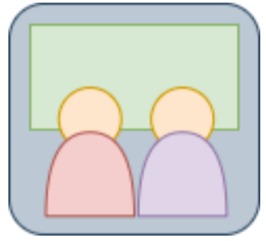
Smartphone App
Material design compatible with different screen sizes
Displays nearby and attended booths separately under different tabs
Buttons for check-in, check-out, and clearing the list
Custom icon
Notes:
Anand
Additionally, the smartphone app was built using material design, making it compatible with different screen sizes across android devices such as smartphones and tablets.
Furthermore, it consists of separate tabs which would display all nearby booths and a list of attended booths respectively.
As a quality of life and resource utilization improvement, we also added buttons for check in - which would start the algorithm and continuously scan, check out - which would stop scanning , and clearing the list of booths.
Lastly, we built a vectorized custom icon - which allows the icon to scale to different sizes and types without loss of quality
Looking at the screenshot, we can see the the high level requirements for this block are met as it flags the closest booth as attended while displaying its RSSI value and contact information.

Slide 22
Successes
Challenges
Booth hardware
Block level design
Decision making algorithm
Decision making algorithm
Using BLE with RSSI values to denote signal strength
The smartphone app
Notes:
Eric [Success]
We had quite a few successes with our project by the end, the major one that enabled us to reach our software goals was the booth hardware working nearly perfectly, with only a wrong value pull up resistor on our I2C bus.
Further our block level design included everything we needed to have our BLE communication work reliably and with the bandwidth we needed. Our battery also had all the components it needed to be charged and used to provide power to the device without charging encountering any issues with interference or safety concerns with using a Lithium Polymer cell,
Finally, the decision making algorithm for determining the closest booth ended up working, and exceeded our requirements for accurate detection even for a short attendance time (as the accuracy of is higher when the algorithm is given more time to determine the closest device)
Anand [Challenges]
While the decision making algorithm was a success, it was also one of the challenges we faced. Originally, we decided to use the formula present below to determine the closest booth by converting the RSSI values into tangible distance representations. However, this formula required the use of ‘n’ an attenuation factor, which was highly dependent on the environment. As such, there was no reliable method for us to find a representative value for n which would hold true for multiple use cases.
Now this issue was compounded by the fact that we used RSSI values to denote the signal strength and conduct the decision making, as RSSI values themselves are not an accurate indicator due to the fact that they wildy vary depending on the environment.
Lastly, a major challenge we face was the smartphone app itself. There were a multitude of challenges throughout the app development process - with the main ones being the variance in functions available across API levels, the differences in permissions required across API levels to get the data we need, and the general buggy nature of android studio which led to the app randomly crashing after working perfectly the previous day. This fact that android studio does not provide any helpful error messages, and none of us having experience with app development or java, further added on to the difficulty

Slide 23
Future Hardware Development
Create a smaller hardware device available to event attendees
Add SD card/USB for offloading data or configuring the device
Reduce the cost by exchanging overrated components
Drive decisions based on actual device power requirements
Notes:
Mason
-we could reduce the size of the attendee device by designing a PCB and circuit for it specifically, rather than repurposing a booth node board
-add functionality to offload data, such as SD card, USB interface, web database
-components are overpowered
-battery is much too large
-regulator can handle way more current than necessary
-if the boards were automatically assembled via a pick and place machine, the size of the components could be reduced significantly. Most of the components we used were physically larger than necessary as we had to solder them by hand

Slide 24
Future Software Development
Improving usability, and resource consumption of the app
Porting to iOS devices
Porting for use on wearables
Creating database containing booth information for each event
Web interface for accessing data for presenters and attendees
Notes:
Anand
For future software developments on this project, we believe that improving the usability and resource consumption of the app would be key. As we saw previously, upon opening the app, we would have spikes in resource utilization due to various checks that are not needed till we reach certain parts of the algorithm.
We could port the app to iOS and wearable devices
Additionally, we could create a database which would contain relevant booth information for each event. This database could then be used in conjunction with a login based web interface that would allow presenters and attendees to access relevant data

Slide 25
SWOT Analysis
Strengths
Low cost Small form factor and extremely portable Provides both software and hardware solutions
Weaknesses
Uses RSSI values for signal strength and decision making Chance for booth detection false positives
Opportunities
Event tracking Contact tracing
Threats
Privacy concerns
Notes:
Eric
We have the SWOT analysis of our whole event attendance system here, with the major strengths being the low cost and simplicity for any event attendee, with our without a compatible smartphone, to take advantage of.
There were a few weaknesses, one being the algorithm is based on RSSI values which are highly susceptible to environmental effects, we did succeed in coping with this shortcoming in the design of our algorithm. Next our algorithm is configured to prefer false positive detections over a possible false negative, this choice was made to ensure we do not miss recording a booth an attendee was at, though it could list a booth as attended incorrectly.
The opportunities, beyond for event attendance, include using the system with slight modifications for contact tracing.
Finally, users may have concerns about privacy when downloading an app, and this is something we need to keep in mind when adding additional features like providing booth presenters with attendee contact info (if an attendee decides to share that information)

Slide 26
Thank you!
Questions?
Notes:
Thank you.
There were quite a few other tests we performed in validating our system, but were left out due to time constraints

