Slide 1
Preparing Your Final Report for ECE 445, Senior Design
Jamie Hutchinson
ECE Editorial Services
jhutchin@illinois.edu

Slide 2
Resources on ECE 445 Web Site
Home➔Guidelines➔Course Overview Scroll down to FINAL REPORT
“Preparing Your Final Report for ECE 445” (final report guidelines)
Word Template (also LaTeX)
Grading rubrics
IEEE reference style

Slide 3
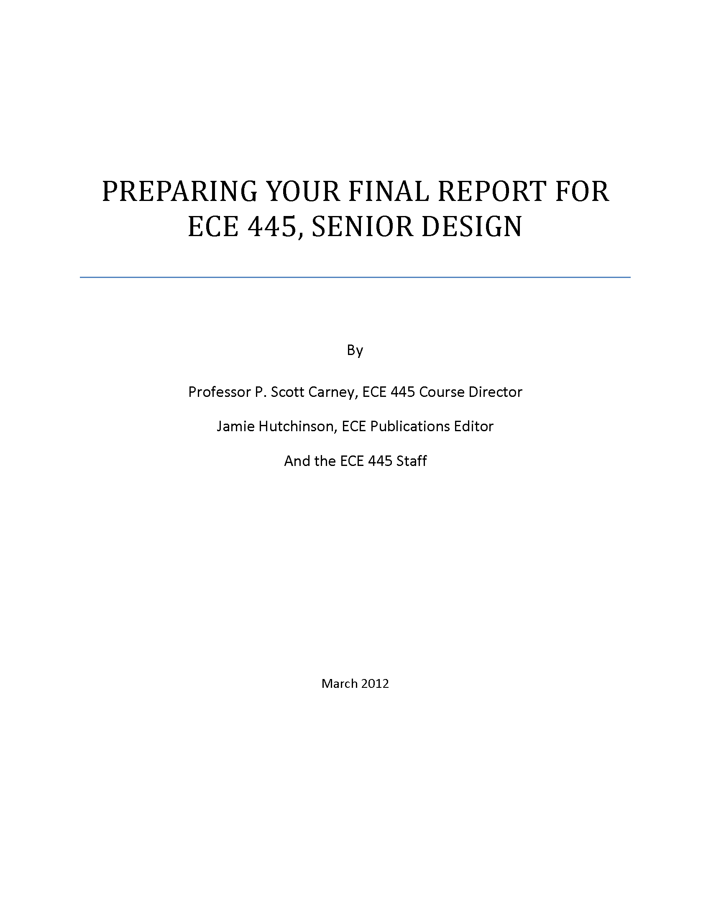

Slide 5
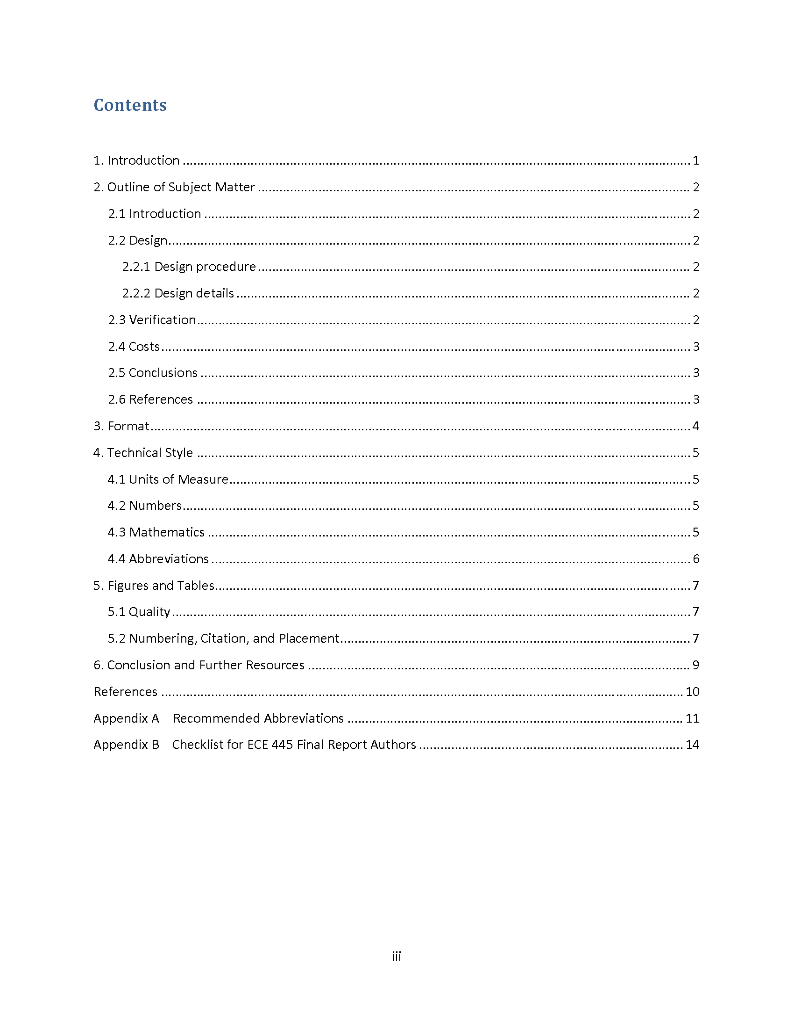

Slide 7
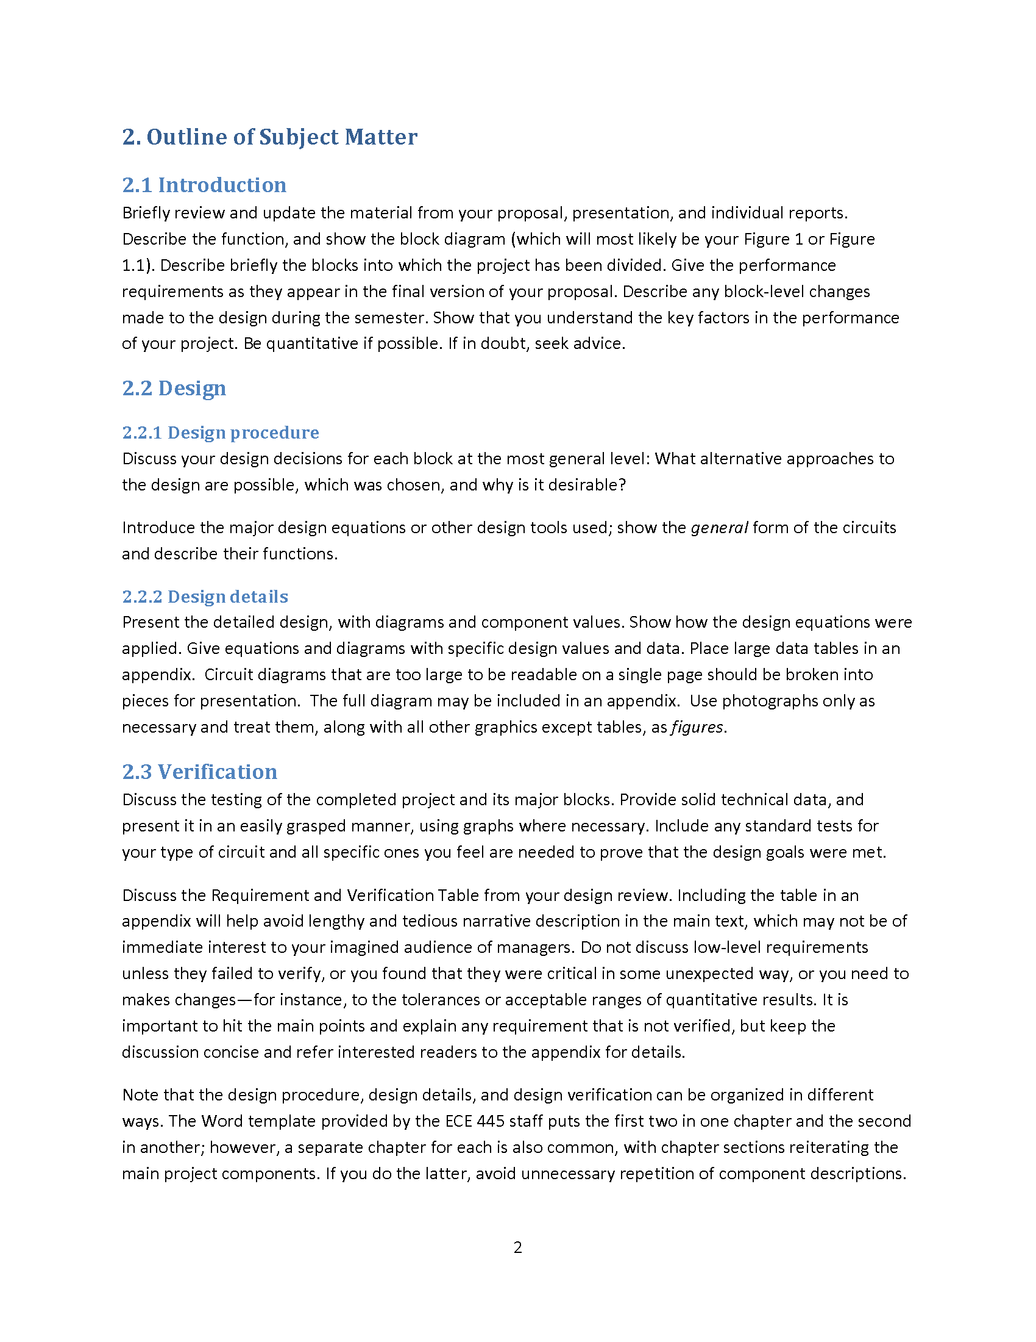

Slide 8
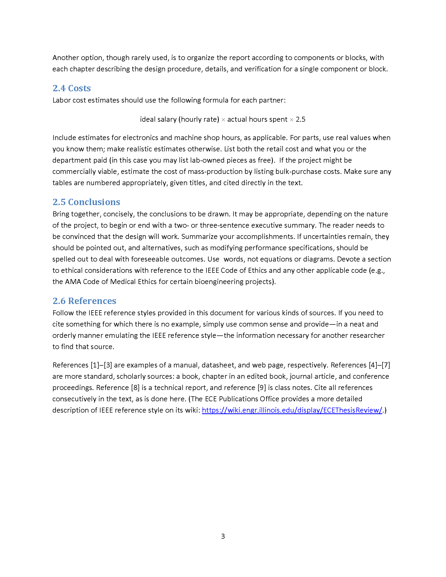

Slide 9
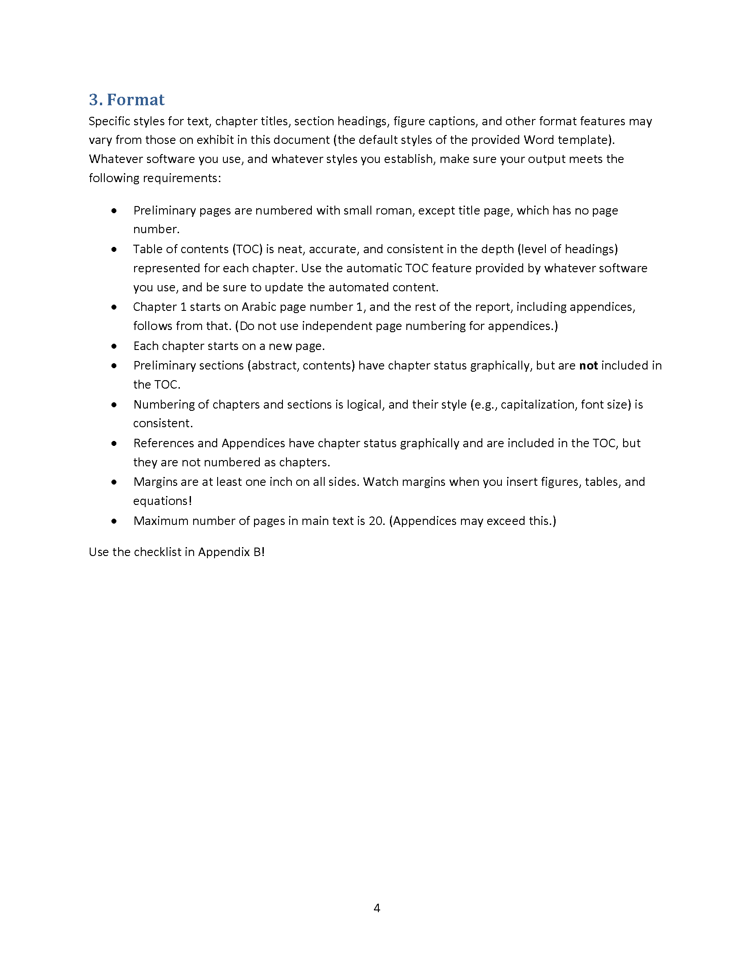

Slide 10
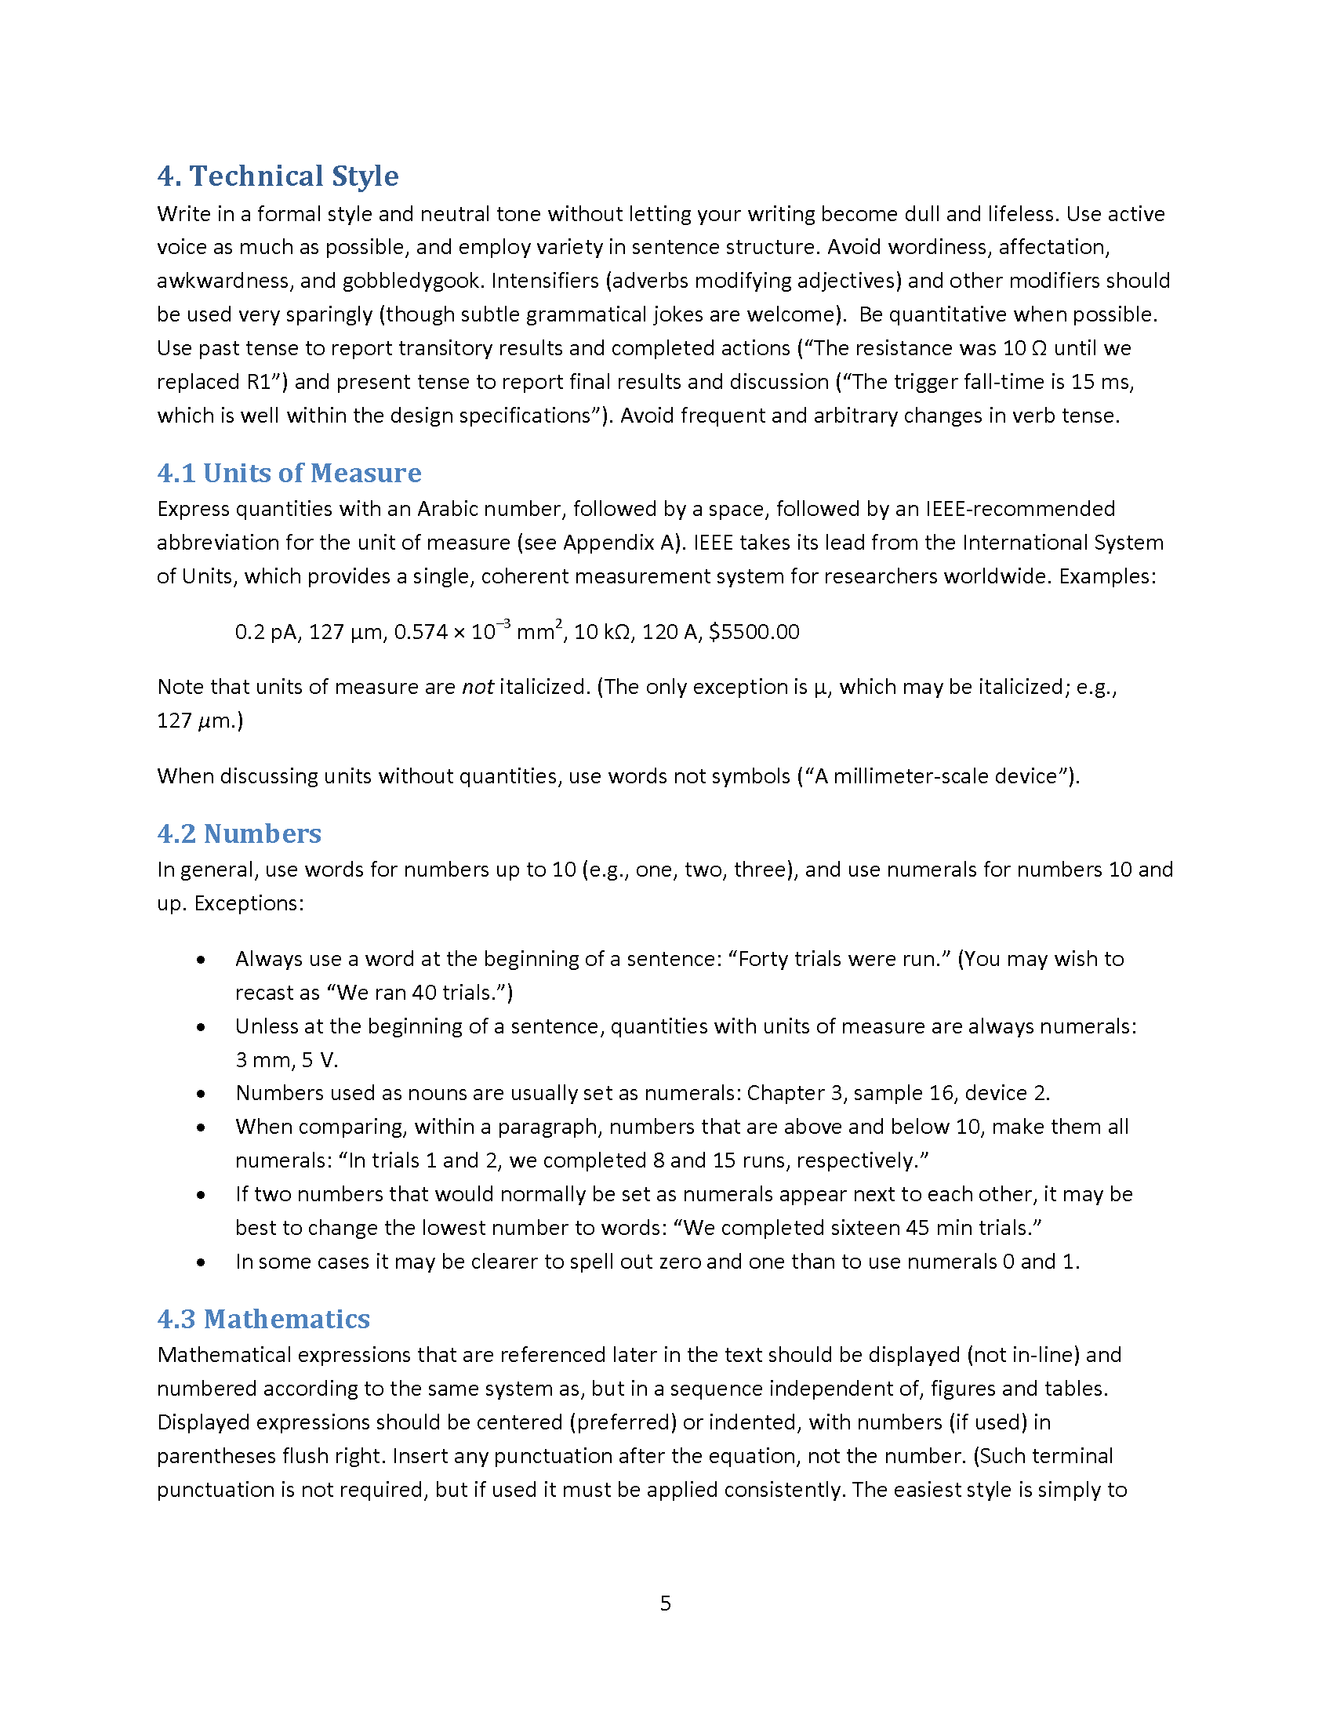

Slide 11
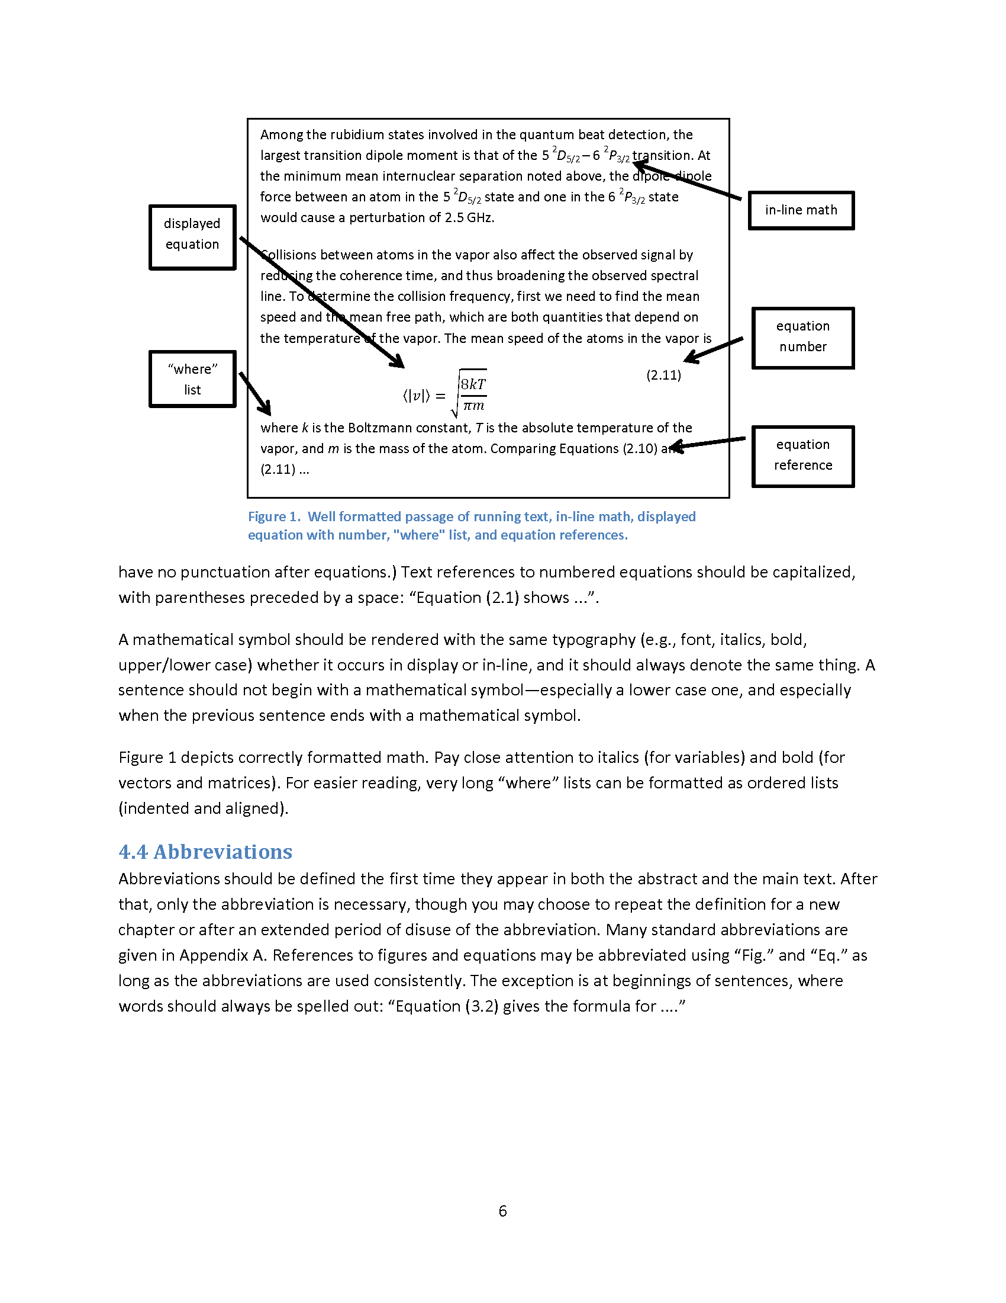

Slide 12
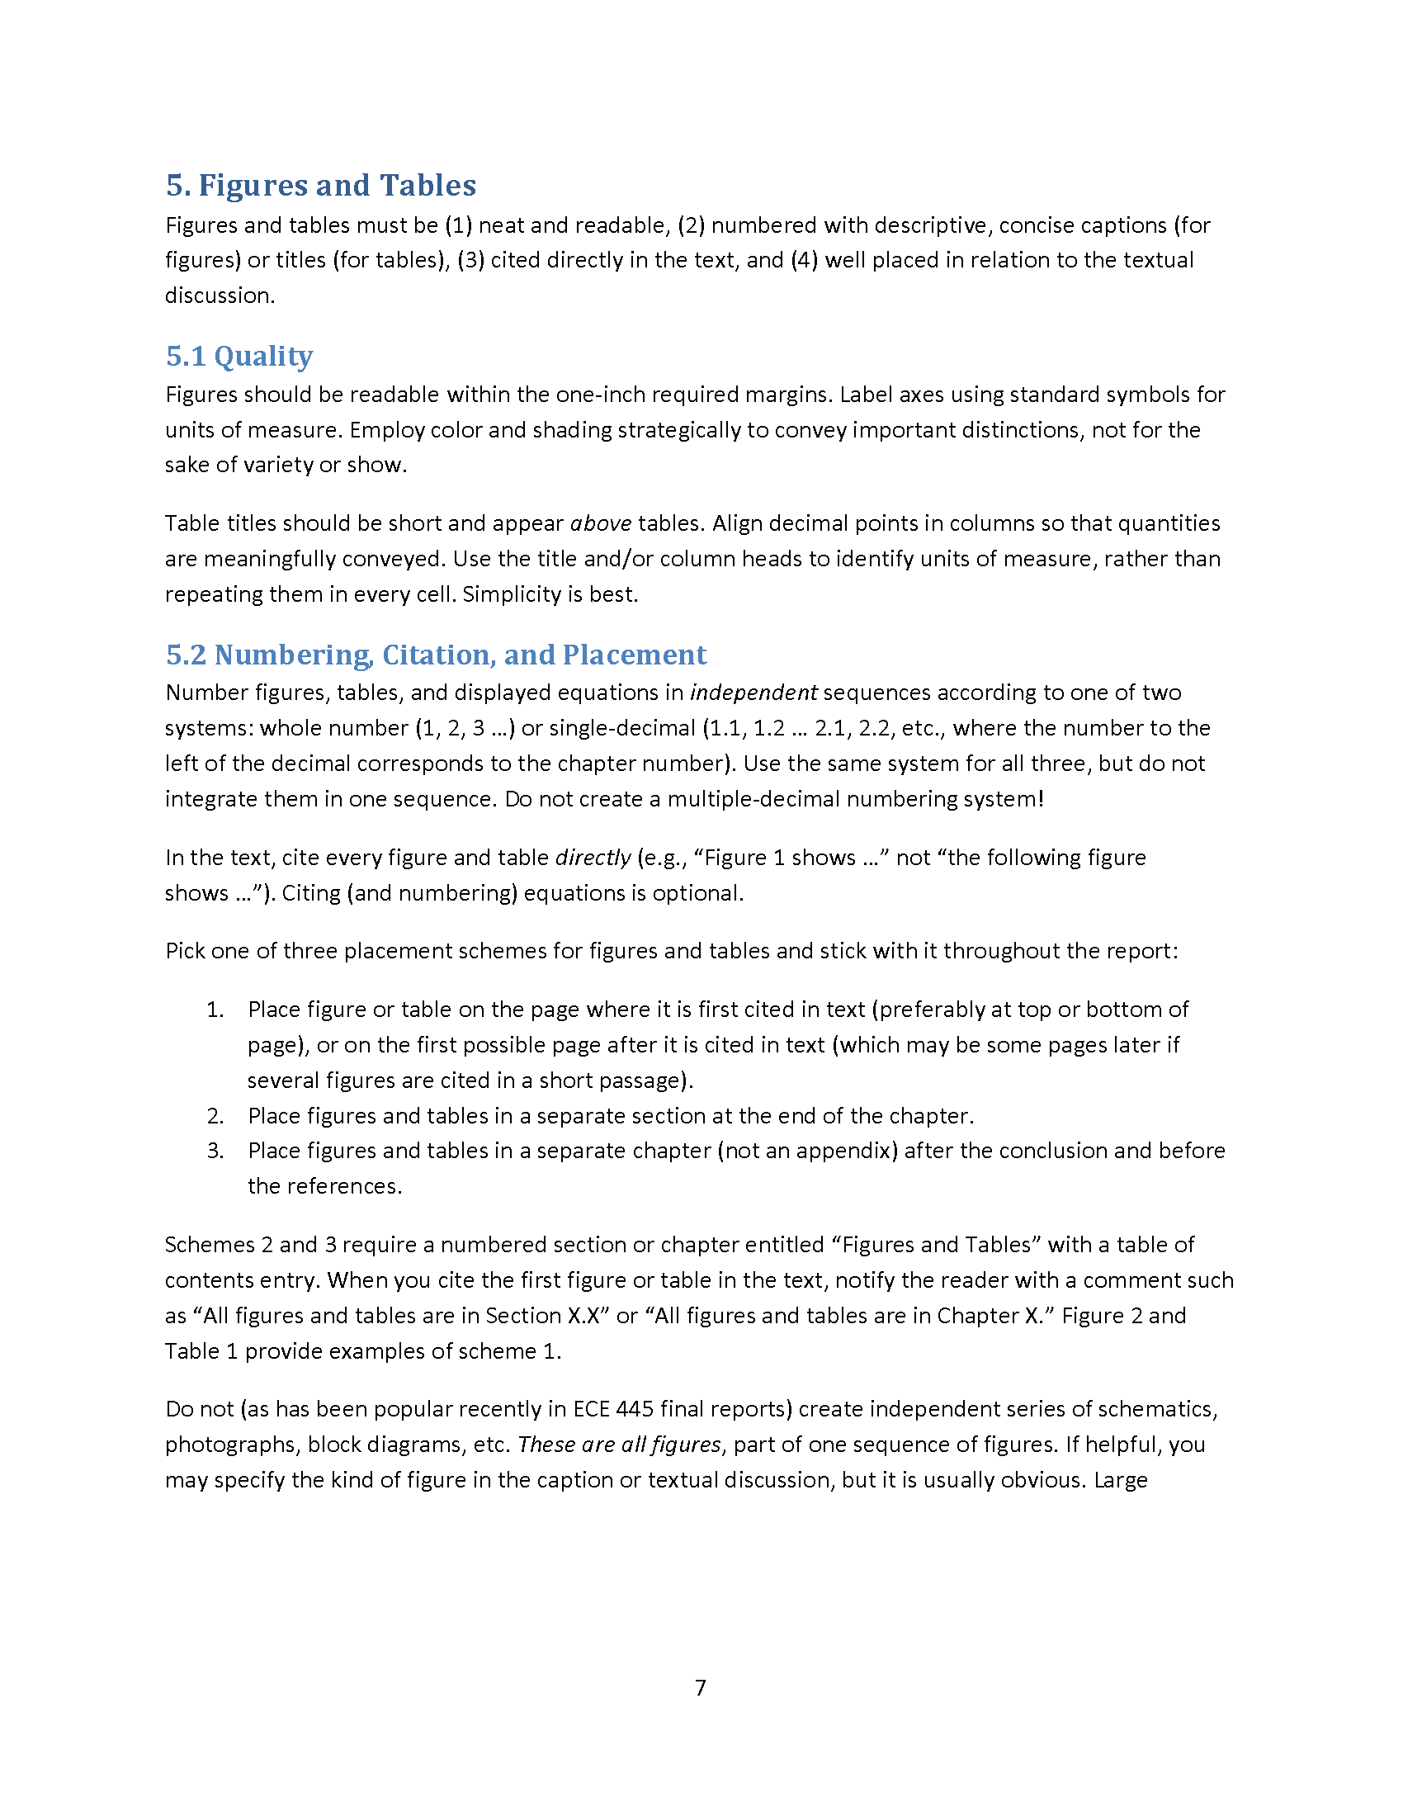

Slide 13
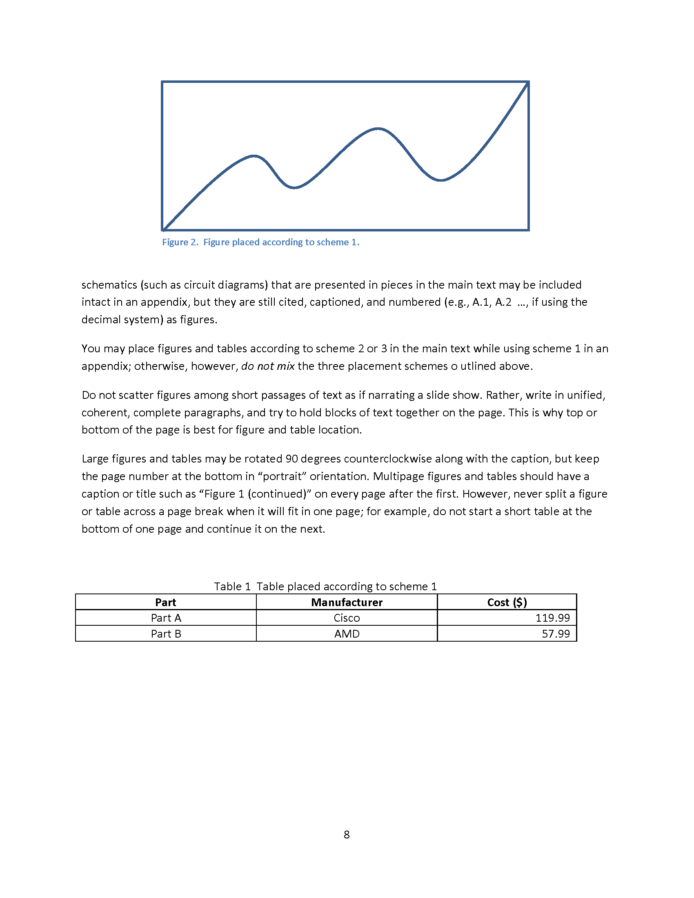

Slide 14
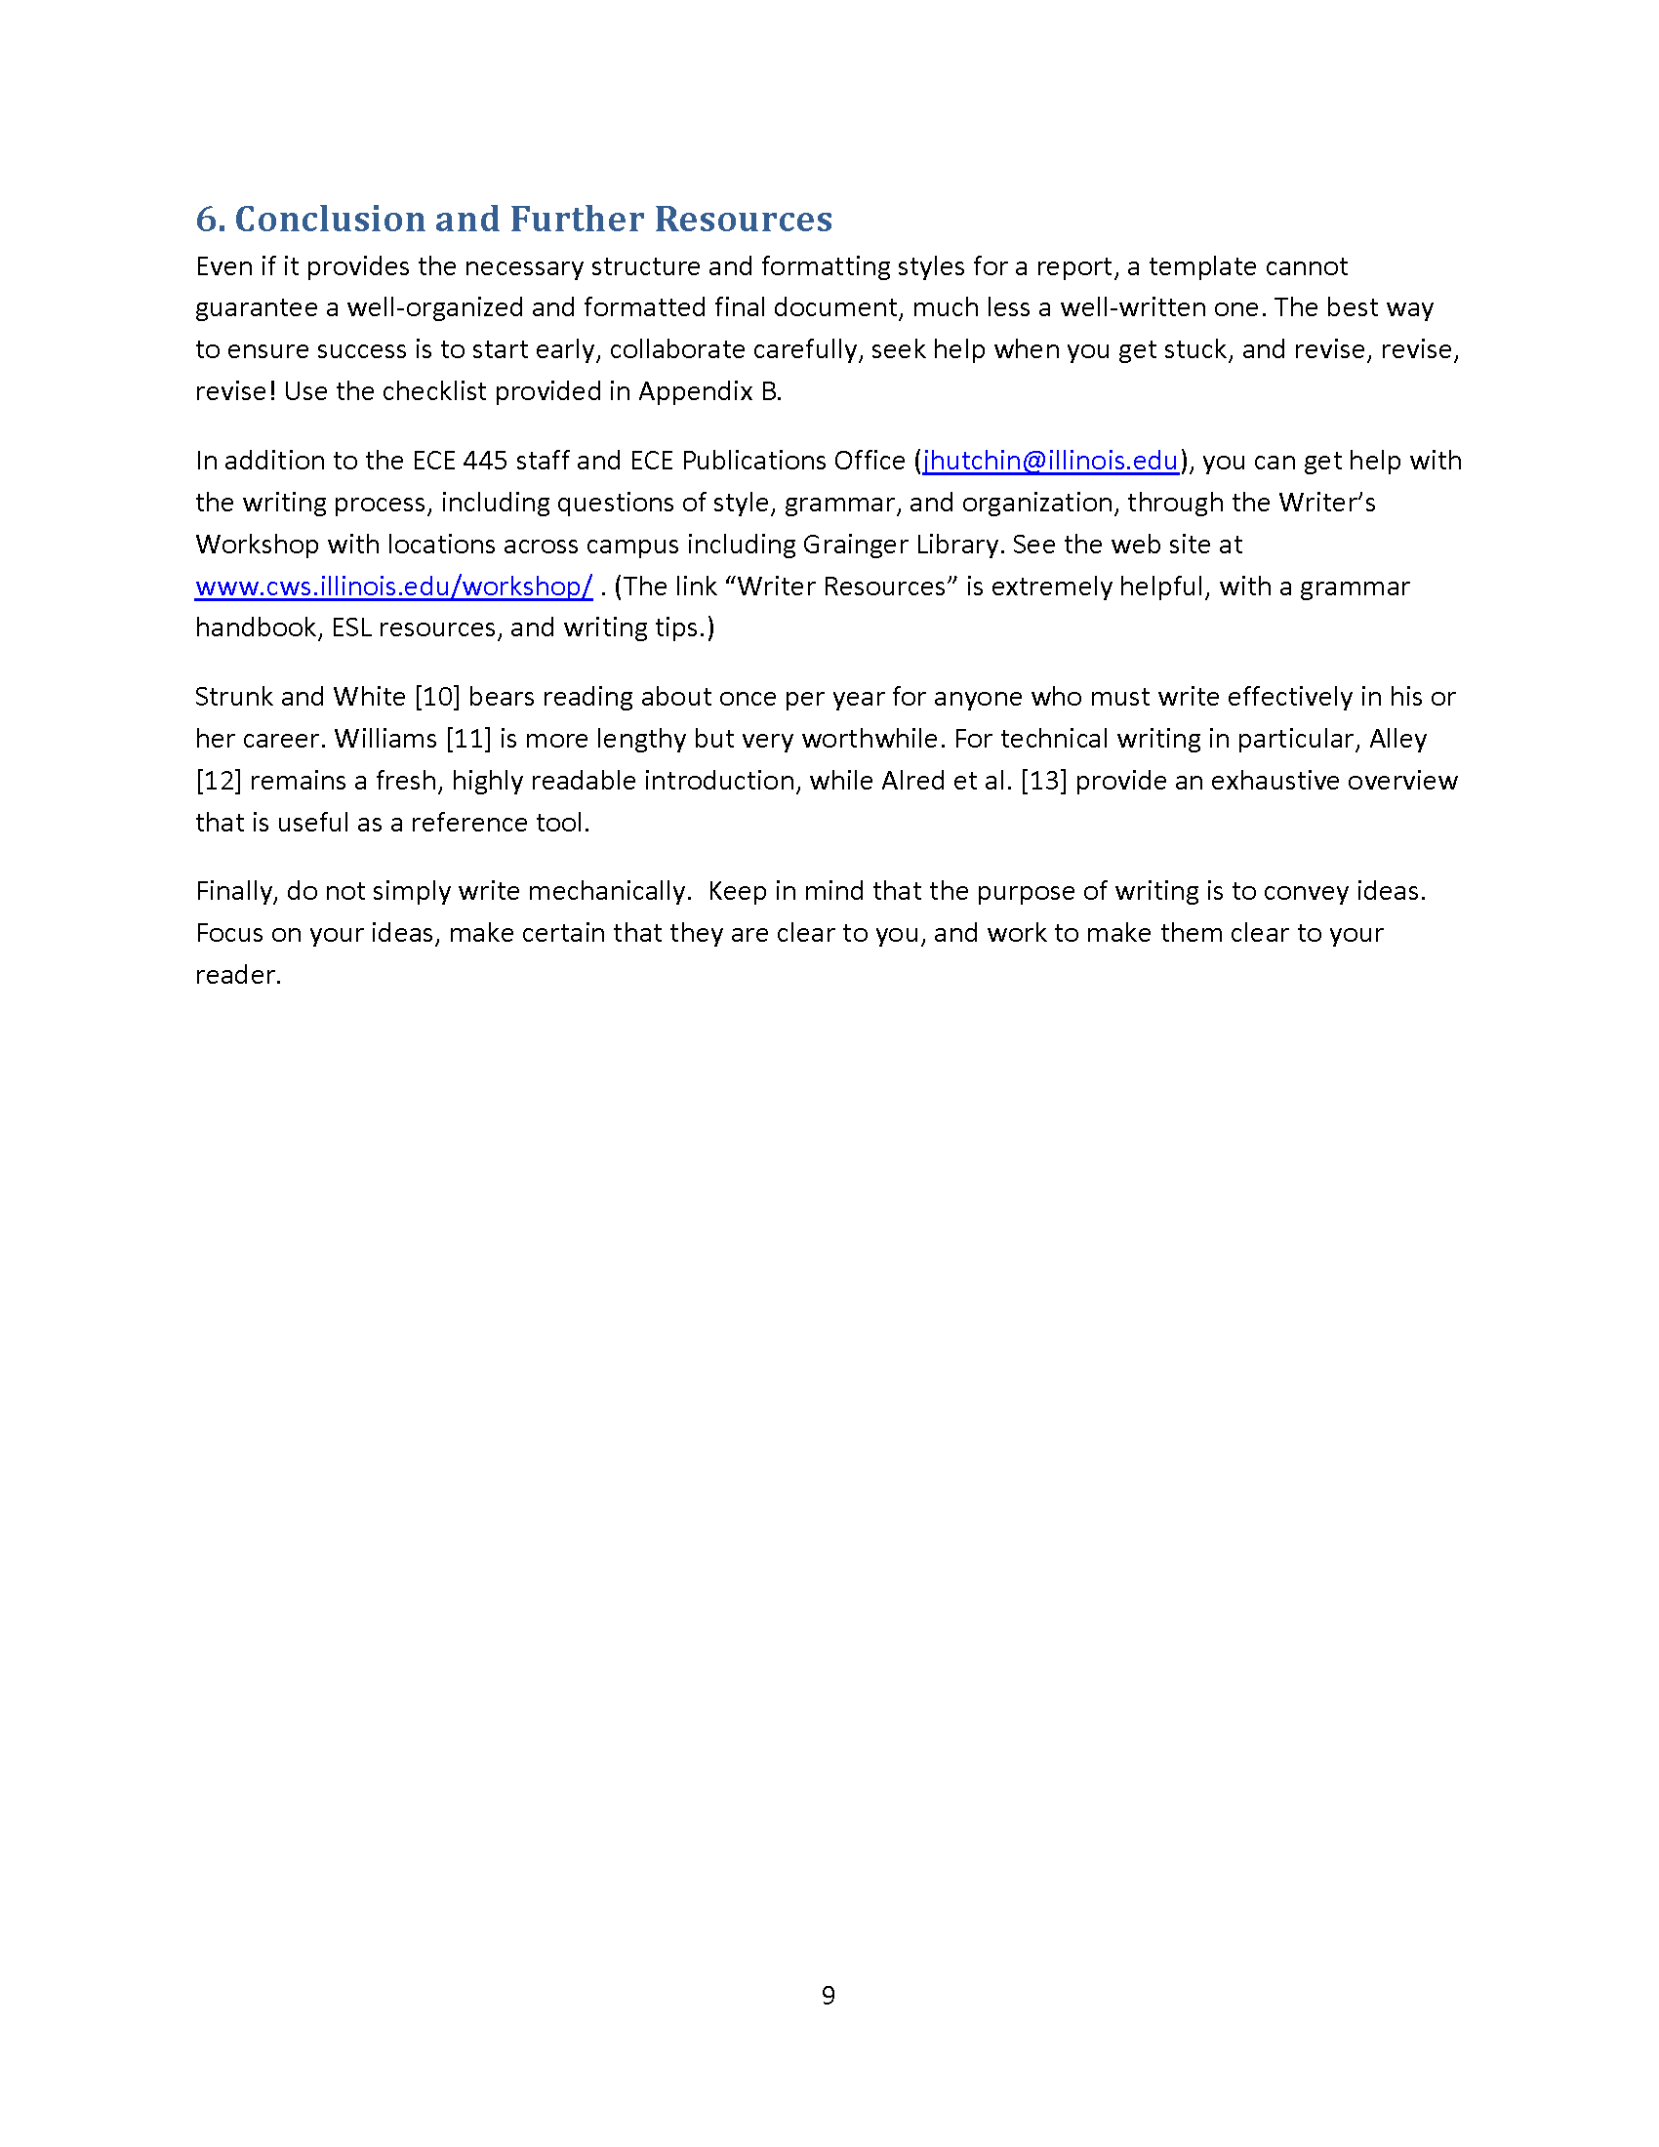

Slide 15
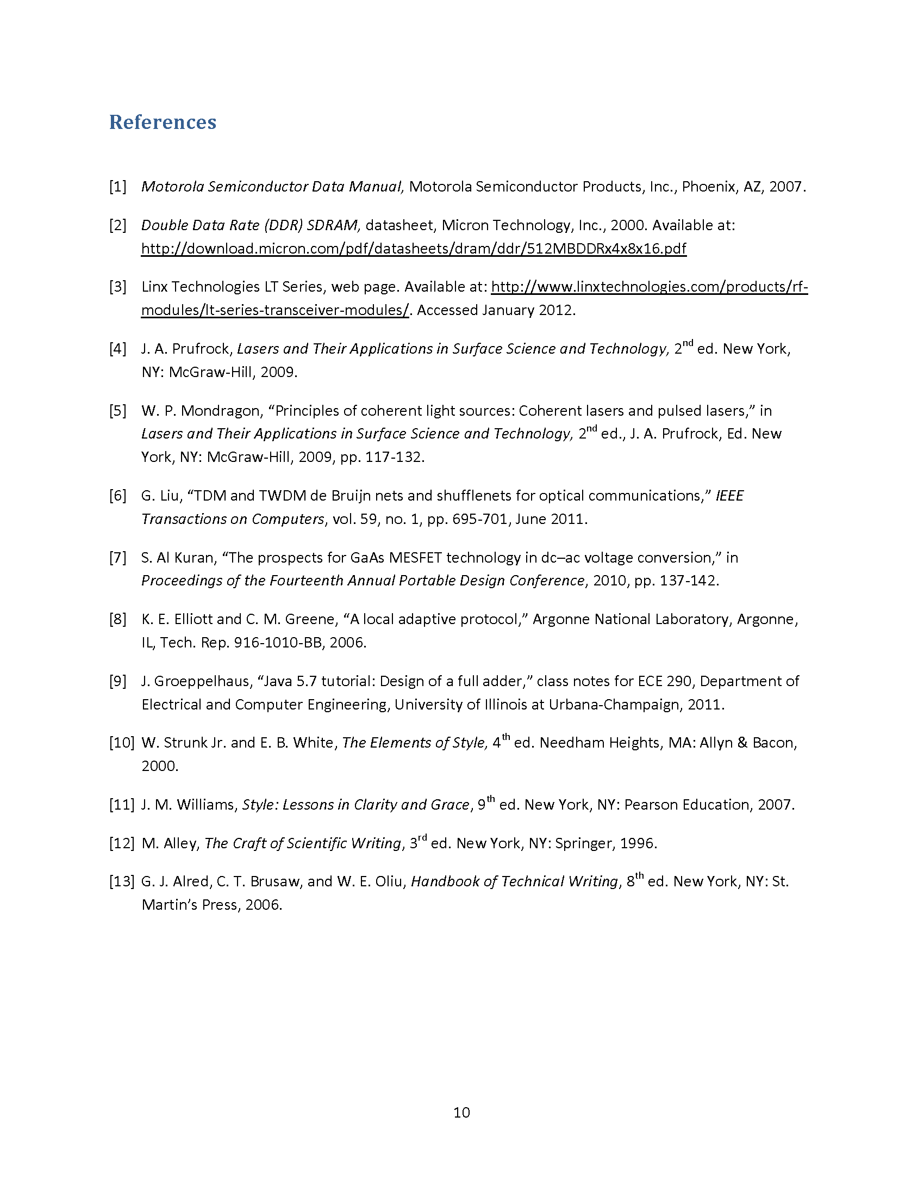

Slide 16
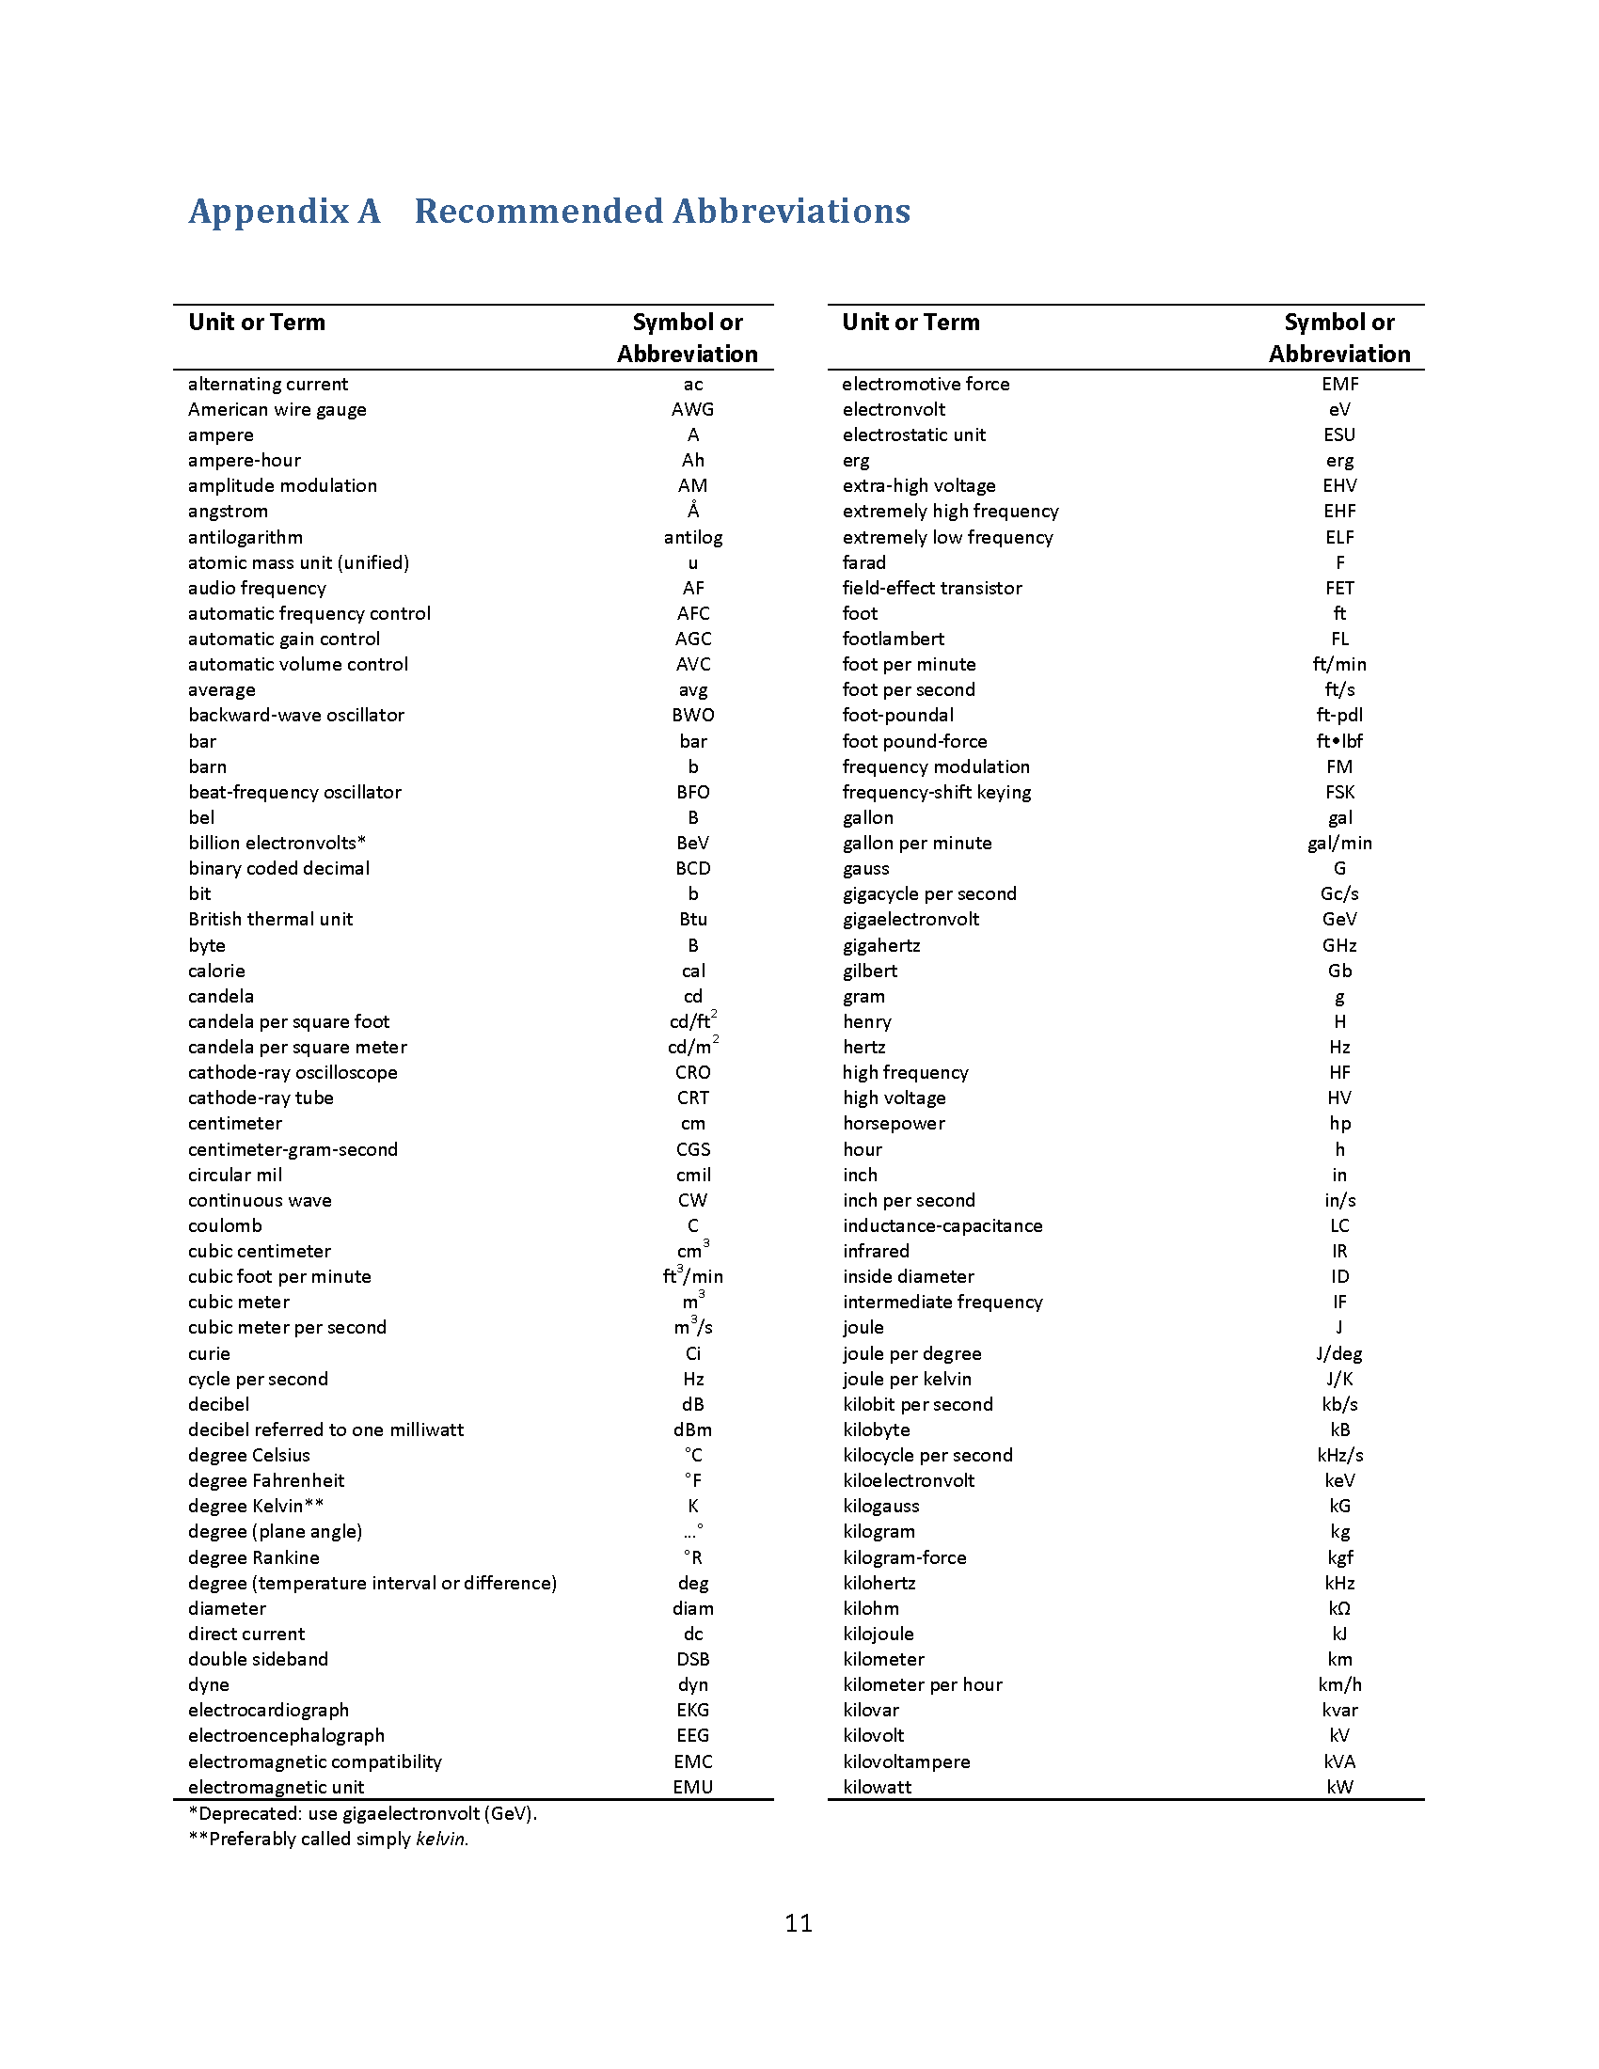

Slide 17
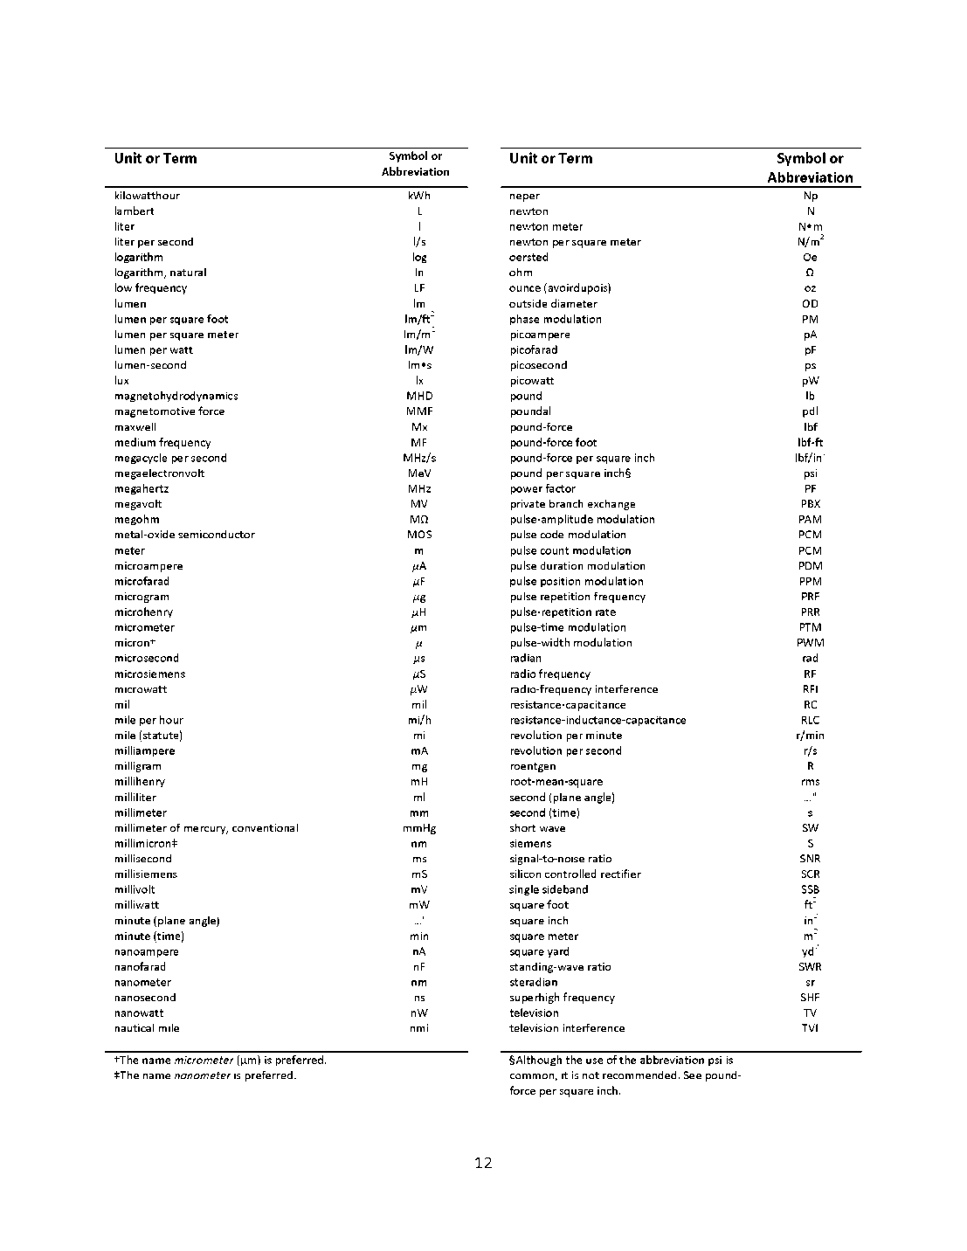

Slide 18
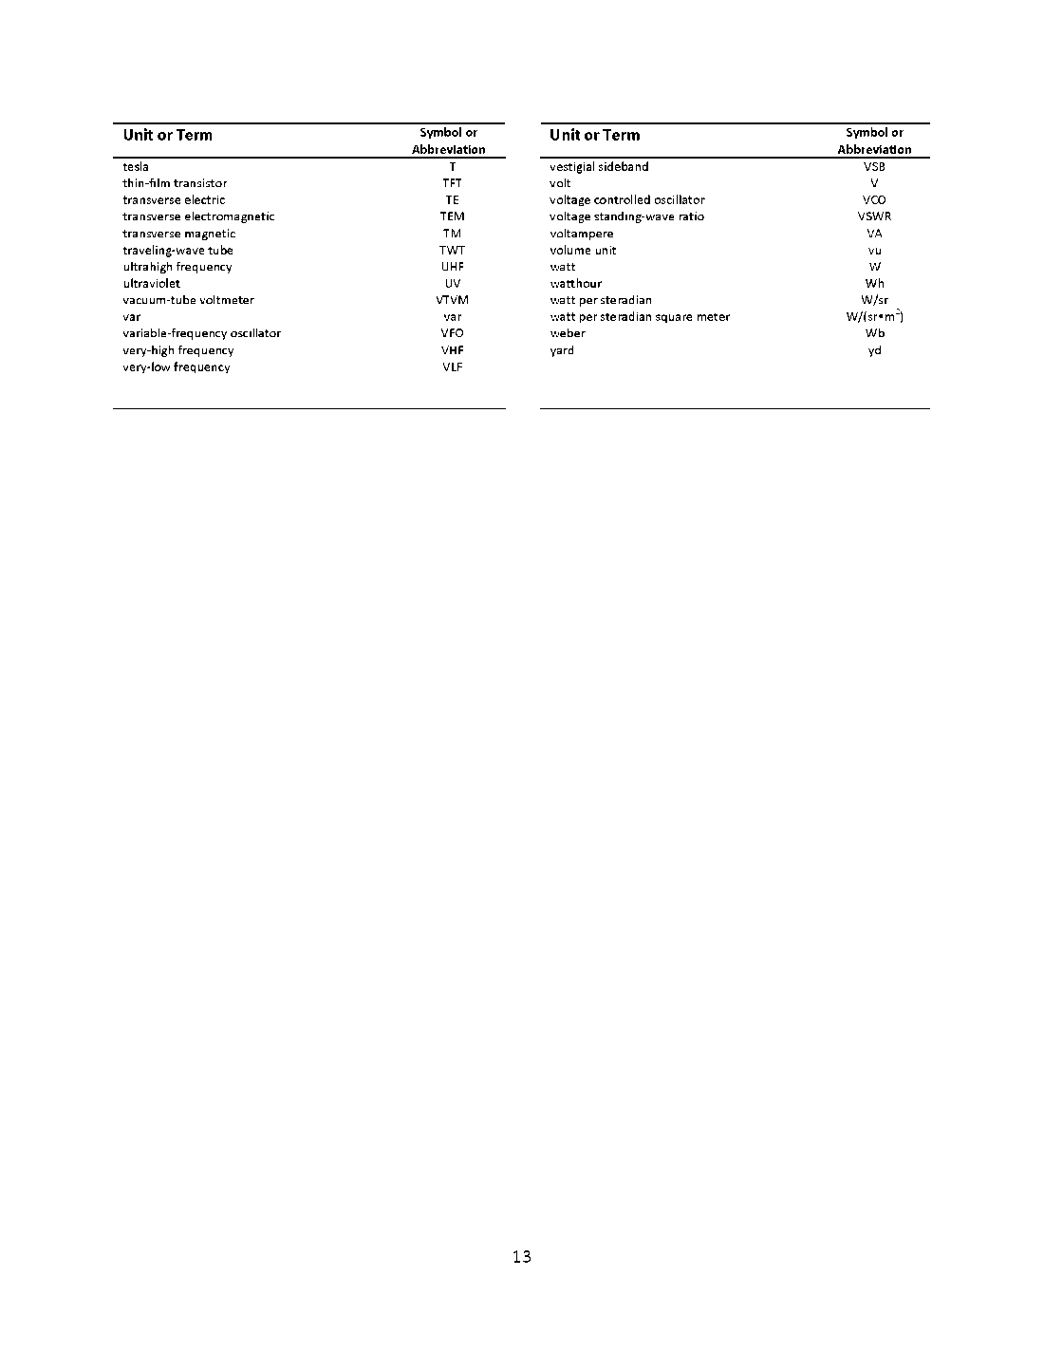

Slide 19
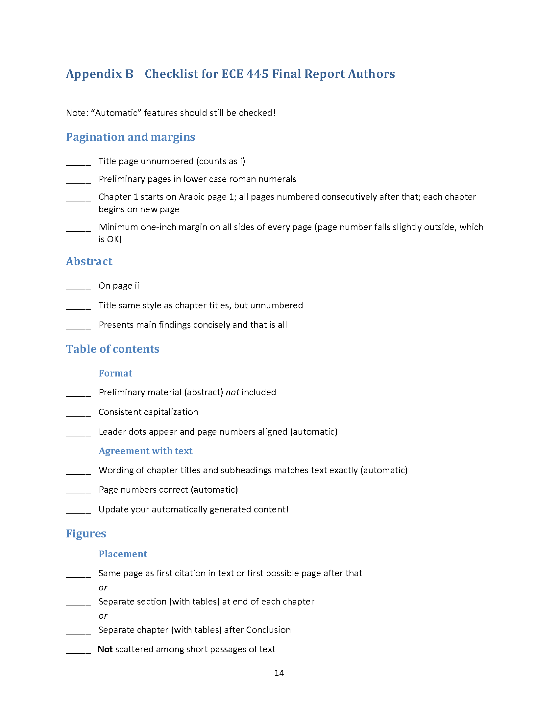

Slide 20
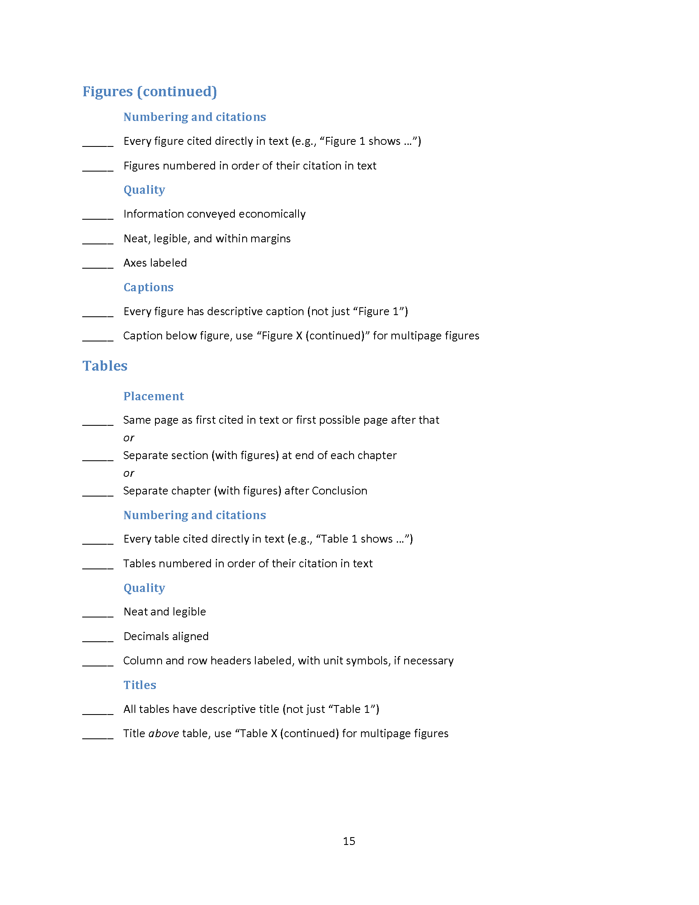

Slide 21
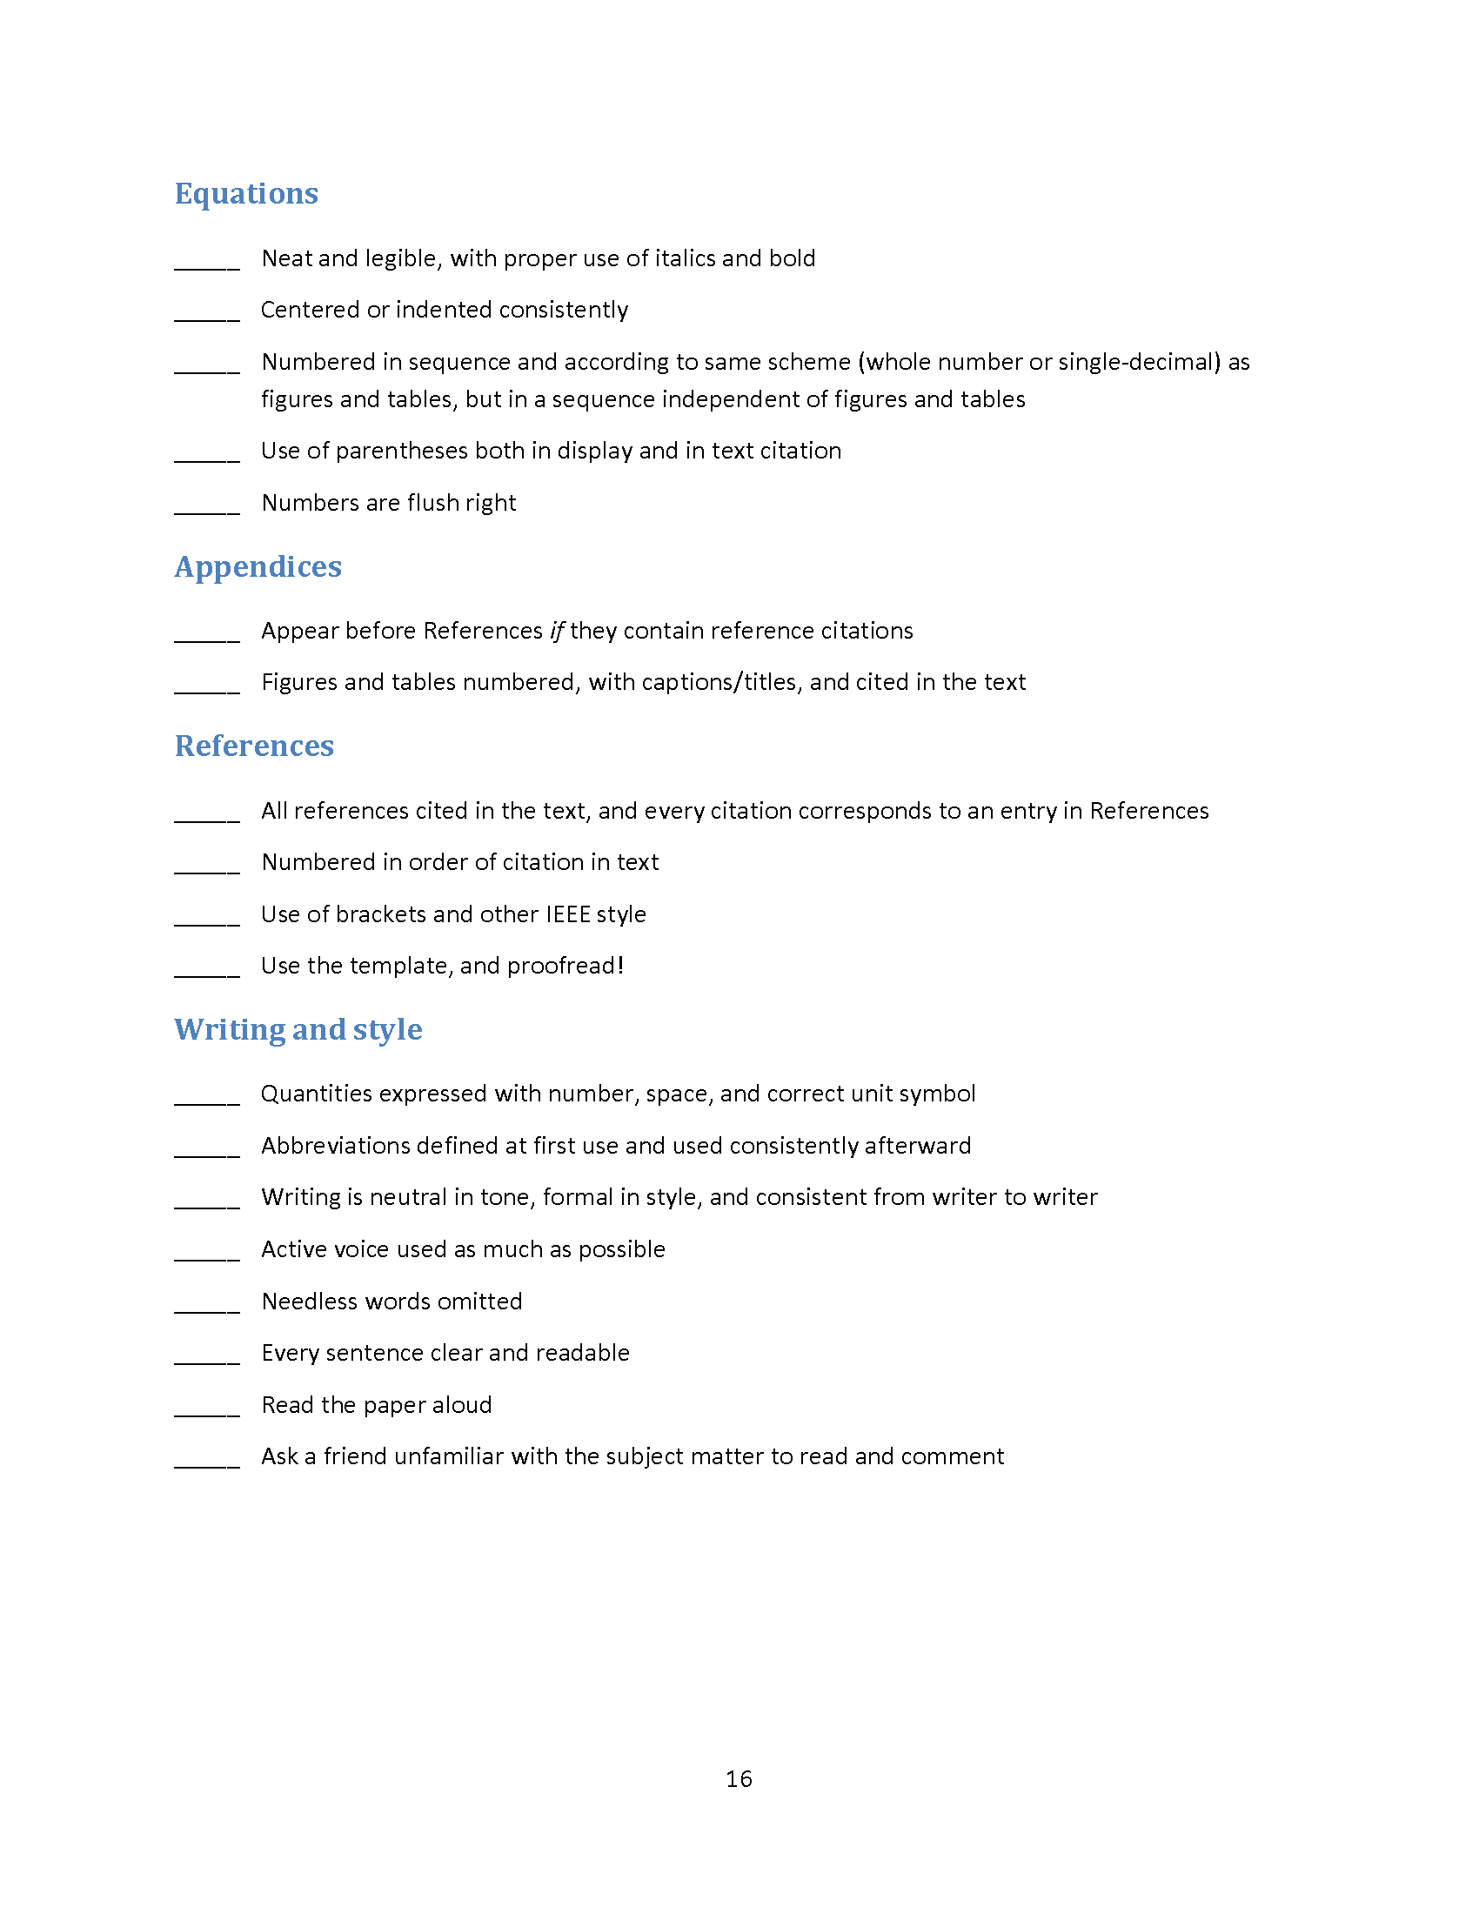

Slide 22
Abstract
Provide 150 words, or less, briefly describing the function and overall design of your project along with main results.
Avoid introductory material such as background, competitors, and motivation—save that for Introduction.
Don’t give a sales pitch.
Do not include in Table of Contents.

Slide 23
Figures and Tables
Three placement options:
Same page as first citation in text, or first possible page after
Separate section at end of each chapter
Separate chapter (not an appendix) at end of main text

Slide 24
Figures and Tables
Cite every figure and table directly in the text (e.g.: “Figure 1 shows …” not “The following schematic shows …”).
Number figures in order of their citation in text.
Use whole number (1,2,3 …) or single-decimal (1.1, 1.2, … 2.1, 2.2 …) system.

Slide 25
Figures and Tables
Convey the information economically.
Make them neat and legible, and stay within 1-inch margins.
Label axes, rows, columns.
Write neat, concise captions.

Slide 26
Figures and Tables
As much as possible, anchor them at tops and bottoms of pages with text wrapping.
Do not pin them to text citations, resulting in scattered figures interspersed with short passages of text—as if narrating a slide show.

Slide 27
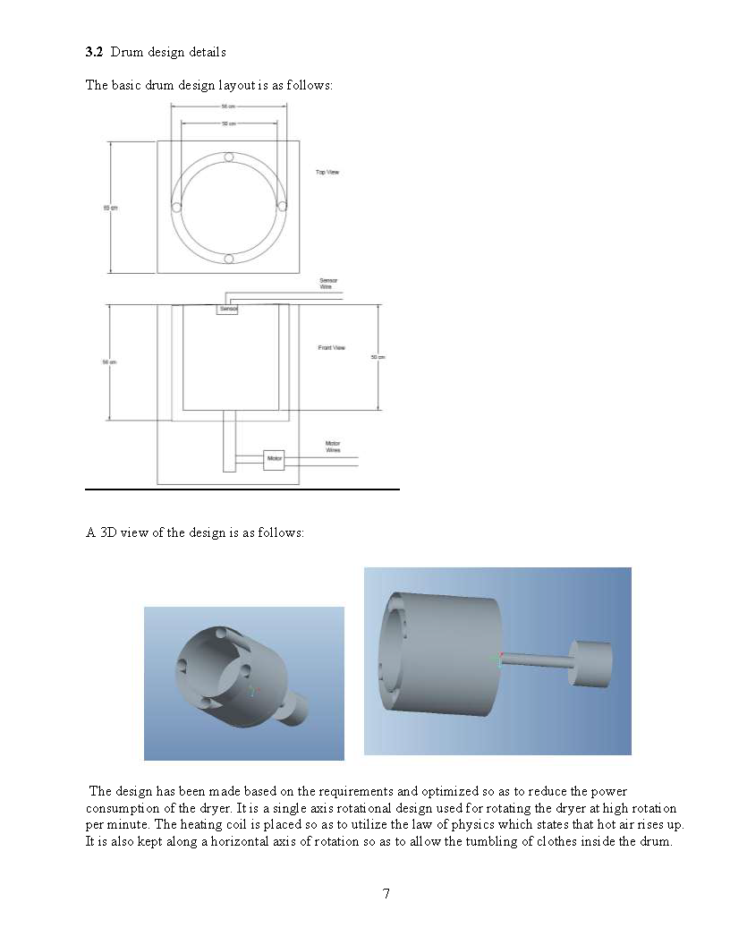

Slide 28
Appendices
Reserve for detailed technical material that, while it may be important, is secondary or would disrupt the project description of the main text.
Examples: Requirement & verification table (required), large data tables, lengthy code, sets of schematics, etc.

Slide 29
Exemplars (score $≥$18)
Spring 2015
2, 21, 29, 31, 34, 37, 44, 56
Fall 2015
4, 9, 10, 21, 26, 32, 41

