Slide 1
Notebooks:
Your Most Powerful Debugging Tool
Your Legal Protection
Your Intellectual Property Protection
An Industry Standard

Slide 2
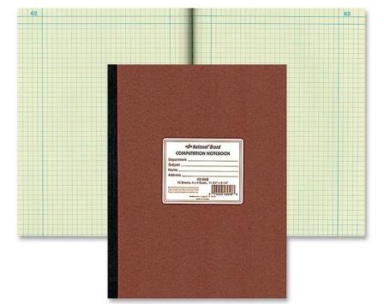
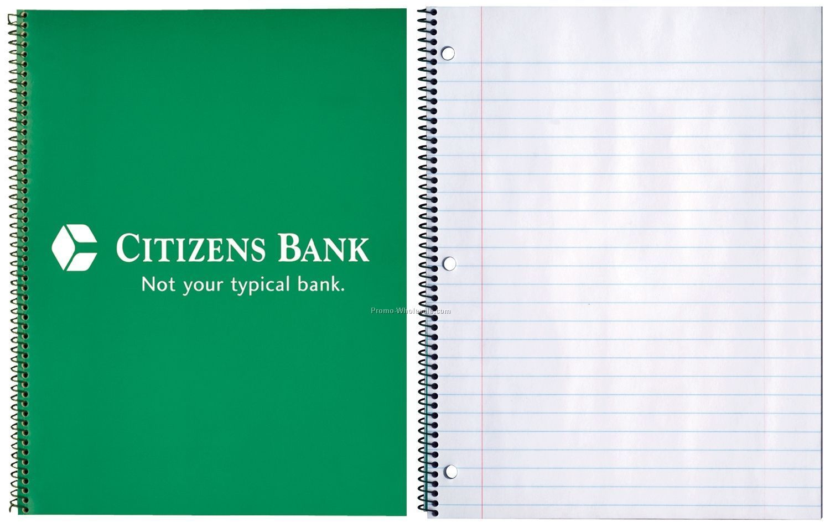
What Is an Acceptable Notebook?
Sewn and Numbered Pages
Carbonless copy is not acceptable
NOT a spiral bound notebook (pages not sewn)
NOT a composition book (pages not numbered)
Good!
Bad!

Slide 3
What More is an Acceptable Notebook?
The very best reference when writing the final report
A record of all of your ideas and your test results
A record of pertinent portions of datasheets
A timeline of your project
A way for your TA to ensure you are on schedule
A chronicle of your design process, from brainstorming to final implementation.

Slide 4
How Does One Maintain a Notebook?
Entries are to be written in PEN – preferably with blue or black ink
NO PENCIL.
Inserts (code snippets, simulation results, etc.) are to be glued in, signed in, and dated in
Each member of the group maintains an individual notebook of individual work – Extensive copying is prohibited
The notebook should be written legibly
The notebook is to be brought to every single TA meeting without exception. We need to see steady and strong progress week to week!

Slide 5
What is Written in the Notebook?
Everything.
The notebook is to be a chronological catalogue of the design process
Everything, from brainstorming to final testing results, is to be recorded
This includes all sketches, all proposed designs and their test results, including those that fail, and all calculations
It is okay to be wrong! The notebook will help you debug!

Slide 6
What is on Each Page of the Notebook?
Your name
The date of your work
Your signature at the end of each entry
Mistakes should be crossed out

Slide 7
Samples

Slide 8
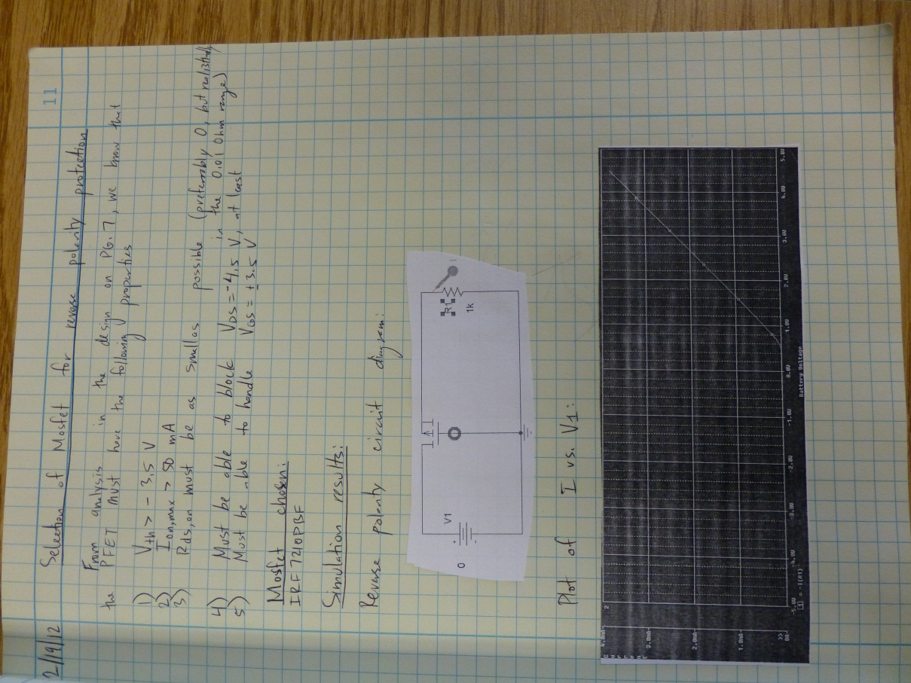
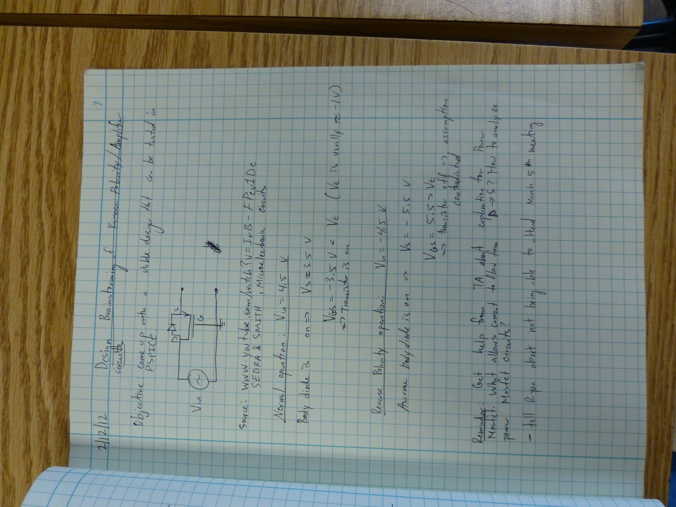

Slide 9
Why All the Fuss Over a Notebook?
The notebook is a chronological record of your work
Maintaining a professional notebook is a critical skill for industry
The notebook protects your intellectual property
The notebook provides legal protection in the event of a lawsuit
The notebook greatly simplifies the writing of the final report
The notebook is 10% of your final grade for the course (50 points of 500 points)
Your TA can help push you in the right direction with the help of your notebooks
DO NOT NEGLECT THE INFINITELY IMPORTANT NOTEBOOK!

Slide 10
Go Build (and Document) Something Cool!

