Slide 1
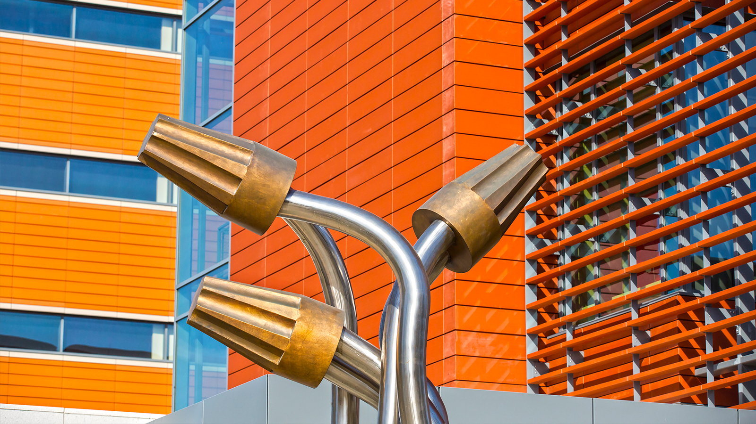

Siebel Center for Design + ECE 445
SPRING 19 PITCH
Rachel Switzky
January 15 2019

Slide 2
SCD MISSION
To foster multidisciplinary collaborations
across campus, using design thinking as an approach to promote human centered design
and mandated quick iterations.

Slide 3
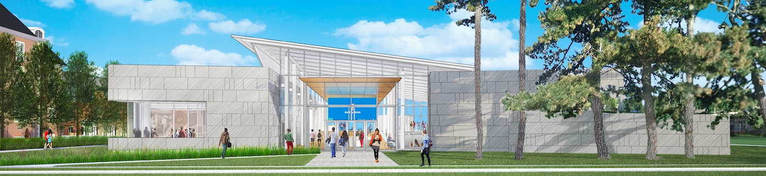
New Siebel Center for Design Building
Opening Fall 2020

Slide 4


Notes:
Updated April 2017

Slide 5
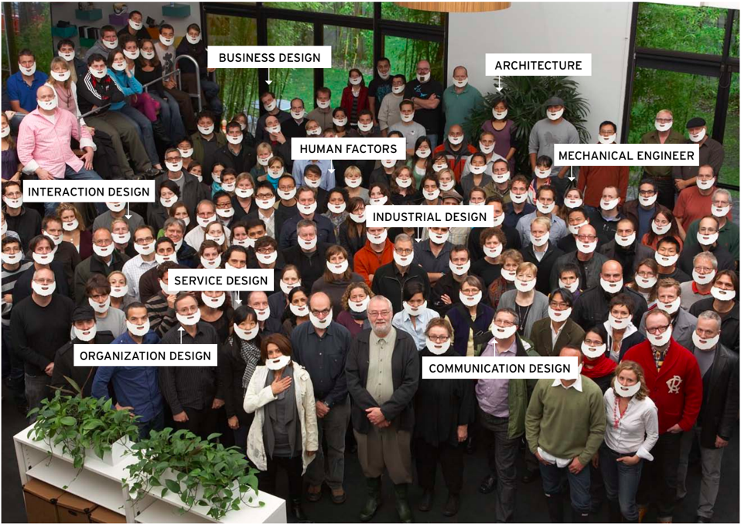
Notes:
Updated April 2017

Slide 6
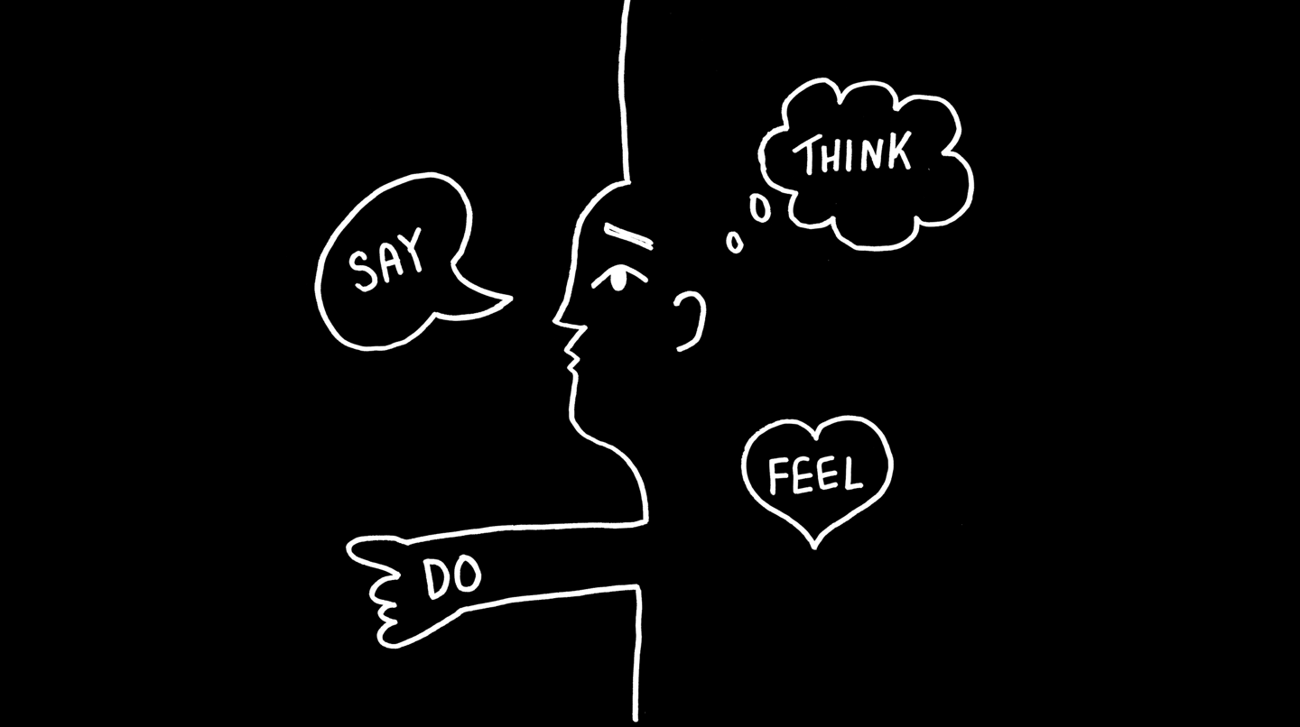
Human Centered Design
Observation
Empathy
Notes:
Updated April 2017

Slide 7
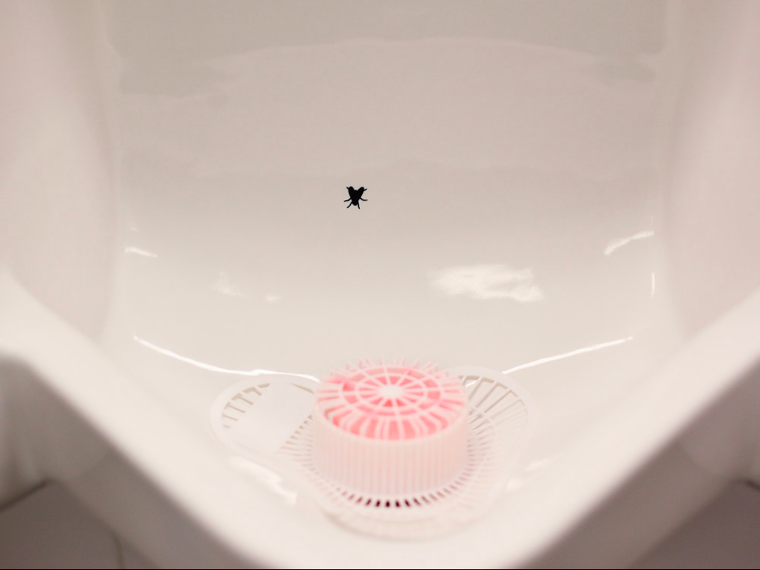

Slide 8
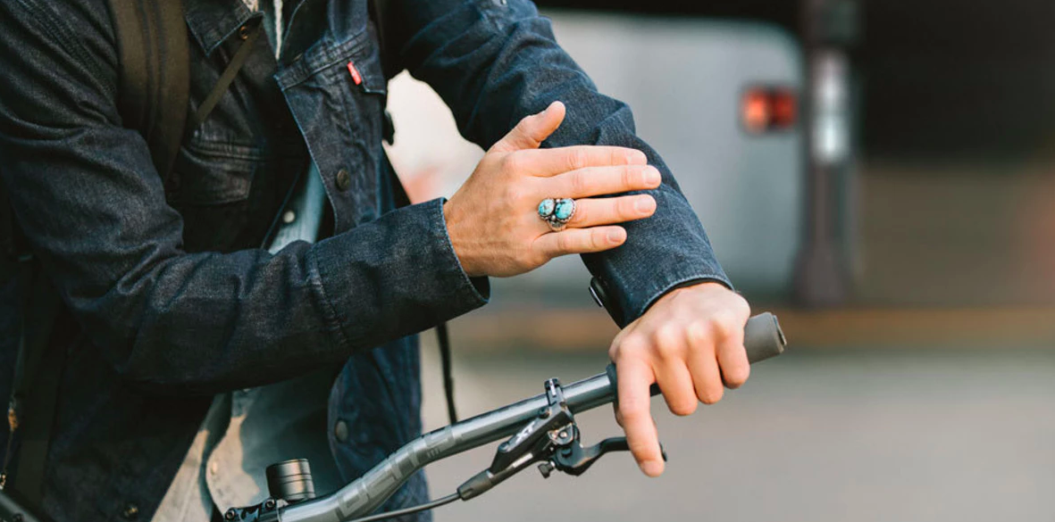

Slide 9
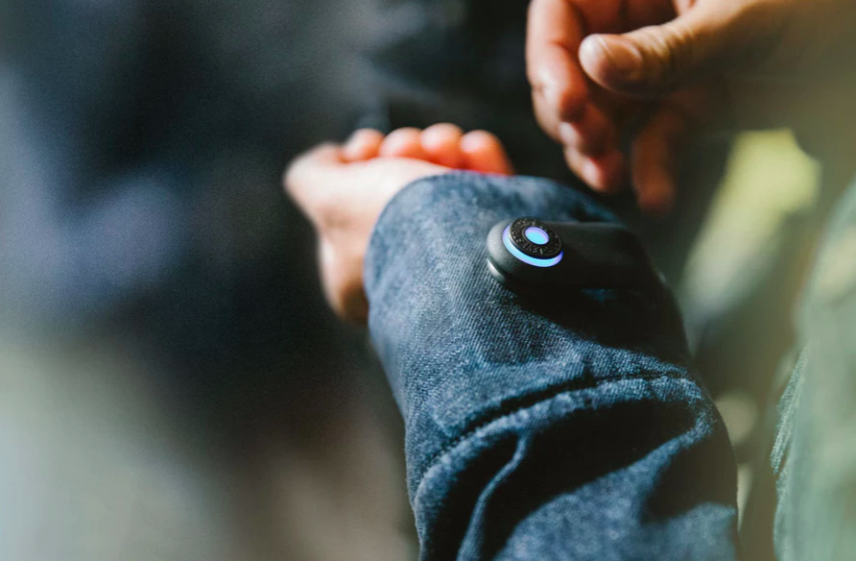
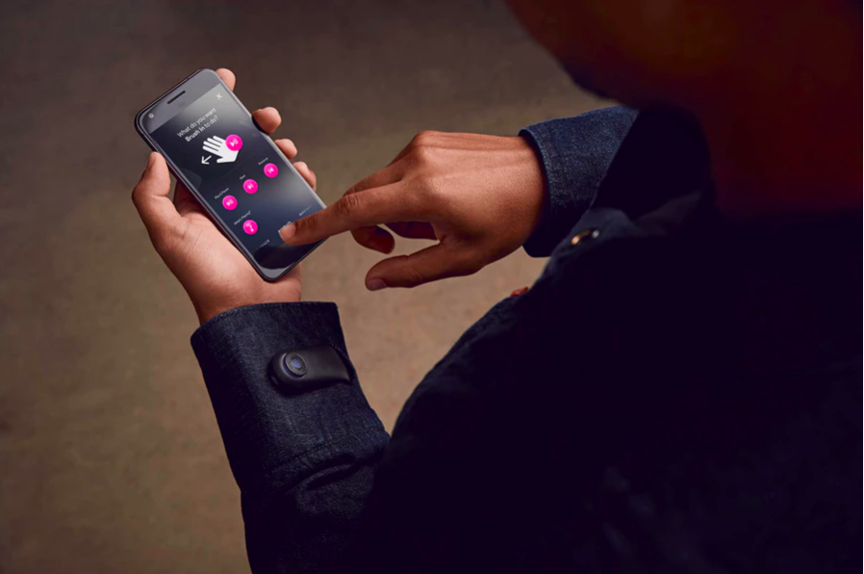

Slide 10
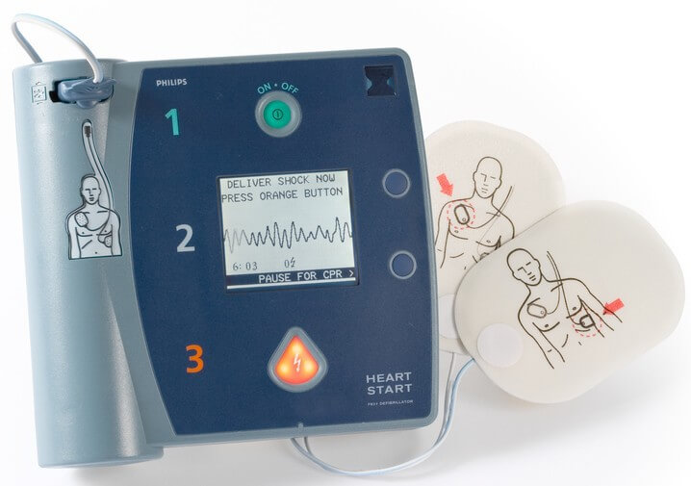

Slide 11
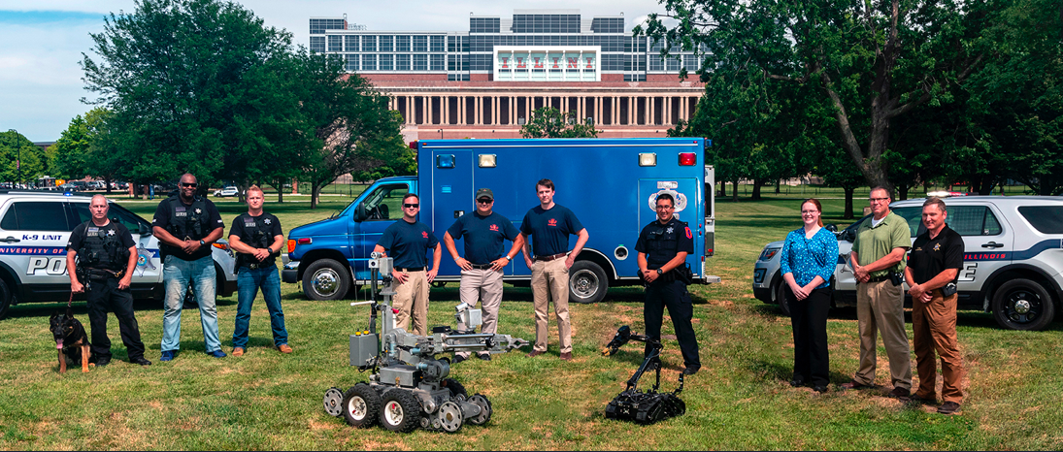
The University Police Department

Slide 12
Project 1: Reconnaissance Robot
How might we help officers check for suspects in tight, hard to access spaces (attics, crawlspaces, etc)?
Operators are at a serious disadvantage when entering these spaces
The areas are often dark, cramped, and have a single access point
Suspects could potentially ambush operators as they enter these areas to perform a thorough search
DESIGN CONSIDERATIONS:
Size
Power efficiency
and battery life
Communication range
High quality video output with lighting mounted on the robot

Slide 13
Project 2: Smart Glove
How might we keep traffic control officers safe
while maximizing traffic flow efficiency?
When officers need to direct traffic around accidents, or for sporting or other events on campus, they typically have to hold heavy light wands or flashlights.
Fatigue can set in quickly from holding objects during prolonged exposure to cold weather.
DESIGN CONSIDERATIONS:
Gestural connection
to communicating
light control
Dynamic heat controls
Weight
Usability around gestures and performance

Slide 14
Project 3: The Future of the Bullet-Proof Vest
How might we mitigate the effects of fatigue
from prolonged body armor use?
Officers often need to wear body armor or bullet-proof vests in order to stay safe in dangerous situations.
The body armor and bullet-proof vests are necessarily rugged and fairly heavy, and this added equipment often makes the officer uncomfortably warm, which can affect their performance on the job.
DESIGN CONSIDERATIONS:
Cooling system
Transparency of communication
Video recording
Material
Feedback mechanisms to environmental factors

Slide 15
The University Police Department Projects
1. Empathize
Develop a deep understanding of the challenges UIPD officers face
through one or more “pop-up” sessions organized by SCD
2. Synthesize
With SCD guidance, refine your project concept ideas based on insights we uncover through meeting with officers
3. Engage
Continue to check back with the UIPD throughout the semester
to garner feedback and tweak your design as necessary through
a series of periodic touch points

Slide 16
Interested?
Contact:
rswitzky@Illinois.edu or designcenter@Illinois.edu

