Slide 1
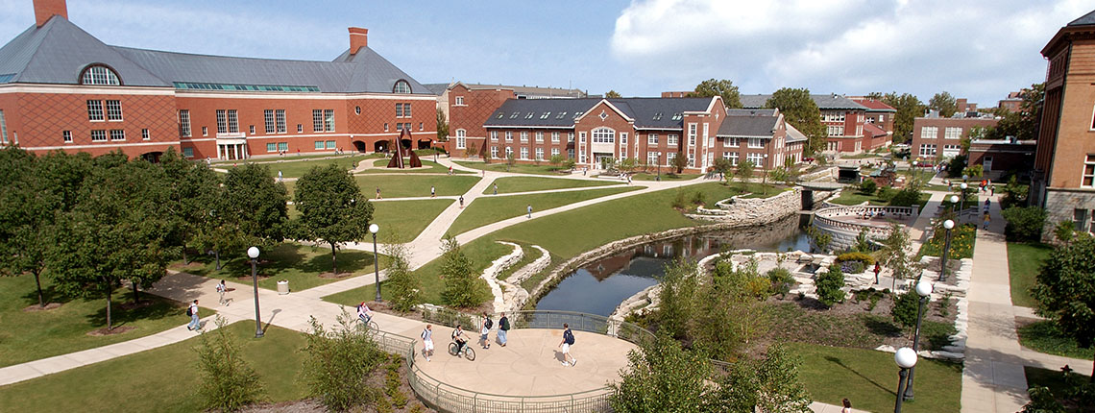
Intellectual Property
Michelle Chitambar, PhD
Technology Manager
29 January 2019
3002 ECEB

Slide 2
Intellectual Property (IP)
Intangible “creations of the mind”:
inventions, written works, art, designs, etc.
IP protection is a tool to help extract this value
Patents
Trademark
Trade Secret
Copyright
Mask Works
Know-How
Notes:
Core philosophy underlying IP
We’re used to the concept of things having value that attaches to an individual or company—you can’t just steal my phone or walk out with the desk you’re sitting at. Intellectual property is a related concept for works of the mind—if I write a book and you buy a copy, you can’t just make thousands of copies to sell without my permission. If I design and patent a new type of computer memory, IBM can’t just incorporate my design into their products unless I give them the right to do so.

Slide 3
Why Protect IP?
Obtain a limited monopoly for IP owners to commercialize their idea
HOWEVER,
IP owners, not governments, enforce IP
Sue infringers
Notes:
Limited in time, geographic region, scope

Slide 4
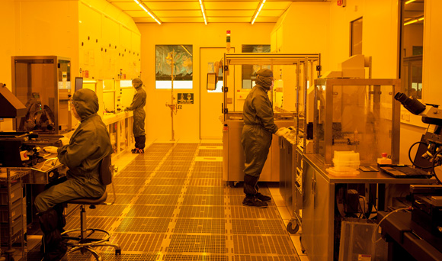
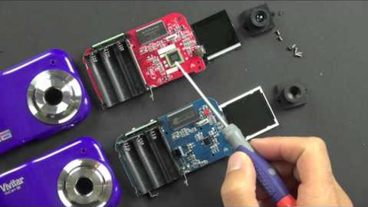
IP Protection: Tool for Public Benefit
R&D is expensive …copying is not
Without IP protection, many innovations would never be developed
Notes:
Without IP, innovators can’t compete with copycats that have no development expenses
Avg. cost to develop new drug $2.6B in 2014

Slide 5
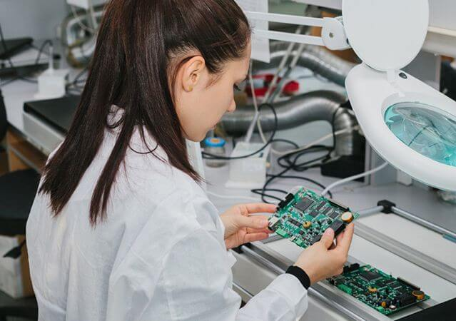
Who Owns IP?
DEFAULT:
Inventors/creators own their own intellectual property
REALITY CHECK:
Most of us sign our IP rights over to employers
UIUC generally only owns student work developed with significant university resources.
Ask OTM for determination if unsure
HOWEVER, project sponsors/clients may own IP for projects they offer.
Notes:
As personnel, you will be one of your employers’ largest R&D expenses. Your work may have minimal value if a competitor can freely copy it.
IP is critical for most start-up companies—you don’t have the economy of scale, personnel, relationships, brand recognition, sales channels, etc. of established companies.
Patent agents, tech transfer, law firms, private practice, within large companies…

Slide 6
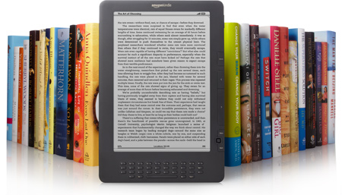
Types of IP: Copyright
Copyright attaches automatically and instantaneously to “expressed form”
Words, photos, artwork, software code, music, video…
Good practice to include copyright mark to avoid damage limitations
Copyright 2018 Board of Trustees of the University of Illinois
© 2018 Michelle Chitambar
Generally expires 70 years after author’s death
Fair use exceptions
Many license types, including open-source

Slide 7
Types of IP: Trade Secrets & Know-How
Keep information out of public domain
“Protect” via confidentiality agreements, etc.
Lasts until is disclosed, reverse-engineered or independently discovered
Notes:
Examples: Coke recipe and Google’s search algorithm

Slide 8
Types of IP: Patents
Last ~20 years
Requirements for patentability:
Novel
Non-obvious
Useful
Patentable subject matter
A patent does not mean the invention has academic merit, is valuable, or is even a good idea… just that it’s patentable.

Slide 9
When Should You Patent?
It depends
Is the technology marketable?
How would this enhance current portfolio?
Do we have the resources to patent?
How strong/defensible will our claims be?
How likely are competitors to copy and compete?
How long are technology/market cycles?
Notes:
Many strategies and considerations, so each person, company, or university’s analysis may be different. Nearly all will depend on context.

Slide 10
Patent Infringement
To infringe, must meet every limitation of issued claim in patent territory and be using for commercial purposes
If isn’t being sold, offered as service, used for commercial purpose, it likely isn’t infringing
To infringe on a Country X patent, must make, use, sell, etc. in Country X
Can’t infringe on a patent application, only an issued patent
If “A widget comprising A, B, and C” is patented, you have to do A, B, and C to infringe
Doing A, B, C, and D still infringes; doing A and B doesn’t; doing A, C, and D doesn’t
Notes:
Many strategies and considerations, so each person, company, or university’s analysis may be different. Nearly all will depend on context.

Slide 11
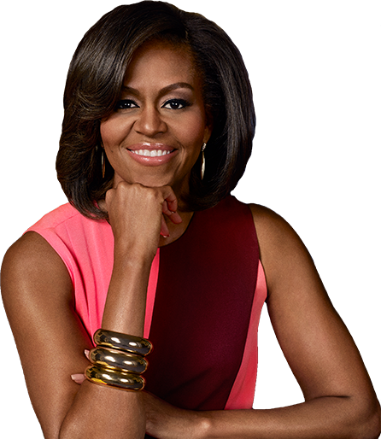
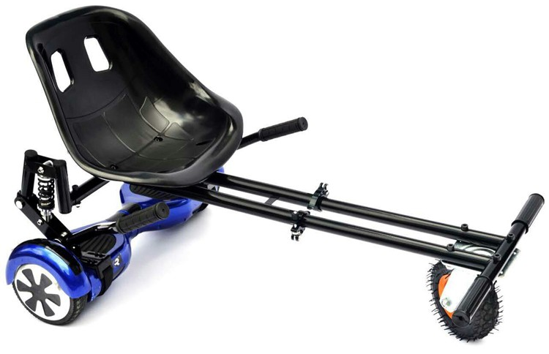
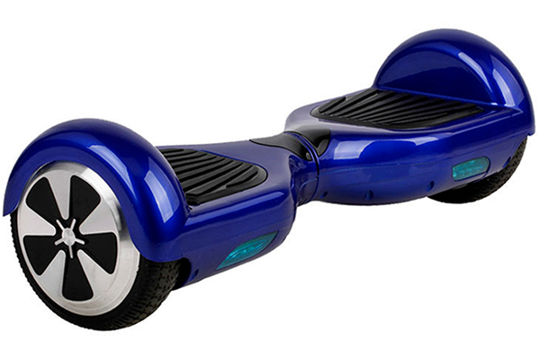
Freedom to Operate
IP rights don’t give you the right to make/use/sell an invention… just the right to exclude others
I need to license Obama’s IP to legally make/use/sell my HoverTrike

Slide 12
Questions?
Michelle Chitambar, PhD mchitamb@Illinois.edu
Technology Manager otm.Illinois.edu

Slide 13
Must-Know Patenting Facts for Inventors
Patents go to first inventor to file
Everything known to public before filing date is “prior art”
Can only protect what you disclose… and can’t add new matter
All patents not made equal—quality matters
Invest in a good patent agent/attorney
Patents can be overturned in whole or part
Provisional filings can be a cheap one-year placeholder
Notes:
Many strategies and considerations, so each person, company, or university’s analysis may be different. Nearly all will depend on context.

Slide 14
Software – Special Considerations
Frequently patented before 2010
Alice decision 2010

