Slide 1
ECE 445: Lecture 1
Prof. Arne Fliflet (afliflet@illinois.edu) Prof. Casey Smith (cjsmith0@Illinois.edu)
Prof. Jing Jiang (jiang56@Illinois.edu)
Prof. Michael Oelze (oelze@Illinois.edu)
Prof. Xiaogang Chen (oxgchen@illinois.edu)
Notes:
ECE Main Slide

Slide 2
Course Introduction
ECE 445 is the capstone course for the ECE Department
Draws on the entire ECE undergraduate experience
Our expectations for you are high
Students frequently produce impressive results – this is your chance to stand out
Outstanding project teams will be able to earn awards
You will use the design process to design, build, test, and demonstrate a novel idea
Exceptional projects are unique, technically challenging, and useful for solving a real-world problem
We will meet as a group the first four Tuesdays to give you the tools you need to get started on your project and be successful in this course
Notes:
A capstone course means it is a demonstration of your newly acquired capabilities as electrical and computer engineers
Think about the courses you found particularly interesting
How could the material be used to solve an interesting problem?
We want you to come up with novel solutions to problems
There needs to be a sufficient amount of complexity
Here has to be an EE element to the project
Project needs to be compatible with time and resource constraints
We fully expect that you will undertake challenging projects
One of the best parts of teaching this course comes at the end when we have to decide on which are the best projects

Slide 3
Course Introduction
Organize into teams of 2-3
Teams may propose a project or take on a pitched project
Teams must identify a problem, determine a solution, and build a product that satisfies the solution
The design and build process will stress communication, teamwork, systems design, and applied technical knowledge
The semester culminates in a demonstration of a working product that meets all project objectives
Search and Approval for Projects
(Weeks 1-3)
Detailed Design
(Weeks 4-6)
Build and Test
(Weeks 7-14)
Demonstrate
(Week 15)

Slide 4
Project Request for Approval (RFA)
All projects start on the Web Board
Each idea must first be presented on the web board
Professors, TA’s, and other students critique and discuss each idea
The first student to pitch an idea is the owner of that idea
After sufficient discussion, an idea can become an RFA
RFAs will be evaluated by staff and either approved or rejected
Projects must meet our criteria for complexity and uniqueness
Deadline for RFA approval is January 31st
This is not when you submit the RFA, but when it is accepted.
5 points extra credit: Early RFA approval by January 24th

Slide 5
Design
The sooner your project is approved, the sooner you can begin the thorough design
The Project Proposal is a high-level description of your project
Outlines a system-level description as well as gives the general functional overview for each aspect of your project
The Design Document is a well thought out instruction manual for your project
Includes detailed hardware schematics and software flowcharts and test procedures and requirements for each aspect of your project
Another ECE student not familiar with your project should be able to follow this document and make a working version of your project

Slide 6
Building and Testing
The middle 8 weeks are devoted to building and testing your project
Work in accordance to the schedule you laid out in DR along with guidance from TA’s and Professors
Identify problems early, make adjustments
Eagle and Soldering assignments help each student gain a basic understanding of PCB design and how to solder

Slide 7
Demonstration and Beyond
Week 15: Demonstrate a fully functioning prototype to your Professor, some TA’s, and other students
Week 16: Give formal presentations on your project and submit Final Report
Beyond: Continue developing and improving your project to create a real-world product

Slide 8
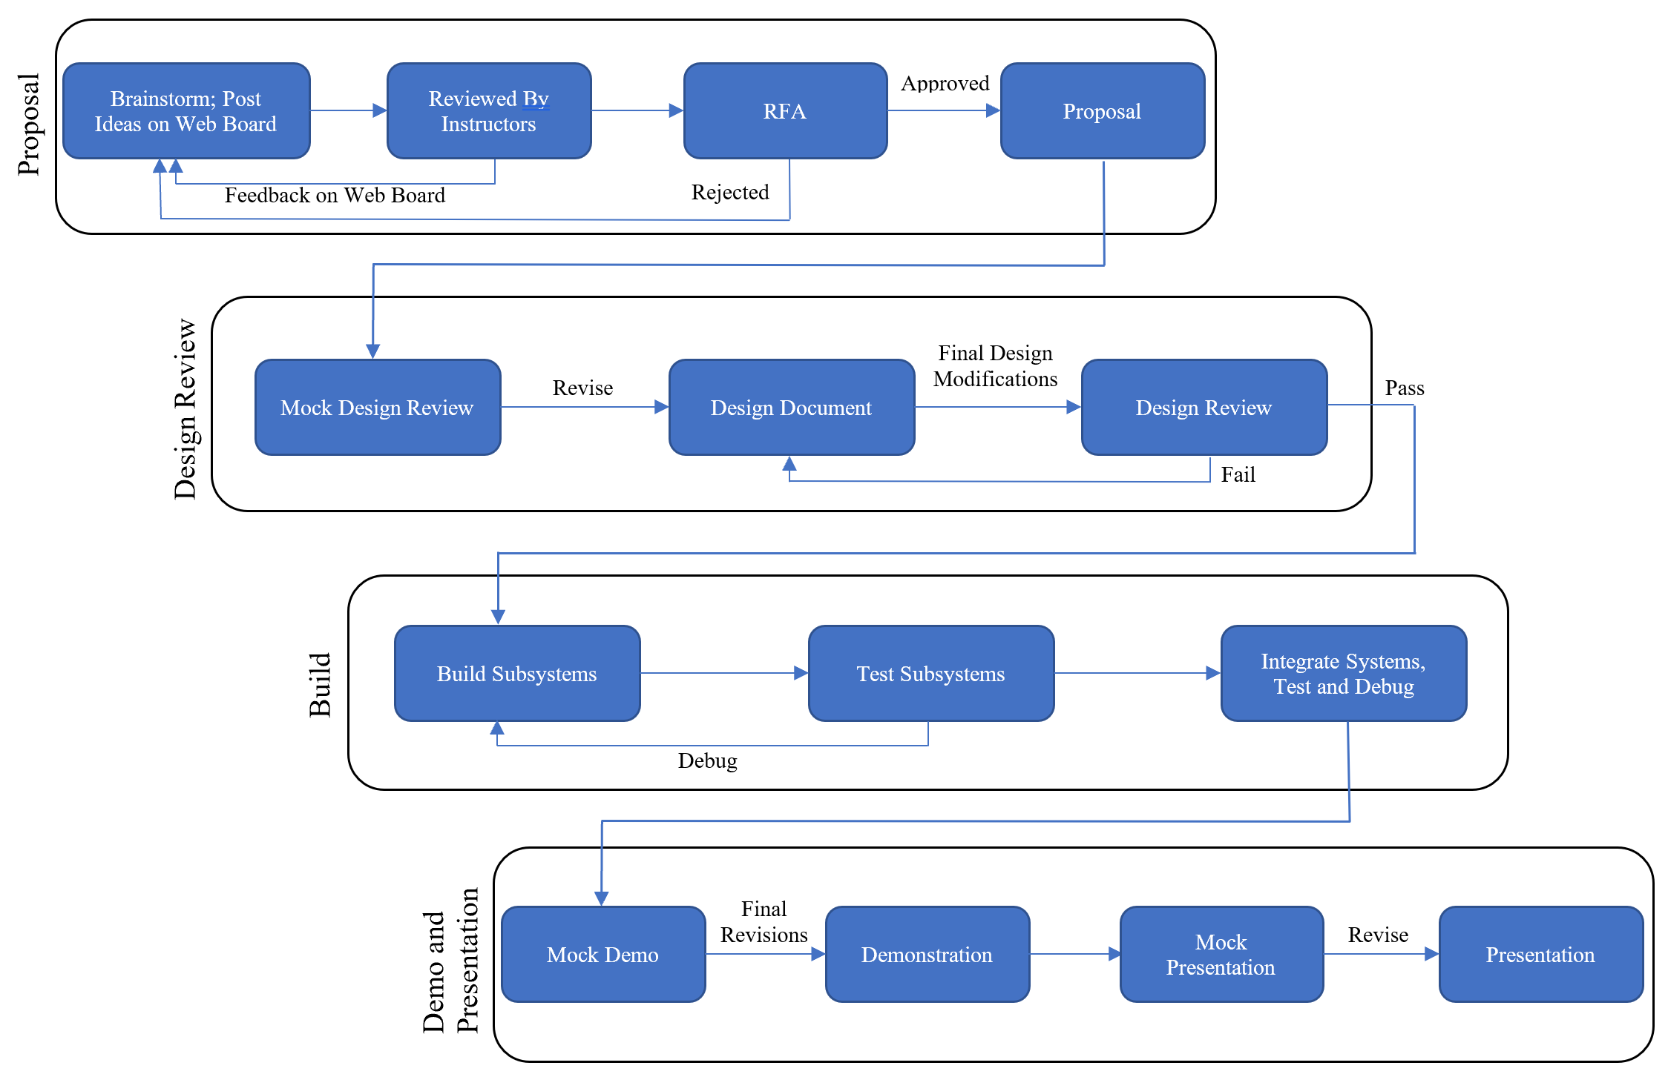

Slide 9
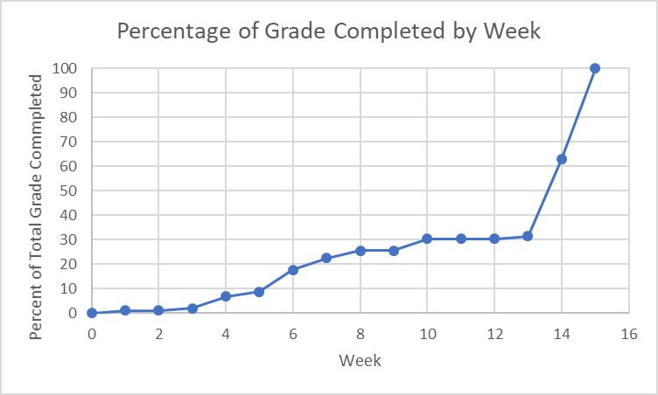
Course Point Accumulation (Total = 510)
Percentage of Points Available by week
Percentage of Total Points
30% of course points (~150) are earned before demo
Demo can earn up to 150 points
Mid-course points are crucial for a good grade

Slide 10
Staff and Support Structure
Five professors and fifteen TAs
Each project will have one TA mentor and one professor
Project teams meet weekly with their TA – the TA is the primary guide and point of contact
Instructors
Professors Arne Fliflet, Casey Smith, Jing Jiang, Michael Oelze, Xiaogang Chen, and Gary Swenson (ex-officio)
TAs
Nicholas Ratajczyk(Head TA), Channing Philbrick, Anthony Caton, Amr Martini, Zhen Qin, Hershel Rege, Dongwei Shi, David Hanley, Soumithri Bala, Kyle Michal, William Null, Christopher Horn, John Kan, Thomas Furlong, and Mengze Sha
Course Directors
Professors Kumar and Oelze

Slide 11
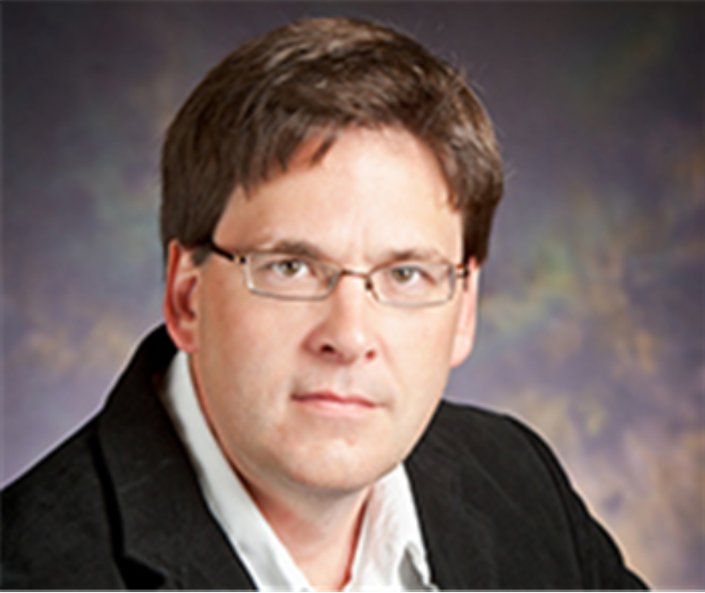
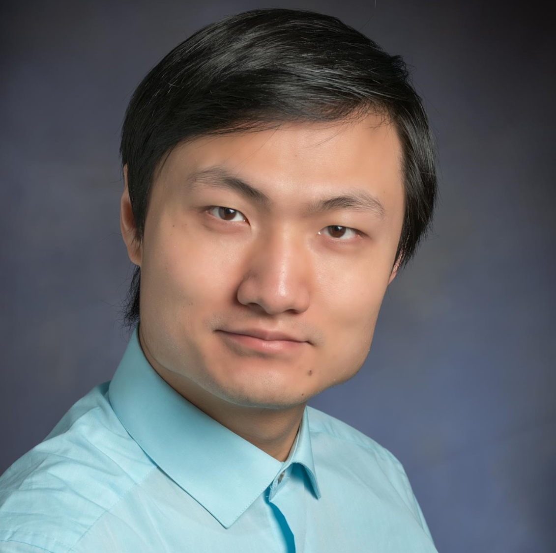
Meet the Professors
Prof. Arne Fliflet
Prof. Xiaogang Chen
Prof. Michael Oelze
Prof. Casey Smith
Prof. Jing Jiang

Slide 12
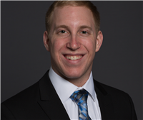
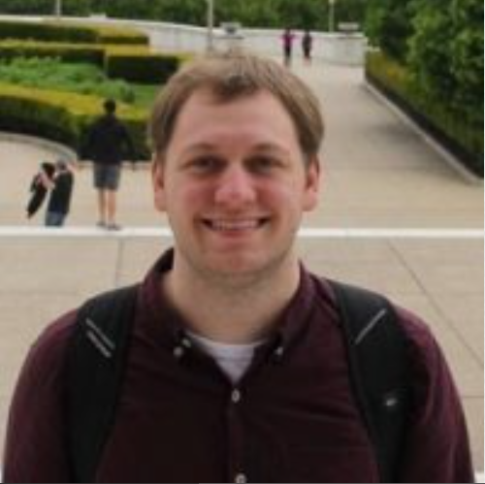
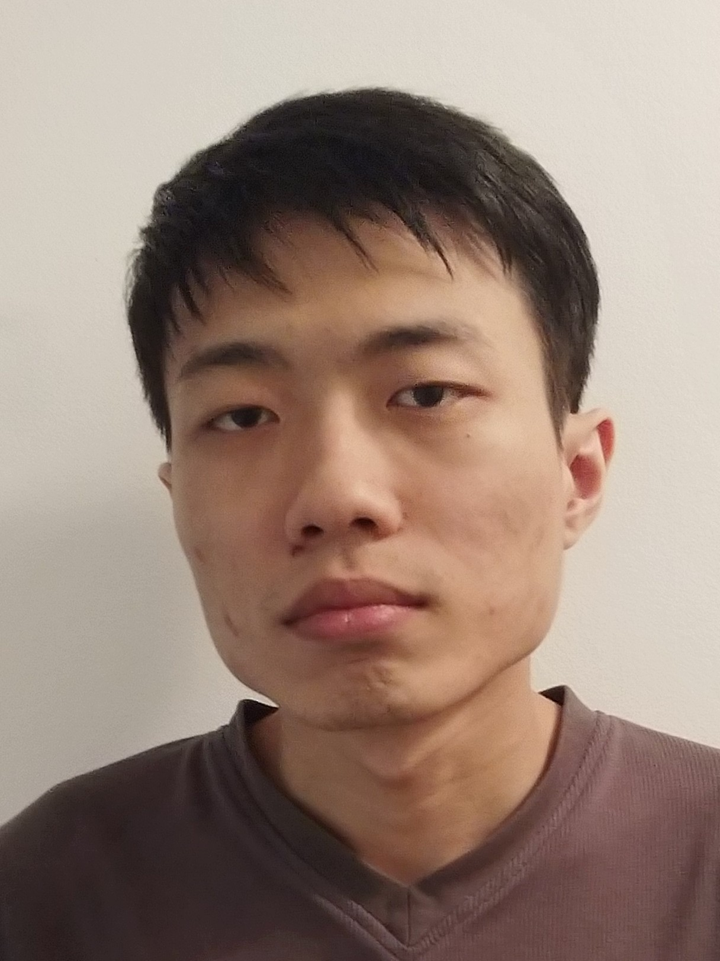
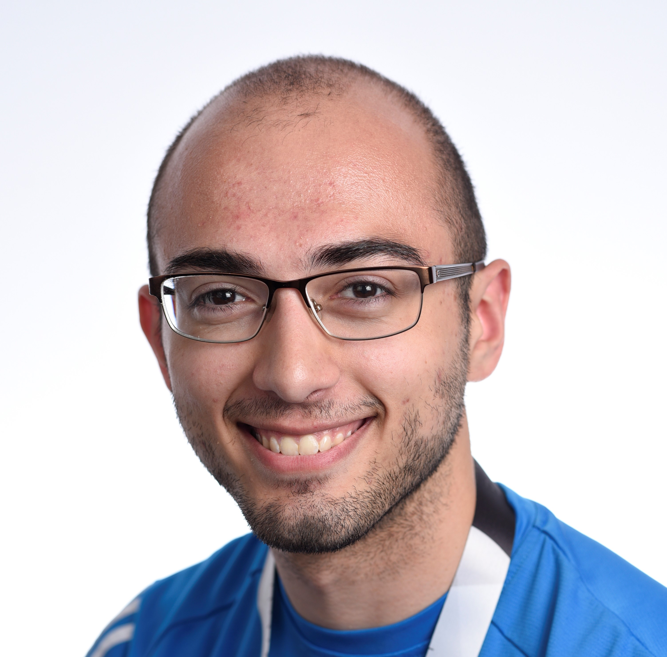
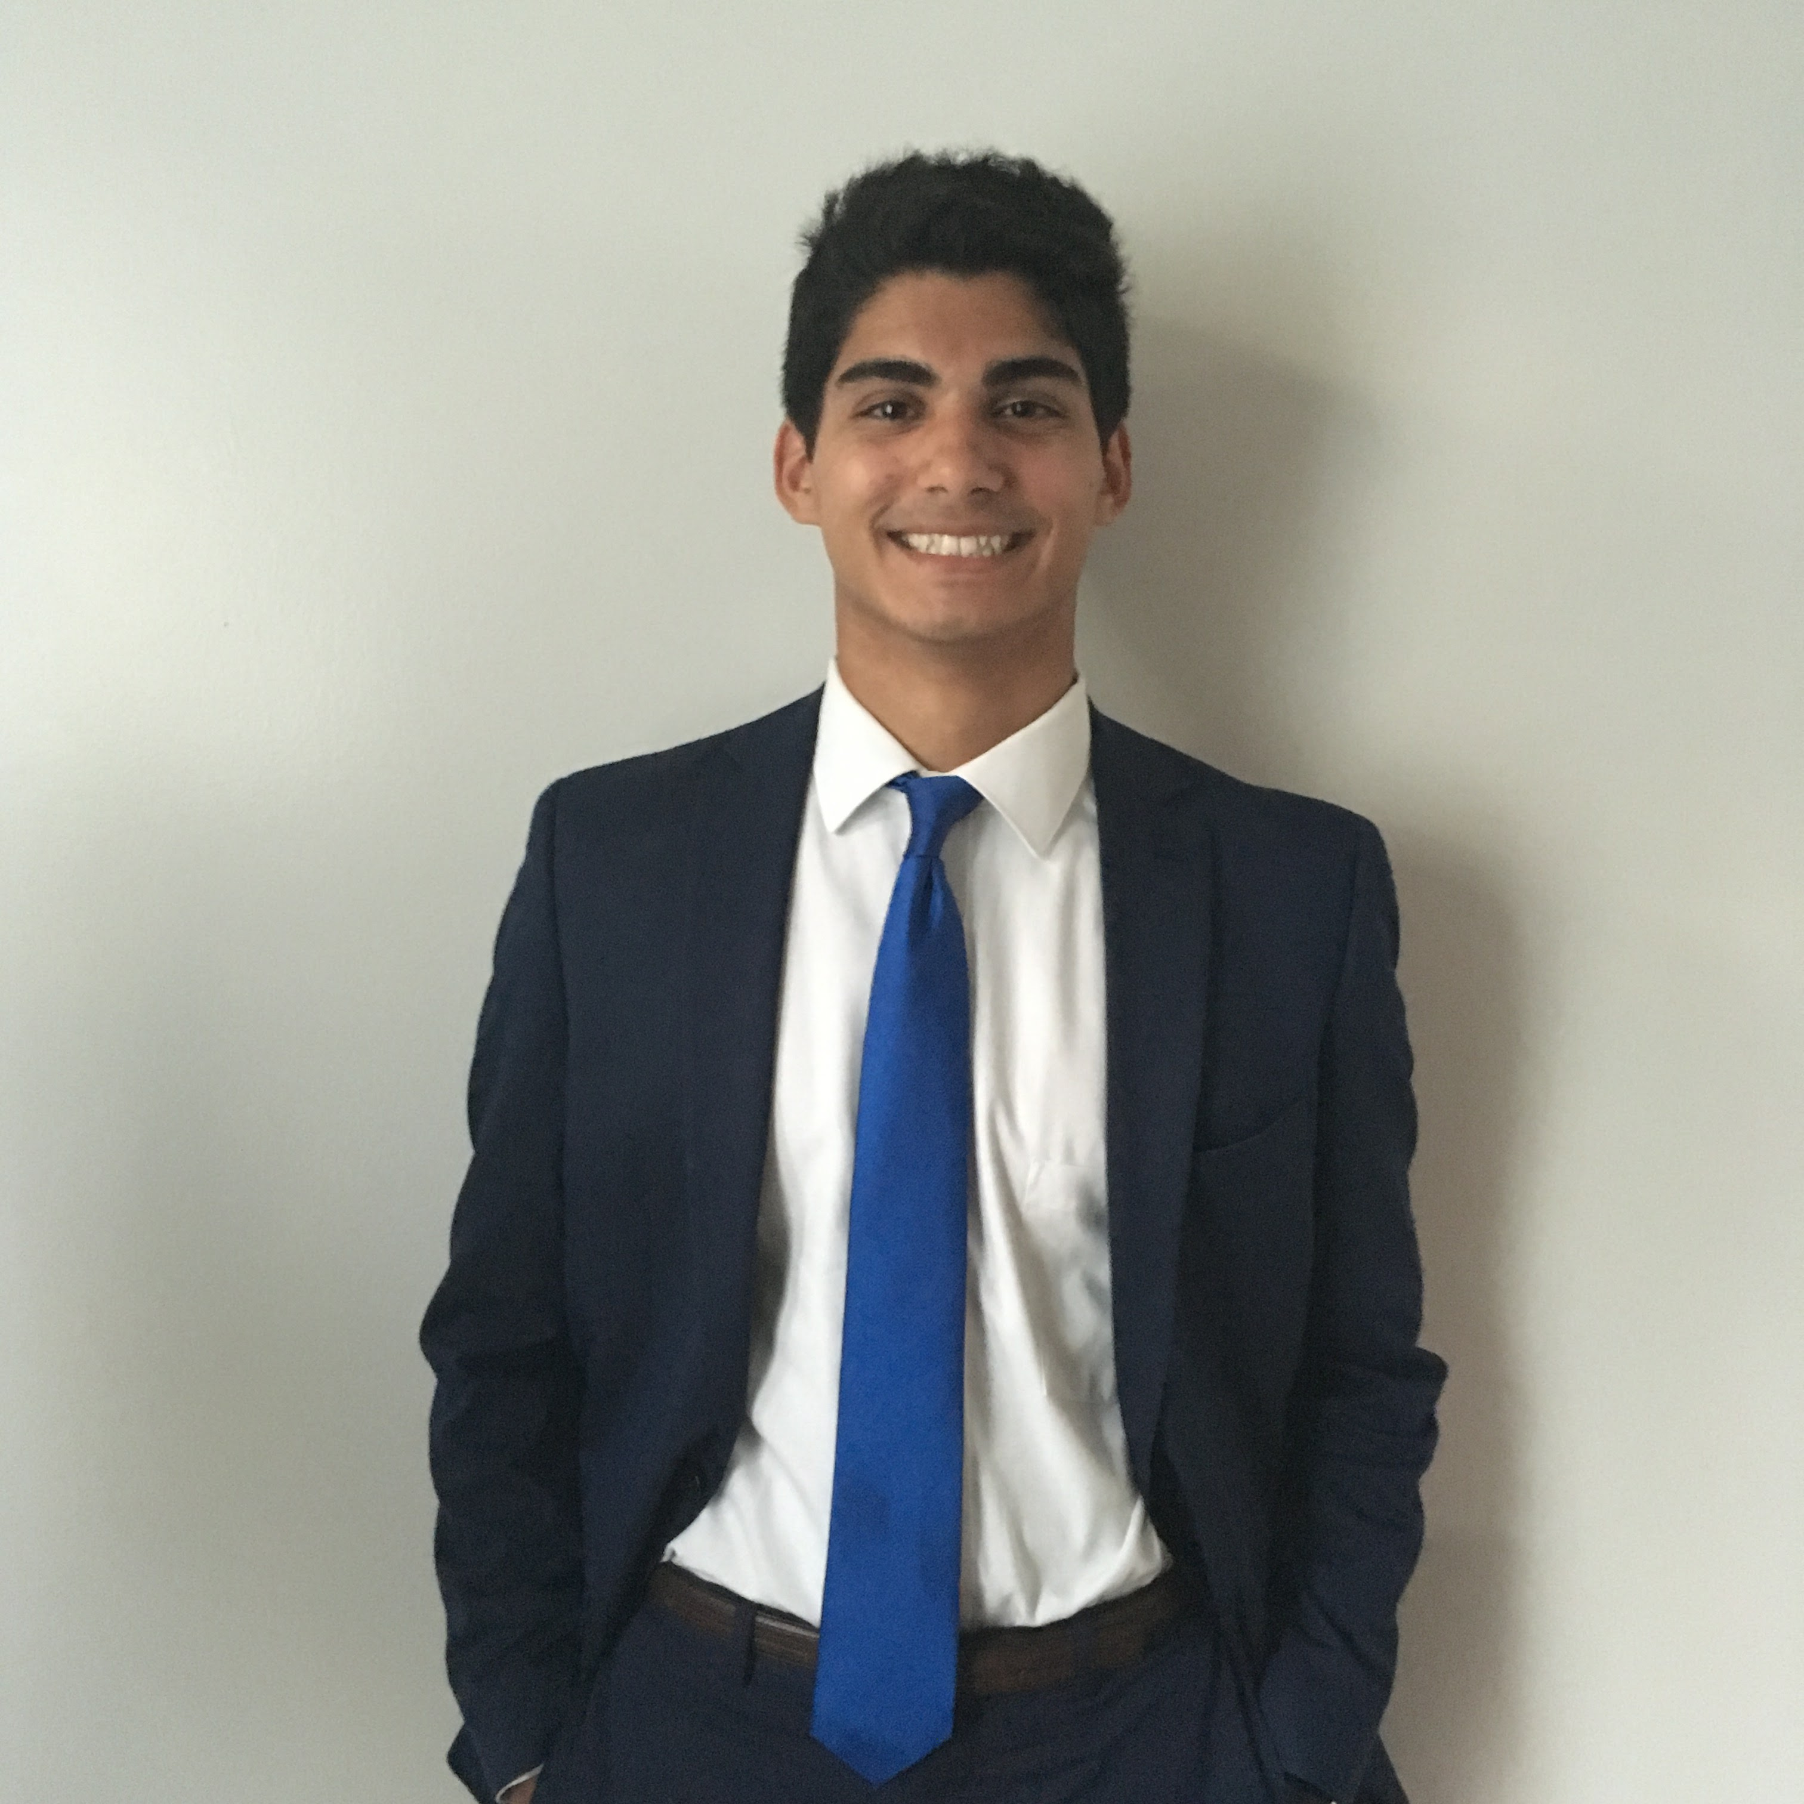
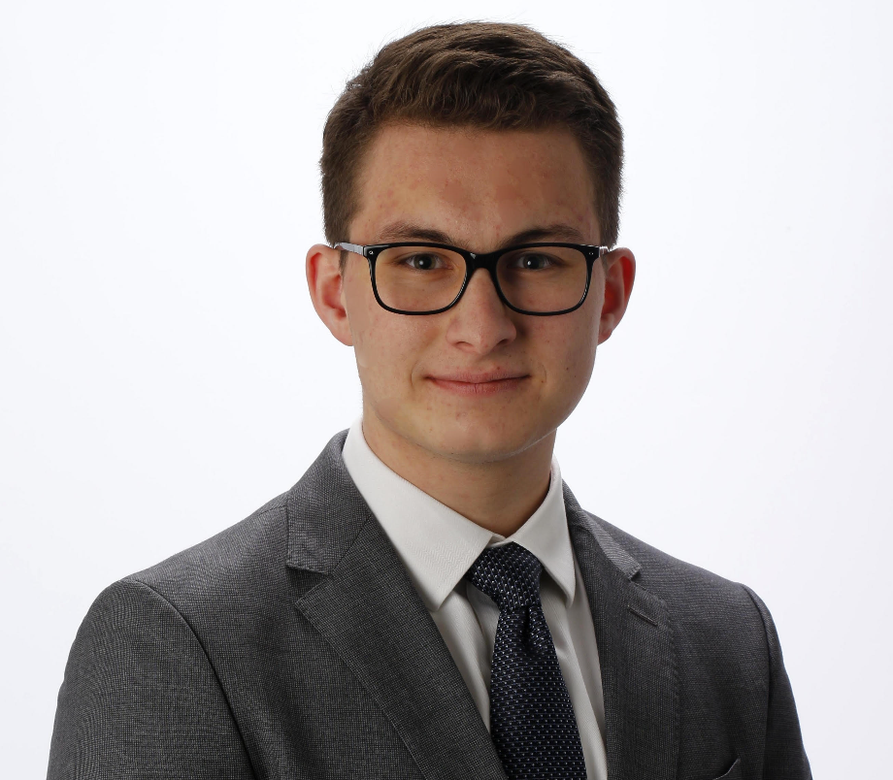
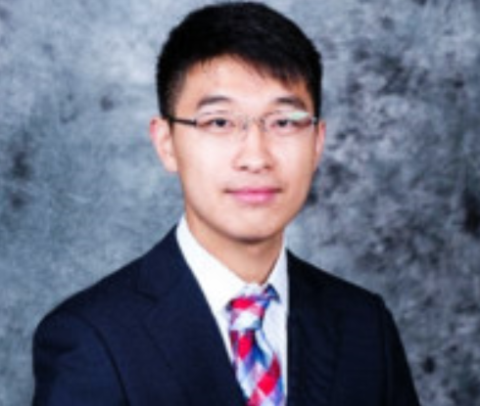
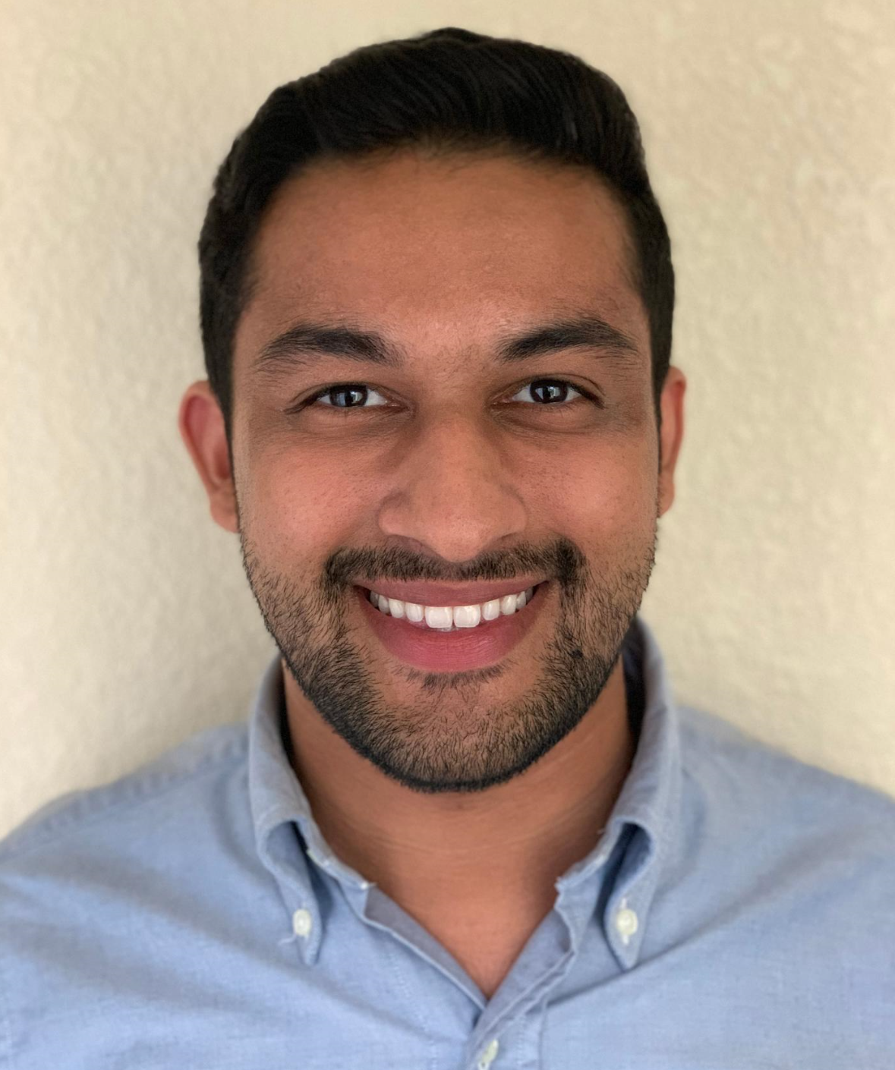
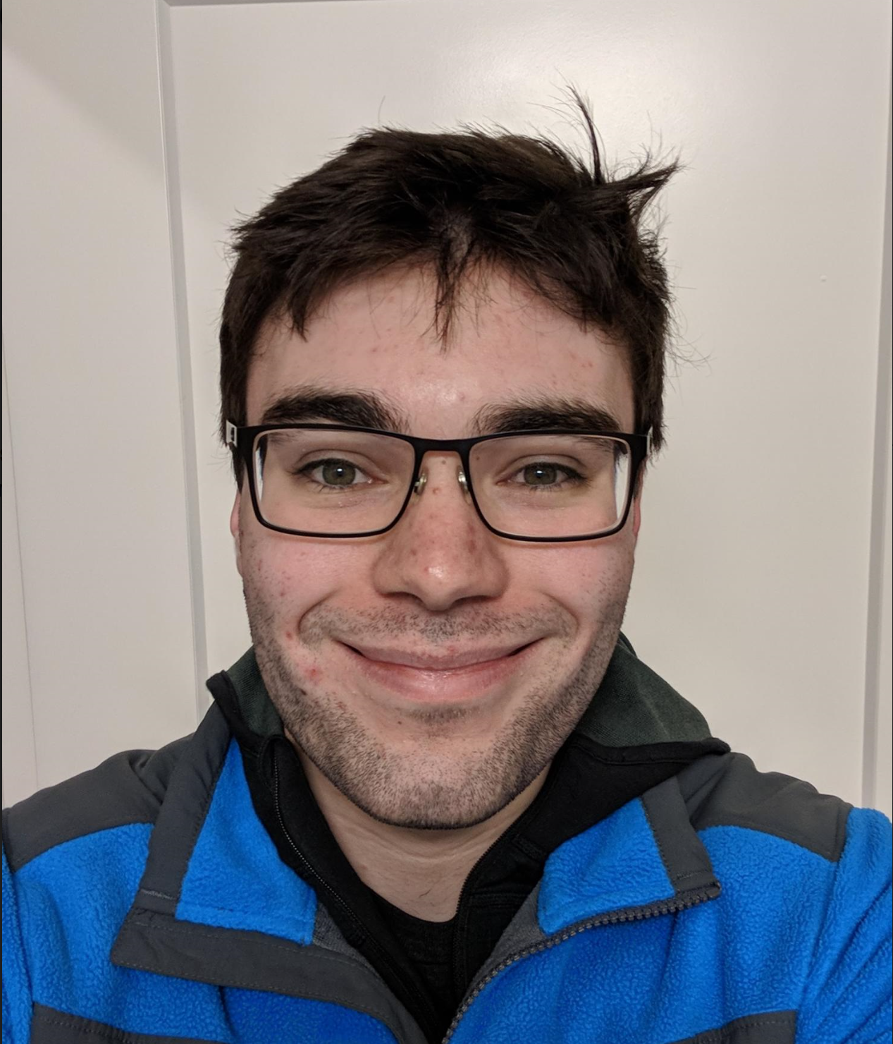
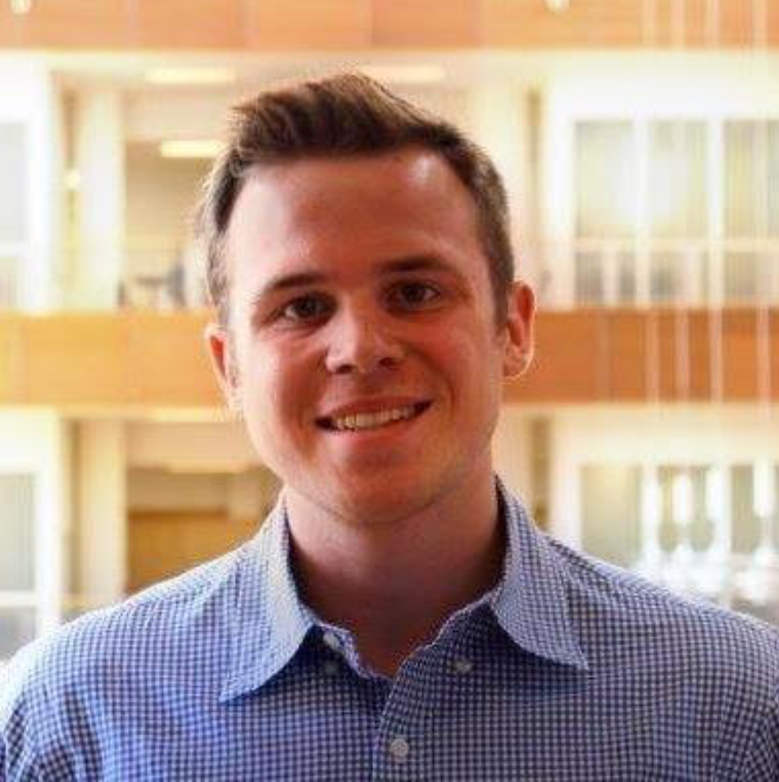
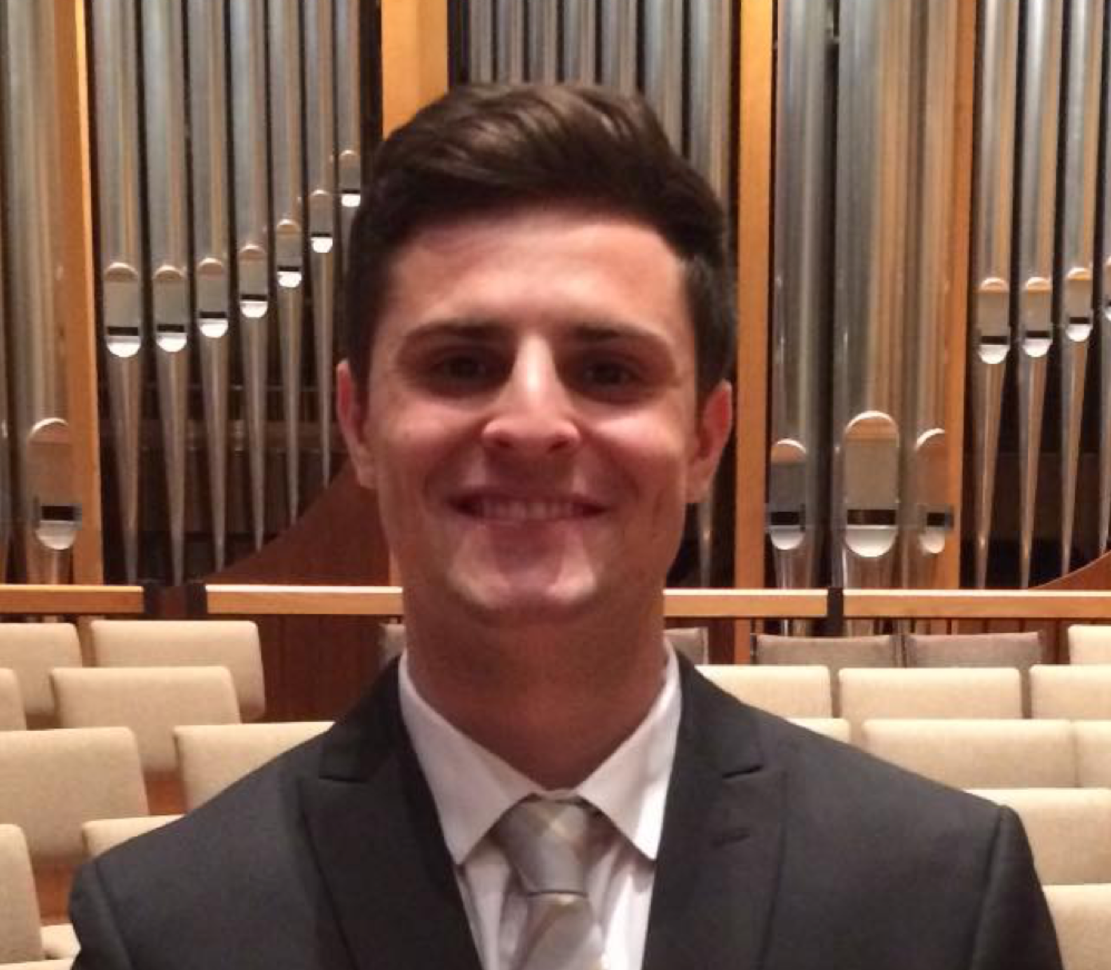
Meet the Teaching Assistants
Nicholas Ratajczyk
Tony Caton
David Hanley
Zhen Qin
Amr Martini
Channing Philbrick
Dongwei Shi
Hershel Rege
Jon Kan
Mengze Sha
Kyle Michal
Soumithri Bala
Christopher Horn
David Null
Thomas Furlong

Slide 13
Closing Remarks
This has been a quick overview – a lot more information is coming
This course is like an express train that is now leaving the station
Expect to work hard
Course grading includes many small assignments with deadlines – always pay attention to the course calendar
Each project includes some risk
Expect to encounter obstacles
Don’t be afraid to seek help
Good Luck!

Slide 14
Project Pitches
Kirill Levchenko
Andrew Singer
Ryan Corey
Shelby Lawson
Rachel Switzky
Paul Kwiat

